Slide 1


Stratigraphic forward modeling of a growth-faulted sub-basin, Frio Formation, Corpus Christi area, South Texas Gulf Coast
Maryam A. Mousavi, Ursula Hammes, Florence Bonnaffé and Didier Granjeon
Bureau of Economic Geology, The University of Texas

Slide 2
Outline
Background and study area
Modeling perspective
2D stratigraphic forward modeling in Frio growth faulted subbasins
Input parameters
Results
Conclusion

Slide 3
Study area
Corpus Christi area
Six sub-basins were defined by Brown et al., 2004
Testing Brown et al. (2004) Subbasin Model

Slide 4
Background
Brown et al. (2004) model: Frio subbasin stratigraphy composed of lowstand (slope and basin-floor fans, prograding wedge), transgressive, and highstand sediments.
Subbasins becoming progressively younger basinward.
Growth faults important in generating roll over and creating traps.
Distribution, thickness, pathways of BFF and SF gravity-transported sediments, and timing of sedimentation/ faulting not well known.
Notes:
Major exploration target along Gulf Coast
exploration has targeted on-shelf highstand and transgressive systems tracts and lowstand prograding-wedge systems tracts with great success
Slope and basin-floor-fan sandstone reservoirs in the Frio lowstand growth-faulted subbasins are promising exploration targets
Distribution, thickness, and pathways of BFF and SF gravity-transported sediments are not well understood and are more complex than HST, TST and PW systems tracts
By the time of growth fault initiated movement, as evidenced by slope fans showing expansion and rollover into the landward growth fault
Rapid loading of coarser-grained sediments resulted in overpressure, subsequent slope failure, and creation of a sediment ridge resulting from fine-grained sediments that were plowed into a ridge, a process that has been observed in overpressured basins around the world
As the prograding-wedge system prograded over the slope fans during late lowstand time, sediment-ridge and growth-fault movement ceased
Transgressive and highstand systems tracts completed the subbasin deposition sequence
A new sequence initiated with the next sea-level lowstand
The sediment ridge by then was dewatered and solidified and created the next third-order shelf edge and slope

Slide 5
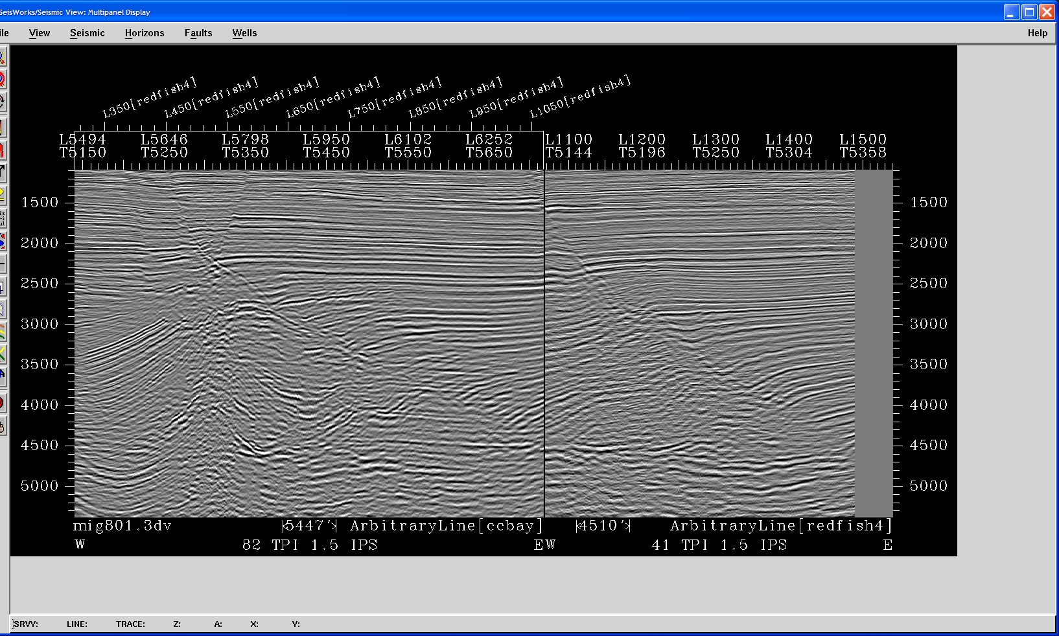
Frio 3rd-Order Subbasins
3D seismic line
Subbasin 3
Subbasin 4
Subbasin 5
gf
gf
HST/TST
pw
LST
sf +bff
sediment ridge
sediment ridge
5400 FT
4500 FT
Notes:
This is what we see on seismic and the next slide shows what we see on logs. Therefore, we want to stratigraphic forward model the genesis of these subbasins to investigate the timing of growth faulting and sedimentation.

Slide 6
Encinal Channel
Red Fish Bay
Mustang Island
Subbasin 3
Subbasin 4
Subbasin 5
HST 6
3000 ft
HST 5
HST 3/4
LST 4
LST 3
LST 5

Slide 7
Modeling perspective
Stratigraphic-forward modeling is a numerical model, which represents the dynamics of sedimentary systems and models the filling of basins from source to sink.
3D numerical model of a basin better targets exploration, estimates oil in place and reduces the uncertainties and risks in exploration operation.
DIONISOS (Diffusion Oriented-Normal and Inverse Simulation of Sedimentation) is a three-dimensional stratigraphic model developed by IFP.

Slide 8
Input Parameters
Accommodation
Subsidence (Large thickness of shallow water sediments)
Eustasy (Sea level changed during geological history)
Sediment supply (fluvial or marine)
Sediment supply is controlled by: height of mountains, size and storage of drainage area, climate, amount of precipitation and vegetation
Water discharge
Notes:
Subsidence has a number of components which two of those are principal: compactional subsidence and fault induced subsidence
Water discharge: The ability of the river to flow and transport sediment

Slide 9
Input Parameters cont.
Sedimentary transport parameters
Long-term evolution of sedimentary process based on:
Topographic slope, diffusion coefficient and water discharge volume (controlled by long-term fluvial and gravity transport)
Short-term basin evolution depends on water velocity and inertia included by catastrophic rain fall, slope failures, and turbidity flow
Transport efficiency
Is controlled by transport coefficients.
Notes:
Transport efficiency tells how easily deposition and erosion take place. Higher coefficient means higher sediment transports

Slide 10
2D stratigraphic forward modeling in Frio growth faulted subbasins
2-D stratigraphic forward modeling of two adjacent sub-basins that are progressively younger in age in the dip direction .
Purpose:
To simulate the development of two adjacent subbasins and the structural and sedimentologic controls in concert with sea-level fluctuations.
To test relationship of growth faults, influence of sea-level fluctuations, sedimentation, role of underlying shale and rise of sediment ridge
The numerical study focused on lower Oligocene from 30.9 to 28.5 Ma separated into 2 simulation runs.

Slide 11
Input parameters to the model
Initial bathymetry
2D model; 100 km in dip direction and 4 km in strike direction. However, each individual subbasin is only 10 km long.
Sand/shale lithology based on well logs
Sand mean grain size 0.5 mm
Shale mean grain size 0.002 mm
Sediment supply values from wire-line log data by estimating sand/shale ratios
Δ Sea level modeled using 2.0 My period, 50 m amplitude sinusoid plus user-defined
Fault induced subsidence as a major subsidence
Low and high energy sediment transport
Notes:
Sea level: variations in the eustasy based on Brown et al. (2004) model and Brown and Loucks (2009) Frio sequences .
Prediction of the tectonic portion of the subsidence is very difficult to establish (Kolb and van Lopik, 1958) therefore we add constant subsidence (roughly) to the model increasing through time to make more accommodation space in the main depocenters

Slide 12
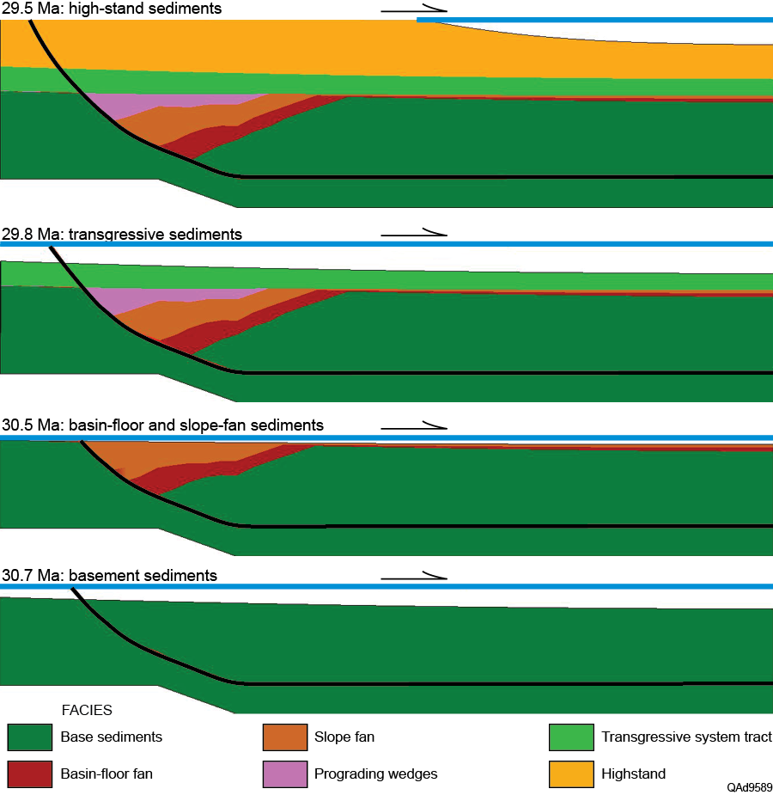
Results (Subbasin 2: 30.7-29.5 Ma)

Slide 13
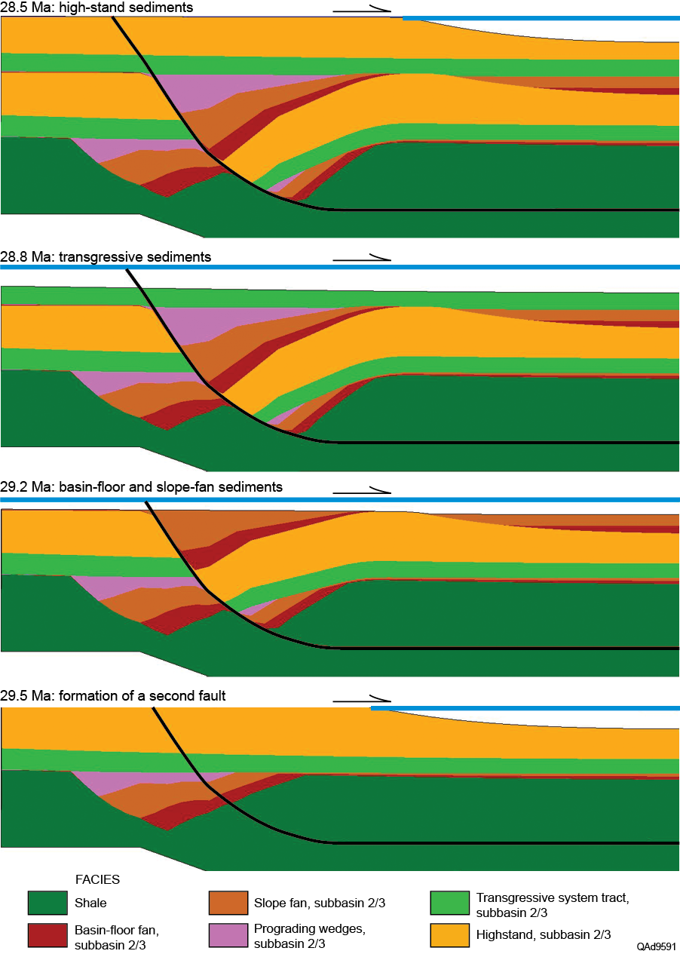
Results (Subbasin 3: 29.5 - 28.5 Ma)

Slide 14
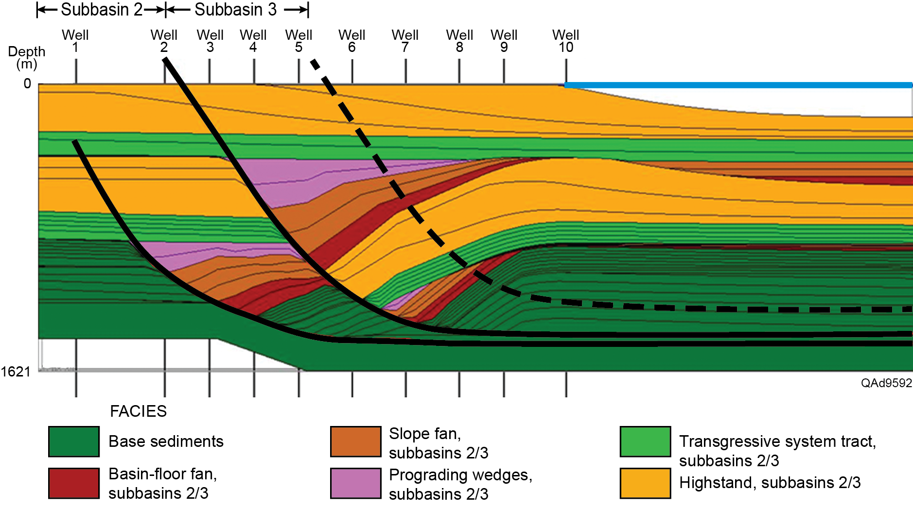
Results

Slide 15
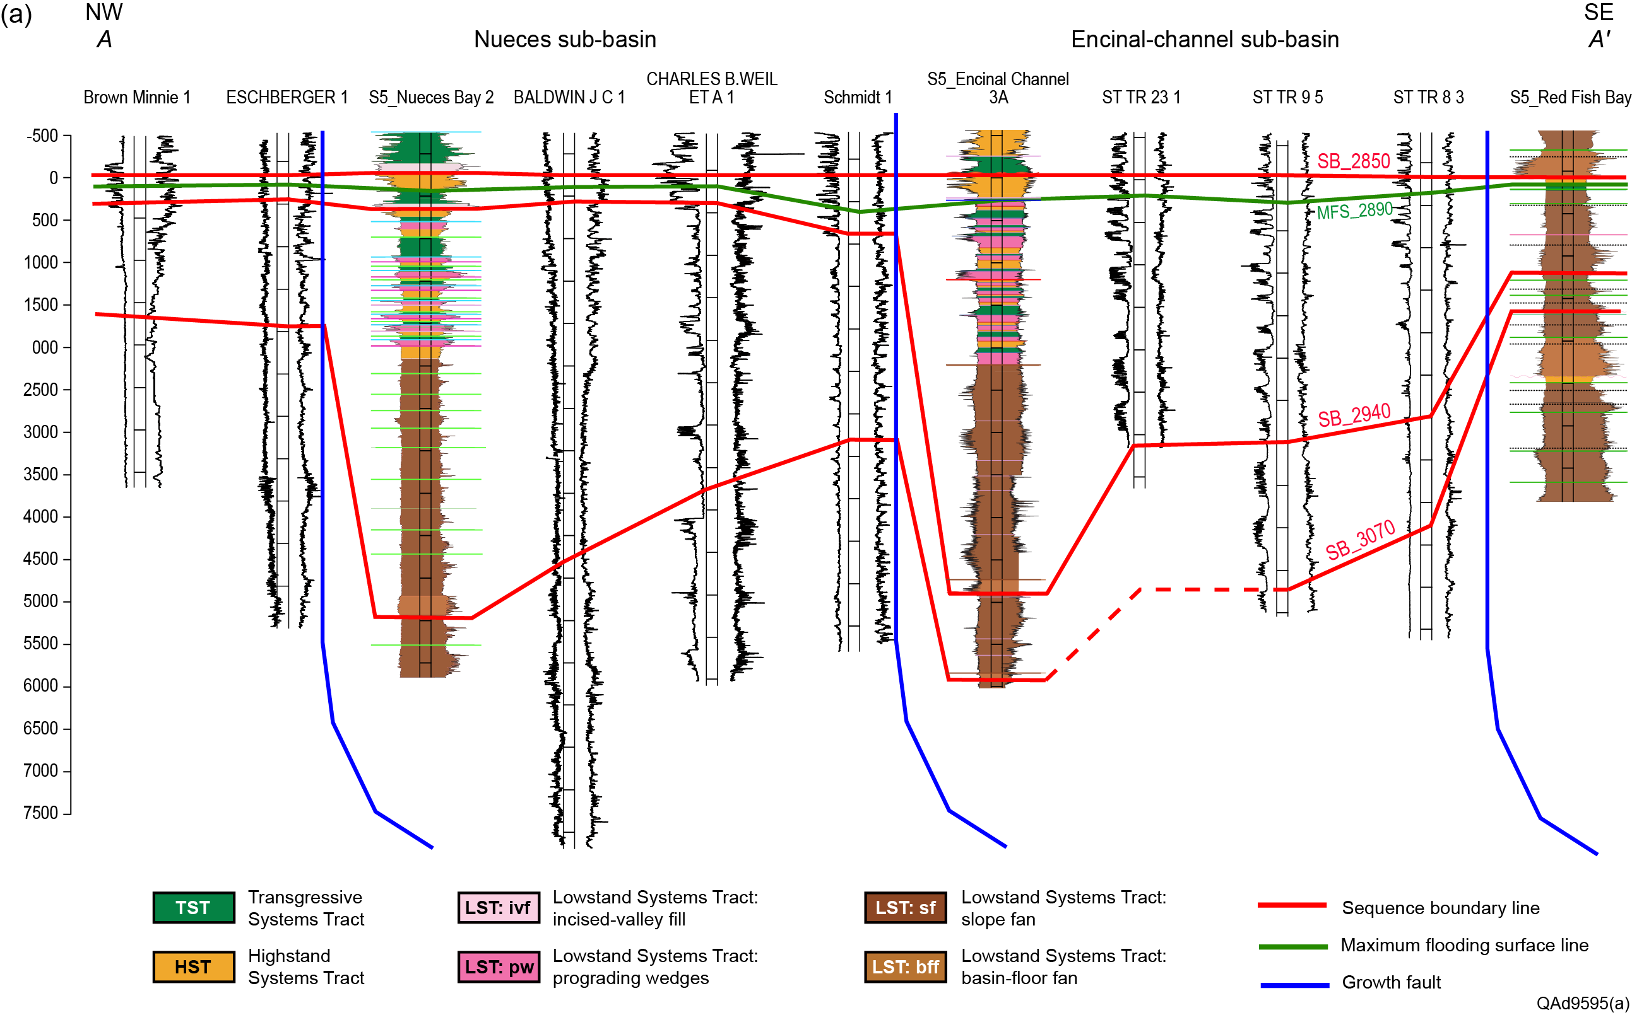
Result

Slide 16
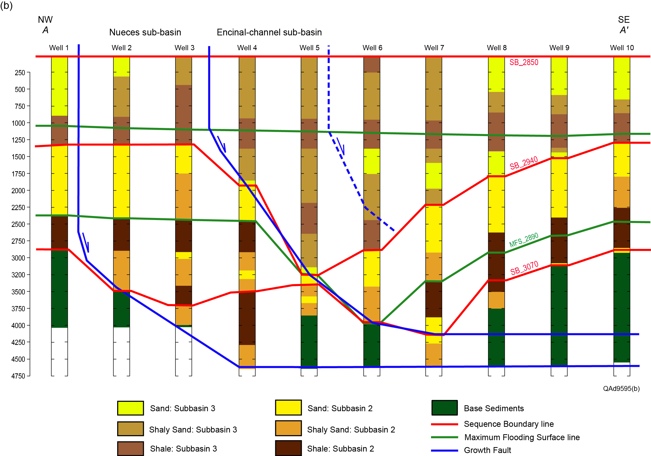
Result

Slide 17
Conclusion
2D stratigraphic forward model using DionisosTM software was constructed of two growth-faulted subbasins in the South Texas Gulf coast area.
Model predicted sediment geometry, sediment types, and timing of growth faulting in Frio subbasins.
Input parameters derived from available data from local wire-line logs and seismic.
Result was compared to 2D cross section with actual data

Slide 18
Conclusion
Defines the relationship of growth faults, influence of sea-level fluctuations, sedimentation rates, role of underlying shale and rise of sediment ridge
Stratigraphic forward modeling facilitates prediction of stratigraphic sequences, lithology, syn-sedimentary tectonics, and distribution of deeply buried lowstand reservoir systems and traps.
Next step: 3D model.

Slide 19
Thank you

Slide 20
Input parameters to the model cont.
Oscillations of sea level are modeled using 2.0 My period, 50 m amplitude sinusoid plus some user-defined variation in the eustasy based on Brown et al. (2004) model and Brown and Loucks (2009) Frio sequences
Fault induced subsidence as a major subsidence
Prediction of the tectonic portion of the subsidence is very difficult to establish (Kolb and van Lopik, 1958) therefore we add constant subsidence (roughly) to the model increasing through time to make more accommodation space in the main depocenters
We used both low and high energy sediment transport

