Slide 1
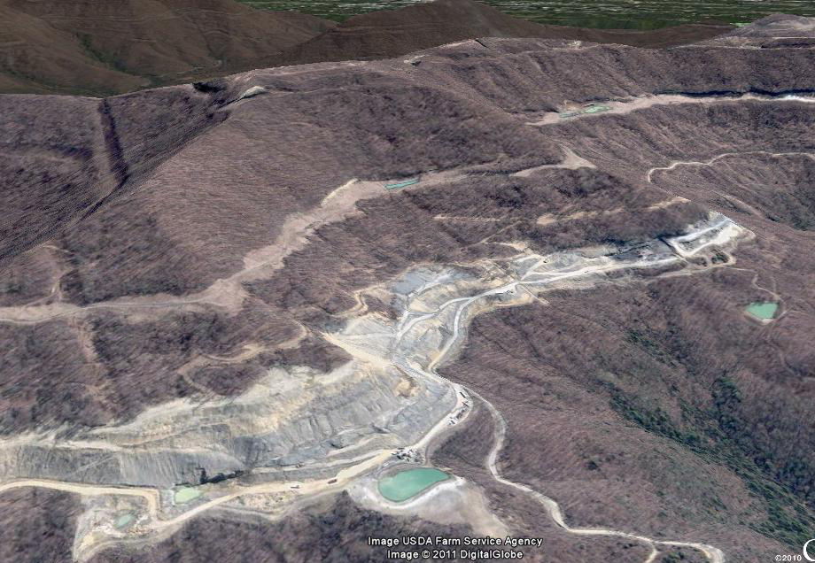
Surface coal mining impacts on concentration-discharge relationships: Identifying spatial and temporal changes in the New River, TN
GSA Annual Meeting, October 12, 2011
Jenny Murphy
Vanderbilt University
USGS TN Water Science Center
George Hornberger
Vanderbilt University

Slide 2
Tennessee
Oak Ridge
Nashville
Knoxville
Memphis
New River
Watershed boundary
Stream
Gauging Station / sample site
Coal mining disturbance
New River
Indian Fork

Slide 3
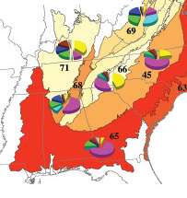

Coal Mining in Tennessee
Land use cover change
from 1973 to 2000
1977: SMCRA enacted
1980: State program begins
1983: “Massive failures”
1984: TN federal program begins
(Loveland et al., 2003)

Slide 4
Data Sets
Parameters
Streamflow (2) Specific conductance (3) Sulfate
New River Indian Fork
2007 2009
Recent
(USGS) (This study)
1977—1980 1975—1981
Historic
(USGS) (USGS)

Slide 5
Methods: Data Analysis
Intra-annual relationships
Linear regression on Log(C)-Log(Q) data
Episodic relationships
(2) C-Q hysteresis plots

Slide 6
Results: Linear regression
b
New River
y = ax
n= 15-min
1976-1982
n=68

Slide 7
Results: Linear regression
b
Indian Fork
y = ax
Recent
“Background”
sulfate
Dickens et al 1989

Slide 8
Methods: C-Q plots
2.5
2.0
1.5
1.0
0.5
0
Total discharge
Non-impacted water
Impacted water
Event water
Concentration
0 10 20 30 40 50
Discharge
After Evans & Davies 1998

Slide 9
Methods: C-Q plots
(a) CE > CNI > CI
(b) CE > CI > CNI
(c) CNI > CE > CI
100
90
80
70
60
50
100
90
80
70
60
50
100
90
80
70
60
50
C1
C2
C3
Concentration
Concentration
Concentration
0 20 40 60 80
0 20 40 60 80
0 20 40 60 80
Discharge
Discharge
Discharge
(d) CI > CNI > CE
(e) CI > CE > CNI
(f) CI > CE > CNI
100
90
80
70
60
50
100
90
80
70
60
50
100
90
80
70
60
50
A3
A1
A2
Concentration
Concentration
Concentration
0 20 40 60 80
0 20 40 60 80
0 20 40 60 80
Discharge
Discharge
Discharge
Evans & Davies 1998

Slide 10
Results: C-Q plots
New River 2007

Slide 11
Results: C-Q plots
New River 2007
~25 m³/s

Slide 12
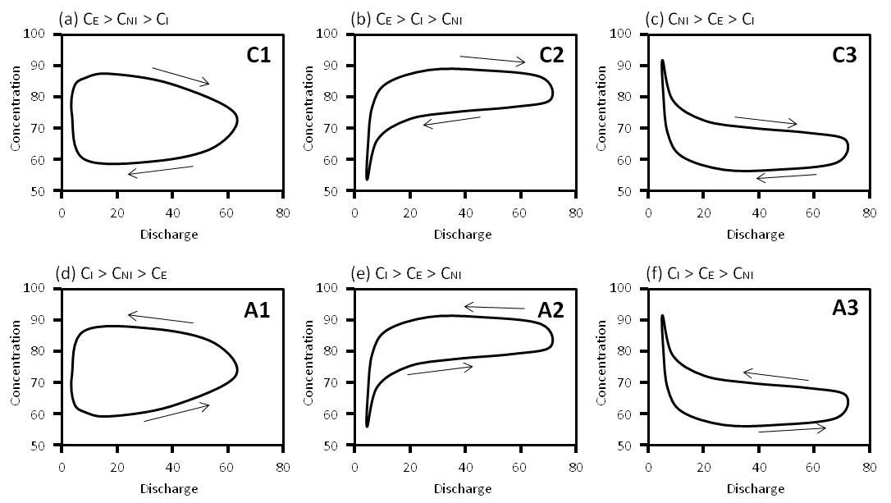
Results: C-Q plots
New River 2007
~25 m³/s

Slide 13
Results: C-Q plots
Indian Fork 2009

Slide 14
Results: C-Q plots
Indian Fork 2009

Slide 15
Results: C-Q plots
Indian Fork 2009

Slide 16
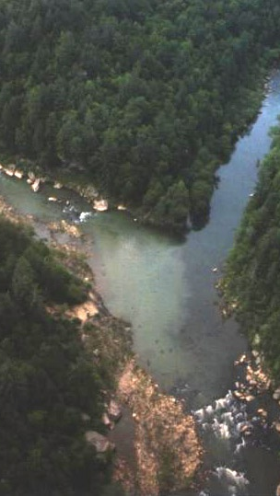
Conclusions
Clear Fork
Temporal: Linear regression
Minimal change in New River
Significant change in Indian Fork
Spatial: C-Q plots
Threshold (25m³/s) for C-Q response in New River
No threshold in Indian Fork
Mixing models
New River
New River (7% disturbed)
3 component mixing
Indian Fork (23% disturbed)
2 component mixing
Big South Fork of the Cumberland River

Slide 17
Conclusions
Clear Fork
Temporal: Linear regression
Minimal change in New River
Significant change in Indian Fork
Spatial: C-Q plots
Threshold (25m³/s) for C-Q response in New River
No threshold in Indian Fork
Mixing models
New River
New River (7% disturbed)
3 component mixing
Indian Fork (23% disturbed)
2 component mixing
Big South Fork of the Cumberland River

Slide 18
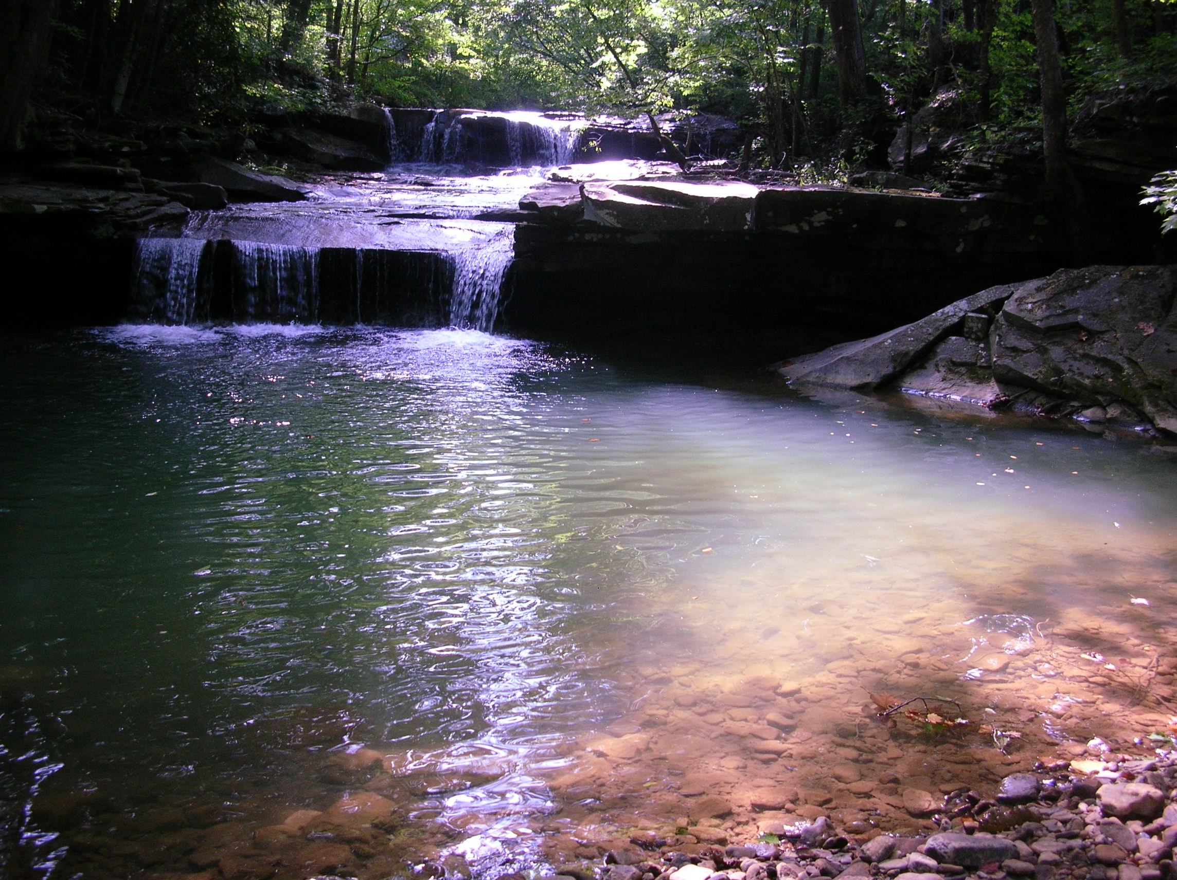
Questions?
Acknowledgements
Vanderbilt University Environmental and Civil Engineering Lab
Vanderbilt University Earth and Environmental Science department
Big South Fork National Recreation Area
Tennessee Water Science Center
GSA student research grant

