Slide 1
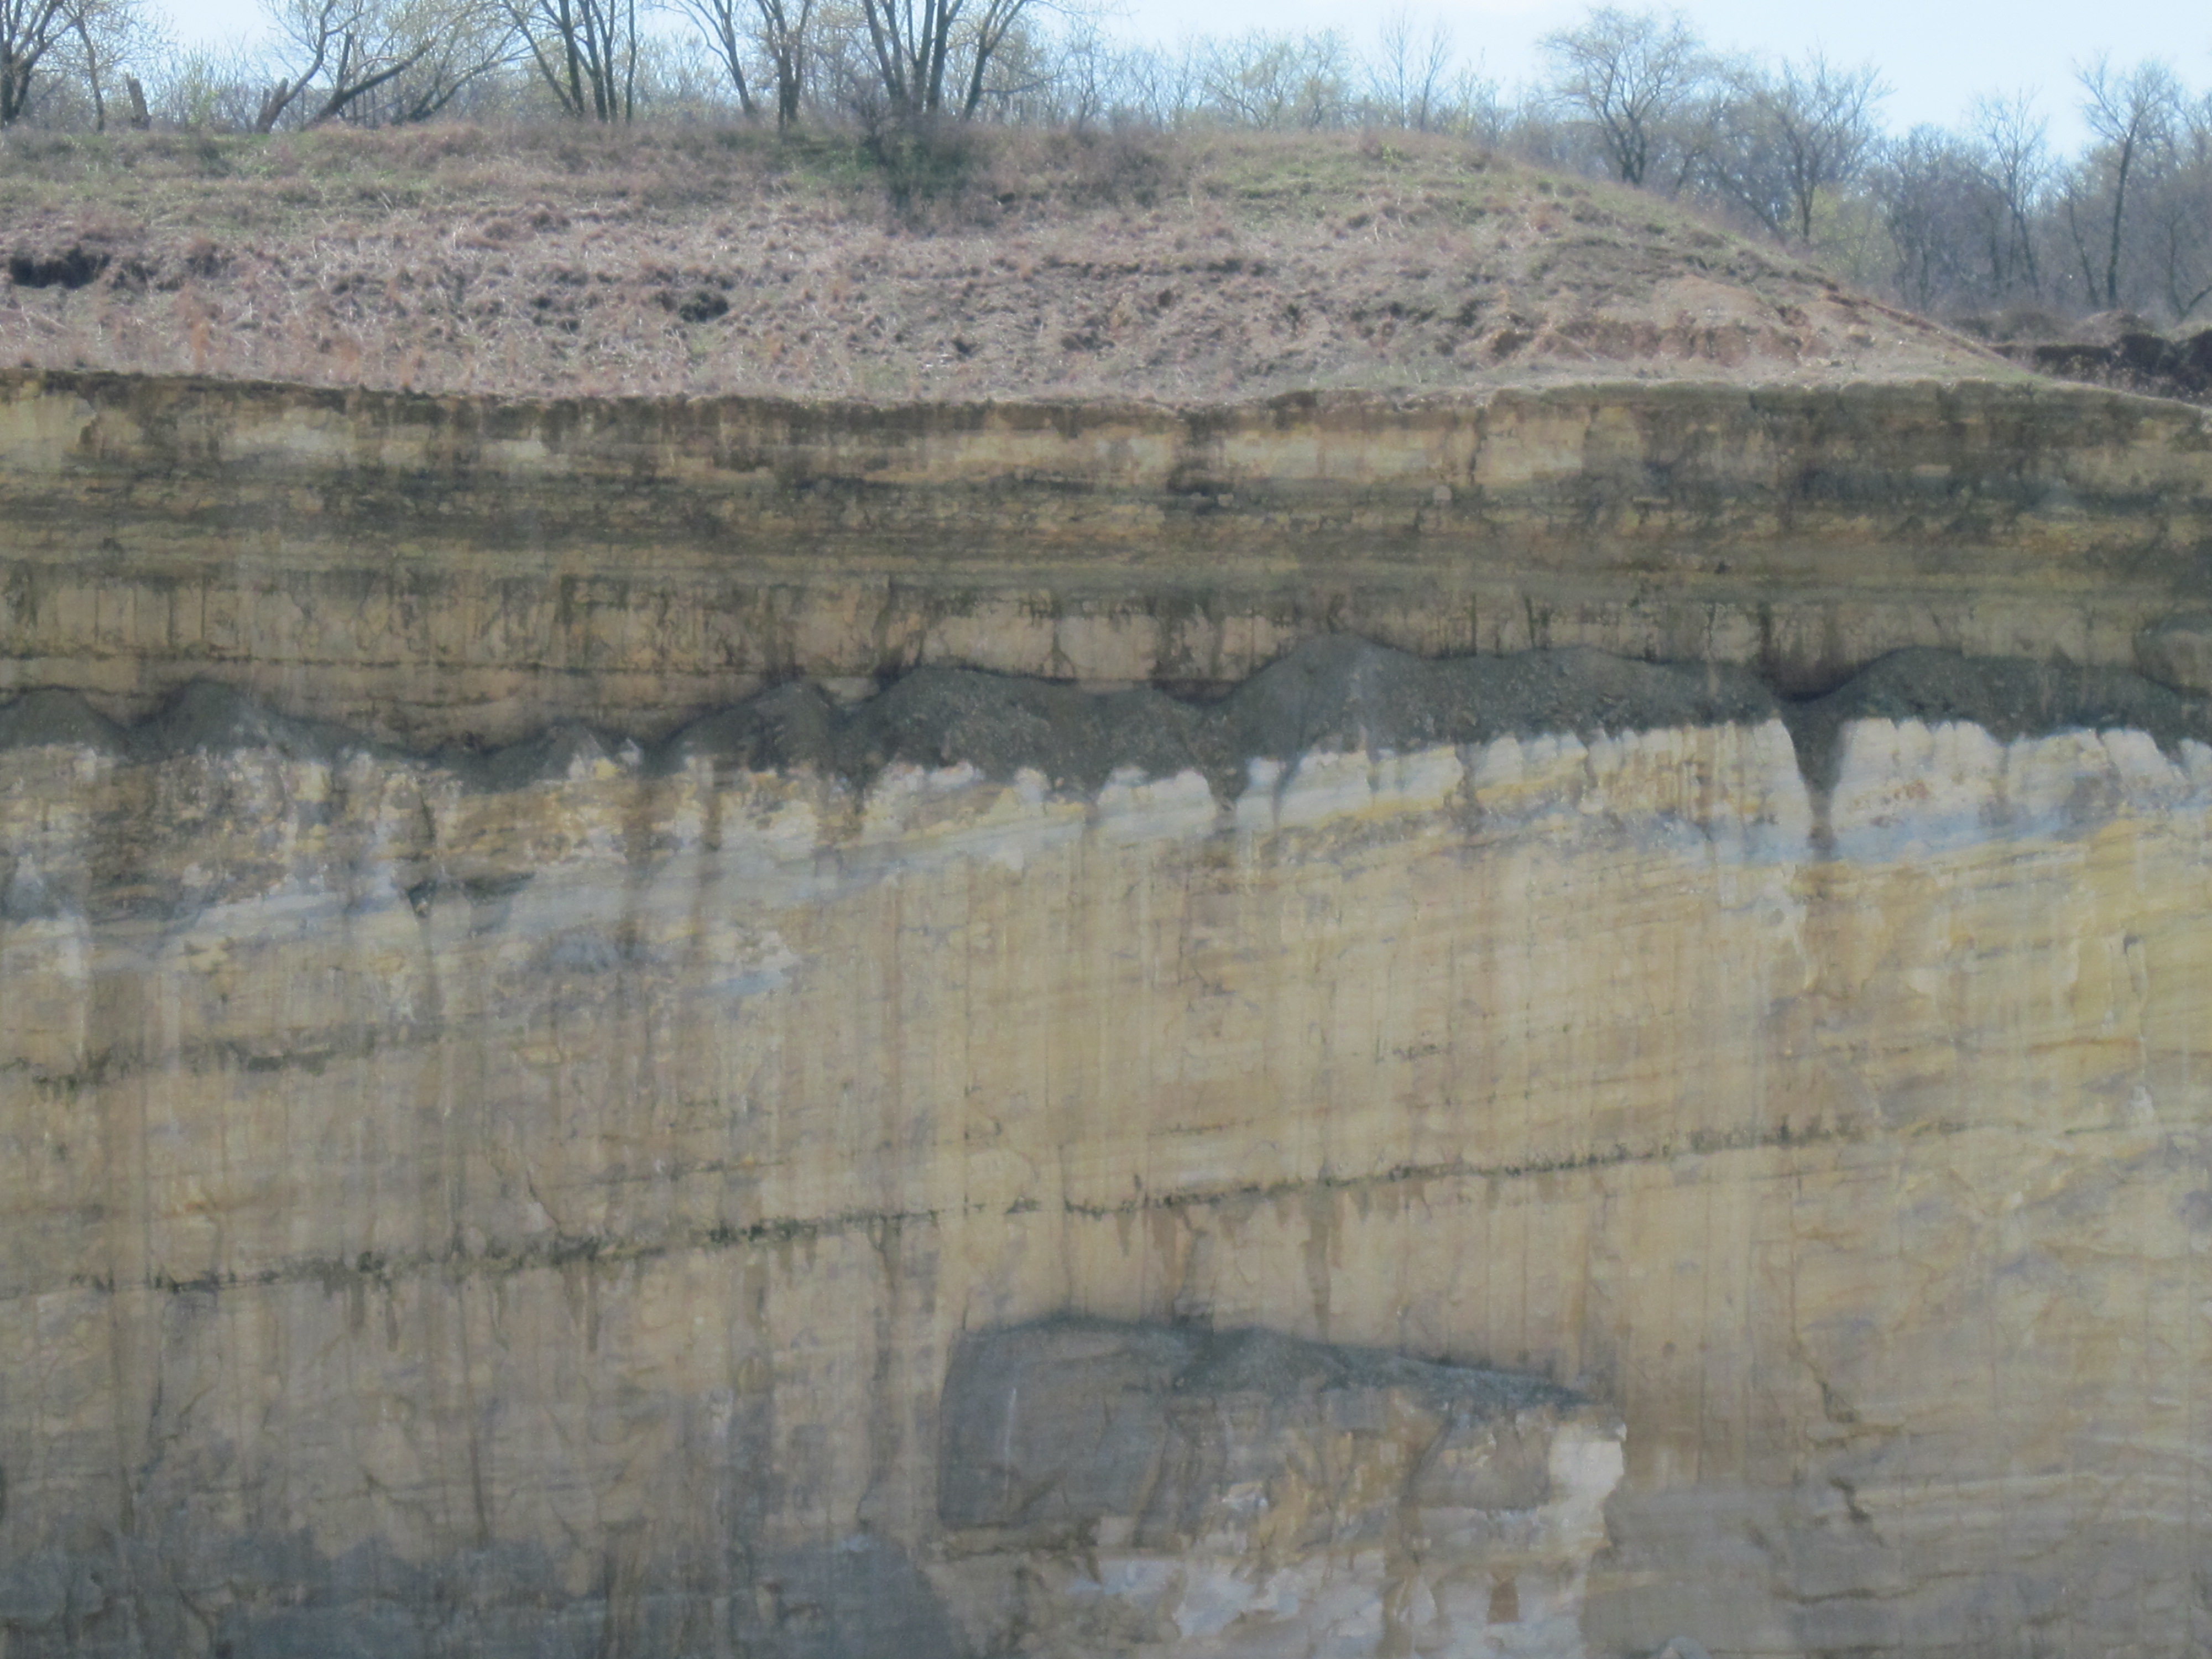

Newly discovered evidence for mid-late Ordovician structural deformation in Ogle County, Illinois
Mary Seid and Dennis Kolata
Illinois State Geological Survey
seid@isgs.illinois.edu
October 11, 2011
Geological Society of America annual meeting

Slide 2
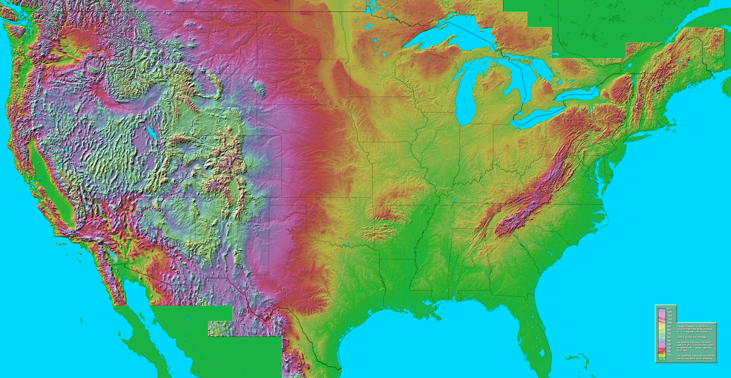
Minneapolis
Chicago
St. Louis

Slide 3
Cordillera
(Pz)
Canadian shield
Hudson Bay basin
(Mz / Cz
cover)
C R A T O N
Crustal provinces of North America
Cordillera
Illinois Basin
Cratonic platform
Colorado Plateau
(Pz
cover)
Appalachians
Coastal plain
Courtesy of S. Marshak

Slide 4
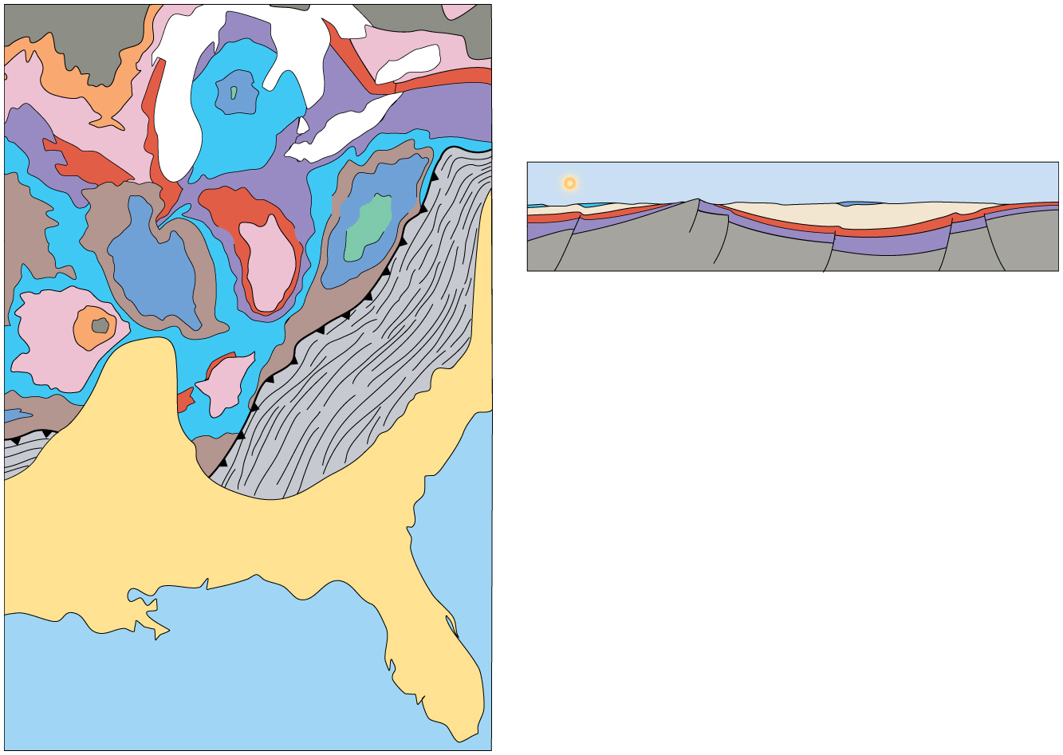
ISSUE . . . What is the nature and origin of epeirogenic structures?
Wisc.
arch
Thinner strata on domes.
Thicker strata in basin.
Michigan
basin
Ozark Dome
Illinois Basin
Illinois
basin
Cin. arch
Basement
Cross-section of basins and domes.
Ozark
dome
Appalachians
"Missi.
embayment"
Cretaceous-Tertiary
Devonian
Permian
Silurian
Coastal Plain
Ordovician
Pennsylvanian
Cambrian
Mississippian
Precambrian
Geologic map of the Midcontinent platform
300 km
(from: Marshak, S. 2009, Essentials of Geology)

Slide 5
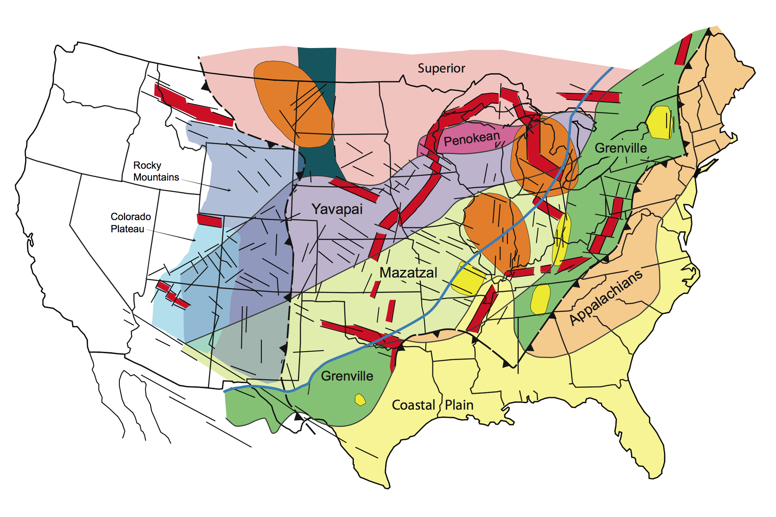
Intracratonic fault-and-fold zones (and rifts)
Documented rift
Dome or arch
Trace of a fault-and-fold zone
Basin
Courtesy of S. Marshak

Slide 6
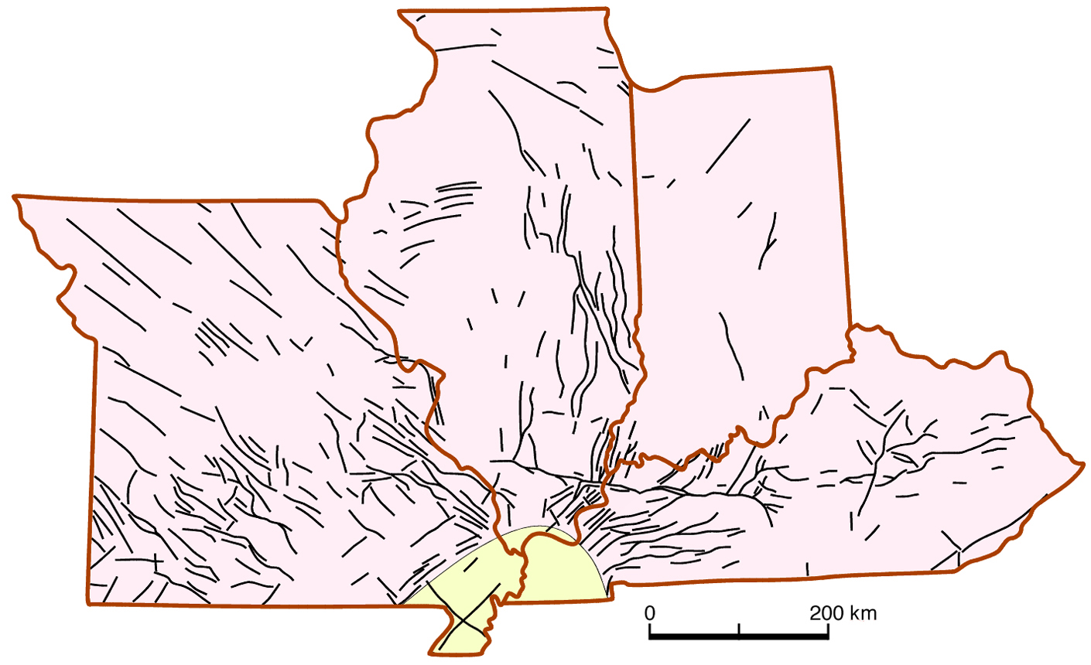
Simplified structural trend map (fault or fold traces) of the Illinois basin and Ozark Plateau region.
Courtesy of S. Marshak

Slide 7
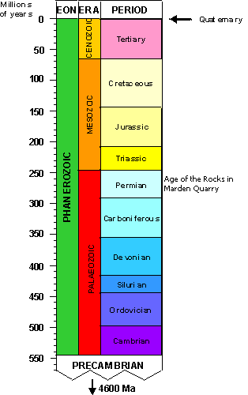
Intracratonic reactivation is roughly coeval with marginal orogenic events.
Alleghanian ?
Acadian ?
Taconic ?
Courtesy of S. Marshak

Slide 8
Late Paleozoic Reactivation (a transcontinental "Ancestral Rockies" event.
(McBride & Nelson)
(from Craddock and van der Pluijm)
Courtesy of S. Marshak

Slide 9
Devonian reactivation, southern IL.
Variation in thickness of the
New Albany Shale across the
Pennyrile fault system, Kentucky
Thinning of Devonian across the
Ste. Genevieve fault system, in
Illinois and Missouri.
(Nelson & Marshak, 1996)
Courtesy of S. Marshak

Slide 10
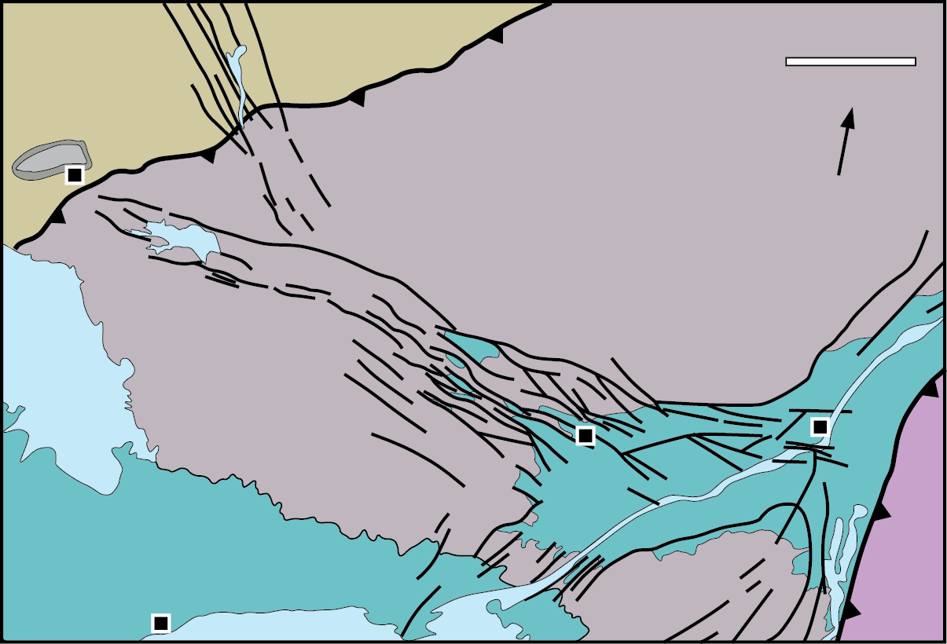
Comparison to the Ottawa - Bonnechere Rift
100 km
N
Sudbury
Montreal
Ottawa
Toronto
adapted from Bleeker, W., 2011
Illustrations courtesy of S. Marshak

Slide 11
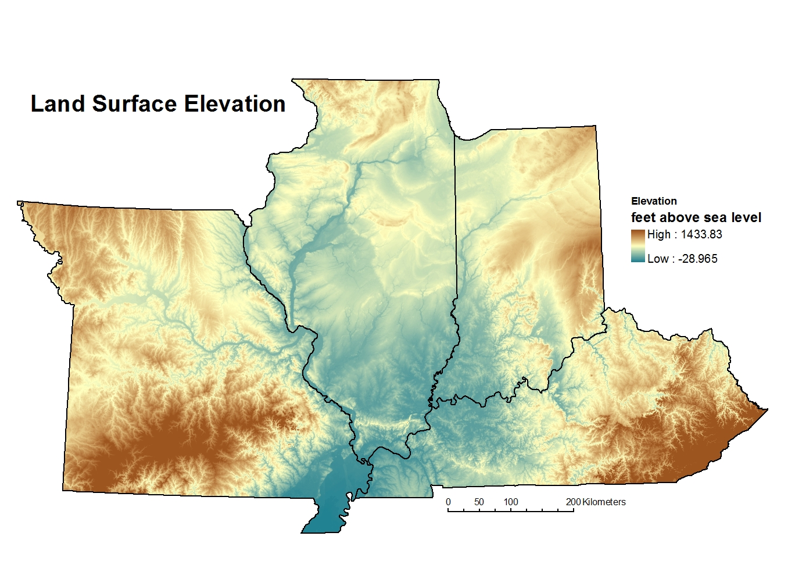
Location in the Great Plains
Chicago
St. Louis

Slide 12
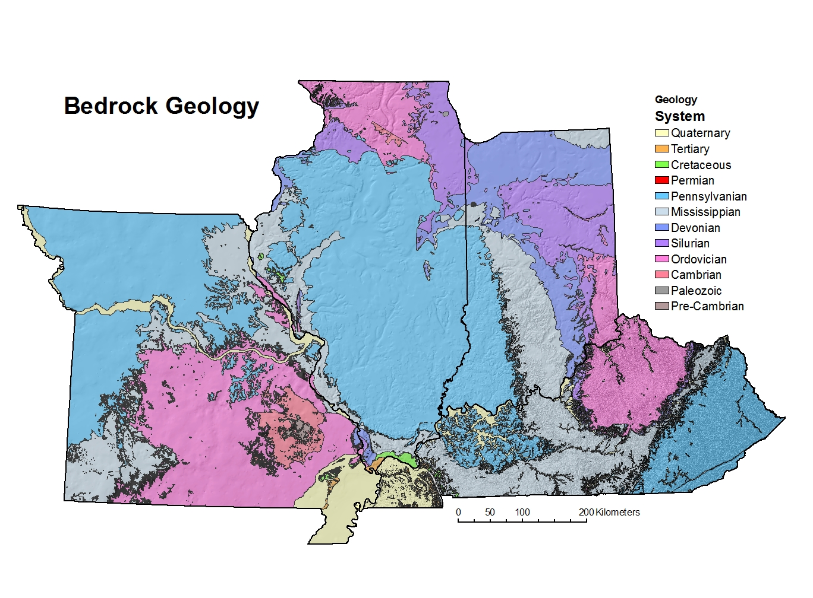
Image courtesy of S. Marshak

Slide 13
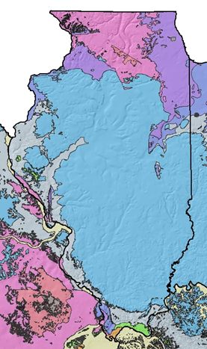
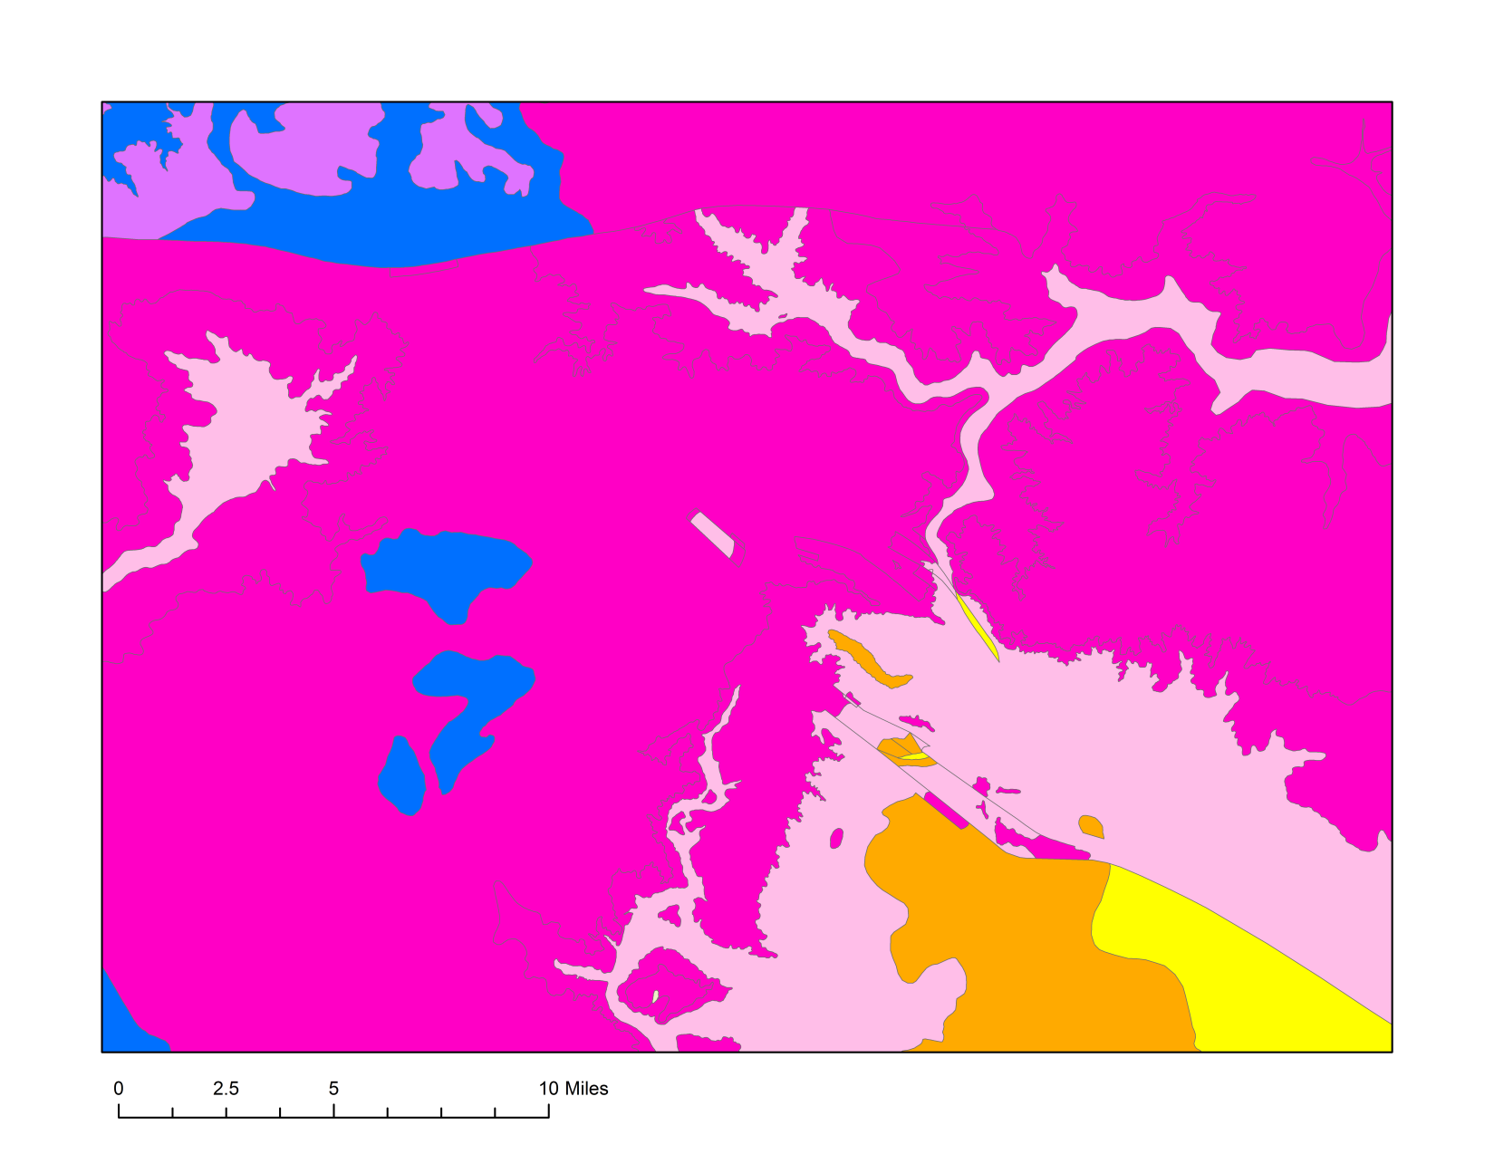
Geologic map of northern Illinois
Silurian
PLUM RIVER FAULT
Ogp
Om
Oa
SANDWICH FAULT
Opdc
Cambrian
0
5
10 miles

Slide 14
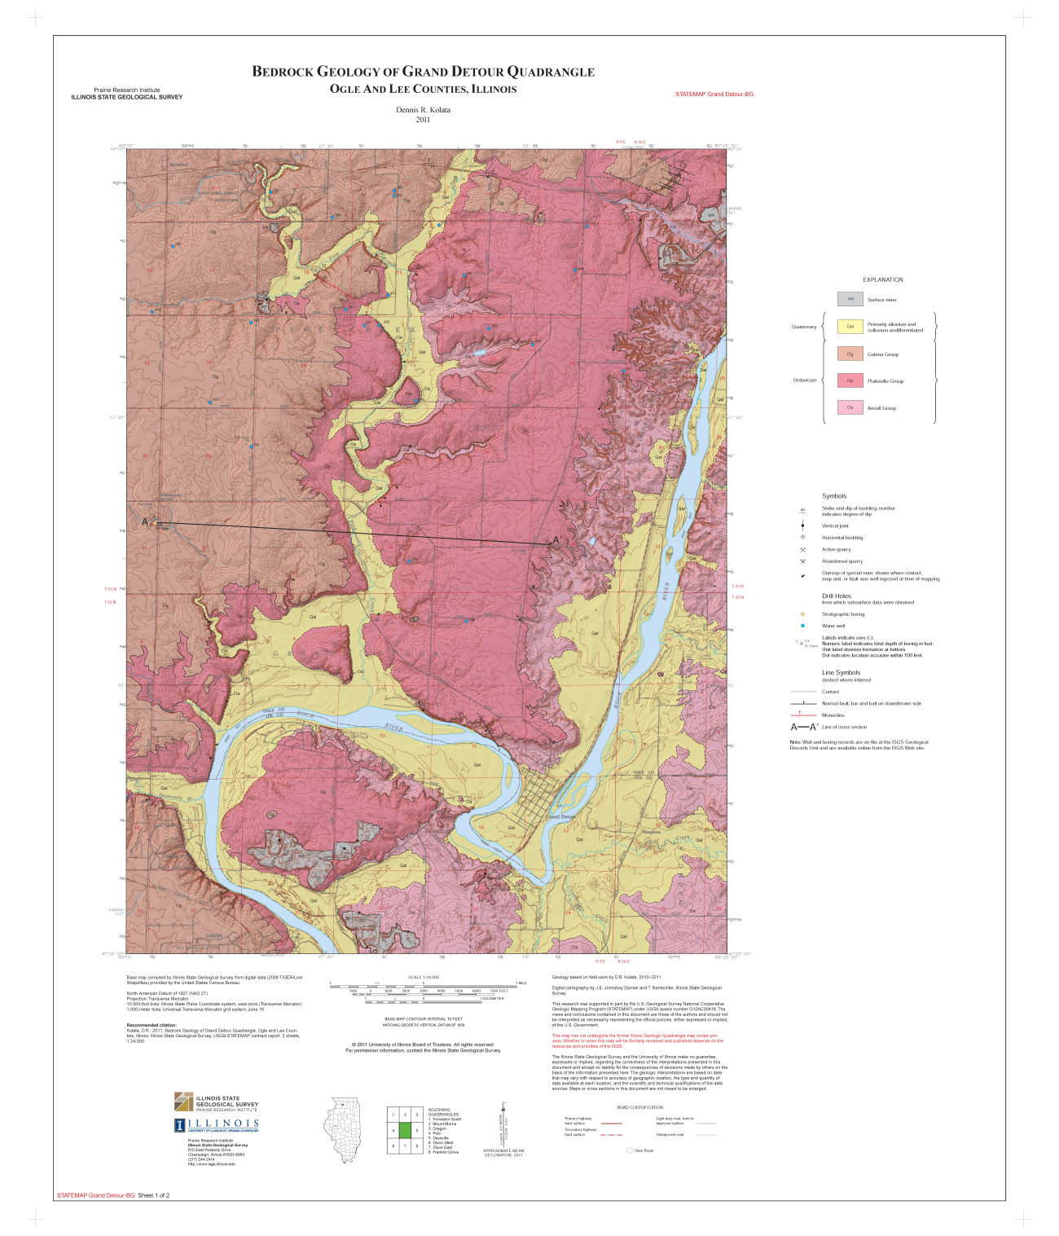
Quarry
1:24,000 scale geologic mapping

Slide 15
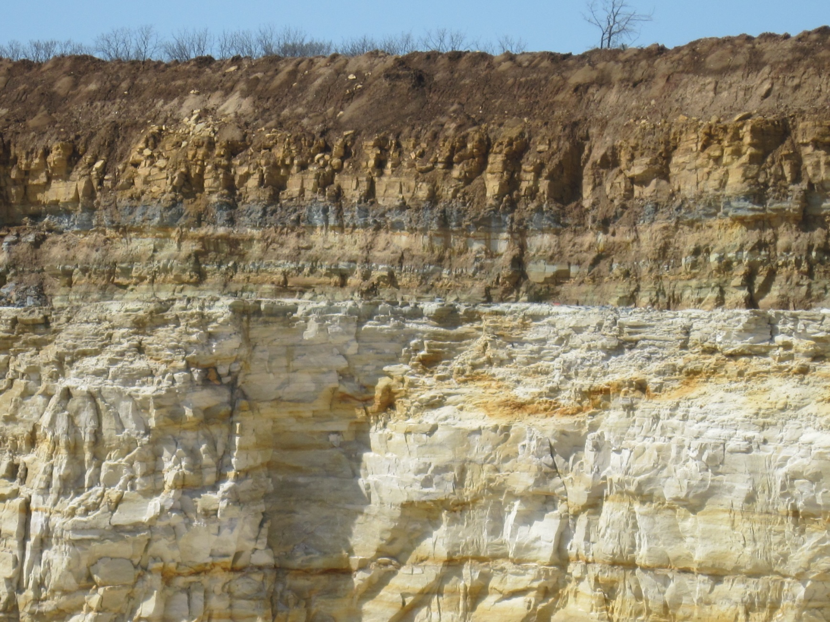
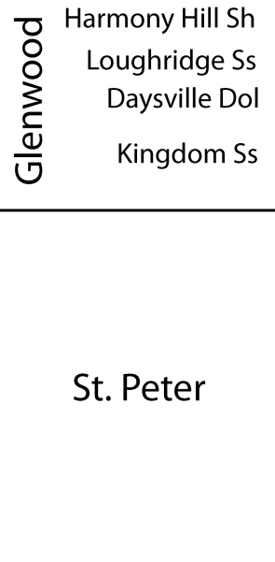
Stratigraphy – well-exposed in quarry wall (looking west)
S
N

Slide 16

We expected strata to be flat as a pancake…

Slide 17
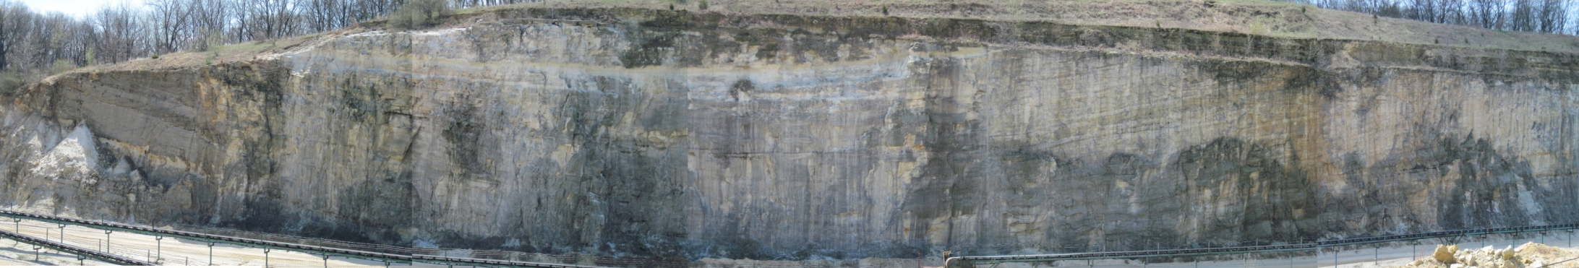
…but we observe a syncline in the St. Peter Sandstone. The Glenwood Formation rests atop an angular unconformity.
E
W
Quarry wall (looking south)
100
feet
1,500 feet

Slide 18
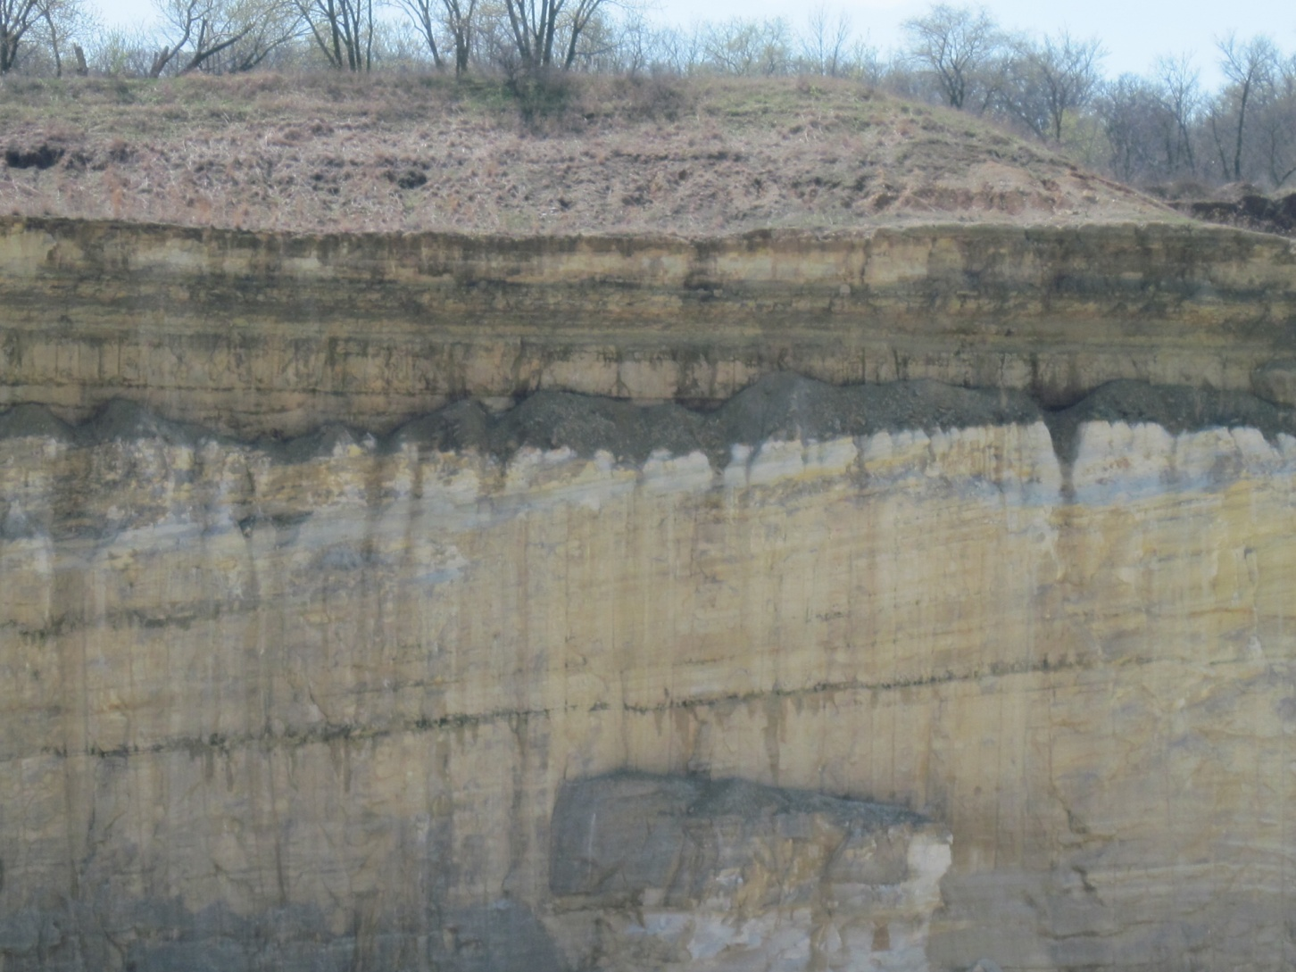
Glenwood
Close up of angular unconformity…
timing is well-constrained to the Turinian Stage!
E
W
St. Peter

Slide 19
Simplified cross section of syncline observed in quarry
E
W
Glenwood
100
feet
St. Peter
bedding
0
500 feet
1,000
1,500
Vertical Exaggeration: ~3x

Slide 20
…but could this be a primary depositional feature?
Environment of deposition of St. Peter Sandstone
?
…but there are no sedimentary structures in the St. Peter at the quarry.

Slide 21
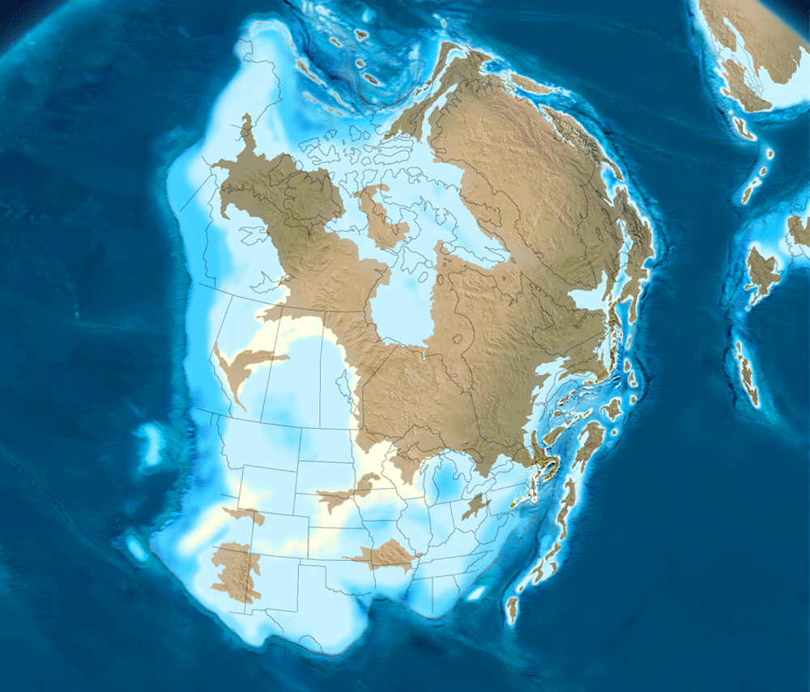
Conclusions
Ron Blakey, NAU Geology

Slide 22
470 Mya: Middle Ordovician
Taconic arc
Ron Blakey, NAU Geology

Slide 23
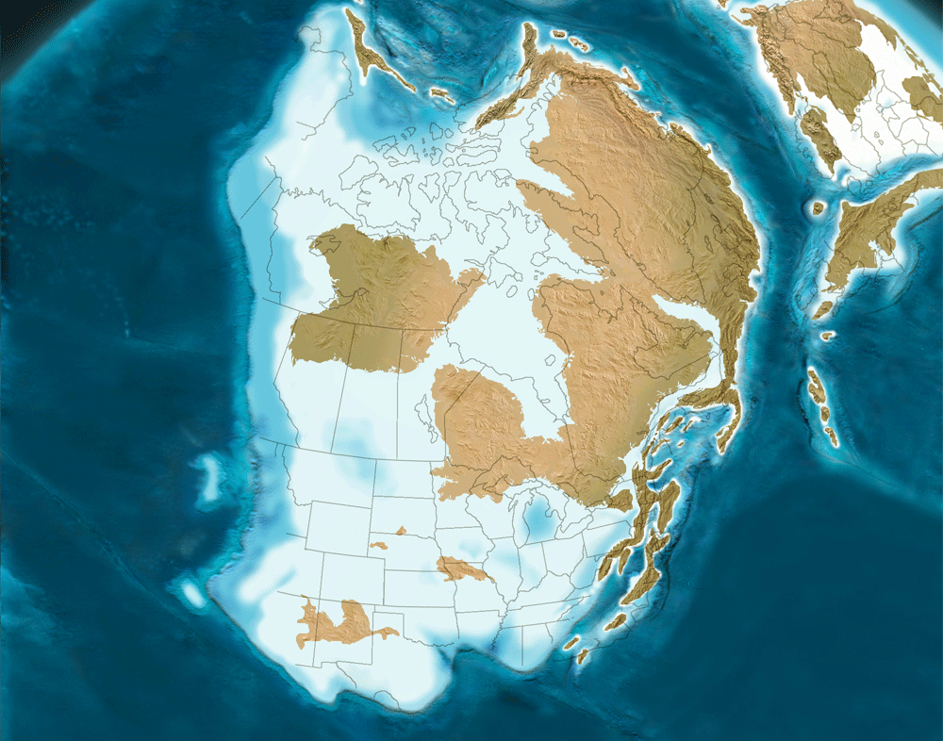
Our quarry
450 Mya: Late Ordovician
Laurentia
Taconic arc
Ron Blakey, NAU Geology

Slide 24
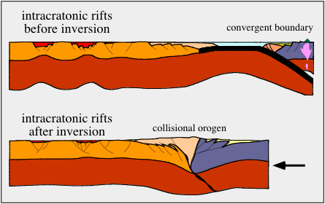
Mid-continent fold-and-fault zones are reactivated by stresses at the continental margin more than 2,000 km away…
(Ziegler)
Midcontinent fault zones
Faults are reactivated, i.e. Sandwich Fault Zone
σ_{s}
intact
Images courtesy of S. Marshak
frictional
σ_{n}

Slide 25
We can add another tectonic event to the geologic timescale in the United States Midcontinent.
Alleghanian ?
Acadian ?
Taconic !

Slide 26
…so, the Sandwich Fault (N. IL) was reactivated during collision of the Taconic arc. But this just brings about more questions…
How widespread was this Ordovician tectonic event in the US Midcontinent?
Are other midcontinent faults reactivated during this time?
Midcontinent fault-and-fold zones
Fold-thrust belt
Sandwich
fault zone
Taconic
arc
Cartoon courtesy of S. Marshak

Slide 27
Acknowledgments
U.S. Geological Survey
STATEMAP grant #G10AC00418
Illinois State Geological Survey
Dennis Kolata
Scott Elrick
University of Illinois Urbana-Champaign
Steve Marshak
Stephanie Mager
Deep Sen
Questions?
Contact:
Mary Seid
seid@isgs.illinois.edu

