Slide 1

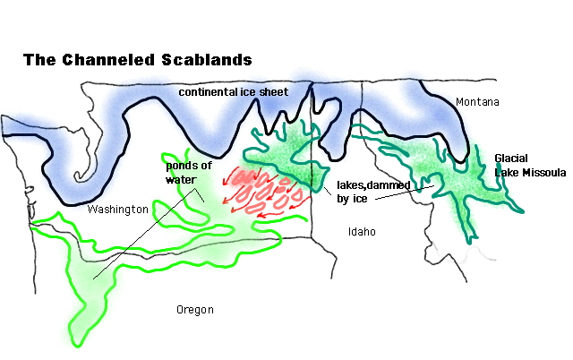

LOOKING
FOR
LAKE
MISSOULA!!

Slide 3
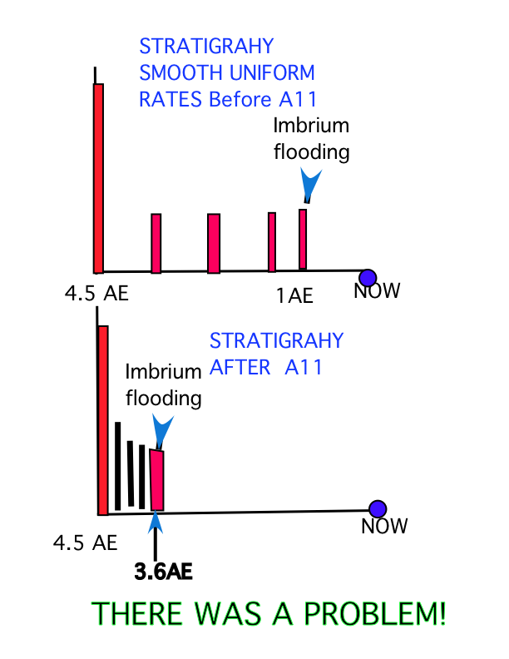
EARLIER MAJOR,
CRATERING

Slide 4


Slide 5


Slide 6


Slide 7
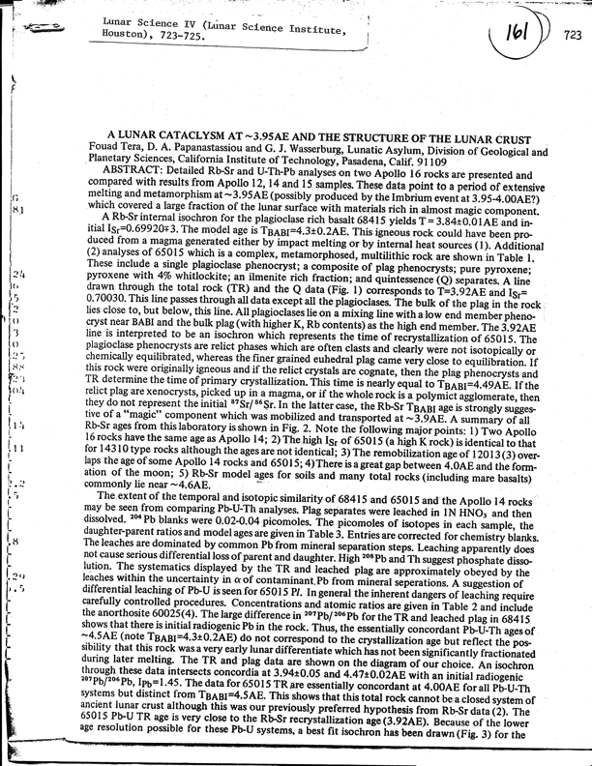
LPSC IV 1973
CONCLUSIONS
Since Imbrium was a relatively young basin forming event, this type of process must have been prevalent prior to 4.0AE. Either the Imbrium blanket has dominated ALL of the materials so far studied, or we must conclude that the major impact events peaked in a relatively short period near 4.0AE. It must in any event have been quite a show from the Earth assuming that you had a really good bunker to watch from.

Slide 8

You
Did not look hard
enough!
It was late & fast!
What is the cause?

Slide 9
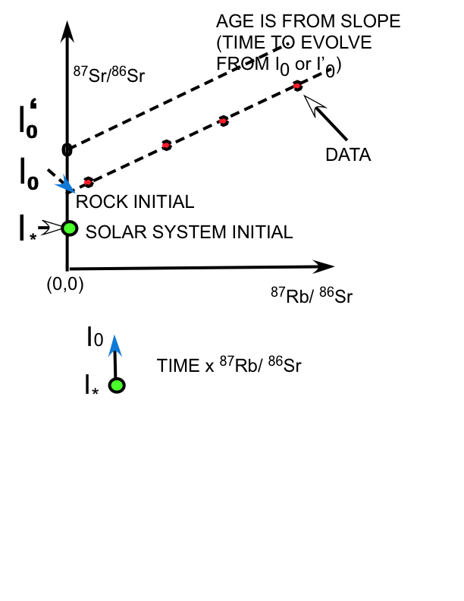

Slide 10
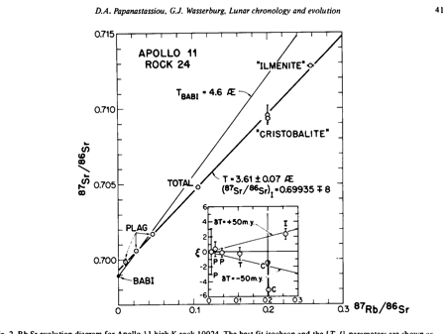

Slide 11
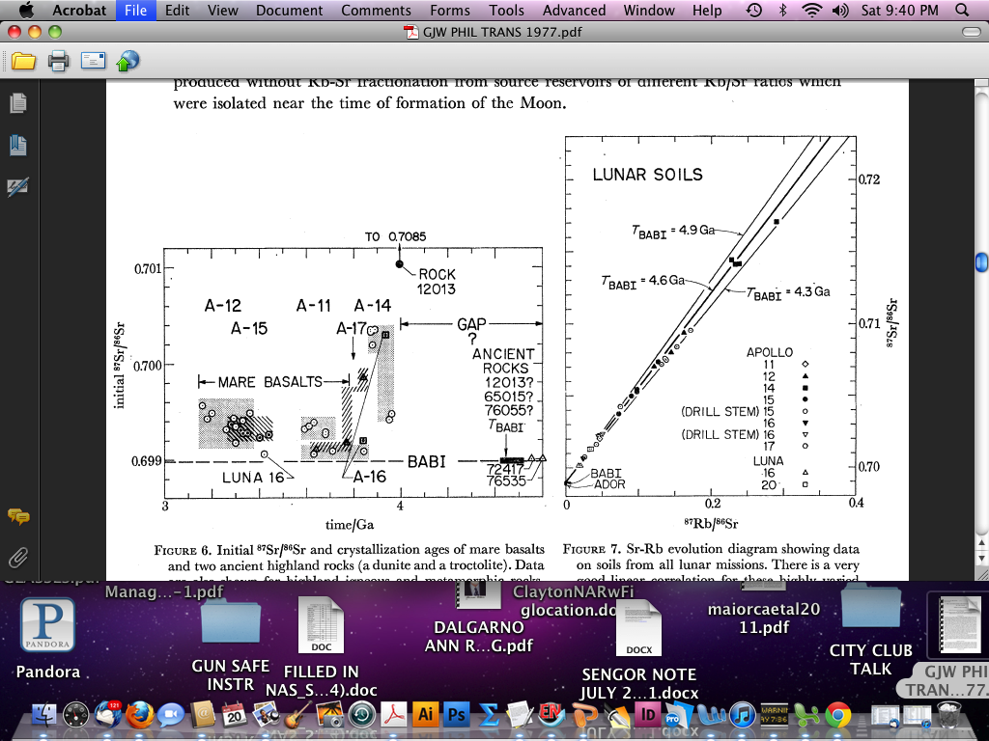

Slide 12
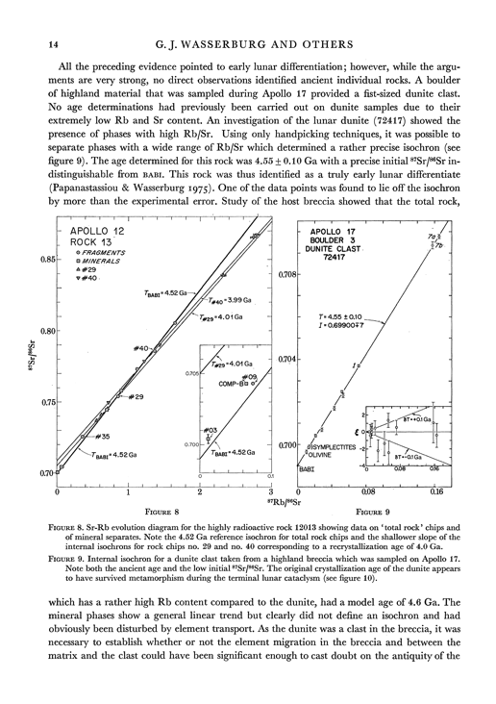

Slide 13
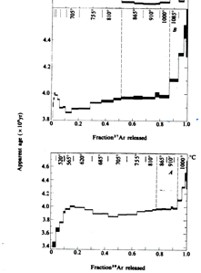
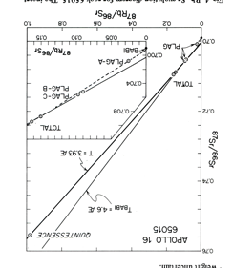
JESSBERGER, HUNEKE & WASSERBURG
1974 nature, v. 248
DAP & GJW EPSL v17 1972
⁸⁷Sr/⁸⁶Sr
40Ar/39Ar
A BRECCIA MADE OF 4.5GY
MATERIAL IMPACT MET. AT 3.9 GY

Slide 14
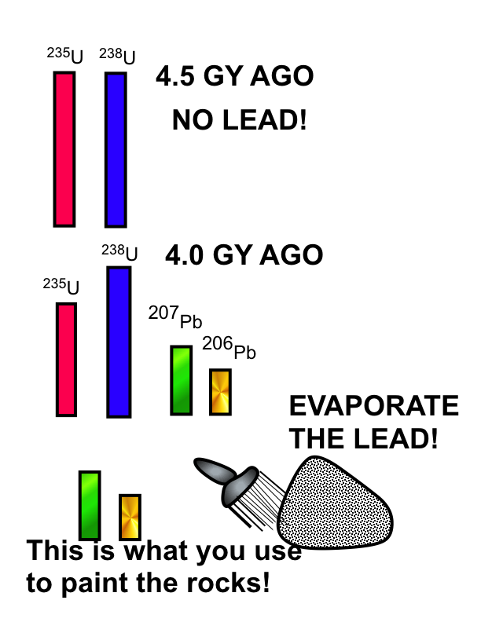

Slide 15
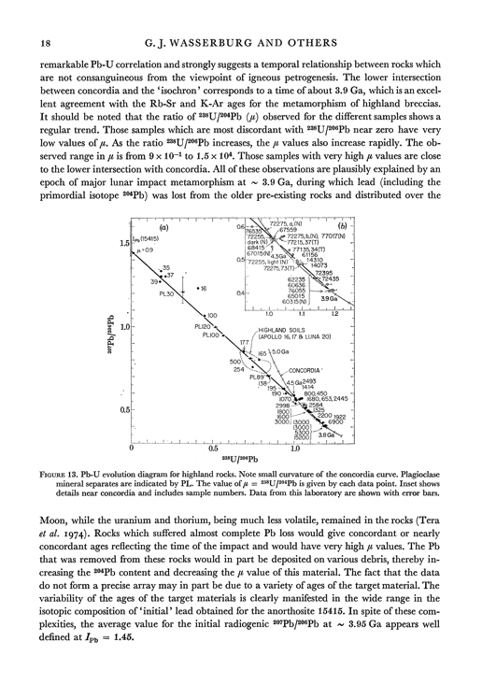

Slide 16
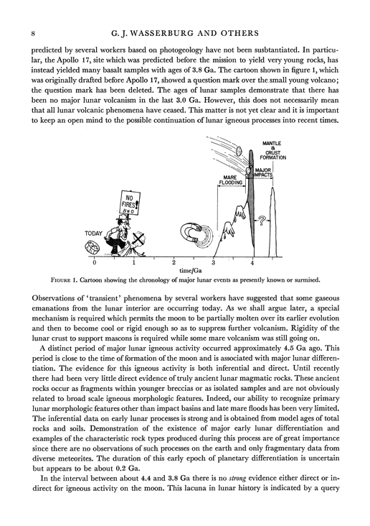
LHB of WHOLE INNER
SOLAR SYSTEM
G. J. Wasserburg, D. A. Papanastassiou, F. Tera, J. C. Huneke:
Phil. Trans. of the Royal Society of London ,1977.

Slide 17
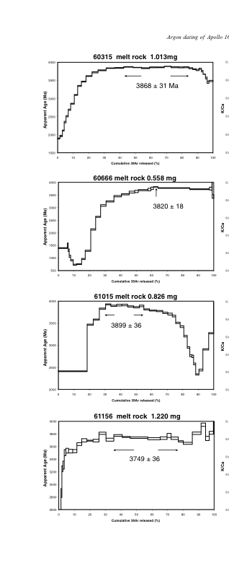
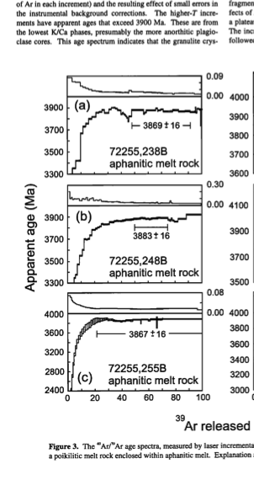
NORMAN ET AL (2006)
DALRYMPLE & RYDER (1989)

Slide 18
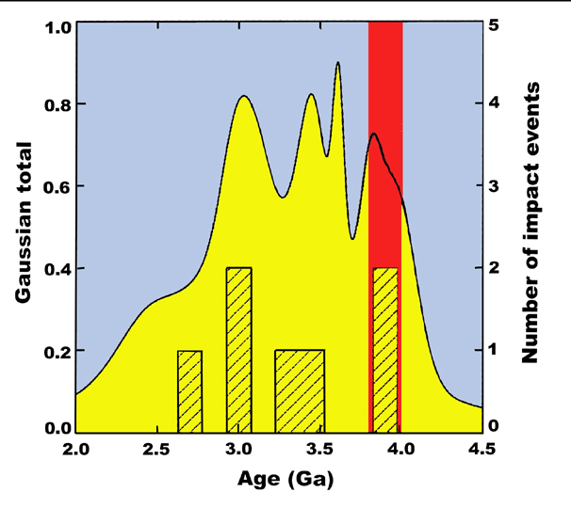
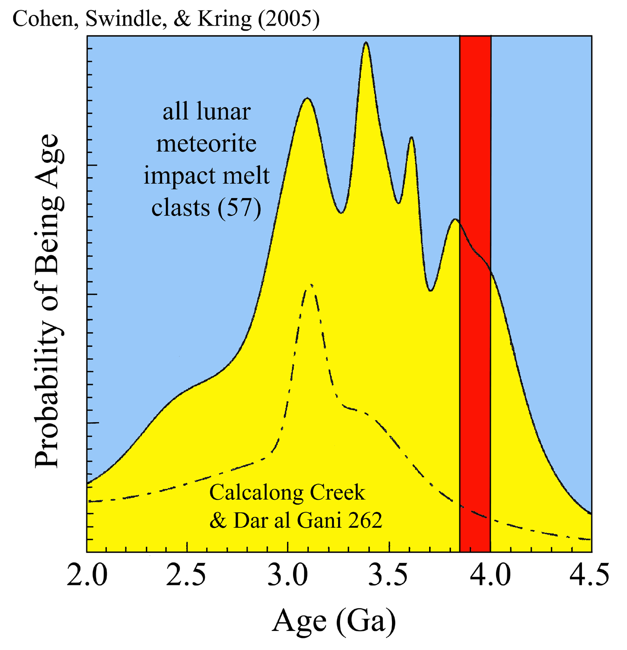
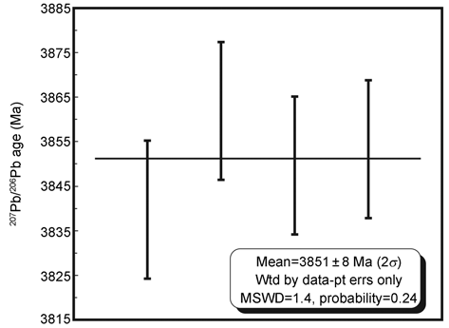
LUNAR METEORITES (AGES)
Cohen, Swindle & Kring (2000)
31 clasts
3.851 Ga
Weighted mean 207Pb/206Pb age of zirconolite in MIL 05035
ZHANG AiCheng, et al. Sci China Earth Sci March (2010) Vol.53 No.3

Slide 19
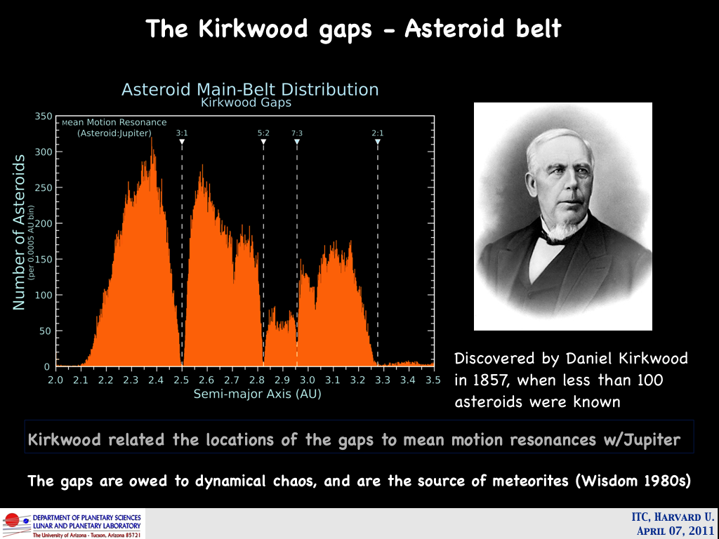

Slide 20
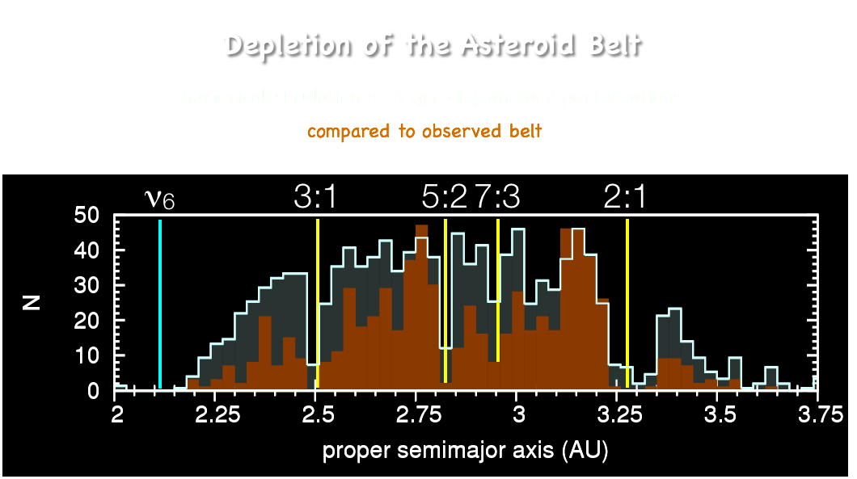

Minton & Malhotra, Nature, 457, 1109 (2009)
Notes:
The main asteroid belt appears more depleted than can be accounted for by the perturbations of the planets in their present configuration:
orange shaded histogram shows the observed distribution, grey shaded histogram shows the simulated asteroid belt under 4 gyr of planetary perturbations.
Excess depletion is found in the inner half of the belt and in the Jupiter-facing sides of the Kirkwood Gaps. This pattern of excess depletion indicates inward migration of Jupiter by about 0.3 AU (which sweeps the Jovian mean motion resonances inward) and the outward migration of Saturn by about 1 AU (which sweeps the nu6 resonance inward).

Slide 21
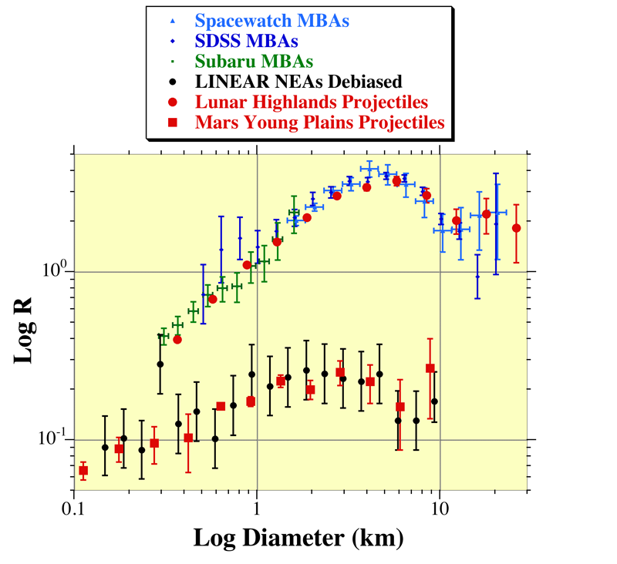
Pop 1
Pop 2
Strom et al., Science, 309, 1847 (2005)
Notes:
Pop 1 projectiles’ size distribution matches that of the main asteroid belt;
Pop 2 projectiles’ size distribution matches that of the near earth asteroids.

Slide 22
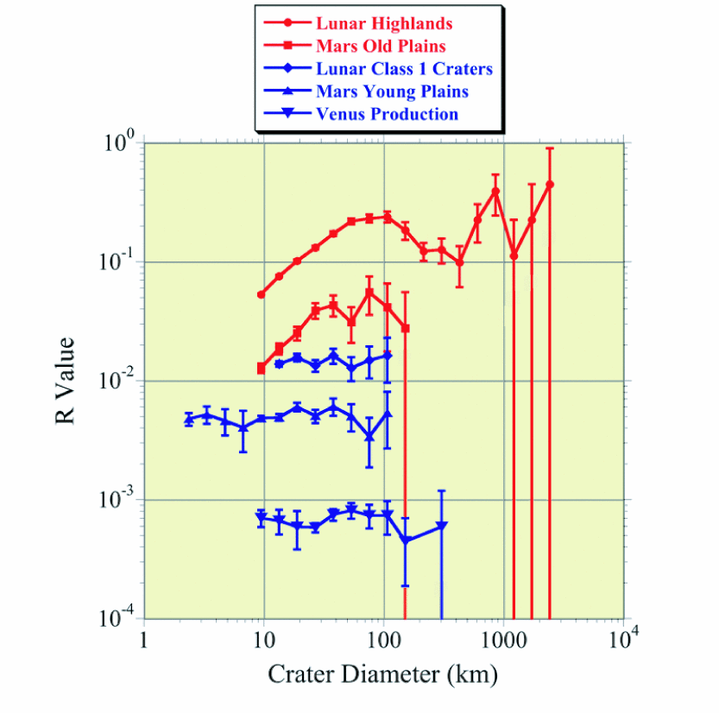
Pop 1
Pop 2
Strom et al., Science, 309, 1847 (2005)
Notes:
Two distinct crater size distributions correlated with age: Pop 1 is old, Pop 2 is younger and very close to -3 power law.
Pop 1 is found on the heavily cratered highlands of the Moon, Mars and Mercury.
Pop 2 is found on the lightly cratered younger surface units of the Moon, Mars, Mercury and Venus.
R value = D³(∆N/∆D)/area

Slide 23
MIGRATION of MAJOR PLANETs
Malhotra, R. The origin of Pluto’s peculiar orbit.
Nature 365, 819–-821 (1993).
Origin of the cataclysmic Late Heavy Bombardment
period of the terrestrial planets.
R. Gomes, H. F. Levison, K. Tsiganis & A. Morbidelli
Vol 435, 2005; nature
Chaotic capture of Jupiter’s Trojan asteroids in the early Solar System
A. Morbidelli, H. F. Levison, K. Tsiganis & R. Gomes,
Vol 435,26 May 2005-nature
Depletion of the Outer Asteroid Belt
Jer-Chyi Liou* and Renu Malhotra .
SCIENCE, VOL. 275,1997

Slide 24
The Asteroid Belt is our
“Lake Missoula” in the skies,
& Migration of
Jupiter & Saturn
appear to be
the log jam breakers.

