Slide 1
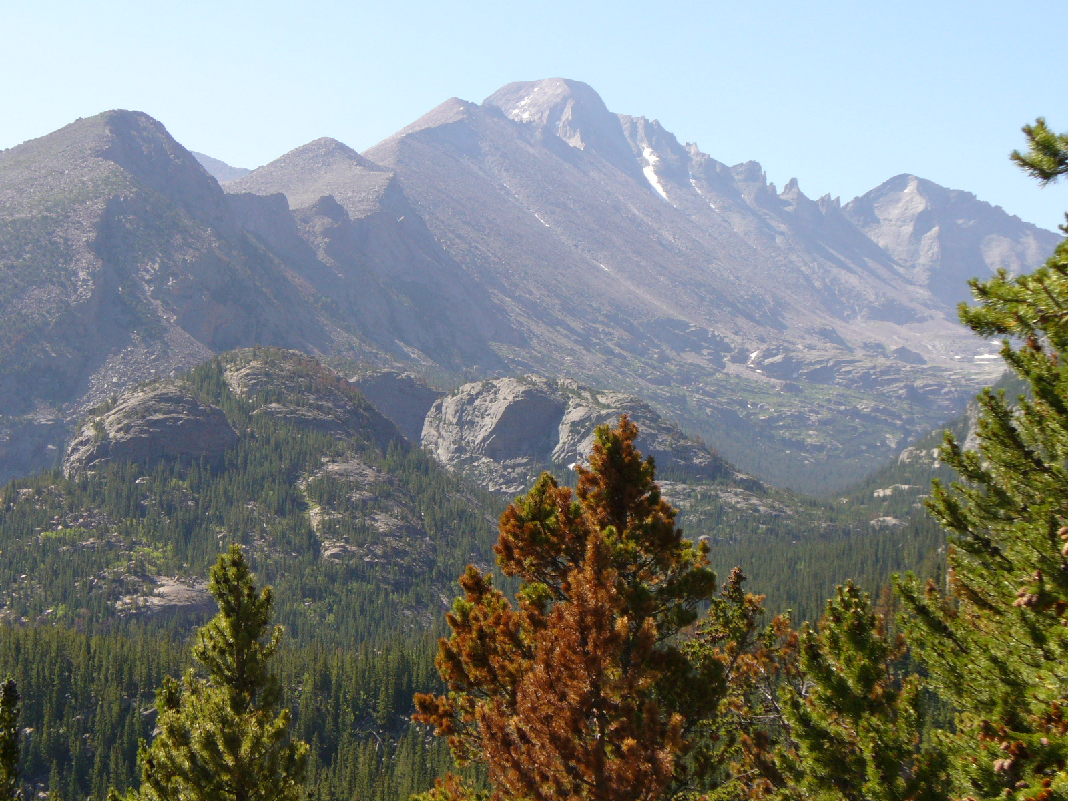
Thinking about deep time: the Intersection of temporal, spatial & numeric reasoning
Kim Cheek
cheek.kim8@gmail.com

Slide 2
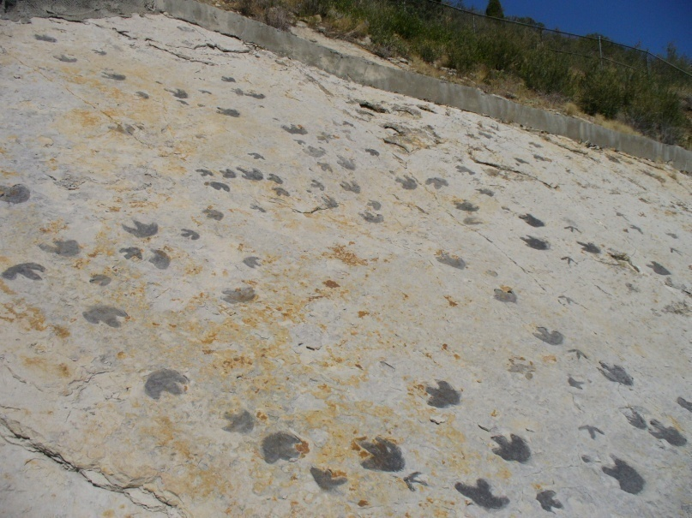
Temporal Succession
Place geoscience events in relative & absolute temporal order
Appearance & disappearance of dinosaurs precedes appearance of humans but by how much?

Slide 3
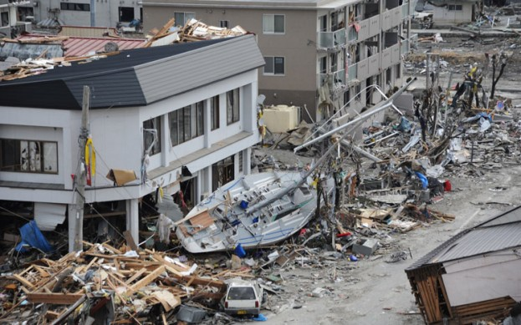
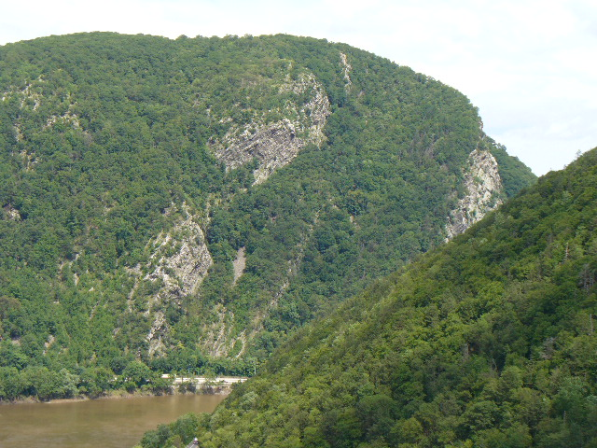
Duration of
Events/Processes
www.motortrend.com
Use information about
rate to infer duration

Slide 4
Impacts understanding in many areas of geoscience (Kusnick, 2002; Kortz & Murray, 2009; Rule, 2007)
Similar alternative conceptions across ages (Trend, 1998, 2000, 2001; Dodick & Orion, 2003; Libarkin, Kurdziel & Anderson, 2007)
Ascribe short temporal periods to events such as folding (Hidalgo & Otero, 2004)
Allege that 2 strata of = thickness require = depositional periods (Dodick & Orion, 2003)
Underestimate duration of events/processes requiring long time periods (Lee, Liu, Price, & Kendall, 2011)

Slide 5
Deep Time
Conventional Time
Large Numbers
Geoscience Content Knowledge (GCK)

Slide 6
Conventional Time Conceptions
Twin ideas of succession & duration, temporal units independent of events, largely mastered by ages 10-11 (Piaget, 1969)
Rudimentary concepts of succession & duration in infants, BUT ability to name month 2 months prior to specific month inconsistent till age 15 (Friedman, 1990, 2005)
Temporal compression of events (Janssen, Chessa, & Murre, 2006), also seen in deep time (Catley & Novick, 2009)

Slide 7
Conventional Time Conceptions
Questions about adults’ ability to use distance & rate information to determine duration (Matsuda, 2001; Casasanto & Boroditsky, 2008)
Spatial component to temporal thinking (Friedman, 1992; Boroditsky, 2000; Boroditsky & Ramscar, 2002)
Numerical connection, too (Walsh, 2003; Liberman & Trope, 2008)

Slide 8
Conceptions of Numbers
Intuitive logarithmic mapping of numbers (e.g, Booth & Siegler, 2006; Dehaene, Izard, Spelke, & Pica, 2008)
Powers of ten function as units, move multiplicatively across them (Tretter, Jones, & Minogue, 2006; Jones, Tretter, Taylor, & Oppewal, 2008)
Issue of quantity not just Arabic numerals (deHevia & Spelke, 2009)

Slide 9
Do students reason about conventional & deep time in similar ways?
Do students understand the relative sizes of numbers in the thousands or greater?

Slide 10
Qualitative, Exploratory Study
Semi-structured interviews (7 tasks)
35 participants
--8th grade (Mdn age: 14 yrs., 4 ½ mo.)
--11th grade (Mdn age: 17 yrs., 1 mo.)
--university undergraduates (Mdn age: 20 yrs.)
Interviews audiotaped & fully transcribed

Slide 11



Duration Animation 1
(DA1)
Duration Animation 2
(DA2)
Duration Animation
3 (DA3)

Slide 12
Reasons for Answers on Duration
Animations
Reason for answer | 3 or fewer correct (n=16) | 4 or more correct (n=19)
Size of layers | 14 | 13
Pattern (alternating speed) | 3 | 4
Perception of rate | 16 | 15
Counting | 8 | 16
Guessed | 4 | 1

Slide 13
‘Cause there is more & I guess that since it’s more it would take more time to fill up (Malik, 11th gr.)
I think they were both around 6 s….I think the yellow might have been just slightly longer. (Nathan, 11th gr.)

Slide 14
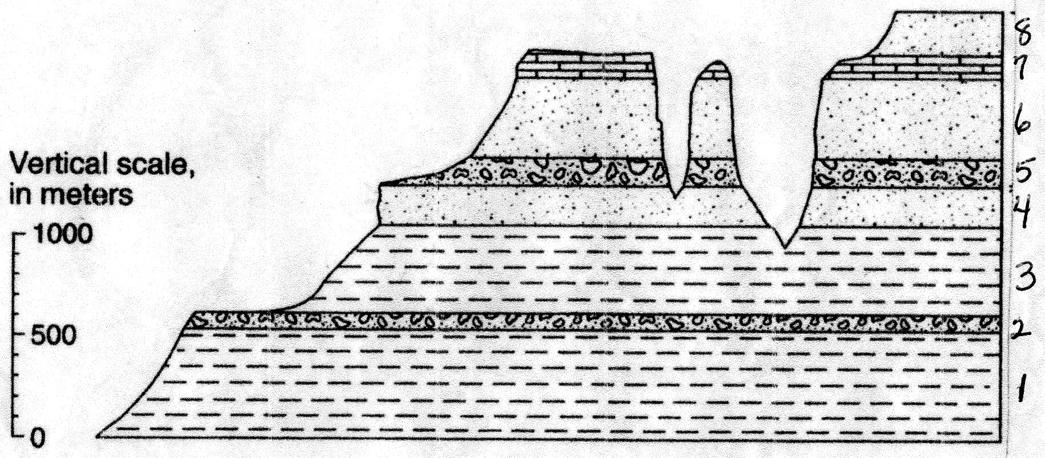
Application to a Sedimentary Sequence

Slide 15
Responses Comparing Time for 2 Sedimentary Layers to Form
Response | Total Freq. | Freq. for 3 or fewer correct (N=16) | Freq. for 4 or more correct (N=17)
Thicker took longer | 8 | 6 | 2
Thinner took longer | 18 | 10 | 8
Same | 3 | 0 | 3
Can’t be determined | 6* | 1 | 5
* Includes 1 student who listed all options as equally plausible

Slide 16
3 Numeric Timelines
Timeline 1 | Timeline 2 | Timeline 3
1 day | 1,000 years | 1 minute
1 month | 100,000 years | 1 day
1 year | 1 million years | 1 month
100 years | 100 million years | 1 year
 |  | 10,000 years
 |  | 10 million years
 |  | 100 million years

Slide 17
Analysis of Timelines
Two-stage sorting process (initial inter-coder agreement: 80%, 89%, & 89%)
3 groups:
Limited Understanding of Smaller Numbers (LSN)
Insufficient Knowledge of Large Numbers to Deal with Deep Time (ILN)
Sufficient Knowledge of Large Numbers to Deal with Deep Time (SLN)
Notes:
80%

Slide 18
Student Groups by Understanding of
Large Numbers
Category | Number of students
 | 8th grade | 11th grade | university
Sufficient knowledge of large numbers to deal with deep time (SLN) | 2 | 6 | 8
Insufficient knowledge of large numbers to deal with deep time (ILN) | 5 | 2 | 4
Limited understanding of smaller numbers (LSN) | 5 | 3 | 0

Slide 19
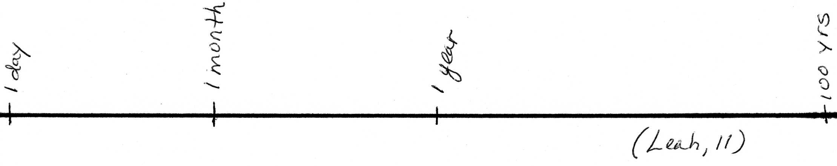
LSN
There might be more space between a day
& a month than between a month & a year (Leah, 11th gr.)

Slide 20
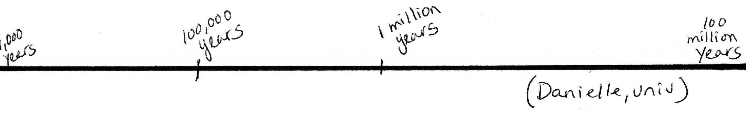
ILN
The numbers between 100,000 and 1 million are very blurry. (Danielle, univ.)

Slide 21
Interviewer: You have about the same amount of space between 1 yr. & 10,000 yrs. as you have between 10,000 yrs. & 10 million yrs.
Ashley (8th gr.): Yeah, ‘cause they’re like be [sic] the same amount…they’re just another year or so.

Slide 22
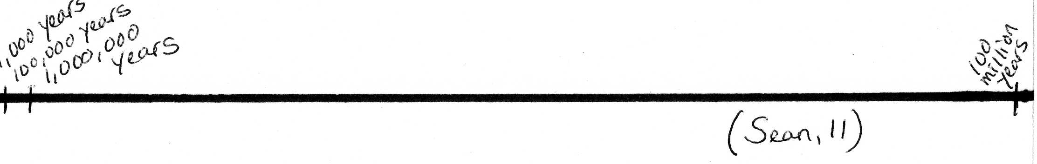
SLN
When it comes to what was going through my head, I was thinking math, math, math the whole time. I was thinking proportions. (Sean, 11th gr.)

Slide 23
Conclusions
Similarity between temporal reasoning in conventional & deep time
--compression of events
--spatial size = temporal duration
--difficulty synthesizing rate & size
Uneven understanding of large numbers even among university undergraduates
May need to explicitly teach proportional relationships
Provide familiar examples when spatial size ≠ duration

