Slide 1


Regional dolomitization: The leaky-aquifer
ascending-brine model
GSA Minneapolis, Mn
Oct 11, 2011
Thomas F. Kraemer
Warren W. Wood
MICHIGAN STATE
UNIVERSITY
Thanks to Dave Clark USGS/NDC for logistical support in the UAE

Slide 2
The dolomite problem!
Dolomite is ubiquitous in the geologic record yet is apparently forming today only in limited environments, thus challenging the paradigm “The present is the key to the past”.
Our thesis is that the dolomite problem is one of:
Identifying on-going dolomitization
Magnesium source and transport
Viable geochemical conditions

Slide 3
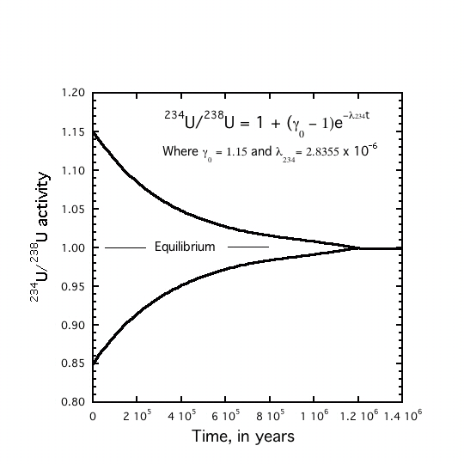
²³⁴U/²³⁸U disequilibrium as indicator of recent dolomite precipitation
Uranium in marine carbonate is released on carbonate dissolution. New mineral precipitation closes the system and restarts the ²³⁴U/²³⁸U “secular equilibrium clock” making possible to identify dolomite precipitation that has occurred less than ~ 10⁶ years BP

Slide 4
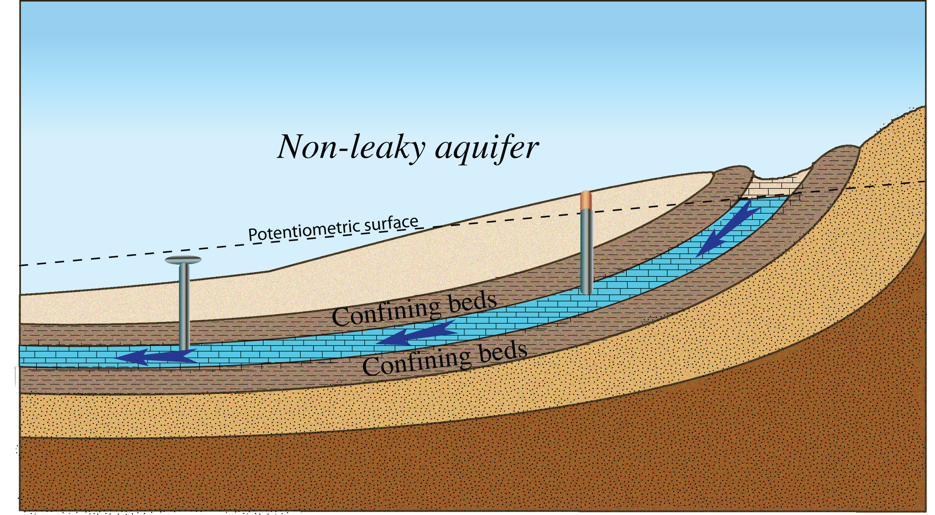
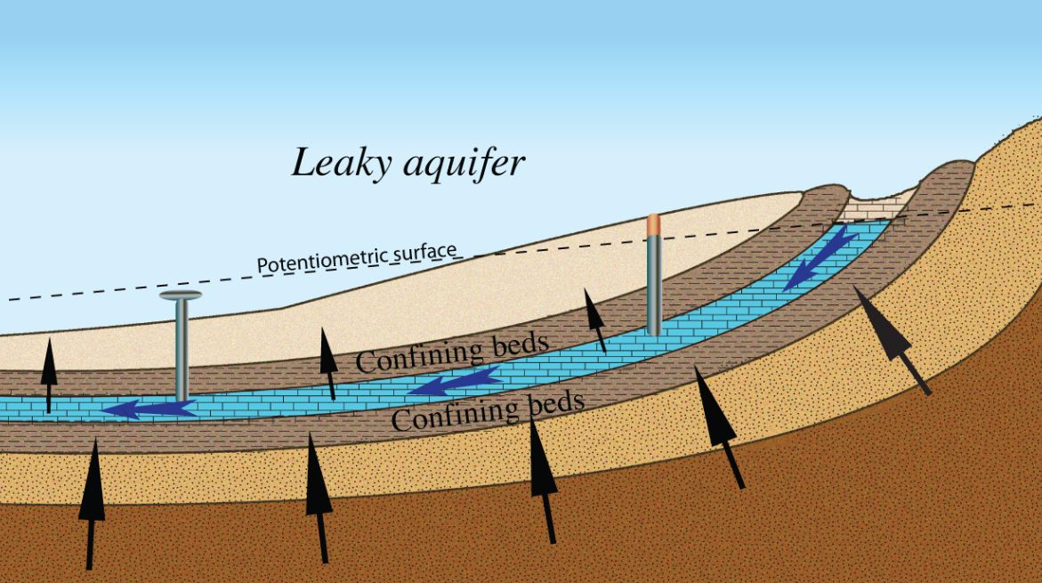
Magnesium transport; The leaky aquifer ascending-brine model
Traditional view of an aquifer system
with intraformational flow. Solutes derived from weathering of aquifer
A more realistic view of aquifer systems with solute leakage. Mg enters the aquifer from ascending geologic brines

Slide 5
Viable geochemical environment: Solute mixing
and decreasing temperature
Declining temperature plus mixing of ascending brines with intraformational flow, creates thermodynamic under saturation with respect to calcite and super saturation with respect to dolomite.
Intraformational flow
Temperature decease with ascent

Slide 6
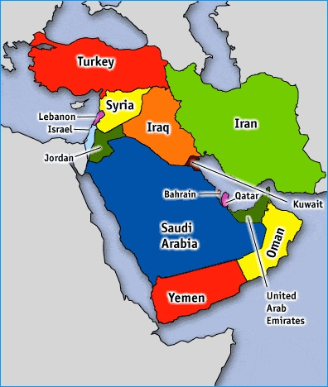
Testing the hypothesis: UAE Location of study area

Slide 7

General location map Gachsaran Fm. UAE
Groundwater flow lines and wells “x” sampled
Current hydrology started about 7 x 10⁶ years BP

Slide 8
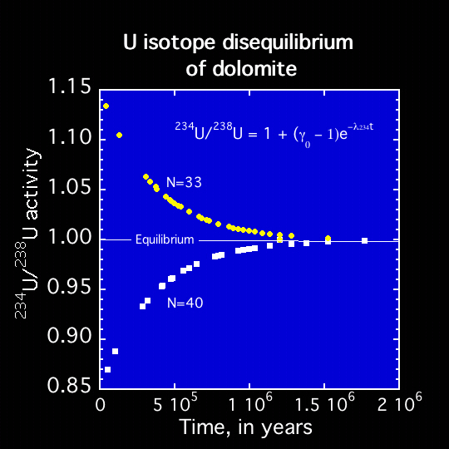
²³⁴U/²³⁸U Uranium isotope ratio disequilibrium of dolomite
Many of the uranium isotopes ( ²³⁴U/²³⁸U) from dolomite are out of equilibrium suggesting recent crystallization. It follows that dolomite is younger than ~ 10⁶ years BP

Slide 9
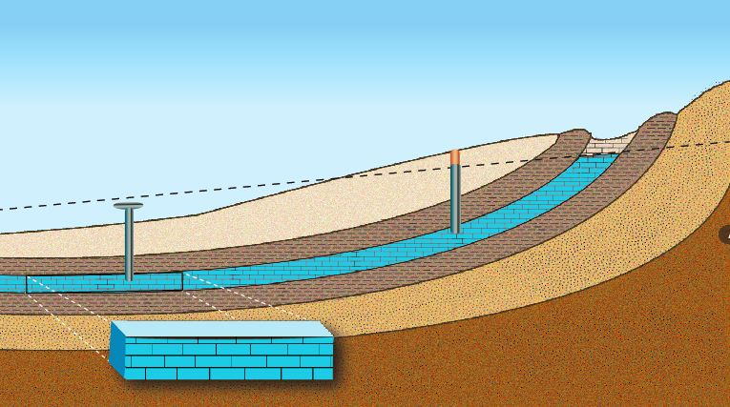
Magnesium mass balance
150 km
1 m
450 m
Mass of magnesium present in a control volume of the aquifer
M_{totMg} = M_{dolMg} + M_{liqMg}
~ 6.8 x 10⁸ kg
Mass of magnesium entering control volume since start of flow system
Q_{Dis} = Q_{Rec} + Q_{leak in} – Q_{leak} _{out}
CQ_{Dis} = CQ_{Rec} + CQ_{leak in}- CO_{leak out}
~11x10⁹ kg

Slide 10
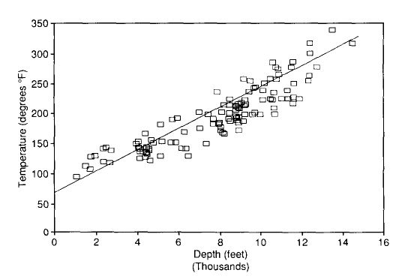
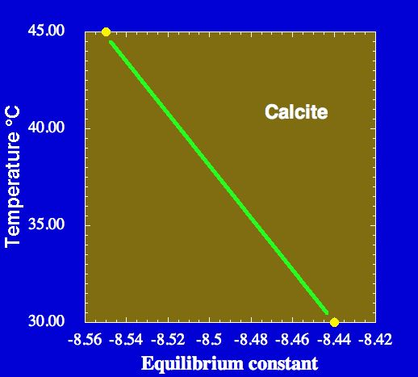
Geothermal gradient ~ 3°C/100 m
Geothermal gradient is ~ 2.7 °C
per 100 m
From Gumati, 1991
Pore water becomes thermodynamically under saturated with respect to calcite owing to calcite’s retrograde solubility. That is. the solutes are transported to areas of continuing lower temperatures along the vertical flow line and thus, remain undersaturated with respect to calcite.

Slide 11
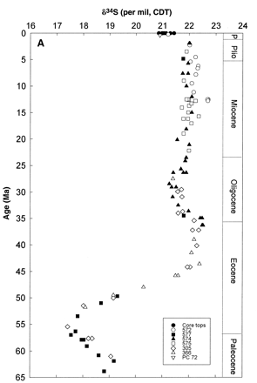
δ ³⁴S in contemporary gypsum suggests source of ascending brines
Pliocene
Miocene
²³⁴U/²³⁸U is out of equilibrium in gypsum as well as dolomite suggesting contemporary gypsum precipitation. The δ ³⁴S values of 18.1 ‰ _{CDT} suggests a Paleocene age brine consistent with ascending brine of that age.
Oligocene
Eocene
Paleoeocene
Modified from Paytan et.al., 2008

Slide 12
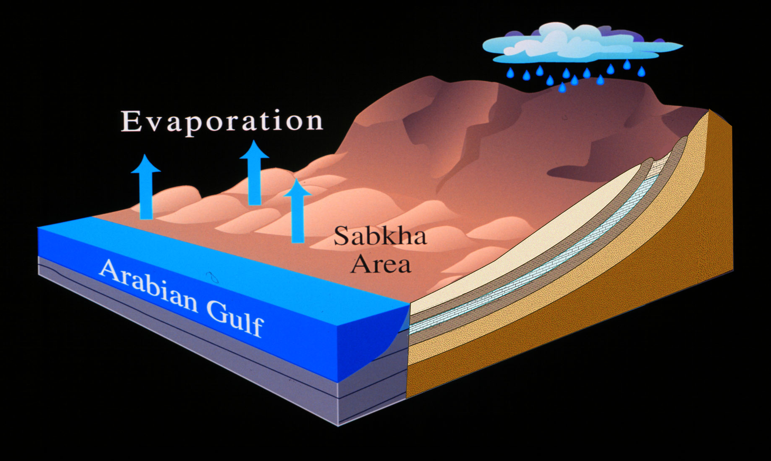
Summary and conclusions
Dolomite results from dissolving marine calcite by a combination of decreasing temperature and mixing with interformational waters and subsequent precipitation of dolomite. Ascending geologic brines provide the required magnesium for dolomite precipitation.
Thank You!

