Slide 1

The Collingwood Member of the
Trenton Formation
A Petrological, Mineralogical, Geological, and Petrophysical Analysis
R.M. Banas and W.D. Pennington
Michigan Technological University

Slide 2
Introduction
  The Collingwood Member
    Middle to Late Ordovician
    Michigan Basin and parts of Ontario
  Originally identified from oil shale seep
    Collingwood area of Georgian Bay
    Mined as an oil shale
  Studied by the Ontario GS as part of the Oil Shale Assessment Project in the 1980’s
  Recent economic interest
    Wildcat wells drilled and tested in 2010
    Profitable subsequent Michigan lease auction
Notes:
The Collingwood member is a middle to late Ordovician deposit in the MI basin and parts of Ontario

Slide 3
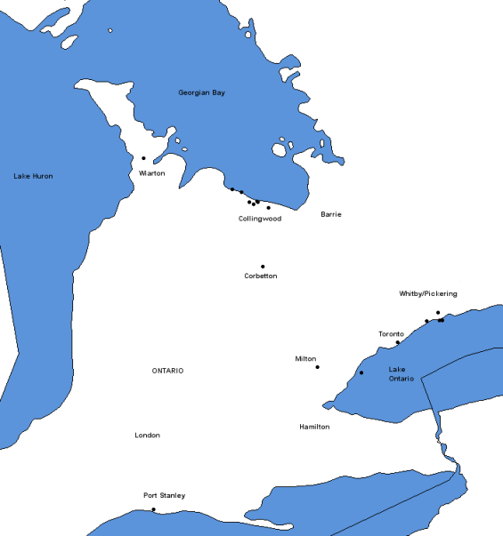
Introduction
  The Collingwood Member
    Middle to Late Ordovician
    Michigan Basin and parts of Ontario
  Originally identified from oil shale seep
    Collingwood area of Georgian Bay
    Mined as an oil shale
  Studied by the Ontario GS as part of the Oil Shale Assessment Project in the 1980’s
  Recent economic interest
    Wildcat wells drilled and tested in 2010
    Profitable subsequent Michigan lease auction
Notes:
It was originally identified from oil seeps in the 1850’s around the Collingwood area of Georgian Bay, Ontario and subsequently mined into the 1860’s
It was studied by the ontario GS as part of the OSAP in the 1980’s (canada)
It Has become a recent economic interest after wildcat wells were drilled and tested resulting in a profitable MI mineral lease auction

Slide 4
Objectives
  Perform a complete review of previous results
  Characterize intrinsic formation properties
  Analyze petrophysical response and general trending across the basin
  Develop a geologic model of deposition
Notes:
Our objectives are…

Slide 5
Rationale
  Already millions of dollars invested into the formation
  Need for new plays and demand for energy
  Poorly understood in the Michigan Basin with little available data
Notes:
Rationale is…

Slide 6
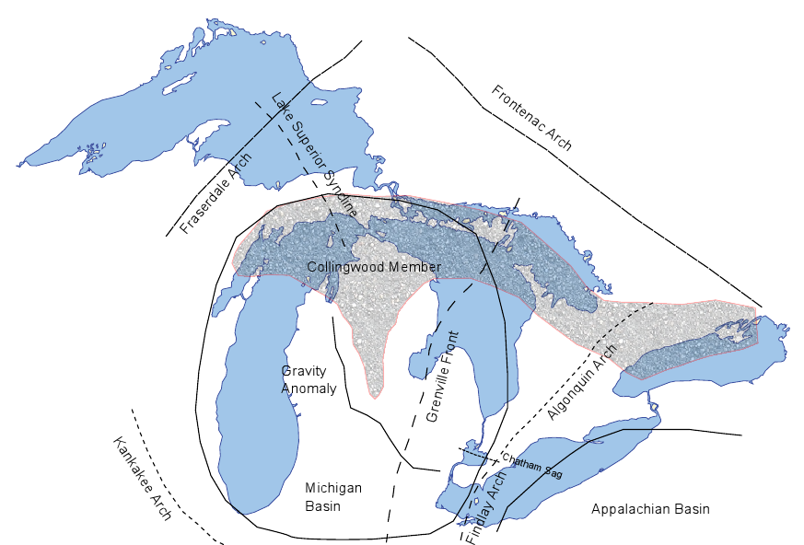
Areal Extents and Structures
Notes:
Here you are looking at a map of the michigan basin and associated geologic structures
The Collingwood is present as the shaded region across the north MI basin and into Ontario
To note, the algonquin arch represents a topographic high and the mid-contintental rift and grenville front have been thought to be highs in the basement
The rift and grenville front may possibly have acted as flanks during subsidence and affected the deposition pattern of the Collingwood

Slide 7
Areal Extents and Structures
Collingwood Deposition
5-50’ thick
Both source and reservior
Notes:
The Collingwood ranges from 5-50’ in thickness and acts as a self-sourced reservoir

Slide 8
Areal Extents and Structures
Collingwood Deposition
5-50’ thick
Both source and reservior
Taconic Orogeny
Deformation of the basin
Tectonic subsidence
Notes:
Approximately during Collingwood time, the Taconic Orogeny occurred which resulted in deformation of the basin and tectonic subsidence events

Slide 9
Areal Extents and Structures
Collingwood Deposition
5-50’ thick
Both source and reservior
Taconic Orogeny
Deformation of the basin
Tectonic subsidence

Slide 10
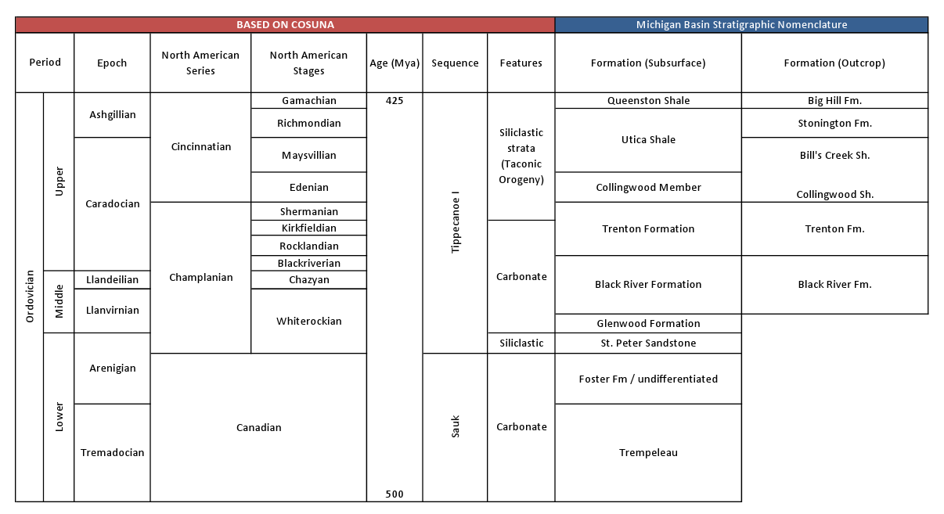
Local Stratigraphy
Chart based on Correlation of Stratigraphic Units of North America
Notes:
The Collingwood is placed in the stratigraphic column below the Utica Shale and above the Trenton Limestone roughly in the upper Ordovician
It is thought that it may be part of the initial siliclastic input from the Queenston Delta during the Taconic Orogeny

Slide 11
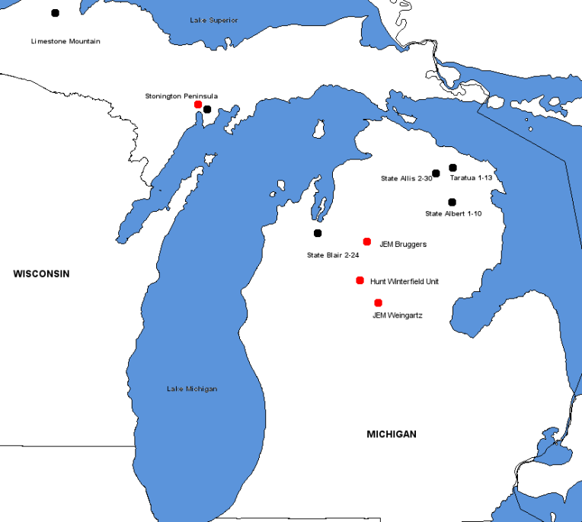
Data Used
  200+ wireline logs
  Thin sections
  XRD data
  SEM imaging
  Core data (Bill Harrison, MGRRE*)
Our samples (red), Hiatt’s (black) in 1985
*Michigan Geological Repository for Research and Education at Western Michigan University
Notes:
The following data was used in our study
Over 200 wireline logs
Thin sections
X-ray diffraction data
SEM imaging
And we were also provided core data

Slide 12
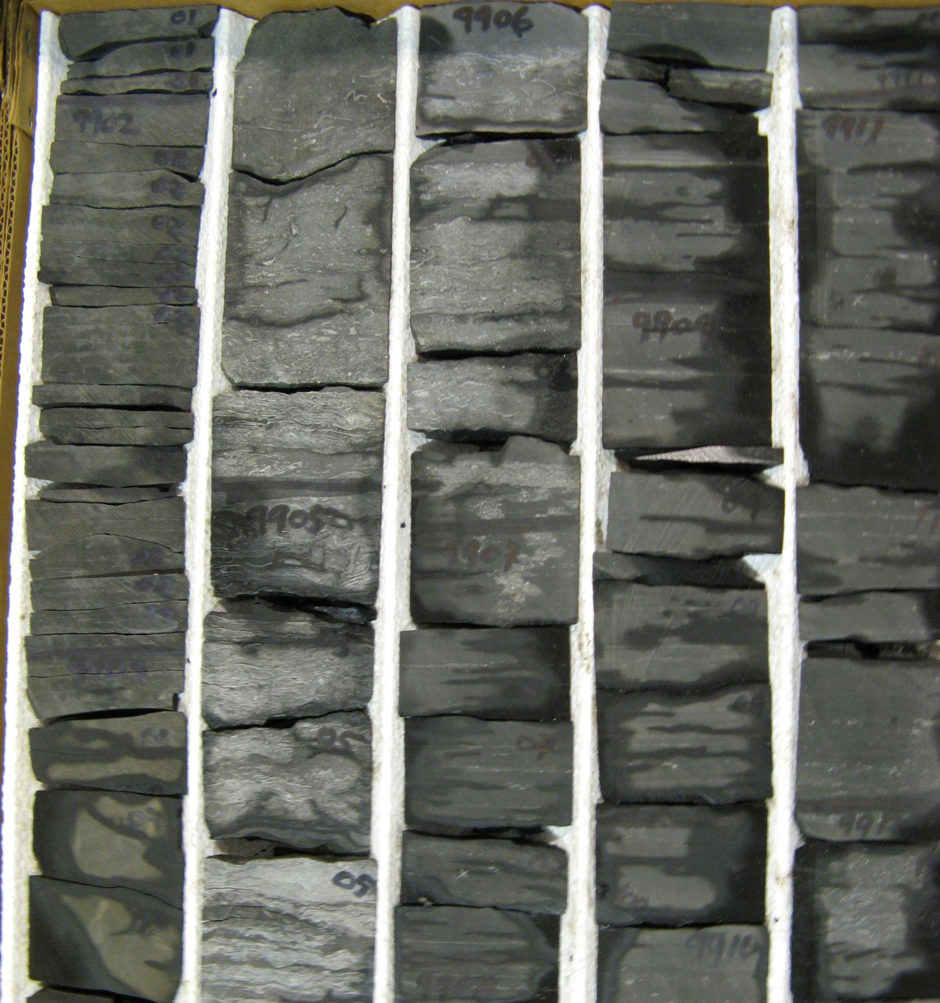
Collingwood
4 Facies in the Core
UTICA SHALE
  Hunt Energy Winterfield Deep Unit A-1 (Clare Co.)
Notes:
The image you’re looking at is part of the Utica shale and a section of slabbed Collingwood core
After studying the Collingwood core, 4 unique facies were identified
The red line in this image indicates the Collingwood/Utica contact

Slide 13
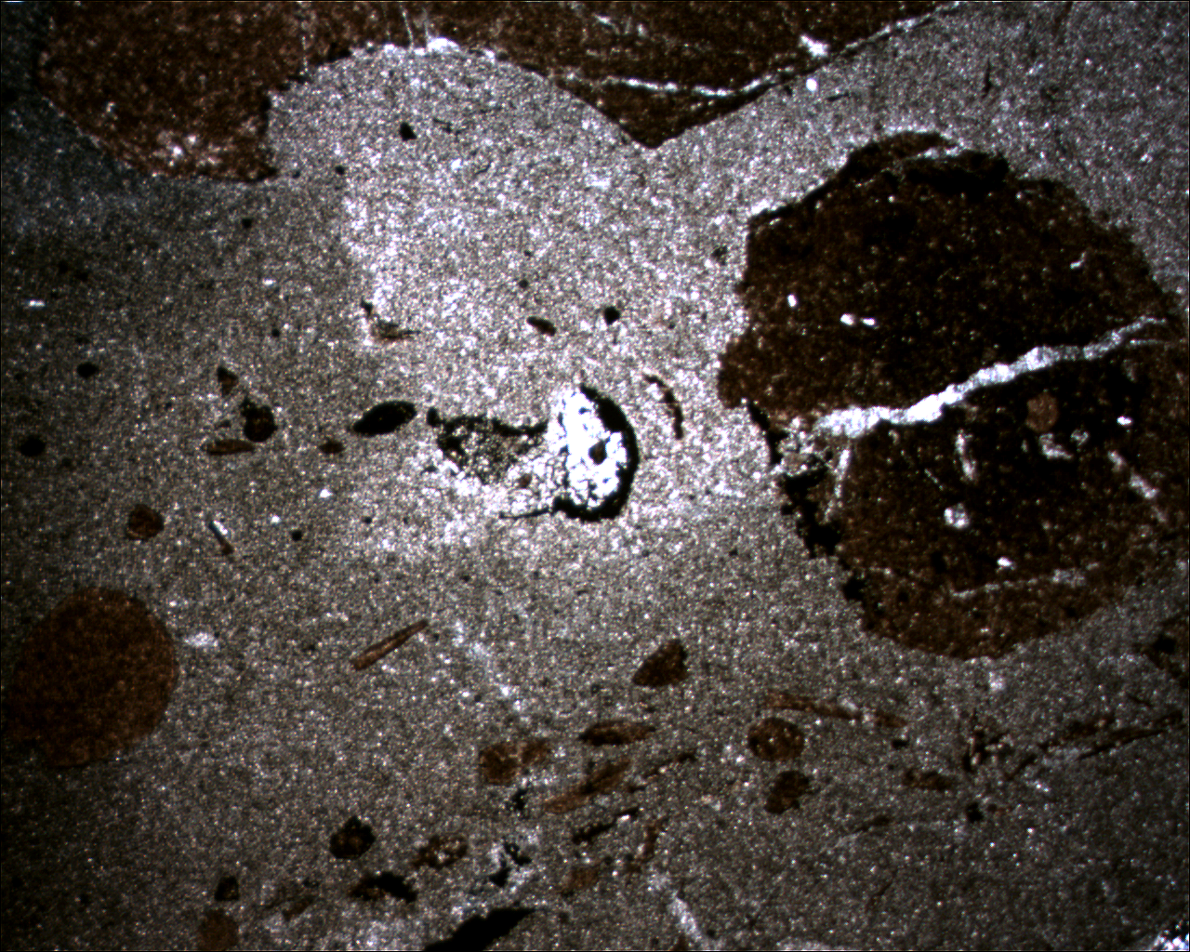
Collingwood
4 Facies in the Core
Hardground
UTICA SHALE
JEM Bruggers 3-7 9,660’
1.25x
1mm
  Hunt Energy Winterfield Deep Unit A-1 (Clare Co.)
Notes:
The first facies is a marine hardground surface at the Collingwood-Utica contact, it is primarily dolomite and
It presents as a phosphatic dololutite

Slide 14
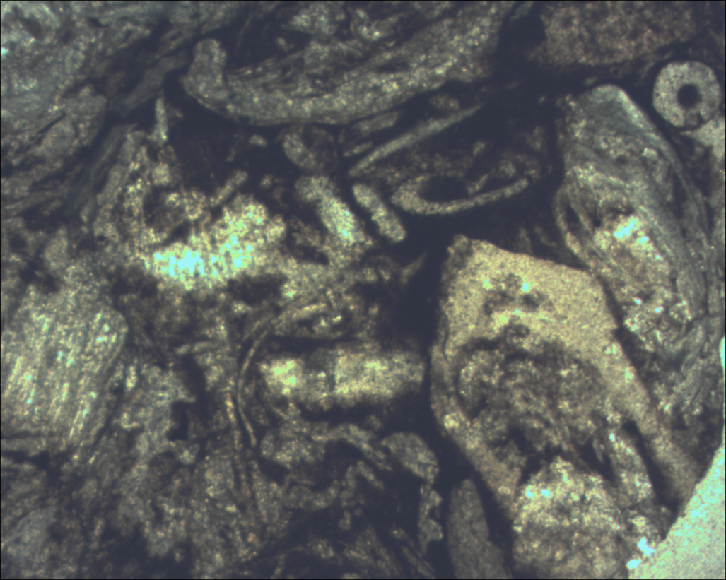
Collingwood
4 Facies in the Core
Hardground
Shell debris
UTICA SHALE
JEM Bruggers 3-7 9,661’
1.25x
1mm
  Hunt Energy Winterfield Deep Unit A-1 (Clare Co.)
Notes:
The next facies is a shell debris layer of packed fossils in a microcrystalline calcite matrix likely related to storm activity
This presents as a bio-calcilutite

Slide 15
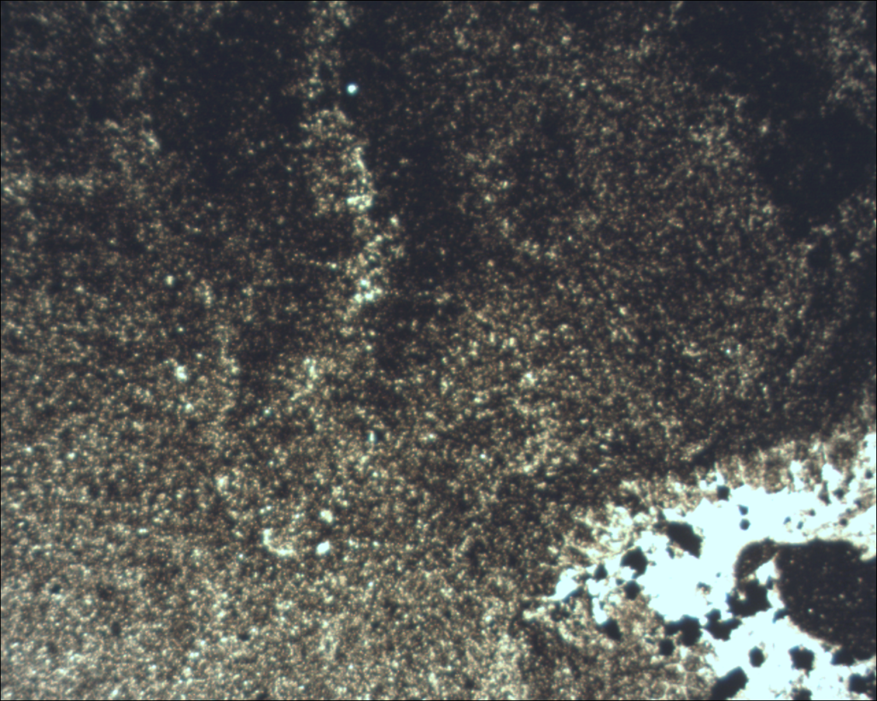
Collingwood
4 Facies in the Core
Hardground
Shell debris
Laminated mud
UTICA SHALE
JEM Bruggers 3-7 9,666’
1.25x
1mm
  Hunt Energy Winterfield Deep Unit A-1 (Clare Co.)
Notes:
The real key facies that distinguishes the Collingwood is a kerogen rich, low energy laminated mud
It consequently also acts as both the source and reservoir portions of the Collingwood with the highest TOC and porosity
It classifies as a siliceous calcilutite

Slide 16
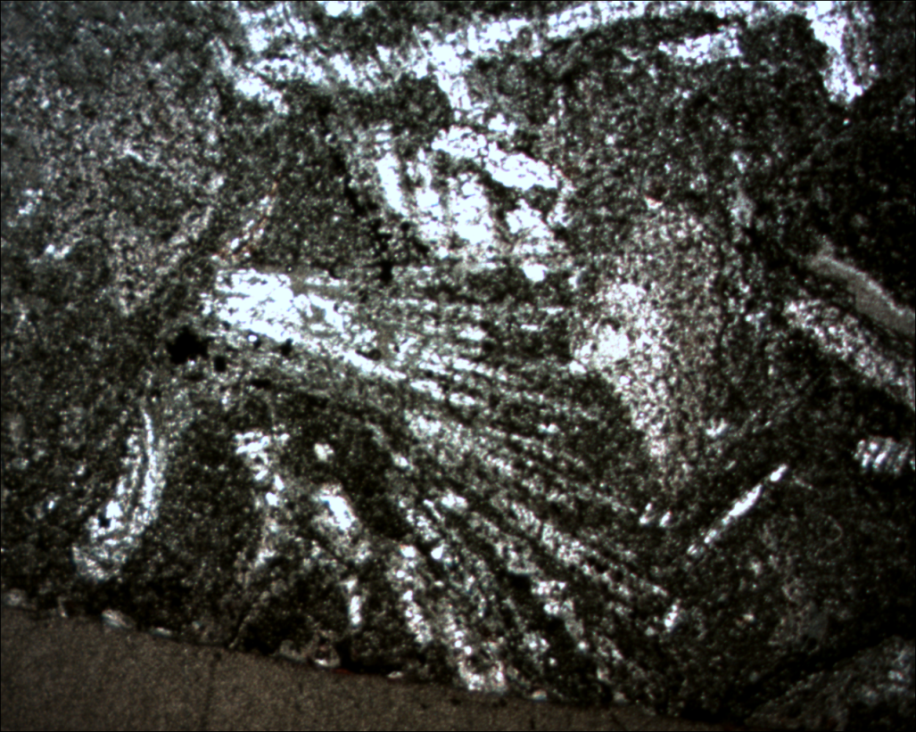
Collingwood
4 Facies in the Core
Hardground
Shell debris
Laminated mud
Homogenized facies
of 2 and 3
UTICA SHALE
JEM Bruggers 3-7 9,671’
1.25x
1mm
  Hunt Energy Winterfield Deep Unit A-1 (Clare Co.)
Notes:
The final facies is a homogenized variant of the previous two with varying amounts of fossiliferous debris and matrix

Slide 17
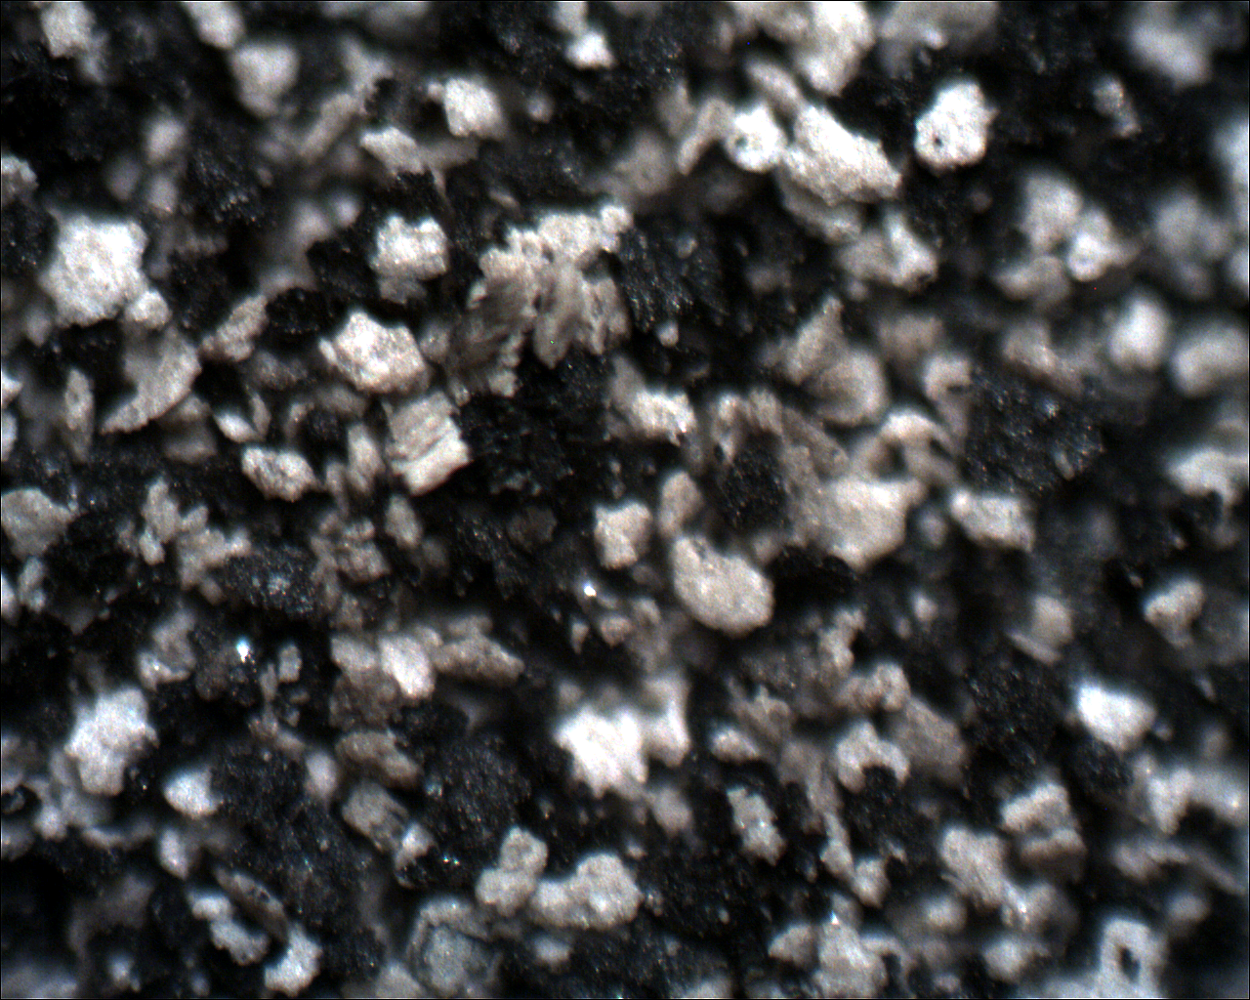
Removal of Carbonates
Residual from laminated mud facies sample treated with
muriatic acid, glacial acetic acid, and hydrogen peroxide
JEM Bruggers 3-7 9,666’
Reflected Light 5x
200 µM
*Sample was passively disaggregated during treatment process
Notes:
A sample from the laminated mud facies was treated with acids to remove the carbonate fraction
During the process of treatment, it was passively disaggregated
The result is what you see,
Thin kerogen rich plates of clay dispersed among
Non-organic microcrystalline silicic grains, or chert
It is likely that the silica component was not syndepositional due to the lack of kerogen present
And it is also unlikely that it was part of late diagenesis due to compaction and the lack of porosity and permeability
A best guess is that it was early diagenetic, however whether it was related to a replacement process or deposited as sediment is , unknown, it does however appear very grain-like

Slide 18
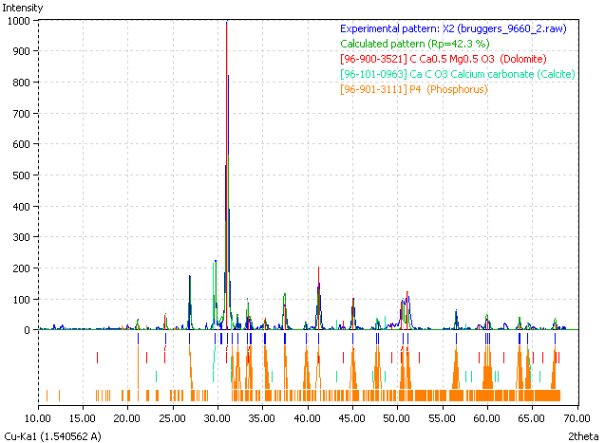
XRD Results
Sample | Mineralogy
Upper contact (dololutite) | Dolomite Anhydrite Calcite Apatite
I/C analysis and pattern matching done with
Crystal Impact Match! Software
Notes:
Moving on to results from x-ray diffraction;
First, we determined that the upper contact contains Dolomite, Anhydrite, Calcite and Apatite

Slide 19
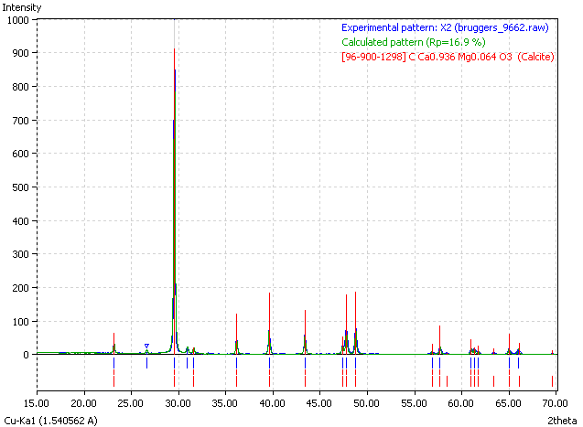
XRD Results
Sample | Mineralogy
Upper contact (dololutite) | Dolomite Anhydrite Calcite Apatite
Shell debris (bio-calcilutite) | Calcite 95%+
I/C analysis and pattern matching done with
Crystal Impact Match! Software
Notes:
The shell debris layers were found to be primarily calcite

Slide 20
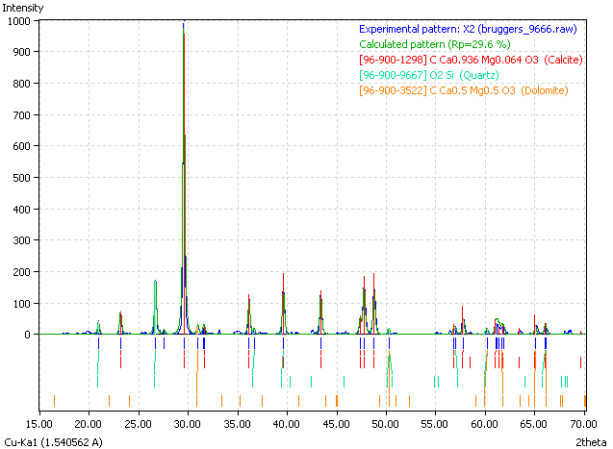
XRD Results
Sample | Mineralogy
Upper contact (dololutite) | Dolomite Anhydrite Calcite Apatite
Shell debris (bio-calcilutite) | Calcite 95%+
Laminated mud (siliceous calcilutite) | Calcite 85% Dolomite 5% Chert 10%
I/C analysis and pattern matching done with
Crystal Impact Match! Software
Notes:
The laminated mud contains primarily calcite, with some dolomite as the carbonate fraction
And anywhere from 10-20% chert

Slide 21
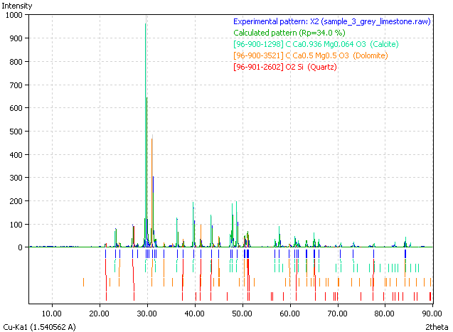
XRD Results
Sample | Mineralogy
Upper contact (dololutite) | Dolomite Anhydrite Calcite Apatite
Shell debris (bio-calcilutite) | Calcite 95%+
Laminated mud (siliceous calcilutite) | Calcite 85% Dolomite 5% Chert 10%
Outcrop (dolomitic bio-calcilutite) | Calcite 50% Dolomite 45% Chert 5%
I/C analysis and pattern matching done with
Crystal Impact Match! Software
Notes:
Finally, a surface sample was obtained from the Rapid River area of Upper Michigan
It is similar to the laminated mud facies in the subsurface
however has a very large dolomite fraction of the carbonate content which is indicative of regional dolmite trends in the basin

Slide 22
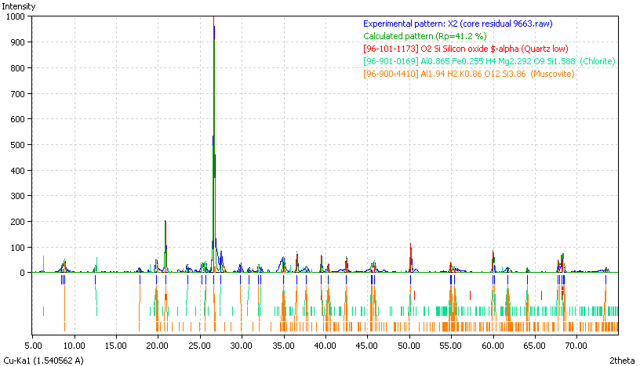
XRD Results
Sample | Mineralogy (0.6g of 6g sample)
Residual (siliceous calcilutite) | Chert 55% Clays 45% (Muscovite/Illite, Chlorite)
Notes:
The residual sample with carbonate content removed was x-rayed to identify the remainder
Here we see that this is comprised of roughly half chert and half clays identified as muscovite/illite and chlorite

Slide 23
XRD Results
Sample | Mineralogy (0.6g of 6g sample)
Residual (siliceous calcilutite) | Chert 55% 5.5% Clays 45% 4.5% Carbonates 90%
Compare to Utica Shale
40% Silica
54% Clays
6% Carbonates
Notes:
If we normalize these results accounting for a 90% carbonate fraction we find that the chert and clay actually compromise only about 5% each,
Compare this to the Utica which has substantially higher levels of chert and clay with far less carbonates

Slide 24
XRD Results
Sample | Mineralogy (0.6g of 6g sample)
Residual (siliceous calcilutite) | Chert 55% 5.5% Clays 45% 4.5% Carbonates 90% Kerogen ??%
Compare to Utica Shale
40% Silica
54% Clays
6% Carbonates
Note: Kerogen was inseparable
Notes:
To note, kerogen was inseparable in the sample and its contribution is unknown

Slide 25
SEM Analysis
  These techniques…
    X-Ray Mapping
    EDS Point Analysis
    Secondary Electron Imaging
  Give us…
    Qualitative understanding of pore structure
    Identification and nature of phases
Notes:
Next, SEM analysis was performed by employing x-ray mapping and imaging
In order to give us a better understanding of pore structure and identify the nature of mineral phases

Slide 26
X-Ray Mapping
Physiological relationship of mineral phases
JEM Bruggers 3-7 (siliceous calcilutite 9,666’)
Notes:
Here is an SE image of the Collingwood
You can notice a rhombohedral structure in the center of the image that is likely calcite;
But we really don’t know the physiological relationship of the mineral phases

Slide 27
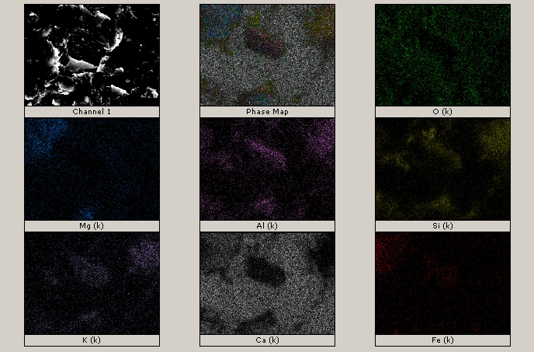
X-Ray Mapping
Chlorite Group (Mg,Fe,Al)₃(Si,Al)₄O₁₀(OH)₆
Mineral phases
Chlorite
JEM Bruggers 3-7 (siliceous calcilutite 9,666’)
Notes:
By using the X-ray mapping technique we were able to identify the various phases in the region by examining the intensity of each elemental spectrum

Slide 28
X-Ray Mapping
Chlorite Group (Mg,Fe,Al)₃(Si,Al)₄O₁₀(OH)₆
Mineral phases
Chlorite
JEM Bruggers 3-7 (siliceous calcilutite 9,666’)
Notes:
Here you can see chlorite, which is rich in Iron, Silicon and Aluminum

Slide 29
X-Ray Mapping
Mica Group KAl₃Si₃O₁₀(OH)₂
Mineral phases
Chlorite
Muscovite/Illite
JEM Bruggers 3-7 (siliceous calcilutite 9,666’)
Notes:
For the mica group, we should see zones of high Potassium, Aluminum and Silicon

Slide 30
X-Ray Mapping
Mica Group KAl₃Si₃O₁₀(OH)₂
Mineral phases
Chlorite
Muscovite/Illite
JEM Bruggers 3-7 (siliceous calcilutite 9,666’)
Notes:
Shown here

Slide 31
X-Ray Mapping
CaMg(CO₃)₂
Mineral phases
Chlorite
Muscovite/Illite
Dolomite
JEM Bruggers 3-7 (siliceous calcilutite 9,666’)
Notes:
Dolomite was also identified

Slide 32
X-Ray Mapping
CaMg(CO₃)₂
Mineral phases
Chlorite
Muscovite/Illite
Dolomite
Remainder calcite
JEM Bruggers 3-7 (siliceous calcilutite 9,666’)
Notes:
In this area
The remainder of the region is calcite

Slide 33
SE Imaging
Secondary electron image
200 µM
150µ
JEM Bruggers 3-7 (siliceous calcilutite 9,669’)
ImageJ Porosity 2.607%
Notes:
This is an SE image that depicts a silicic grain embedded in the calcite matrix similar in size to those observed in the acid digested residual sample

Slide 34
SE Imaging
Chert clasts in carbonate matrix
JEM Bruggers 3-7 (siliceous calcilutite 9,669’)
ImageJ Porosity 4.105%
Notes:
If we zoom in and take a closer look;
We get a better feel for the nature of the rock, especially due to the poor optical properties under a microscrope due to kerogen content
Here we can see that the embedded grains of chert and clay do not appear porous and the majority of porosity seems to be associated with the matrix

Slide 35
SE Imaging
Carbonate calcilutite matrix / cement
JEM Bruggers 3-7 (siliceous calcilutite 9,669’)
ImageJ Porosity 21.55%
Notes:
Taking a detailed look at the matrix we can see the nature of porosity generated from small plates of micocrystalline calcite cemented together

Slide 36
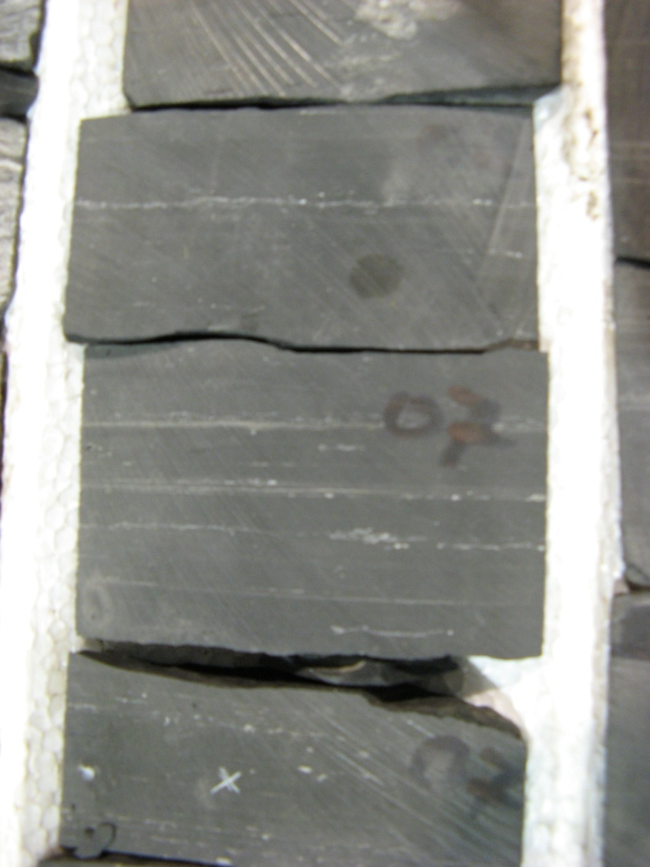
Core Analysis
Collingwood
Φ _{(eff.)} | 2-4%
K _{(md)} | <0.1
TOC _{(wt%)} | 2-6
Hunt Winterfield Deep Unit A-1, 9,907’
  Data from JEM Bruggers 3-7, JEM Weingartz 1-7 and Hunt Winterfield Deep Unit A-1
  (provided by Bill Harrison, MGRRE)
Notes:
Core data was provided to us in the form of laboratory measurements of porosity, permeability and TOC
The Collingwood typically presents with about 2-4% porosity, very little permeability and approximately 2-6% TOC, primarily in the laminated mud facies
To note, these wells were selected from the deep basin and it has been observed in Canada, that less mature, shallower rocks can have TOC values ranging up to 10%

Slide 37
Core Analysis
Utica Shale
Φ _{(eff.)} | Up to 8%
K _{(md)} | 2-4
TOC _{(wt%)} | 0.5-1.5
Collingwood
Φ _{(eff.)} | 2-4%
K _{(md)} | <0.1
TOC _{(wt%)} | 2-6
Trenton
Φ _{(eff.)} | <1%
K _{(md)} | <0.1
TOC _{(wt%)} | <1
Hunt Winterfield Deep Unit A-1, 9,907’
  Data from JEM Bruggers 3-7, JEM Weingartz 1-7 and Hunt Winterfield Deep Unit A-1
  (provided by Bill Harrison, MGRRE)
Notes:
The surrounding formations were also sampled in this data
From these points we can see generally that the Trenton is very tight
And the Utica has slightly better porosity and permeability with ½ to 1.5 % TOC

Slide 38
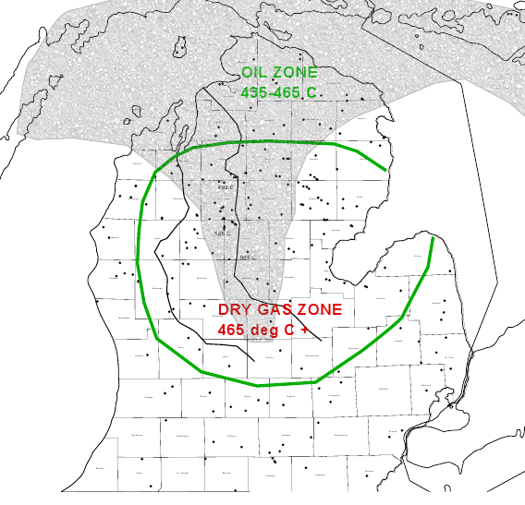
Maturity
  Oil & Gas Window Estimate (TMax shown)
Conodont Color Alteration Index data from Trenton (Hogart & Sibley, MSU)
Pyrolysis & Production data from Bill Harrison at MGRRE / MDEQ
Notes:
This image shows an estimate of the oil and gas window for the Collingwood as depicted by the green line
It was generated using Conodont Color Alteration Index Data from the Trenton Formation via Hogart and Sibley
This is a rough estimate as the resolution of the data was not very high

Slide 39
Maturity
  Oil & Gas Window Estimate (TMax shown)
Oil produced from
St. Koehler & Kendall 1-27HD
(Cheboygan Co.)
43 deg API
Conodont Color Alteration Index data from Trenton (Hogart & Sibley, MSU)
Pyrolysis & Production data from Bill Harrison at MGRRE / MDEQ
Notes:
We do know however, that oil was produced in Cheboygan County

Slide 40
Maturity
  Oil & Gas Window Estimate (TMax shown)
Oil produced from
St. Koehler & Kendall 1-27HD
(Cheboygan Co.)
43 deg API
Dry gas & condensate produced from
St. Pioneer 1-3
(Missaukee Co.)
Conodont Color Alteration Index data from Trenton (Hogart & Sibley, MSU)
Pyrolysis & Production data from Bill Harrison at MGRRE / MDEQ
Notes:
And dry gas and condensate in Missaukee

Slide 41
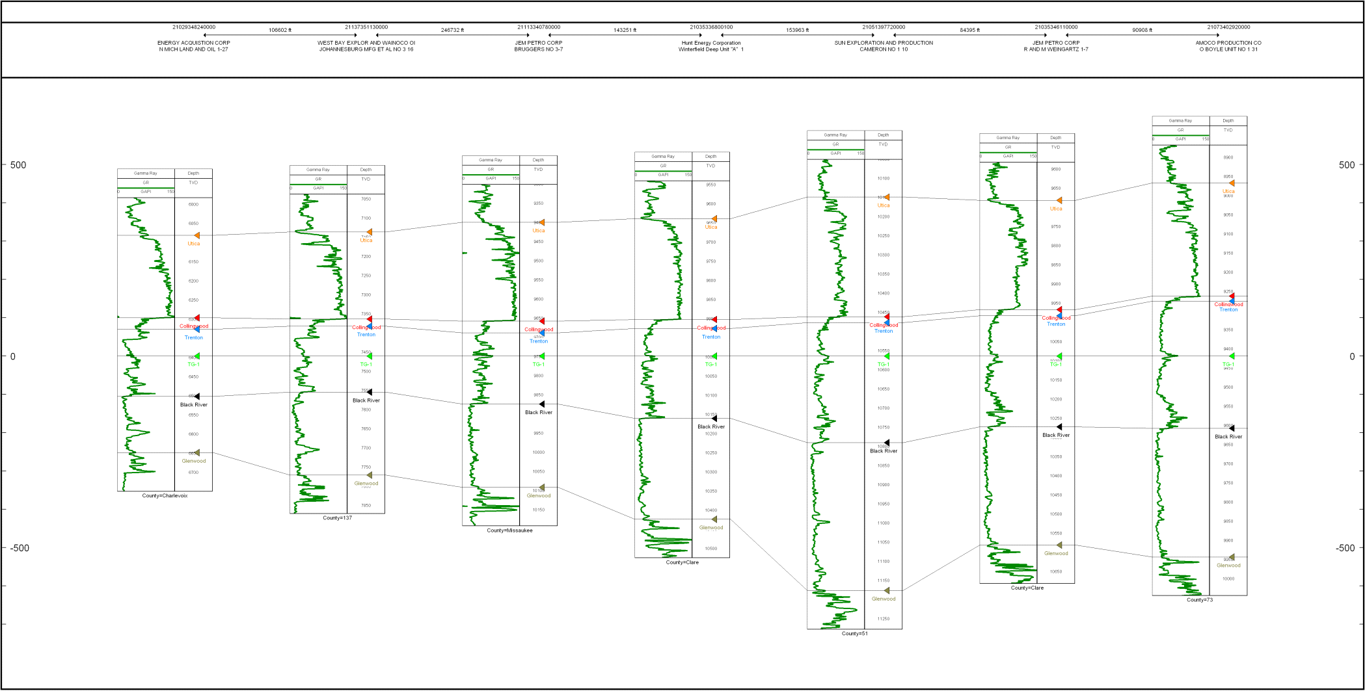
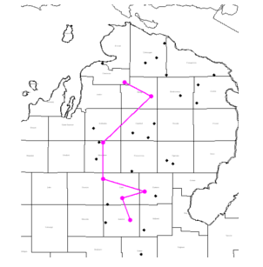
Cross Section
N
S
Notes:
Presented here is a cross section through the Collingwood and surrounding strata from the N to S in the MI basin
The image is levelled on TG-1, a chronostratigraphic bentonite layer noted by Lilienthal to be identifiable in most of the Trenton (center green and flat)

Slide 42
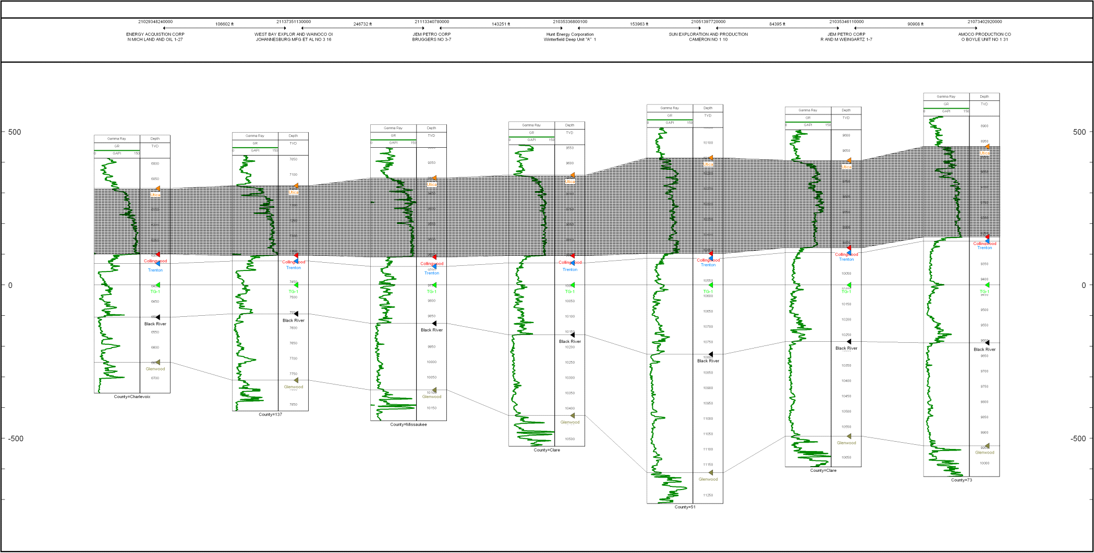
Cross Section
N
S
Utica Shale
Notes:
Here we can see the Utica shale, which overlies the Collingwood
Its depocenter is in the south of the basin and thickens in that direction

Slide 43
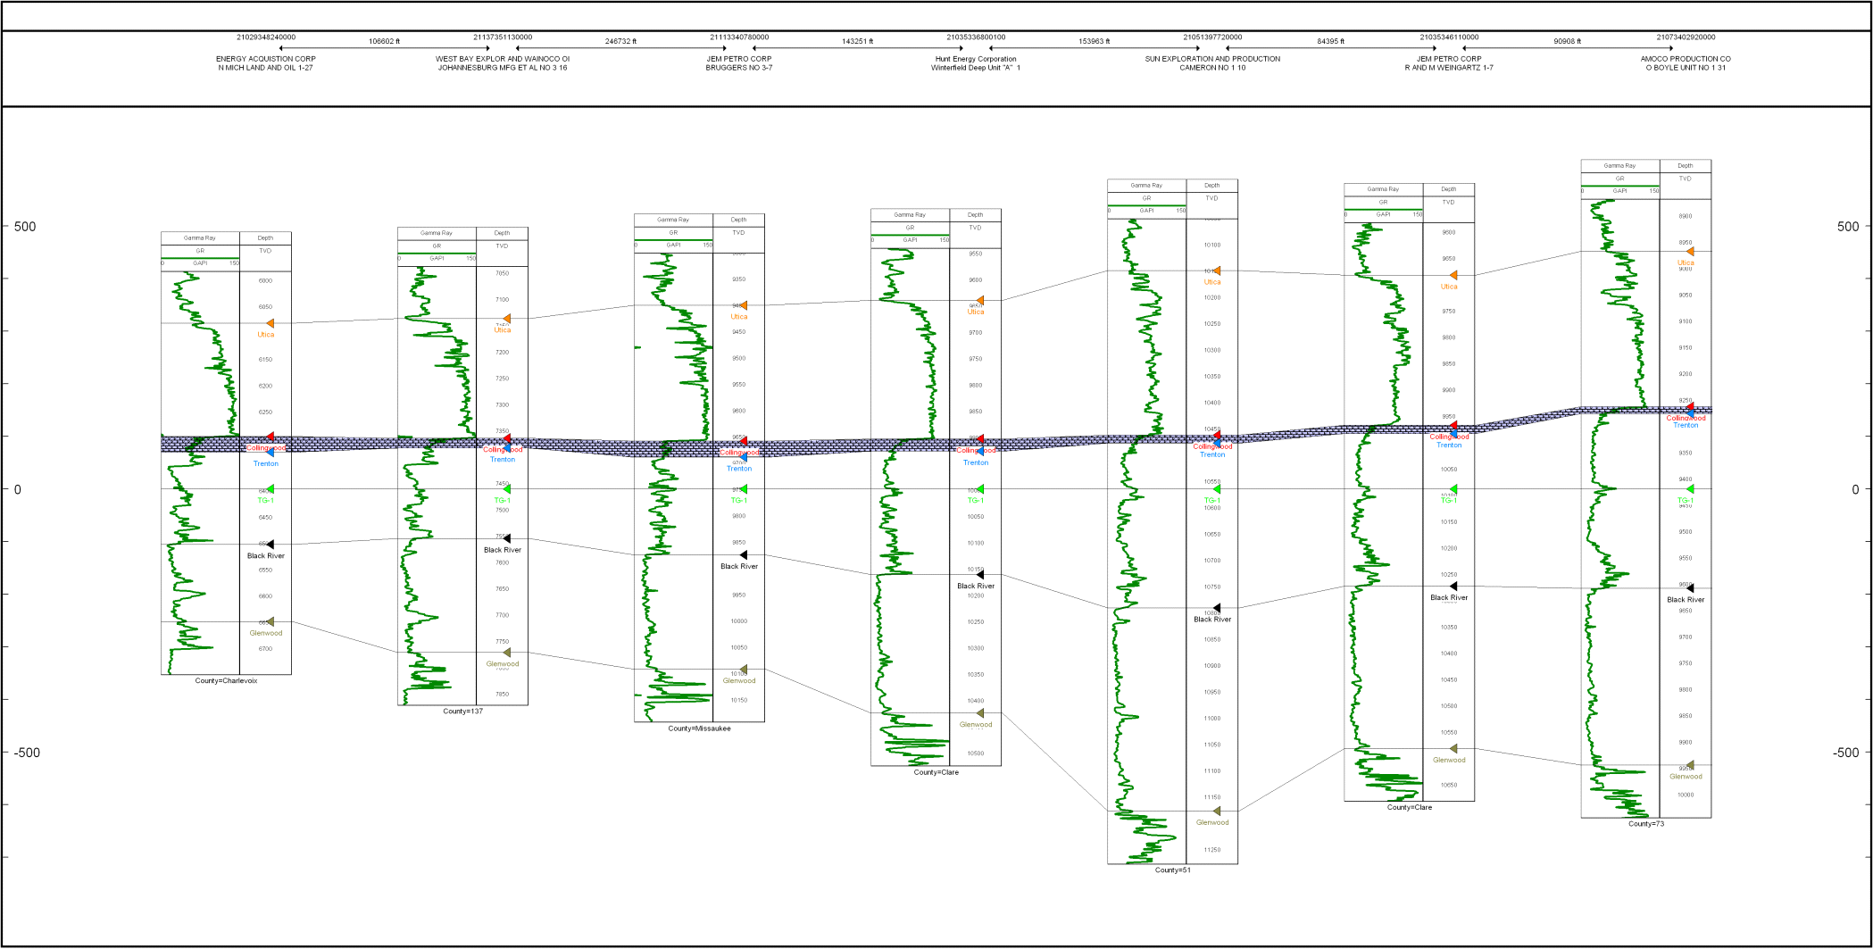
Cross Section
N
S
Collingwood
Notes:
Here, we have the Collingwood notably thinner than the surrounding packages
Its depocenter is in the north of the basin, opposite of the Utica and thickens in that direction

Slide 44
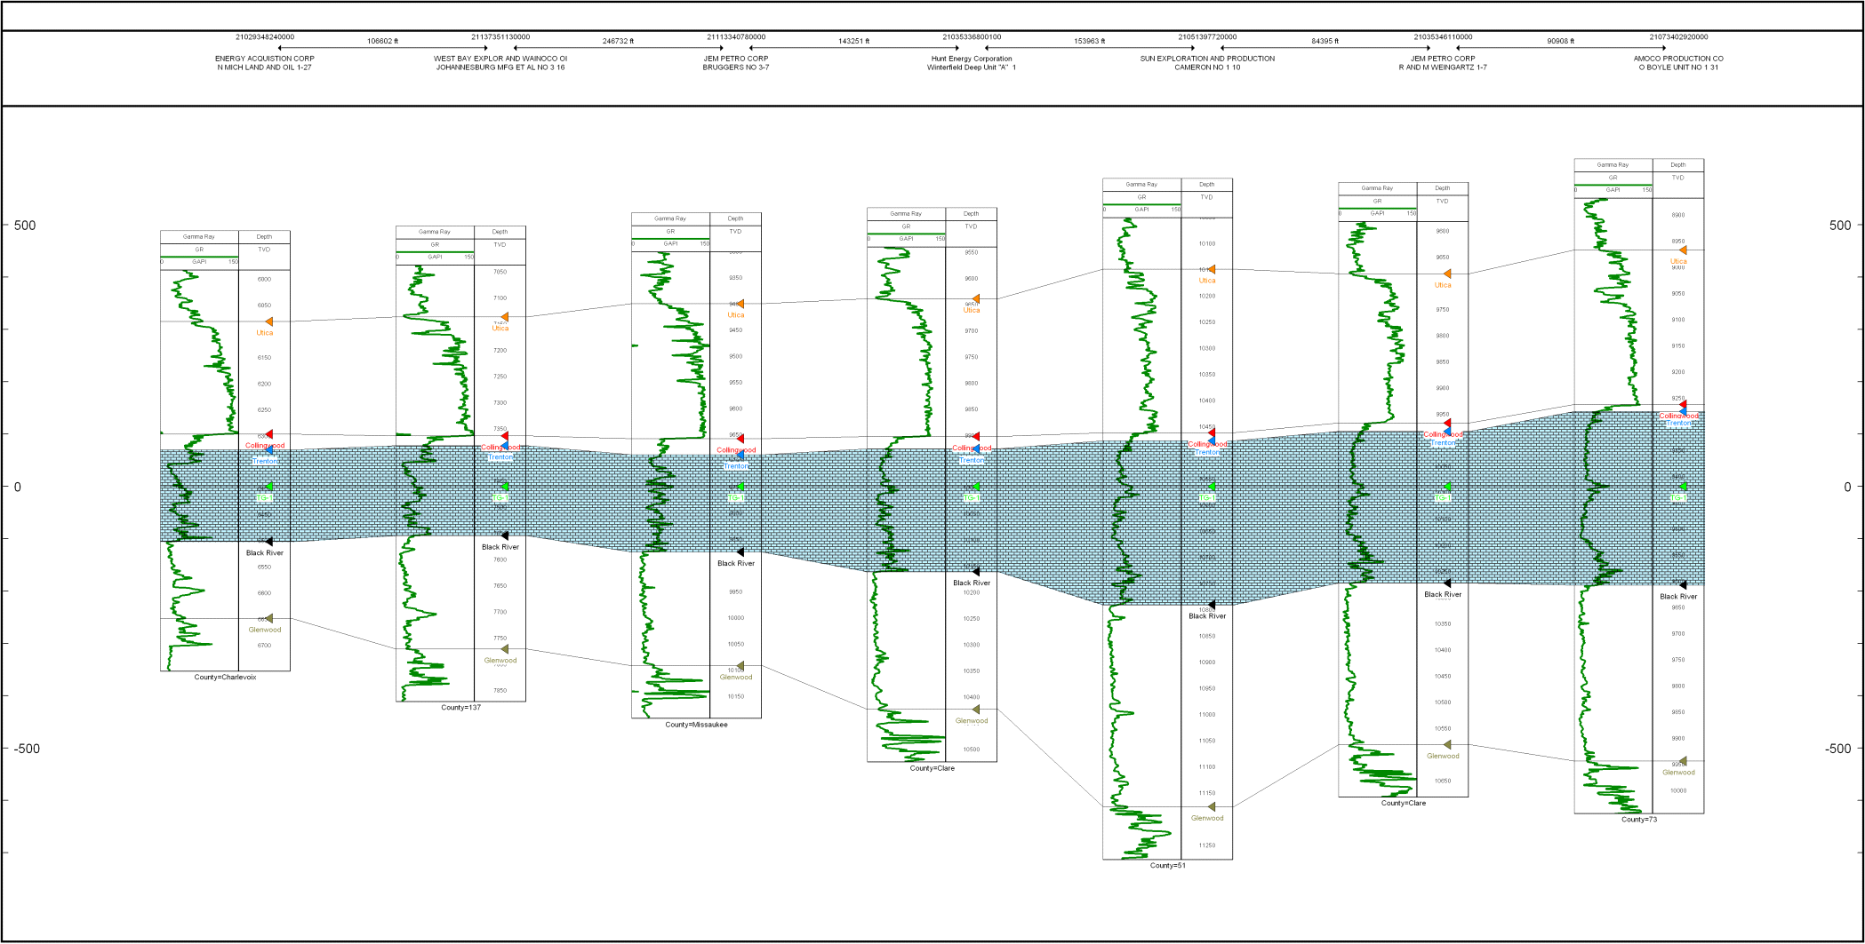
Cross Section
N
S
Trenton
Notes:
The Trenton, like the Utica also thickens toward the south of the basin
To note, we can see that the gamma-ray signature in the north part of the basin (leftmost wells) is much noisier

Slide 45
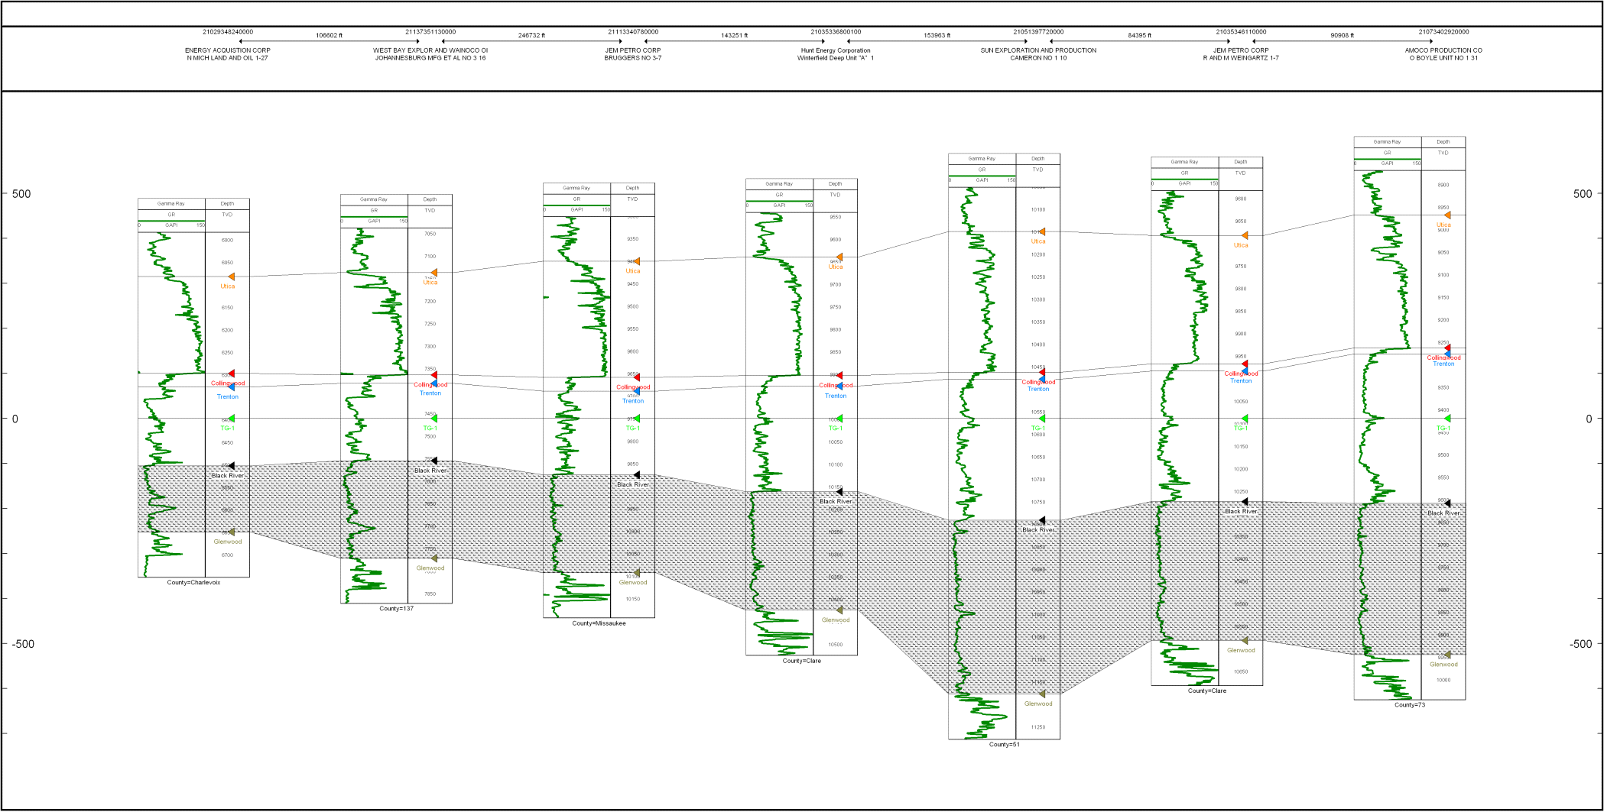
Cross Section
N
S
Black River
Notes:
Finally, below the Trenton is the Black River, which also thickens toward the south;
This illustrates that the Collingwood is unique in the sense its depocenter does not trend like the other units

Slide 46
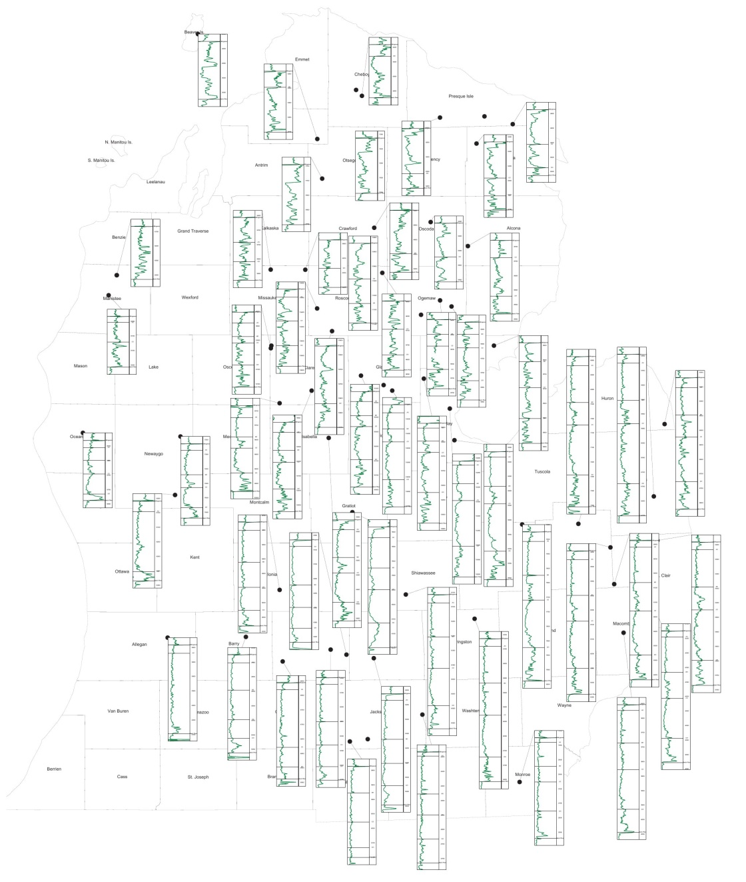
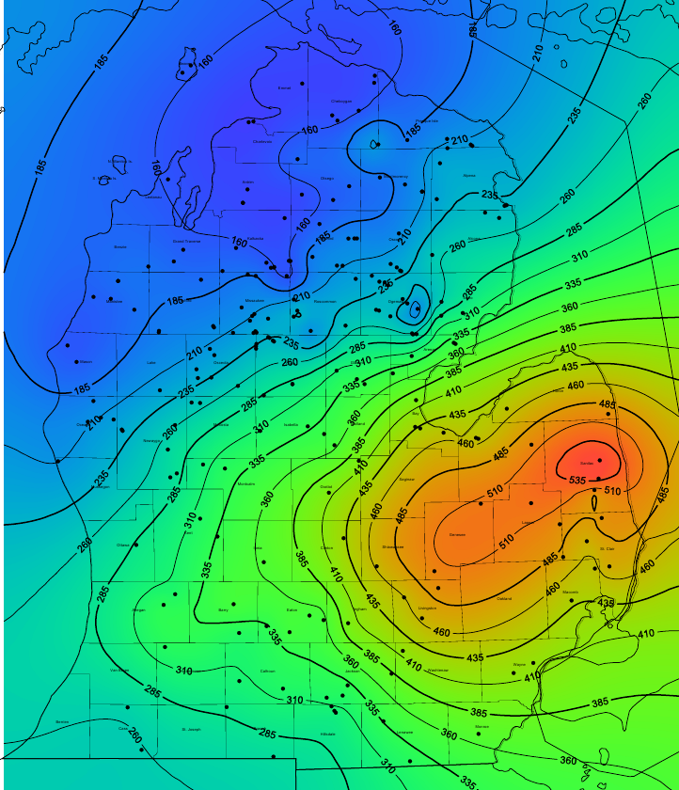
Trenton Gamma-Ray Character
Trenton Formation Thickness
(Red) Maximum
(Blue) Minimum
Notes:
In examining the nature of the gamma-ray in the Trenton,
We can draw a line through the middle as shown separating two distinct areas;
To the northwest of the line, gamma-ray signature is noisy and deposition is thin
To the southeast of the line, the gamma-ray is lower amplitude, well defined and deposition is thick
If we look at an isopach of Trenton Thickness (right), we can identify what appears to be a carbonate shelf margin right about where this transition occurs

Slide 47
Geologic Model
  Production
    Upwelling near carbonate shelf
    High phytoplanktonic productivity
  Preservation
    Stratification of O₂ in water
  Tempestites
    Near storm weather wave base
  Deep water (relative)
    No evidence of shoaling/subaerial exposure (Wilson et al, 2001)
    Similar models: basin below O₂ (Rancourt, 2009)*
  Other black shales existed during timeframe (i.e. Ohio)
    Large scale anoxic event
* Based on palaeobiology
Notes:
To develop a geologic model we account for the following
Production of organics via upwelling currents that result in high phytoplanktonic productivity
A perservation mechanism in the stratification of oxygen in the water
Tempestites in the core show that the Collingwood must have been near a storm weather wave base
Waters levels should be “relatively” deep due to lack of evidence of subariel exposure or shoaling of topographic highs such as the Algonquin arch and Trenton carbonate platform
In addition, other authors offer biological evidence to support deep water
And finally, other black shales existed during this timeframe which may point to a large scale anoxic event

Slide 48
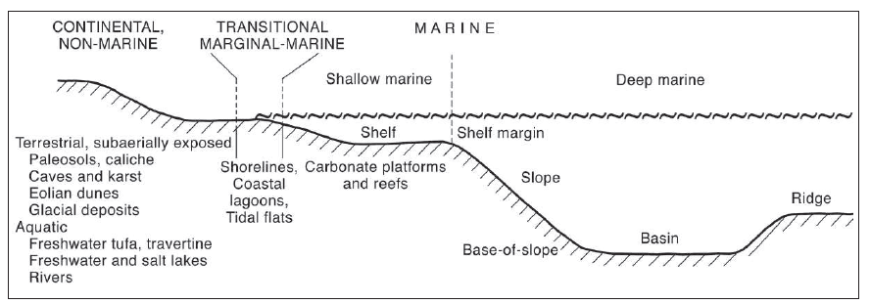
Geologic Model
  Deep marine basin off carbonate shelf margin
  Accommodation for Collingwood from subsidence
SE
NW
Figure from E. Flugel, Microfacies of Carbonate Rocks 2nd ed.
Notes:
Shown here is a model depicting a deep marine basin off a carbonate shelf margin
To note, when we say “deep marine” we mean this relatively such that the water was deeper here than it was over the unexposed highs,
So really we don’t know what the magnitude of the slope was
The shape of the Collingwood may be related to a depression generated via subsidence events

Slide 49
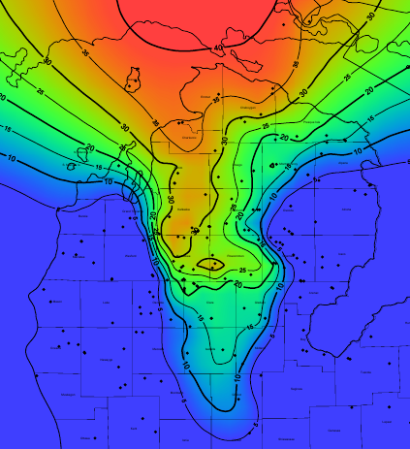
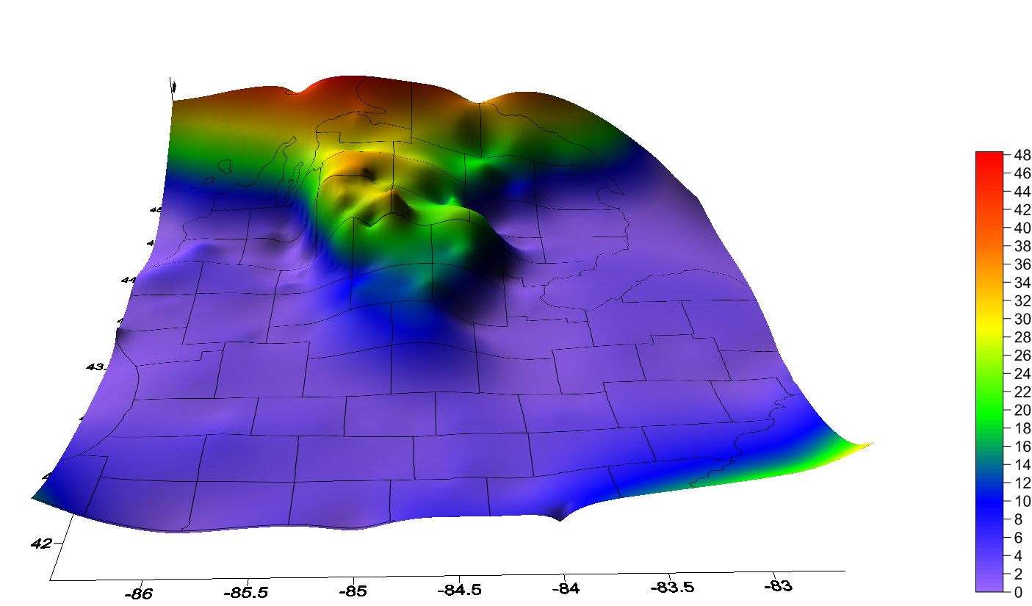
Collingwood Thickness
Notes:
Displayed are an isopach and 3d image of Collingwood thickness
From this map, we can note that the Collingwood is generally thickest in the northern parts of the basin and in the center of its areal extents
Toward the edges and to the south, it thins
This image was generated from picks in the wellbores represented as black dots

Slide 50
Petrophysical Response
  Basic logging measurements (compared to Trenton)
  Best way to identify on logs is a combination of these measurements (especially ΔLogR)
    It is our suggestion that GR should not be used on its own
High | Low
Resistivity (LLD) | Bulk Density (RhoB)
Neutron Porosity (NPHI)
Sonic Transit Time (DT)
  Petrophysical response due to adsorbed HC, kerogen, and porosity
Notes:
The Collingwood has the following response to basic petrophysical measurements
Resistivity, neutron porosity and sonic transit time all read high when compared to the Trenton
Bulk density reads low
This is due to the response of adsorbed hydrocarbons, kerogen and porosity on logging tools
The best way to identify the Collingwood is a combination of all these measurements
And it is our suggestion that GR should not be used on its own, due to the high amplitude and noisy nature of the underlying Trenton in the north part of the basin

Slide 51
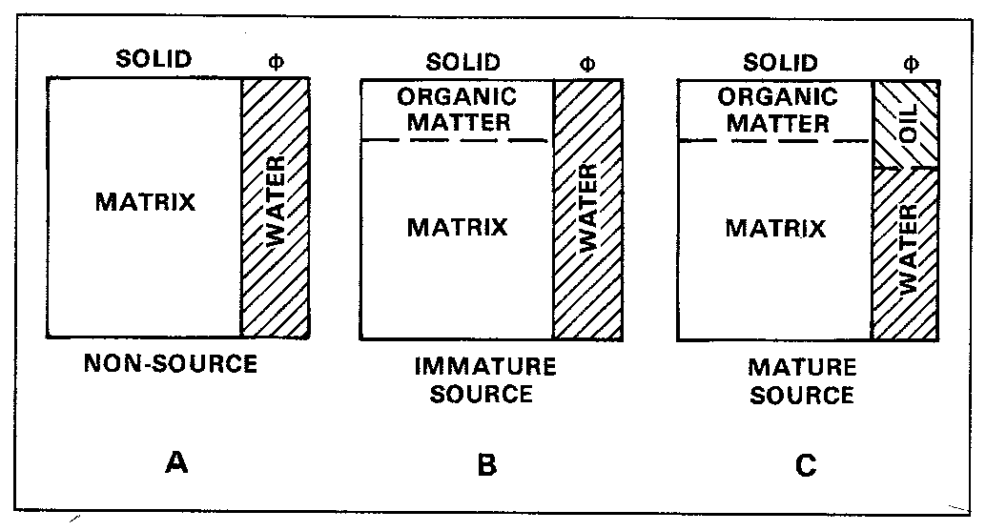
ΔLogR Procedure (Passey et al, Bowman)
  Find linear regression Log₁₀(Res) vs. DT in Trenton to give DTR()
  Take DTR()-DT as ΔLogR
  TOC = ΔLogR x 10^{(2.297-0.1688xLOM)}
  Calibrate to core data
Figure from Passey et al 1990
Notes:
The Delta Log R technique from Passey was used to help quantify TOC content in wells without core data
To do this, the following procedure was followed;
A regression was calculated using resistivity and sonic transit time
And then TOC was computed via this regression with Passey’s equation as shown
LOM is a parameter in this equation and was provided via our thermal model constructed to estimate oil and gas windows

Slide 52
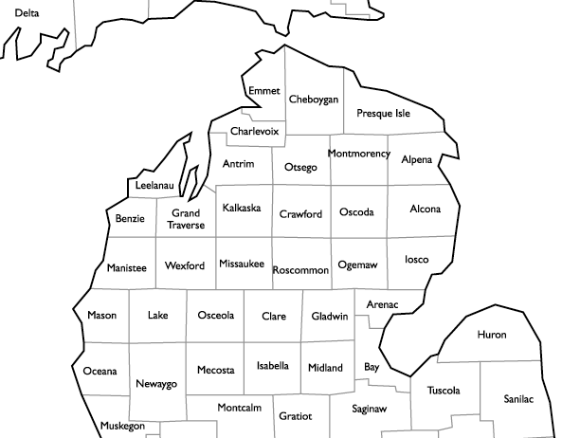
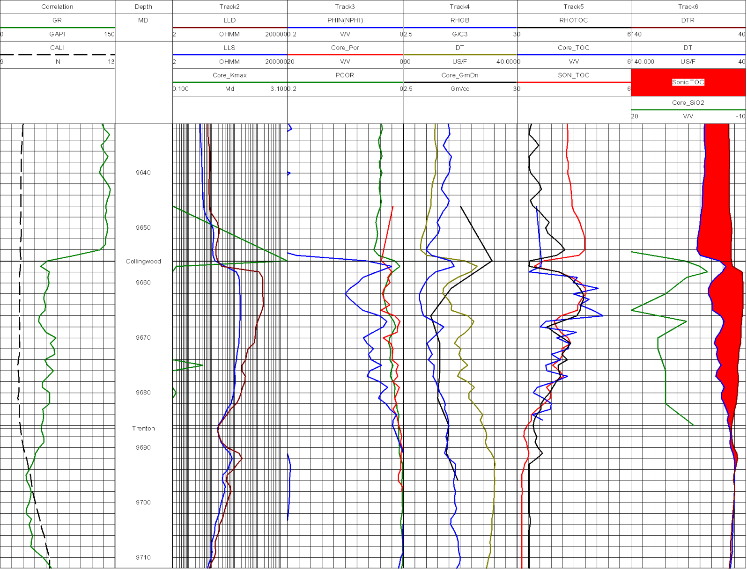
Petrophysical Logs
JEM Bruggers 3-7, Missaukee County
Notes:
Shown here is the JEM Bruggers well in Missaukee county, close proximity to the St. Pioneer, one of the wildcat wells drilled in 2010
The typical Collingwood response is shown as it deviates from the Trenton
High resistivity, porosity, DT and TOC are observed

Slide 53
Petrophysical Logs
JEM Bruggers 3-7, Missaukee County
Notes:
After employing the Delta Log R technique we can easily visually identify the extent of the Collingwood based on its organic nature as a mature source

Slide 54
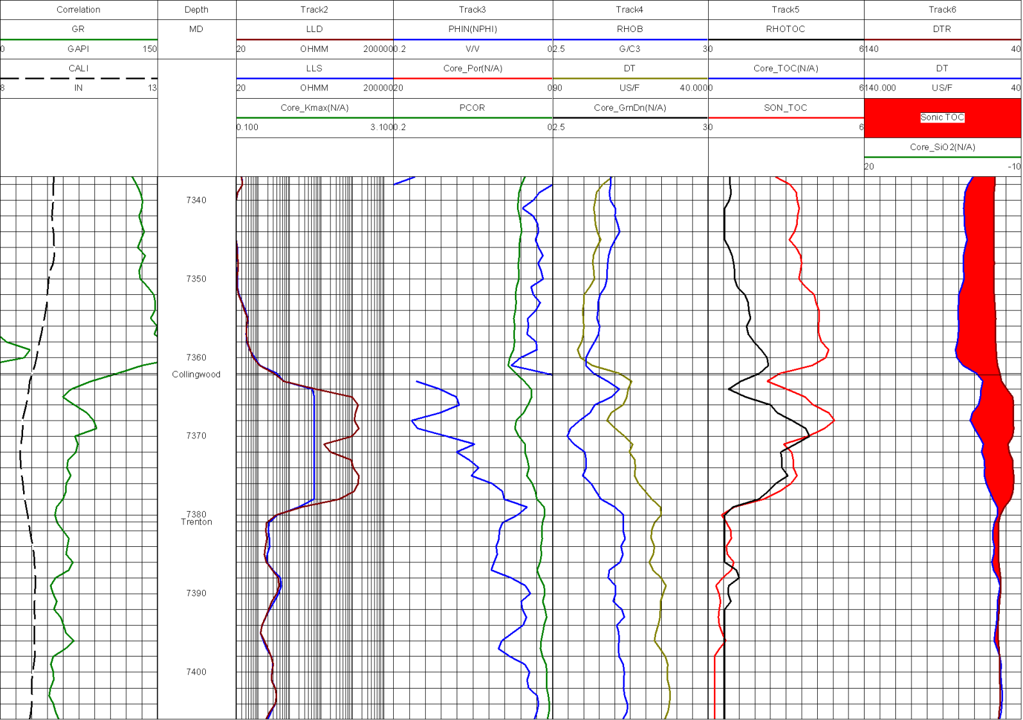
Petrophysical Logs
Johannesburg MFG et al #3-16, Otsego County
Notes:
Here is a well in Otsego county, farther north in the basin

Slide 55
Petrophysical Logs
Johannesburg MFG et al #3-16, Otsego County
Notes:
To note here, the red curve is a TOC value calculated accounting for LOM in Passey’s equation
The black line is a TOC value calculated from a straight regression in deep basin cores
We can see that by accounting for LOM, TOC content is higher, as we should expect

Slide 56
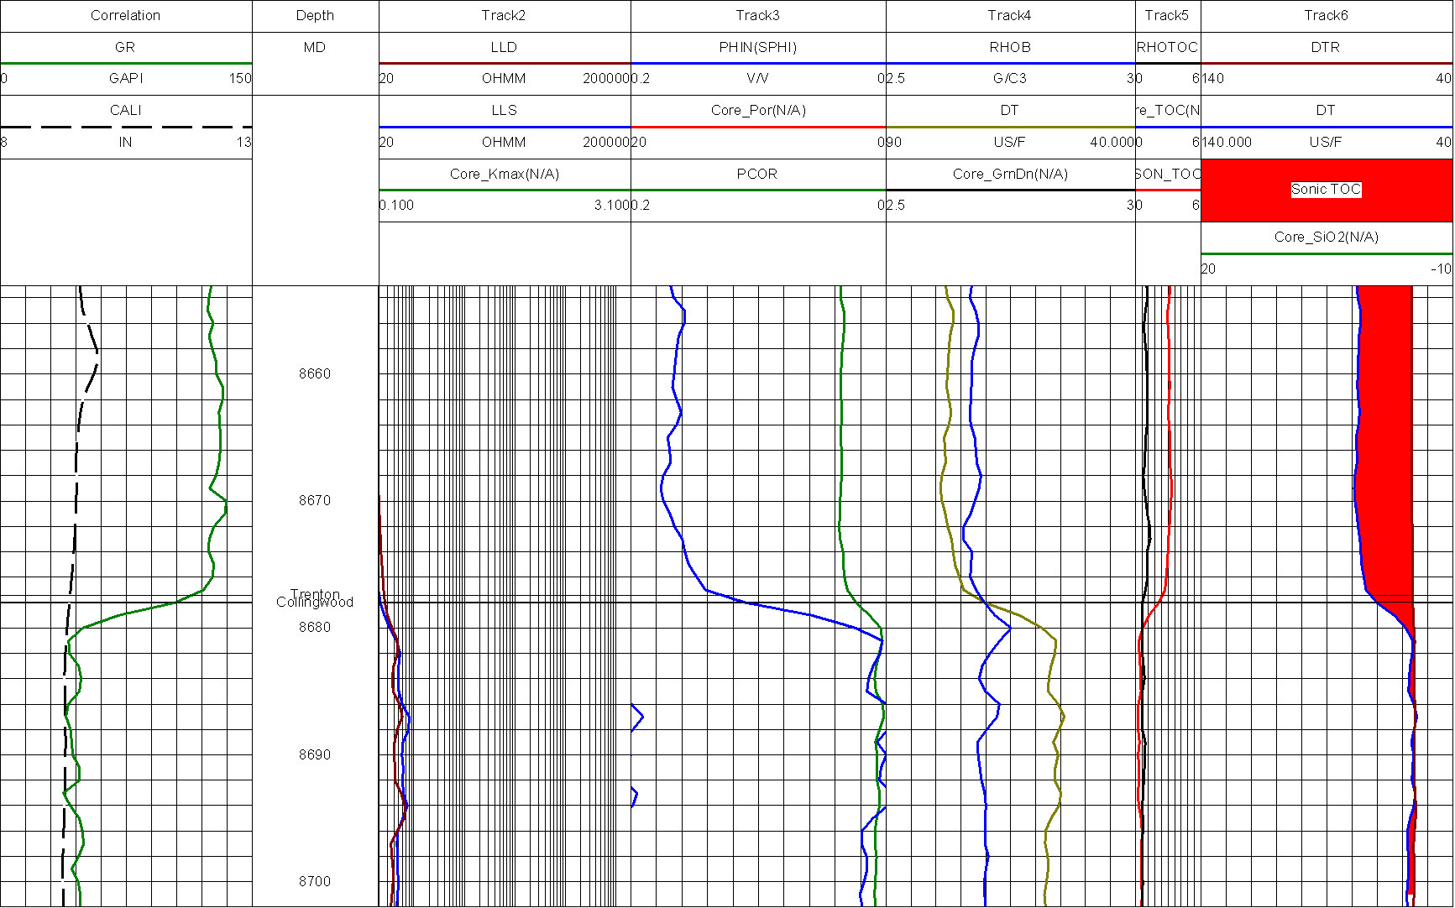
Petrophysical Logs
Gulf Oil St. Mitchell 1-31, Alcona County (No Collingwood)
Notes:
Finally, shown here is a well that does not contain the Collingwood

Slide 57
Petrophysical Logs
Gulf Oil St. Mitchell 1-31, Alcona County (No Collingwood)
Notes:
It is fairly easy to observe that there is no deviation in any curves from the Trenton
and things appear very “tight” and inorganic

Slide 58
Conclusions
  The Collingwood is not really a shale, rather a self-sourced carbonate reservoir with some possible contribution from the overlying Utica
  Calcite, dolomite, and silica are primary mineral constituents
  Acid treaments may not be effective due to kerogen and silica content
  Formation produces gas, condensate, and oil phases in different parts of the basin based on maturity
  ΔLogR technique would be much more valuable with a good thermal model and core data from north basin
  The “best areas” to drill are in the north of the basin and the center of the areal extents
  Porosity structure in carbonate fraction
    Dolomitized exposures should be better reservoirs

Slide 59

Acknolwedgements
  Special thanks to SPWLA for the generous grant to conduct this research
  Bill Harrison (MGRRE) for core & data
  Ted Bornhorst (Michigan Tech)
  George Robinson (Michigan Tech)
  Jim Wood (Michigan Tech)
Notes:
I would like to make the following acknowledgements
Thank you for your attention

