Slide 1

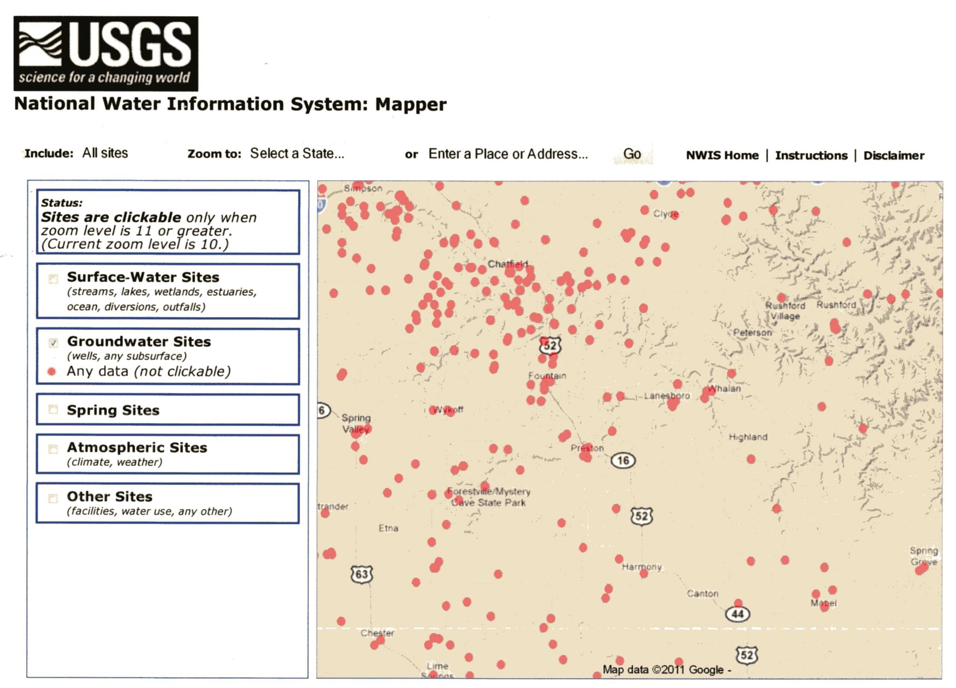
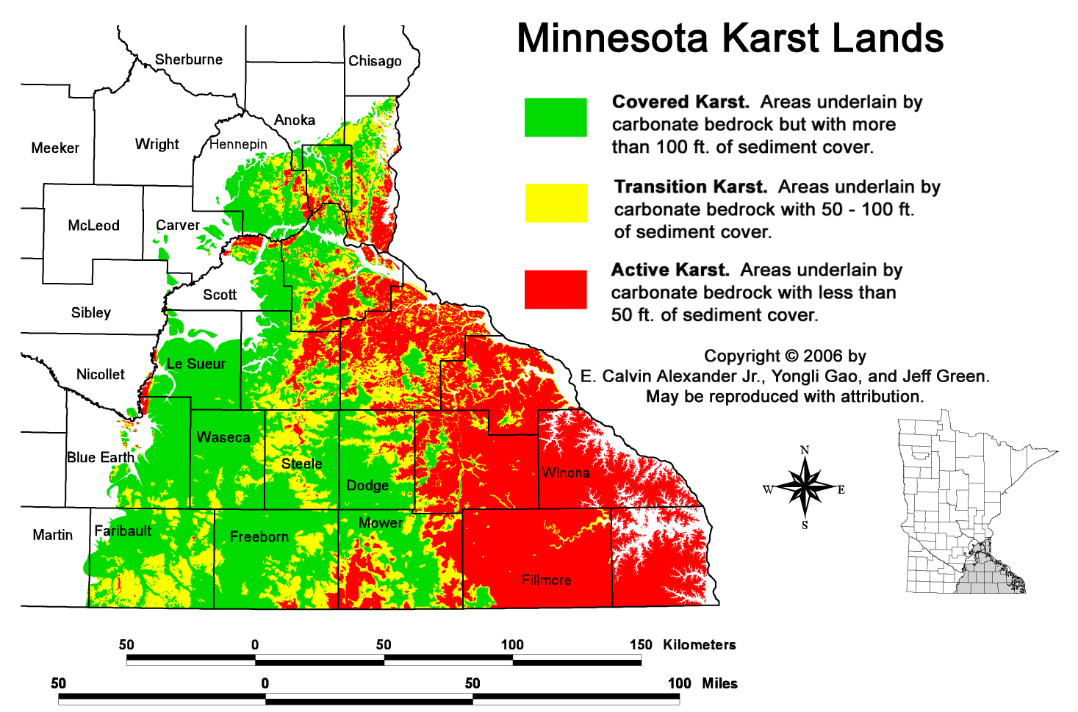
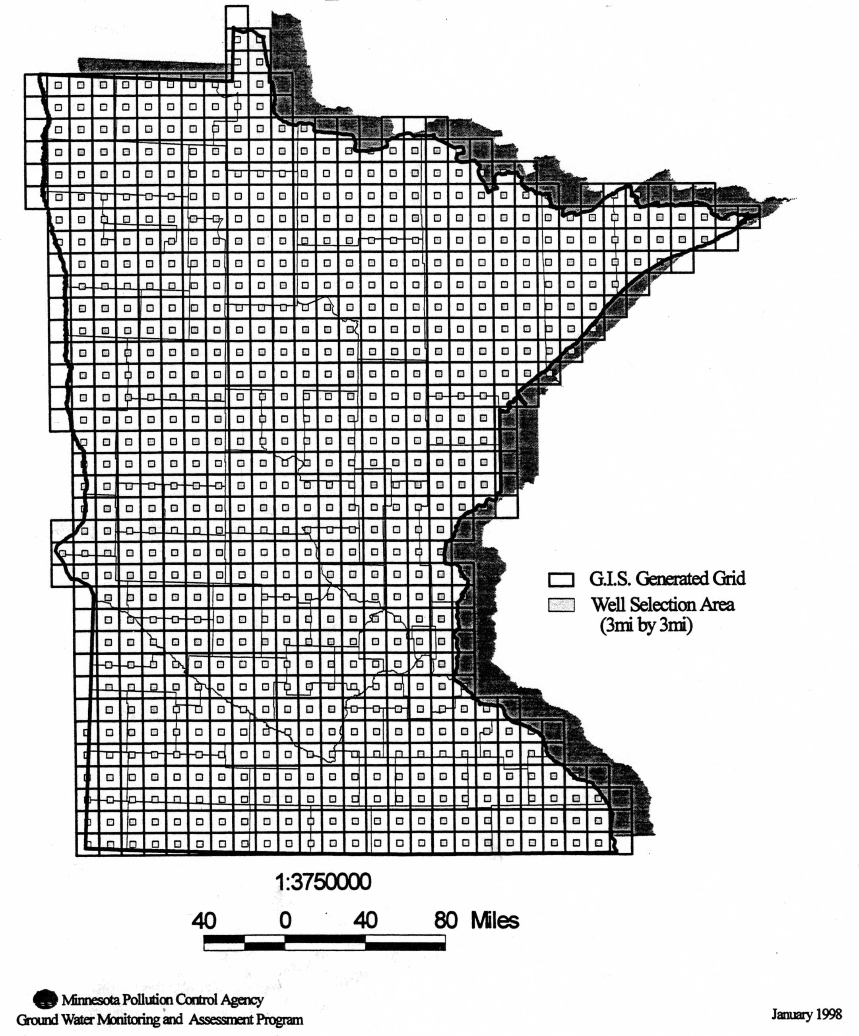
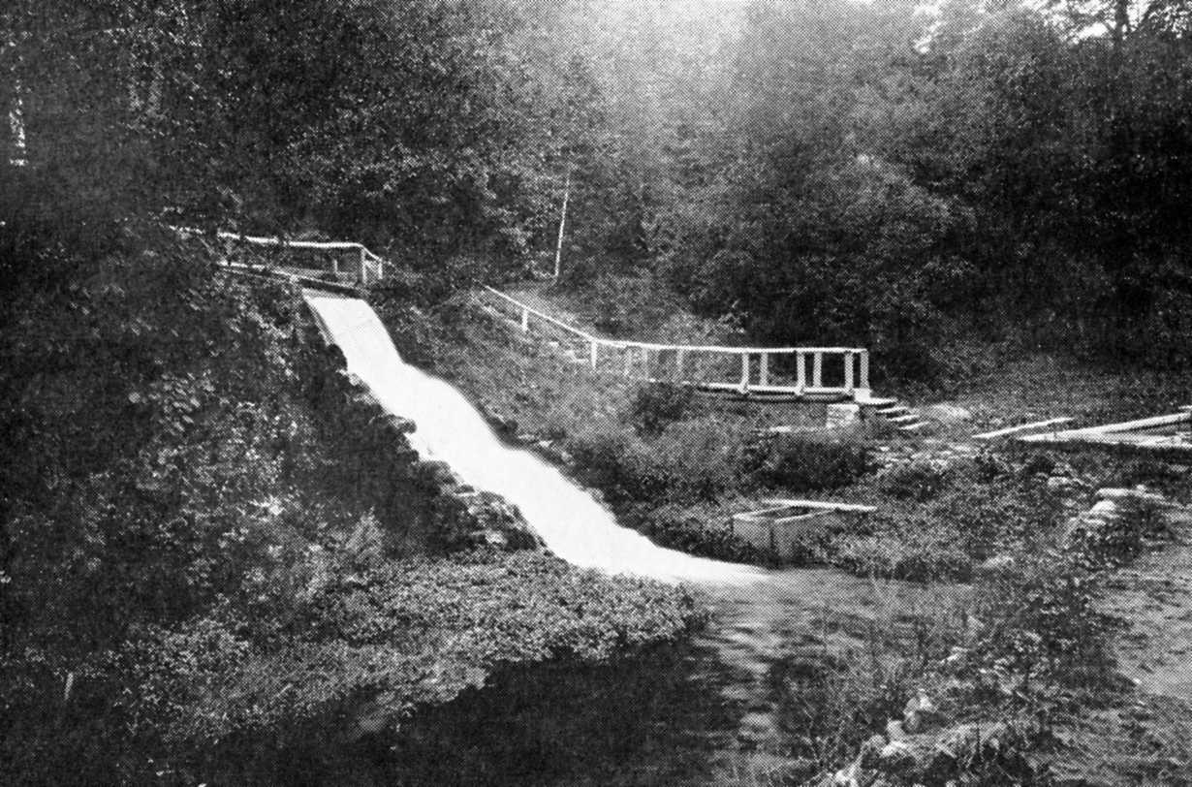
SURFACE AND GROUNDWATER NITRATE DATABASES FOR SOUTHEASTERN MINNESOTA, USA
Greg Brick¹, E. Calvin Alexander, Jr.¹, Justin Watkins², James R. Lundy³
¹Department of Earth Sciences, University of Minnesota, Minneapolis, MN 55455
²Minnesota Pollution Control Agency, 18 Wood Lake Drive, Rochester, MN 55904
³Minnesota Department of Health, 625 North Robert St, St. Paul, MN 55164
Abstract
Southeastern Minnesota
USGS
Historical Trends
Initial results of a Minnesota Pollution Control Agency (MPCA) funded collation of nitrate databases for surface and groundwater of the 10 counties of southeastern Minnesota’s (SE MN) karst region are presented. The goal is to identify existing data that can help define time trends and mechanisms of nitrate water pollution.
The U.S. Geological Survey’s National Water Information System contains data collected from 1889 to present for the entire nation and is available on the Internet.
The MPCA created three successive state-wide ambient (background) groundwater monitoring programs, which includes nitrate data, maintained in the EPA’s STORET database: from 1978 to 1990, from 1992 to 1996, and from 2003 to present. In the current program, urban surface and groundwater are sampled by the MPCA while rural waters are sampled by the Minnesota Department of Agriculture. Another MPCA program, Milestone Rivers, has nitrate data from 1953 onwards. The Garvin Brook watershed of SE MN was studied in more detail.
The Minnesota Department of Health (MDH) began recording nitrate data from the initial testing required for the installation of new wells in 1974. Eventually these data will be linked to the County Well Index, maintained by the Minnesota Geological Survey, which includes aquifer-specific information and unique well numbers. MDH also maintains the Minnesota Drinking Water Information System, collecting nitrate data from public water systems. Another MDH effort, since 2008, is the Voluntary Nitrate Monitoring Network, unique to SE MN, which relies on citizen volunteers to sample domestic well waters.
The Minnesota Department of Natural Resources’ (DNR) Part B of the County Geologic Atlas series often includes nitrate data, available on the Internet. The DNR’s state fish hatcheries have monitored nitrate concentrations in source springs.
Smaller units of government and independent researchers have accumulated much data. The Olmsted County Regional Laboratory has more than 36,000 well-water analyses from surrounding counties. County nitrate clinics, where individuals can have well-water tested, are another large source of data. The Metropolitan Council (Twin Cities) collects surface water samples along the Mississippi River. University of Minnesota dissertations also contain much nitrate data.
Web interface for the USGS National Water Information System.
Courtesy of Ron Spong.
List of Databases
MPCA Ambient Programs
Nitrate Chronology
U.S. Geological Survey:
National Water Information System
Minnesota Pollution Control Agency:
Ambient Programs
Milestone River Monitoring Program
Minnesota Department of Health:
MNDWIS
New Well Database
Voluntary Nitrate Network
Minnesota Department of Agriculture:
Rural springs & streams
Nitrate Clinics
Minnesota Department of Natural Resources:
County Geologic Atlas, Part B
State Fish Hatcheries
Minnesota Geological Survey:
County Well Index
Counties:
Olmsted Regional Laboratory
Dakota County AGQS
Hastings Area Nitrate Study
Nitrate clinics
Metropolitan Council (Twin Cites):
Mississippi River monitoring
University of Minnesota (dissertations)
1751 Marggraf (Germany) detects nitrate in Berlin water wells.
1785 Atmospheric nitrogen fixation by Cavendish sparking air.
1790 Chaptal suggests the name nitrogen.
1836 Boussingault (France) detects nitrate in springwater.
1887 Warington (UK) publishes first time series of nitrate in Rothamsted groundwater.
1898 Crookes (UK) warns of world nitrogen shortage.
1905 First nitrate analysis for the Mississippi River.
1906 Early use of the term “nitrogen cycle” (OED).
1911 Nitrate detected in se MN groundwater but called “trace.”
1913 Haber-Bosch fixation of atmospheric nitrogen.
1938 Agricultural nitrogen pollution not mentioned in USDA Yearbook.
1944 Norman Borlaug arrives in Mexico to start the Green Revolution— heavy use of nitrate fertilizer.
1945 Hunter Comly reports Blue Baby syndrome, proposes 10 ppm NO3-N standard.
1962 US Public Health Service adopts10 ppm standard.
1960s/1970s Groundwater nitrate rises steeply in the Big Spring Basin of Iowa and elsewhere.
1970 Anthropogenic nitrogen fixation equal to all terrestrial ecosystems (Delwiche).
1970s Marine dead zones first observed.
2005 Anthropogenic nitrogen fixation double that of all natural processes on land combined (Townsend & Howarth).
Well sampling grid for the 1992-1996 MPCA ambient program.
Lanesboro Fish Hatchery Spring

