Slide 1
The Future for Soil in the Earth Sciences
Michael H. Young¹, Dani Or², Jan W. Hopmans³
1 – Bureau of Economic Geology, University of Texas at Austin
2 – Environmental Sciences, Swiss Federal Institute of Technology Zurich
3 – Land, Air and Water Resources, University of California at Davis
GSA Meetings 2011
Geo-Workforce Preparation for 21st Century Challenges

Slide 2
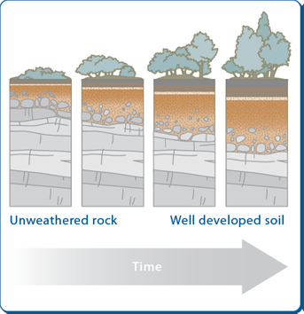
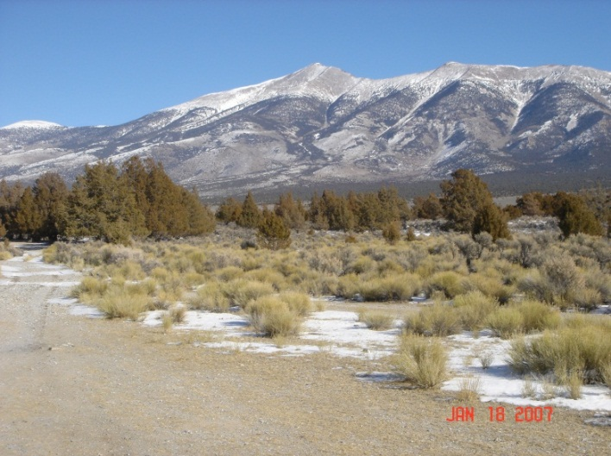
Soil science and geological processes are intertwined
Hans Jenny’s (1941) five soil forming factors:
Topography
Parent material
Biotic influences
Regional climate
Time
Many earth science issues (food source, geohazards, biosphere health) have their roots in soils and geology
The study of soil and geological processes need to be more substantially connected through interdisciplinarity

Slide 3
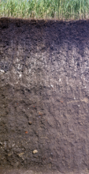
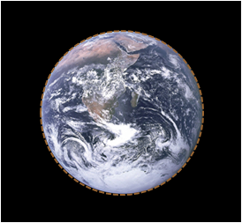
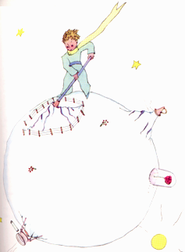
Soil – Earth’s life support system
Earth’s life support body: soil is the film of life which covers much of Earth land surface.
A natural body: soil is a functioning complex natural body with unique characteristics (Brady & Weil, 2001)
Biologically active: hosts the largest pool of biodiversity of all biospheres
Provides ecosystem services: provisions of fresh and clean water, food, carbon storage, essential for human needs
Preserves human history: Sedimentary record contains human imprint and hence historical record.
what is essential is invisible to the eye

Slide 4
Changes in anticipated career emphasis
1992
2004
Baveye et al., 2006

Slide 5
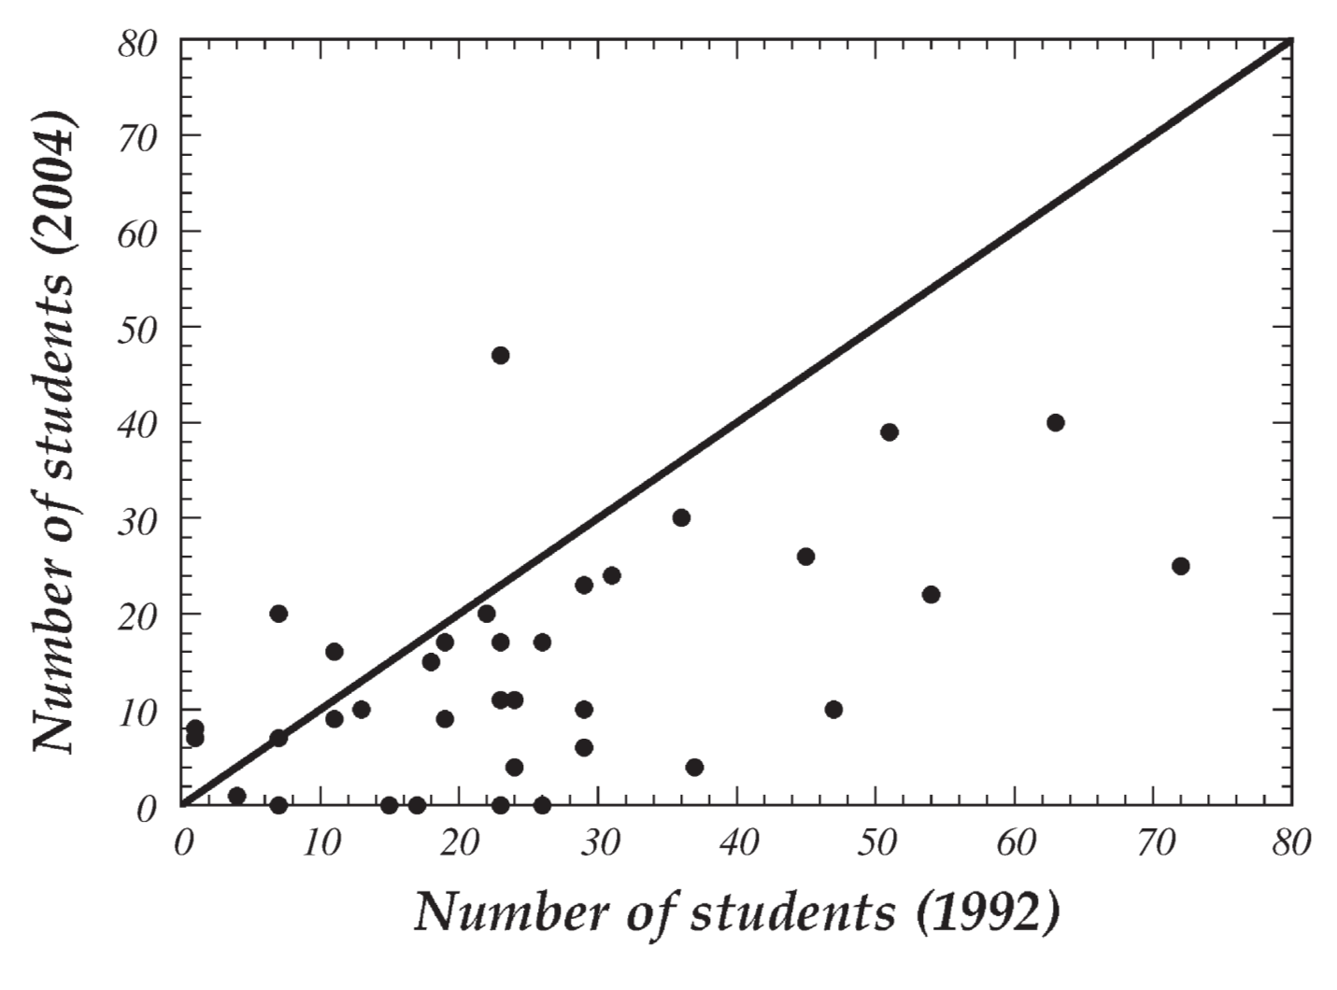
Graduate student enrollment – Soil degrees
Baveye et al., 2006
36 institutions responded to both surveys (1992 & 2004)
Only 5 institutes reported increases in both years

Slide 6
Student enrollment – Geosciences
American Geological Institute DGD Enrollment Survey, accessed 2011

Slide 7
Negative feedback loops
Research – Redirected or Repurposed
Education - Rebranded
Funding – Reduced/Reallocated
Student Enrollment Suffers:
The Science Suffers
Society and Stakeholder Needs – Redefined or Unmet
Over-compartmentalizing scientific research and education is negatively affecting ALL earth sciences.

Slide 8
Some options for education
Do nothing – Allow trends to roll forward; basic soils programs, students will eventually disappear
Fundamental research activities on soils will substantially diminish
Applications using soil concepts will lose firm footing
Distribute concepts – Embed basic soils education into other scientific/ engineering disciplines as existing soils programs are downsized or folded
Fight the trend – more effective advocacy with stakeholders and Deans/ Provosts; improve communication with undergrad and graduate students
“Lobby” administrators to replace retiring faculty and strengthen ties to stakeholders with interests in soils-related outcomes
Add soil science concepts directly into UG using interactive approaches in classroom and field

Slide 9
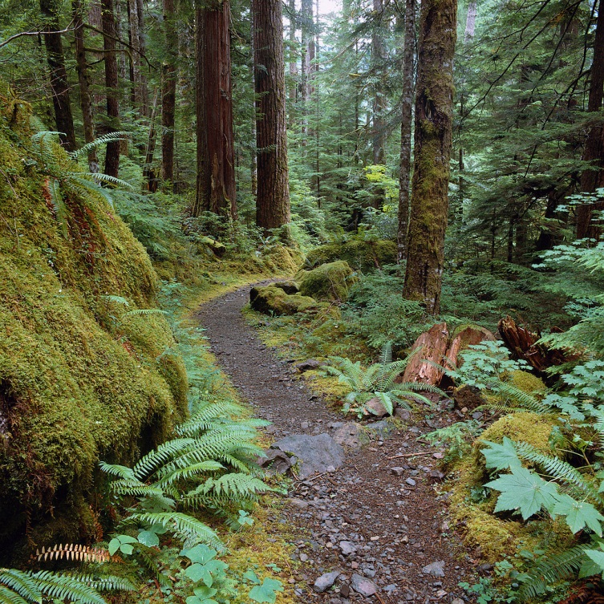
Calls to reinvigorate the science
Soil Physics community at SSSA developed and published a white paper* and companion article, articulating:
Our understanding of the issues
Solutions for solving them
Scores of comments received supported the efforts and agreed that change was needed
Final version was published and companion article published in CSA News in October 2011 issue
SSSA has convened a task force to consider structural changes and may implement them beginning in 2012

Slide 10

Solutions to reinvigorate research
Meetings
Focus on “big science questions” and integrative solutions
Translate findings into societal actions
Structure of Soils Society
Reduce internal boundaries
Structure along themes, rather than disciplines
Education
Expand targeted workshops on developing programs and leaders
Expand national leadership role in soil science education
Leadership and Communication
Reach out to sister organizations – New soils-based technical committee at AGU and new MOU were done in 2011
Promote scientific outreach

Slide 11
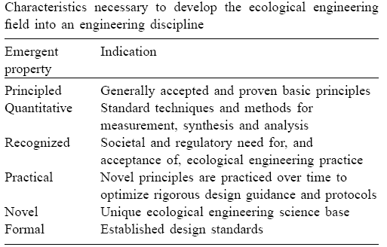
Lessons from another discipline
Soil science must embrace new directions in the same way Civil Engineering embraced Environmental Engineering (formerly Sanitary Engineering)
Disappearance of Rural Engineering is a warning sign, in contrast, the establishment of Environ. Eng. and recently, Ecological Eng. offer hope
The good news – soil science enjoys 4 out of 6 characteristics (+ journals, societies, and history)
Redefining our scope to regain acceptance and societal need, key to a vibrant discipline
Expand acceptance into training opportunities for students

Slide 12
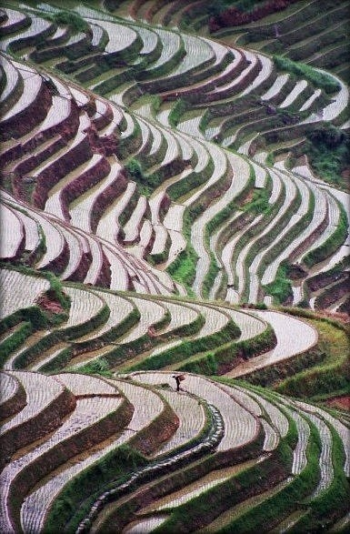
Conclusions and going forward
Soil science and geoscience exist in different educational and research universes – they can benefit and expand by integrating
Examples in research realm where this works :
Critical zone observatories
NEON activities
Create Soils-based section at GSA that emphasizes biospheric processes (QGG Section
website currently does not mention “soil” anywhere) and/or promote bottom-up and top-down connections with SSSA
Embed soil science concepts throughout earth sciences education, stressing broader environmental and societal gains

Slide 13
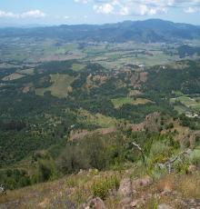
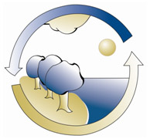



Questions and Comments?
http://www.napawatersheds.org

