Slide 1


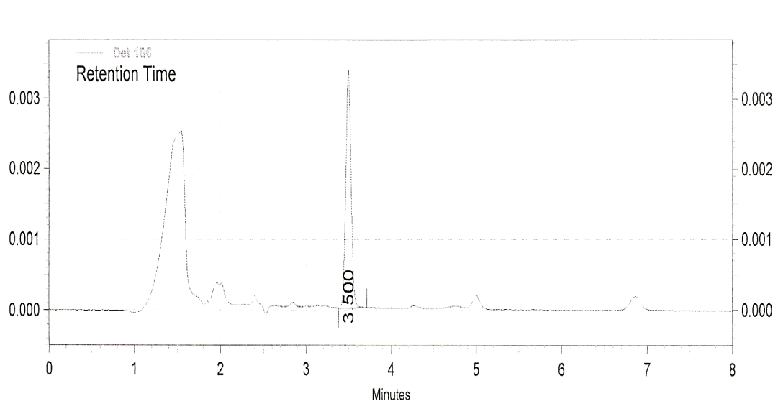
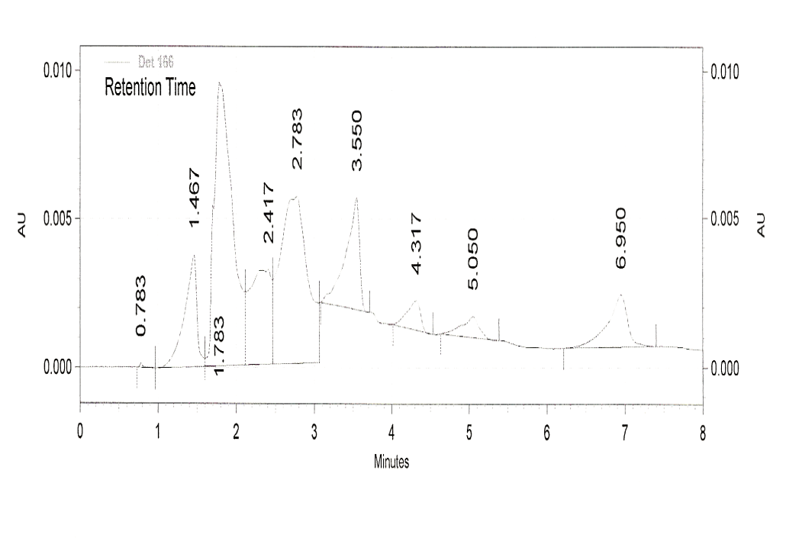
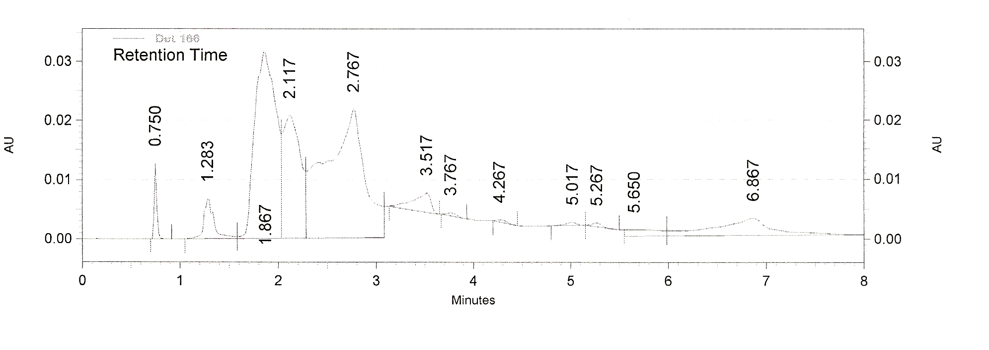
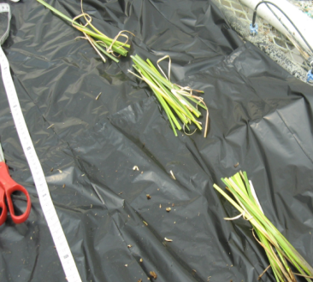
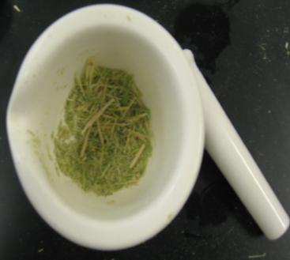
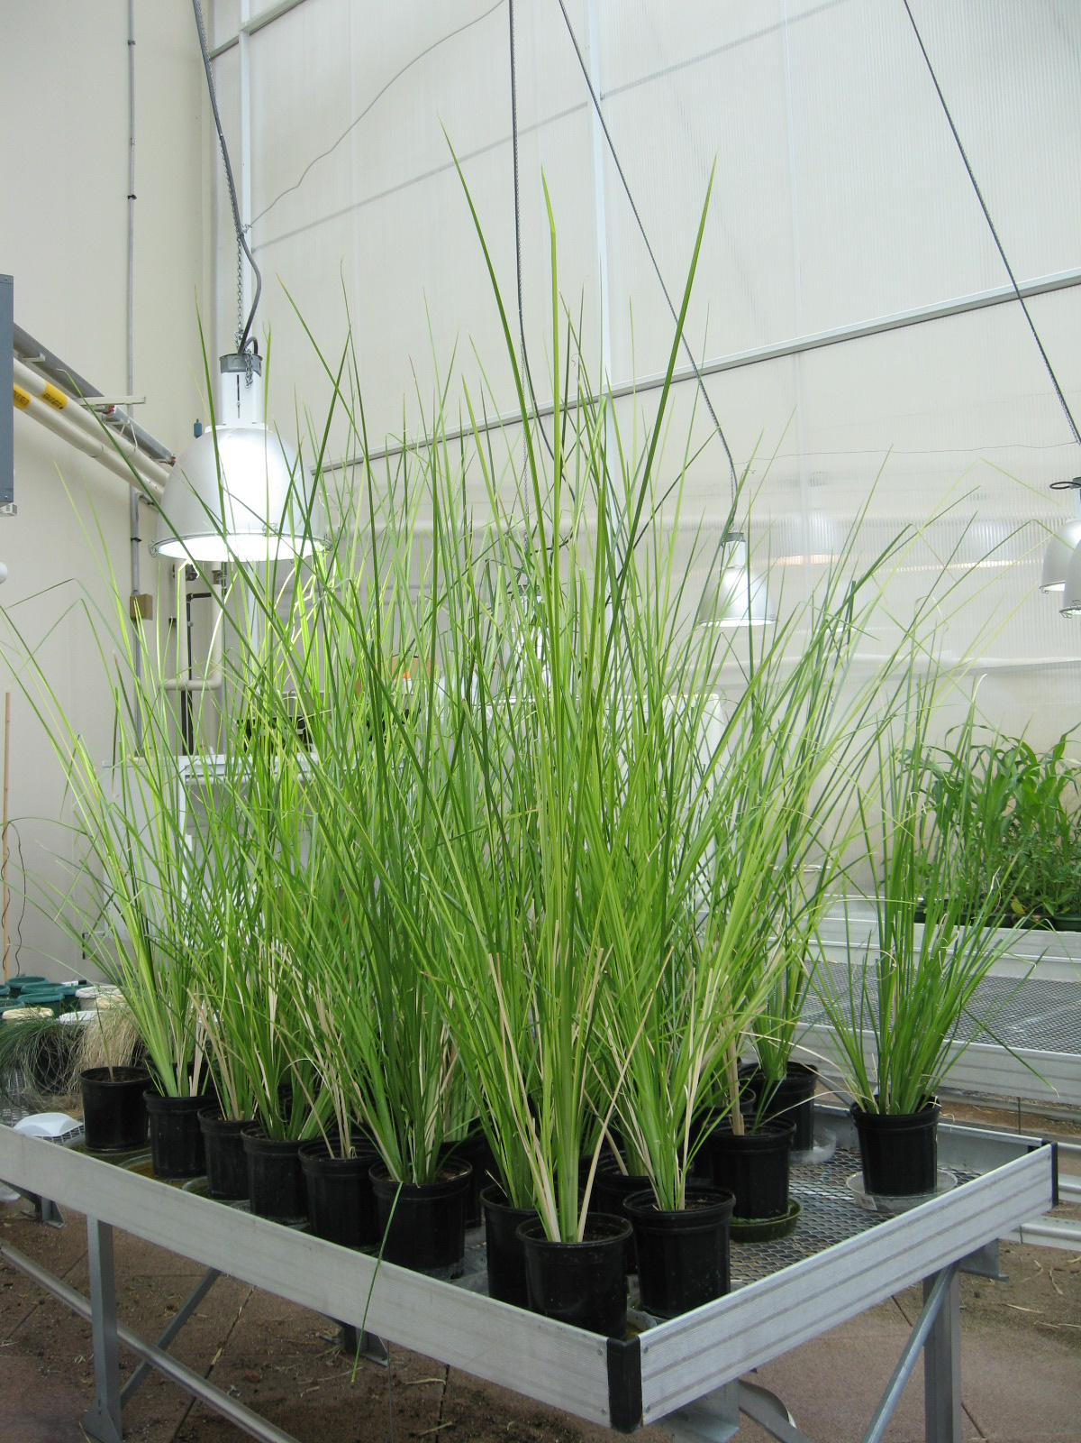
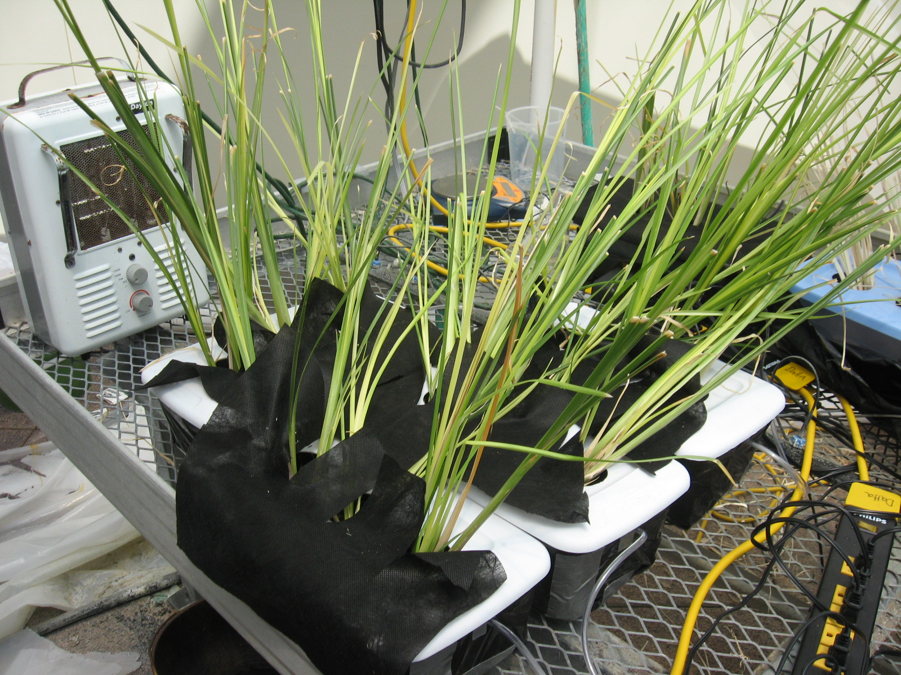
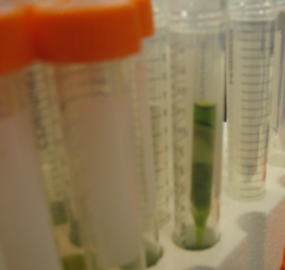
Phytoremediation of hexahydro-1,3,5-trinitro-1,3,5-triazine (RDX) using Chrysopogon zizanioides
Claire Doskey¹, Dibyendu Sarkar², and Rupali Datta¹
¹Biological Sciences Department, Michigan Technological University, Houghton, MI, 49931 ²Earth and Environmental Studies Department, Montclair Sate University, Montclair, NJ, 07043
ABSTRACT
RESULTS
Figure 6: Effect of RDX on Plant Biomass over 30 days exposure: Effect of RDX on plant growth inhibition was calculated as initial biomass minus final biomass after 10, 20 and 30d. A loss in biomass was observed in plants exposed to all of the different concentrations of RDX (0.25,1, and 2 ppm). However, control plants grown in media not exposed to RDX also showed biomass loss.
Hexahydro-1,3,5-trinitro-1,3,5-triazine (RDX) is a nitramine compound that has been used heavily by the military as an explosive. Manufacturing, use, and disposal of RDX have led to several contamination sites across the United States. RDX is both persistent in the environment and a threat to human health, making its remediation vital. The use of plants to extract RDX from the soil and metabolize it once in its tissue, is being looked at as a possible solution. In the present study, the tropical grass vetiver (Chrysopogon zizanioides) was grown hydroponically in the presence of 3 concentrations of RDX: 0.25, 1, and 2 ppm. The uptake of RDX was quantified by HPLC analysis of media samples taken daily over a 30-day experimental period. Vetiver was harvested on days 10, 20 and 30 of the experiment and extracted to determine the localization of RDX within the tissue and identify any metabolites. Phytotoxicity of RDX to vetiver was also monitored. This preliminary greenhouse study of RDX uptake by vetiver indicates the potential ability of this grass to serve as a RDX phytoremediation model.
HPLC Analysis of Media Samples
RDX
BACKGROUND
The nitramine compound, RDX, was once one of the major explosives used by the military, which has contributed to several contamination sites throughout the U.S. Such contamination sites have high levels of RDX exceeding the maximum contaminant level for drinking water, 0.002 mg/L RDX is persistent in the soil and reaches the groundwater due to its high water solubility. It is considered toxic and has been shown to have effects on the central nervous system, gastrointestinal, and renal system in humans. Such environmental persistence and threat to human health has led to a need for remediation of the RDX contamination sites. Past methods of remediating explosive contaminated soil include: open burning/open detonation, adsorption onto activated carbon or resin, advanced photooxidation, biodegradation, composting, and chemical treatment. Phytoremediation is a promising alternative to past remediation methods as it is cost-effective, environmentally friendly, and is thought to be a particularly effective method for removing low concentrations of contaminants that are spread over a large area, which matches well as a good remediation method for explosives contamination because it is widespread and diffuse within the contamination sites. Several initial phytoremediation studies have been tried, both in soil and with hydroponics and results show uptake of RDX by plants and subsequent translocation from the roots to the shoots and more apical parts of the plants. Chrysopogon zizanioides (vetiver) has been previously used in several phytoremediation studies by our group due to its large biomass, marked by its expansive root system, tolerance of various contaminants, and ability to grow in extreme soil conditions. Vetiver has been successful in the uptake of TNT in our lab and greenhouse experiments, and it was hypothesized that it may be capable of phytoremediation of RDX as well, due to the similarity in their chemical structures.
Figure 1: HPLC Chromatogram of Media Sample: Chromatogram of a media sample taken from a 2 ppm RDX treatment after 18 hours.
Figure 2: RDX in Media samples 0-18hr: Change in RDX concentration in hydroponic media samples over the first 18 hours of exposure to RDX. Data represent the average of 3 replicates in each of the 3 concentration treatments.
Figure 7 Bioconcentration of RDX: Bioconcentration factor (conc. RDX in plant/ conc. of RDX in media) after 30 days of exposure to each RDX treatment (0.25, 1, and 2ppm RDX).
HPLC Analysis of Plant Samples
A
B
DISCUSSION
Figure 3: HPLC Chromatogram of plant Sample: Chromatogram of plant root (A) and shoot (B) taken from a 2 ppm RDX treatment after 30 days.
This study presents preliminary results from a greenhouse experiment on uptake of RDX by vetiver grass grown hydroponoically.
A rapid decrease in RDX concentration in the media was seen within the first 18 hours of the experiment with the greatest loss in RDX/time within the first 6 hours and leveling off thereafter (Fig. 2).
Plant tissue samples were also analyzed after 10, 20 and 30 days of exposure to RDX. A loss in biomass was observed in plants exposed to all the different concentrations of RDX (0.25,1, and 2 ppm). However, control plants grown in media not exposed to RDX showed greater biomass loss out of all the treatments, so there does not appear to be a link between the RDX exposure and loss of plant biomass.
HPLC analysis of plant extracts from each RDX treatment (after 30 day harvest) showed that the mass of RDX in the shoot tissue of vetiver was about equal to the mass of RDX found in the root tissue of vetiver, with slightly more RDX being found to remain in the root tissue (Fig. 4). This result was unexpected as other studies have found RDX to more readily translocate to more apical parts of plants.
The translocation index and bioconcentration factors were calculated to further analyze the plant uptake of RDX and its movement within plant tissue. Similar translocation indices were observed for the three RDX treatments, with the 1 ppm RDX treatment showing the greatest translocation index. The bioconcentration factor was minimal, which could perhaps be accounted for by possible degradation of RDX in plant tissue (Fig. 3).
Studies are underway with both contaminated water and soil to test the efficacy of vetiver in RDX uptake and degradation.
METHODS
Vetiver was grown from bare root divisions in soil. After about two and a half months of growth in soil, the plants were extracted and rinsed thoroughly with deionized water to remove soil from the roots. The plants were then weighed and shoots were cut to be about 40g each, for a total mass of 120g (3 plants) per container in each 3L hydroponic system. Plants were allowed to acclimate in the hydroponic system before the 30 day treatment with RDX was initiated. The 3 concentration treatments were: 2 ppm, 1 ppm, and 0.25 ppm RDX. Three replicates of a control containing no RDX was also included along with a control at each of the RDX concentration with no plants.
The hydroponic media was sampled over a period of 30 days In order to measure the uptake of RDX. Samples were taken every 6 hours for the first 72 hours, every 12 hours for days 4-10 and every 24 hours for the duration of the experimental period. These samples were analyzed by HPLC to determine the concentration of RDX in each treatment over time.
Vetiver was harvested, extracted and analyzed by HPLC to quantify the amount of RDX in vetiver tissue. Vetiver was harvested at days 10, 20 and 30 of each of the 3 concentration treatments in addition to the control plants. During the plant harvest, root tissue was separated from shoot tissue. The shoot tissue was separated into the top, middle and bottom thirds. The tissues were ground into a fine powder using liquid nitrogen and extracted in acetonitrile. Following 18hr sonication and 5 min centrifugation (2500x g), the extracts were passed through a 50:50 (wt:wt) florisil:alumina pipette column and analyzed by HPLC to identify and quantify RDX present in plant tissues.
Figure 4: Mass of RDX in plant root and shoot tissue: A comparison of the mass of RDX in shoots to that found in the roots of vetiver tissues after 30 days of exposure. Roots accumulated marginally higher amounts of RDX when compared to the shoot tissue.
Figure 5: Translocation Index of RDX in plant tissue: Translocation index [(amount RDX in shoot/ amount RDX in root )x 100] of RDX calculated from plants samples exposed to 0.25 ppm, 1ppm, and 2ppm of RDX harvested after 30 days. The 1ppm RDX treatment showed the greatest translocation of the three treatments.
Acknowledgement
The senior author would like to thank the Department of Biological Sciences at Michigan Technological University for providing her with a Teaching Assistantship, and for the facilities that were used in this study.

