Slide 1
Engaging Early Career Undergraduates in the Geosciences Through Field and Research Activities
Kenneth M. Voglesonger, Jean M. Hemzacek,
and Laura L. Sanders
Department of Earth Science
Northeastern Illinois University
Geological Society of America National Meeting
October 10, 2011

Slide 2
Overview
Northeastern Illinois University (NEIU) & First Year Experience (FYE) Program
Muddy Waters: Chicago’s Environmental Geology
National Science Foundation Opportunities for Enhancing Diversity in the Geosciences
(NSF-OEDG)
Targeted Investigations in Environmental Resources Related to Agriculture (TIERRA) Project
United States Department of Agriculture (USDA)
Preliminary results from year one
Goals for the future

Slide 3

Northeastern Illinois University
Comprehensive public university
North side of Chicago
Federally designated Hispanic Serving Institution
12,000 commuter students
Most diverse public university in the Midwest (U.S. News and World Report)

Slide 4
Student Population – Fall 2010
Total Undergraduate Enrollment | Native American | Asian | African American | Hispanic | Caucasian | Other
9,498 | 0.3% | 9.5% | 10.0% | 31.2% | 39.5% | 9.5%
First generation college students: 41.8%
First year students:
12% African American; 41% Hispanic

Slide 5
Earth Science Majors – Fall 2010
Total Majors | Native American | Asian | African American | Hispanic | Caucasian | Other
41 | 0.0% | 7.3% | 2.4% | 17.1% | 53.7% | 19.5%
Decrease in diversity
Occurs in all STEM disciplines

Slide 6
First Year Experience Program
Required courses for all freshman
Integration of academic success skills, transitioning from high school to college, and discipline specific content
Focus on Chicago
Earth Science
Two Courses
Chicago Rocks! – Geology in the City
Muddy Waters: Chicago’s Environmental Geology
Recruitment from courses
More diverse target audience

Slide 7
Muddy Waters Course
Supported by NSF-OEDG
Focused on Environmental Geology within the urban Chicago environment
Natural and anthropogenic impacts on:
Water quality
Water quantity
Focus on field and laboratory activities
Goals:
Increase number of students majoring in STEM-related fields
Improved awareness of geoscience disciplines and careers

Slide 8
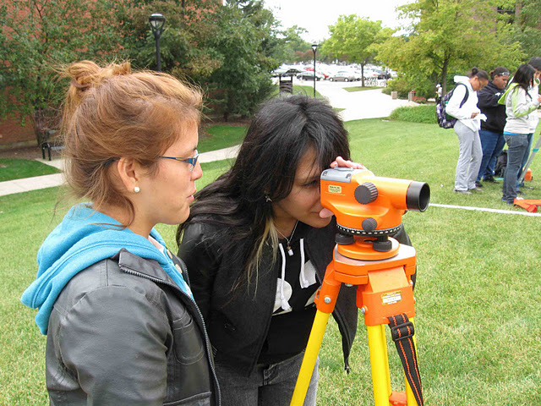
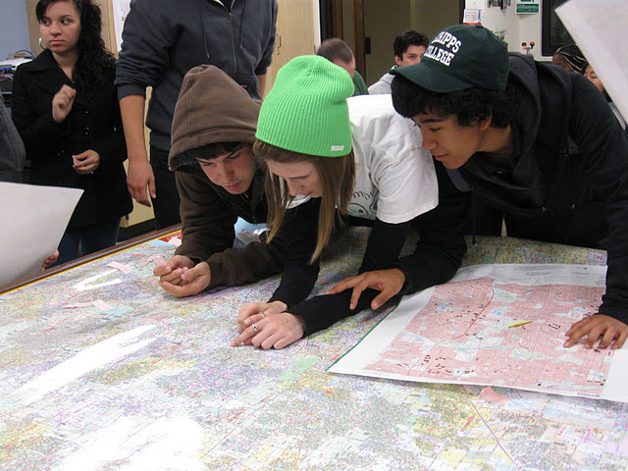
Muddy Waters – Field and Lab Activities
Local weekly field trips
North Branch of the Chicago River, North Shore Channel, Forest Preserves, Lake Michigan, groundwater wells
Basic Surveying
Topography and Gradient
Telescopic Level, Stadia Rod, Total Station

Slide 9
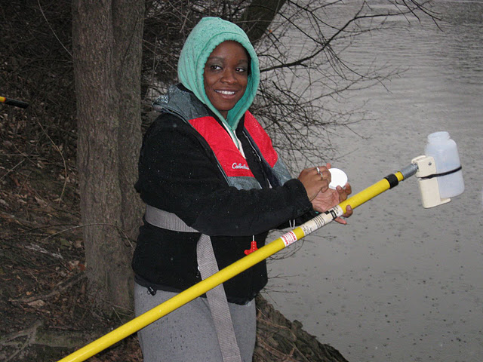
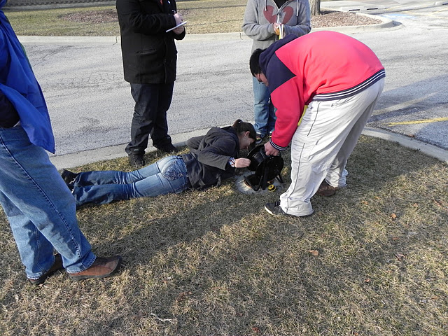
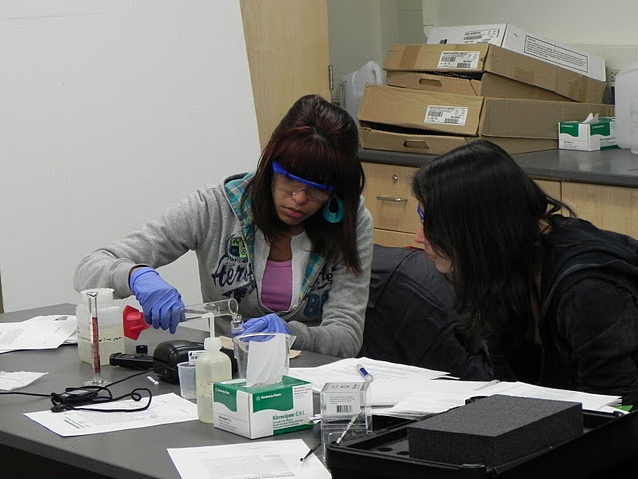
Muddy Waters – Field and Lab Activities
Water Sampling and Analysis
pH, Dissolved Oxygen, Conductivity
Colorimetry
Nitrate, Phosphate, Sulfate, Chloride, Fluoride

Slide 10
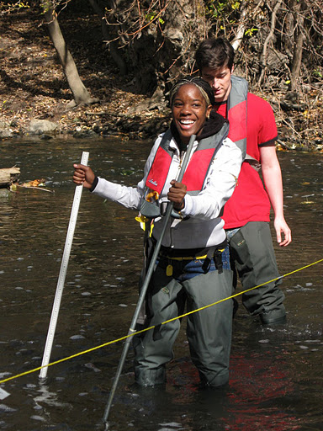
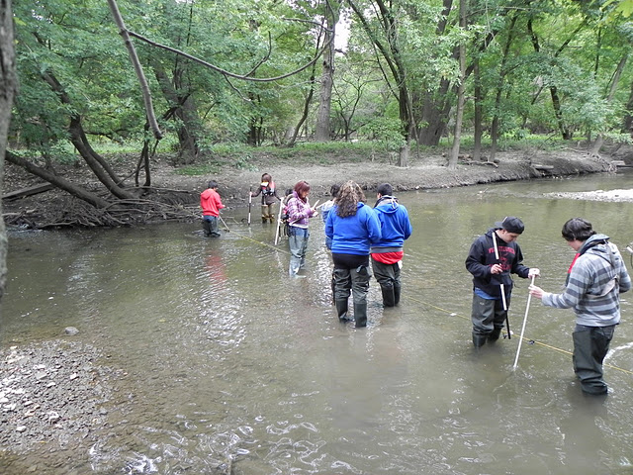
Muddy Waters – Field and Lab Activities
Water Quantity
Watersheds and the hydrologic cycle
Stream velocity and discharge
Semester project: Calculation of a water budget for North Branch of the Chicago River Watershed, urban impacts on water quality parameters

Slide 11
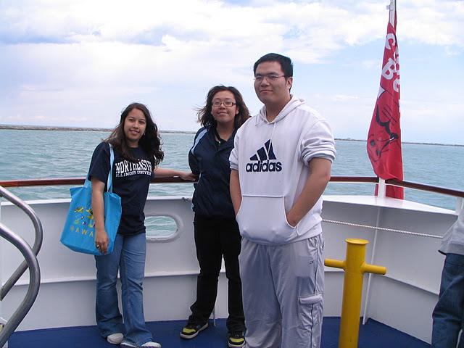
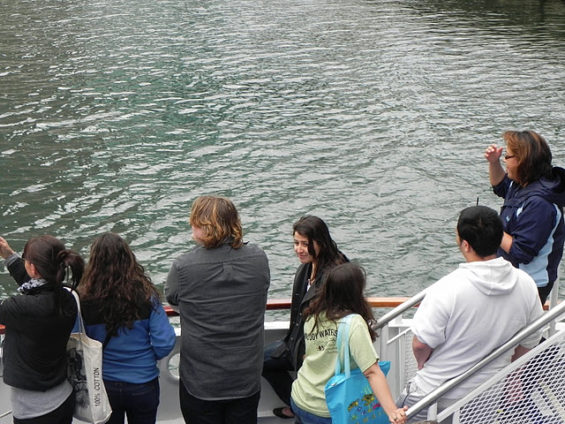
Muddy Waters – Other Activities
End of Semester Field Trip – build a sense of community, bridge to the major
High energy, fun, attractive
Include advanced Earth Science majors
Stickney Water Treatment Plant
Boat Tour
Alumni Visits
Professionals working in Environmental Geology Careers

Slide 12
Muddy Waters Enrollments
 | Enrollment | Native American | Asian | African American | Hispanic | Caucasian | Other
Fall 2010 | 17 | 0 | 2 | 2 | 6 | 5 | 2
Spring 2011 | 8 | 0 | 2 | 2 | 3 | 1 | 0
Fall 2011 | 43 | 0 | 0 | 0 | 29 | 9 | 5
Demographics representative of first year student population
Increase in enrollments in year two
Recruitment Strategies

Slide 13
Muddy Waters Preliminary Results
Student Pre- & Post-Surveys from Spring 2011
Questions focus on
Plans to take more Earth Science and other STEM courses
Attitudes about science and Geology
Small pool of students (n=8)
Limitations on statistical analysis of results

Slide 14
Number of Muddy Waters Students indicating:
Very likely to take science courses past general education requirements
Pre = 3, Post = 7
Very likely to take another Earth Science course
Pre = 1, Post = 5
Strongly agree that science is fun
Pre = 1, Post = 7
Strongly agree that a science degree could help them get a good job
Pre = 1, Post = 4

Slide 15
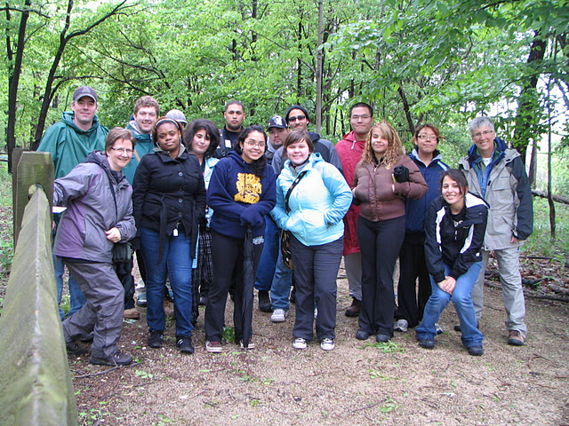
TIERRA Project
Targeted Investigations of Earth Resources Related to Agriculture
Recruitment from Earth Science First Year Experience courses
Summer research program focused on soil science
Relation to agricultural sciences
Summer 2011 – 13 students
Paid positions, 10 weeks, 16 hours per week

Slide 16
TIERRA Students
13 students
Two students – already Earth Science Majors
Rest undeclared
 | Total Students | Native American | Asian | African American | Hispanic | Caucasian | Other
Summer 2011 | 13 | 0 | 2 | 2 | 4 | 4 | 1

Slide 17
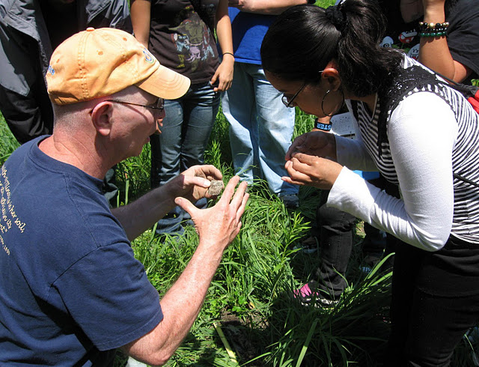
TIERRA Project
Training
Soil Sampling
Physical properties of soil
Chemical analysis of soil
Surveying, creation of topographic maps
Research Projects
5 groups of students
All focused on North Park Village Nature Center
Located in Chicago, North of NEIU
Mark Bramstedt, Illinois State Soil Scientist

Slide 18
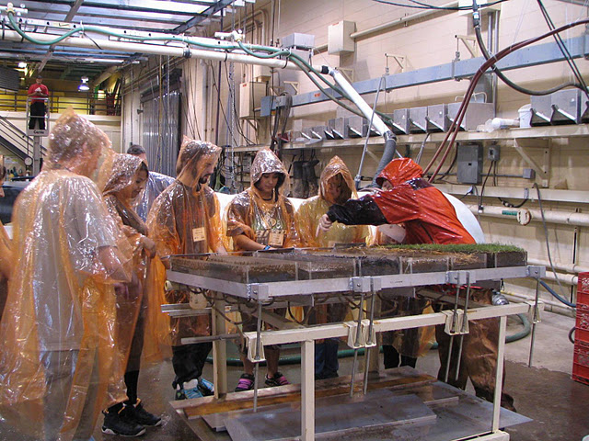
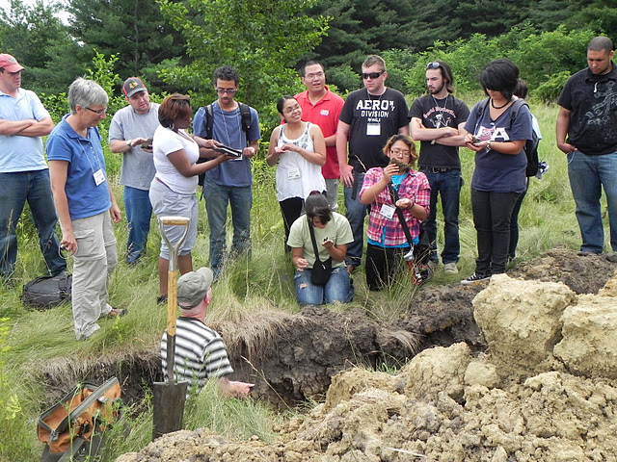
TIERRA Project
Exposure to professionals and careers in USDA – related professions
Field Trips
Field Offices of National Resources Conservation Service (NRCS)
USDA regional offices
University of Illinois at Urbana – Champaign (UIUC)
National Soil Erosion Research Laboratory (NSERL)
Purdue University
Field Sites with NRCS Staff

Slide 19
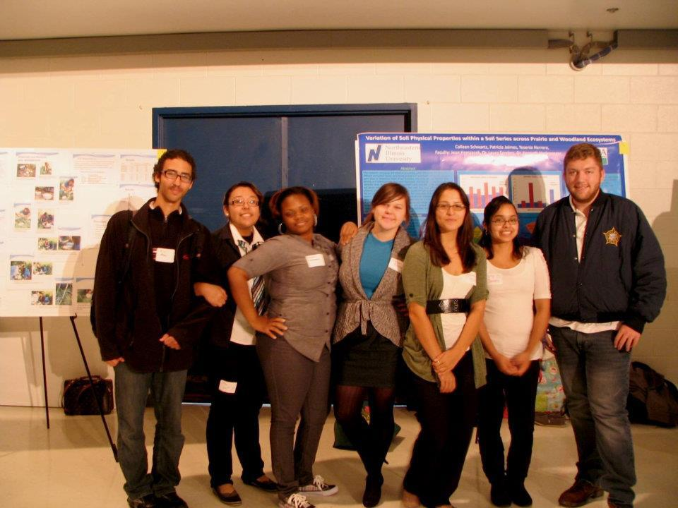
TIERRA Research Projects
NEIU Student Research Symposium
2 poster presentations
1 oral presentation
Society for the Advancement of Chicano and Native American in Science (SACNAS) National Conference; San Jose, California
October 27th – October 30th
4 poster presentations

Slide 20
TIERRA Increase in Content Knowledge
Self-reported results:
Strongly disagree (1), disagree (2), agree (3), strongly agree (4)
17 geoscience concepts and 10 geoscience terms
Examples:
Soil horizons, soil texture, soil porosity, soil structure, clay minerals, Munsell color
Pre-survey average: 2.4
Post-survey average: 3.5
11 skills related to performing a research project
Examples:
Analyze soil texture, measure soil pH, read a topo map
Pre-survey average: 2.7
Post-survey average: 3.7

Slide 21
TIERRA Scientific Research Skills
Skill | Pre-survey (Strongly agree) | Post-survey (Strongly agree)
Ability to give an oral presentation | 20% | 50%
Interpret a graph or chart | 0% | 70%
Draw conclusions from data | 0% | 70%
Write a scientific abstract | 0% | 70%

Slide 22
TIERRA: Awareness of & Interest in Geoscience Careers
Based on student reflections
Activity | Increased Awareness | Increased Interest
NSERL, Purdue University | 54% | 31%
NRCS Field Office and Field Sites | 46% | 31%
UIUC, NRCS Headquarters | 16% | 54%
Campus Visit from State Soil Scientist | 8% | 38%
Performing the research project | 8% | 38%
Training sessions | 8% | 38%
Writing abstracts, preparing presentations | 0% | 0%
Working with professional resources | 8% | 0%

Slide 23
TIERRA: Interest in STEM-fields
Changes in average rating of students’ likelihood of majoring in STEM fields
(1 = highly unlikely; 2 = unlikely; 3 = likely; 4 = highly likely)
Discipline | Pre-Survey Average | Post Survey Average
Geology/Earth Science | 2.9 | 3.7
Environmental Science | 2.4 | 2.9
Mathematics | 1.1 | 1.3
Physics | 1.5 | 1.7
Computer Science | 1.5 | 1.6
Biology | 2.2 | 2.2
Chemistry | 1.5 | 2.0
Engineering | 1.5 | 1.9

Slide 24
Results
13 students
2 already declared Earth Science majors
One Hispanic/Latino, One African American
Remaining 11 students
6 declared Earth Science Majors
2 Hispanic/Latino students
2 Caucasian students
2 Asian students
One declared Computer Science Major

Slide 25
Conclusion
Synergy between First Year Experience courses and TIERRA Project
Increased diversity in target audience
Increased exposure to Earth Science Department
Overall increase in
Content knowledge
Ability to perform scientific research
Awareness and interest in Geoscience careers
Increased interest in STEM majors
Recruitment of majors
Sense of community and connection to the department

Slide 26
Future Work
Administer Undergraduate Research Self Assessment Analysis Survey (URSSA) following SACNAS Conference
Hunter, Weston, Laursen, and Thiry, CUR Quarterly Report, 2009
Complete analysis of assessment results
Current Semester – First Year Experience Courses
Muddy Waters – 43 students enrolled
67% Hispanic/Latino
Chicago Rocks! – 48 students enrolled
Spring 2012 Semester
Offering one section of each course (24 students per section)
Summer 2012
Target of 16 students for TIERRA project

Slide 27
Acknowledgments
National Science Foundation, Opportunities for Enhancing Diversity in the Geosciences
Award Number 0914497
PI: Laura L. Sanders
Co-PIs: Jean M Hemzacek, Kenneth M. Voglesonger
United States Department of Agriculture
USDA-NIFA HEP Award # 2010-02071
PI: Laura L. Sanders
Co-PIs: Jean M Hemzacek, Kenneth M. Voglesonger
National Resources Conservation Service
Mark Bramstedt, Illinois State Soil Scientist
National Soil Erosion Research Laboratory
North Park Village Nature Center
Purdue University, University of Illinois at Urbana-Champaign
Janise Hurtig, PRAIRIE Group, University of Illinois at Chicago
NEIU Student Center for Science Engagement

