Slide 1
From Intro Geo to GIS:
Examples from Creative Faculty Across the Country for Teaching Undergraduate Geoscience Courses Using Planetary Data
Barbara Tewksbury
Hamilton College
btewksbu@hamilton.edu
Notes:
How many are planetary geologists doing research in planetary? I am a bit of an imposter. Although unlike many in this room – I personally remember Apollo, Viking, and Voyager, I am not a planetary scientist. So I’m like many people who want to use planetary examples but need a little help.
Purpose of the talk is to give examples from wonderful creative faculty around the US. End the talk with some advice on how to make this work; resources to help you.

Slide 2
Why incorporate planetary data?
New (exciting! exotic!) examples
Student learning improves when students are engaged/hooked
Practice observation and data analysis skills in new planetary environment
Students learn best when they apply what they know to analyze/synthesize/interpret, rather than just learn about a topic.
Notes:
Learning: engagement/hook; analysis; reflection, aha insights. Reflect on things they have taken for granted about their own planet.....understanding of science in general

Slide 3
Why incorporate planetary data?
Reflect on their own planet
What is different?
How much of a difference do the conditions of our own planetary experiment make?
Students learn more when they reflect on what they know
Leaps in understanding of their own planet
Notes:
Learning: engagement/hook; analysis; reflection, aha insights. Reflect on things they have taken for granted about their own planet.....understanding of science in general

Slide 4
Wealth of available data
Difficult to imagine an undergraduate geoscience course for which relevant extraterrestrial data are not available and easily accessible
Notes:
Title of talk is from Intro to GIS. The wealth of recent data from other planets on everything from geophysics to climate change provides an opportunity to expand examples beyond the terrestrial realm in undergraduate courses ranging from intro geo to GIS,
Mars, Moons of the outer planets, launch of GRAIL, new data from Moon & Mercury.
from hydrogeology to petrology, from structural geology to paleontology. Readily available data sets for planets other than the Earth have made it possible for faculty to develop outstanding assignments and activities that emphasize data analysis and that provide students with first hand experience in the kind of analyses that geoscientists use to better understand geologic processes and histories on both the Earth and other planets. ; g

Slide 5
The challenge
Coming up with a good idea
Finding the data
Developing the assignment/activity
Strategies
Adapt/adopt
Design your own
Notes:
I don’t’ think that I have to convince you that this is a good idea; in many ways I’m preaching to the converted. Could be the reverse, actually – you have the data and you need to come up with a good idea of what to do with it.
Going to look at two strategies – adapt/adopt or develop your own - will look at both strategies.

Slide 6
Adapt or adopt
Doesn’t reinvent the wheel!
Bug colleagues
Use On the Cutting Edge web resources
serc.carleton.edu/NAGTWorkshops
Notes:
Purpose is to showcase a few good ideas; adopt, adapt, or be inspired by these catalyst ideas.; going to show just a few examples, mention some others.

Slide 7
Aspects in common
All of the activities described here:
Go beyond teaching students about planets
Involve students in more than knowledge acquisition
Have students do geology using planetary data
Promotes learning and “Ah-ha” insights
Notes:
All of these have in common the things that are important to cutting edge; go beyond teaching students _about_ the planets; doing geology using planetary data; involving students in more than knowledge acquisition; same questions, different data sets;

Slide 8
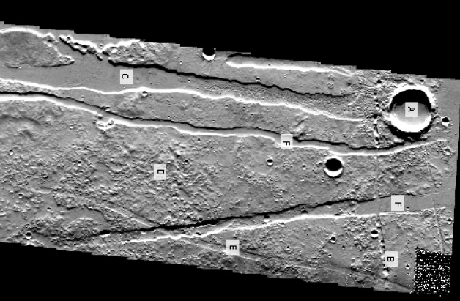
From an intro geo course
Audeliz Matias, Empire State Coll.
Teaching relative age interpretation
Notes:
from an intro geo course, reading geologic maps and introducing the concept of relative dating using data from the Moon and Mars; identify features but goes beyond that; interpret relative ages; could also introduce analysis of limitation sin interpretations or what additional data you wold like to have. Could do with variety of data sets. Features? Processes? History?

Slide 9
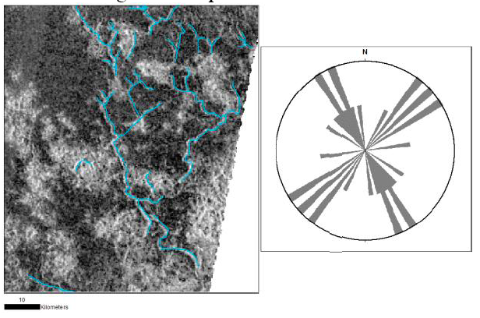
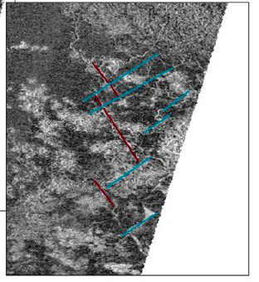
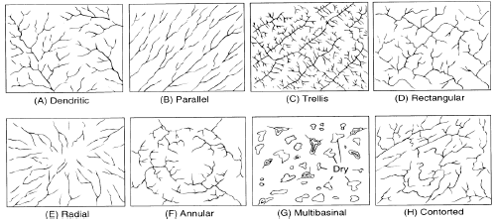
From a geomorph course
Devon Burr, University of Tennessee
Interp. of drainage patterns on Titan
Notes:
Devin’s Titan example; morphologic classification of drainage networks – patterns can provide info about underlying geology – another planet with methane rivers – talk about a hook! Rectangular drainage pattern suggest structural control by features in underlying bedrock.

Slide 10
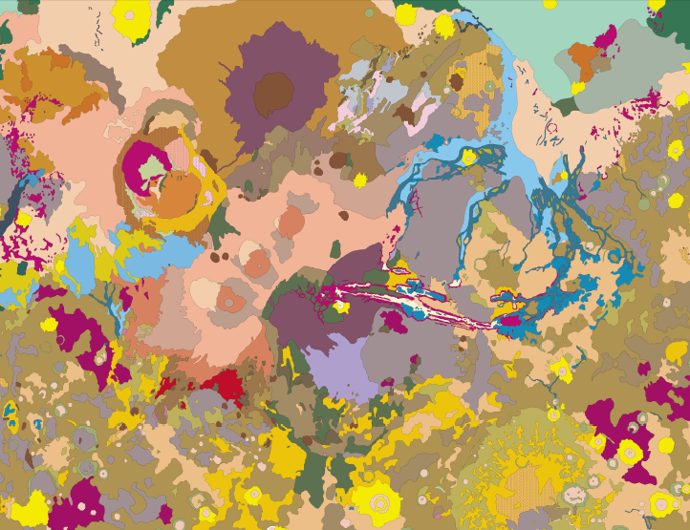
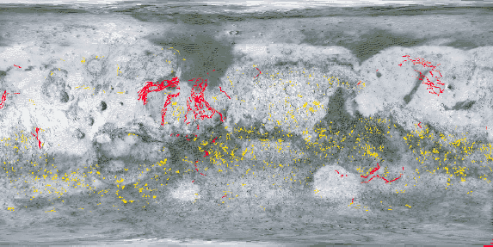
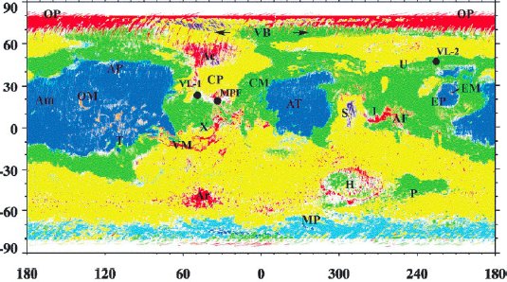
From an intro course
Tracy Gregg, University at Buffalo
Landing site selection, Mars; 3 teams
Notes:
Team activity – geo team: what do you want to know?, engineering team: thermal inertia and rock abundance, within 15 of equator; biologists: water, past or present, plus heat.; team approach – know it well enough to teach it

Slide 11

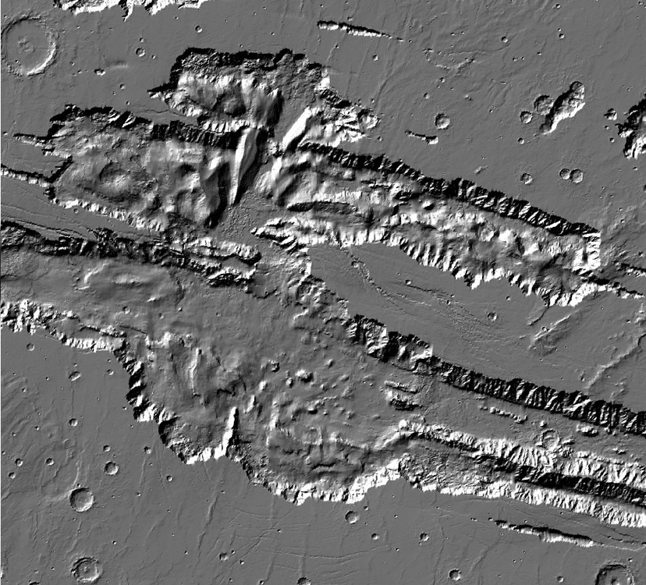
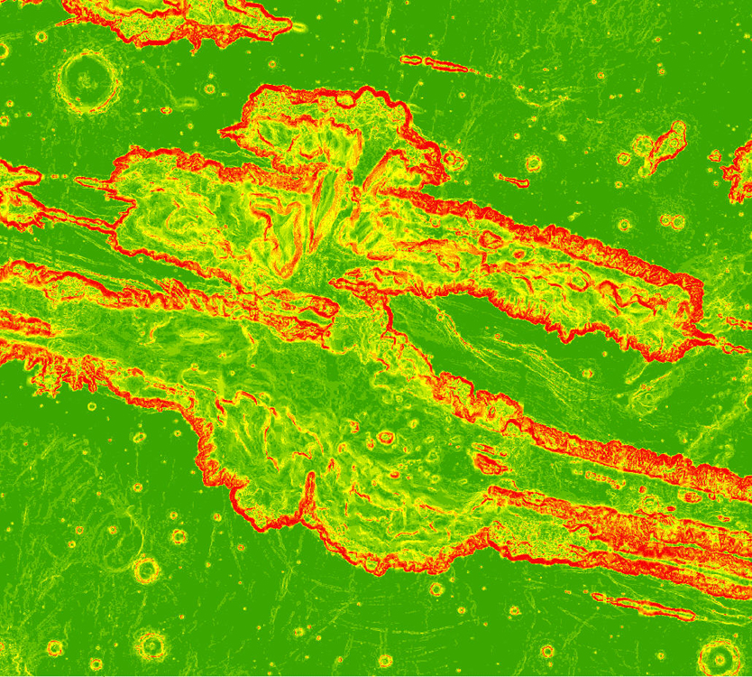
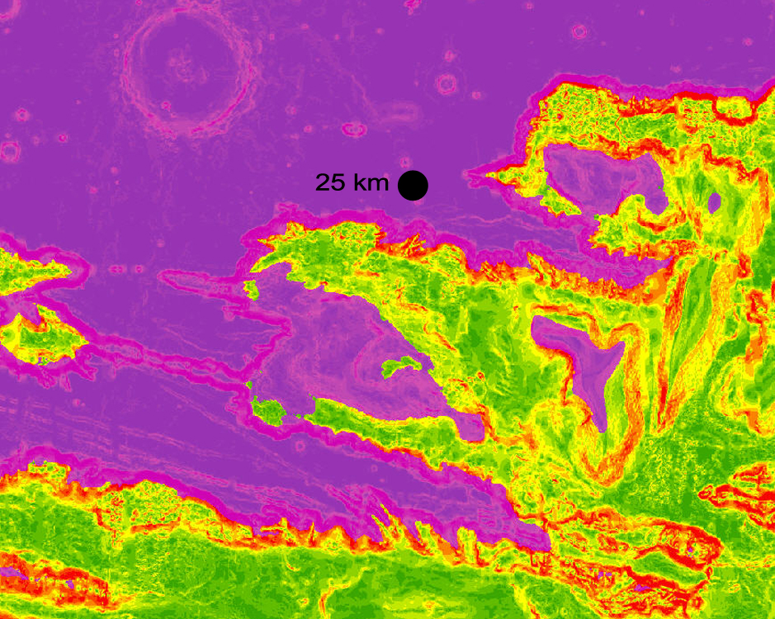
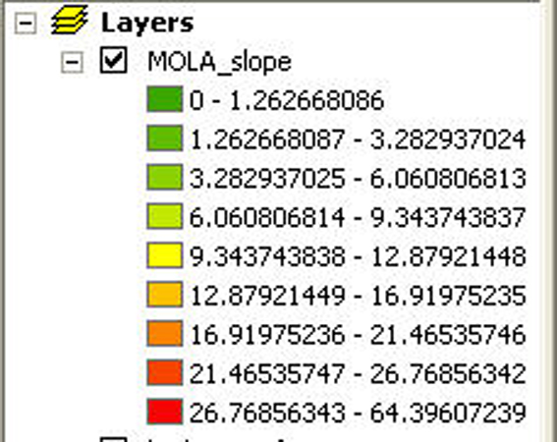
From a GIS course
Brian Hynek, Univ. of Colorado
Landing site selection; ArcMap
Notes:
from a GIS course, terrain analysis for landing site selection on the Moon or Mars

Slide 12
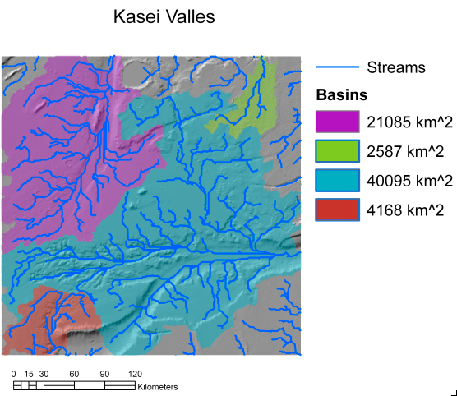
From a hydro course
Arwen Vidal, U. of Colorado
ArcGIS ArcHydro Tools
Notes:
On another planet -

Slide 13
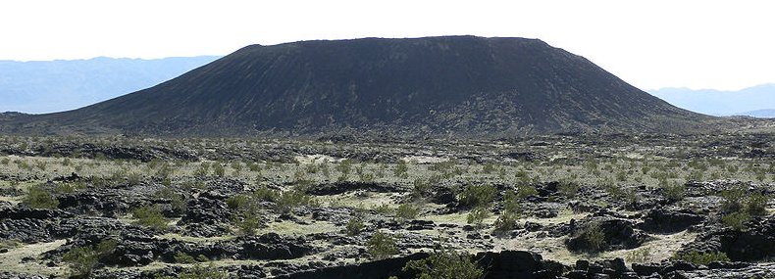
From an intro geo course
Eric Grosfils, Pomona College
What if Amboy Crater had erupted on the Moon? Mars?
Notes:
rom a petrology course, analysis of factors affecting morphology and development of lava flows and cinder cones on the Earth, Mars, and Venus Mojave Desert, 6 Ka; Test blanket statements in into textbooks about correlations between morphology; Changes in g but also could do other things; he takes a highly quantitative approach; thickness a flow must attain before flowing is a fcn of g and yield strength

Slide 14
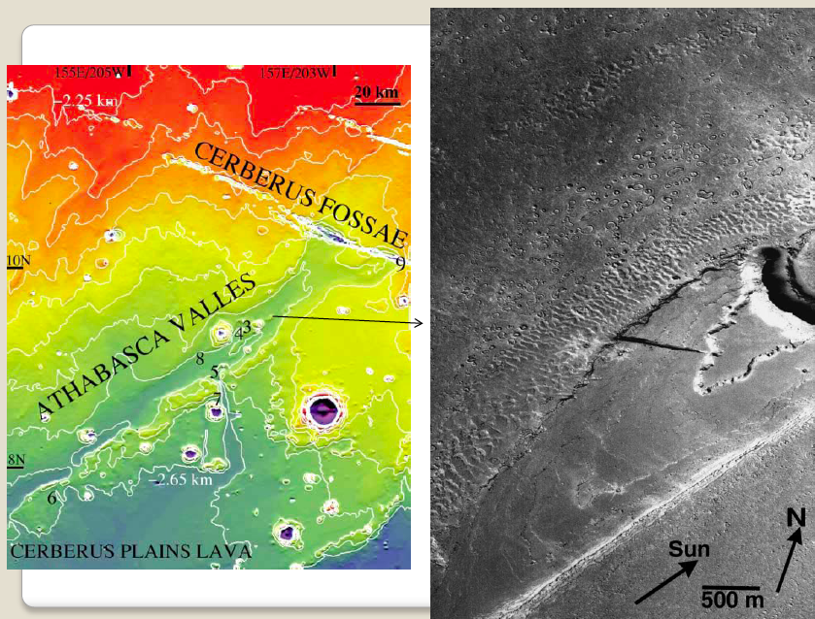
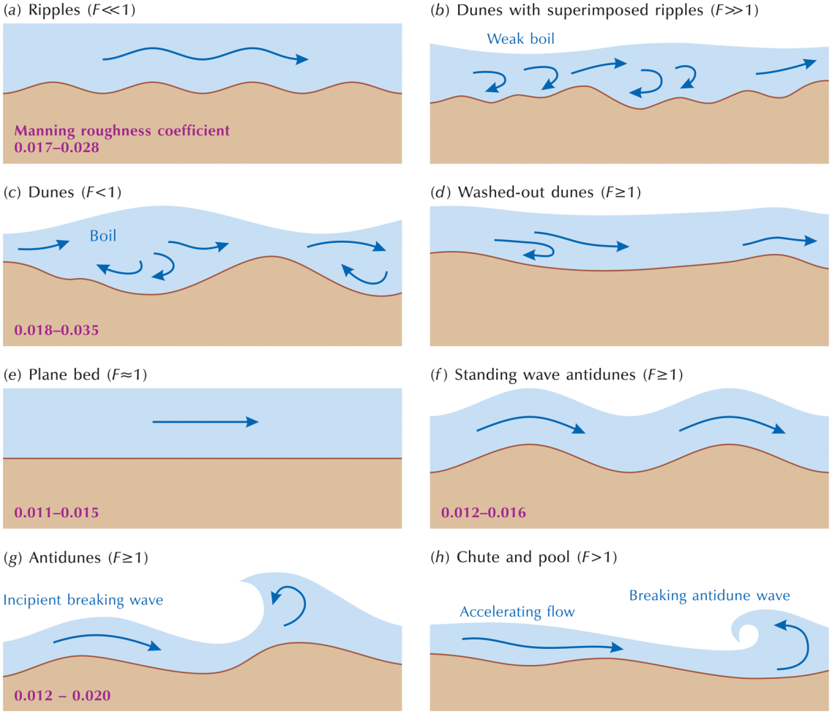
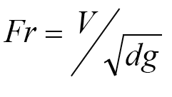
From a seds/geomorph course
Devon Burr, University of Tennessee
Analysis of flow regime in Athabasca V.
Notes:
from a surface processes course, analysis of bedforms and inferred discharge on Mars
Froude # correlates with bedform; flow height estimatde from streamlined forms; perfect opportunity for uncertainty analysis, with or without other published data.

Slide 15
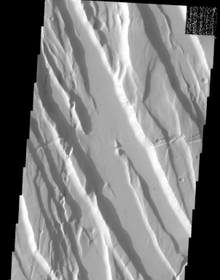
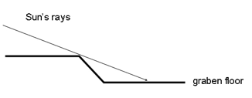
From a structural geology course
Moi; estimating regional extension in Ceraunius Fossae
Notes:
from a structural geology course, estimating regional extension using THEMIS images of Mars graben Ceraunius Fossae; using shadow angle and knowing image parameters; ask them to guess the % extension; good opportunity to easily test impact of assumptions

Slide 16
Other examples
Geochem/petrology: Mars or Moon spectroscopic data to determine mineralogy (Laurel Goodell & T.C. Onstott, Princeton)
Global change course: analyze matter/energy cycles on Mars (Eric Pyle, JMU)
Teaching geologic mapping using Venus Magellan SAR data (Vicki Hansen, UMN, Duluth)
Notes:
Mention John Hogan using this in his structural geology course – gives engineers experience with “fuzzy data”

Slide 17
Designing your own
Need an idea? Mine the literature.
Helps in locating data
GSA Today article on pit crater chains on Mars (Ferrill et al., 2004)
Hogan (MS&T): structural geo course – normal faults on a planet other than Earth
Tewks: intro course – origin of depressions in Libyan Desert north of Tazerbo well field.
Notes:
What if you aren’t a planetary geologist? Give example from my class as an example; using articles solves the data problem, and you know it’s do-able

Slide 18
Designing your own
Primary strategy – what are you trying to accomplish?
Hook/engagement
Personal application, analysis, and problem-solving
Reflection on significance
Focus beyond teaching them about the planets.
Notes:
What to do? What are the goals of the course? New kind of data set; how to find the data?

Slide 19
Developing your own
Online resources at On the Cutting Edge serc.carleton.edu/NAGTWorkshops
Effective teaching strategies focused on student learning, not just information transfer
Assessment strategies to figure out whether what you did worked to improve student learning
Course design strategies for accomplishing course goals through effective assignments
Submit your own activities!
Notes:
What if you want to develop your own? Cutting edge resources – teaching strategies, course design, ideas from catalyst idea pages; what makes an outstanding activity?

