Slide 1

Grade 4-12 Student Conceptions of Astronomical Phenomena
Jason Petula, Ph.D.
Assistant Professor of Education
Pennsylvania State University
DUE-0962792

Slide 2
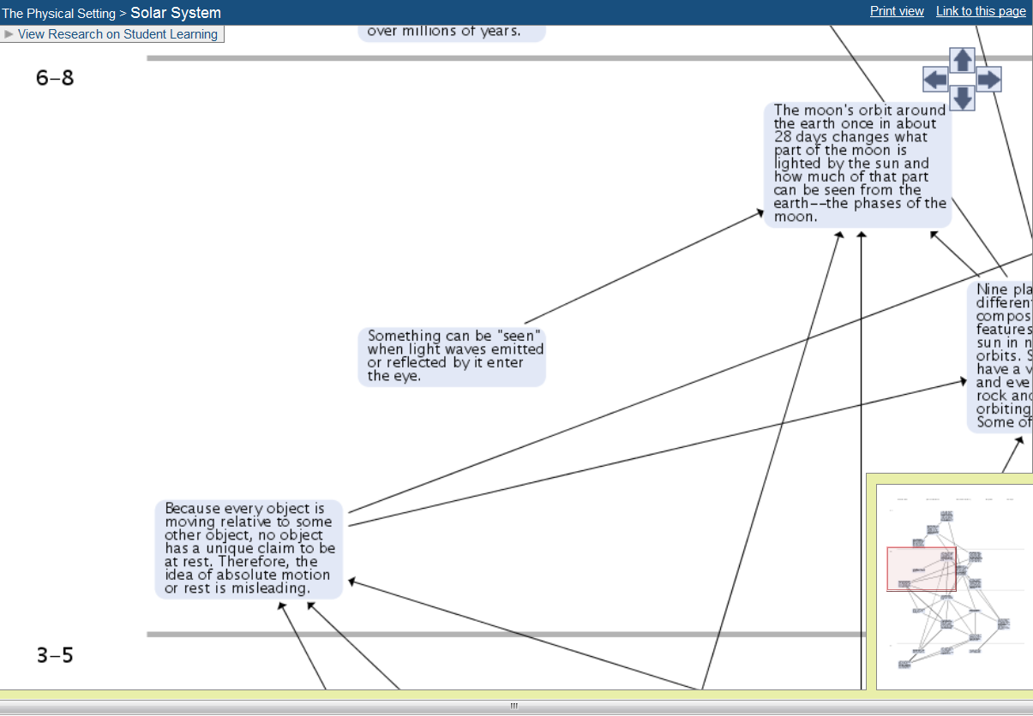
What should students know?
http://strandmaps.nsdl.org/?id=SMS-MAP-1282
Notes:
National Science Digital Library (NSDL) Science Literacy Maps.

Slide 3
What should students know?
NSES Content Standard D Earth and Space Science Standards
Earth in the solar system
Most objects in the solar system are in regular and predictable motion. Those motions explain such phenomena as the day, the year, phases of the moon, and eclipses.
http://www.nap.edu/openbook.php?record_id=4962&page=160
Notes:
National Science Education Standards (NSES)

Slide 4
What should students know?
By the end of grade 5. The orbits of Earth around the sun and of the moon around Earth, together with the rotation of Earth about an axis between its North and South poles, cause observable patterns. These include day and night; daily and seasonal changes in the length and direction of shadows; phases of the moon; and different positions of the sun, moon, and stars at different times of the day, month, and year.
Some objects in the solar system can be seen with the naked eye. Planets in the night sky change positions and are not always visible from Earth as they orbit the sun. Stars appear in patterns called constellations, which can be used for navigation and appear to move together across the sky because of Earth’s rotation.
http://www.nap.edu/openbook.php?record_id=13165&page=124
Notes:
A Framework for K-12 Science Education: Practices, Crosscutting Concepts, and Core Ideas (2011) Board on Science Education (BOSE)

Slide 5
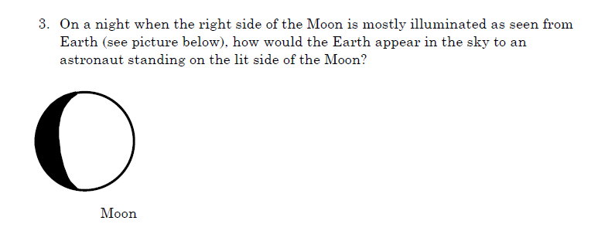
How do students progress from novice to expert understanding?
Phenomena Diurnal Motion Lunar Phases Seasons Season Change in Stars Planetary
Cross-Cutting Themes Pattern Scale Time Motion Position & Relations
Notes:
[take a moment and convince the person sitting next to you that you are correct]
The previous documents influence our understanding of the upper anchor. The questions asked in the assessment had various questions that we categorized by the phenomena and cross-cutting themes. The Astronomy Learning Progression team also acknowledges that that the initial questions asked may provide better data in the future.

Slide 6
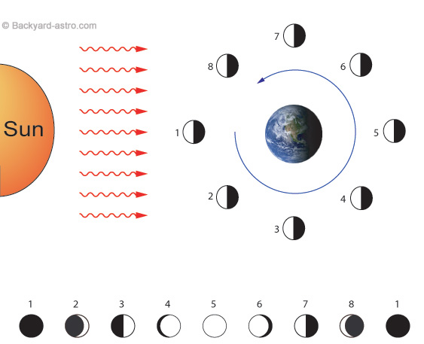
Experts Definition
http://www.backyard-astro.com/blog/index.php/weblog/comments/2006_02_201/
Notes:
Before coding, experts revealed how they approach the answer; this allowed us to calibrate our understanding around the ‘correct answer’.

Slide 7
Data
Notes:
Patterns in the distribution of participant responses may facilitate future data collection. For example, it may be advantageous to conduct conceptual interviews with participants from specific categories (e.g., waning gibbous, full earth, partially correct, etc.). Since grade level did not appear to be a factor of how students responded, it was decided to ignore grade level and focus on the path students take from novice to expert understanding related to this phenomenon.

Slide 8
Findings
2.2 % of participants answered correctly
5.6 % of participants answered partially correct or better
Waning gibbous was the most common incorrect response (i.e., 18.9%)
Full Earth was the second most common incorrect response (i.e., 15.6%)
Conceptual interviews of samples from specific categories may reveal initial learning progressions

Slide 9
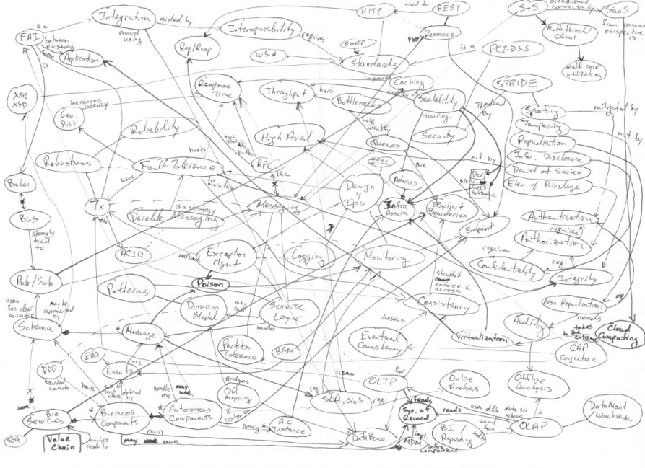
Next steps
Questions
References
American Association for the Advancement of Science
(2001a). Atlas of Science Literacy. Washington, DC:
American Association for the Advancement of Science.
Black, P., Wilson, M., & Yao, S.-Y. (2011). Road Maps for
Learning: A Guide to the Navigation of Learning
Progressions. Measurement, 9(2-3), 71-123.
Committee on Conceptual Framework for the New K-12
Science Education Standards (2011). A Framework for
the New K-12 Science Education Standards.
Washington, DC: National Academy Press.
Duschl, R., Maeng, S., & Sezen, A. (2011). Learning
progressions and teaching sequences: a review and analysis,
Studies in Science Education, 47:2, 123-182
National Research Council (1995). National Science
Education Standards. Washington, DC: National
Academy Press.
http://www.udidahan.com/wp-content/uploads/concept-map.jpg
Notes:
One goal of the research project is to develop learning progressions in Earth & Space Science. The research on learning progressions is presently in the early stages of development.

