Slide 1
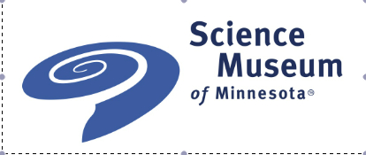


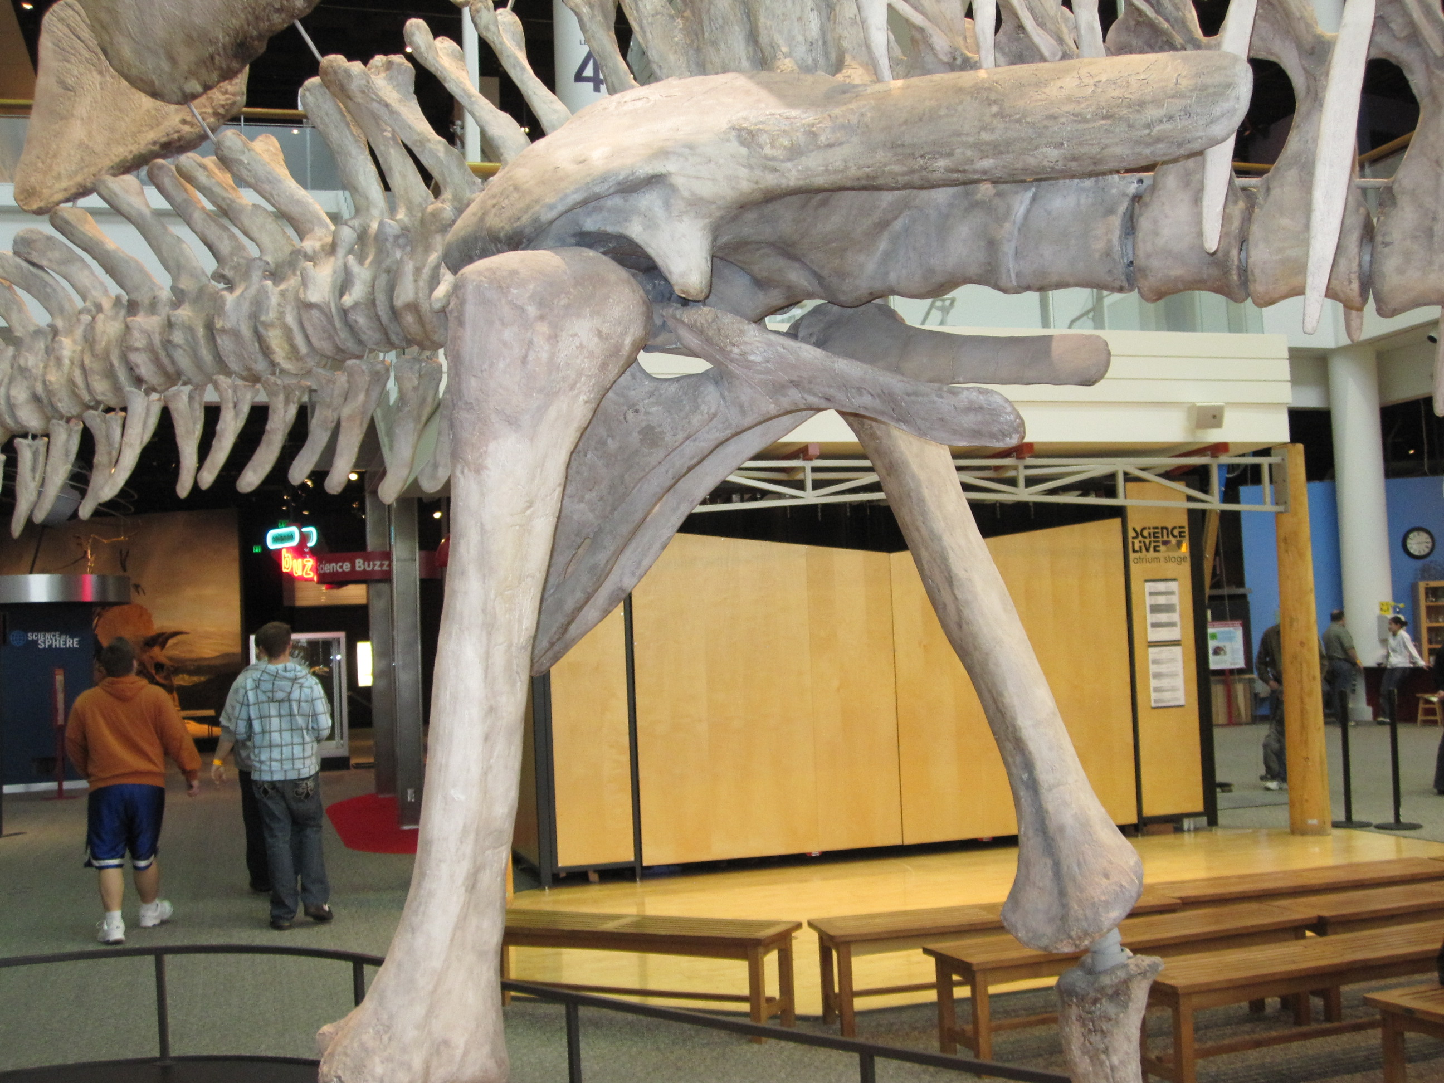
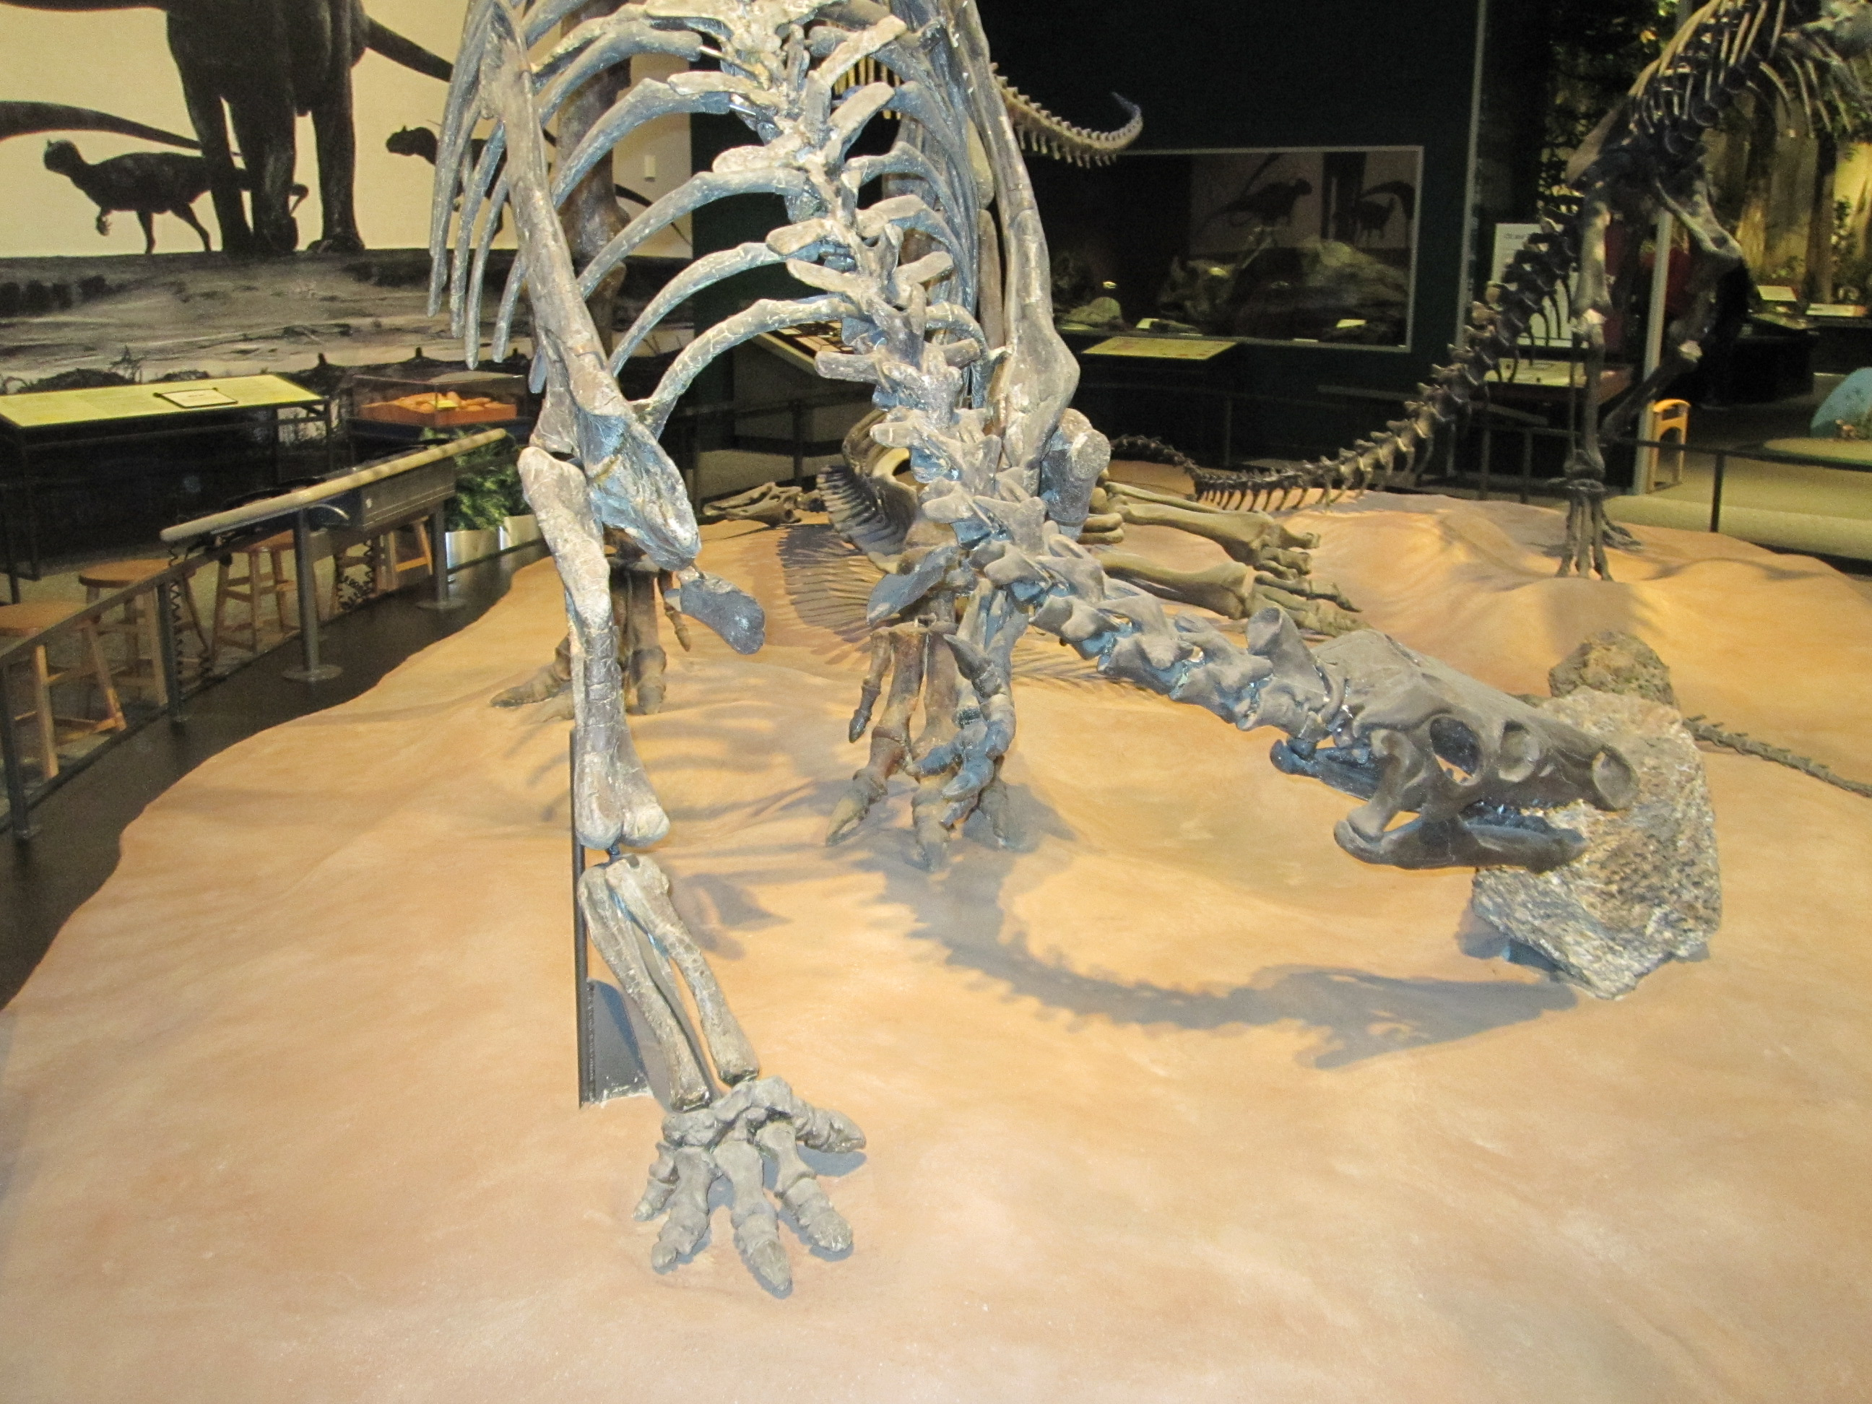
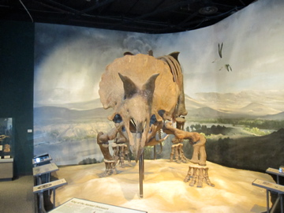
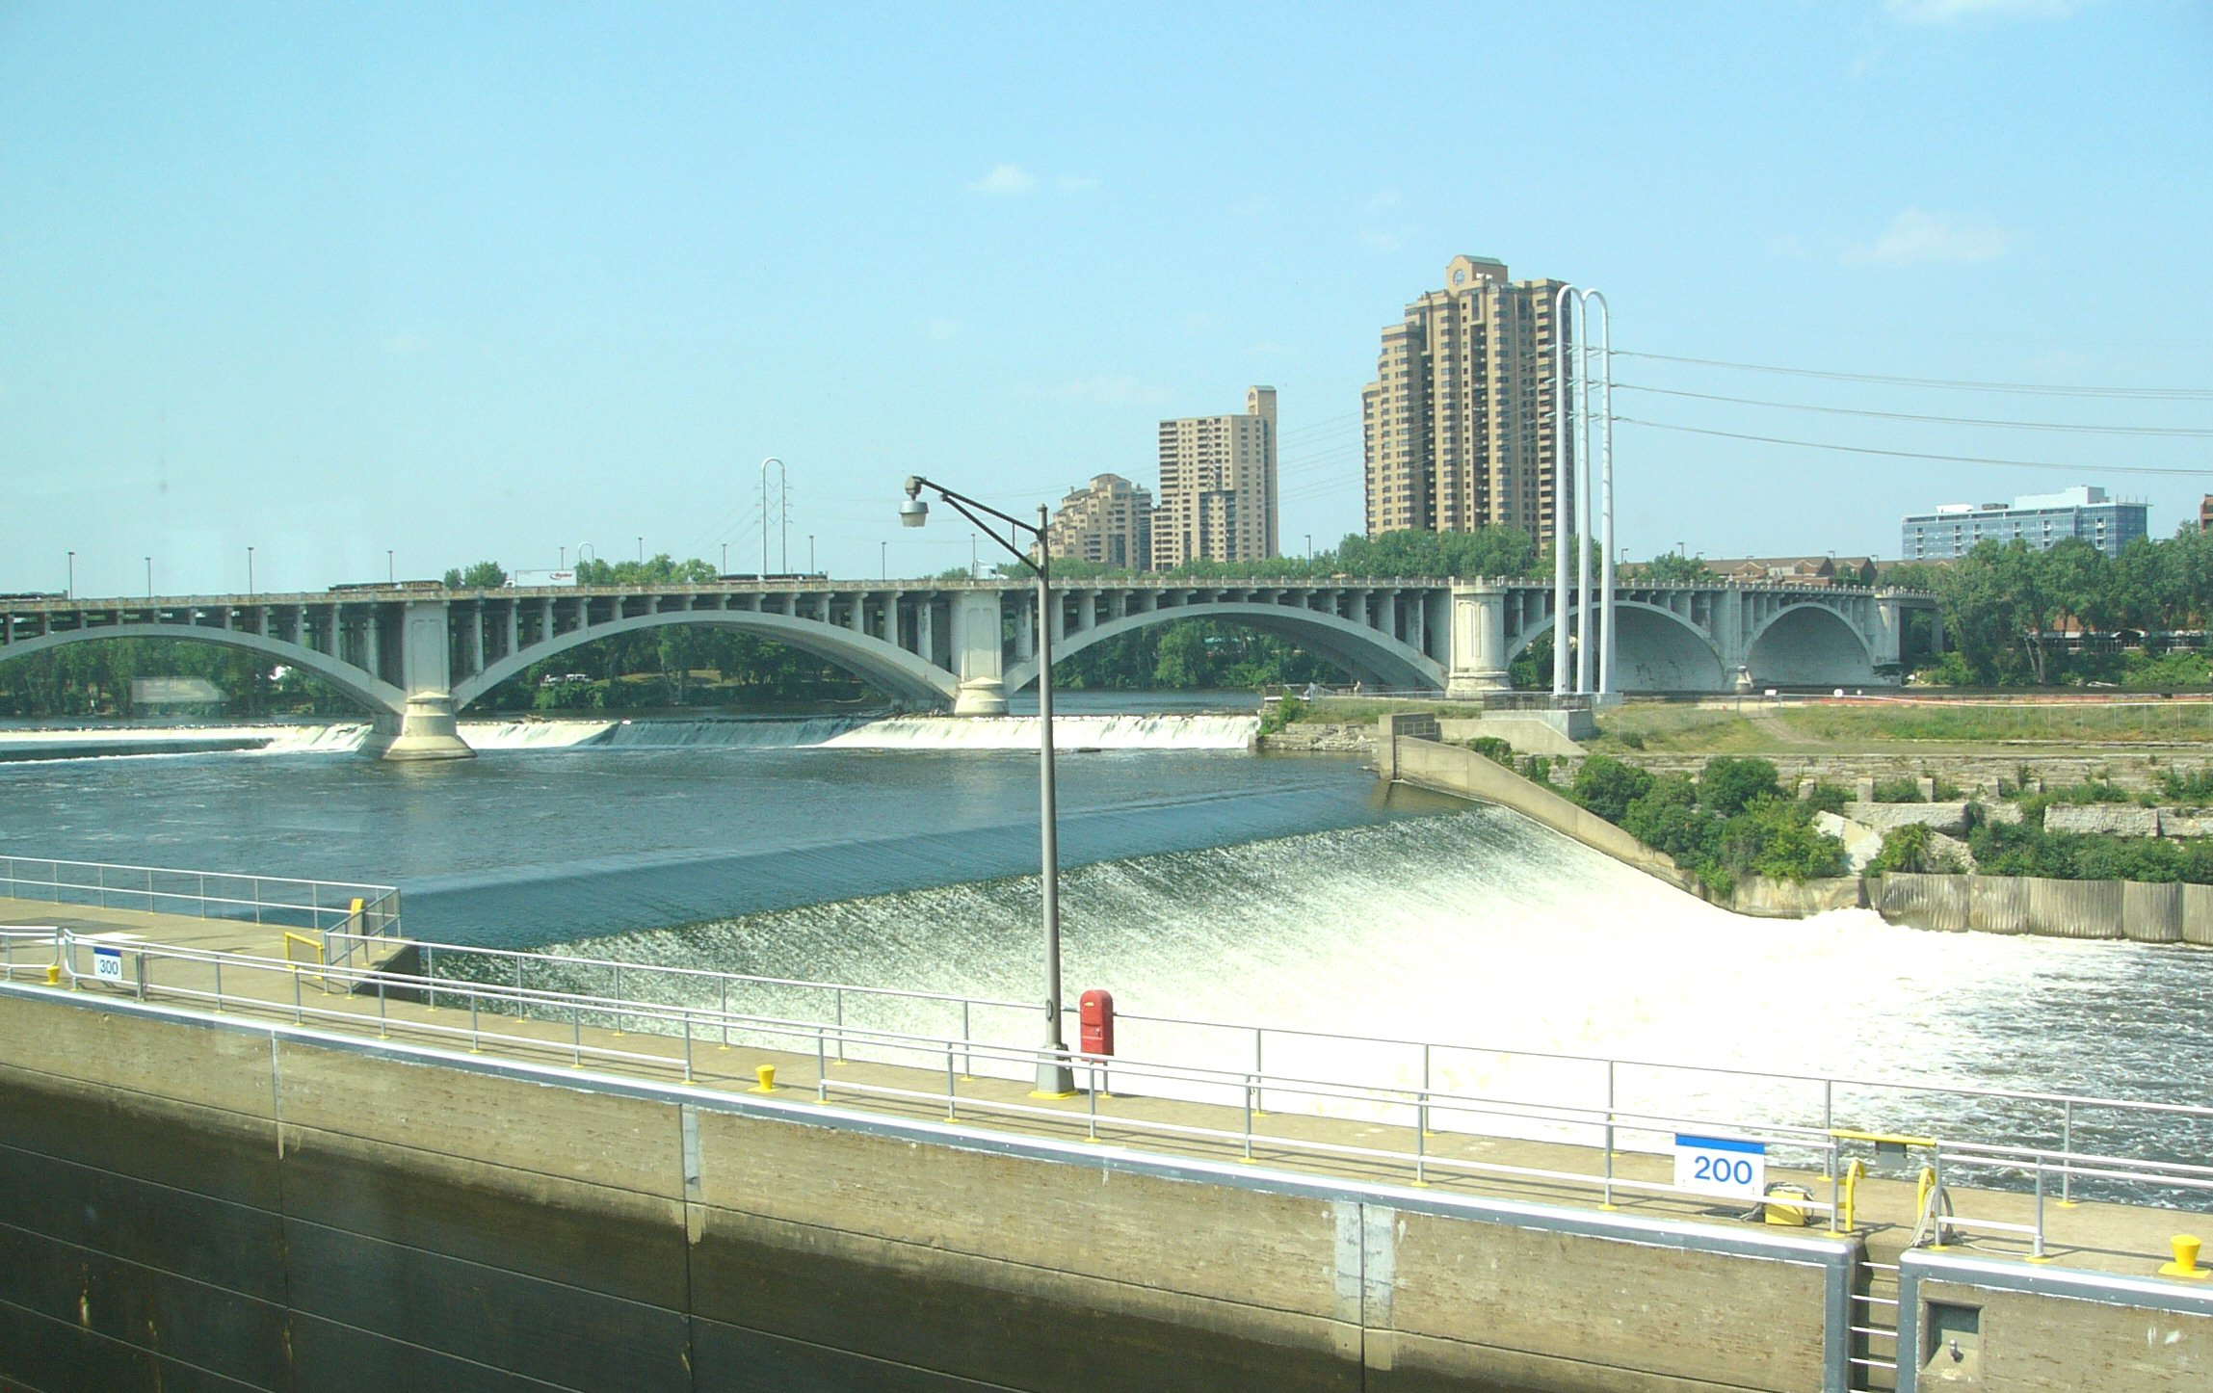
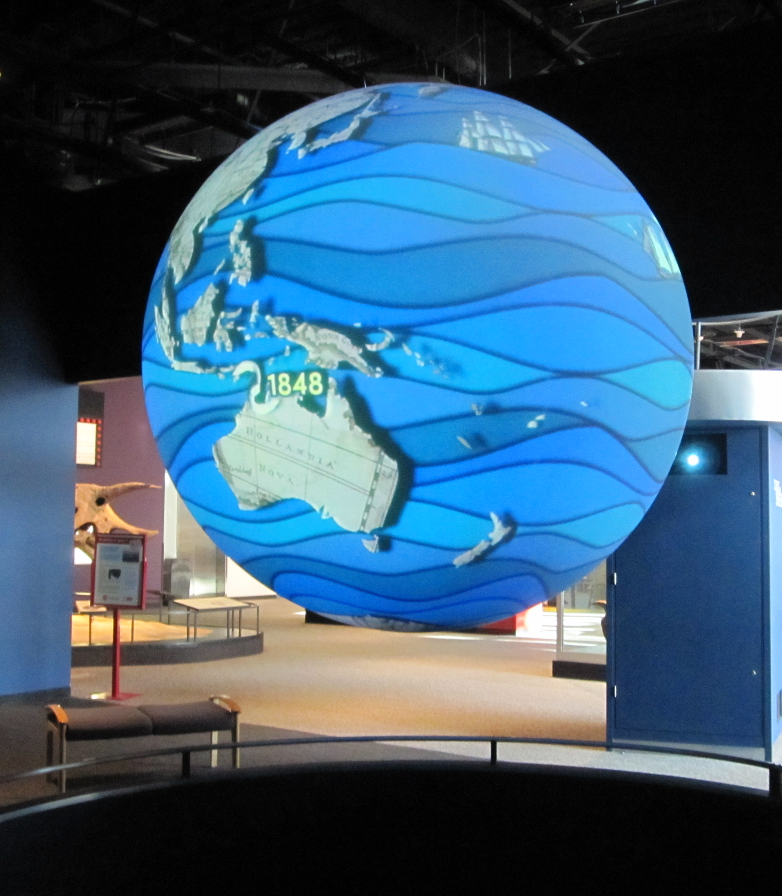
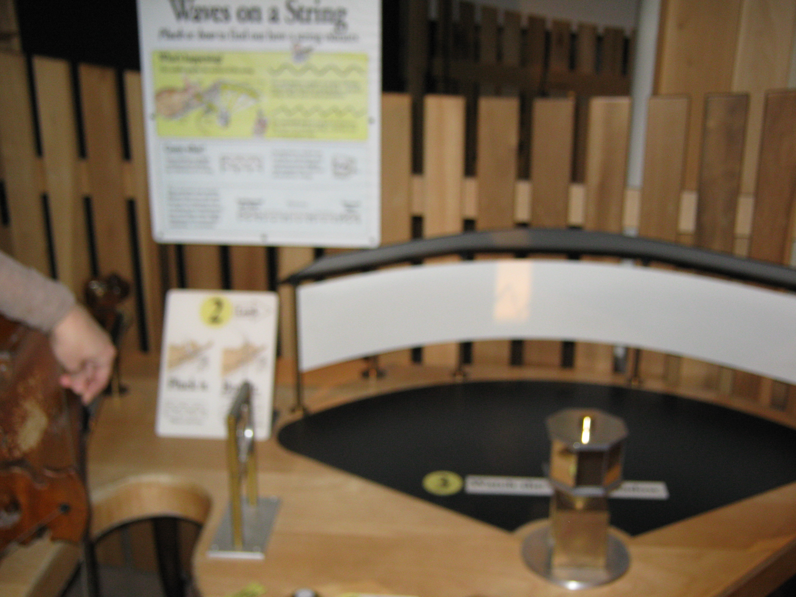
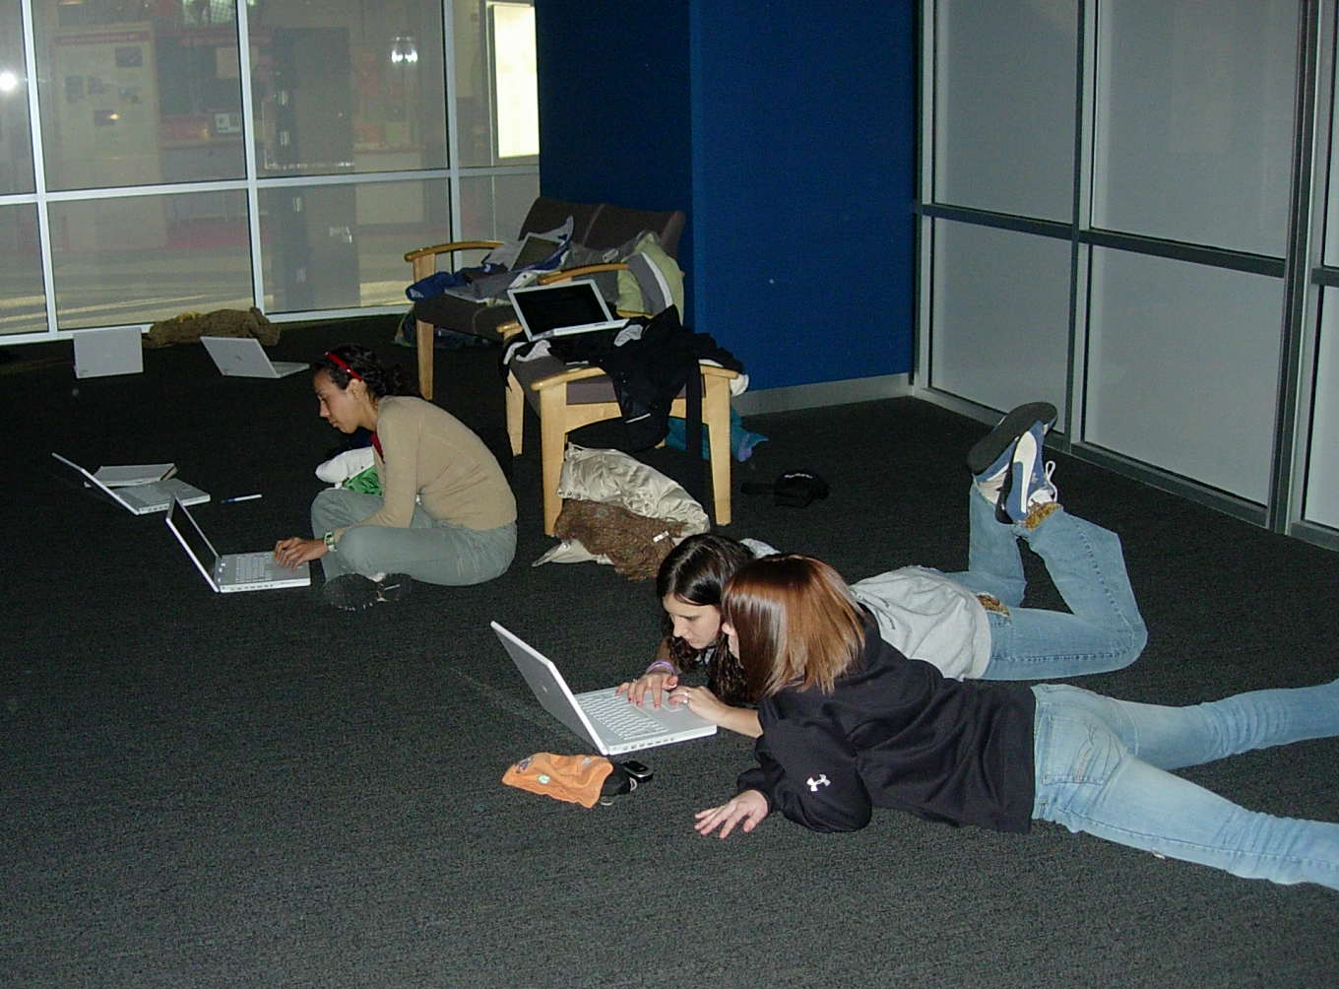
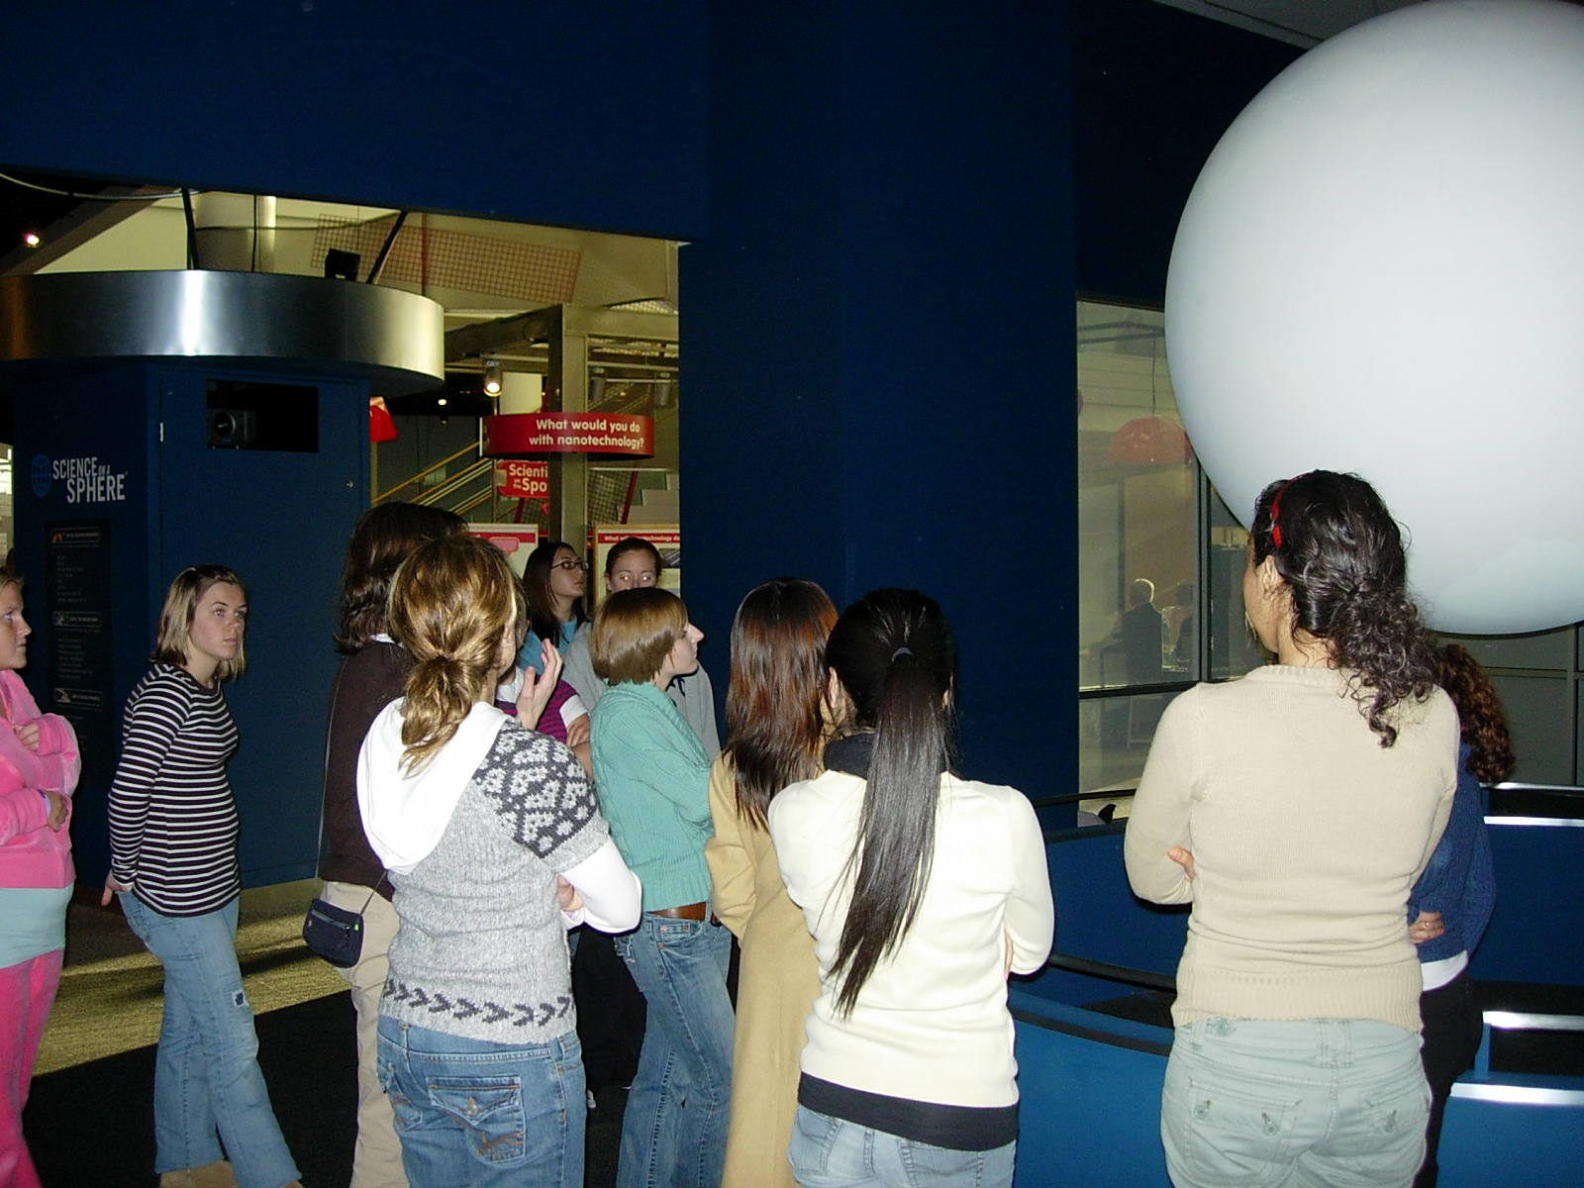
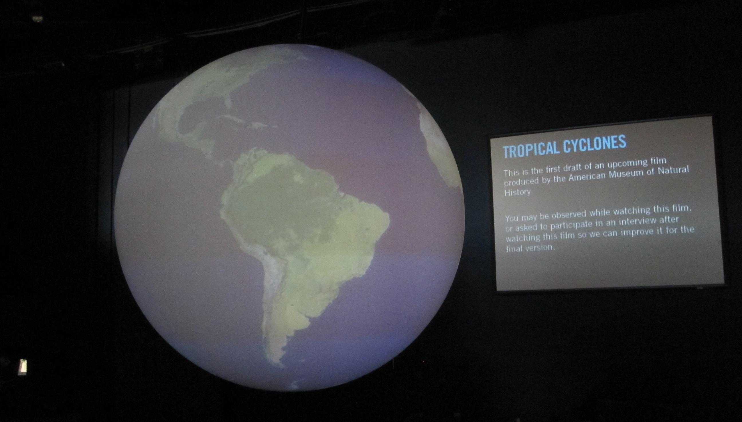
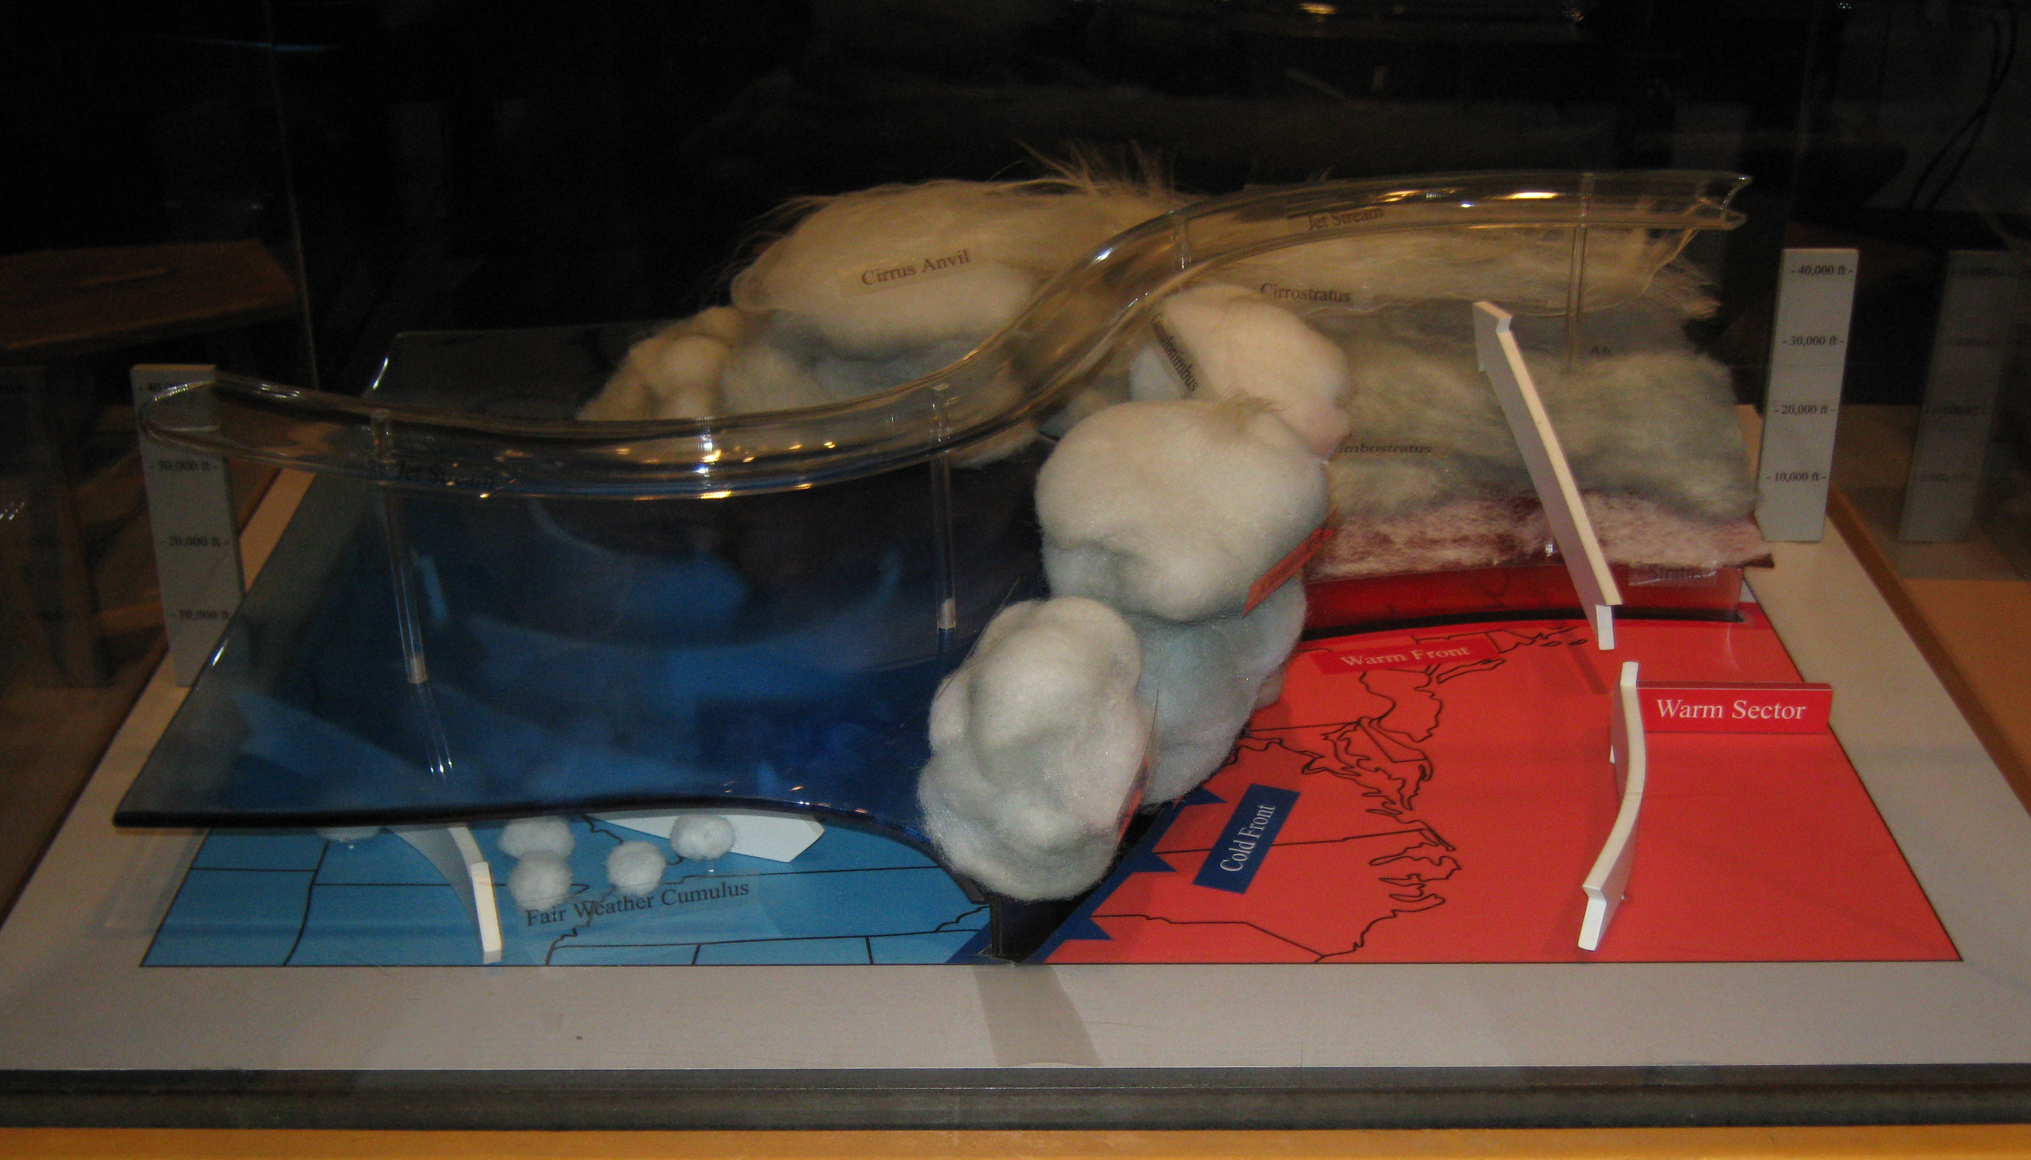
USING MUSEUMS FOR COLLEGE-LEVEL GEOLOGY FIELDTRIPS
Abstract
Molly Phipps, PhD, Senior Evaluation and Research Associate, Department of Evaluation and Research on Learning, Science Museum of Minnesota, 120 West Kellogg Blvd, St. Paul, MN mphipps@smm.org
Kent Kirkby, PhD, Associate Professor, Department of Geology and Geophysics, University of Minnesota, 103 Pillsbury Hall, 310 Pillsbury Dr SE, Minneapolis, MN 55455 Kirkby@umn.edu
Anthony Murphy, PhD, Executive Director, National Center for STEM Elementary Education, St. Catherine University, 2004 Randolph Ave, St. Paul, MN 55105 apmurphy@stkate.edu
Science and natural history museums have a vast array of geologic resources that could be used to augment college-level geoscience courses yet they are often underutilized. Museums often have stunning mineral collections, fossils, and hands-on interactive exhibits that can demonstrate geological principles in a way that traditional labs and field trips cannot. Many museums have extensive collections of weather-related interactives that allow students to experiment with convection, cloud formation, weather fronts, etc. with equipment that would be prohibitively expensive for a geosciences department to maintain. A growing group of museums have Science on a Sphere units (large spherical display systems) that display global data that can be used to make global processes more understandable. Many museums have extensive fossil collections that can be used to better understand morphology and evolutionary processes. With all these great resources that are designed to be easy to understand and easy to use, why aren’t more geoscience instructors using museums?
Paradoxically, the answer is related to why most people like museums: they’re designed to simplify concepts and make them easy to understand. So, without some sort of mediation by a professor, museums just are not intellectually challenging enough to justify college-level learning. We will share two different models for using The Science Museum of Minnesota for college-level learning. Dr. Murphy, who teaches at a small liberal-arts college, accompanies his students to the museum and guides them through complex visualizations on the Museum’s Science on a Sphere. Dr. Kirkby, who teaches at a large land-grant university, developed a self-guided field trip that takes advantage of the museum’s extensive Cretaceous fossil collection. Dr. Phipps works at the museum and has been working to increase the connections between colleges and the museum by evaluating the college student visits and working to make the museum more accessible to both instructor lead and self-guided college student field trips.
Self-Guided Fieldtrips
Student Outcomes
University of Minnesota
Large-lecture format course for non-majors
Focuses on comparative anatomy
Dinosaurs and other vertebrate fossils Currently extra credit Connections between form and function Students come to the museum on their own Background module and lab guide
I went with my friend who is still commenting on what a great tour guide I was and is amazed at the type of information I was able to explain. I am confident that…I will be able to use that "self-guided tour" for many years to come as I am positive I will be taking my future classroom students on field trips to the Science Museum.
Self-guided fieldtrips
Students found the experience helpful and enjoyable
Students came to the museum with friends and family
Women, minority students, and struggling students participated in greater number
Students performed better on post-test than those who did not participate
Instructor-led fieldtrips
Works best with instructor as guide instead of lecturer
Helps students see the earth as one system
Gives a global perspective
Museums and Higher Education
New college student fieldtrip rate (same as K-12 fieldtrips)
Encouraging professors to use the museum for learning
New audience
Topic | Mode of Coverage |  | Pre-quiz |  | Post-quiz |  | Change
 | Lecture | Lecture & Museum | MM | LO | MM | LO | MM | LO
Range of dinosaur size | X |  | 35% | 37% | 51% | 62% | 16% | 25%
Why were some dinosaurs so large? |  | X | 13% | 31% | 86% | 91% | 73% | 60%
Leg design |  | X | 29% | 42% | 75% | 53% | 46% | 11%
Function of heat-shedding features |  | X | 17% | 30% | 99% | 90% | 82% | 60%
Vertebrae design – weight carrying | X |  | 39% | 39% | 41% | 60% | 2% | 21%
Vertebrae design – larger guts |  | X | 9% | 6% | 52% | 18% | 43% | 12%
Benefits of bipedal stance | X |  | 37% | 29% | 49% | 60% | 12% | 31%
Overall | X |  | 37% | 35% | 47% | 61% | 10% | 26%
Overall |  | X | 17% | 27% | 78% | 63% | 61% | 36%
That trip to the science museum was hands-down the BEST museum visit I have experienced (although the Vatican was pretty interesting…).
Setting
Science Museum of Minnesota
Combined natural history and hands on science museum
Extensive fossil collection
Science on a Sphere
Hands on manipulatives
Instructor-Led Fieldtrips
Saint Catherine University
Small Liberal-Arts University
Environmental Biology course for STEM Education majors
Completes Climate Change Module
Focus on global systems
Students use MacBooks to complete lab
SOS is the backdrop for a systems perspective. Instructor does minimal instruction, more of a facilitation
Lab sheet has a sequence of visualizations, questions and websites for the students to visit
Instructors interpret visualizations for a basic understanding
Students work in pairs to complete the lab sheet
Value of Fieldtrip
Future Directions
“My goodness, how much fuel is used in this everyday.” “Seeing the waves between US and Europe was cool.” “The large amounts of planes cause large number of GHG emissions.”
Developing further self-guided fieldtrips including outdoor and museum-based trips.
Working to make the self-guided fieldtrip accessible and usable for other college and university instructors throughout the area.
Spread the word about the fieldtrip rate to other professor
Working with preservice teachers at the museum
Use tablet computers at the museum to show them how to lead interactive fieldtrips
Perceived Value of Films
“You get to see both sides of the earth.”
“Cool way of seeing the seasons……impact on the environment.”

