Slide 1
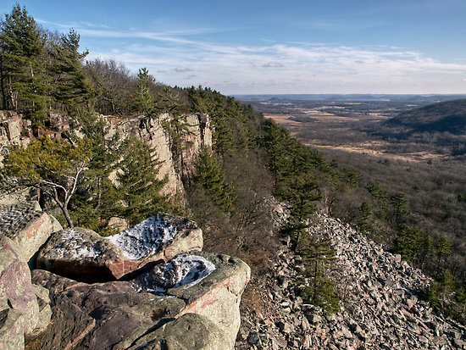
Enhancing the Deglaciation Chronology of Wisconsin using in-situ Cosmogenic Radionuclide
David J. Ullman¹, Anders E. Carlson¹,
Kent M. Syverson², Marc W. Caffee³
¹University of Wisconsin-Madison
²University of Wisconsin-Eau Claire
³Purdue University

Slide 2
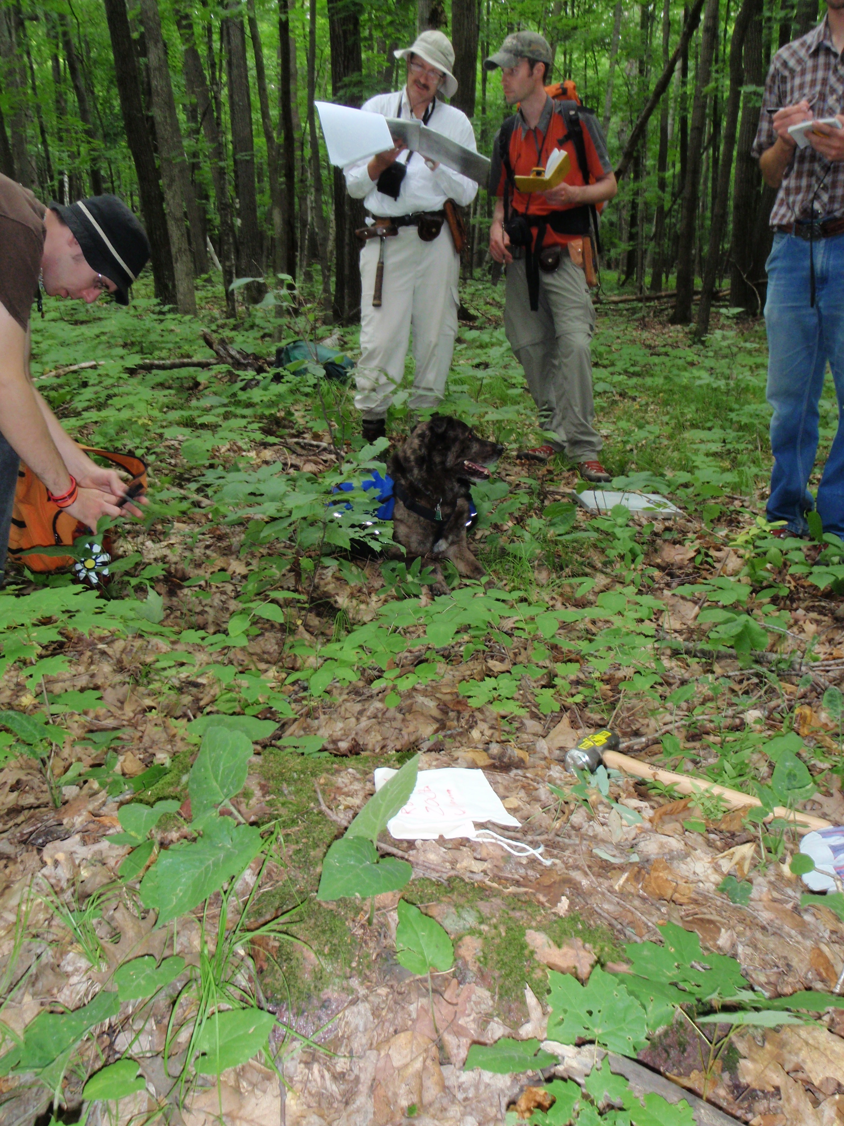
Outline
Existing southern Laurentide chronology
New retreat chronology in WI using in-situ cosmogenic nuclides
Implied retreat mechanisms
Notes:
Why is the southern Laurentide Ice sheet interesting????

Slide 3
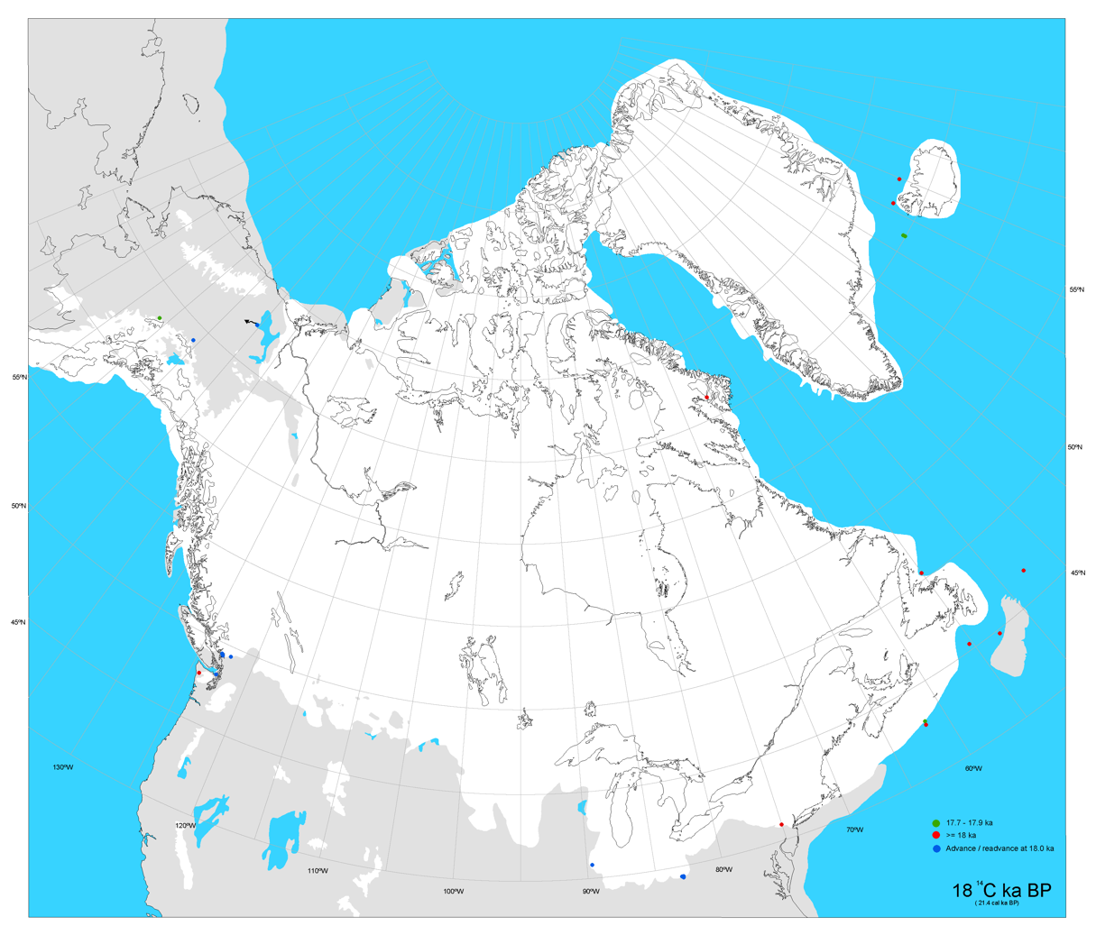
The Southern Laurentide

Slide 4

The Southern Laurentide

Slide 5
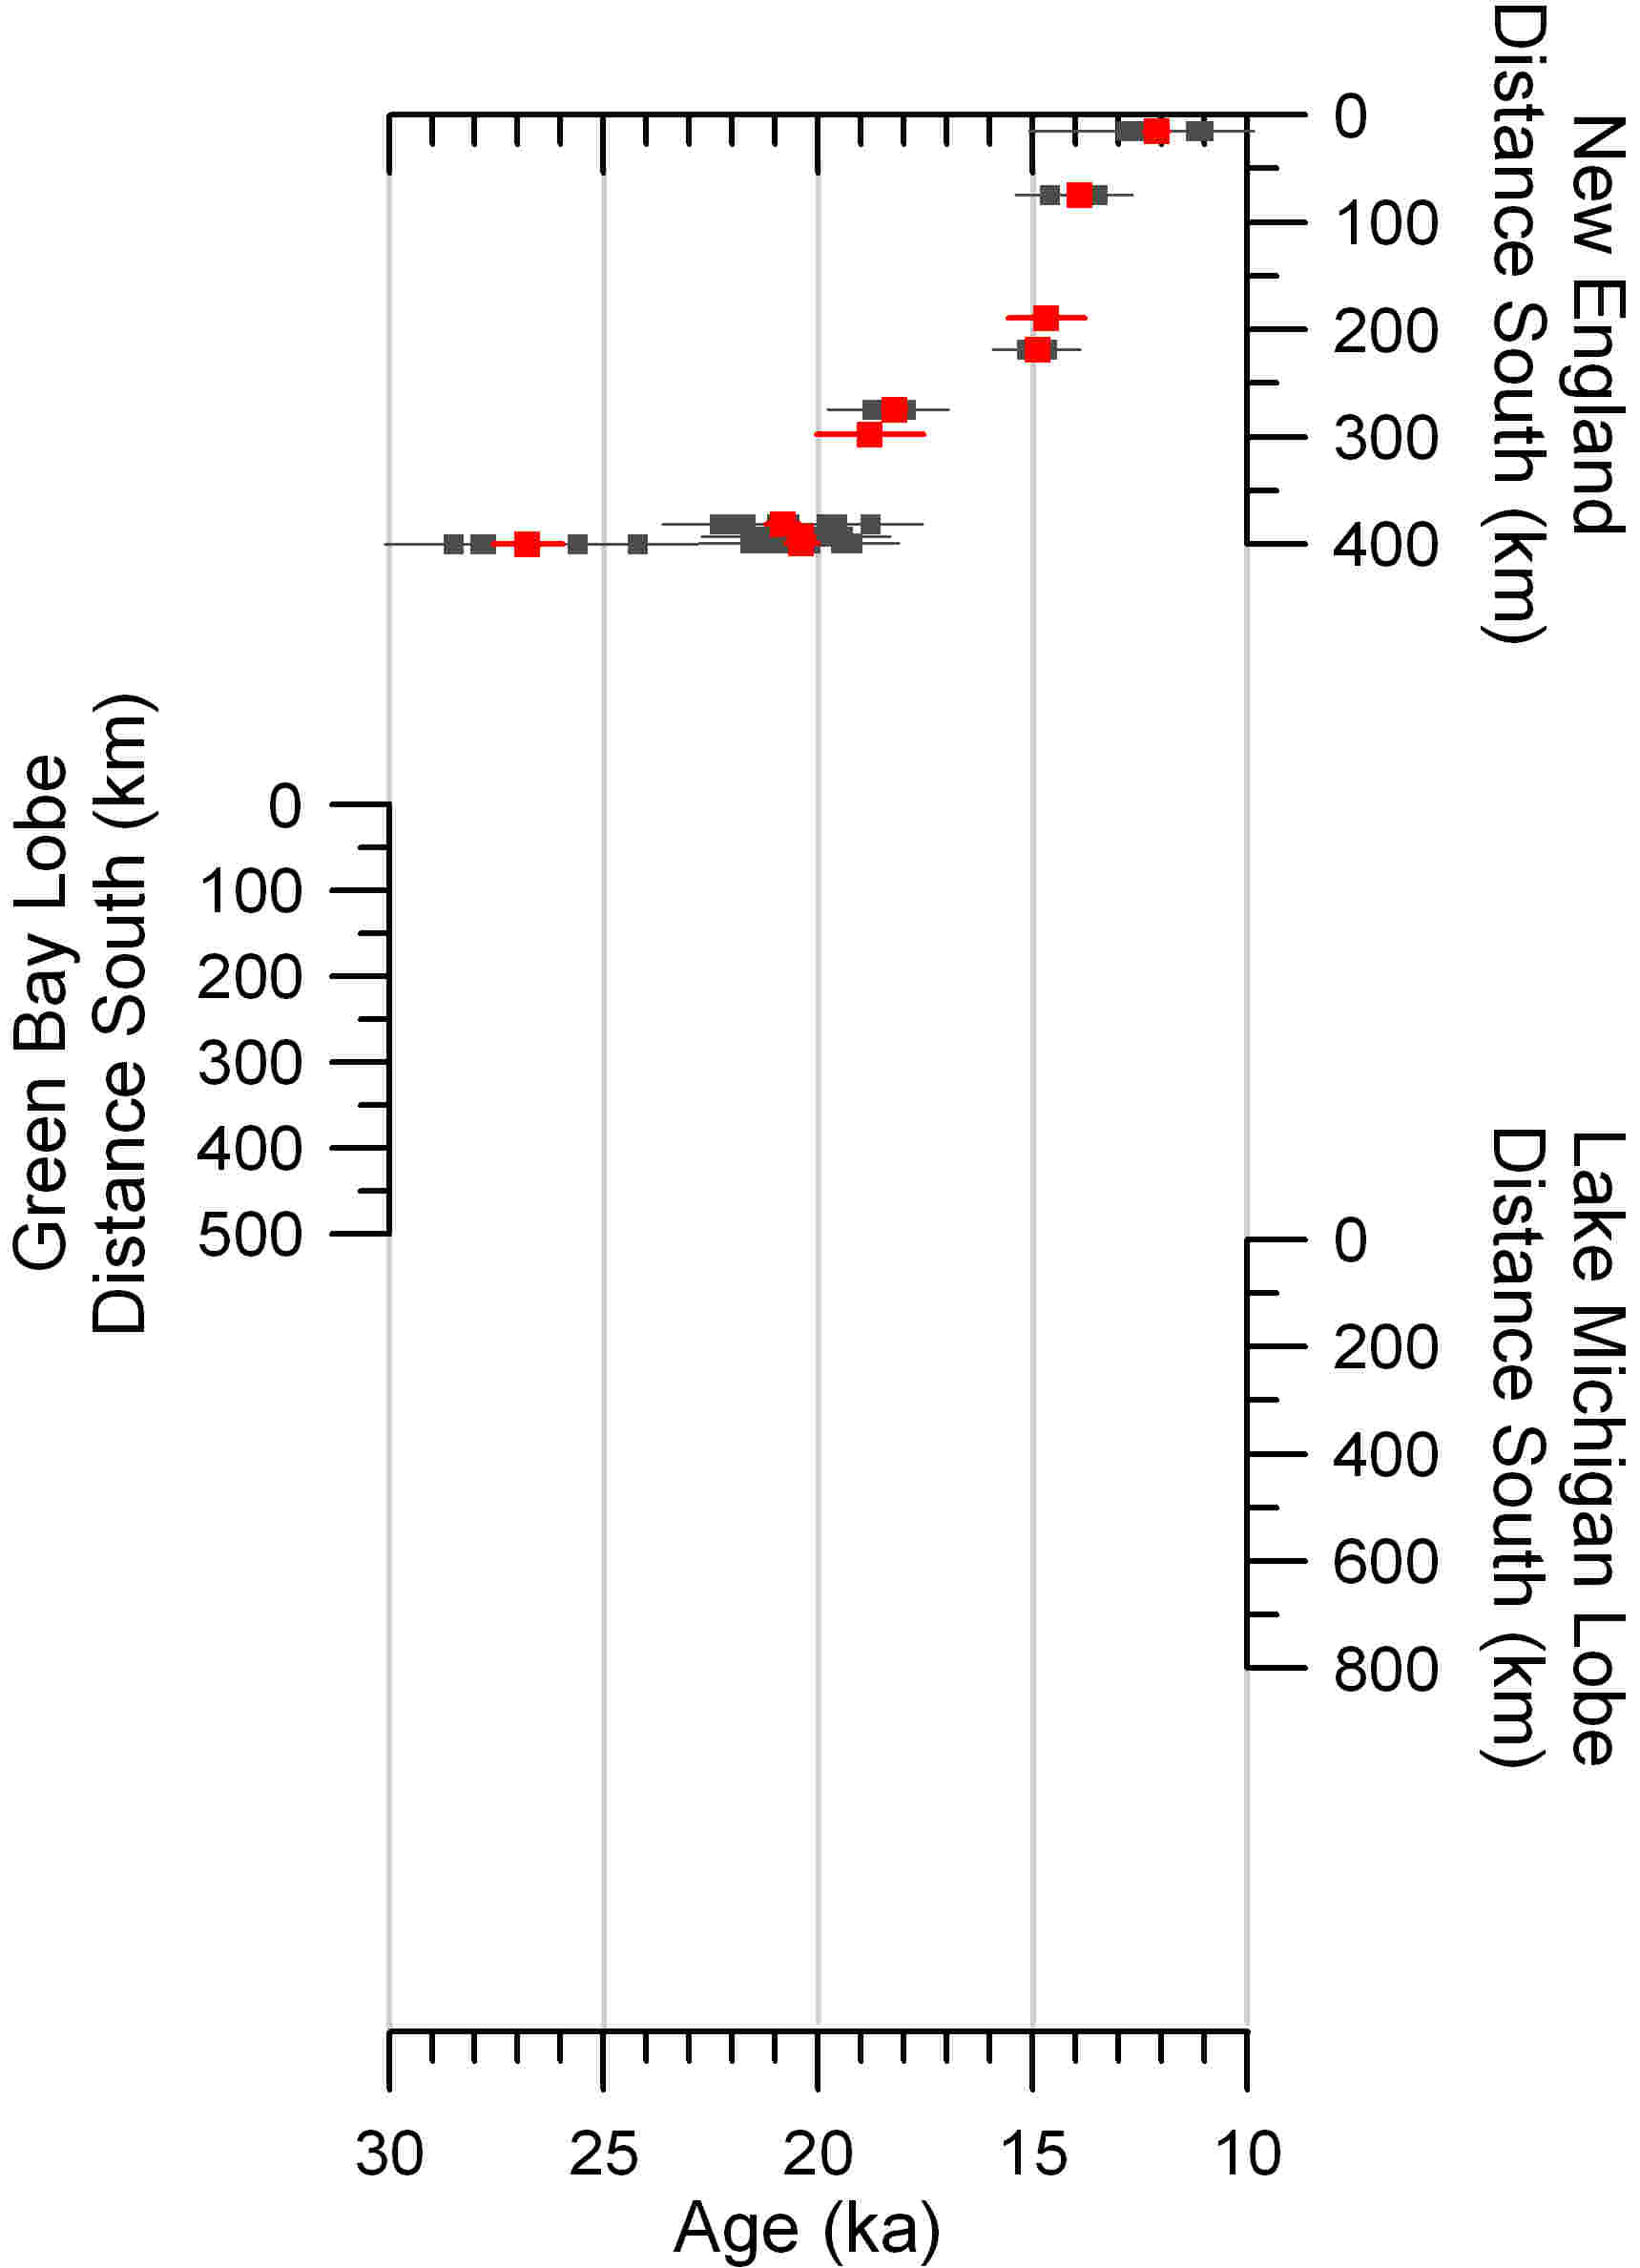
Existing Chronology
New England Exposure Dates
  ~27 ka or ~21 ka
Balco et al., 2009
Notes:
Much of Dave’s career has centered on characterizing the nature and chronology of the Laurentide along this southern margin.

Slide 6
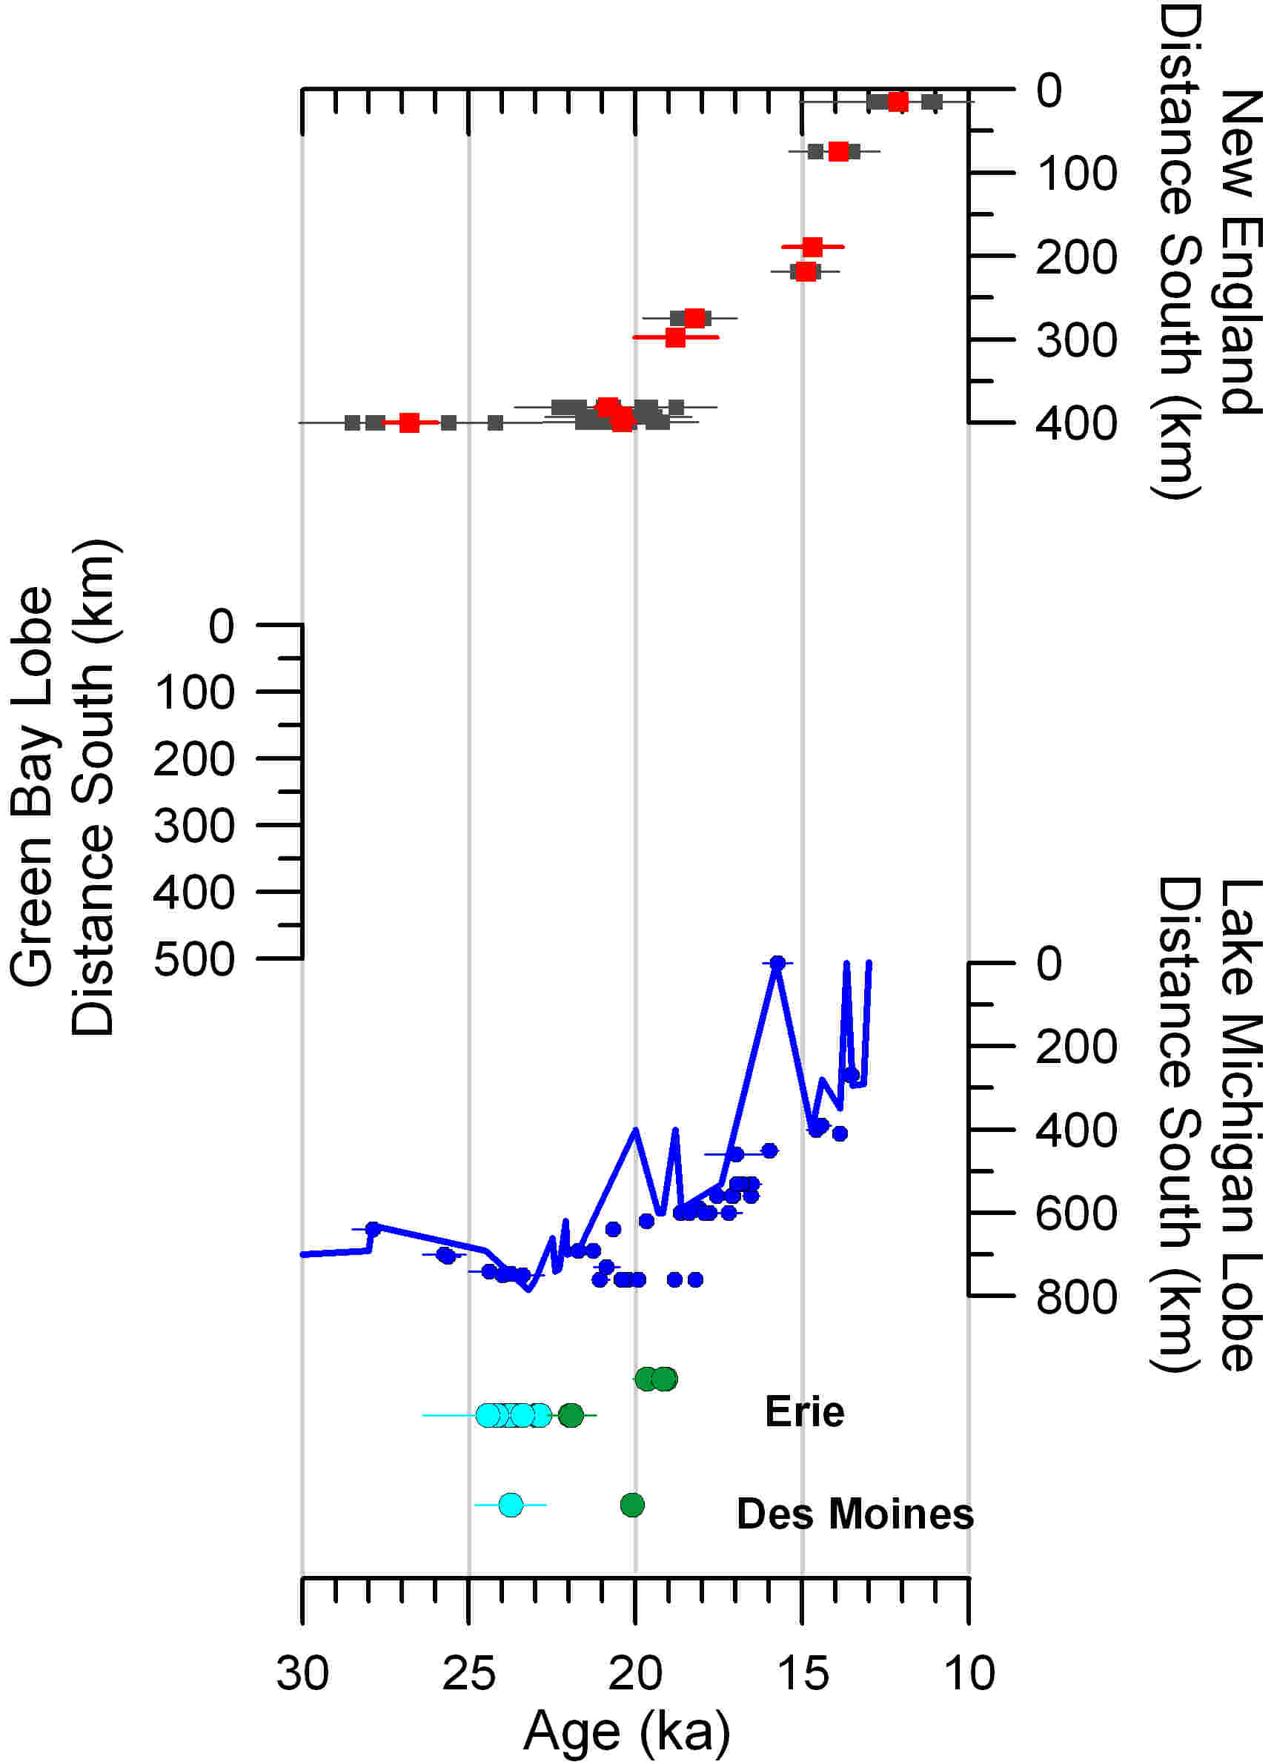
Existing Chronology
New England Exposure Dates
  ~27 ka or ~21 ka
Ice retreat from IA, IL, IN, OH
  ~23 ka
Balco et al., 2009; Hansel and Johnson, 1992; Patterson et al., 2003, Curry et al., 2011; Lowell, 1995; Clark et al., 2009
Notes:
Much of Dave’s career has centered on characterizing the nature and chronology of the Laurentide along this southern margin.

Slide 7
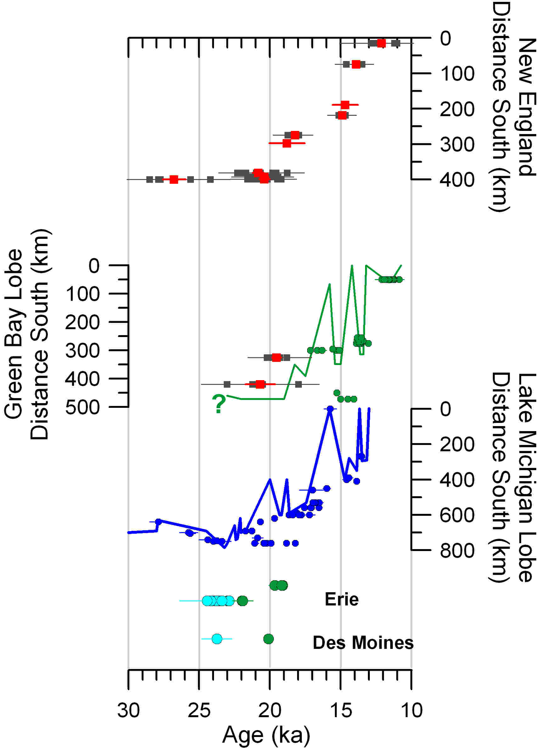
Existing Chronology
New England Exposure Dates
  ~27 ka or ~21 ka
Ice retreat from IA, IL, IN, OH
  ~23 ka
Green Bay Lobe
  Before 17-15 ka?
Balco et al., 2009; Hansel and Johnson, 1992; Patterson et al., 2003, Curry et al., 2011; Lowell, 1995; Clark et al., 2009; Maher and Mickelson, 1996; Maher et al., 1998; Colgan et al., 2002
Notes:
Much of Dave’s career has centered on characterizing the nature and chronology of the Laurentide along this southern margin.

Slide 8
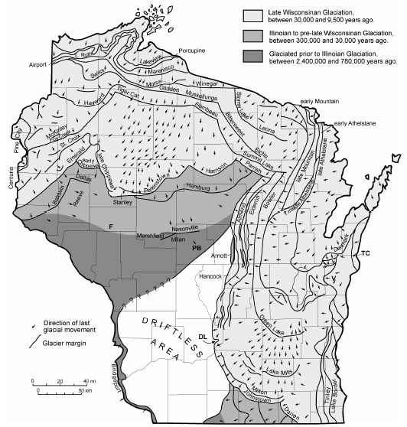
Existing WI Chronology
Valders Till
  ~15.6 ka (13.0 ¹⁴C ka)
Two Creeks
  ~13.7 ka (12.1 – 11.8 ¹⁴C ka)
Initial retreat in WI
  Before 17-15 ka
TC
V
DL
Maher et al., 1998; Maher and Mickelson, 1996;
Notes:
Small Ice retreat from Martha’s Vineyard in New England at 27 ka, but major retreat by 21 ka
Some suggest early retreat ~18.7ka (15.5 14C ka) – Clayton et al, 1992; Colgan 1996, 1999
Later retreat ~15.6ka (13.0 14C yr), Maher and Mickelson, 1996
Cosmo dates – BEDROCK DATES, INHERITANCE, Colgan et al, 2002
Valders Member, Kewaunee Formation ~15.6±0.5 ka (leaves below till) – Maher and Mickelson
Two Creeks forest bed ~13.7±0.2 ka (Kaiser, 1994)
Last advance into WI – Lakeview Phase, 11.1-11.7 ka

Slide 9
Existing WI Chronology
Valders Till
  ~15.6 ka (13.0 ¹⁴C ka)
Two Creeks
  ~13.7 ka (12.1 – 11.8 ¹⁴C ka)
Initial retreat in WI
  Before 17-15 ka
Bedrock ¹⁰Be dates
  Before ~20 ka
TC
V
DL
Maher et al., 1998; Maher and Mickelson, 1996; Colgan et al., 2002
Notes:
Small Ice retreat from Martha’s Vineyard in New England at 27 ka, but major retreat by 21 ka
Some suggest early retreat ~18.7ka (15.5 14C ka) – Clayton et al, 1992; Colgan 1996, 1999
Later retreat ~15.6ka (13.0 14C yr), Maher and Mickelson, 1996
Cosmo dates – BEDROCK DATES, INHERITANCE, Colgan et al, 2002
Valders Member, Kewaunee Formation ~15.6±0.5 ka (leaves below till) – Maher and Mickelson
Two Creeks forest bed ~13.7±0.2 ka (Kaiser, 1994)
Last advance into WI – Lakeview Phase, 11.1-11.7 ka

Slide 10
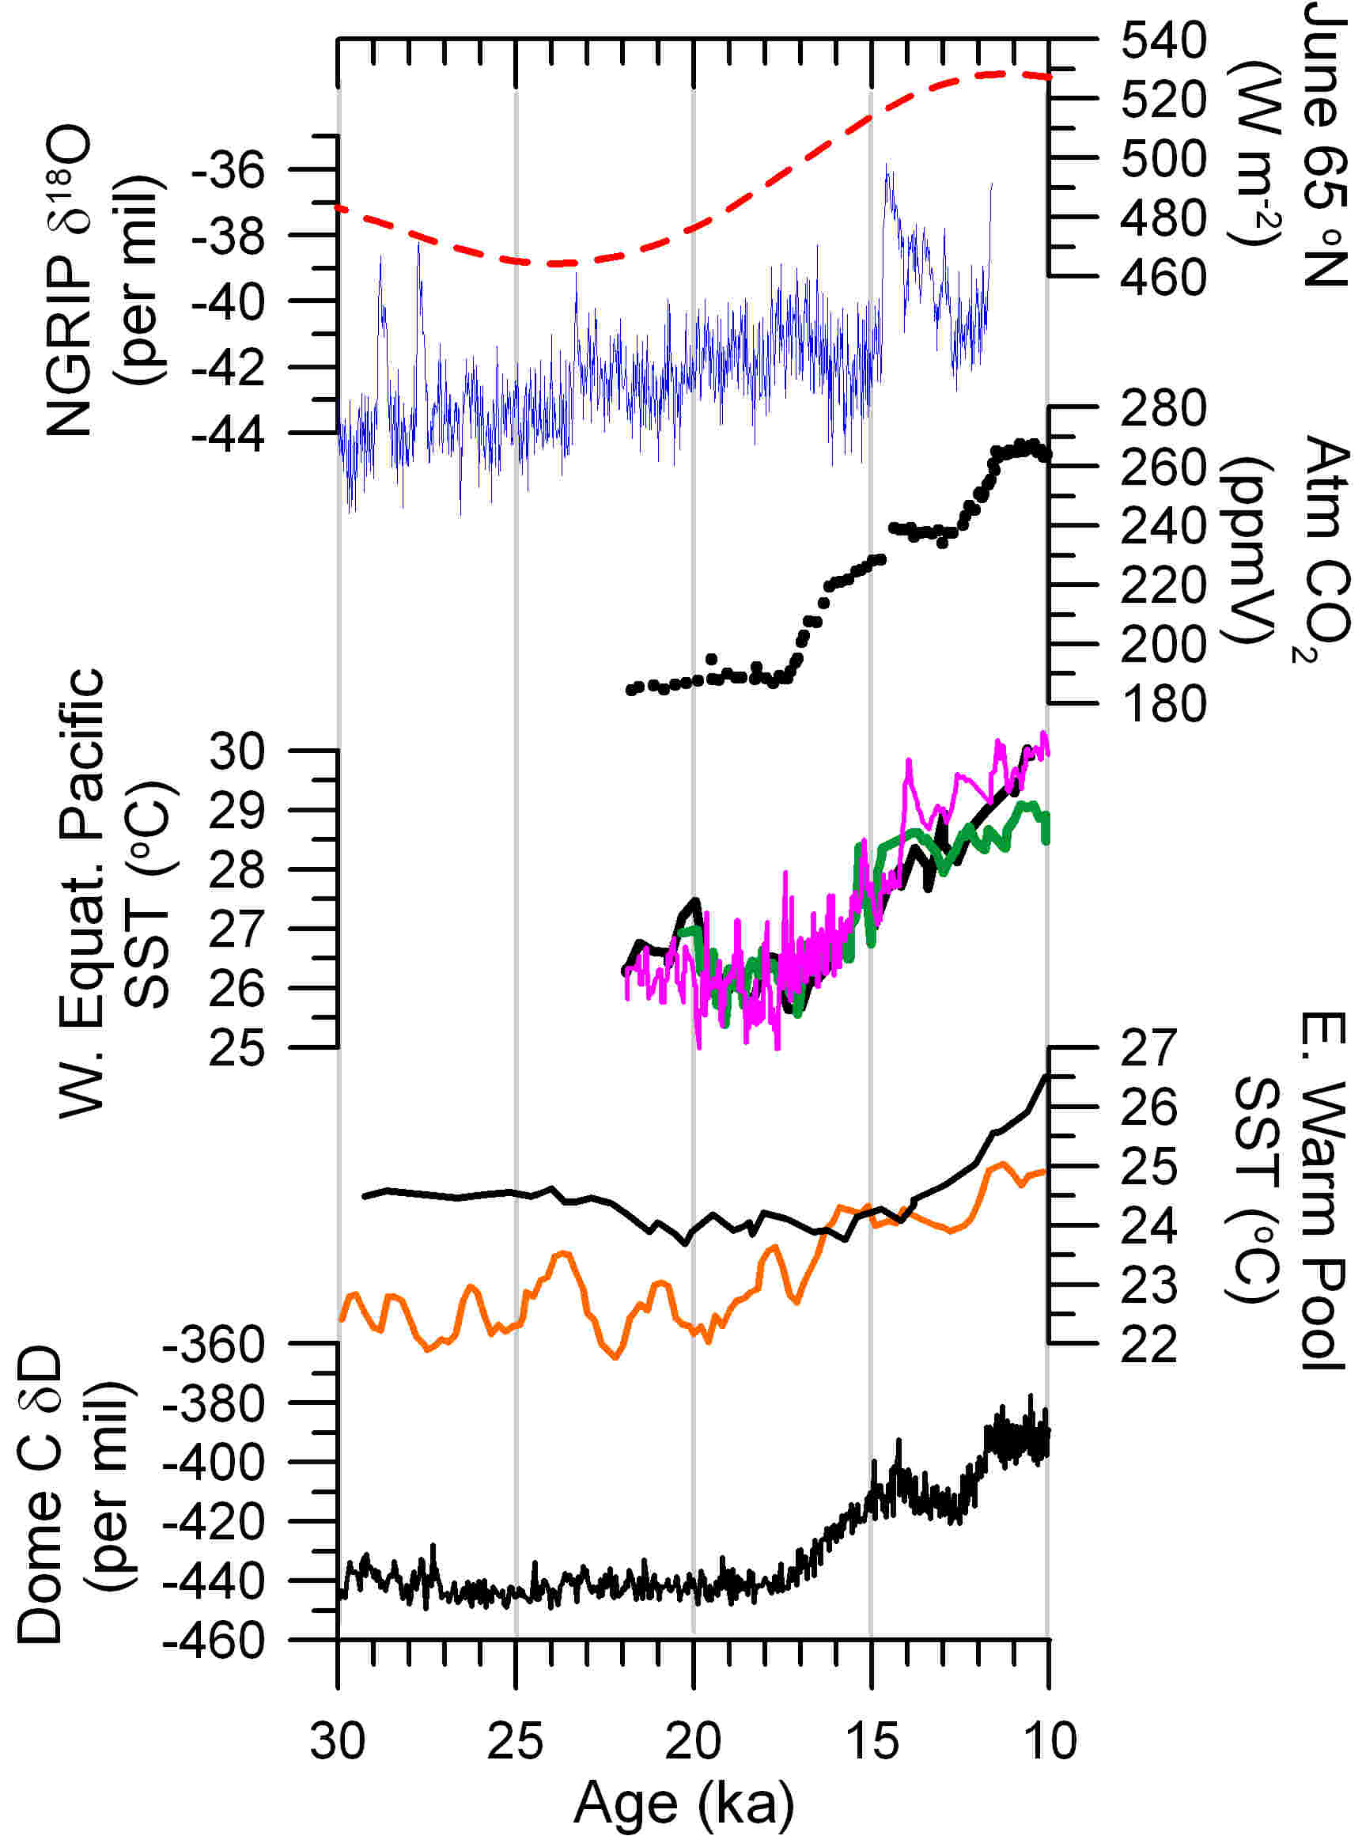
Climate Controls
Previous chronology of initial retreat in WI
  early – before 20 ka?
  late – 17-15 ka?
Laskar et al., 2004; Lemieux-Dudon et al., 2010; Svensson et al., 2008; Lea et al., 2006; Klinkhammer et al., 2009; Stott et al., 2007; Jouzel et al., 2007

Slide 11
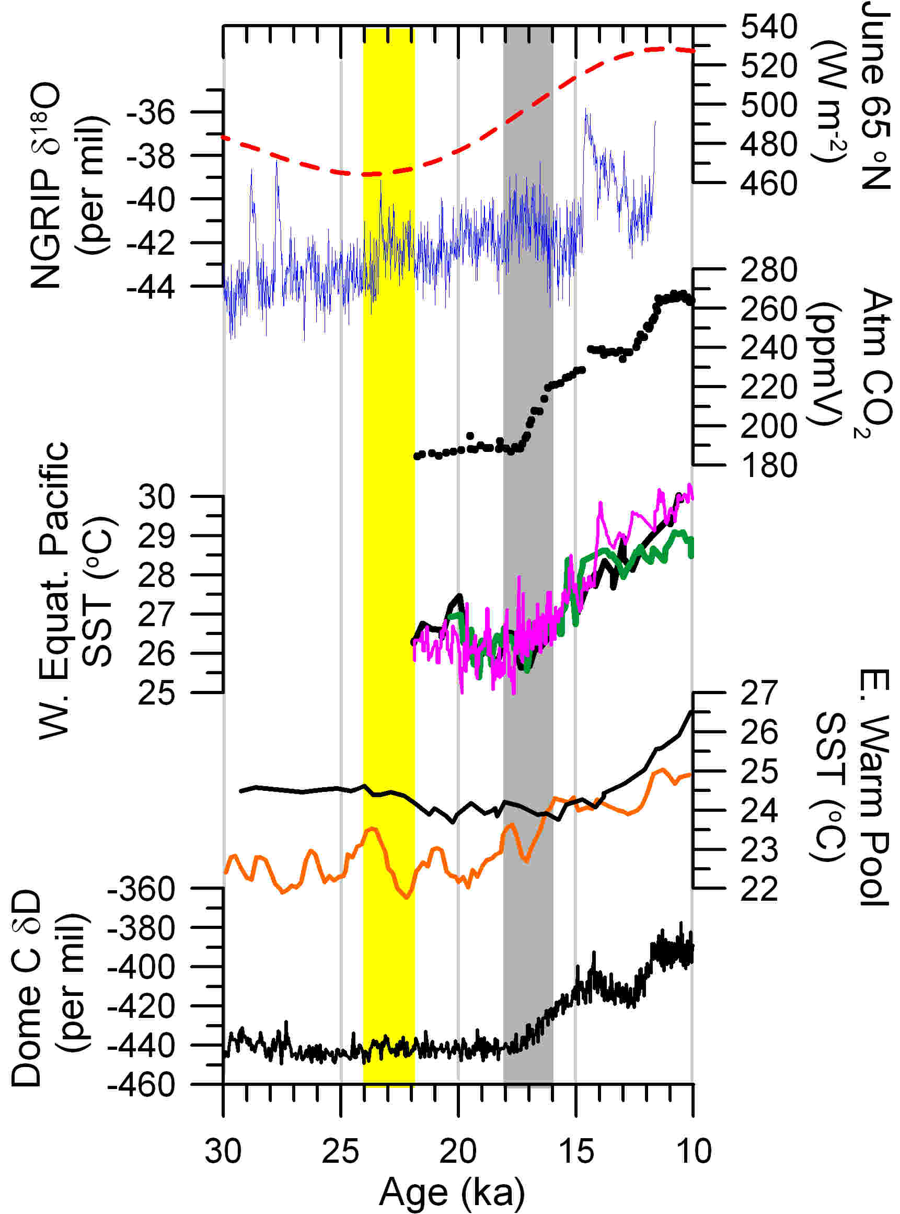
Climate Controls
Previous chronology of initial retreat in WI
  early – before 20 ka?
  late – 17-15 ka?
Hypothetical Forcings
  Boreal Summer Insolation (~23 ka)
  Tropical warming (~17 ka)
  CO₂ rise (~17 ka)
  Southern Hemisphere warmth (~19 ka)
Laskar et al., 2004; Lemieux-Dudon et al., 2010; Svensson et al., 2008; Lea et al., 2006; Klinkhammer et al., 2009; Stott et al., 2007; Jouzel et al., 2007

Slide 12
Developing a New Chronology

Slide 13
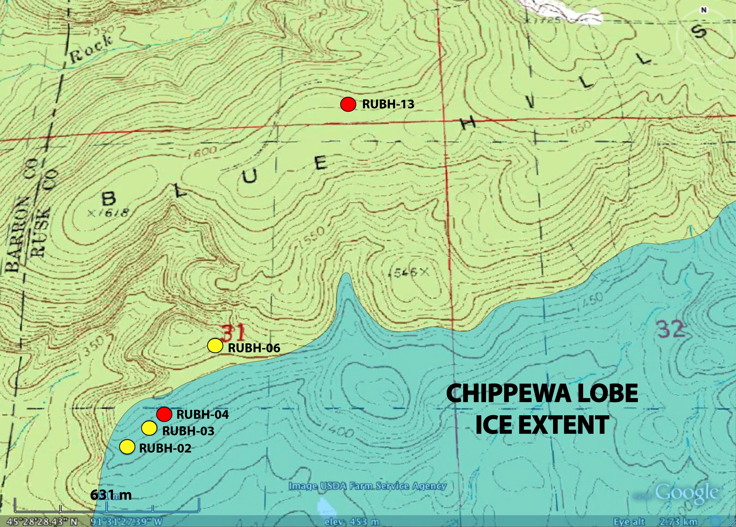
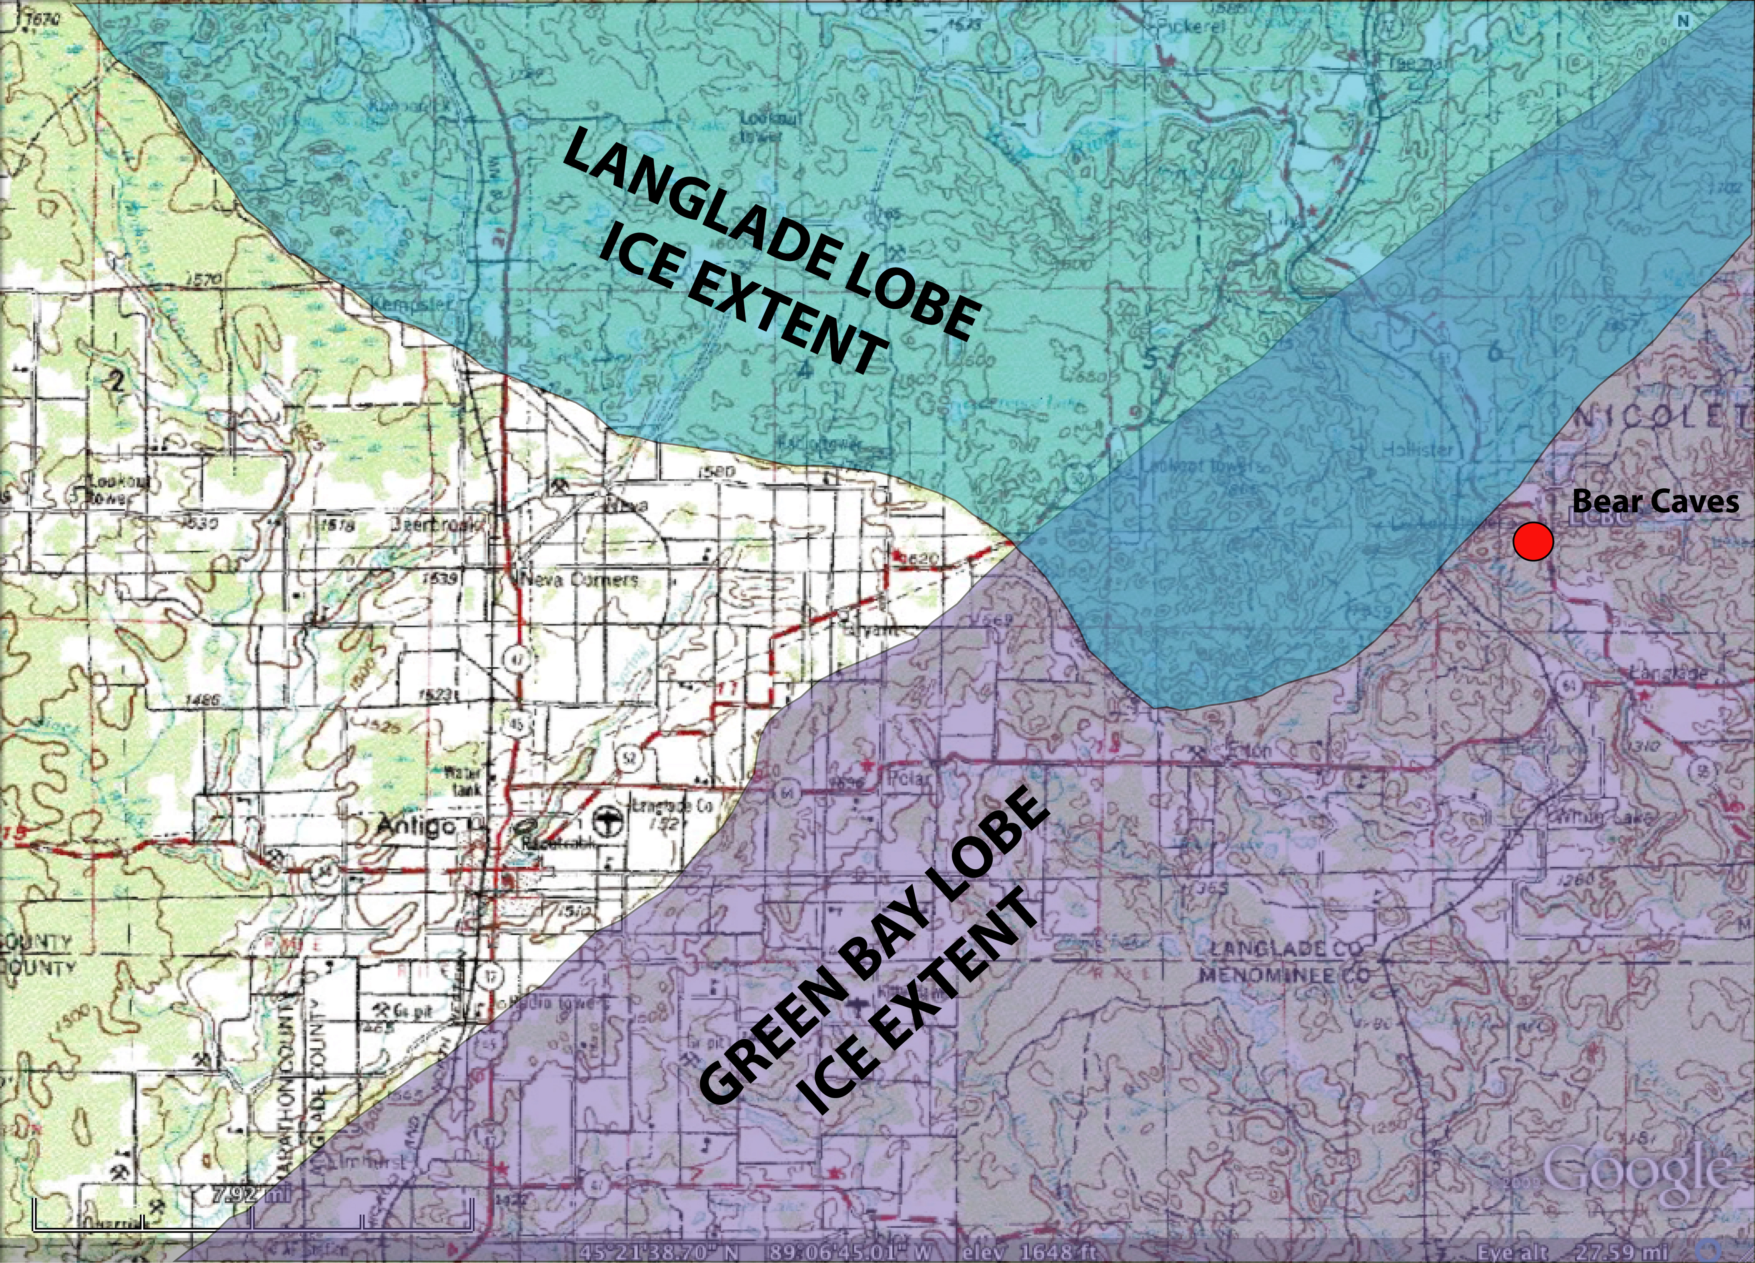
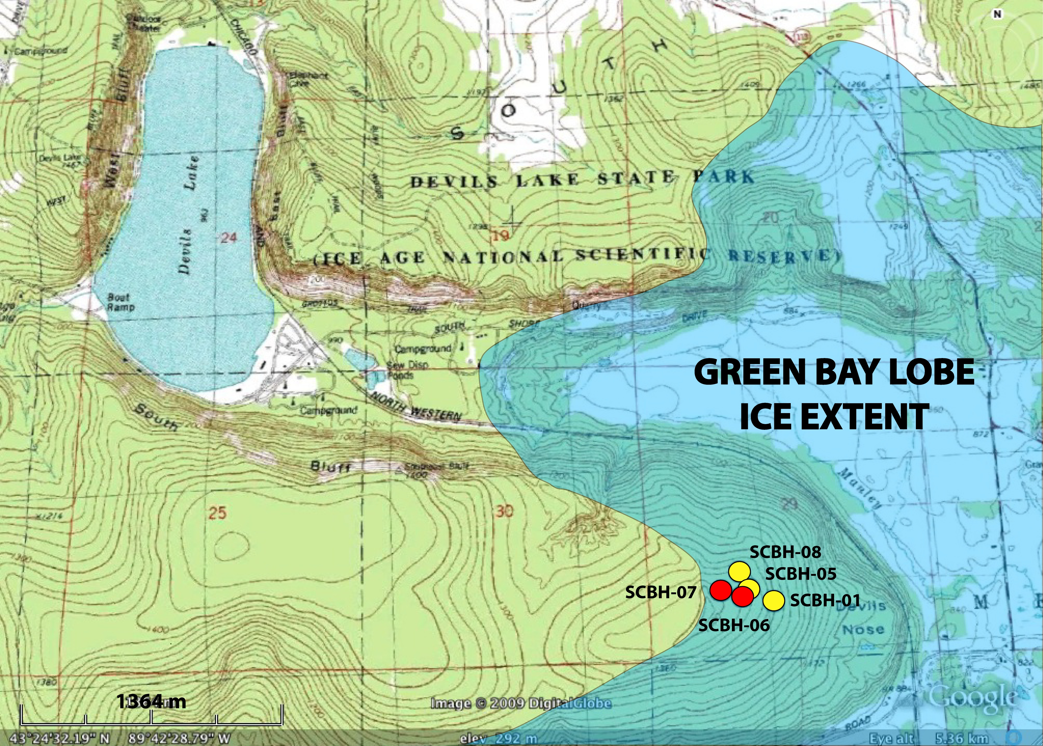
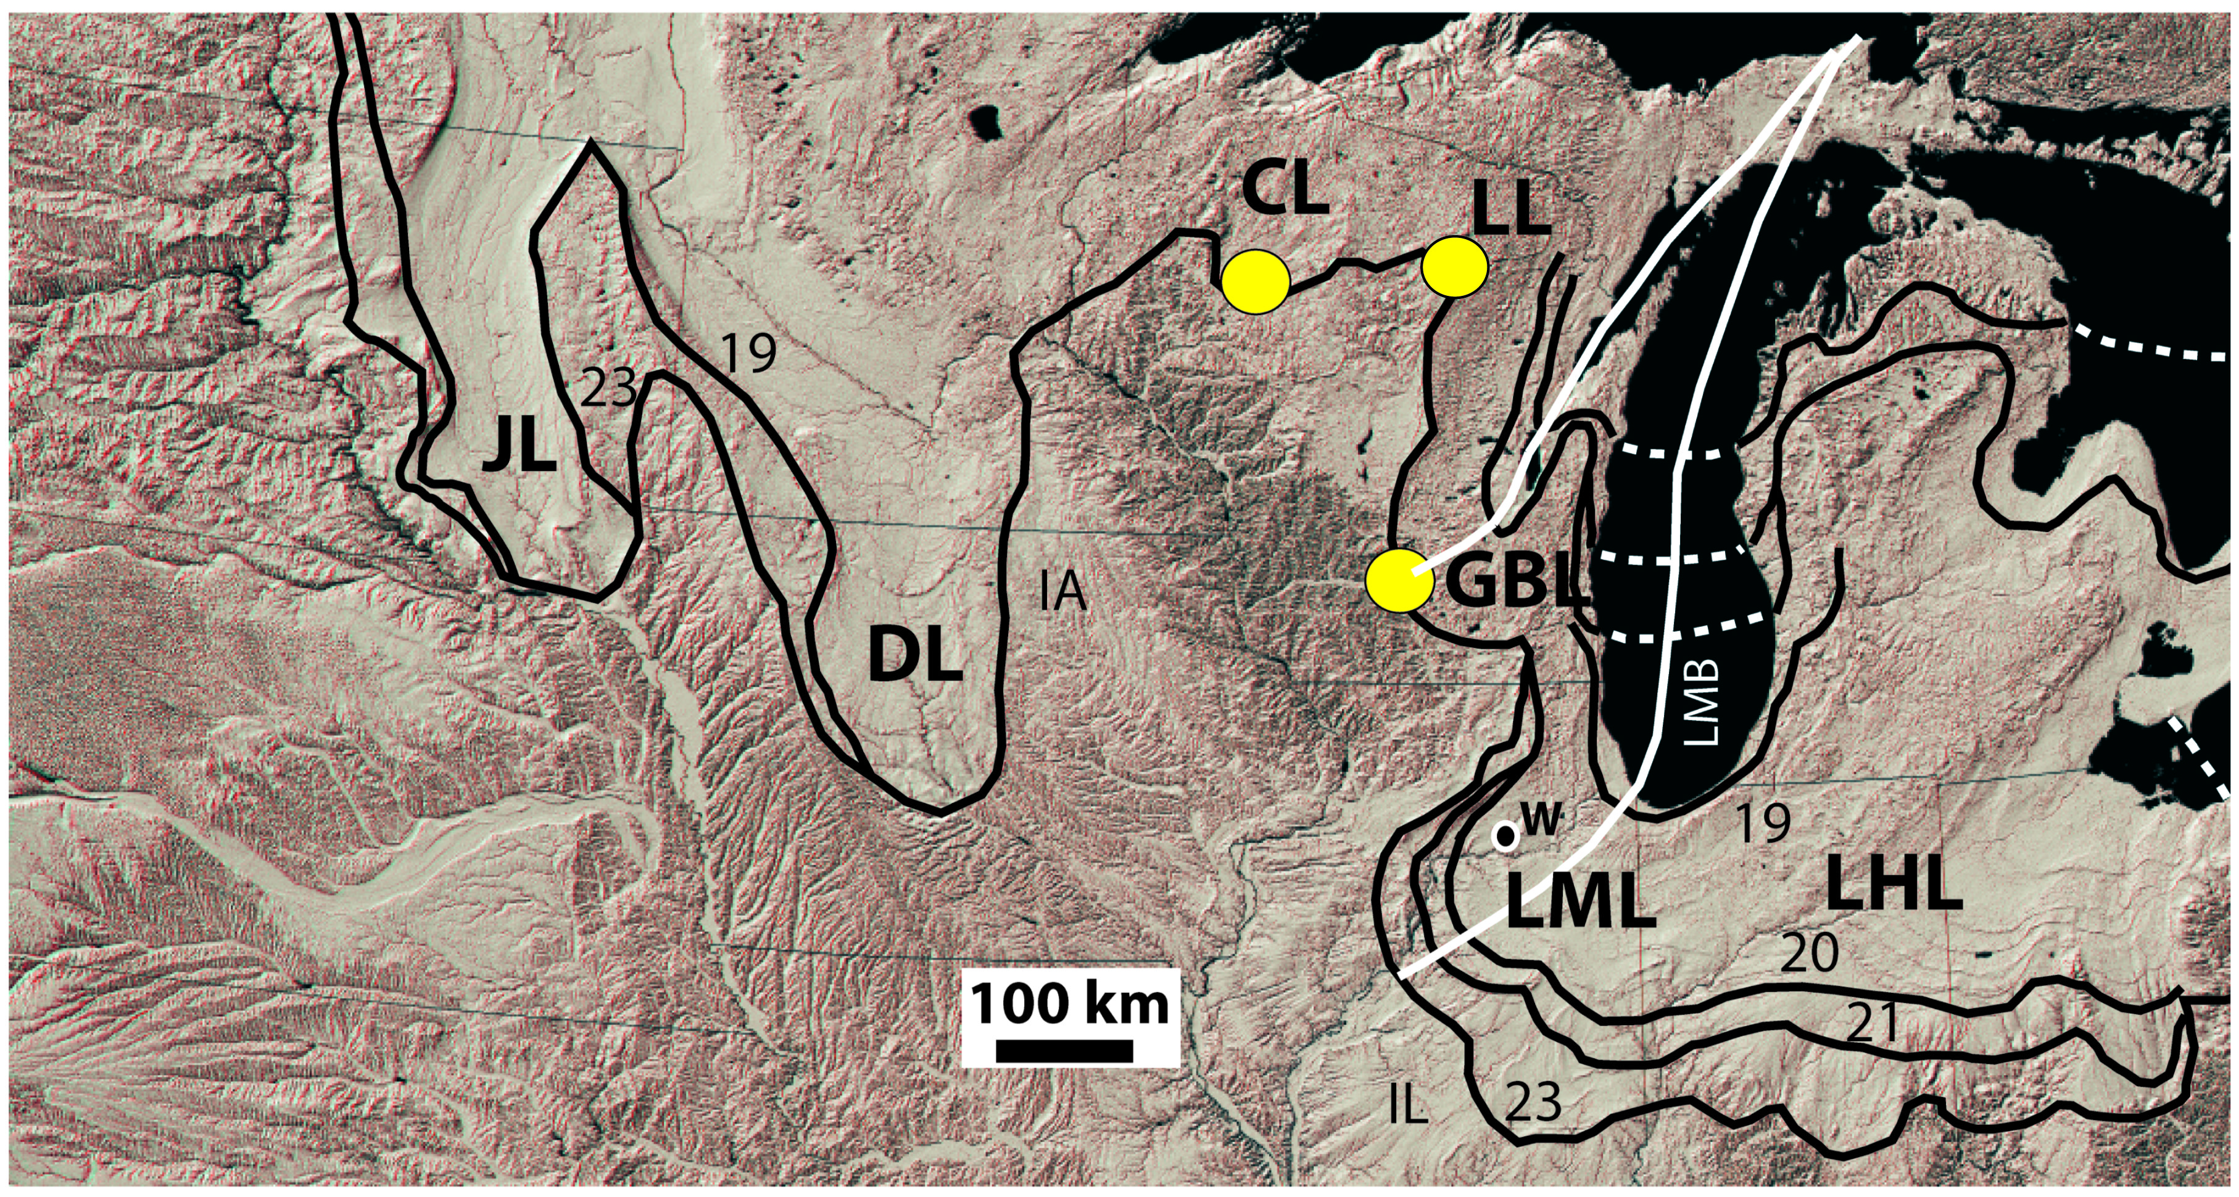
New Surface Exposure Chronology

Slide 14
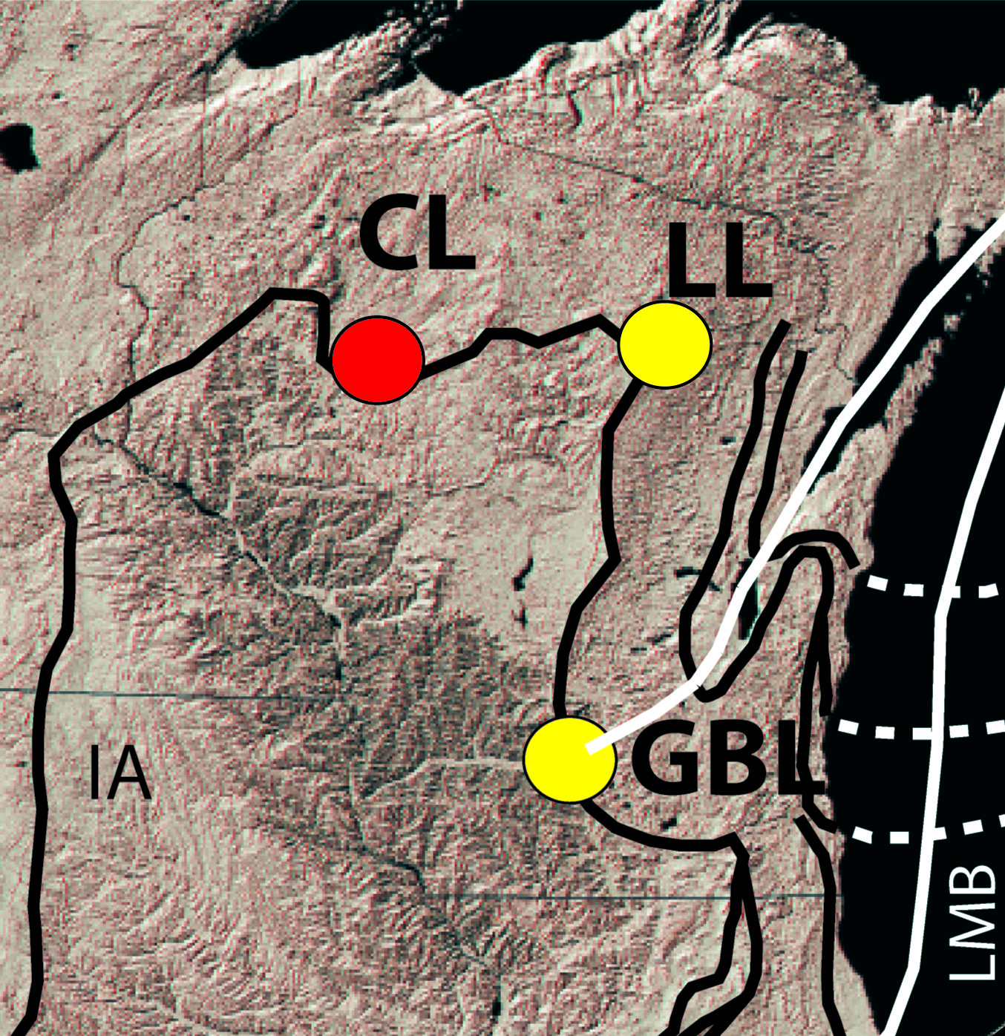
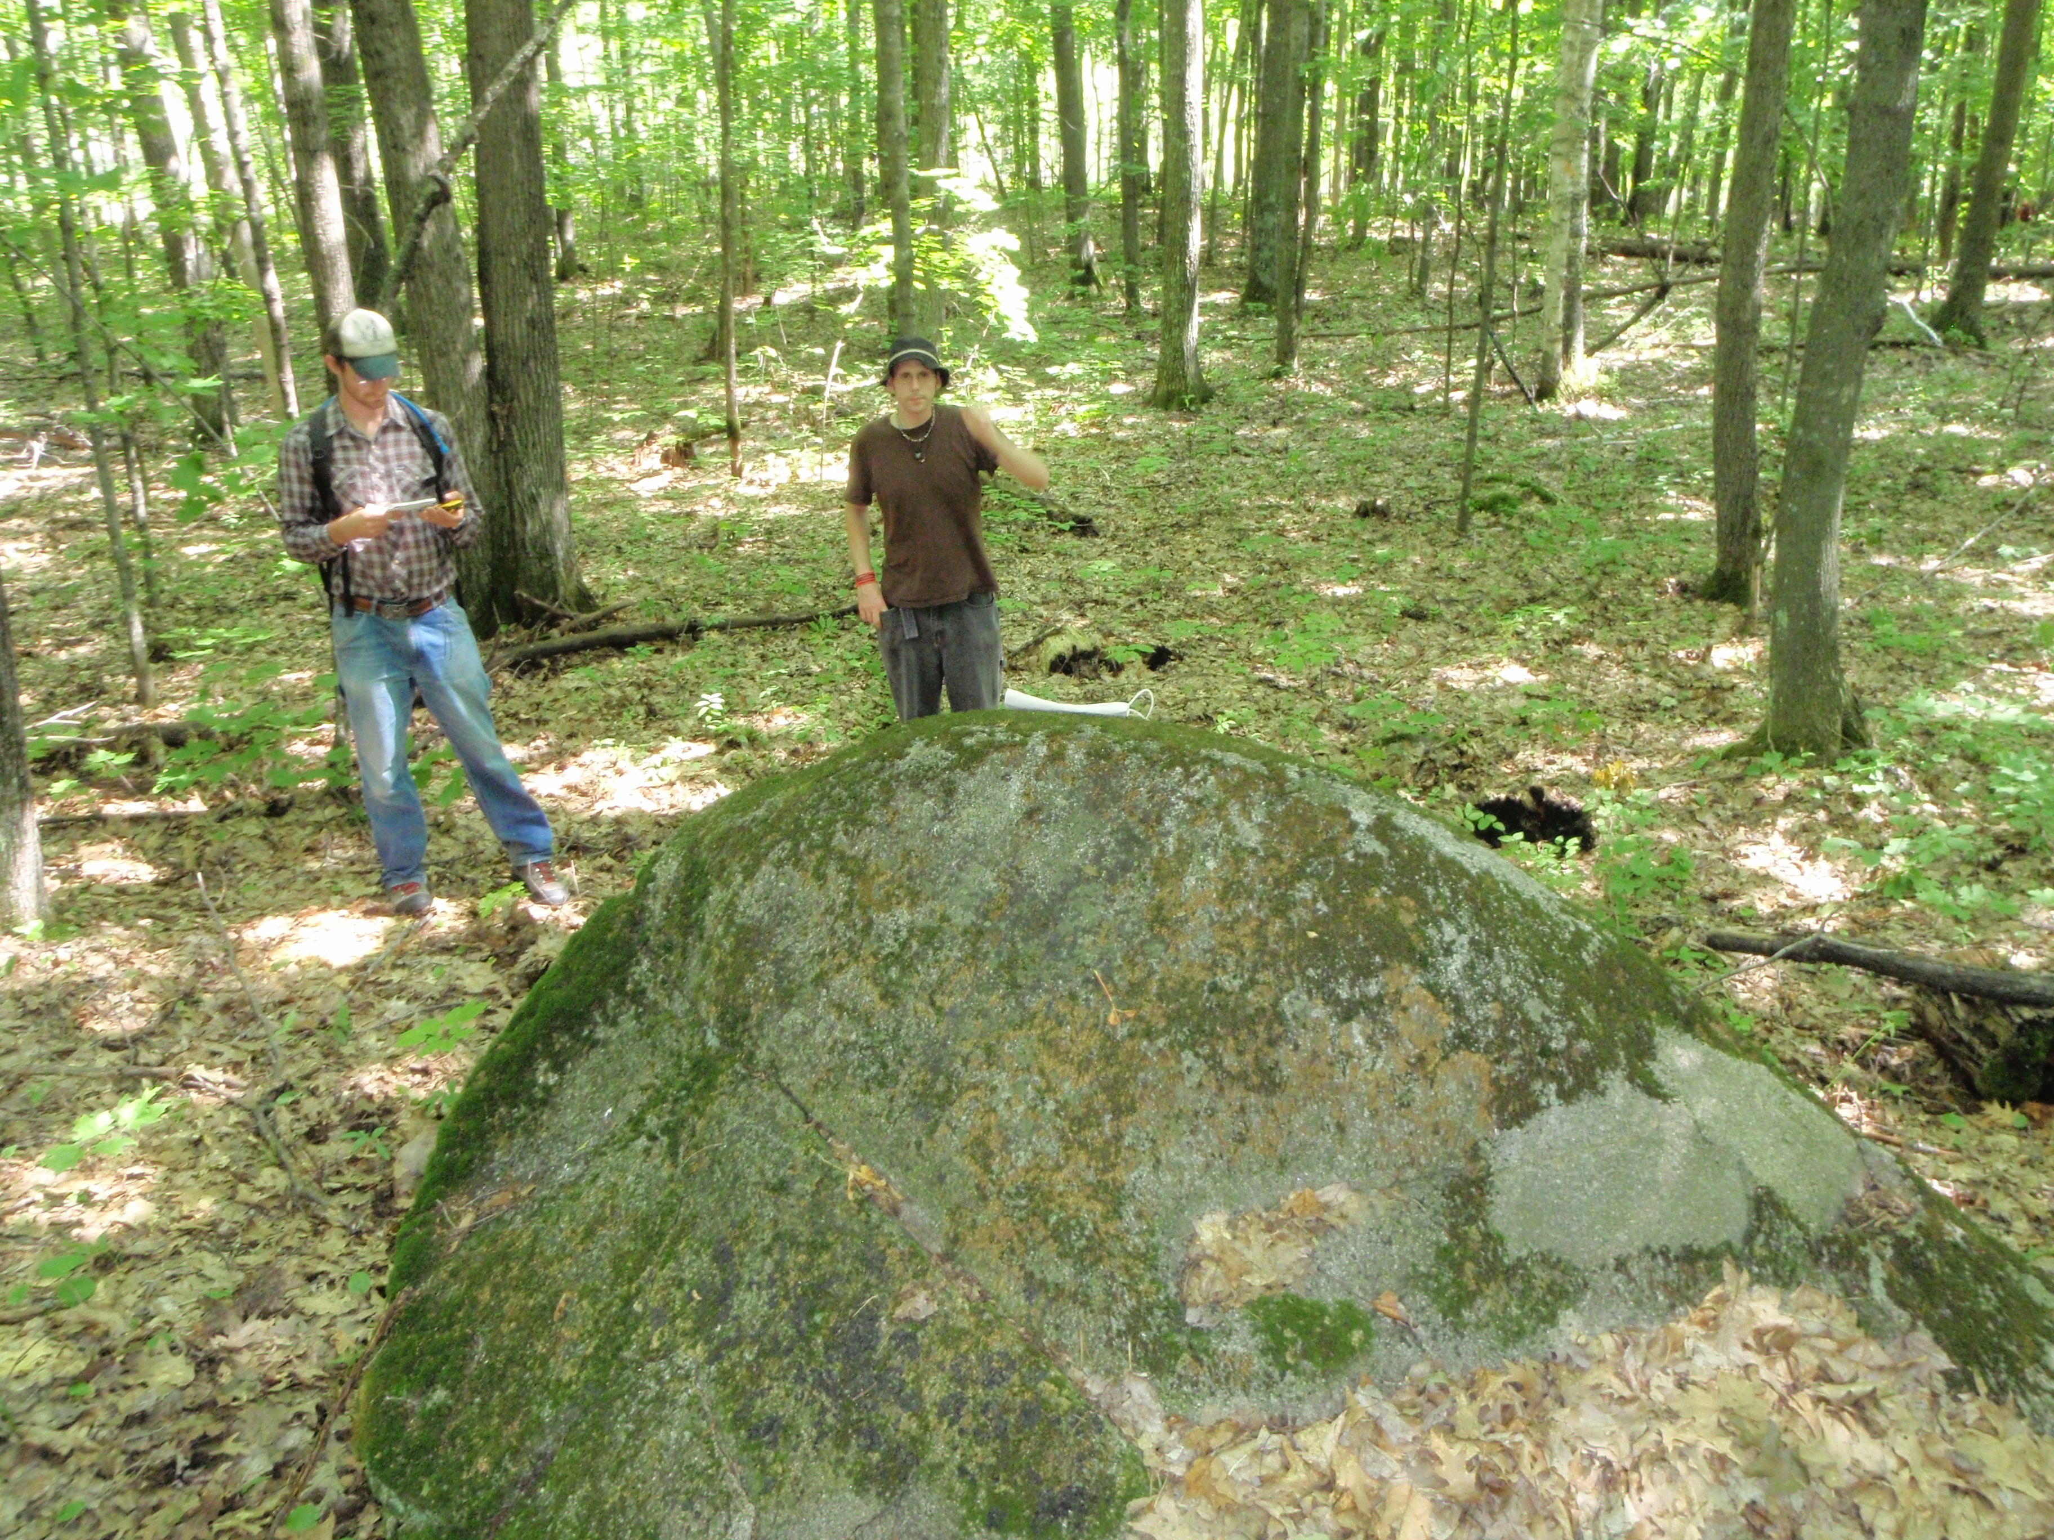
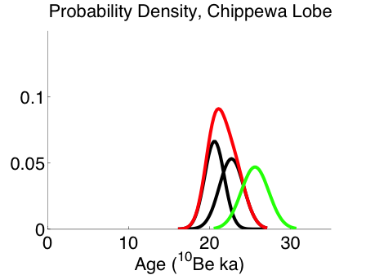
Chippewa Lobe
Late
Early
Mean Age Determination
Late Phase
21.7 ± 1.1 ka (n=2)
Early Phase
25.6 ± 1.7 (n=1) ???
(2 outliers removed)

Slide 15
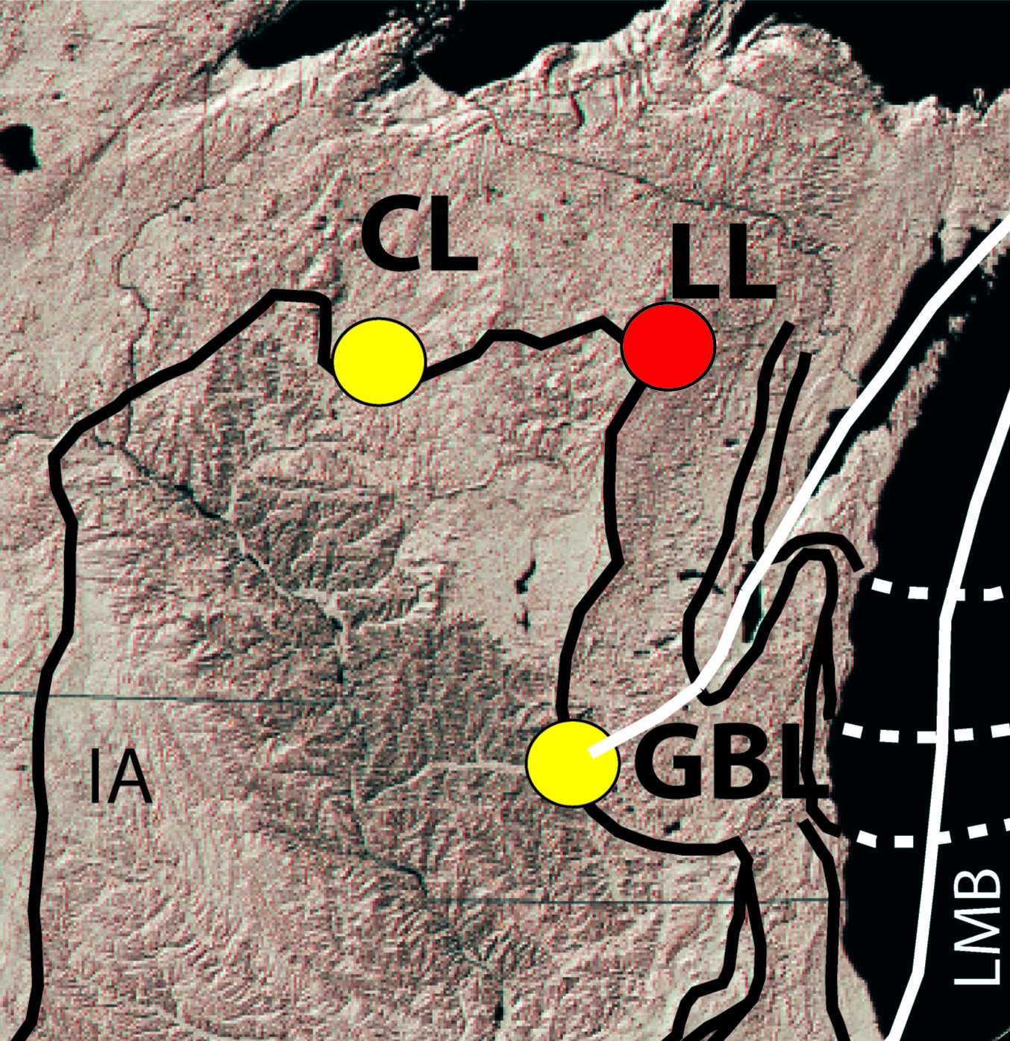
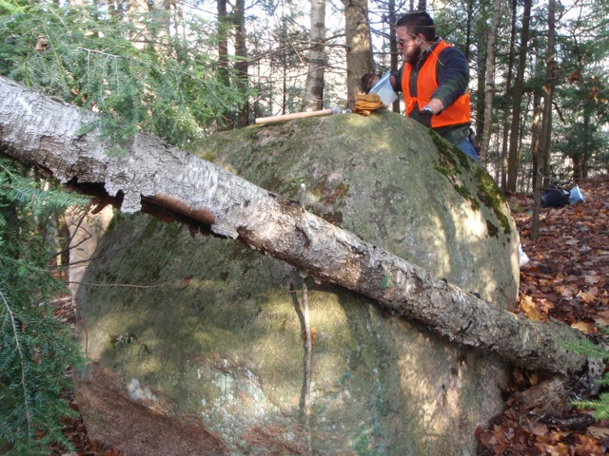
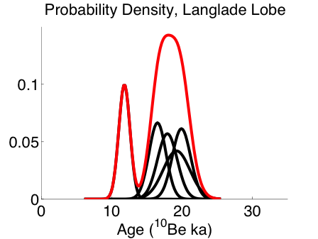
Langlade Lobe
Mean Age Determination
18.4 ± 0.8 ka (n=4)
(1 outlier removed)

Slide 16
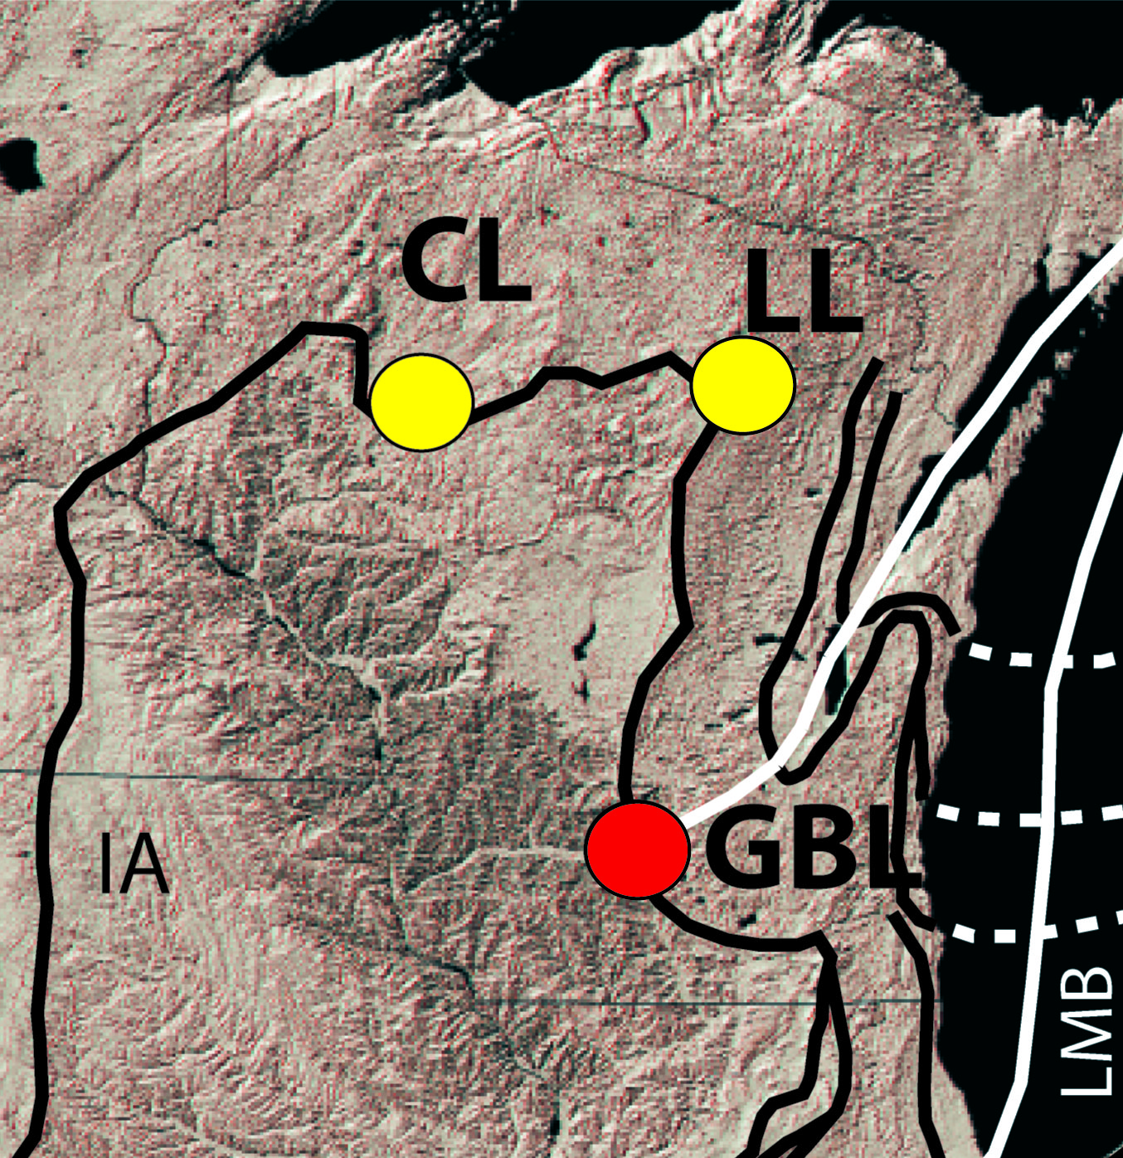
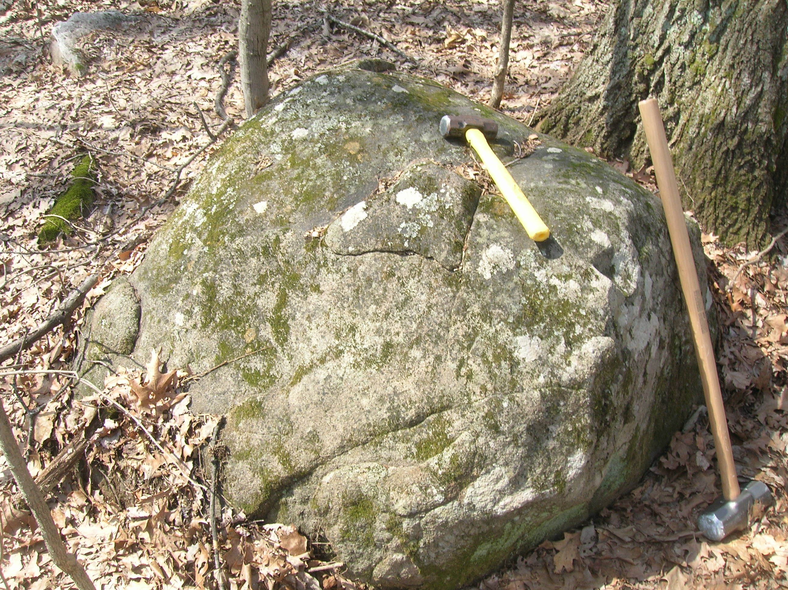
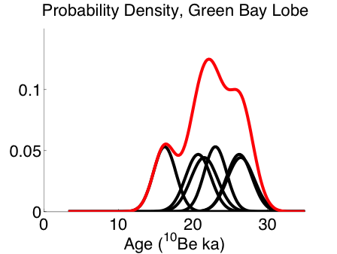
Green Bay Lobe
Mean Age Determination
22.3 ± 1.6 ka (n=6)
(standard error as uncertainty)
(3 outliers removed)
Notes:
If the data is normally distributed, then the analytical uncertainty is greater than the geological uncertainty (variation in deposition, rolling, unstable surface, exhumation, shielding, etc). Thus we can use the standard error as a measure of the uncertainty in the total sample set.
Outliers removed using Chauvenet’s Criterion – determines how much a suspect point differs from the mean. Uses the property of that for a Gaussian distribution, 95% of the variability in the dataset is contained by 2 standard deviations. Calculate the probability that the suspect data point is contained within the Gaussian distribution. By Chauvenet’s Criterion, if this probability is less than 0.5, then the suspect data point can be discarded. MENTION MSWD AS AN ALTERNATIVE!!! (See later slides)

Slide 17
A new retreat chronology
3 new ¹⁰Be sites
3 new ¹⁰Be sites

Slide 18
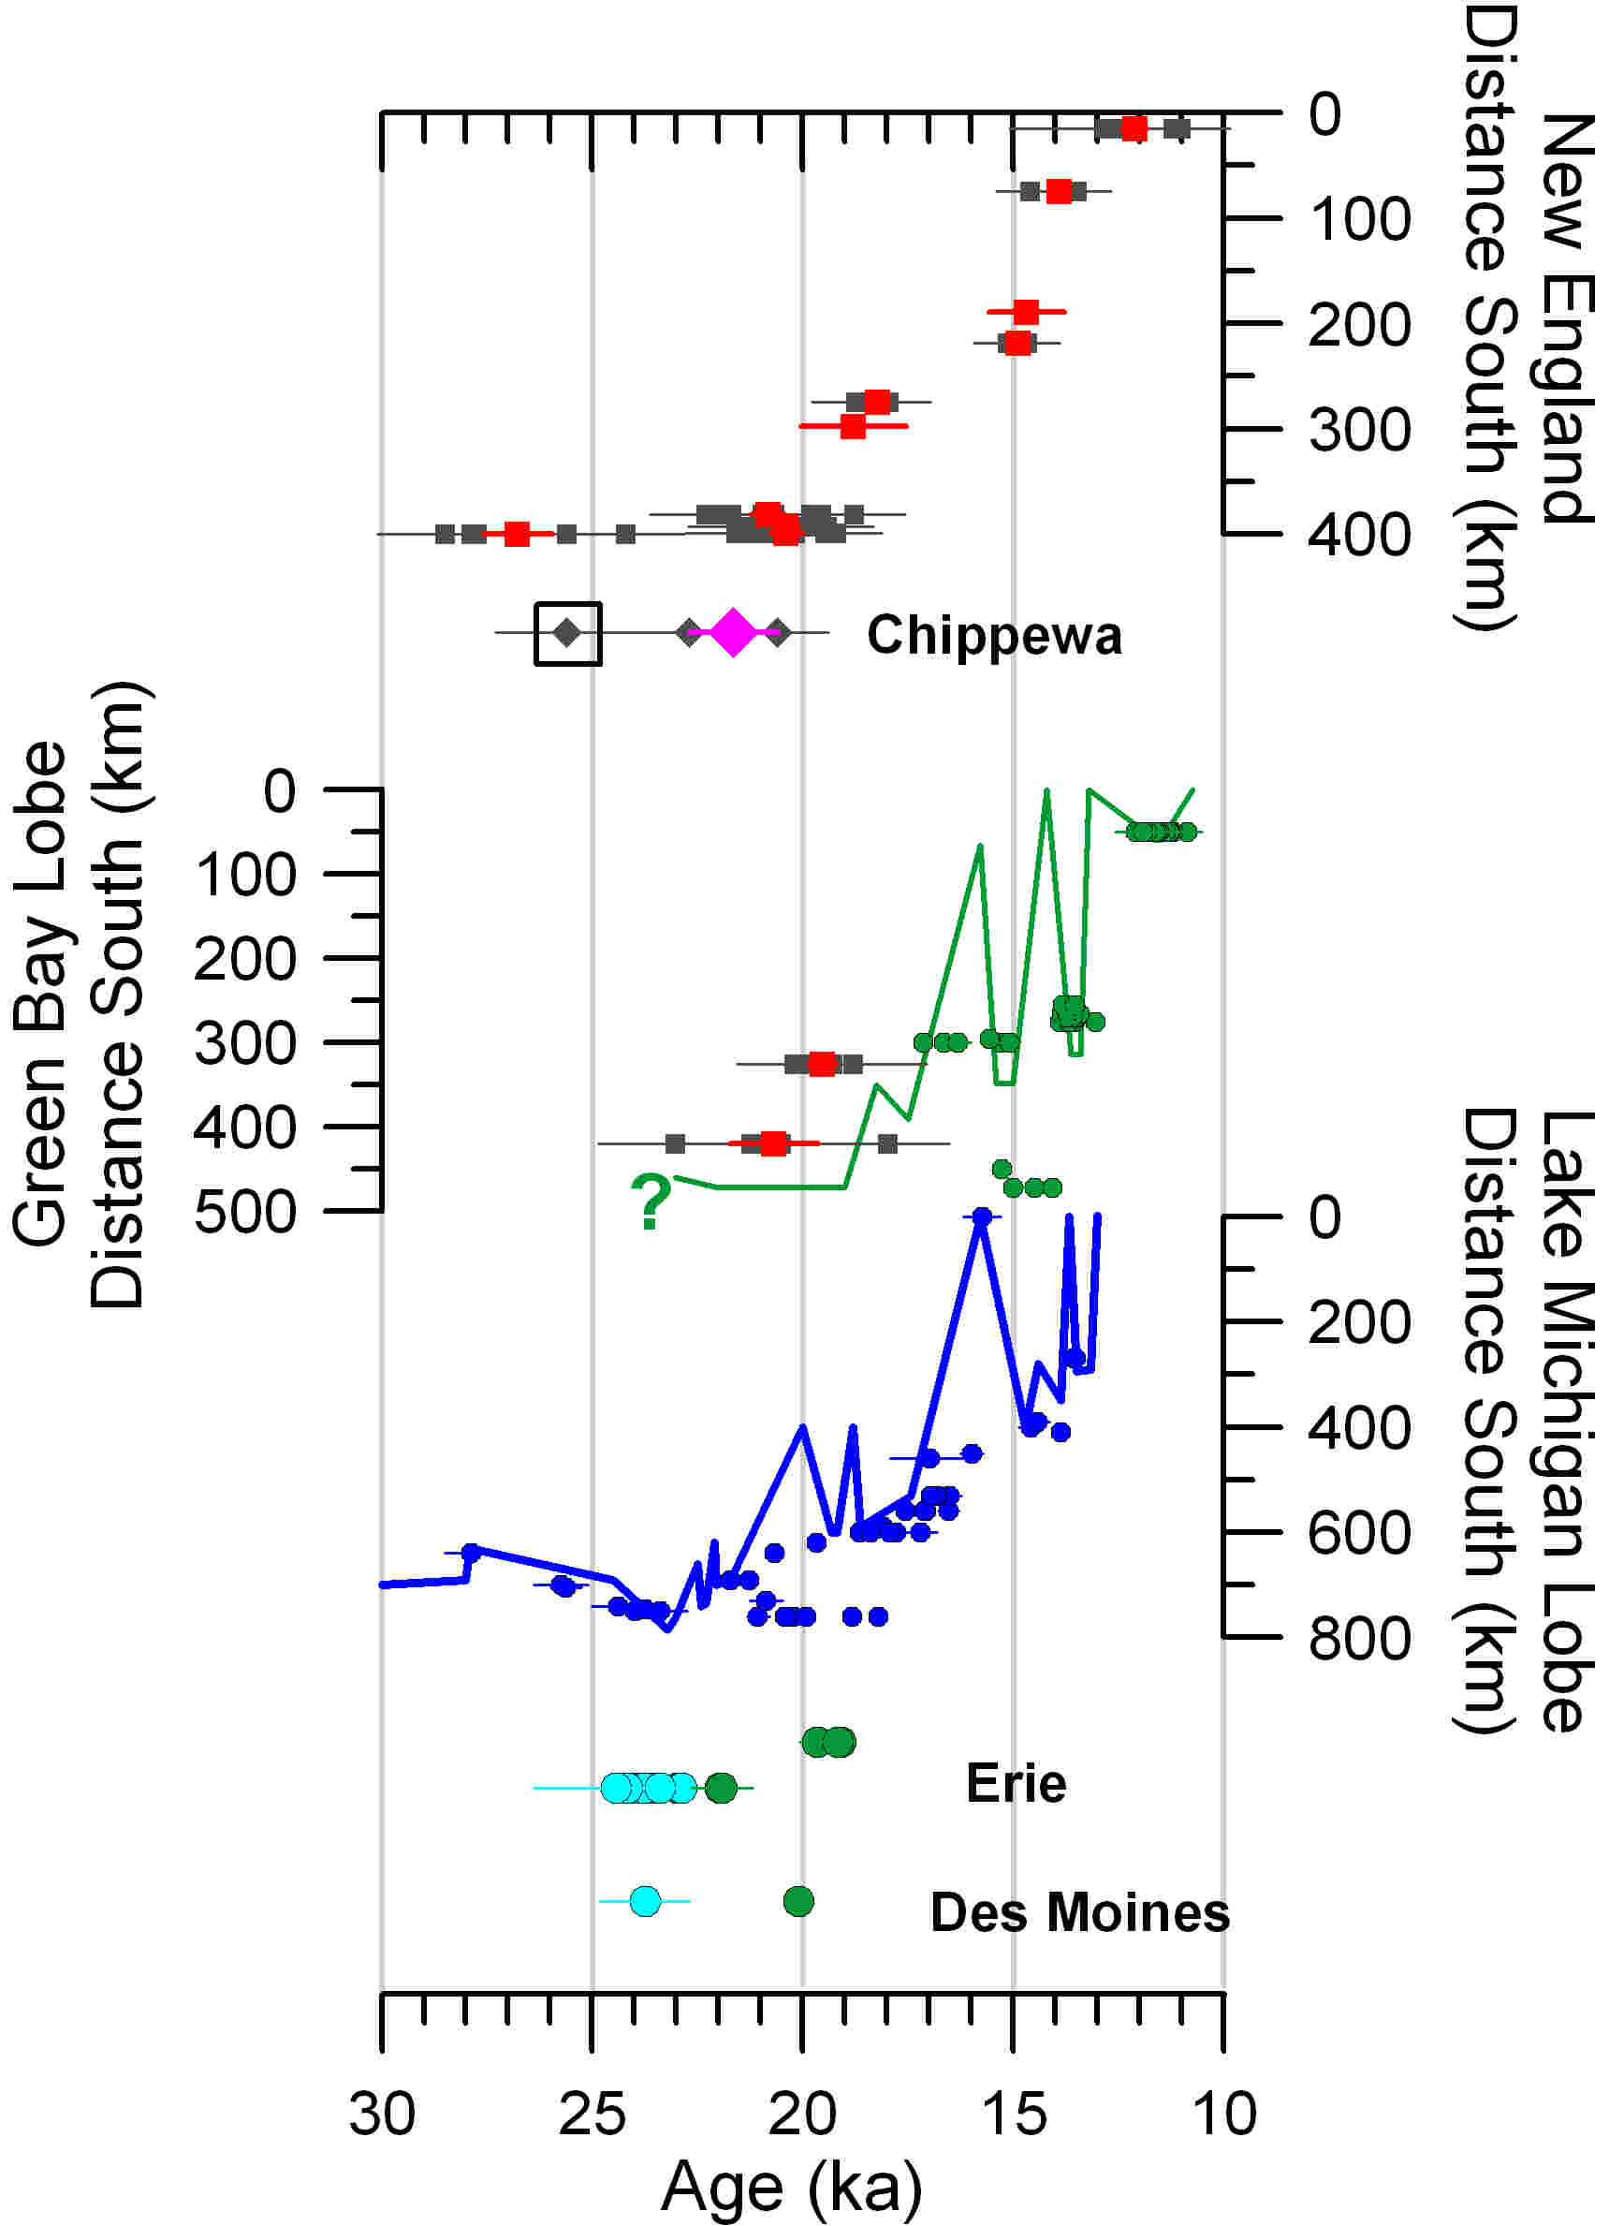
A new retreat chronology
3 new ¹⁰Be sites
3 new ¹⁰Be sites
  Chippewa Lobe
    Early Phase – 25.6 ± 1.7 ka
    Late Phase – 21.7 ± 1.1 ka

Slide 19
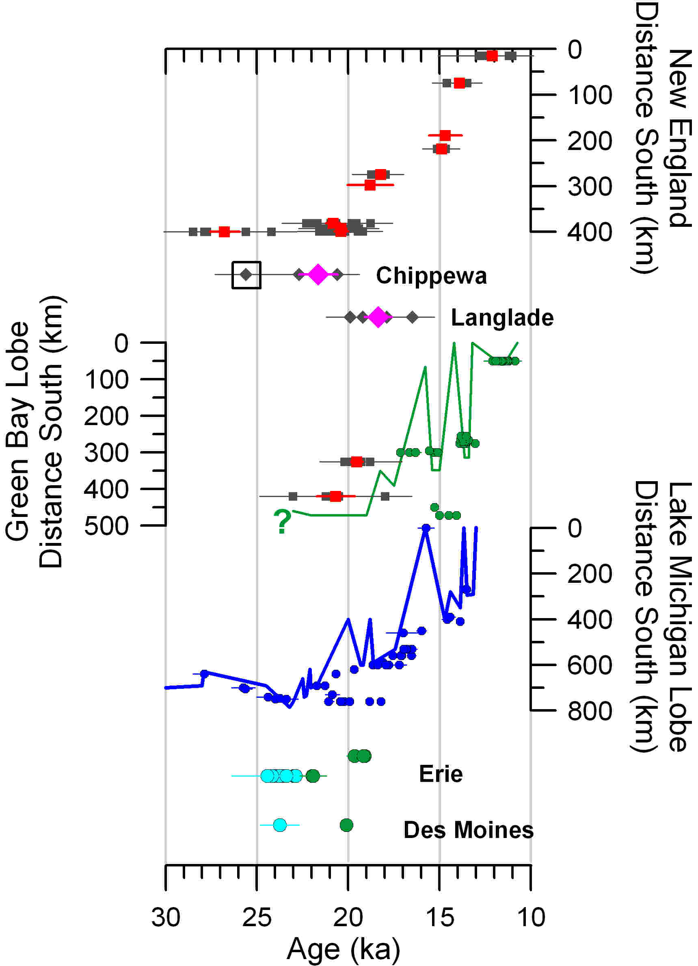
A new retreat chronology
3 new ¹⁰Be sites
3 new ¹⁰Be sites
  Chippewa Lobe
    Early Phase – 25.6 ± 1.7 ka
    Late Phase – 21.7 ± 1.1 ka
  Langlade Lobe
    18.4 ± 0.7 ka

Slide 20
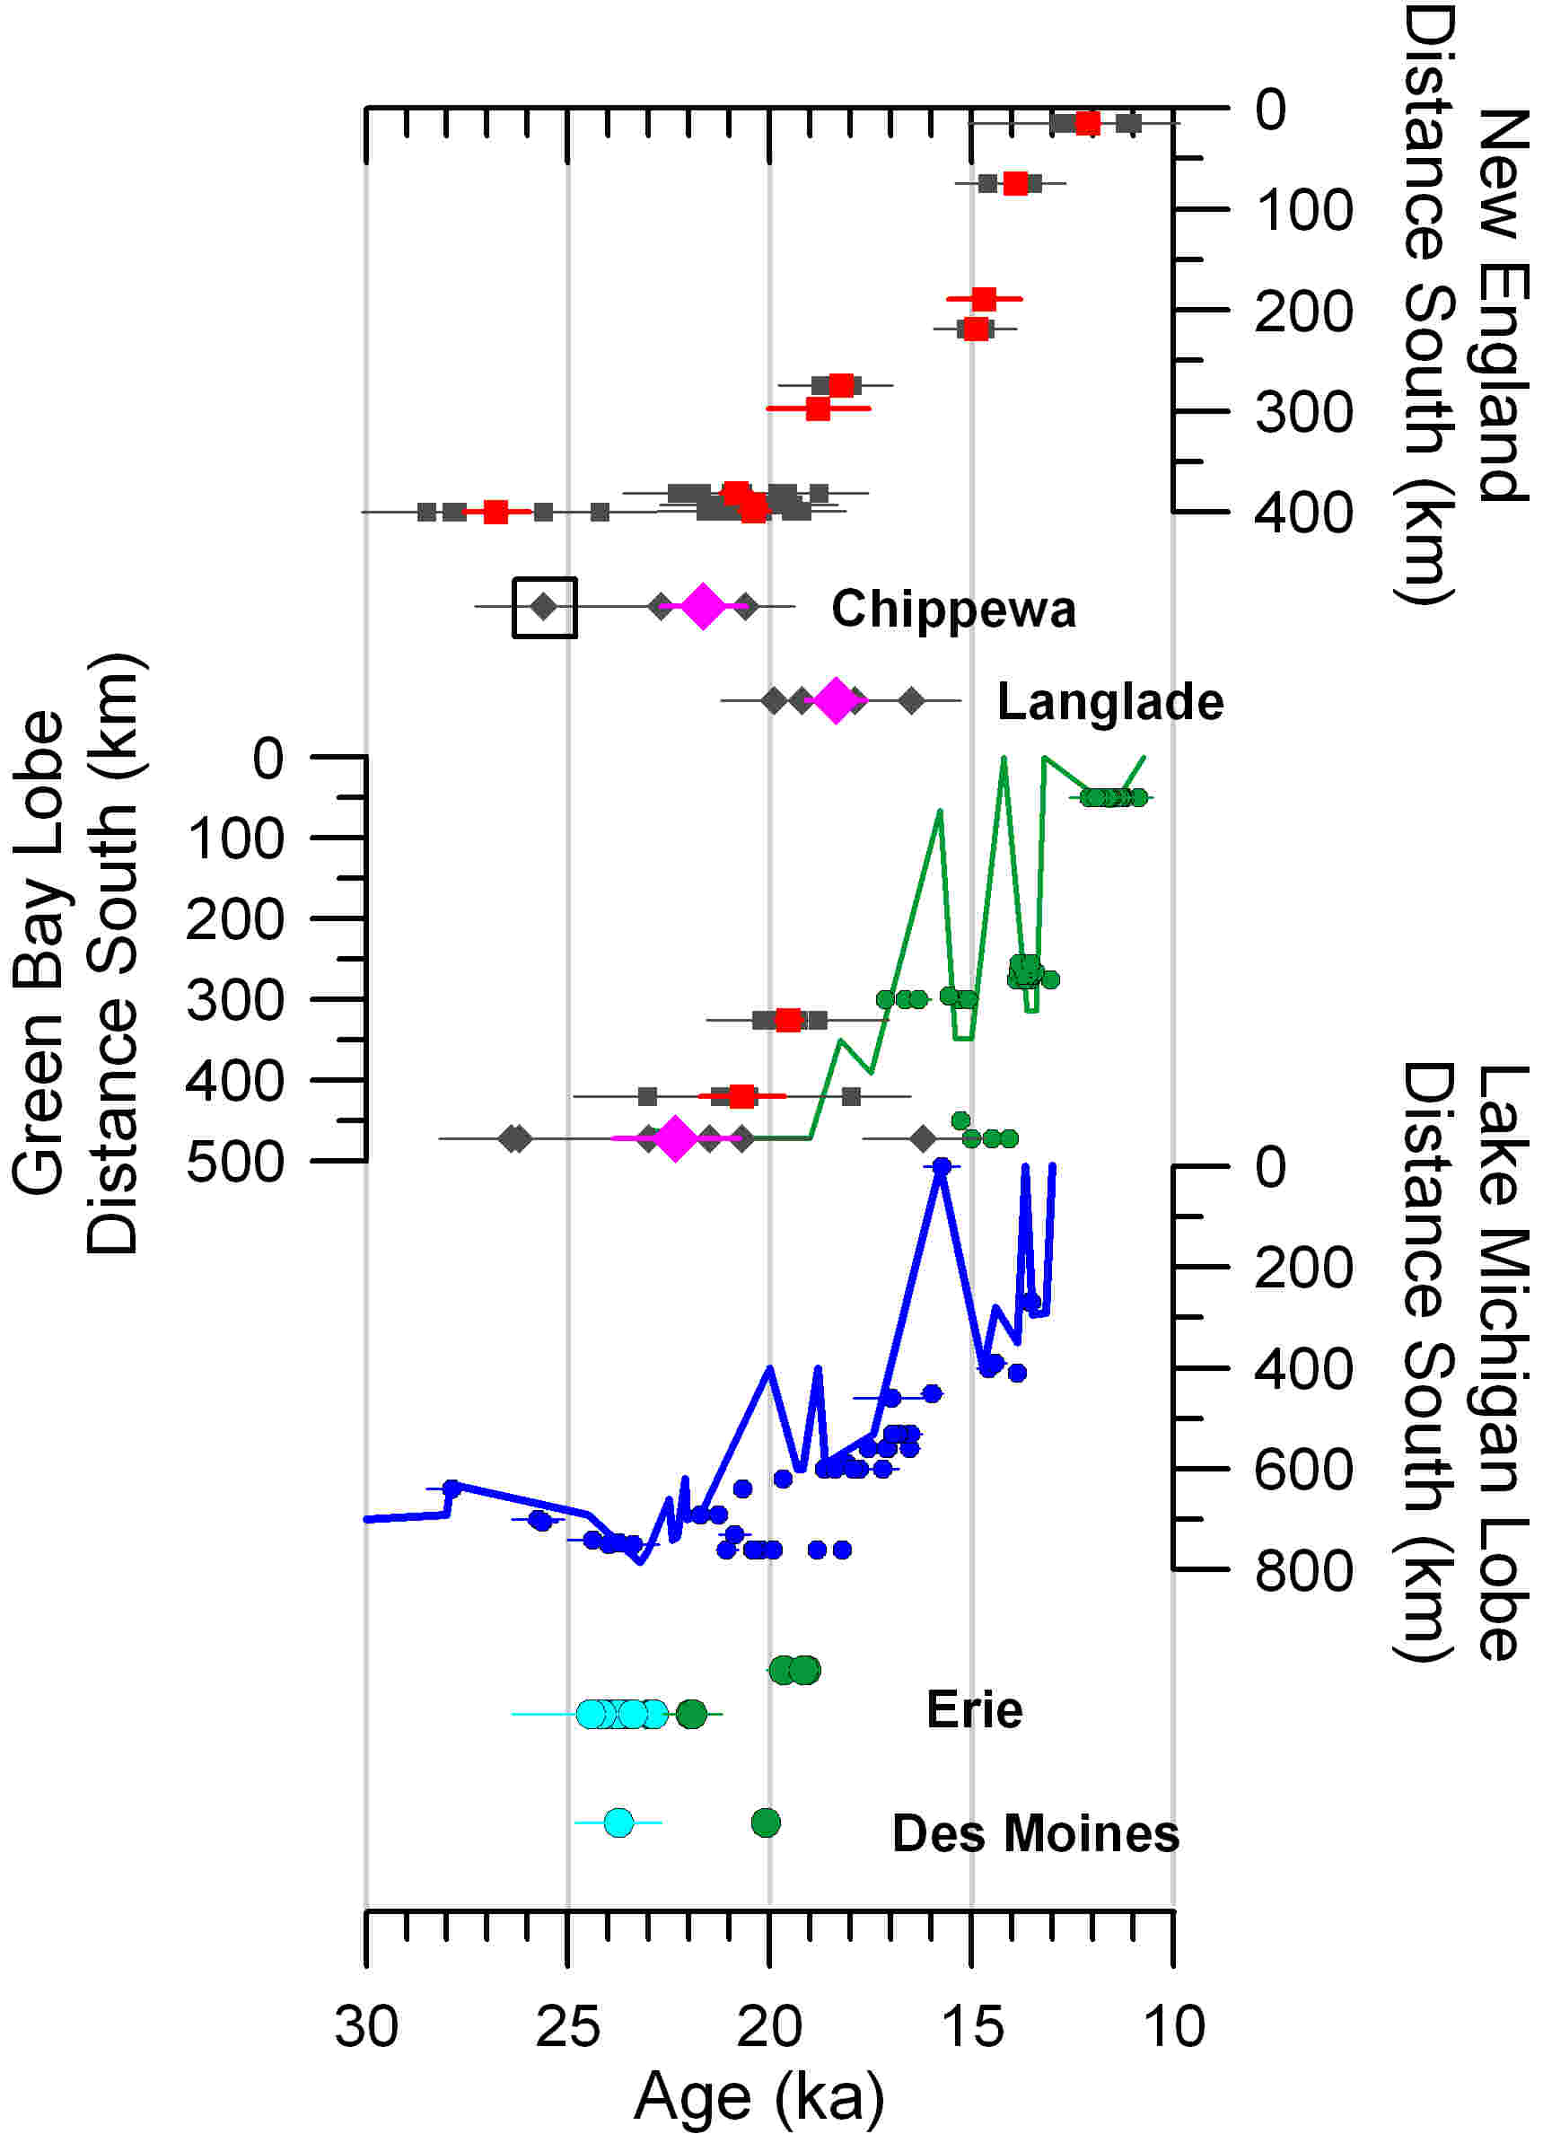
A new retreat chronology
3 new ¹⁰Be sites
3 new ¹⁰Be sites
  Chippewa Lobe
    Early Phase – 25.6 ± 1.7 ka
    Late Phase – 21.7 ± 1.1 ka
  Langlade Lobe
    18.4 ± 0.7 ka
  Green Bay Lobe
    22.3 ± 1.6 ka
Green Bay

Slide 22
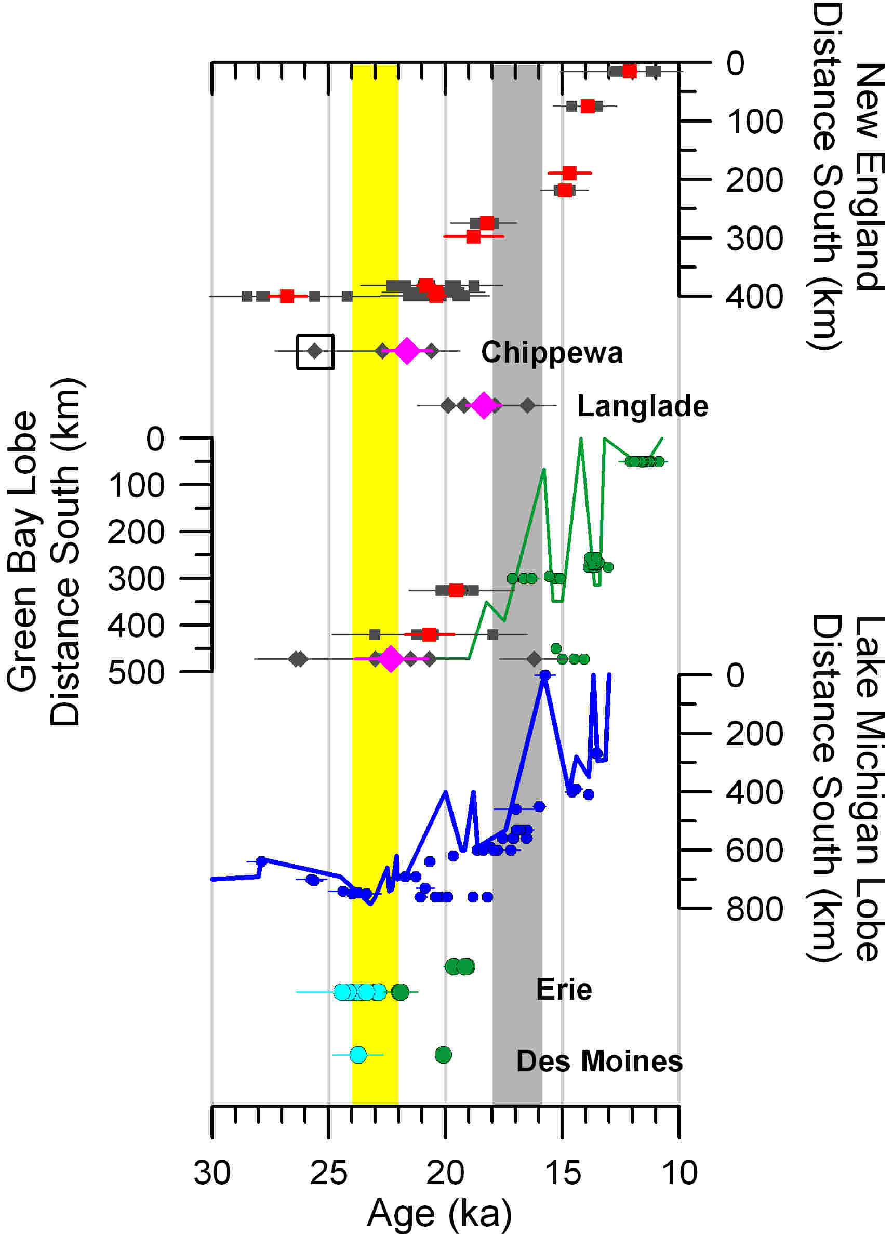

Slide 23
Summary
New surface exposure chronology indicates initial retreat at ~22ka in Wisconsin
Timing suggests insolation trigger for retreat onset

Slide 24
Questions?

Slide 25
Testing the Insolation Mechanism

Slide 26
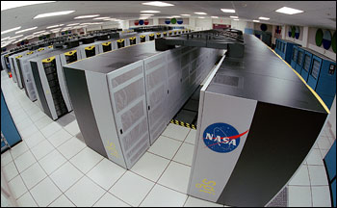
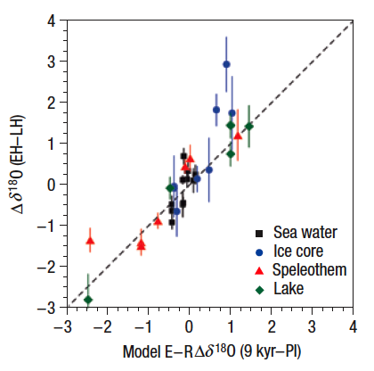
Testing the Insolation Mechanism
LGM climate from NASA GISS ModelE-R AOGCM (Schmidt et al., 2007)
Offline Energy Mass Balance Model of Anslow et al., 2008
Notes:
GISS – tracers of aerosols, water isotopes, methane; OTHER MODELS REQUIRE CONVERSION OF VARIABLES TO PROXIES
21 ka – warming at end of Last Glacial Maximum
16.5 ka – cold period during H1
15.5 ka – warming after H1
14 – following abrupt warming of B-A
13 – period of warming leading up to YD
11.5 – warming at end of YD
Vegetation maps according to Ray and Adams 2001, from National Climatic Data Center website of NOAA

Slide 27
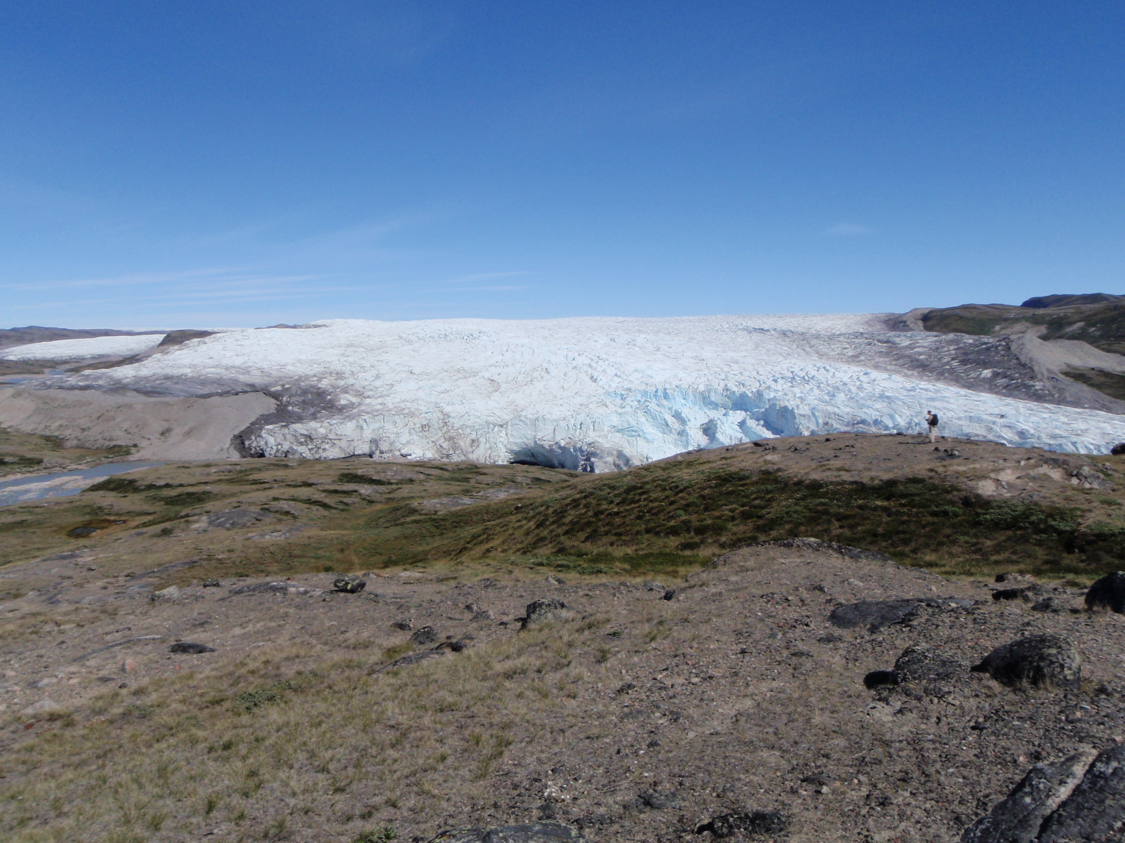
Energy-Mass Balance Model
Precipitation
Sensible
Heat
Net Longwave
Wind
Humidity
Refreezing
Absorbed
Shortwave
Surface
Roughness
Latent Heat
Albedo Snow & Ice
Albedo Terrain
Anslow et al. (2008)
Notes:
MASS BALANCE MODEL DOES NOT INCLUDE DYNAMICS – testing surface ablation component of retreat only – compare with retreat chronology

Slide 28
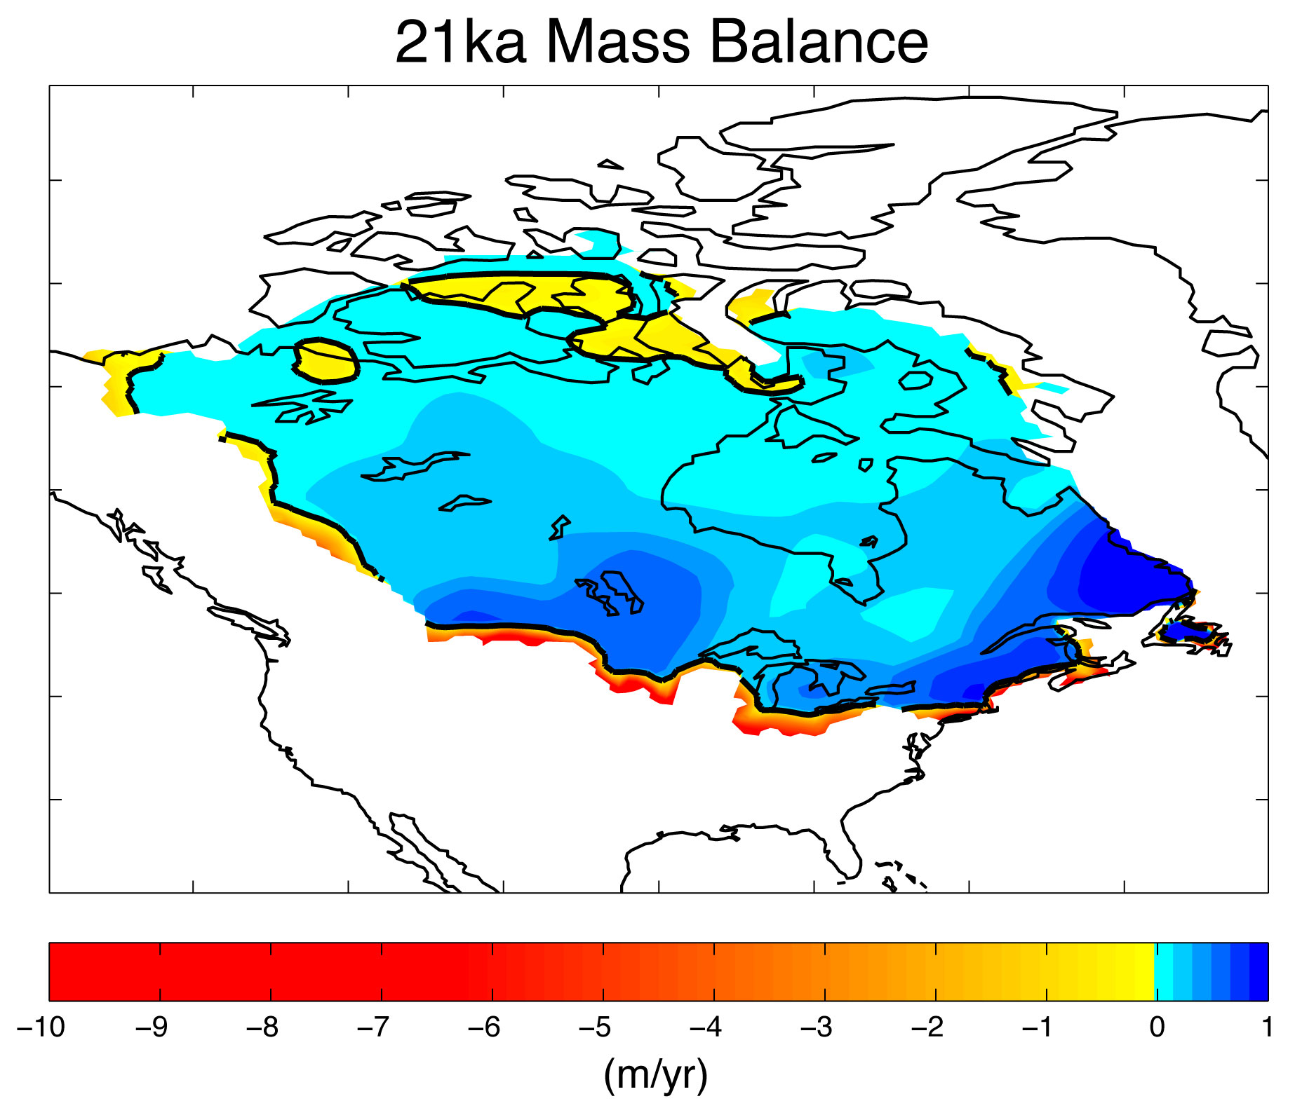
21ka Mass Balance
Total Mass Balance
  -0.03 m/yr
Equivalent Sea Level
  +0.11 cm/yr
Slight positive mass balance over most of LIS
Strong negative mass balance along southern margin
Notes:
Model Parameters: Ice/Snow Roughness, Ice/Snow Albedo decay

Slide 29
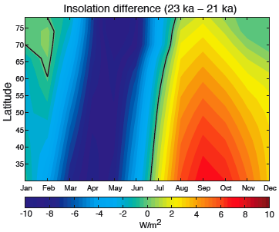
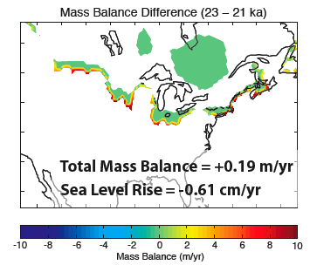
23ka Mass Balance
Adjust insolation to 23ka
All else equal
Total Mass Balance
  +0.19 m/yr
Equivalent Sea Level
  -0.61 cm/yr
Insolation changes alone from 23ka to 21ka sufficient to drive mass balance shift
Notes:
Model Parameters: Ice/Snow Roughness, Ice/Snow Albedo decay

