Slide 1
ABRUPT CHANGES IN DEPOSITION RESULTING FROM HYDROLOGIC AND TECTONIC EVENTS, PLIO-PLEISTOCENE HUECO BASIN, RIO GRANDE RIFT
Langford, R. P. Doser, D., Cannon, S.,
University of Texas El Paso

Slide 2
The gist
Closely spaced wells in the Southern Rio Grande Rift exhibit abrupt changes across a 7 X 12 km area that reflect rearrangements of environments.
Because the changes are spread over 16 km and are nearly synchronous, they are inferred to reflect tectonic and hydrologic events within a system sensitive to change.

Slide 4
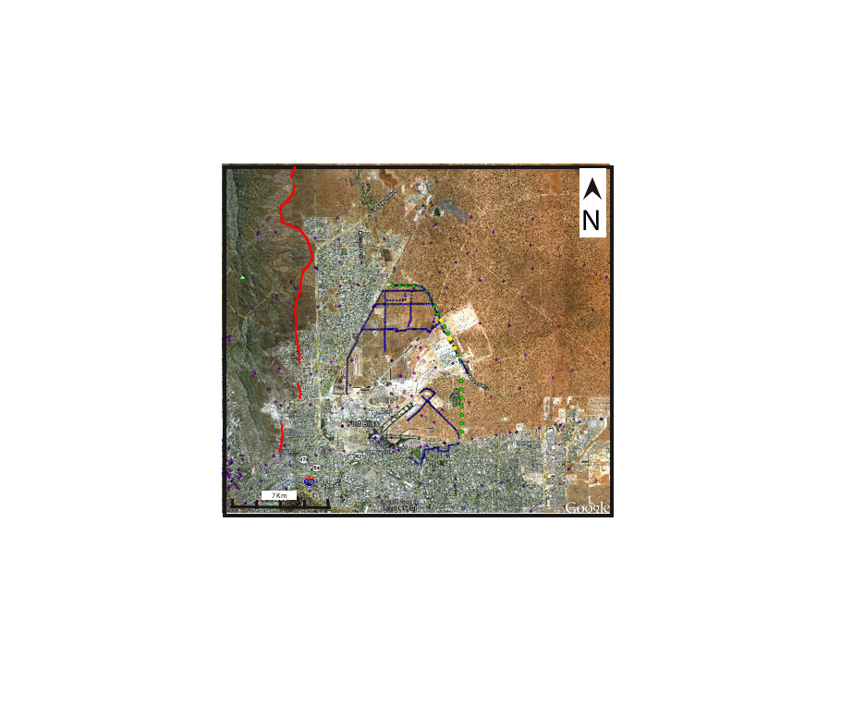
9 km
6.8 km
Franklin Mountains – Alluvial Fan Sediment Source
12 km

Slide 5
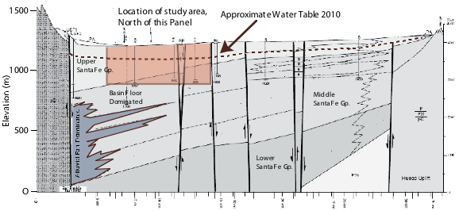
from Hawley et al. (2007)

Slide 6

Graben
Ramp thickens to S

Slide 7
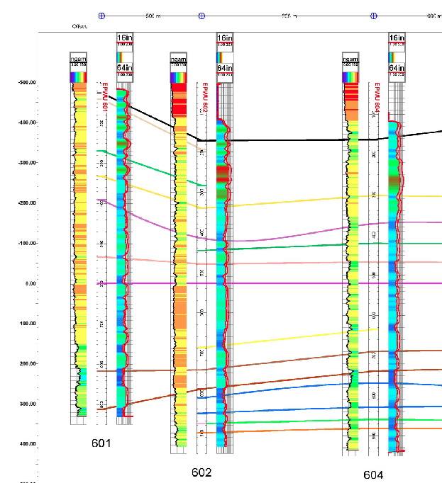
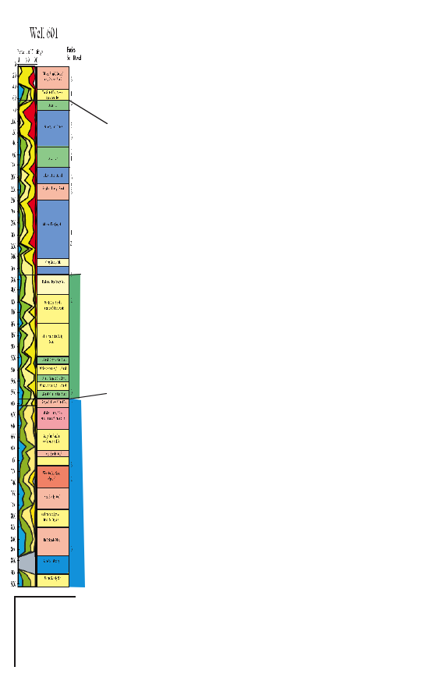
Data
Gamma Ray and
Resistivity Logs from 27 wells.
Cuttings collected every 10 ft.

Slide 8
Cuttings analyzed in detail w grain size in 5 wells environments interpreted from modern analogs

Slide 9
REsults

Slide 10
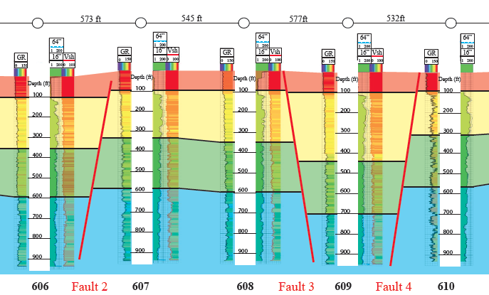
Syndepositional faults offset stratigraphy and thicken intervals

Slide 11
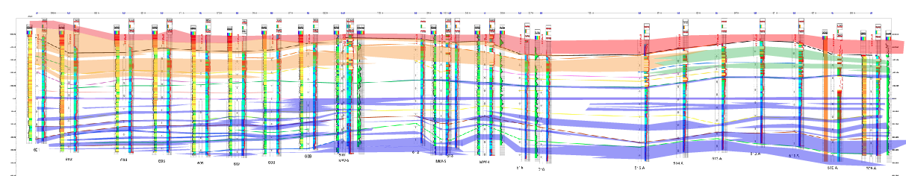
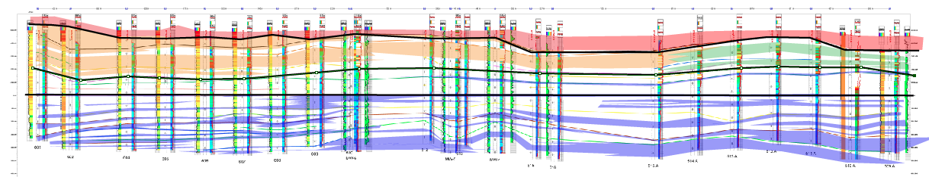
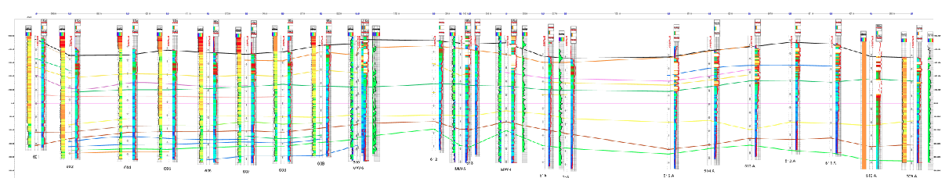
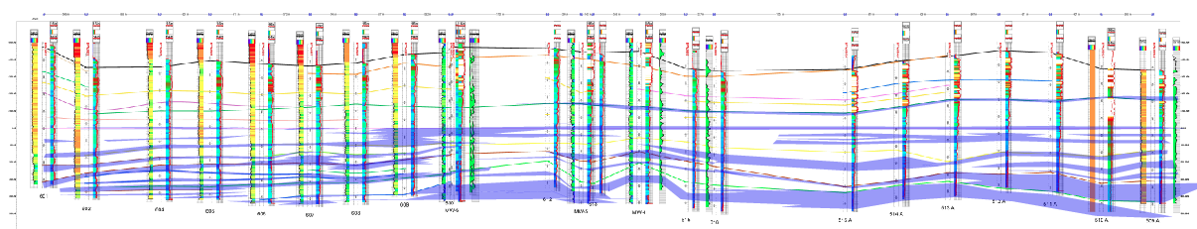
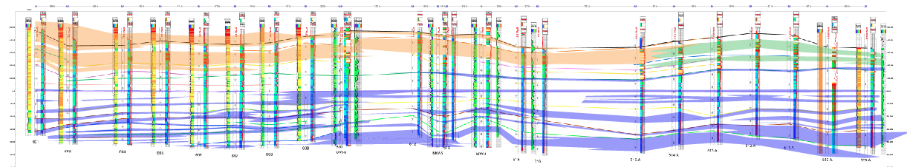
Correlation reveals abrupt changes
4
3
2
1

Slide 12
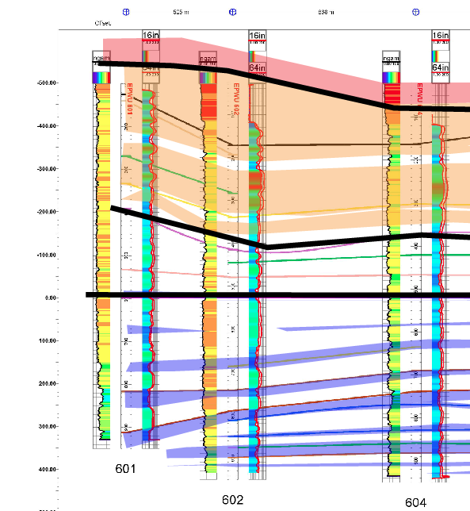
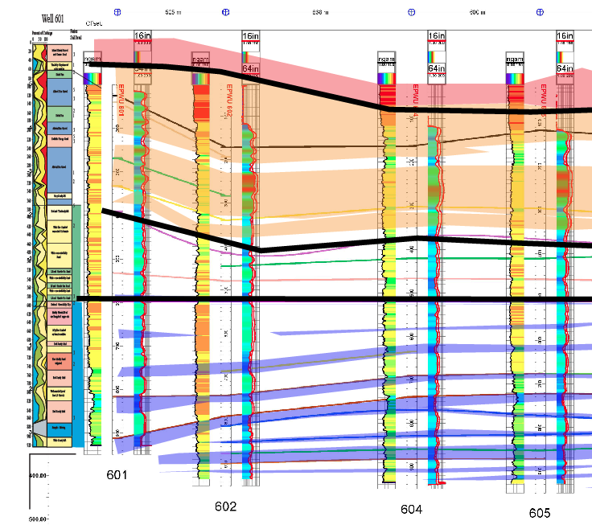

Slide 13
So What causes the changes? Why so Abrupt?

Slide 14
Topographically low basin floors receive groundwater from the region and have broad flat basin floors and restricted fans.
Because the deposition rate is higher in the lacustrine areas, distal fans are buried.

Slide 15
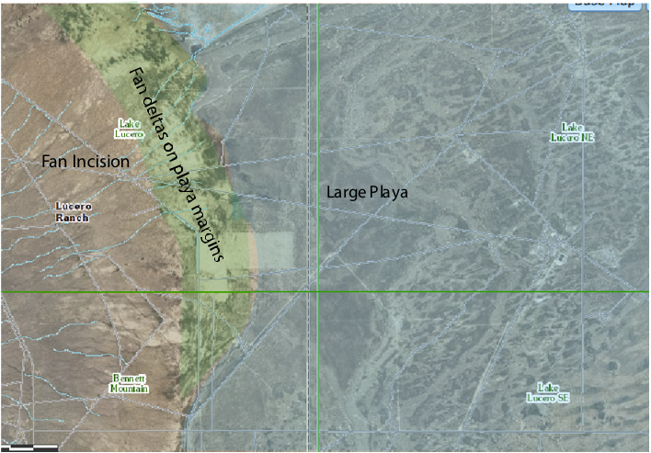

Slide 16
Stage 2.
Faulting or deflation of the flat lacustrine basin floor, can create a relict surface, flat, but above the level of groundwater discharge.
Small Playas
Eolian deposition
Distal fans and axial streams.
Abrupt change related to tectonism

Slide 17
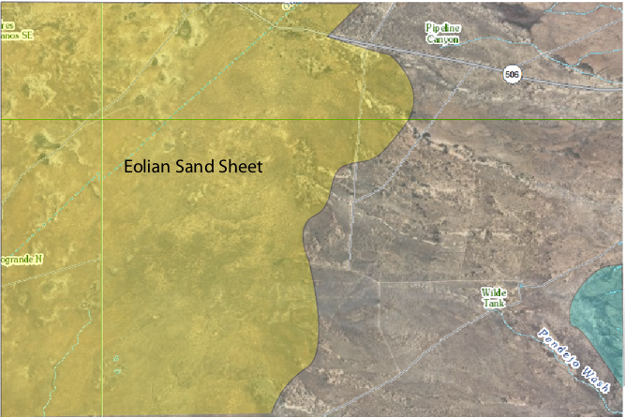

Slide 18
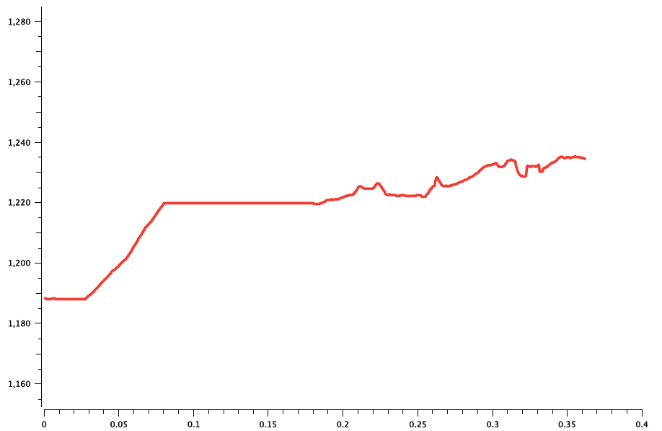

Slide 19
Stage 3
Rapid Progradation of alluvial fan.
Fills fault topography

Slide 20
Stage 3

Slide 21
Stage 3
Increased sedimentation rate?
Climate Change?

Slide 22
Stage 4
Sudden influx of Rio Grande
Topographically lower than Mesilla Basin.
Mesilla Basin filled with Rio sediments.

Slide 23
Stage 3

Slide 24
Summary
Abrupt changes in environment are nearly synchronous across 10 km down depositional gradient.
Interpreted to result from –
Changes in relative topographic position of basin floor.
Low Playa
High eolian/fluvial plain
Low relative to adjacent basin – Rio Grande Influx
Changes in Climate
Increased alluvial fan deposition rate.

