Slide 1


FIRST RESULTS FROM THE SCIENCE LITERACY CONCEPT INVENTORY: THE REASONING WE DON'T PRODUCE THROUGH GEN-ED
Edward B. Nuhfer, CSU Channel Islands
Christopher B. Cogan, CSU Channel Islands
Carl T. Kloock, CSU Bakersfield

Slide 2
With thanks to our team of collegial conspirators…
Edward Nuhfer, Faculty Development & Geology, Channel Islands
Jerry Clifford, Physics, Channel Islands
Christopher Cogan, Environmental Sciences & Resource Management, Channel Islands
Anya Goodman, Biochemistry, San Luis Obispo
Carl Kloock, Biology, Bakersfield
Beth Stoeckly, Physics, Channel Islands
Christopher Wheeler, Geology, Channel Islands
Gregory Wood, Physics, Channel Islands
Natalie Zayas, Science Education & Environmental Sciences, Monterey Bay
Notes:
Note: 9 people, 5 disciplines, and 4 CSU campuses

Slide 3
What kind of “science literacy?”

Slide 4
General Education, Liberal Education and Science
General Education
Strives to impart content knowledge that citizens should know
This accords with the type of science literacy tested on certain science literacy tests:
All radioactivity is man-made.
Radioactive milk can be made safe by boiling it.
The earliest humans lived at the same time as the dinosaurs.
Respond by agree-disagree.
(Miller, 1998)
This is not a bad goal to strive for, but content knowledge is not what most catalog descriptions present as their reason for requiring a basic science course.

Slide 5
General Education, Liberal Education and Science
Liberal Education
Occurs through "… the collaboration and integration of general education and the major.”
Gaining understanding of the larger framework of reasoning that connects all of the science disciplines is conducive to integration. The main learning outcome thus sought for the general requirement is not disciplinary, but metadisciplinary.
Disciplinary knowledge cannot contribute much to such integration across diverse majors. Such knowledge alone cannot support liberal education.
Catalog descriptions usually confirm that the requirement for general science courses exists to provide the kind of science literacy that enables the educated citizen to understand and employ the framework of reasoning of science.
This is the kind of science literacy addressed by the Science Literacy Concept Inventory (SLCI). It assesses the degree to which students understand science as a way of knowing and can employ science’s framework of reasoning under circumstances that a citizen may encounter in everyday life. Therefore, we deliver the SLCI under such conditions rather than as a timed in-class test.

Slide 6
What follows is a presentation of what we have learned from using the SLCI. The nature of the instrument and how we constructed it is the subject of the talk that follows by Dr. Chris Cogan
As result of scheduling, we take a bit of license from Carl Sandburg’s Rutabaga Stories: we’ll do “the second thing first and the first thing second.”

Slide 7
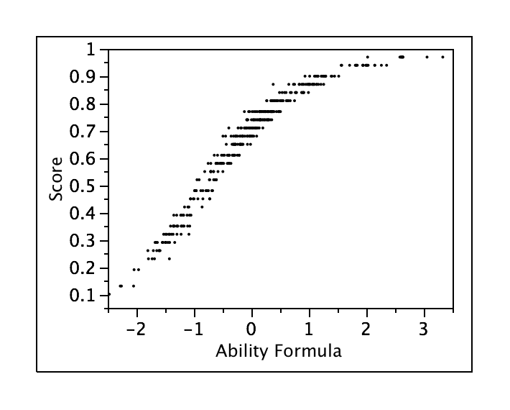
A Bit of Jargon for What is to Come

Slide 8
Face Validity?
Do professors outscore students?

Slide 9
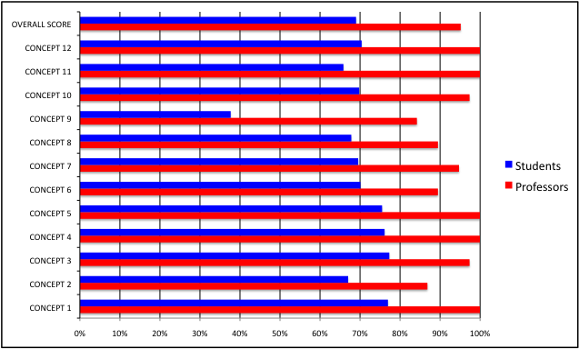
Yes, on every conceptual measure
On current 25-item version, students average 69%. Profs average 95%.

Slide 10
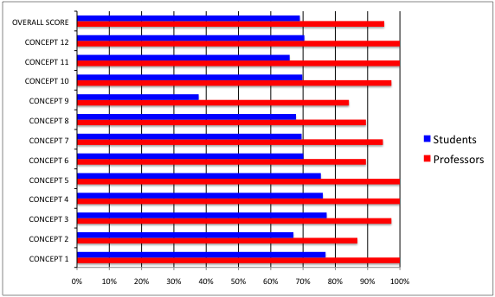
Students have some literacy: zero literacy = 25% (random guessing).

Slide 11
How much do our required general education science courses advance the citizens’ ability to employ science’s framework of reasoning?

Slide 12
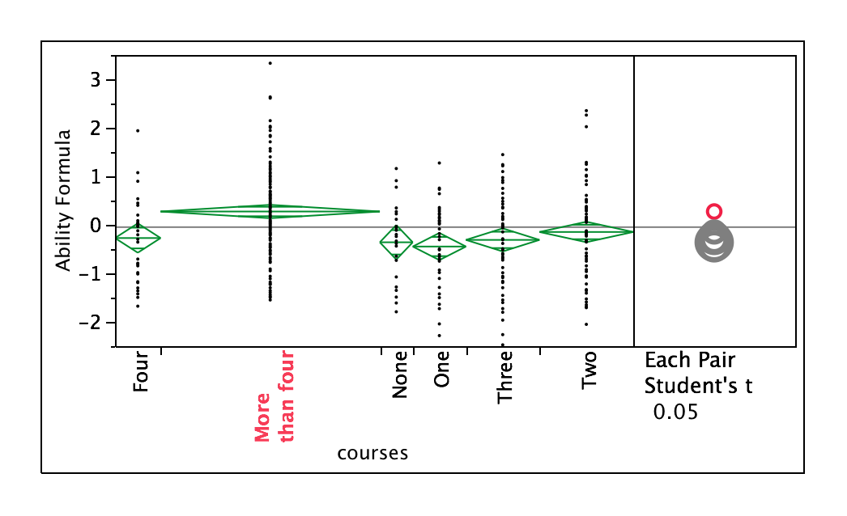
In general, these courses make no significant difference.

Slide 13
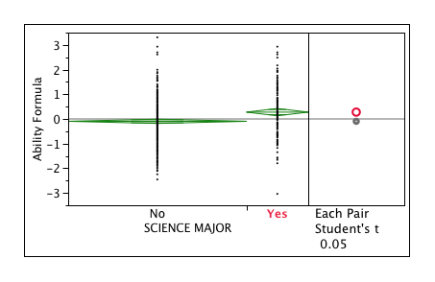
Our majors are developing a bit of literacy

Slide 14
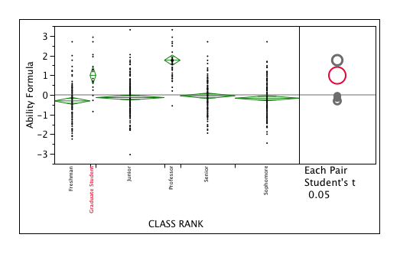
Undergraduates improve a little, but that seems not because of just science courses (previous slide). The improvement of grad students may be a result of selectivity.

Slide 15
What else are we discovering?

Slide 16
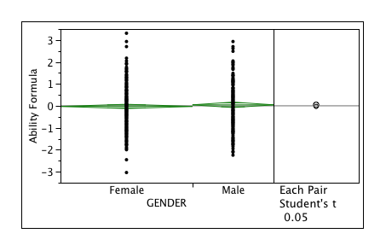
No general difference by gender

Slide 17
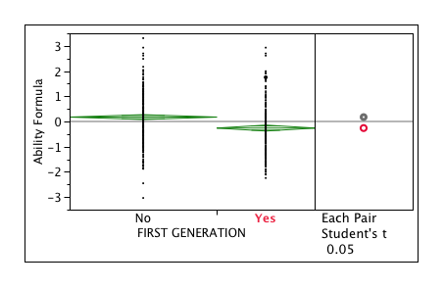
First generation students score lower

Slide 18
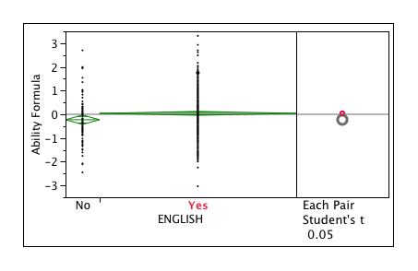
Those whose first language is English score higher.

Slide 19
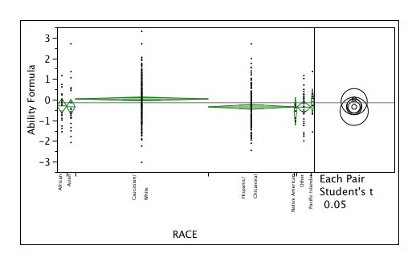
Race (for now) seems to be a mixed bag. Caucasians’mean score is highest, but differences within groups are as great as between groups. Local differences can be greater than national. We believe that it is important to track longitudinal data for one’s own campus.

Slide 20
Let’s see one example of local aberration.

Slide 21
On a pilot test, Rutgers’ students showed the general trend of no significant difference by gender.

Slide 22
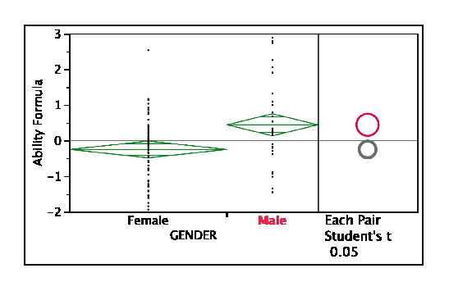
But our Channel Islands’ students showed major gender differences on the same pilot…

Slide 23
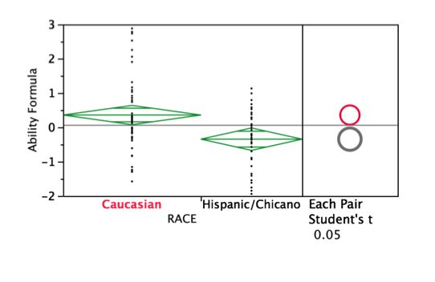
Channel Islands is a Hispanic Serving Institution…

Slide 24
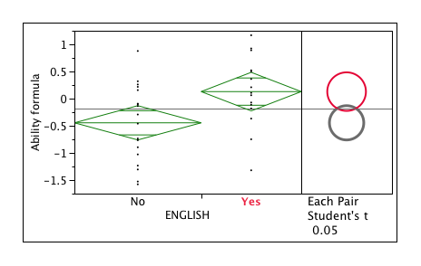
…and Channel Islands Hispanic students are not all the same; English as a first language has a major effect. Hispanics whose first language is English score on average the same as other Caucasians. The campus enrolls more women than men.

Slide 25
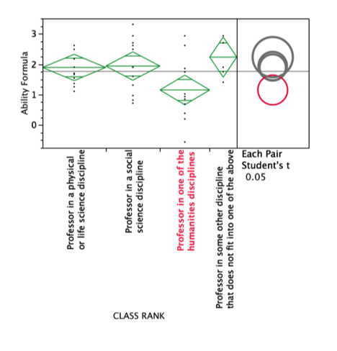
We profs do differ a little by metadiscipline.

Slide 26
Wrong answers on a concept inventory based on reasoning are as valuable to us as the number answered correctly. They help us to rank the severity of held misconceptions.

Slide 27
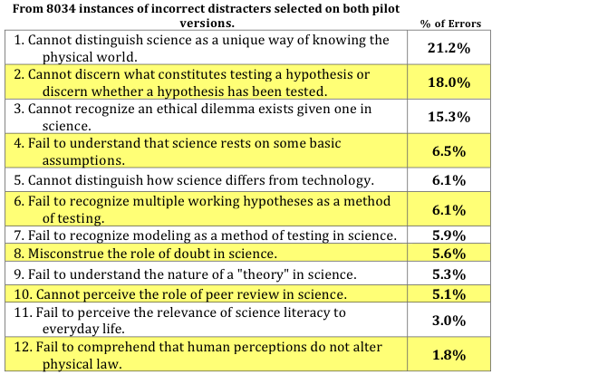
Themes and their frequency revealed by incorrectly selected distracters.

Slide 28
Summary: Early Results
We have a fledging concept inventory that seems viable, reliable, valid and useful.
Students do enter college with some science literacy already, but we seem to add little to their understanding of science as a way of knowing.
Professors in general, including non-science professors, are highly science literate…but we don’t pass this aspect on well to our students.
Overall, we don’t produce science literacy with general education courses.
Overall, we don’t advance science literacy much even with four science courses.
We gained valuable knowledge about misconceptions about science as a process of reasoning and way of knowing from this instrument.

Slide 29
Curious????
Contact ed.nuhfer@csuci.edu to get a site to run the SLCI in your course

Slide 30
Results on this talk came from
Pilot tests of two subtests of 40-items each
Version 1 with 427 respondents
Version 2 with 341 respondents
The resulting product of the pilot being run now. It consists of a 25-item SLCI made from items that tested well from item response analyses from the two pilots. The SLCI looks at a concepts of science literacy (detailed in talk that follows by Dr. Cogan).
Currently reliability is R = .82 with 688 respondents

Slide 31


FINIS!

