Slide 1
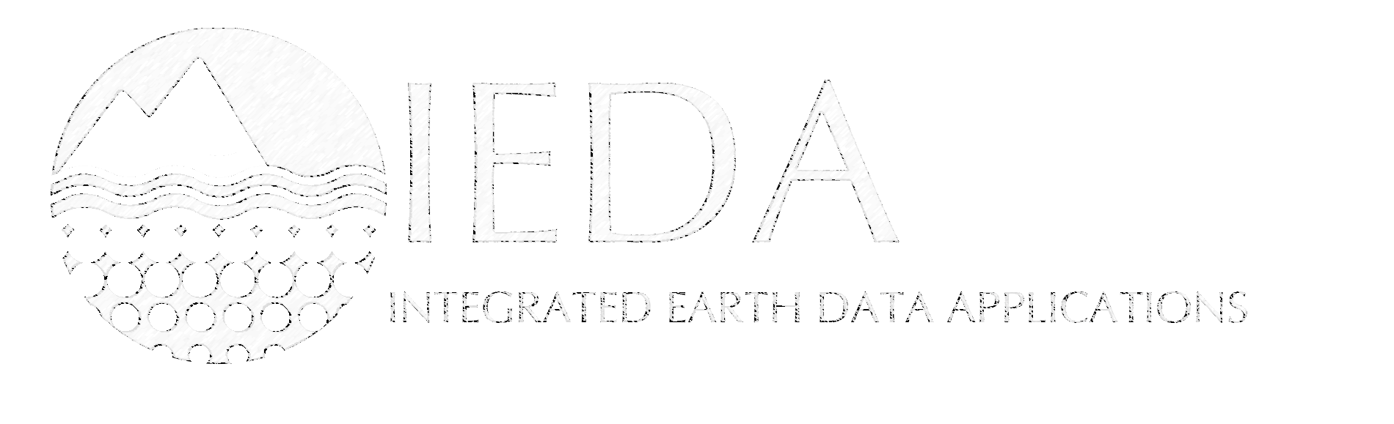

From Darkness to Light
The Long Tail of Sample-based Data in the Next Decade
Kerstin Lehnert
www.iedadata.org

Slide 2
“Dark Data is information and results from research that has not been properly archived, and therefore is not known to exist and cannot be utilized.”
From: Digital Curation – the Class Blog
http://blogs.ischool.utexas.edu/digitalcuration/2010/09/29/dark-data-needs-an-advocate/

Slide 3
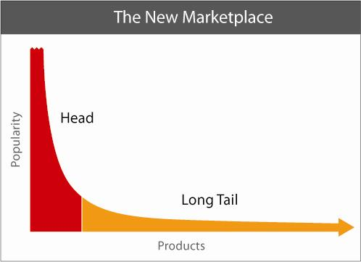
Chris Anderson’s Long Tail
Notes:
The theory of the Long Tail is that our culture and economy is increasingly shifting away from a focus on a relatively small number of "hits" (mainstream products and markets) at the head of the demand curve and toward a huge number of niches in the tail. As the costs of production and distribution fall, especially online, there is now less need to lump products and consumers into one-size-fits-all containers. In an era without the constraints of physical shelf space and other bottlenecks of distribution, narrowly-targeted goods and services can be as economically attractive as mainstream fare.

Slide 4
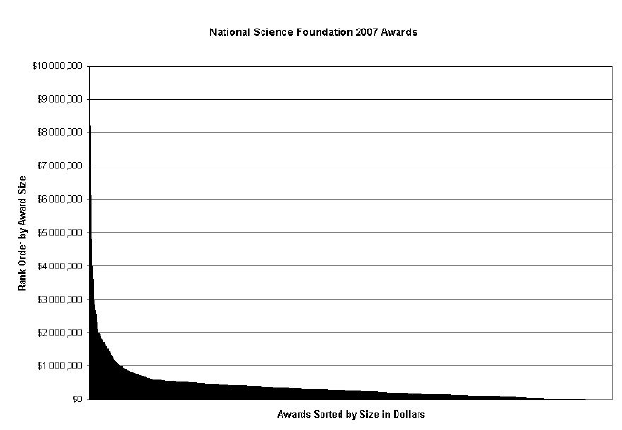
Bryan Heidorn’s Long Tail
Heidorn, P. Bryan (2008). Shedding Light on the Dark Data in the Long Tail of Science. Library Trends 57(2) Fall 2008 .
Notes:
Heidorn notes that
high volume data tend to be well-planned, well-curated, and highly visible to scientists worldwide. data gathering at the head of the graph tends to be highly automated with specialized instrumentation.
data on the right tends to be less well planned, more poorly curated and less visible.
In 2007, there were 12,025 grants, awarding a total of just under $2.9 billion. The top 20% of these grants (2,405), received a little over 50% of the total funds. If viewed by the percent of the dollar value, not by number of grants, the top 254 grants received 20% of the revenue.

Slide 5
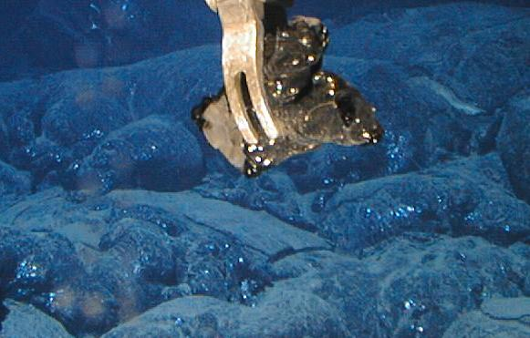
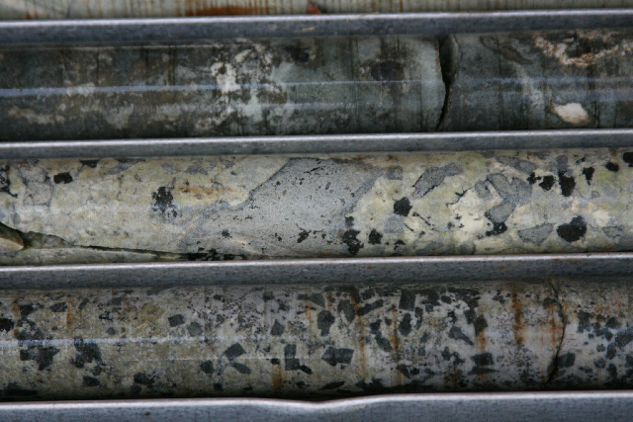
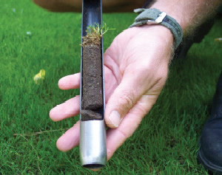
Sample-based data
“Observations commonly involve sampling of an ultimate feature of interest.”
(OGC O&M 2.0.0 / ISO19156; editor: Simon Cox)
observations made on a sample
  mostly ex-situ observations (lab data)
information about the sample
the physical object

Slide 6
Big Data vs Small Data
Big Data (Head)
Small Data (Tail)
homogeneous
mechanized
uniform procedures
central curation
maintained
immediately reused
make careers
heterogeneous
hand generated
unique procedures
individual curation
not maintained
seldom reused
currently unnoticed

Slide 7
Why do small data stay in the darkness?
Lack of infrastructure
  No adequate repositories exist.
  Lack of tools & support for data curation.
Lack of reward structure/incentives
  Large effort to organize and document the data.
  No professional recognition for data sharing.
  Publications often contain only abstract representations of the data.
Traditional scientific articles are the only way to provide access.
Researchers ‘hold’ the data for later mining.

Slide 8
Sample-based (Small) Data Issues
Highly diverse (thousands of variables and materials)
Diverse & customized data acquisition procedures
Complex data documentation
Lack of data formats
Data often not digital: field notes, visual sample descriptions
Lack of data repositories
Culture of non-sharing

Slide 9
Why sample-based data matter
data on samples are key to our knowledge of Earth’s dynamical systems and evolution
  global climate change and paleoclimate
  biogeochemical cycles
  magmatic processes, mantle dynamics
samples are a relevant component of earth observations
calibration of models and simulations of earth systems
samples and sample-based data are often expensive to acquire

Slide 10
Foci for the next decade
infrastructure
  repositories, standards, workforce
incentives
  attribution, recognition, cool tools
support
  resources, training

Slide 11

Geoinformatics for Geochemistry
developed data models and databases for sample-based analytical data
built highly successful geochemical synthesis databases (PetDB, EarthChem)
developed standards for data reporting
created the International Geo Sample Number as a unique identifier for samples
since October 2010 part of the NSF-funded IEDA Data Facility

Slide 12
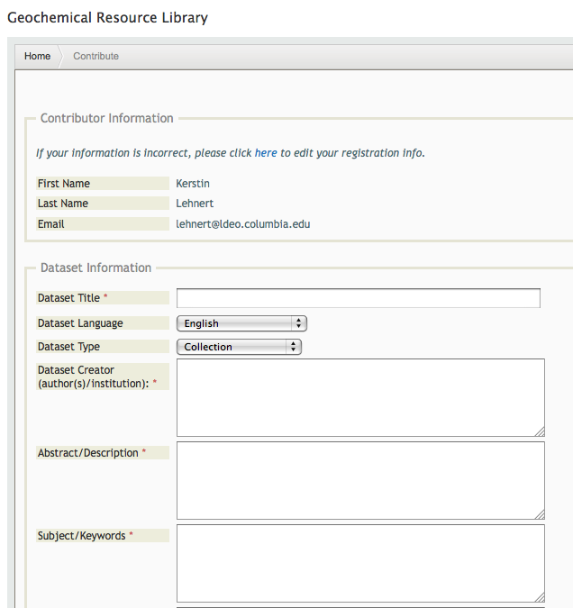
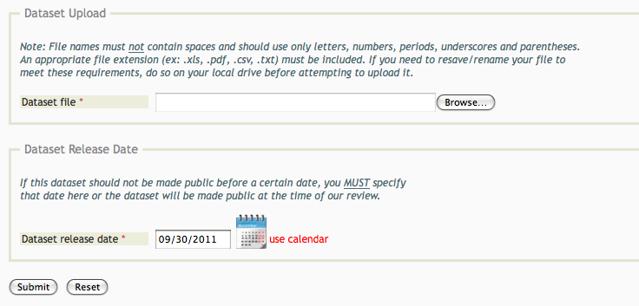
Repository Service
Geochemical Resource
Library
Repository for sample-based data
Web-based user submission

Slide 13
GRL: New Capabilities in 2012
Linking datasets to NSF award numbers
  IEDA Data Compliance Report lists datasets in the GRL & MGDS
  Interoperability with FastLane
Extended metadata for discovery
  Include sample identifiers & locations for samples in dataset metadata
Long-term preservation of data (CU Libraries)
Dataset registration with DOIs (DataCite)

Slide 14
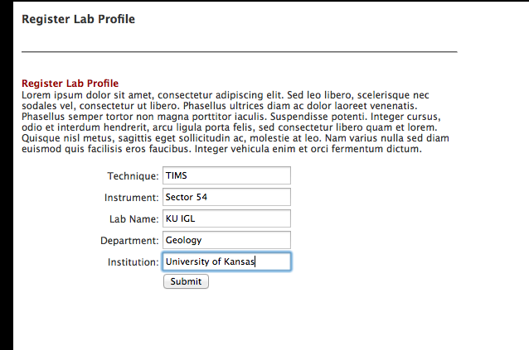
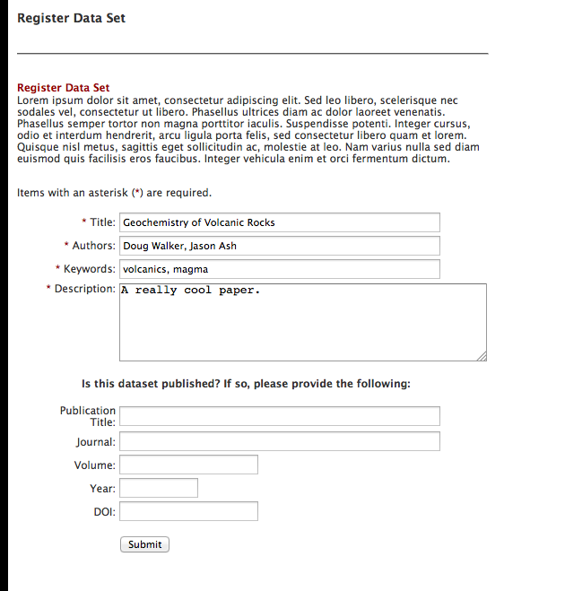
GfG Data Submission

Slide 15
DOI:10.1594/IEDA/100004
Metadata record in the Geochemical Resource Library

Slide 16
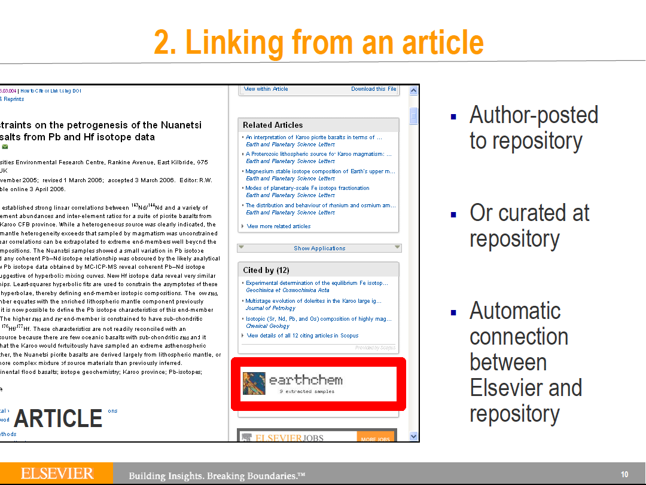

Slide 17
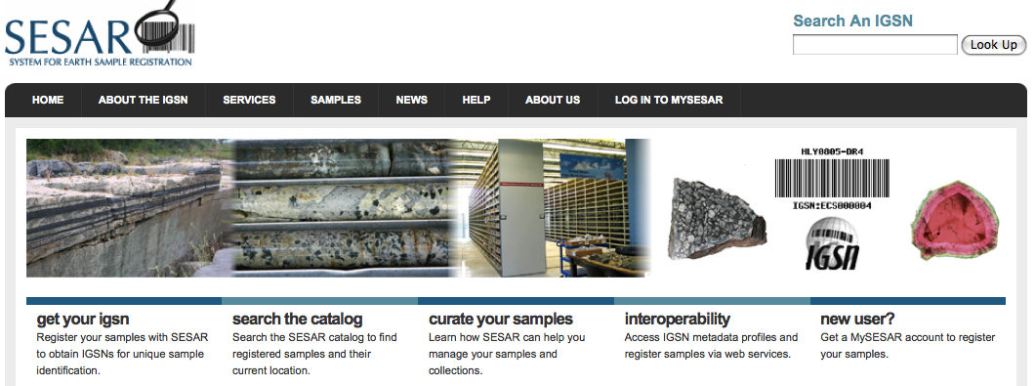

sample registration at SESAR
Facilitate discovery of samples
Ensure unique identification
Preserve sample metadata
www.geosamples.org

Slide 18
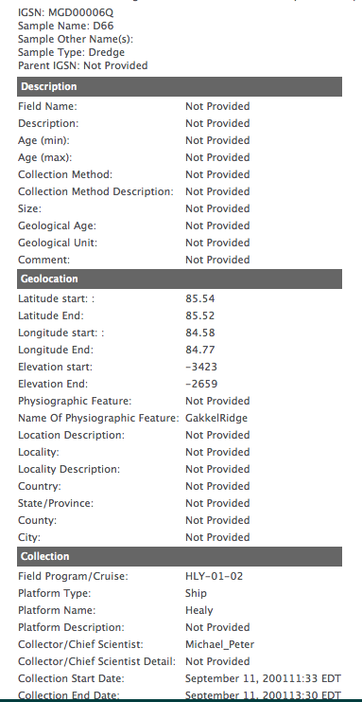
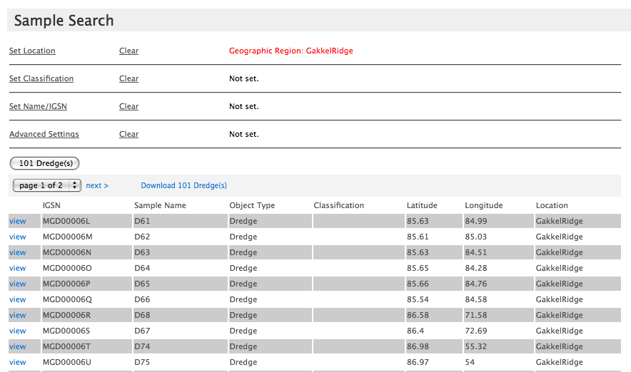

Slide 20
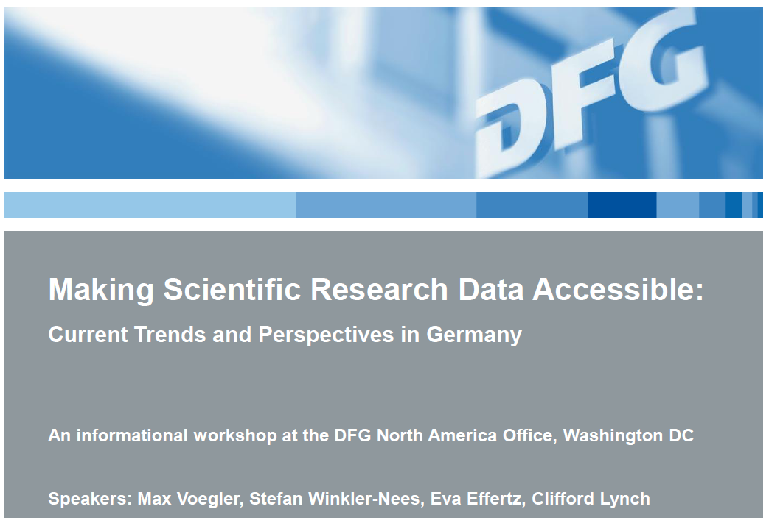
Light on the Horizon
Growing recognition globally of the need for access to scientific data
  NSF’s new implementation of their data sharing policy
  Funding to develop GEO data infrastructure
    DataNet
    EarthCube
Slide courtesy of B. Ransom, NSF/OCE

Slide 21



light on the horizon
New services & tools emerging that facilitate curation of sample-based data
  SESAR sample registration
  data publication
  tools for data & metadata capture

Slide 22
Much more is needed
recognition of data citation as a professional achievement
a new workforce
resources for data curation
data management as part of the Geoscience curriculum
community governance

Slide 23

Dark data is important, and we will not know how important it may be until more and more of it is made available to us.

