Slide 1

Development of a Concept Inventory for Science Literacy
Christopher B. Cogan, CSU Channel Islands
Edward Nuhfer, CSU Channel Islands
Carl T. Kloock, CSU Bakersfield
Geological Society of America, Minneapolis, Minnesota, 12 October 2011

Slide 2
General Education Science Courses
Typically Stated Goal:
Students should achieve “Science Literacy”
i.e. Students should know what science is and how it operates as a conceptual way of knowing.
Typical Reality:
Focus is relegated to discipline-specific knowledge and convergent problems.
Neglects meaningful learning frameworks of reasoning and processes of science.
Result:
Misconceptions about science persist beyond courses and graduation.

Slide 3
General Education vs Liberal Education and Science
Liberal Education…
Is acquired through the collaboration and integration of General Education and the major.
However, GE content emphasis limits integration across majors.
Understanding a framework of reasoning and way of knowing does allow such transfer.
The latter is the type of science literacy we address in our Science Literacy Concept Inventory (SLCI).
(This includes material addressed in the AAAS Project 2061 Atlas of Science Literacy.)
Notes:
http://www.project2061.org/publications/atlas/default.htm

Slide 4
Major Questions about Science Literacy
What does the educated citizen really need to know about science?
How do we know science literacy when we see it?
And how do we measure it?

Slide 5
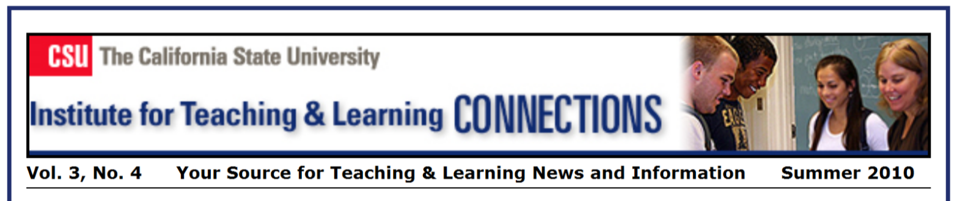
Exploration
CSU Institute for Teaching and Learning
Cross disciplinary group of 9 Scientists
Begin with civil discussions…

Slide 6
…among the Co-Conspirators
Edward Nuhfer, Faculty Development & Geology, Channel Islands
Jerry Clifford, Physics, Channel Islands
Christopher Cogan, Environmental Sciences & Resource Management, Channel Islands
Anya Goodman, Biochemistry, San Luis Obispo
Carl Kloock, Biology, Bakersfield
Beth Stoeckly, Physics, Channel Islands
Christopher Wheeler, Geology, Channel Islands
Gregory Wood, Physics, Channel Islands
Natalie Zayas, Science Education & Environmental Sciences, Monterey Bay

Slide 7
Starting from the beginning…
Science is...
A system to acquire knowledge, often through the development of models to help us understand the natural world and human behavior and society. Each of these systems usually follows variations on time-tested formal scientific methods, and the results are always subject to peer review and change.

Slide 8
What’s Science?
"Science is the acquisition of reliable
but not infallible
knowledge of the real world,
including
explanations of the phenomena"
(Strahler, 1992)
Science involves only testable knowledge about the physical world.

Slide 9
Project Phase 1. If a graduate is “science-literate,” what signature outcomes should the graduate exhibit as a result?
Step 1. What does extensive literature reveal?
Step 2. How does our pooled expertise inform this literature?
Step 3. Write assessable learning outcomes based upon Steps 1 & 2.
Step 4. Prioritize these outcomes
What is minimal – “good enough”?
What is ideal?

Slide 10
Project Phase 2. Reality check: GE Outcomes important enough to be required – should reflect a major unifying concept that carries across all disciplines of science.
Step 1. For each outcome, state the correlative concept, and scrap any outcomes that don’t reflect such concepts.
Step 2. Articulate common misconceptions about each that get in the way of understanding.
We arrived at twelve final outcomes; seven we deemed essential.

Slide 11
12 Concepts of Science Literacy
1. Science explains physical phenomena based upon testable information about the physical world.
2. In modern life, science literacy is important to both personal and collective decisions that involve science content and reasoning.
3. Doubt plays necessary roles in advancing science.
4. Scientists use evidence-based reasoning to select which among several competing working hypotheses best explains a physical phenomenon.
5. A theory in science is a unifying explanation for observations that result from testing several hypotheses.
6. Peer review generally leads to better understanding of physical phenomena than can the unquestioned conclusions of involved investigators.

Slide 12
12 Concepts of Science Literacy
7. Science can test certain kinds of hypotheses through controlled experiments.
8. All science rests on fundamental assumptions about the physical world.
9. Science differs from technology.
10. Scientific knowledge is discovered, and some discoveries require an important history.
11. Science employs modeling as a method for understanding the physical world.
12. Scientific knowledge imparts power that must be used ethically.

Slide 13
So what?
Now we know what to teach –
But are we teaching it?

Slide 14
PHASE 3. Measurement
Disciplinary Concept Inventories
Physics (Hestenes, Wells and Swackhamer, 1992).
Chemistry (Mulford 1996).
Geology (Libarkin and Anderson, 2007)
Biology (D’Avanzo, 2008)
Plus others in some sub-disciplines (astronomy, genetics etc.)
No existing Concept Inventory for General Education Science Literacy
So we are making one.
(began with principles from Libarkin 2008)

Slide 15
Which of the following statements presents a hypothesis that science can now easily resolve?
Example of a Concept Inventory Question:
A. Warts can be cured by holding quartz crystals on them daily for a week.
B. A classmate sitting in the room can see the auras of other students.
C. Radio City Music Hall in New York is haunted by several spirits.
D. People with chronic illnesses have them as punishment for past misdeeds.

Slide 16
Student can articulate in her/his own words a reasonable definition for what constitutes science.
Student Learning Outcome 1.
Concept Misconception
Science explains physical phenomena based upon testable information about the physical world.
Science is on a mission to refute religion; scientists study the paranormal.
In this case: student is unable to distinguish untestable statements from testable hypotheses.

Slide 17
Which of the following statements presents a hypothesis that science can now easily resolve?
A. Warts can be cured by holding quartz crystals on them daily for a week.
B. A classmate sitting in the room can see the auras of other students.
C. Radio City Music Hall in New York is haunted by several spirits.
D. People with chronic illnesses have them as punishment for past misdeeds.

Slide 18
Examples of other misconceptions
Expressing doubt of commonly accepted beliefs may be rude, impolite and disrespectful. Informed doubt is not distinguished from uninformed bias or appeals to authority.
All science involves controlled experiments; a hypothesis is a proven fact; conflicting hypotheses are all equally valid.
“It’s ONLY a theory.” A theory is just an interesting idea that some people like to believe. Neither evidence nor testable explanations are issues.

Slide 19
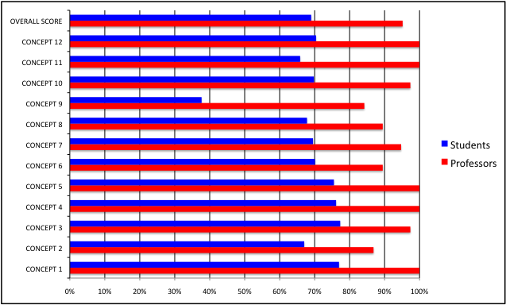
Science Literacy Concept Inventory Results
students score lower than profs in every measure

