Slide 1
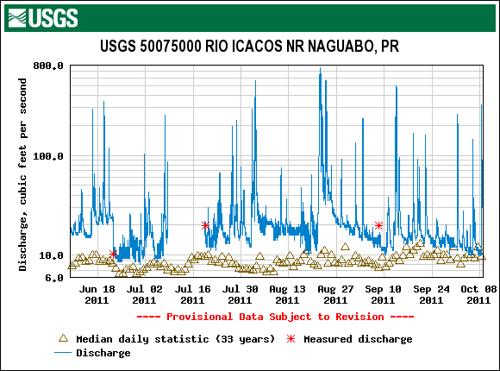
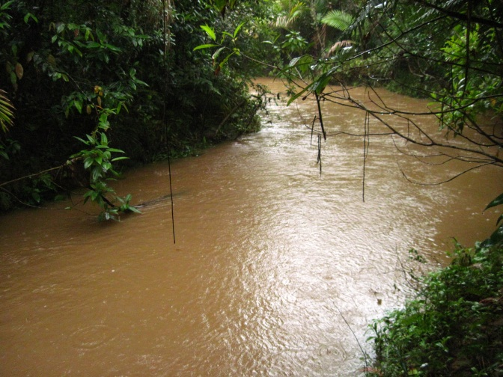
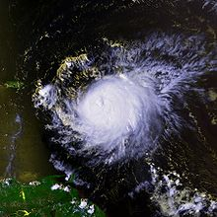
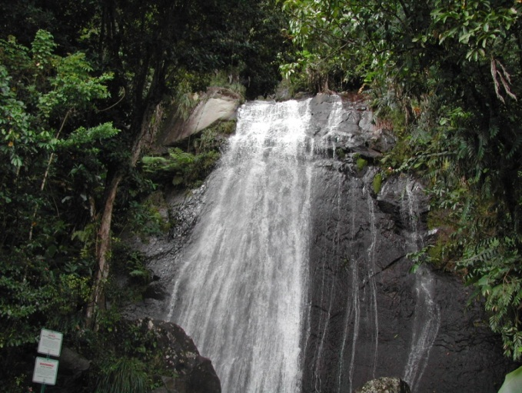




Stream Solute Export and Biogeochemistry in the Luquillo Mountains, Puerto Rico
Richard L. Brereton
William H. McDowell
University of New Hampshire
University of
New Hampshire
Notes:
Subscript and superscript chemical formulas

Slide 2
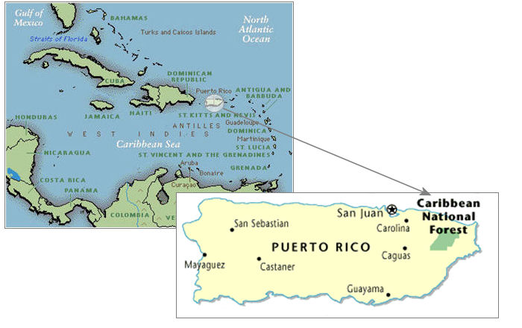
El Yunque National Forest, PR
The only tropical rainforest in the U.S.
70% of runoff is withdrawn (Crook 2005)
LTER since 1988
CZO since 2009

Slide 3
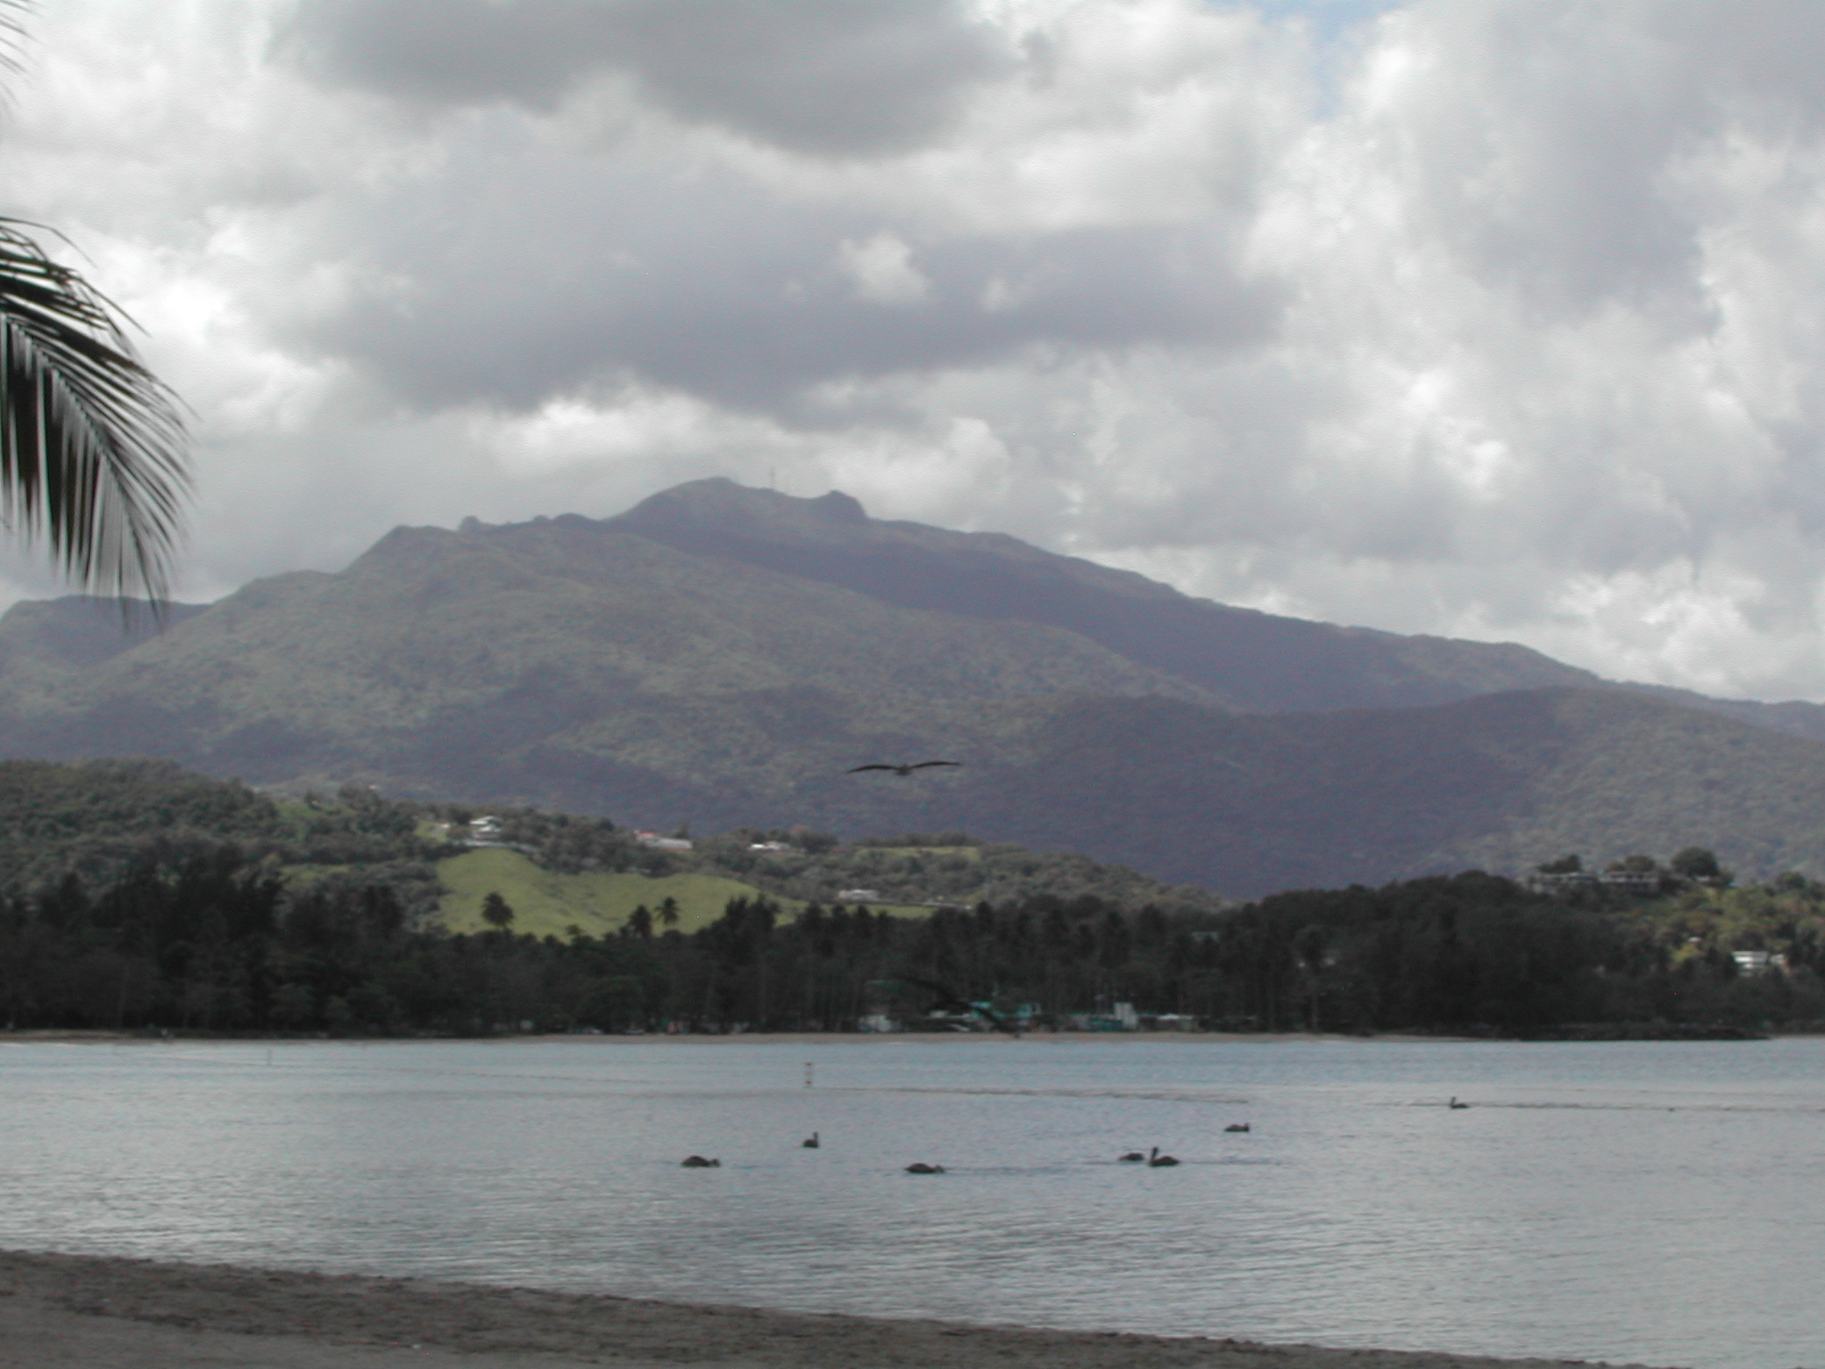
Tropical Montane Wet Forest
Notes:
1000 m elevation
3.5-4.5 m of rain
6 m is the upper limit

Slide 4
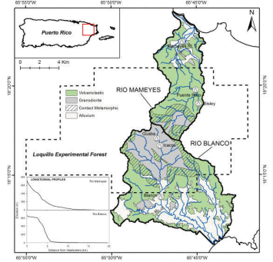
Two Very Different Watersheds
Rio Mameyes
Volcaniclastic bedrock
3.5 m/y of rain
Lower avg. elevation
Rio Icacos/Blanco
Granodiorite bedrock
4.5 m/y of rain
Higher avg. elevation

Slide 5
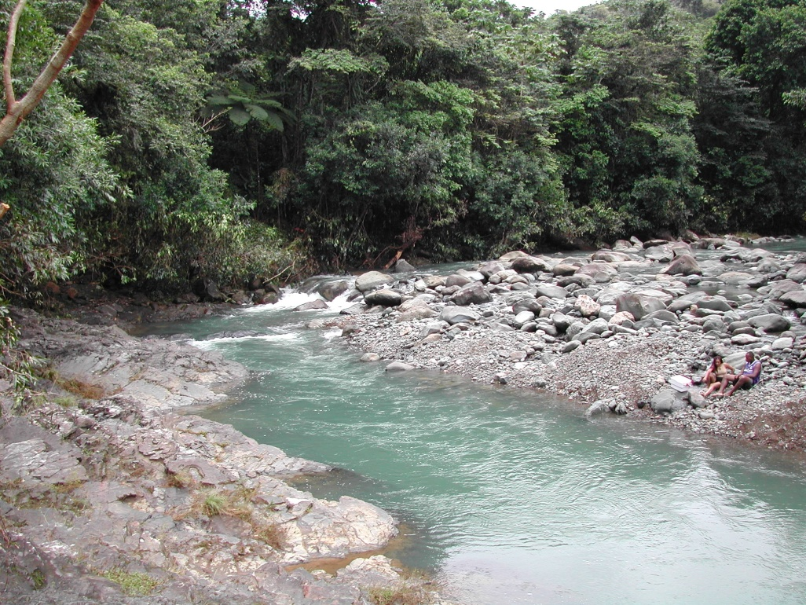
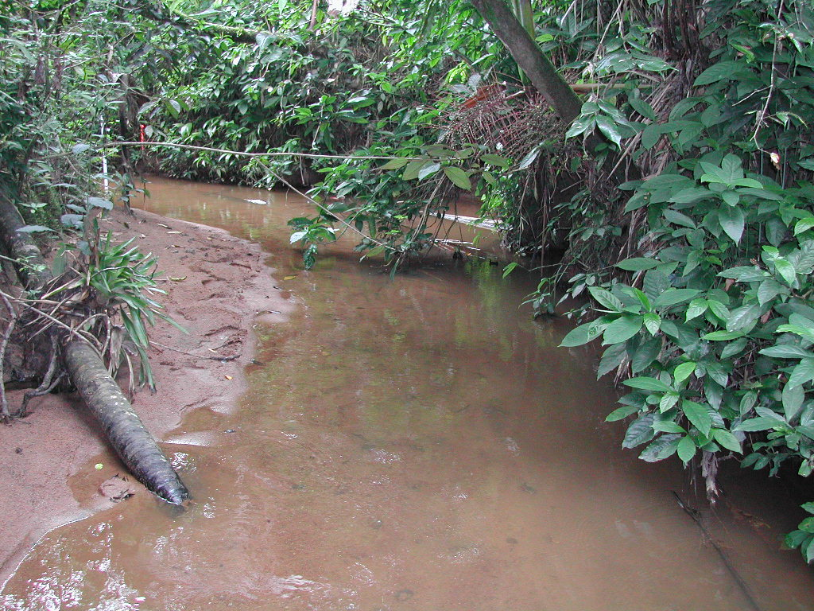
Volcaniclastic:
Rio Mameyes
Bisley watersheds
Q. Sonadora
Granodiorite
Rio Icacos
Q. Guaba

Slide 6
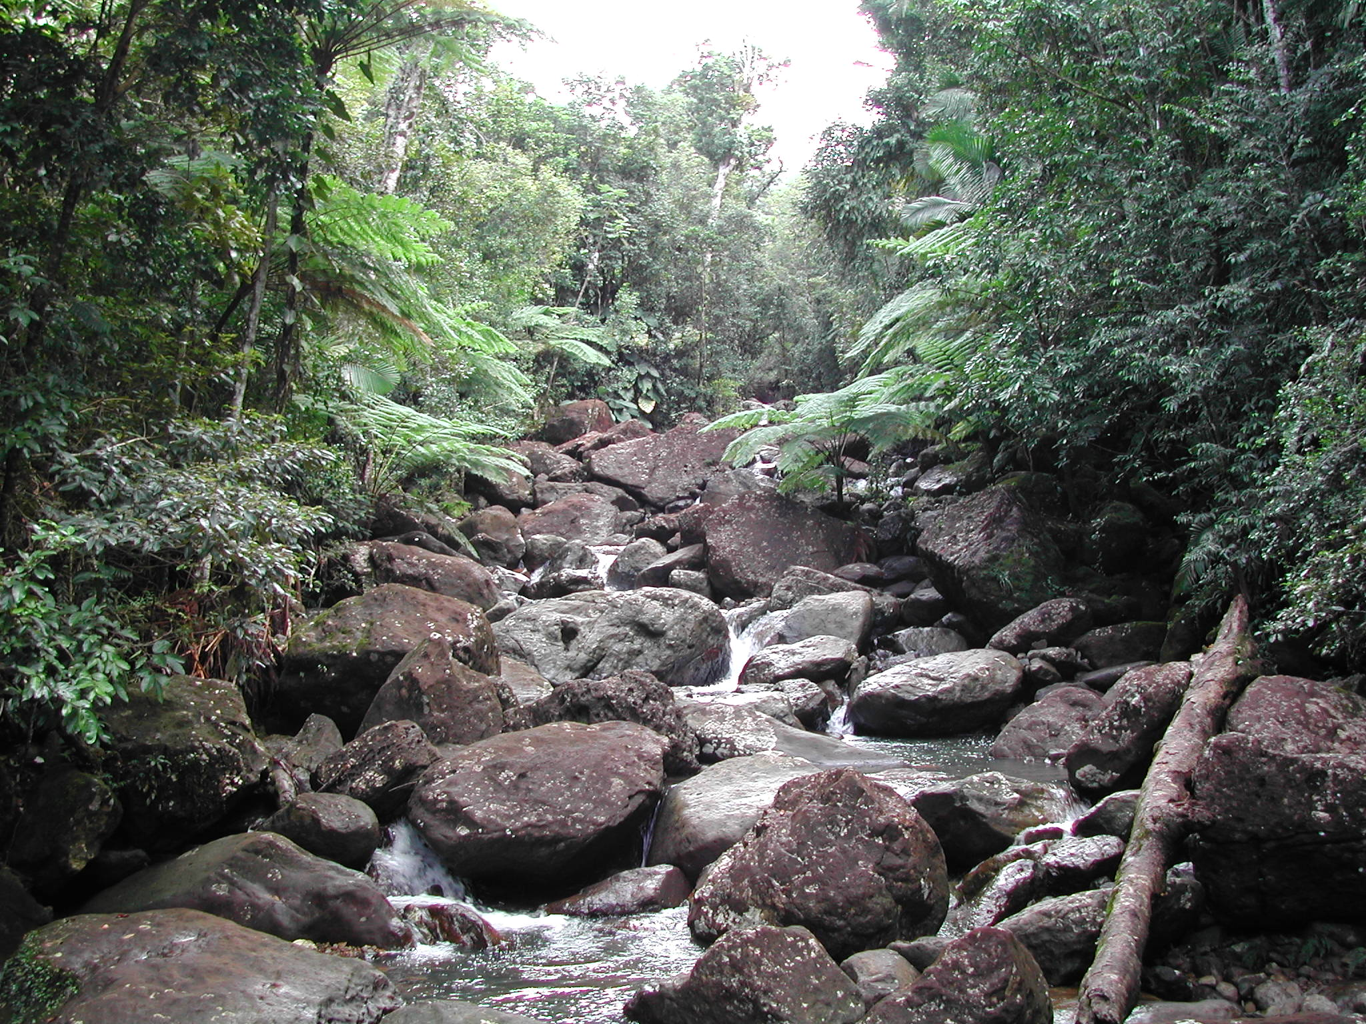
Quebrada Sonadora - low flow
Notes:
Same spot on the Sonadora at low flow. We sample all flows to understand ecosystem behavior over time

Slide 7
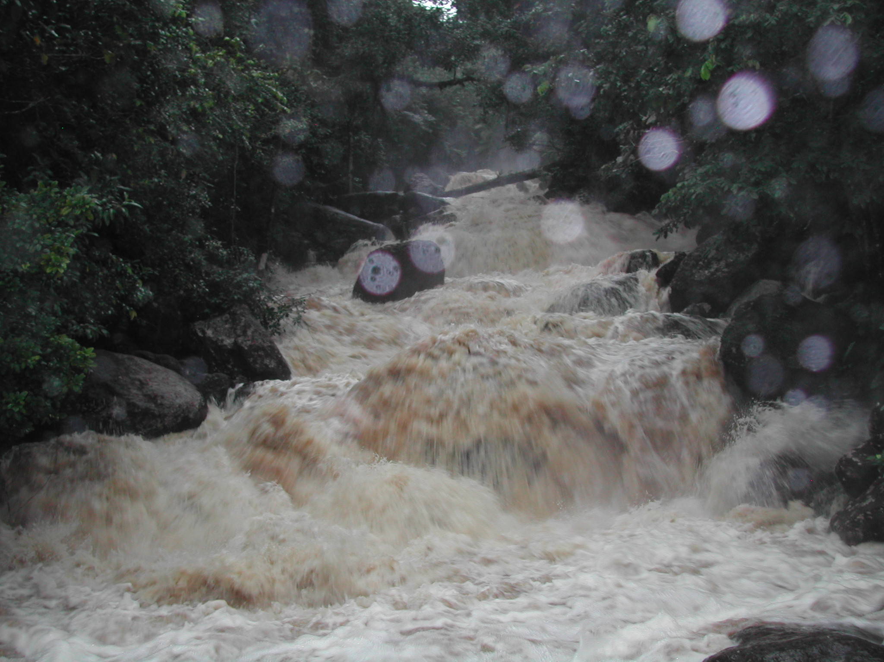
Notes:
Sonadora at high flow

Slide 8
Controls on stream chemistry
Major ions reflect lithology and sea salt
Dilution at high flows
Silica dilution is among highest measured (Godsey et al. 2009)
TSS increases with flow
Biogeochemical puzzle: Carbon and Nitrogen

Slide 9
Shanley, McDowell, and Stallard 2011
“Boomerang” effect of DOC in the Icacos

Slide 10
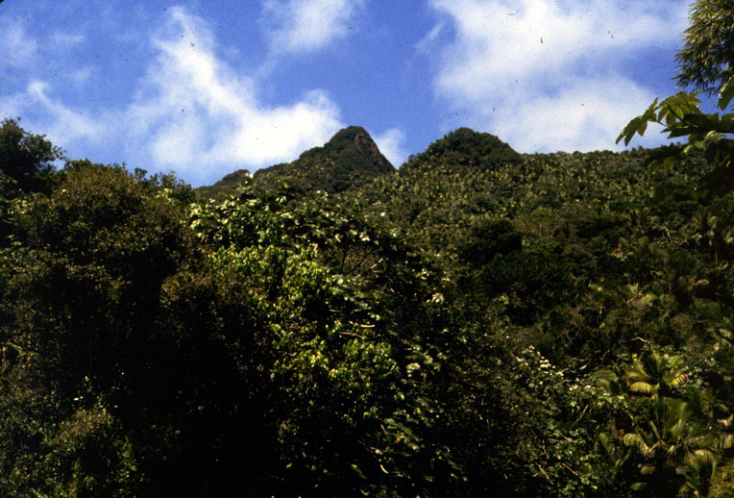
El Yunque, 1984
Notes:
1983
Look for before/after photos
One slide for all photos

Slide 11
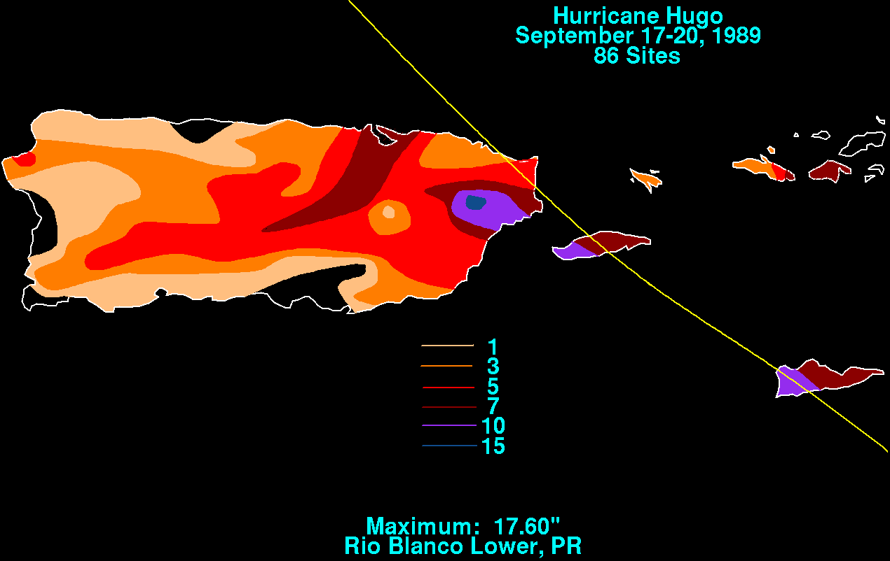
1989 – Hurricane Hugo
Study Area
Category 4 Hurricane:
226 km/hr sustained
(Inches of rain)

Slide 12
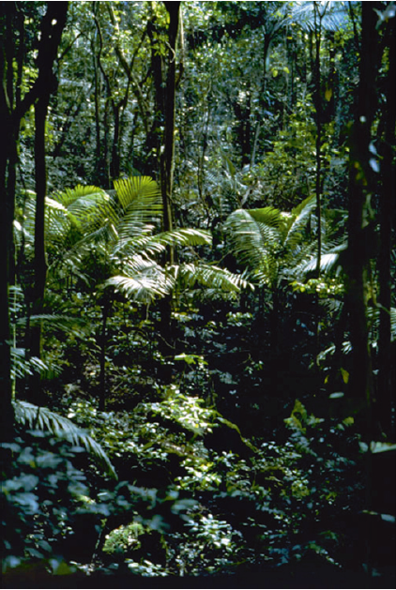
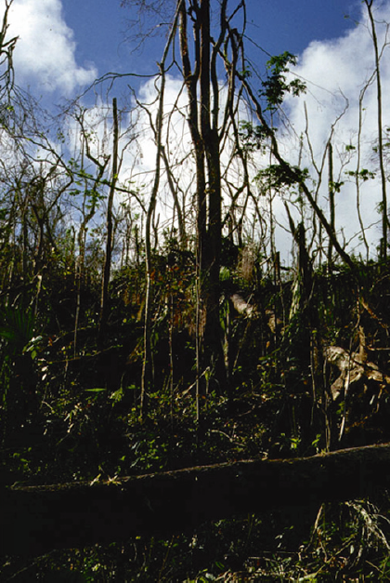
Bisley Experimental Watersheds
Before Hugo After Hugo

Slide 13
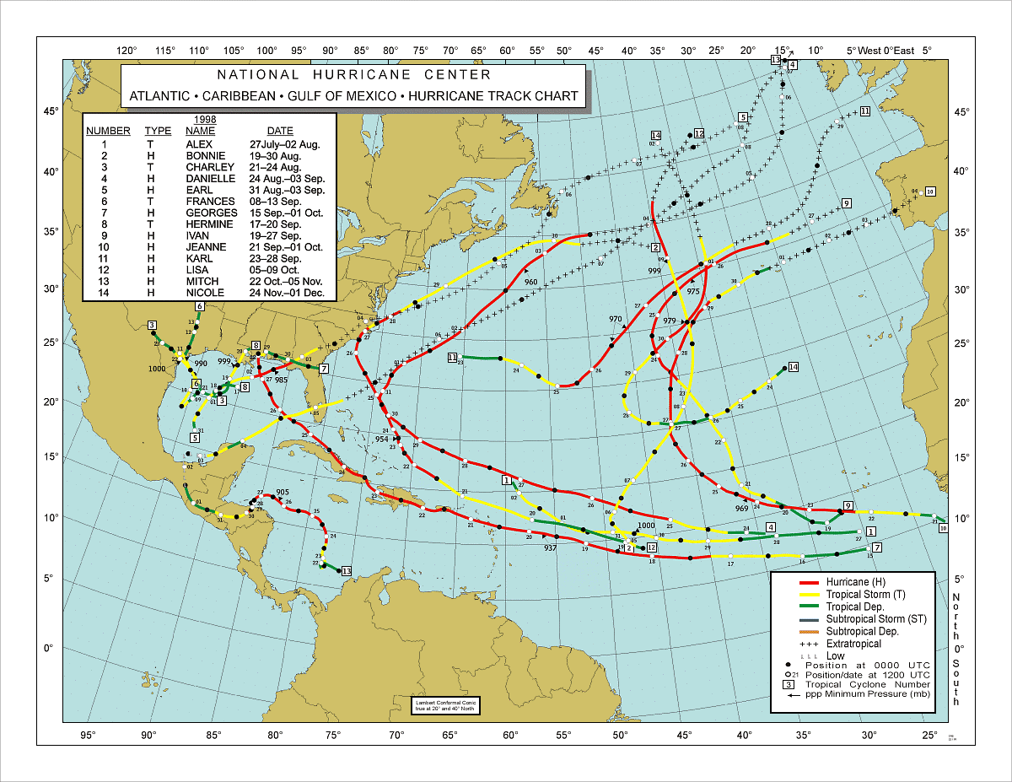
Georges, 1998 Category 3, 175 km/hr sustained

Slide 14
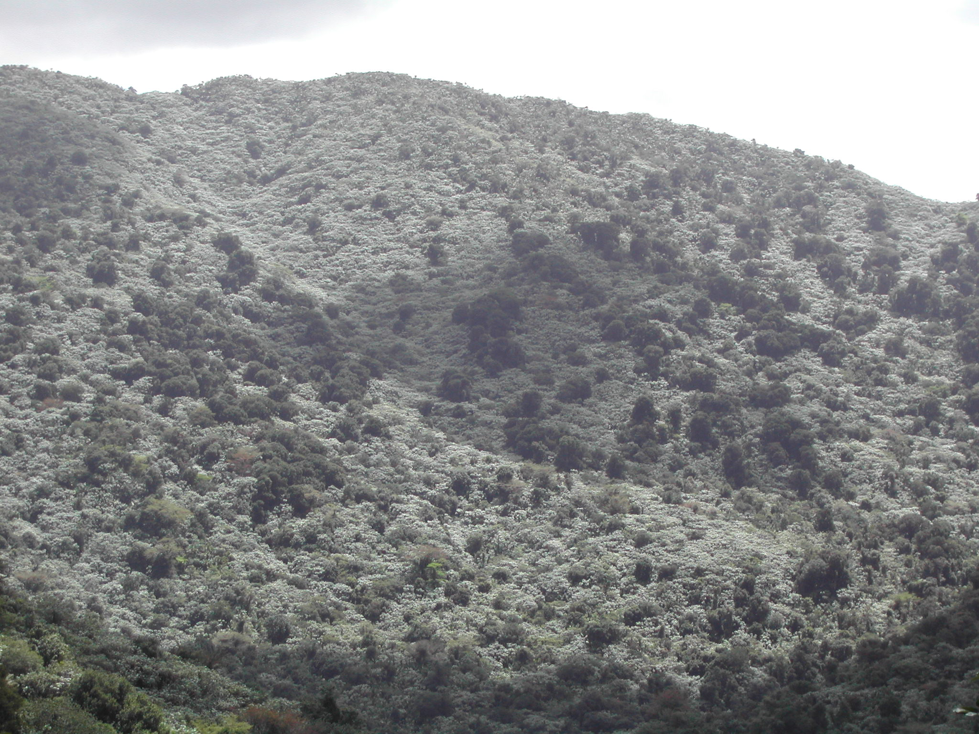
Mameyes headwaters – 2005
Notes:
Regrowth
This photo is not black and white – cecropia leaves are white underneath – fast-growing colonizer

Slide 15
Weathering products and DOC: no response to hurricanes
Icacos after Georges
Notes:
Weathering products show dilution, DOC shows increase

Slide 16
Nitrate response in two small watersheds after Georges (1998-2009)
Volcaniclastic
(Prieta)
Quartz diorite
(Guaba)
Notes:
Where is baseline?

Slide 17
Two larger basins,
Sonadora (254 ha) and Icacos (326 ha) after Georges (1998-2009)
Pre-Hurricanes
1983-1986
Rio Icacos
Q. Sonadora
Notes:
Icacos is still not back to pre-hurricane NO3

Slide 18
What makes nitrate behave so differently from other solutes?
Why the slower return to baseline in granodiorite watersheds?

Slide 19
Biogeochemical controls on N flux to streams
Hydrologic flow path – groundwater? surface runoff?
Residence time – contact with soils
What is the matrix?
Redox conditions – climate
Riparian denitrification
NO₃ N₂O N₂
Notes:
Nitrous oxide!!

Slide 20
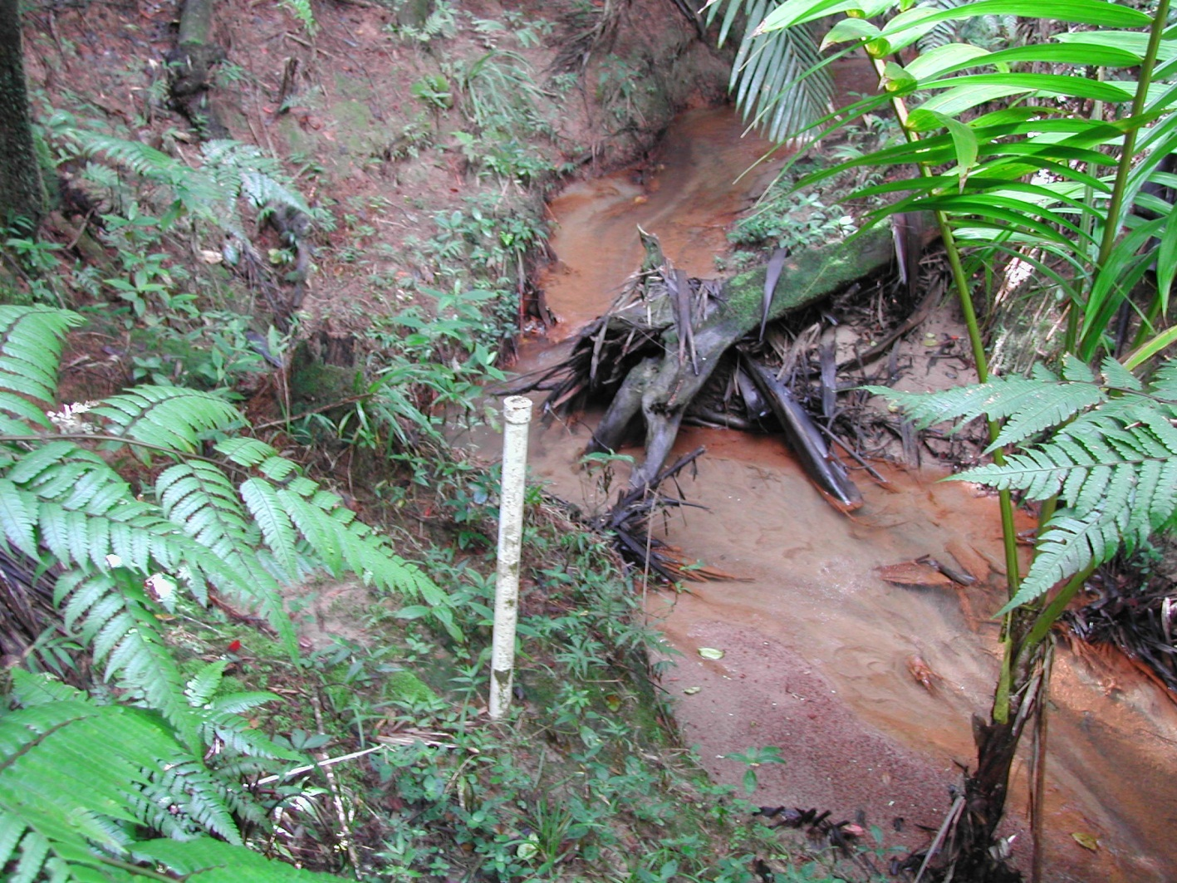
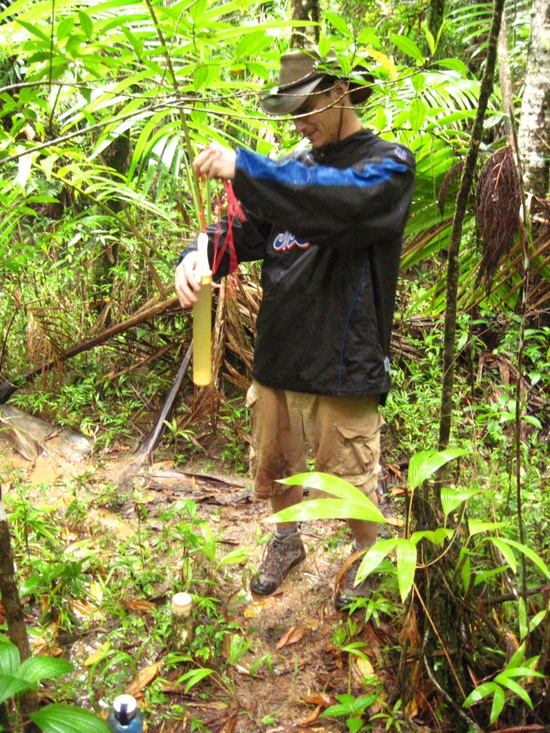
Groundwater monitoring wells
Transects across catena

Slide 21
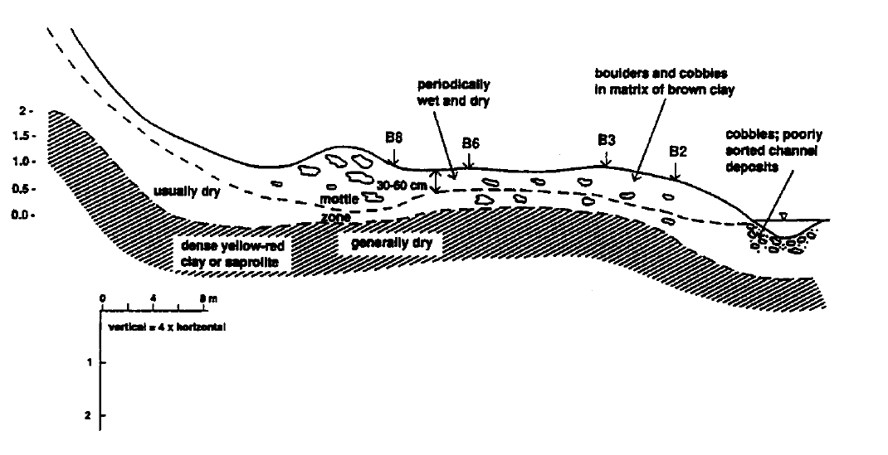
Bisley – volcaniclastic
Riparian zone:
Denitrification “hotspot”
periodically anaerobic
C source
high retention time
Modified from McDowell et al. 1992

Slide 22
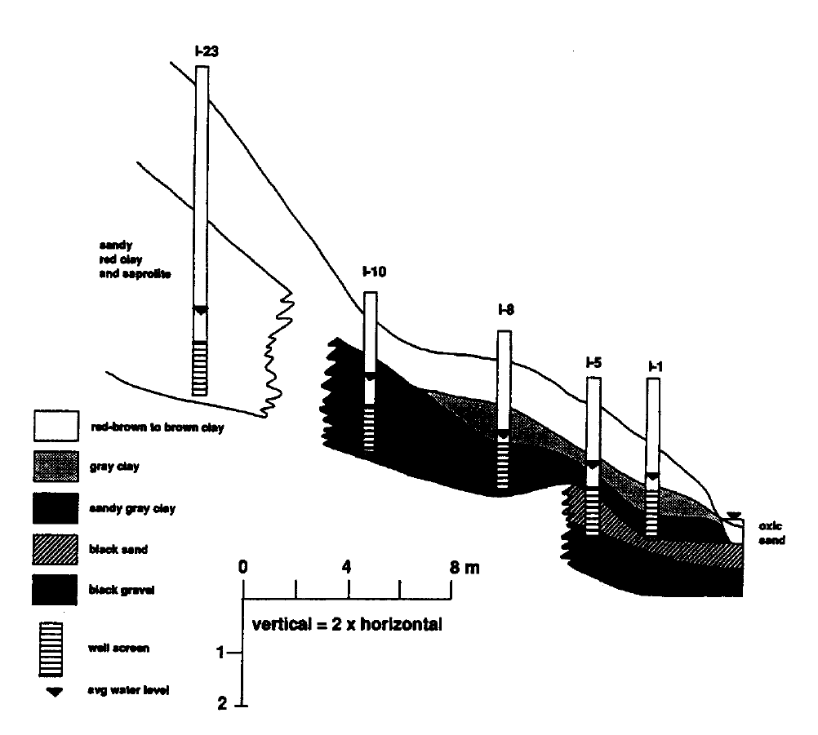
Icacos trib. – granodiorite watershed
Key:
NO₃
NH₄
550
35
Slope
Riparian Zone
450
30
20
370
20
560
5
560
Stream:
100
10
Flows into Icacos
Modified from McDowell et al. 1992
Notes:
No red and green, add legend
DON levels don’t change

Slide 23
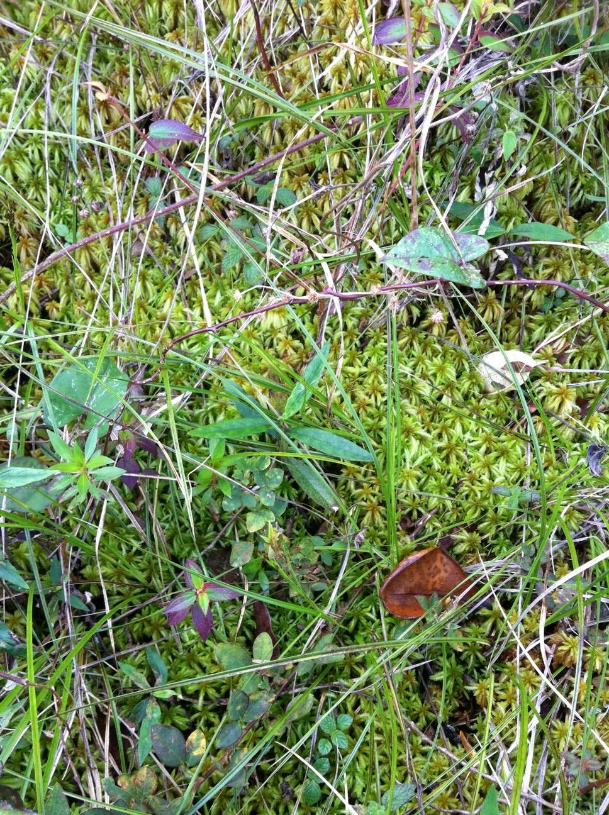
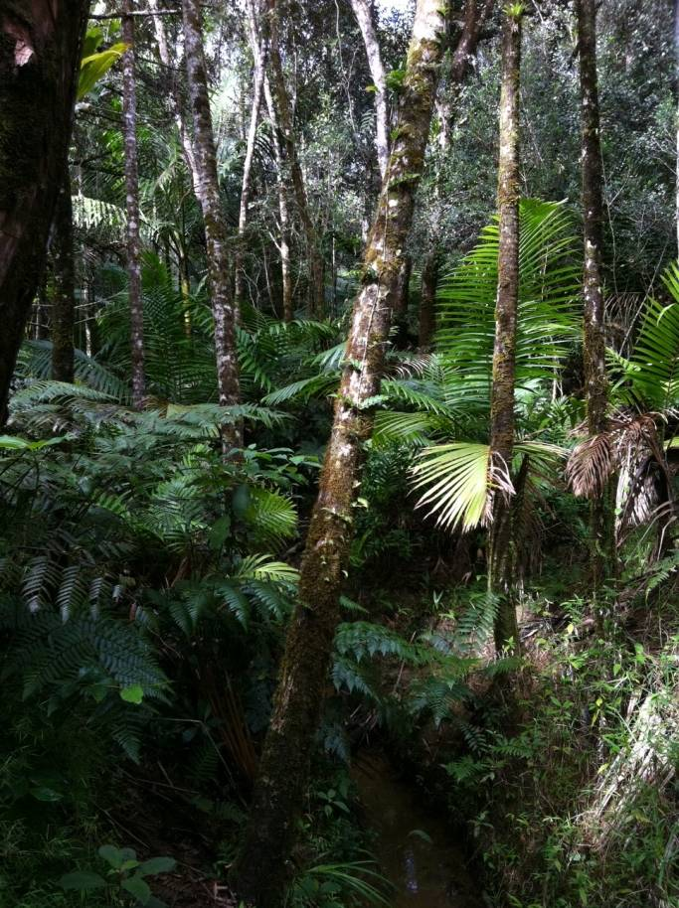
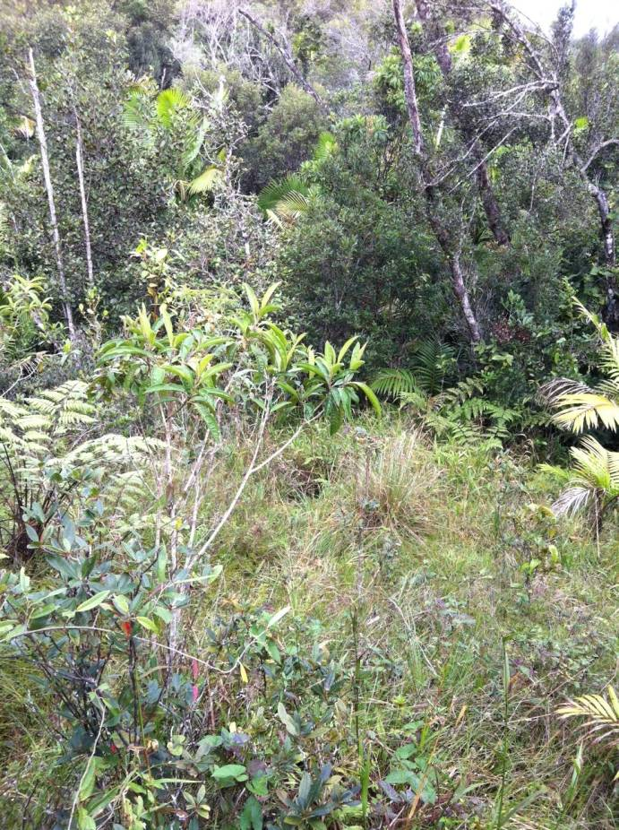
Icacos – slow recovery
Notes:
Large patches of open canopy, ground covered with mosses

Slide 24
Conclusions
Luquillo stream chemistry reflects lithology overlain by vegetation, climate, disturbance history
Hurricanes cause dramatic shifts in forest biogeochemistry, reflected in stream nitrate peaks
Riparian zones hold the key to understanding long-term nitrogen dynamics in the Luquillo Mountains
Notes:
Long term vs. short term synthesis
Importance of riparian retention

Slide 25
Acknowledgements
Funding from NSF-LTER, NSF Ecosystems, NSF-CZO, USFS IITF, UPR, UNH
Collaborators include F. Scatena, A. Lugo, D. Schaefer, C. Asbury, J. Merriam, J. Potter, and others
Field and laboratory assistance from M. Salgado, M.J. Sanchez, J. Bithorn, J. Merriam, J. Potter, J. Orlando, and others

Slide 26
Questions?
Key:
NO₃
NH₄
550
35
Slope
Riparian Zone
450
30
20
370
20
560
5
560
Stream:
100
10
Flows into Icacos
Modified from McDowell et al. 1992
Notes:
No red and green, add legend
DON levels don’t change

