Slide 1
New Site Features and Benefits
Lauren Marley
Marketing & Communications Specialist
marley@geoscienceworld.org

Slide 2
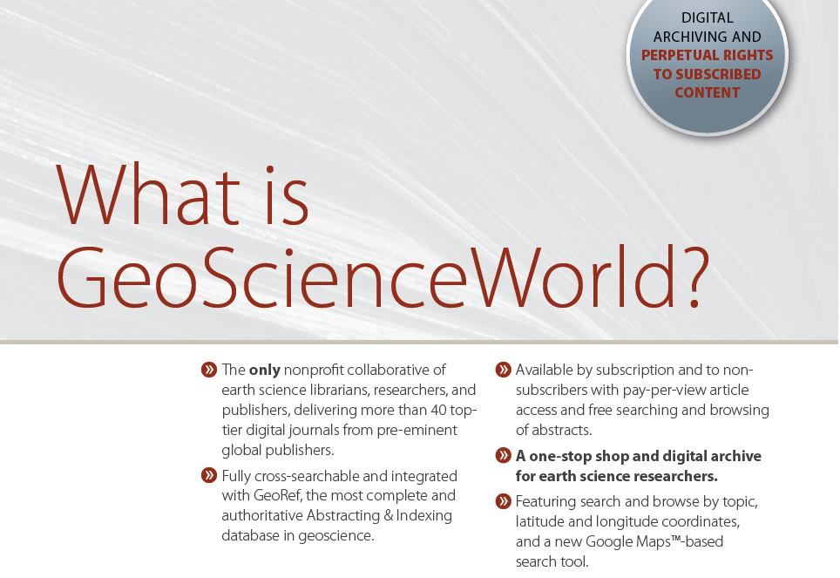

Slide 3
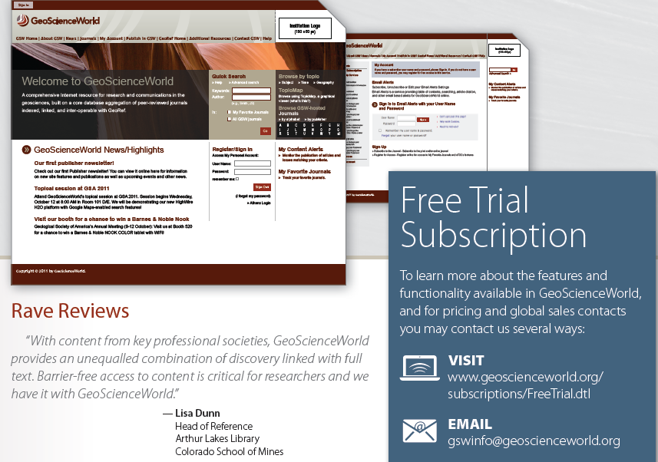

Redesigned home page live in early 2012

Slide 4
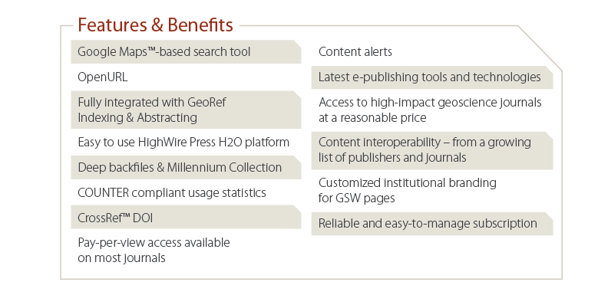
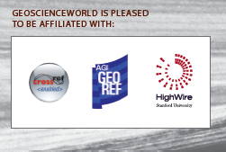

Slide 5
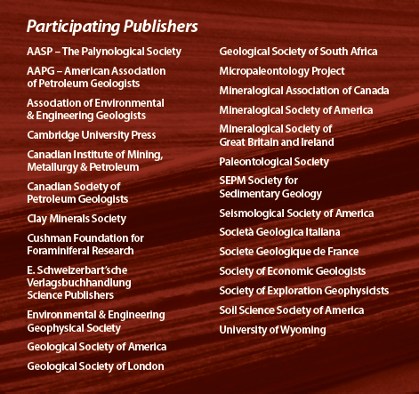
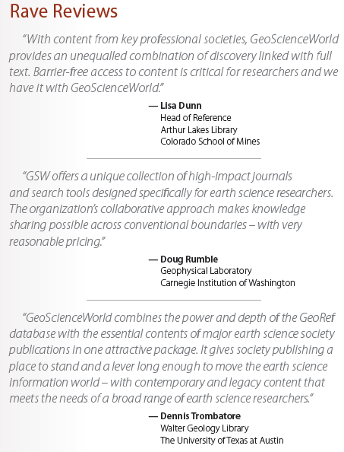

Slide 6
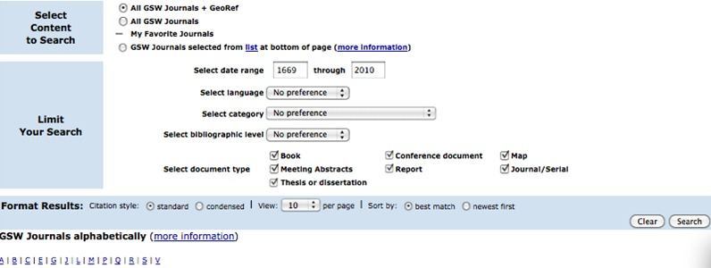
Advanced search of GSW and GeoRef or restricted searching to specific journals

Slide 7
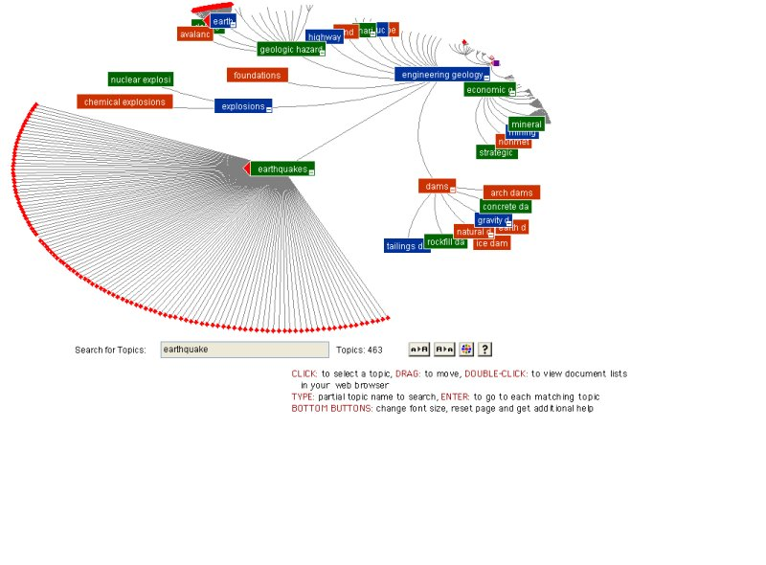
Intuitive browsing using Topic Maps and
Google Maps ™

Slide 8
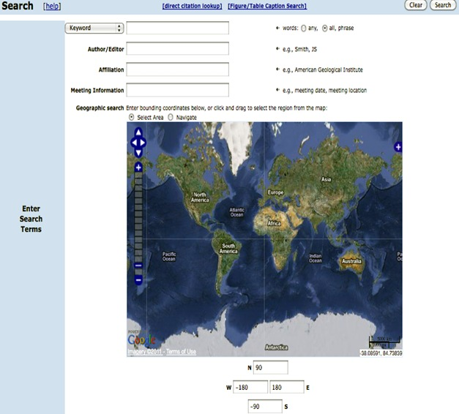
Combine keyword, advanced, and/or
map-based searching choices
Latitude and longitude coordinates
are auto-generated by map tool

Slide 9
Geographic search options

Slide 10
Easy pan, zoom, and highlighting

Slide 11
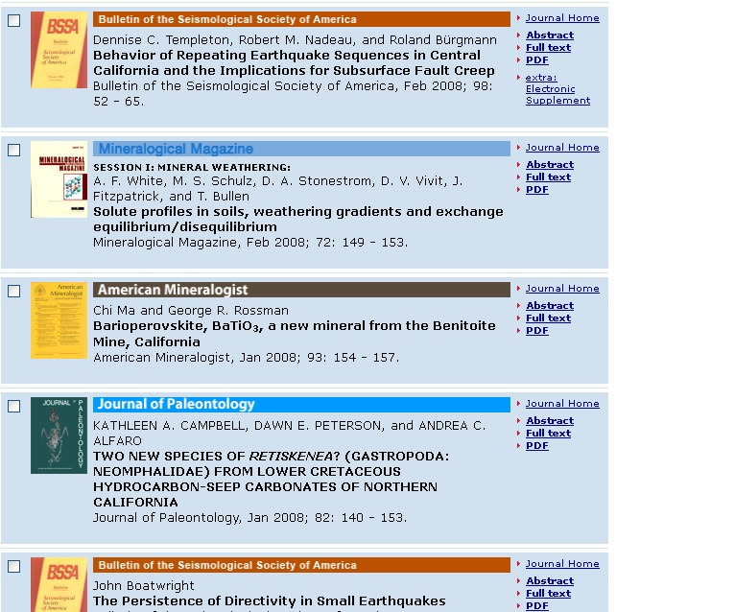
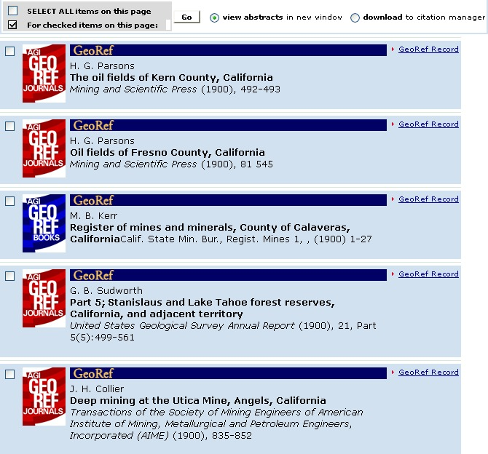
Recent and archival results

Slide 12
c
Start with a simple keyword search “earthquakes”
Limit by date, content type, language, journal titles …
Create search queries using the map tool
Pan and zoom -- coordinates in the map box change with the area of the map displayed
Select an area on the map to limit your keyword search by geography
You’ve now combined your keyword “earthquake” with search limiters defined by the map area you’ve selected. Coordinates for your highlighted area are displayed below the map.
Search

Slide 13
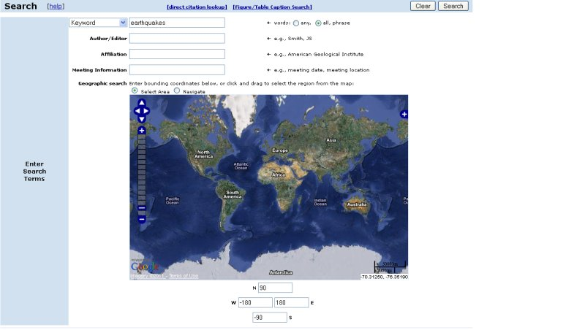
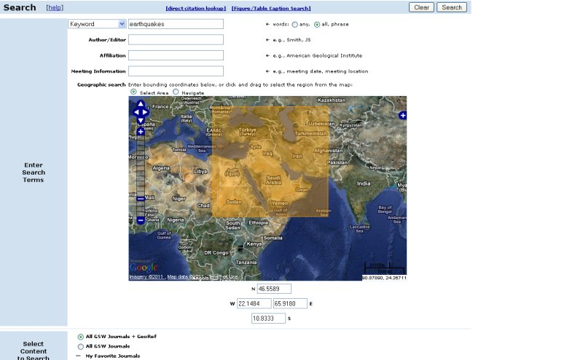

Slide 14
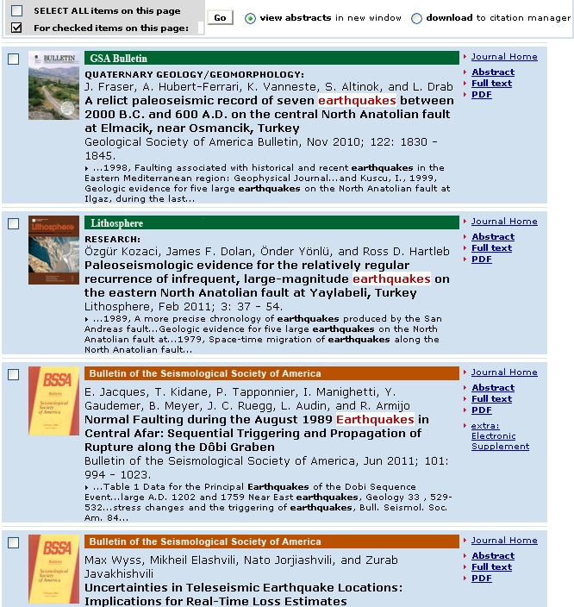
Choose from the newest
full-text articles and supplements alongside abstracts and links
for millions of entries
indexed by GeoRef

Slide 15
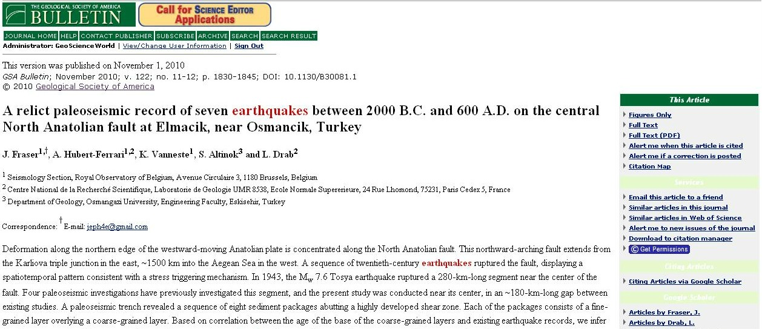
Abstract view

Slide 16
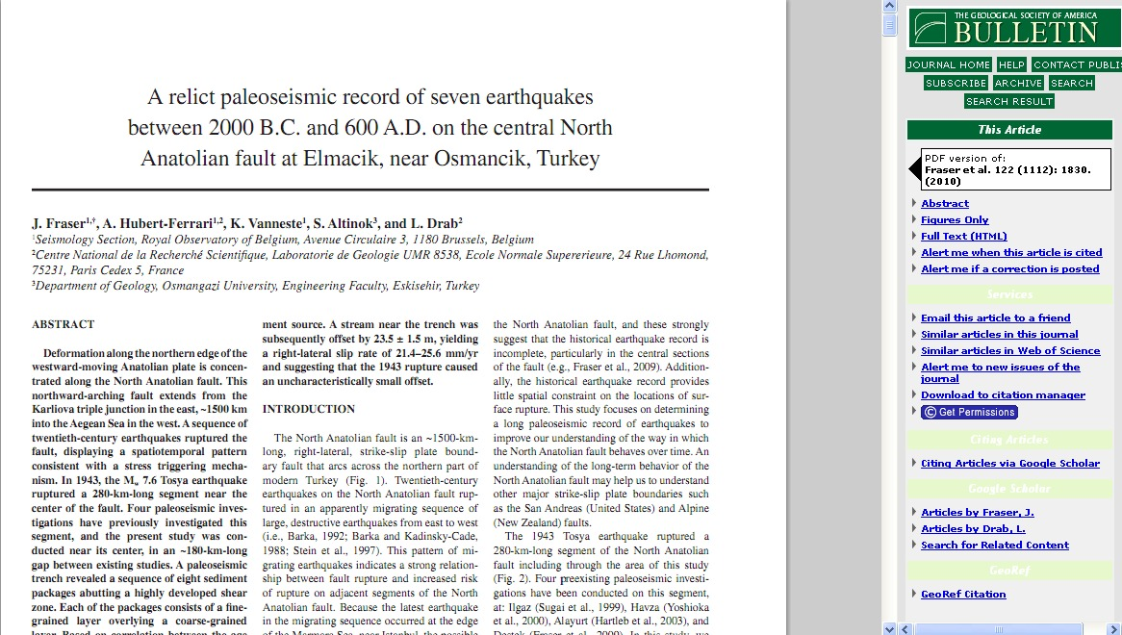
Full-text view

Slide 17
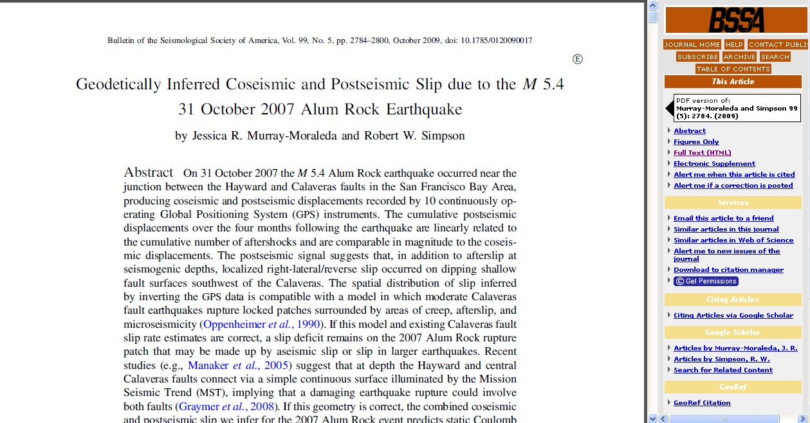
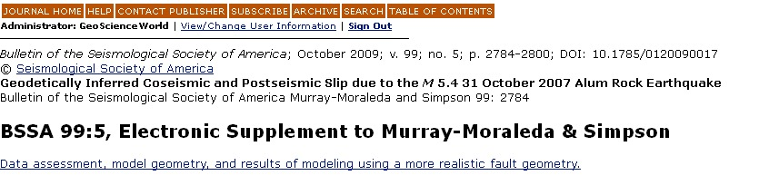
Supplemental materials, citation downloads,
content alerts, related article recommendations

Slide 18
Coming Soon (Q1/Q2 2012)
Google ™ Analytics
RSS feeds
Support for publish ahead of print and continuous publishing options
Support for mobile journals sites

Slide 19
Redesigned home page live in early 2012

Slide 20
Sign up for our new, quarterly newsletter gswinfo@geoscienceworld.org

Slide 21
Thank you

