Slide 1
Using Structural Diagenesis to Infer the Timing of Natural Fractures in the Marcellus Shale
Laura Pommer
M.S. Candidate in Geology
Julia Gale, Peter Eichhubl, Andras Fall, Steve Laubach
Fracture Research and Applications Consortium (FRAC)
Bureau of Economic Geology
Notes:
I am studying natural fracture cements in the Marcellus Shale to establish the timing and conditions of fracture growth.

Slide 2
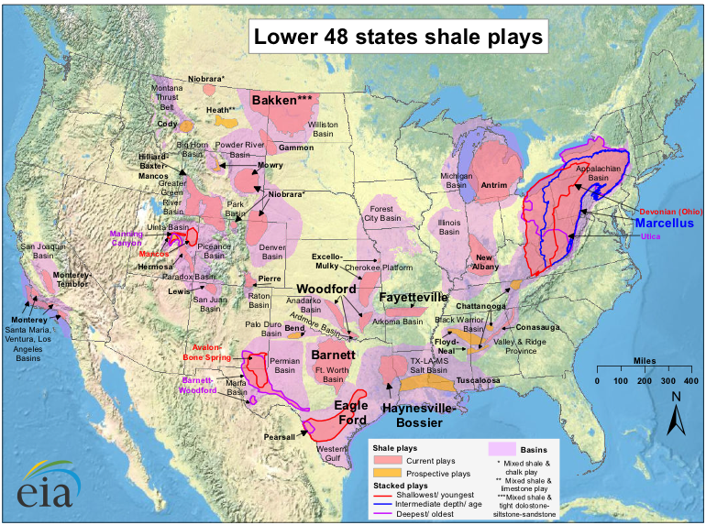
Unconventional Plays: Shale Gas
Marcellus Shale
84 TCF Natural Gas
2011
Notes:
This map shows the distribution of the major shale gas plays in the US, shown in pink and yellow
.
I will focus on the Marcellus Shale, shown here in the blue box. The Marcellus Formation is one of the largest and most important unconventional resources and is estimated to contain up to 84 TCF of natural gas reserves.

Slide 3
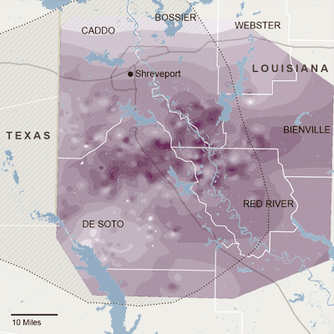
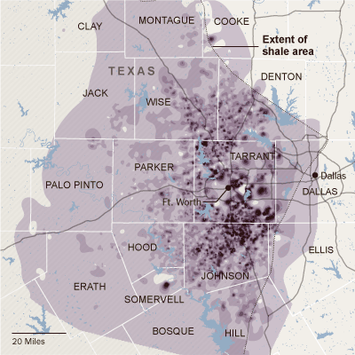




Production Variablility
Haynesville
Barnett
NY Times, June 26, 2011
“Sweet spots” in unconventional plays
Common symptom of natural fracture presence
Notes:
The spotty pattern on these maps from the Haynesville in LA and Barnett in TX shale plays shows “sweet spots” areas of high productive wells, surrounded by large areas where wells produce far less gas.
Similar variability is seen in the Marcellus.

Slide 4
Question & Methods
Natural fractures influence production
Difficult to sample in subsurface
Outcrop fractures might provide insight into subsurface
Are outcrop fractures in the Marcellus a valid proxy for subsurface fractures?
Outcrop/subsurface comparison of
Fracture orientation
Fracture cement texture
Cement fluid inclusion properties
Cement isotopic composition
Notes:
Natural fractures CAN influence production, but they are difficult to sample in the subsurface.
Outcrop fractures might provide insight into these subsurface fractures.
The main question motivating my research is whether outcrop fractures are a proxy for those in the subsurface.
I will test this question using a number of methods to compare the outcrop and subsurface fractures including
most studies have looked at orientation and do not investigate further. I will take a look at the info about cmeents

Slide 5
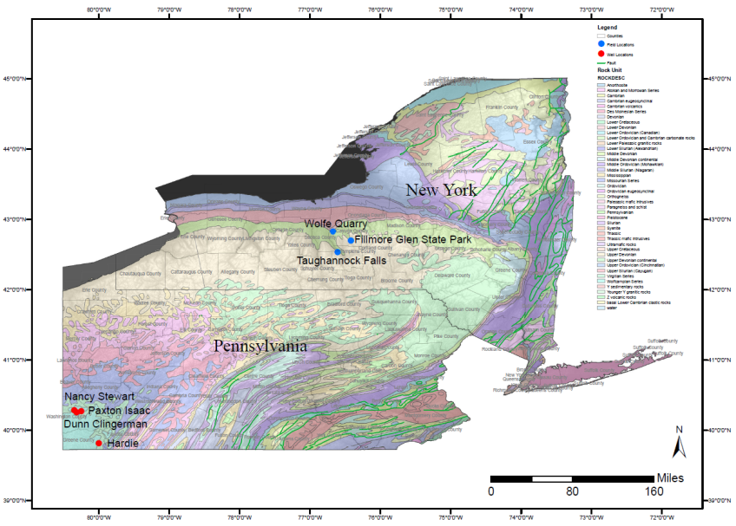
Sample Locations
Data for GIS map from USGS, 2012
EIA, 2012
Notes:
Map of core and outcrop study locs
Inset map shows aerial extent of Marcellus
See here that the outcrop is about 300 miles from the location of the wells,

Slide 6
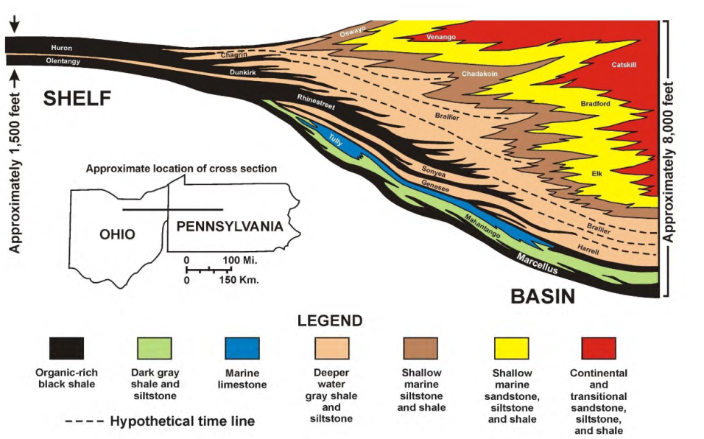
Geologic Setting
Harper and Koestelnik, 2009
Notes:
This East to West cross section covers part of Ohio and Pennsylvania.
My study locations lie outside of its scope, however it gives a good representation of the Devonian black shales and their interfingering with limestone units.

Slide 7
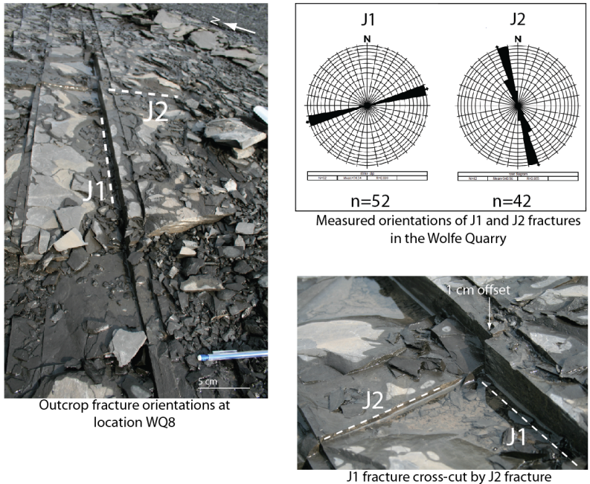
Outcrop Fracture Orientations
J1 fractures predate J2
Notes:
The picture shows the typical Marcellus outcrop fracture configuration, with two fracture sets that are roughly orthogonal, known as J1 and J2 in the literature.
J1 trends ENE and is observed to pre-date J2 using cross cutting relationships.
Shown in the upper right are my measurements of orientation from our field site.

Slide 8
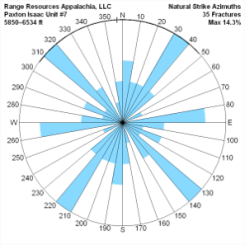
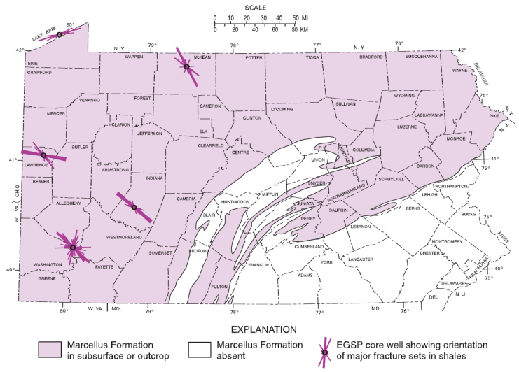
Subsurface Fracture Orientation
J2 fracture orientation and Alleghanian S_{Hmax} similar
J2
J1?
Paleo S_{Hmax}
Alleghanian Deformation front
EGSP, 1981 modified by Harper, J., 2009
Coincidence of orientations enough to determine fracture timing?
Notes:
Map shows J2 fracture orientations from wellbores in PA.
I have overlain the inferred maximum horizontal stress for the Alleghanian deformation front. Notice that the sh max is approximately the same orientation as that of the J2 fractures.
Previous work has suggested that J2 fractures formed in response to this predicted Shmax during the Alleghanian.
subsurface fracture orientations from a well in Washington county, near this well here.
The J2 set on the map shows up strongly, but there appear to be two other main fracture orientations, either of which could be J1.
Is the coincidence of the orientations of J2 and predicted Shmax during the Alleghanian enough to say when these fractures formed?

Slide 9
Fracture Timing
Core and outcrop fractures not an exact match
Orientations vary
Number of fracture sets are different
Fracture timing from geometry inconclusive
Fracture morphologies and petrography
Fracture cement geochemistry tied to burial history
Fracture timing information independent of geometry
Notes:
As you can see, the orientations in core and outcrop do not match and the timing is inconclusive.
But we can use fracture cement studies to tie fractures to burial history and extract timing information. The next few slides will show how I am going to do this.

Slide 10
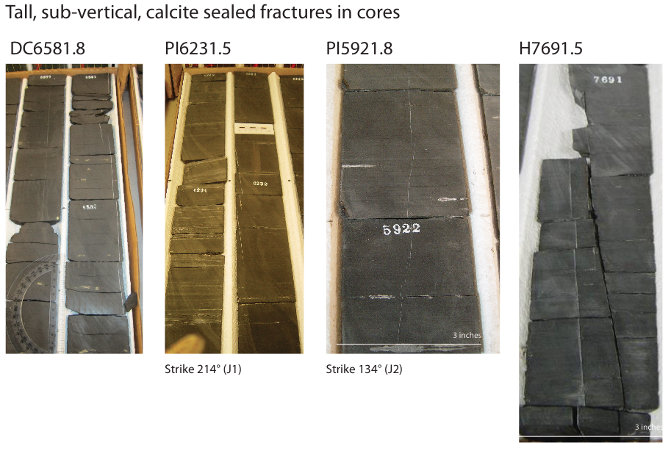
Core Samples-Sub-vertical Fractures
Note: Only Paxton Isaac core was oriented
J1 and J2 are not broken out for subsurface studies
Notes:
Here are photos of the tall, steeply dipping fractures we observed in every well, as well as in the outcrop.
WE do have orientations for the PI but not the other cores infer on the basis of orientation.

Slide 11
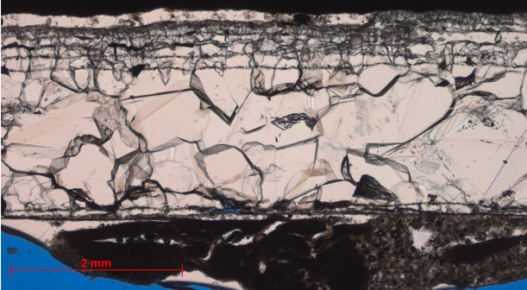
Cement textures in sub-vertical outcrop fractures
Fracture wall
Crack Seal Texture
Blocky Calcite
Fracture wall
J1 Outcrop Sample WQ4
Crack seal marks phases of fracture opening and cement precipitation
Notes:
This slide shows calcite cement textures in a Marcellus fracture from outcrop.
These are the fracture walls, and this is the cement fill.
Note the crack seal texture, observed by of the presence of small, host rock inclusions parallel to fracture wall,
This marks phases of fracture opening and cement precipitation.

Slide 12
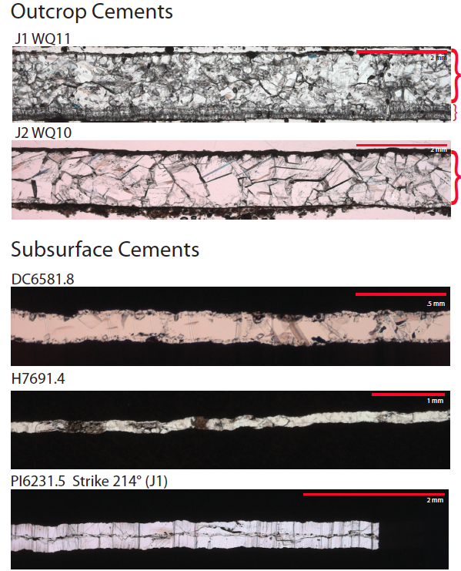
Outcrop vs. subsurface cement textures sub-vertical fractures
Outcrop Fractures
J1: Early crack seal cement
Later blocky cement
J2: No crack seal
Blocky cement
Subsurface
One or two increments of blocky cement
No crack seal
Fibrous fill common
Notes:
Showing cement differences in core and outcrop tall steep fractures.
First one, crack seal texture, indicated by the presence of tiny host rock inclusions running parallel with the orientation of fracture opening. This type of texture shows syn-kinematic growth, or cement precipitation contemporaneous with fracture growth.
Note crack seal only happens in outcrop samples, some are multiphase, but none exhibit traditional crack seal

Slide 13
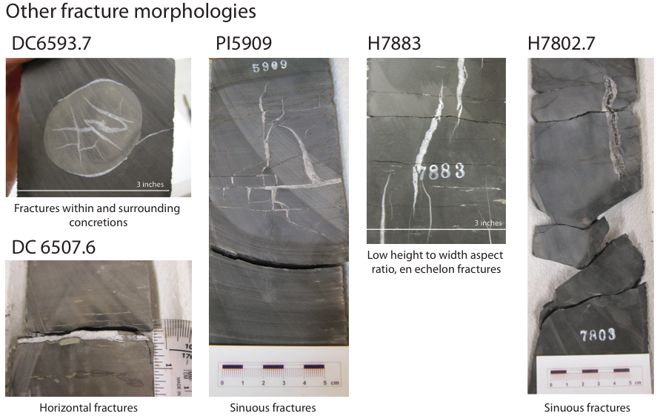
Core Samples-Other Fractures
Only observed in core samples
Notes:
Other fracture morphologies observed only in core. This could be because we do not see them in outcrop or because they do not exist

Slide 14
Timing from Fracture Cements
Fracture morphologies vary between outcrop and core
Petrography gives little timing information
Geochemistry of cement
Fluid inclusion analysis
Inclusion types; trapping temperatures
Stable isotope analysis
Pore fluid chemistry; paleo-temperature
Insights into conditions of cement precipitation
Timing through correlation with burial history curve
Notes:
As you can see, fracture morphologies vary significantly between core and outcrop, and even petrographically it is difficult to draw any conclusions about when these fractures formed relative to each other.

Slide 15
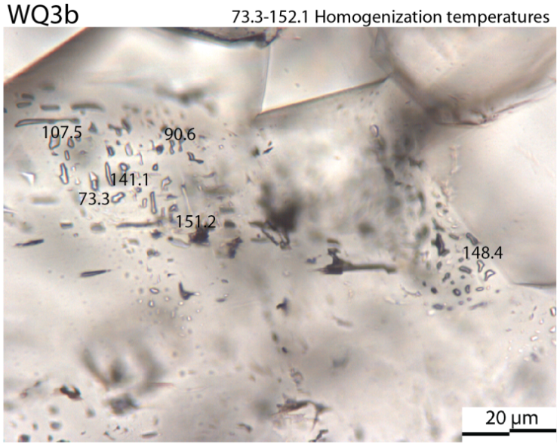
Secondary, two-phase aqueous inclusions
Subsurface and outcrop
Post-date cement precipitation
Appear as small planes
Wide range of T_{h} from partial resetting, average 100° C
→ temperature at which fluids were trapped
Notes:
Only saw secondary Fis, which are, by definition, formed after initial cement precipitation during microfracture events and appear as small planes in petrography.
Secondary two phase aqueous inclusions were commonly observed in core and outcrop samples and demonstrate a wide range of homog. Temps, with an average of around 100 degrees C.
If the samples continue to be heated with burial, we will have partial resetting of many of the original fluid inclusion homogenization temperatures, which could account for the variation in TH we see.

Slide 16
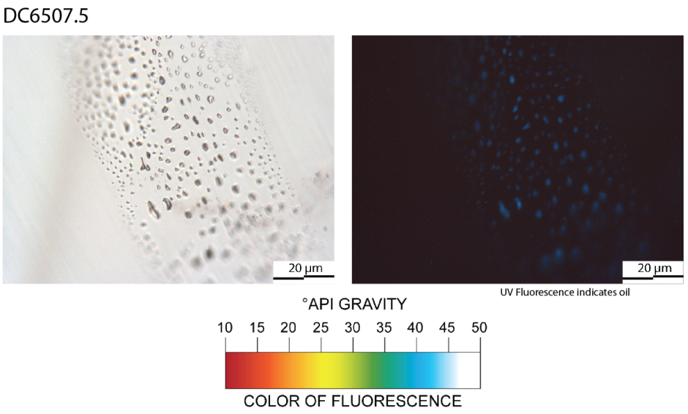
Secondary, single-phase oil inclusions
Subsurface only
Notes:
Single phase oil inclusions only observed in subsurface samples
Uv on right indicates the presence of oil

Slide 17
Fluid Inclusion Analysis
Homogenization temperature of secondary aqueous inclusions 73-151°C for WQ3b
Average T_{h} ~100°C
Secondary inclusions post-date fracture opening and cementation
Subsequent heating and partial resetting of fluid inclusions
Minimum trapping temperature of the fluids
Hydrocarbons migrated after initial fracture formation

Slide 18
Stable Isotope Analysis
δ¹⁸O
Controlled by rock/water interactions
Calcite precipitation temperature
Compare with homogenization temperatures from fluid inclusions
Apply brackets to burial curve
δ¹³C
Controlled by
Interactions between microbes and organic matter
Inorganic carbon from carbonate
Source of carbon in the carbonate
Notes:
My stable isotope analysis will look at both delta oxygen 18 and delta carbon 13
Oxygen isotopes are controlled by rock/water interactions
From the delta oxygen 18 measurements we can tell the temperature at which the calcite cements were precipitated.
We then compare these to the trapping temperatures from our secondary fluid inclusions to see if they can constrain the timing any more
Carbon isotopes are controlled by either microbial interactions with organic matter or inorganic carbon from carbonate
These isotopes can tell us information about the source of carbon and the types of reactions that it incurred

Slide 19
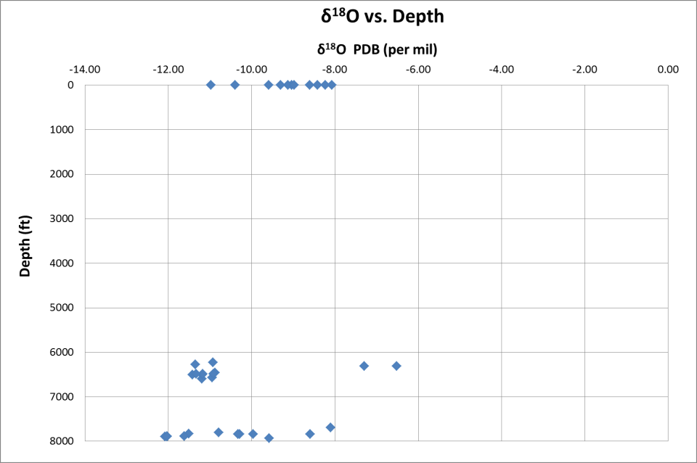
Stable Isotope Analysis
Outcrop Samples
Cement precipitation
50-100°C
Subsurface Samples
Friedman and O’Neil, 1977
Notes:
Here we have oxygen isotopic values versus depth. I have plotted outcrop samples at a depth of 0.
Oxygen appears to be depleted and grouped around -10 per mil with some deviation but not a significant amount.
Assuming a marine pore water composition, these data correspond with precipitation temperatures between 50 and 100 degrees C.

Slide 20
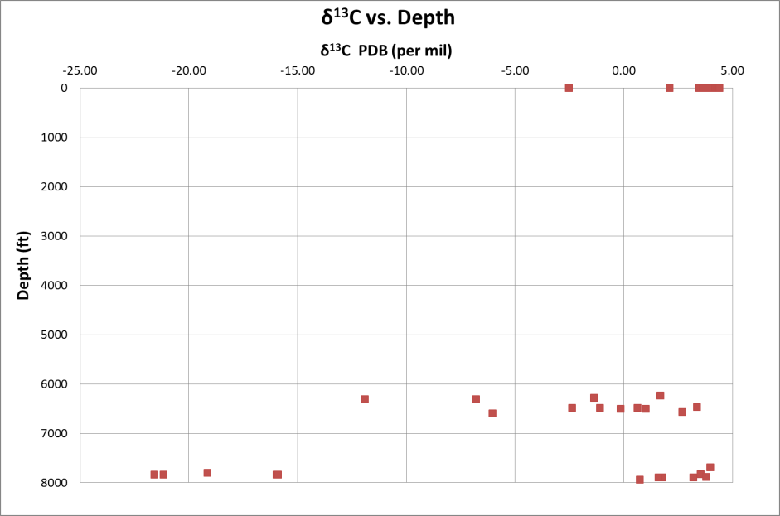
Stable Isotope Analysis
Outcrop Samples
Organic carbon source?
Likely inorganic carbon source
Subsurface Samples
Fractures in concretions
Notes:
Carbon displays a wider range of values, but it is important to note that the outcrop samples are similar to the majority of the subsurface samples.
There are delta carbon 13 measurements roughly grouped around 0 per mil, which likely indicate a dominant inorganic carbon source. Heavier values could an organic origin.
These data, which are depleted of carbon 13, correspond with wide, sinuous fractures with multiple cement phases, that are related to concretions.
(The relatively depleted measurements could be from early inorganic, authigenic carbon sources since the oxygen values of these same samples indicate shallow burial around 60 C and they appear to pre-date hydrocarbon generation.)

Slide 21
Stable Isotope Analysis
Oxygen isotopes indicate cement precipitation temperatures between 50-100°C
Assuming marine pore water composition
Carbon isotopes are consistent with inorganic carbon source
Outcrop and core data align
Excepting concretions

Slide 22
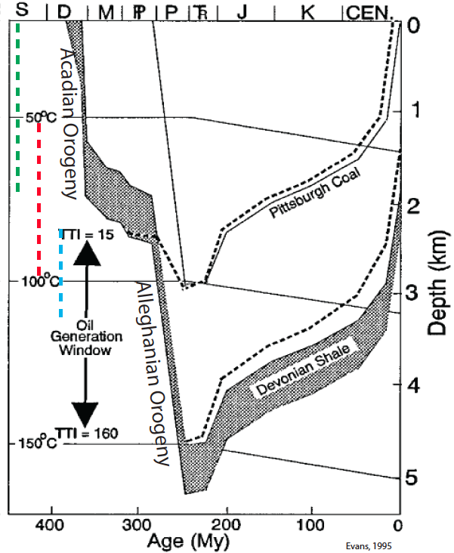
Fracture Timing
Fracture opening before or simultaneous with cement precipitation
Cement precipitation temperatures from δ¹⁸O
Minimum T_{h} of secondary inclusions
Fractures formed during Acadian-early Alleghanian
Evans, 1995
Notes:
Since cement precip predates the secondary inclusions, which have higher homogenization temps, we know that the samples must have been on the burial side of the curve
From fluid inclusion microthermometry, we have a minimum trapping temperature from the secondary inclusions and know that they must post-date cement precipitation.
Given what we know from our oxygen isotopic data, we can constrain precipitation of the cements to a range between 50 and 100 degrees C
and see that the fractures must have formed all at the same time, during the Acadian Orogeny or in the early part of the Alleghanian.

Slide 23
Conclusions
Fracture sets
Outcrop: Two vertical sets, barren or calcite filled
Core: Three vertical sets, mainly calcite filled; horizontal; in concretions
Fluid inclusions
Secondary inclusion minimum trapping temperatures ~ 100°C
Stable isotopes
δ¹⁸O is comparable for outcrop and core
Gives precipitation temperatures of 50-100°C
δ¹³C is comparable for outcrop and core in most samples
Suggests a dominant inorganic carbon source

Slide 24
Conclusions
Constrain timing of fractures to Acadian and/or early Alleghanian during burial
Fractures are not neo-tectonic
Tall, cemented fractures in outcrop appear analogous to subsurface fractures
BUT
Other fractures are present in core; some have different isotopic signatures
Orientations do not always match

Slide 25
Acknowledgements
Jackson School of Geosciences
Bureau of Economic Geology
FRAC
Range Resources
Anadarko Petroleum
GTI
Dr. Julia Gale
Dr. Peter Eichhubl
Dr. Steve Laubach
RPSEA
Funding for this project is provided by RPSEA through the “Ultra-Deepwater and Unconventional Natural Gas and Other Petroleum Resources” program authorized by the U.S. Energy Policy Act of 2005. RPSEA (www.rpsea.org) is a nonprofit corporation whose mission is to provide a stewardship role in ensuring the focused research, development and deployment of safe and environmentally responsible technology that can effectively deliver hydrocarbons from domestic resources to the citizens of the United States. RPSEA, operating as a consortium of premier U.S. energy research universities, industry, and independent research organizations, manages the program under a contract with the U.S. Department of Energy’s National Energy Technology Laboratory.
Dr. Andras Fall
Dr. Tobias Weisenberger
Dr. Kitty Milliken
Larry Wolfe

