Slide 1


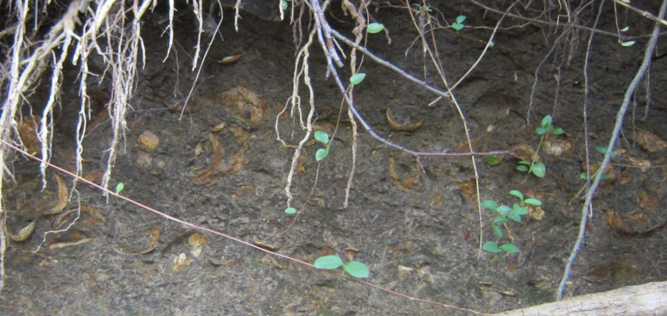
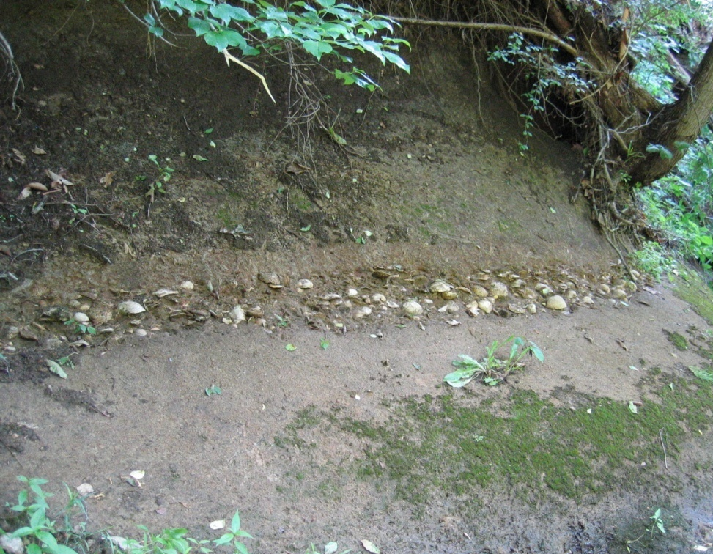
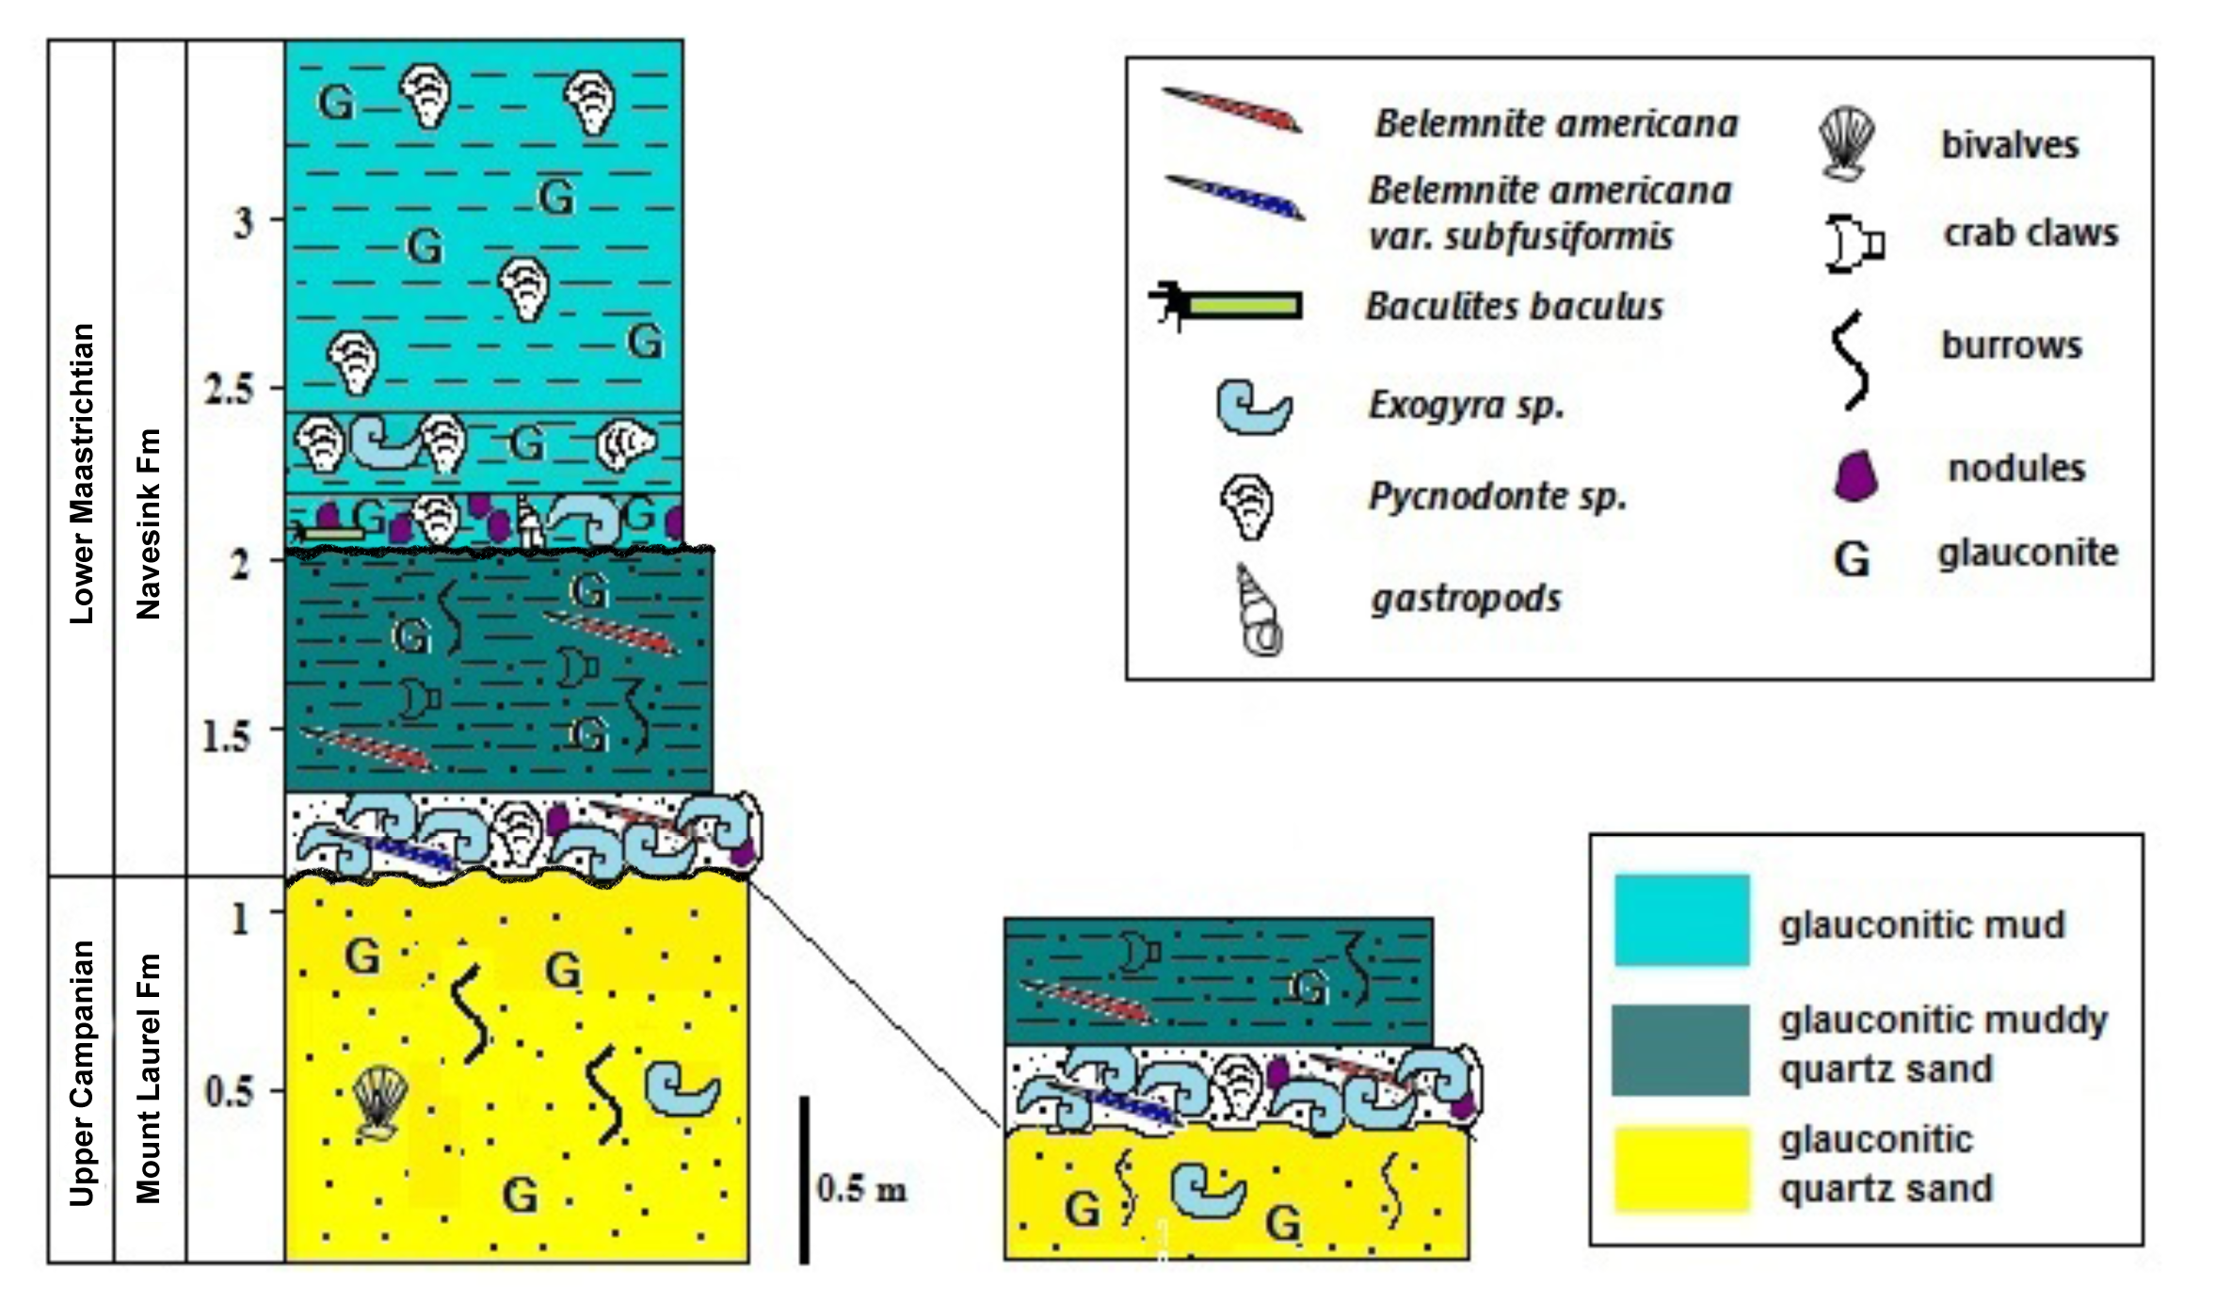
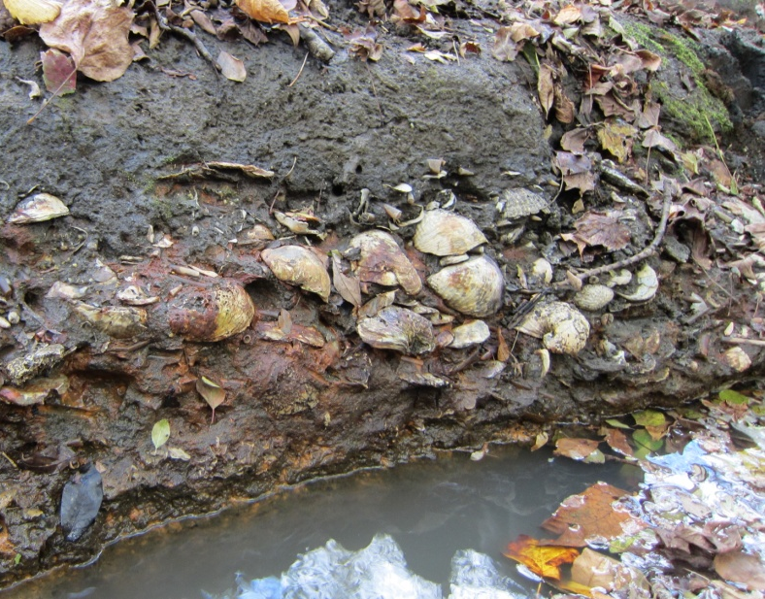
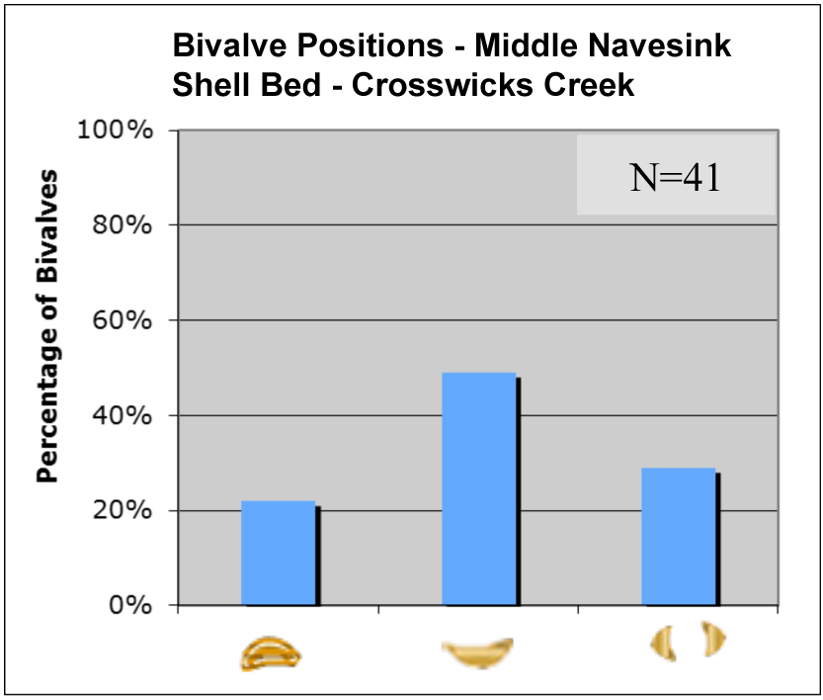
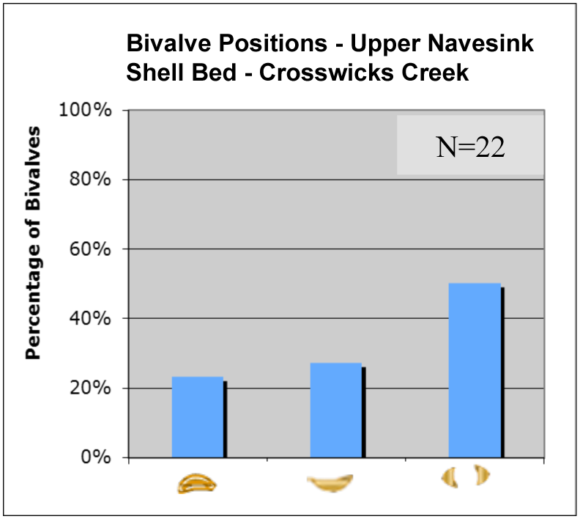

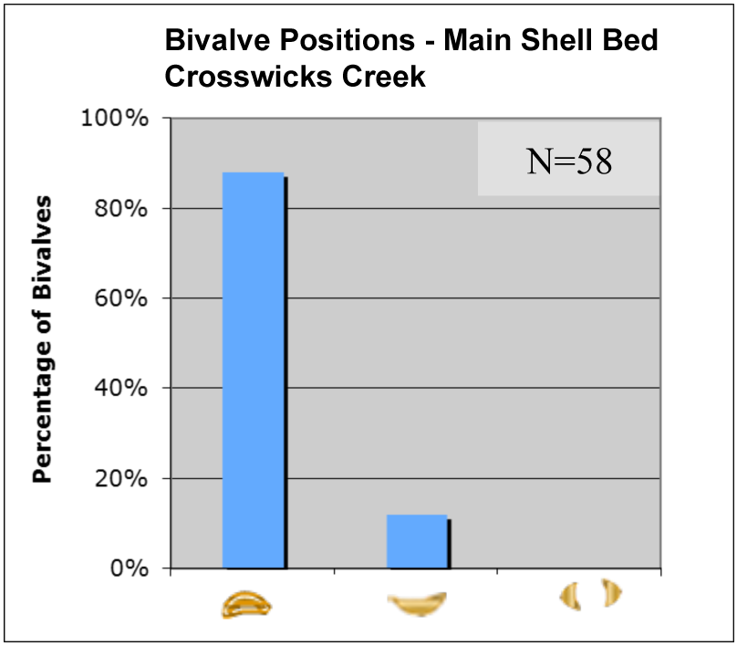
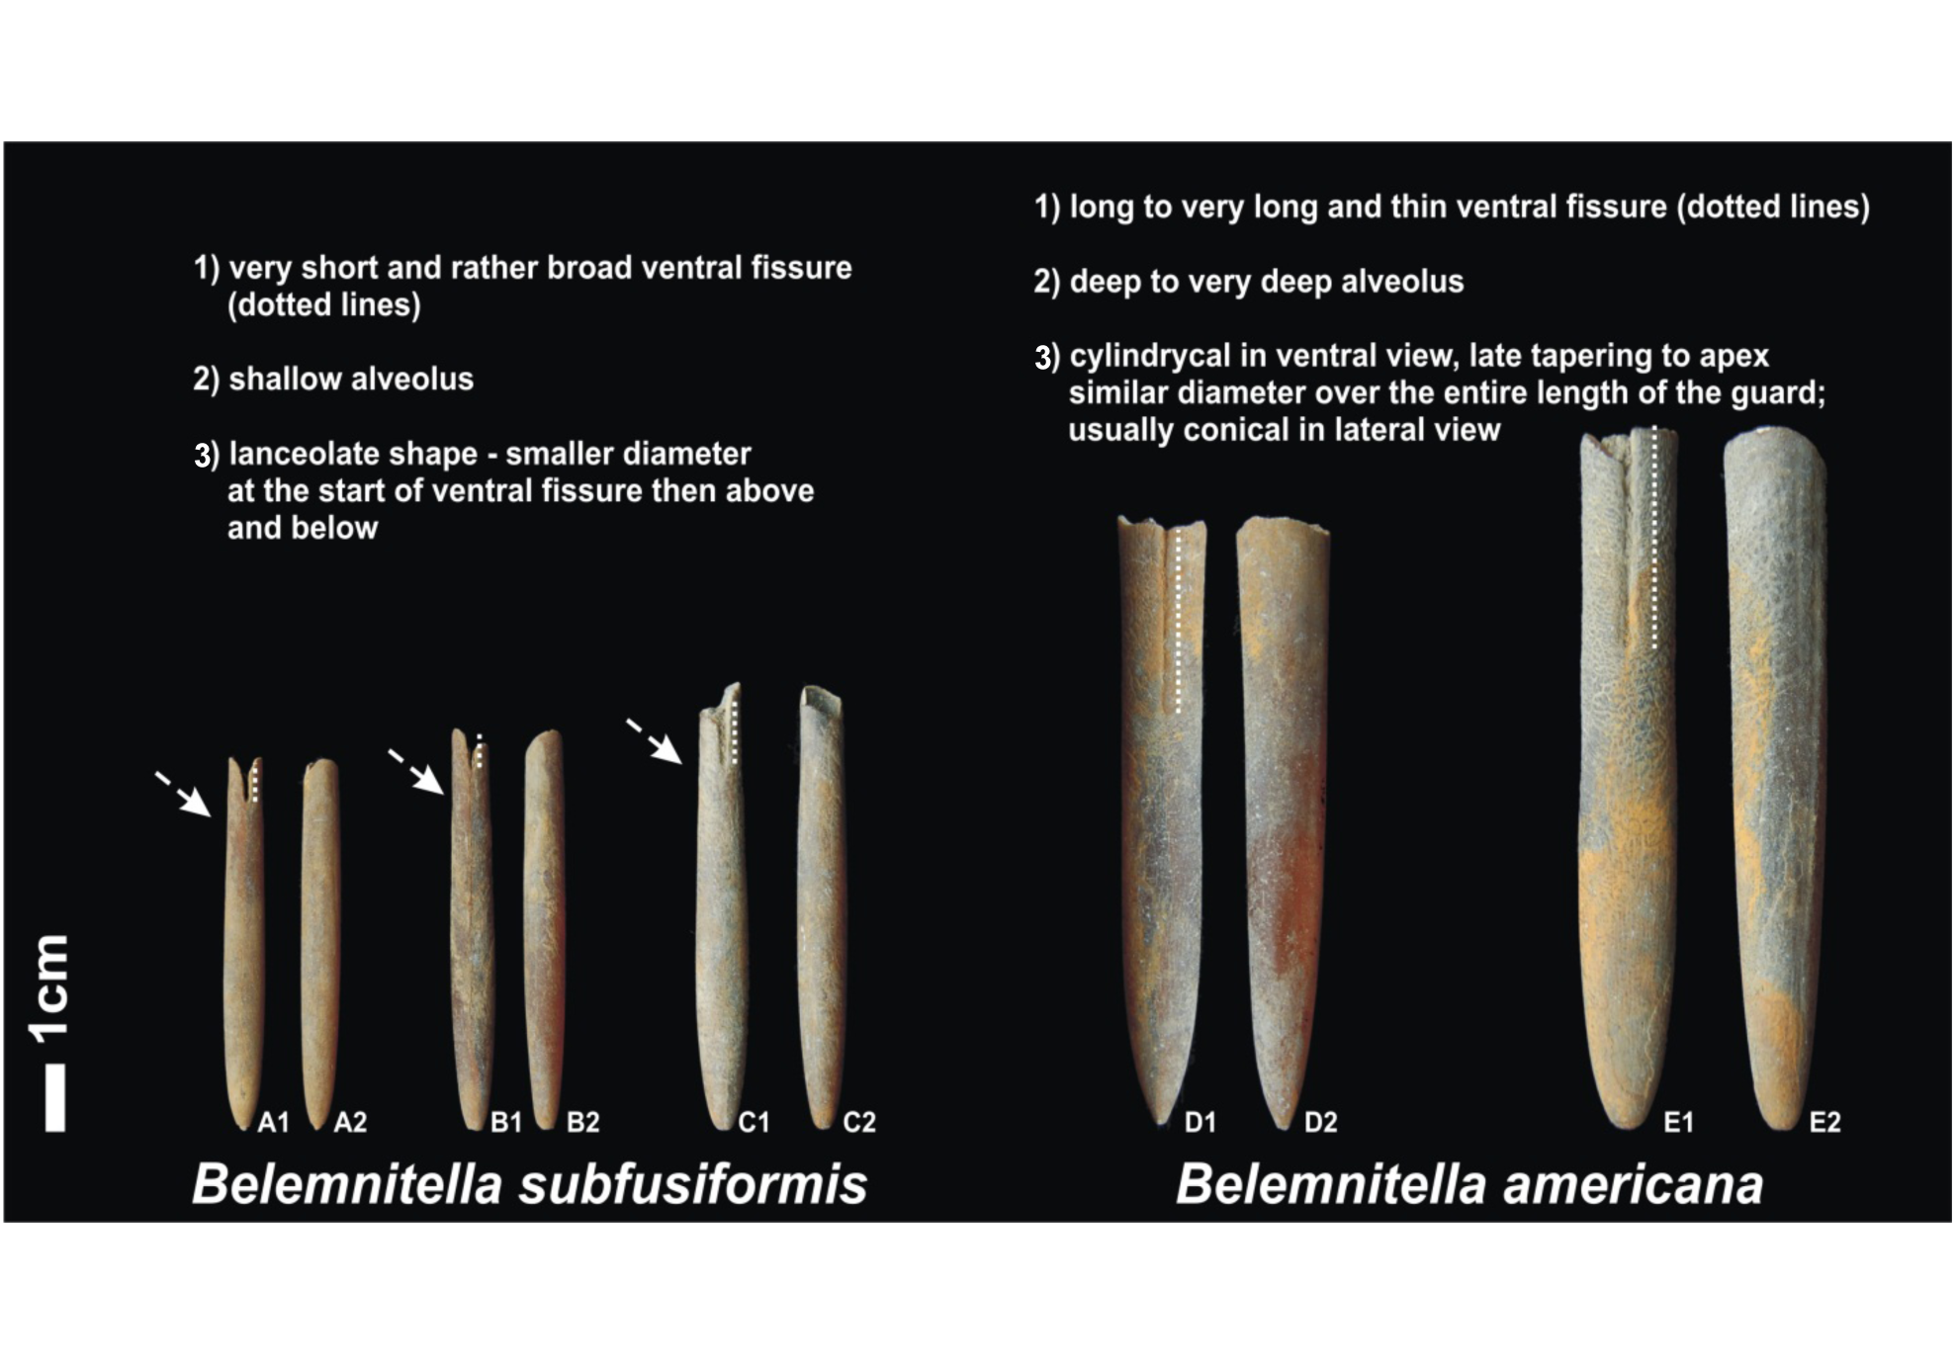
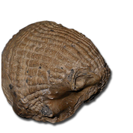
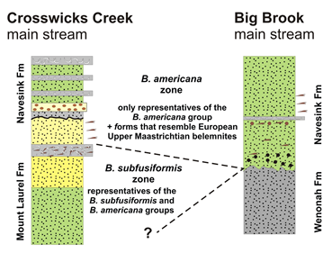

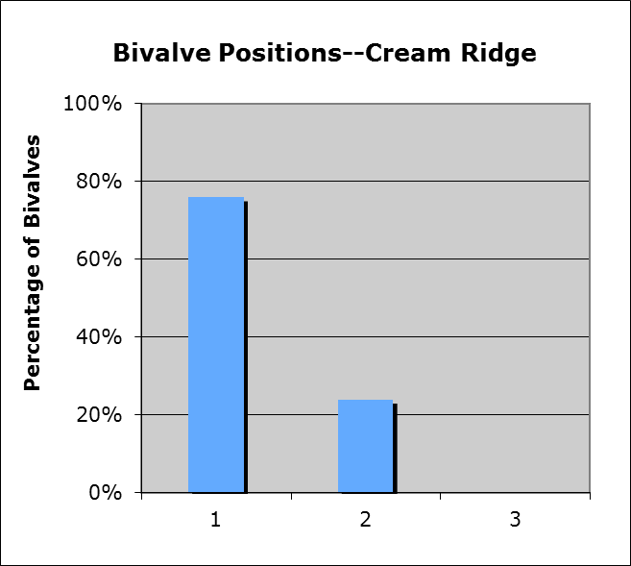

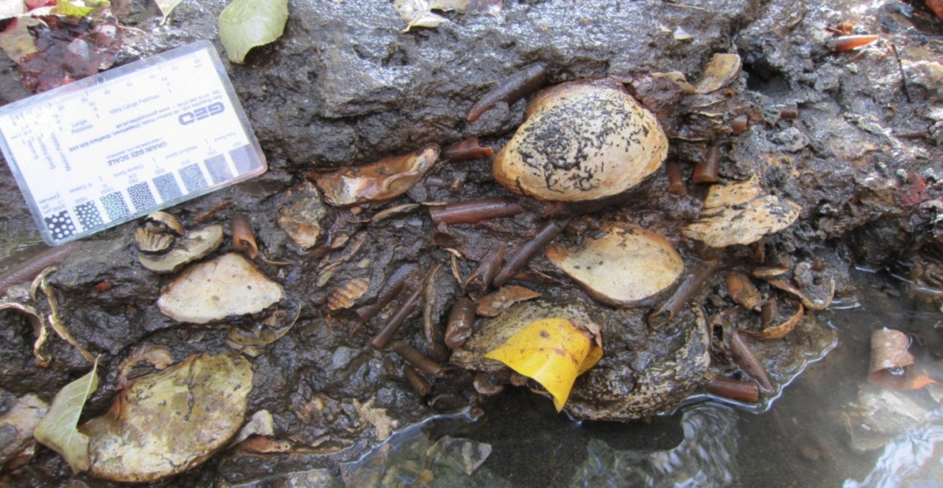
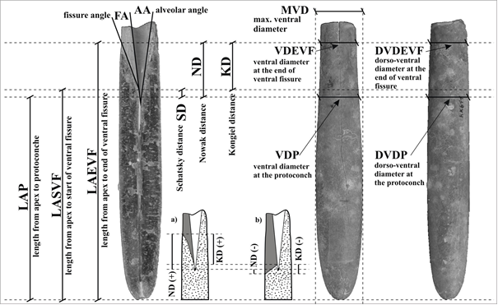
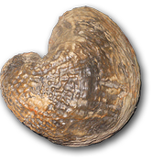

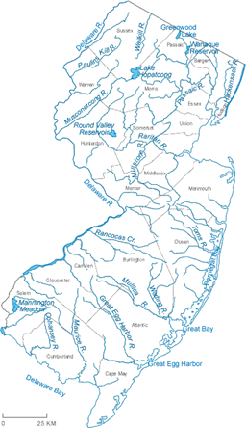
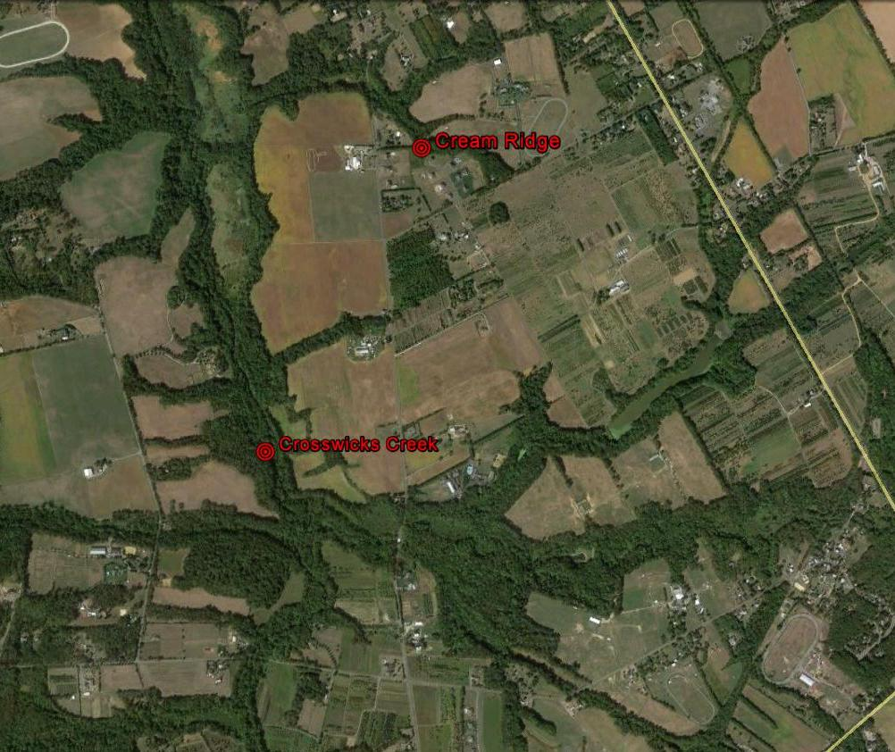
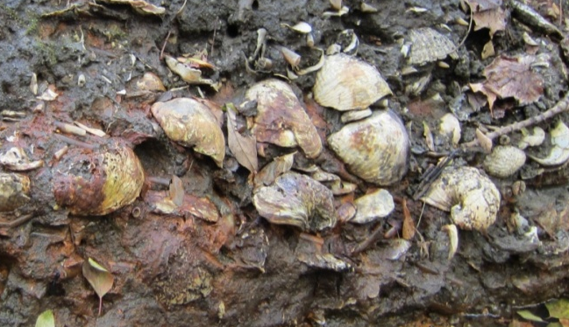
TAPHONOMIC ANALYSIS OF A LATE CRETACEOUS OYSTER BED AT THE TOP OF THE MOUNT LAUREL FORMATION IN MONMOUTH COUNTY NEW JERSEY: LONG TERM HIATAL CONCENTRATION, STORM DEPOSIT OR TSUNAMI?
KOPUN, Jeanne¹, CASTRO, Carolina¹, GARB, Matthew P. ¹, LARINA, Ekaterina¹, and REMIN, Zbyszek², (1) Earth and Environmental Sciences, Brooklyn College, 2900 Bedford Ave, Brooklyn, NY 11210, jeannekopun@gmail.com, (2) University of Warsaw, Faculty of Geology, Zwirki i Wigury 93, Warsaw, 02-089, Poland
ABSTRACT
Fossil concentrations of large bivalves, such as Exogyra sp. and Pycnodonte sp., are not uncommon features of the Cretaceous Atlantic Coastal Plain. Most show evidence of heavy bioturbation, which leaves a more random orientation to the fossils. This study focuses on a more unusual fossil concentration occurring at the top of the Mt Laurel Fm in the Crosswicks basin of New Jersey. The shell bed is approximately 20cm thick, bioclast supported and stacked concordantly. The matrix is composed of medium to coarse glauconitic quartz sand. It is dominated by large oysters (Exogyra cancellata, Exogyra costata and Pycnodonte convexa), as well as belemnites (Belemnitella americana). There is a wide range of preservation, from articulated well-preserved shells to bored and broken ones. Eighty-five percent of the large oysters were found with bottom valves concave down, suggesting transport. Initial findings show little to no apparent preferred orientation to the belemnites possibly due to influence of the large oysters on the sea bottom during deposition. Three possible processes were considered to explain the concentration of fossils and the preferential orientation of the large oysters: storms (event or composite concentration), tsunami (event concentration) or long-term lag due to sediment bypassing (hiatal concentration). The lack of sedimentary features in the strata associated with storm or tsunami deposits seems to rule these out as likely processes. A more likely explanation is long term lagging possibly due to sediment bypassing on the continental shelf. The fragmentary nature of the deposit, as well as apparent time averaging of the oysters and belemnites, suggests this as the most likely scenario. The uppermost occurrence of E. cancellata and the lowermost occurrence of E. costata are mixed within the shell bed. There is also a change in the belemnite fauna across the bed. Within the bed, B. americana and its variants were found together with B. subfusiformis, whereas above the shell bed, only B. americana and its variants seem to occur. The relatively high concentration of glauconitic also suggests slowing depositional rates. We argue the shell bed represents a hiatal concentration related to eustatic sea level change towards the end of the Campanian.
STRATIGRAPHY
TAPHONOMY
DISCUSSION
Preliminary results indicate that the Cretaceous Atlantic Coastal Plain experienced a eustatic sea level change during the late Campanian/early Maastrichtian, expressed as a long-term transgressive lag deposit. Graded bedding and sheet sands commonly associated with both tsunami deposits and storm deposits are not evident in the shell bed at the top of the Mount Laurel Formation (Hampson 2010) (Fujuno et al. 2006) (Bondevik et al. 1997). Bioturbation is prevalent throughout the matrix. Single event deposits should have heavier bioturbation at the top, decreasing downward, suggesting the shell bed was not the result of a single, quick event.
There is a taphonomic change in the preservation of the shell bed. Many of the bivalves were broken, abraded, or bored within the shell bed at Cream Ridge and Crosswicks Creek. Articulated bivalves were not common. Most fossils are better preserved, including belemnites with the tips intact, in the top 10cm, while almost all from the bottom 10cm exhibit more signs of wear, including belemnites with broken tips and borings. The change in preservation shows a complicated taphonomic process related to longer timeframes of deposition and possibly changing sediment output. The beginning stages of transgression tend to produce broken shell fragments such as those documented at the bottom of the shell bed. Better preserved fossils are more common in the later stages of transgressive events when fossils are below wave base and more rapid burial is taking place (Brett 1995).
The preferential orientation of the oysters is curious. It is evidence of strong currents throughout the deposition of the shell bed. Storm deposits could be responsible, except the common features associated with storm deposits are absent, such as hummocky cross stratification or escape burrows (Boyajian and Thayer 1995). No apparent preferential alignment of the belemnites might be due to the settling around the larger and heavier oysters.
Long term lag deposits, such as those described by Kidwell (1992) are time-averaged deposits. A strong piece of evidence for a long duration event resulting in the deposition of the shell bed comes from the mixed assemblage of belemnites and exogyras. The last occurrence of Belemnitella subfusiformis and Exogyra cancellata and the first occurrence of Exogyra costata are evidence of a mixed assemblage within the shell bed, strengthening the argument for a long term lag.
Crosswicks Creek
Cream Ridge
METHODOLOGY
Two localities in the Monmouth county region of New Jersey were examined for this study. Stratigraphic sections were carefully measured and the boundaries for the examined fossil bed were clearly marked using a 2cm square grid with letters and numbers to indicate positions of organisms. Data was collected for analysis on the orientation of oysters within the fossil bed. Positions of bivalve and belemnite fossils were taken every 4cm vertically at each site. Orientation data for belemnite fossils in situ were collected using a Brunton compass.
Fig. 9. Correlation of the two sections examined at Crosswicks Creek and Cream Ridge noting relative position of the main shell bed separating the Mount Laurel formation from the Navesink formation.
BELEMNITE MORPHOLOGY
BIOSTRATIGRAPHY
SIGNIFICANCE
The orientation of the oysters suggests movement by strong currents and transport.
No significant preferential orientation of the belemnites.
No graded bedding to suggest tsunami deposits
There are no bedding features commonly associated with storm deposits.
Biostratigraphic mixing of belemnite and oyster species suggests a longer-term lag deposit.
N=99
REGIONAL GEOLOGY
The Mount Laurel and the Navesink Formation are part of the Matawan group and were deposited during the upper Cretaceous period; the underlying Mount Laurel is of the late Campanian, and the Navesink formation ranges from early to late Maastrichtian. The Mount Laurel formation is a glauconitic quartz sand that ranges from fine- to medium-grained sediments. The overlying Navesink formation consists of a glauconitic mud to sand mix. This formation contains a nodule bed and a small fossil layer of shells arranged with no specific orientation. In the two localities examined, there are no bedding features. Of note, there is a 20 cm thick, dense shell assemblage, dominated by bivalves and belemnites out of life position in the Mount Laurel Fm. The preservation of the bivalves and belemnites is better toward the top of the shell bed, and the shells in the bed are touching each other and are not separated by sediment grains. Causes as to the reasons for this arrangement were examined.
Orientation of belemnites Mt Laurel shell bed Crosswicks Creek.
Belemnitella americana
Exogyra costatacostata
N=41
N=103
ACKNOWLEDGEMENTS
We would like to thank the Geological Society of America for this opportunity. This project would not be possible if not for the NSF, by way of Award #1035076 (Building Hybrid Communities of Practice to Benefit Urban Geoscience Students through Sustained Geoscientist-Teacher Partnerships). We thank Wayne Powell and Jennifer Adams for their work on this program. We would also like to thank Ralph Johnson, curator of the MAPS collection, and the land owners, who allowed us access to the site. We are incredibly indebted to Mike Fernandez for his assistance with graphics. Finally, we would like to thank Gregry Livingston, Madelyn Moyer, and Remy Rovelli for helping us collect our samples.
Orientation of belemnites Mt Laurel shell bed Cream Ridge.
STUDY AREA
Fig. 3. Typical representatives of the Belemnitella subfusiformis group [A – C] and Belemnitella americana group [D – E]; 1 – ventral view; 2 – lateral view. Note the lanceolate shape of the subfusiformis and cylindrical shape of the americana. The arrows indicate the thinnest area around the start of ventral fissure in representatives of the subfusiformis group; dotted lines indicate the length of the length of the ventral fissure.
Fig. 4. 15 direct measurements and 14 ratios based on row data were used as input data in ANN simulation.
REFERENCES
Bondevik, S., Svendsen. J. I., and Mangerud, J., 1997, Tsunami sedimentary facies deposited by the Storegga tsunami in shallow marine basins and coastal lakes, western Norway:Sedimentology, v. 44, p. 115-1131.
Brett, C.E., 1995, Sequence stratigraphy, biostratigraphy, and taphonomy in shallow marine environments: Palaios, v. 10, p. 597-616.
Boyajian, G. E., and Thayer, C. W., 1995, Clam Calamity: A Recent Supratidal Storm-Deposit as an Analog for Fossil Shell Beds: Society for Sedimentary Geology, v.10, p.484-489
Fujino, S., et al., 2006, Structure and depositional processes of a gravelly tsunami deposit in a shallow marine setting: Lower Cretaceous Miyako Group, Japan: Sedimentary Geology, v.187, p. 127-128.
Hampson, G. J., 2010, Sediment dispersal and quantitative stratigraphic architecture across an ancient shelf: International Association of Sedimentologists, Sedimentology, v.57, p. 96–141.
Martino, R. L., and Curran A. H.,1990, Sedimentology, Ichnology and Paleoenvironments of the Upper Cretaceous Wenonah and Mt. Laurel Formations, New Jersey: Journal of Sedimentary Petrology, v.60 (1), p.125-144.
Razzhigaeva, N. G., et al., 2006, Sedimentation Particularities during the Tsunami of December 26, 2004, in Northern Indonesia: Simelue Island and the Medan Coast of Sumatra: Marine Geology, v. 46 (6), p. 929-945.
Belemnitella subfusiformis
Fig. 6. Correlation between Crosswicks Creek and Big Brook. Note the lack of the
B. subfusiformis at Big Brook and its presence at Crosswicks Creek. The base of the Navesink Formation at Crosswicks Creek is slightly problematic – it could be placed at the base, at the top of the shell bed or at the unconformity approximately 90 cm above the shell bed (black line).
Fig. 7: Belemnites in situ with no preferential orientation (Cream Ridge Mt Laurel shell bed). Arrows indicate random orientation of belemnites.
Exogyra cancellata
Fig. 5. Ranges of Exogyra and Belemnite species throughout the sections at Crosswicks Creek/Cream Ridge and Big Brook in Northeastern Monmouth County, New Jersey.
The exploration of the self-organizing Kohonen maps, which represent the answer on the input data of trained artificial neural network, especially Kohonen neural networks, enables recognition of two main morphological groups; these are as follows:
1) Belemnitella ameriacana group
2) Belemnitella subfusiformis group
These two forms have been previously understood as variants of B. americana, the original definition of which is very wide. Both groups consist of several species the stratigraphic significance of which is currently under study. Within the B. americana group at least four to five morphotypes can be distinguished, whereas the B. subfusiformis is less divers and most probably represented by only two morphotypes. These morphotypes can be differentiated by several external and internal features used to describe the morphology of belemnite guard (Fig. X), and are interpreted to represent separate species (compare Remin, 2012).
Regional Belemnite Zonation
At this moment, a detailed belemnite zonation for the whole upper Campanian and lower Maastrichtian sedimentary sequences of the New Jersey Costal Plain would be premature and highly debatable. Therefore, for the time being, two easily recognizable forms with high stratigraphic potential are recognized: the older Belemnitella subfusiformis and younger Belemnitella americana.
Based on the occurrence of the distinguished forms in the studied localities – Crosswicks Creek, Cream Ridge and Big Brook – the following conclusions can be made:
1) At Crosswicks Creek and Cream Ridge, where distinct shell beds [oyster and belemnites] occur, the representatives of both groups are recognizable – B. subfusiformis and B. americana.
2) At Big Brook, only representatives of B. americana occur, together with new forms, suggesting that the base of the Navesink sequence is younger than shell bed exposed at Crosswicks Creek & Cream Ridge (Fig. 2).
3) Above the base of the Navesink Fm at Big Brook, some additional forms can be recognized [currently under study]. These new forms closely resemble those known from Europe from the middle and upper Maastrichtian
1 cm
Fig. 1. Study area showing two localities sampled in southwestern Monmouth County, New Jersey.
Fig.8: Preferential orientation of large oysters in a concave down position noted by dash lines (Cream Ridge Mt Laurel shell bed).

