Slide 1
Human-Based Computation for Microfossil Identification
C.M. Wong¹, A.P. Harrison¹, K. Ranaweera², and D. Joseph¹
¹Electrical and Computer Engineering, University of Alberta
²Arts Resource Centre, University of Alberta

Slide 2
Outline
Introduction
Iterative and Incremental Development
Human Interaction
Computation Algorithms
Conclusion

Slide 3
Introduction

Slide 4
Introduction: Motivation
Image understanding is considered an artificial intelligence (AI) complete problem, i.e., a central problem unsolvable with a simple algorithm.
Human-based computation is gaining popularity as a method to tackle AI-complete problems.
To make noteworthy progress, it helps to have a concrete application of sufficient importance.
Microfossil identification is one such application, and we focus on Foraminifera identification.

Slide 5

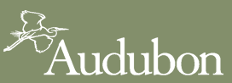

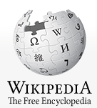
Introduction: Crowdsourcing
Crowdsourcing
Distributed Thinking
Citizen Science
Human-Based Computation

Slide 6
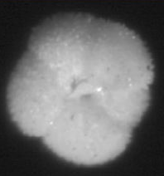
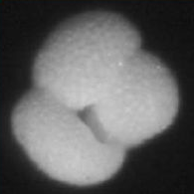
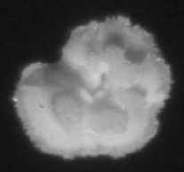
Introduction: Foraminifera
Foraminifera (forams) are single-celled protozoa with shells (~1 mm) that live in bodies of water.
Fossilized shells are used to map hydrocarbon deposits through biostratigraphy and to study prehistoric environments via geochemistry.
Forams and other microfossils, for the most part, are still identified by experts manually.
Acarinina Subbotina Morozovella

Slide 7
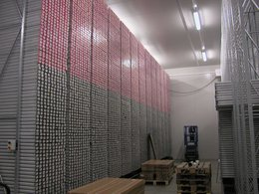
Introduction: Foraminifera
There has been much interest in automated foram identification.
Rule-based or artificial neural network (ANN) based approaches may be too simplistic.
Leading AI researchers have said as much for similar applications.
Bremen Core Repository (BCR) of the Integrated Ocean Drilling Program (taken from the BCR website)

Slide 8
Iterative and Incremental (I²) Development

Slide 9
I² Development: Overview
This is an ideal engineering model because:
Priorities are refined based on test results;
Modification of a prior design saves time;
Key requirements are validated earlier.
Requirements
Refinement
Testing and
Validation
Design
Modification

Slide 10
I² Development: Design 1
Name: Computer-Aided System for Specimen Identification and Examination, Version 1.
Requirement: Reduce expert workload.
Implementation: Exploit clusters of similar images after invariant transform.
Validation: See two papers in Marine Micropaleontology (2009).
Specimen Acquisition
Computation Algorithms
Human Interaction

Slide 11
I² Development: Design 1

Slide 12
I² Development: Design 2
Name: CASSIE, Version 2.
Requirement: Improve digital representations to address impact of illumination variability.
Modification: Apply/advance computer vision.
Validation: See Journal of Microscopy (2011), CVIU (2012), and TPAMI (2012) papers.
Specimen Acquisition
Computation Algorithms
Human Interaction
Specimen Dissemination

Slide 13
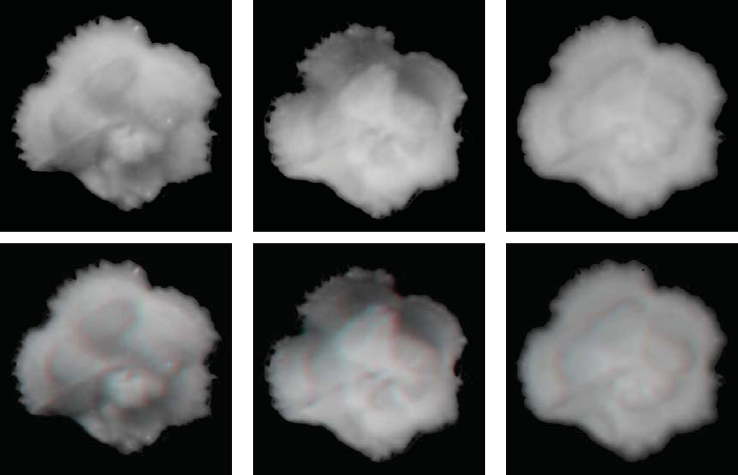
I² Development: Design 2

Slide 14
I² Development: Design 3
Name: Microfossil Quest.
Requirement: Transition from a computer-aided system to a crowdsourcing system.
Modification: Frontend and backend drafted.
Validation: Unit testing completed.
Specimen Acquisition
Human Interaction
Specimen Dissemination
Computation Algorithms

Slide 15
Human Interaction

Slide 16
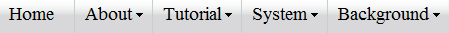
Human Interaction: Overview
The human part of the Microfossil Quest is implemented by a new website:
To interact with citizen and expert volunteers;
To inform users, including the general public.
Website pages may be navigated non-linearly using a menu; layout goes left-to-right from more specific to more general information.

Slide 17
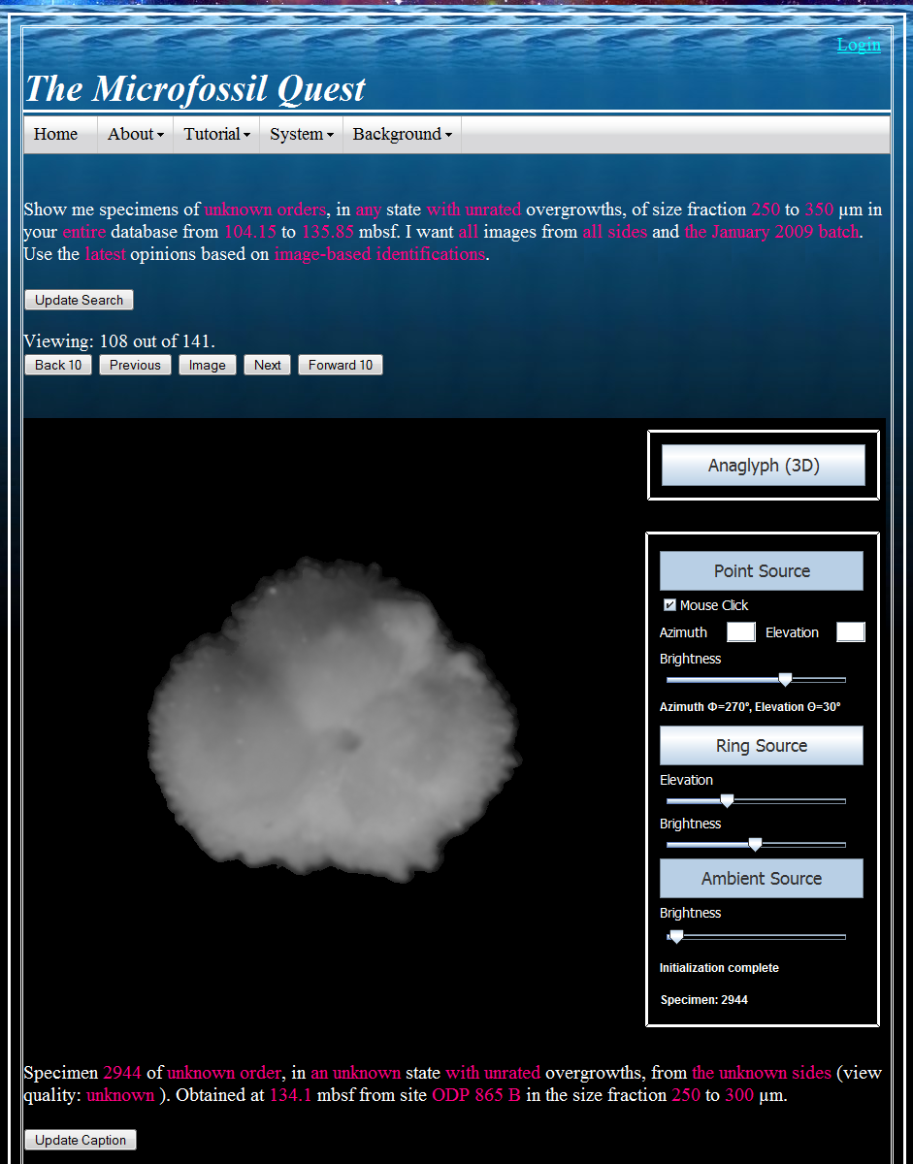
Human Interaction: Home
Users can search the database for a subset of specimens.
To update specimen identifications, users edit captions.
Completed draft: http://www.ece.ualberta.ca/~imagesci/microfossilQuestO865.

Slide 18
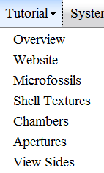
Human Interaction: Tutorial
For citizen science aspect of human-based computation system, training is critical.
Information also serves to educate the public.
Topics have been drafted top-to-bottom from easiest to hardest concepts.

Slide 19
Human Interaction: System
The website describes engineering aspects of the Microfossil Quest system non-linearly.
Users are able to click on different modules to get more details.
The work offers a case study in human-based computation design.
Users
Specimen Acquisition
Knowledge Base
Computer Intelligence
Human Intelligence

Slide 20
Computation Algorithms

Slide 21
Computation Algorithms: Overview
While a website is the frontend of the Microfossil Quest, a new dynamic hierarchical identification (DHI) algorithm forms the backend. It uses:
Unsupervised and supervised learning;
Dynamic and hierarchical learning.
Testing was done with materials (250 specimens) described in Marine Micropaleontology (2009).
Validation was done in comparison to the k-nearest neighbours (KNN) algorithm.

Slide 22
Computation Algorithms: Unsupervised Learning
Assumes that similar looking specimens are more likely to have similar identifications.
Organizes all specimens automatically using agglomerative hierarchical clustering (AHC).
Uses invariant transform to factor out position, rotation, and scale, and correlation coefficients to estimate similarity of specimen pairs.
Visualized with trees, although AHC algorithm may be computed efficiently with matrices.

Slide 23
Computation Algorithms: Unsupervised Learning
0.4118
1472
2105
2104
2105
1472
1205
1633
0.5854
0.5027
0.9141
0.9
0.4104
0.2458
0.7
1205
0.3122
0.7087
0.5
0.2474
1633
2104
0.2
0.3066

Slide 24
Computation Algorithms: Unsupervised Learning
0.4104
1472
2105
2104
2104
2105
1472
1205
1633
0.5027
0.9
0.5854
0.2458
0.7
1205
0.7087
0.5
1633
0.2
0.3066

Slide 25
Computation Algorithms: Unsupervised Learning
0.4104
1472
2105
2104
2104
2105
1472
1205
1633
0.5027
0.9
0.2458
0.7
1205
1633
0.5
0.2

Slide 26
Computation Algorithms: Unsupervised Learning
2105
2104
2104
2105
1472
1205
1633
0.9
0.2458
0.7
1205
1633
1472
0.5
0.2

Slide 27
Computation Algorithms: Unsupervised Learning
2104
2105
1472
1205
1633
0.9
0.7
All
0.5
0.2

Slide 28
Computation Algorithms: Supervised Learning
Assumes knowledge may be propagated based on visual similarity and a priori probabilities.
Uses AHC tree to generate indirect (computer) identifications from direct (human) ones.
Gets indirect identification of a specimen from the majority identification of its cluster.
Estimates confidence of indirect identification from worst-case similarity within cluster.

Slide 29
Computation Algorithms: Supervised Learning
M. vela
M.
M. subb
M. subb
M. vela
M.
0.9
M. vela
M. vela
0.75
M. subb
M. subb
0.51
M. subb
M. subb
M. vela
0.35
M. vela
M. vela
M. subb
M. subb
M. vela
0.108
M. vela
M. vela
M. subb
M. subb
M. vela
M. vela

Slide 30
Computation Algorithms: Dynamic Learning
Assumes volunteers are only able to identify a small number of specimens in a session.
Establishes priorities for direct identifications to increase efficiency of indirect identifications.
Sorts specimens for direct identifications using a greedy algorithm, i.e., direct identification that most increases total confidence gets priority.
Uses AHC tree to compute priorities efficiently based on relative positions of merge levels.

Slide 31
Computation Algorithms: Dynamic Learning
∞
∞
∞
∞
−∞
∞
∞
2011
2012
2013
2014
2015
2016
2017
∞
=1-0.9
0.9
0.1
0.8
∞
0.2
0.6
0.4
0.2
−∞
0.5
0.4
0.2
−∞
0.5
0.3
0.7
0.1
0.4
0.2
−∞
0.5
0.2
0.7
0.1
0.4
0.2
−∞
0.5
0.8
priority
(2)
(6)
(4)
(5)
(3)
(1)

Slide 32
Computation Algorithms: Hierarchical Learning
Computation algorithms are affected by taxonomic level available for specimens in the AHC tree.
Run algorithms hierarchically, from generic to specific level, using multiple AHC trees.
Order | Genus | Species
Unknown | Unknown | Unknown
Known | Unknown | Unknown
Known | Known | Unknown
Known | Known | Known

Slide 33
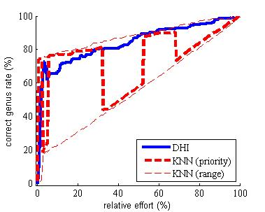
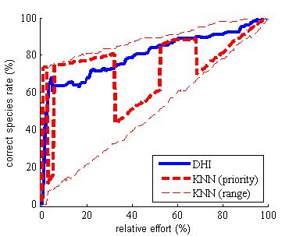
Computation Algorithms: Correct Identifications
Correct rates measure propagation of direct genus/species identifications in the dataset.
DHI propagates more efficiently than KNN.

Slide 34
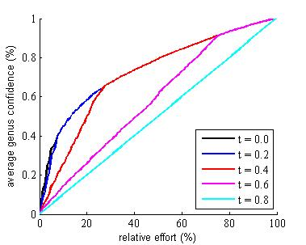
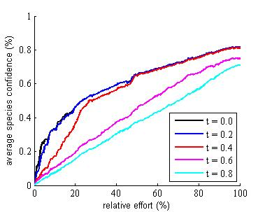
Computation Algorithms: Self Validation
Average confidences correlate with correct rates but they require no “ground truth” information.
This provides a partial form of self validation.

Slide 35
Conclusion

Slide 36
Conclusion: Summary
Human-based computation is proposed to accelerate microfossil identification.
Iterative and incremental development is an ideal engineering model for the purpose.
The Microfossil Quest, which focuses on forams at present, provides an ongoing case study:
Human interaction uses a multi-faceted website, including virtual reflected-light microscopy;
Computation algorithms integrate unsupervised, supervised, dynamic, and hierarchical learning.

Slide 37
Conclusion: Contributions
Notable multi-disciplinary publications:
5 papers in paleontology, microscopy, and AI journals for a 6-year program (2006–2012);
Includes paper in TPAMI, the #1 AI journal.
Training of highly qualified personnel:
C.M. Wong hired as software engineer by Intuit;
A.P. Harrison returned for PhD with Alexander Graham Bell Canada Graduate Scholarship;
K. Ranaweera now leads research support and development team in humanities computing.

Slide 38
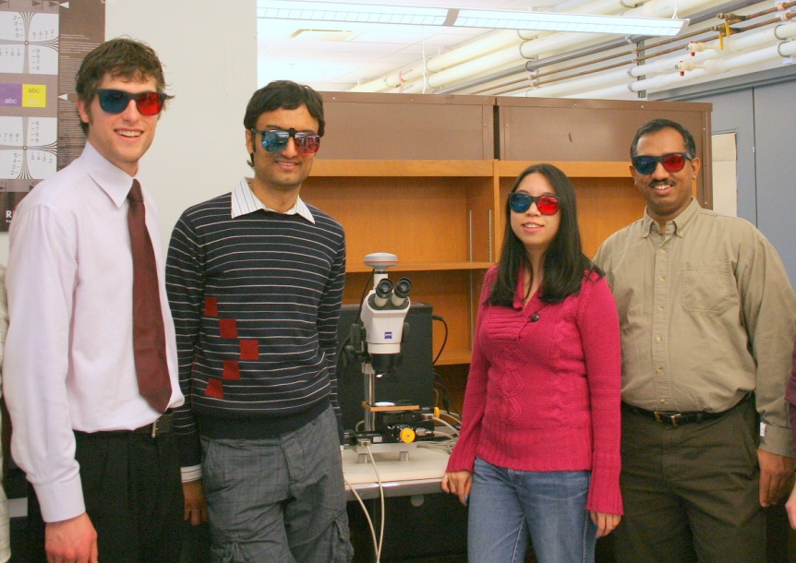
Acknowledgements
Many thanks to Alberta Innovates (formerly Alberta Ingenuity) and NSERC for financial sponsorship.
Many thanks also to S. Bains, Ø. Hammer, N. MacLeod, G. Miller, and R. Norris for their contributions.
Left to right: A.P. Harrison, D. Joseph, C.M. Wong, and K. Ranaweera

