Slide 1
BACKWARD-FADED SCAFFOLDING: AN INQUIRY-BASED TIDE ACTIVITY FOR ELEMENTARY PRESERVICE TEACHERS
Presenter: Jeff D. Thomas
2012 Geological Society of America Annual Meeting and Exposition in Charlotte, NC
November 4-7, 2012

Slide 2
Why I Created this Activity
Attended FINESSE (Faculty Institutes for NASA Earth and Space Science Education) Workshop
Introduce concepts related to tides such as tidal cycles (e.g. diurnal, 50-minute change), tidal ranges, spring and neap tides
Provide an authentic, real-world context for learning (e.g. investigating local tides in Connecticut)
Foster inquiry-oriented instruction that is more student-centered

Slide 3
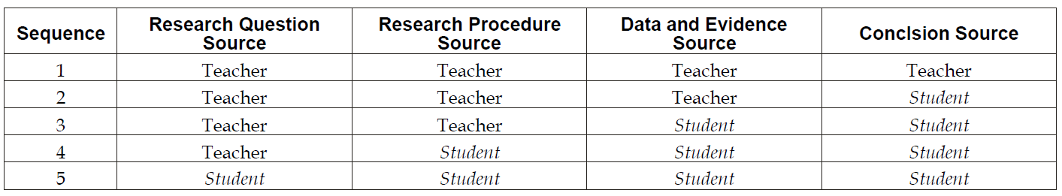
Instructional Framework of the Tide Inquiry Activity
Goal: Deliver a sequence of “mini-inquiries” that begins as more teacher-centered to ones that end as more student-centered.
Backward Faded Scaffolding for Inquiry-oriented Instruction
Slater, Slater, and Shaner (2008). Impact of backwards faded scaffolding in an astronomy course for preservice elementary teachers based on inquiry. Journal of Geoscience Education. v56 (5).

Slide 4
Outline
Part 1: What do tides in Connecticut look like over a 24-hour period?
Research Question | Research Procedure | Data/ Evidence | Conclusions
Teacher | Teacher | Teacher | Teacher
Part 2: How do tides change in Connecticut over a 10-day period?
Research Question | Research Procedure | Data/ Evidence | Conclusions
Teacher | Teacher | Student | Student
Part 3: Independent Research
Research Question | Research Procedure | Data/ Evidence | Conclusions
Teacher/Student | Student | Student | Student

Slide 5
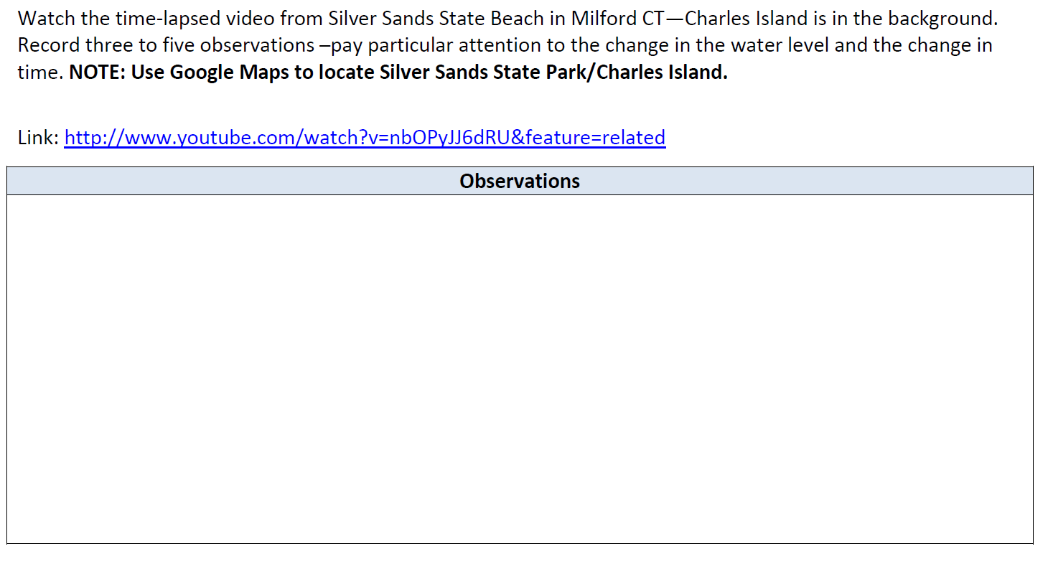
Pre-Lab (Goal: Engage students’ prior knowledge)
Map
Video

Slide 6
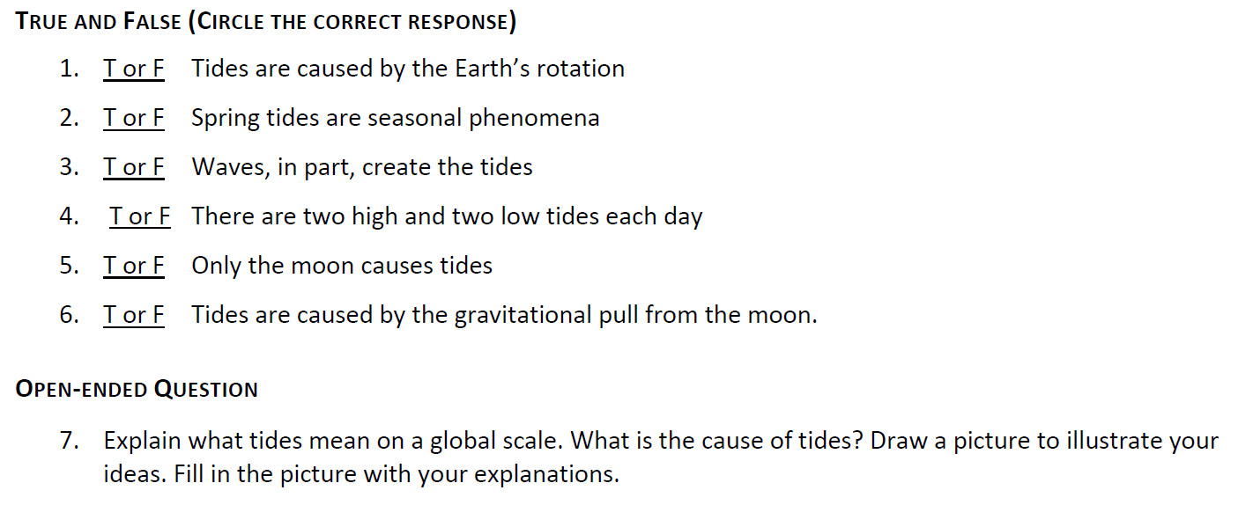
Pre-test
Resources:
Feller, R. (2007). 110 misconceptions about the ocean. Oceanography (20)4.
Viiri, J. (2000). Students understanding of tides. Physics Education (35)2.

Slide 7
Phase 1 of the Investigation
The Tide is High

Slide 8
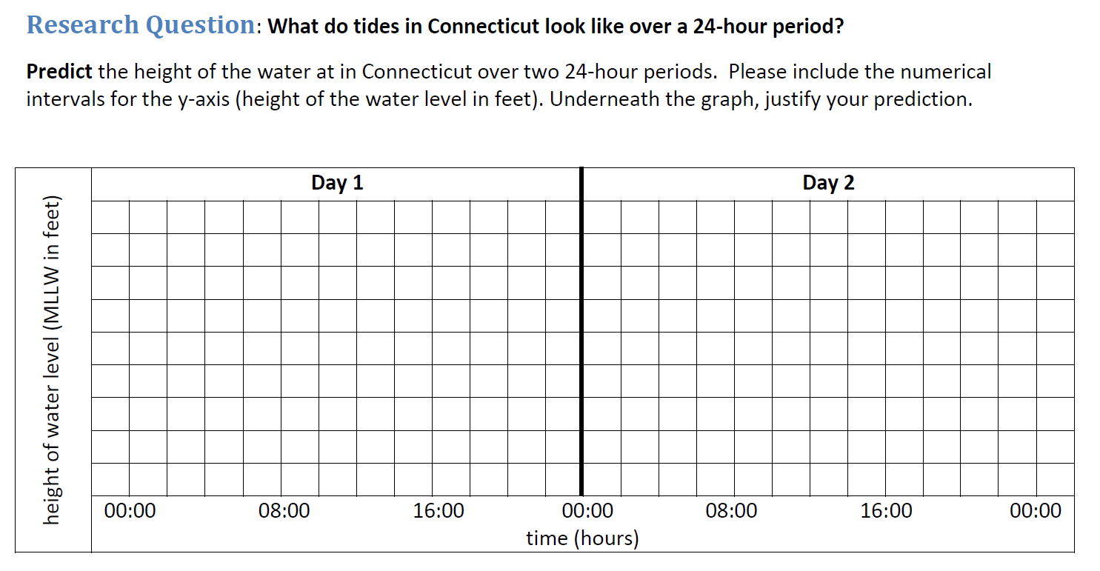
Phase 1: Research Question (Source: Teacher)
Students predict tidal patterns based on the pre-lab. Teacher provides the research question.

Slide 9
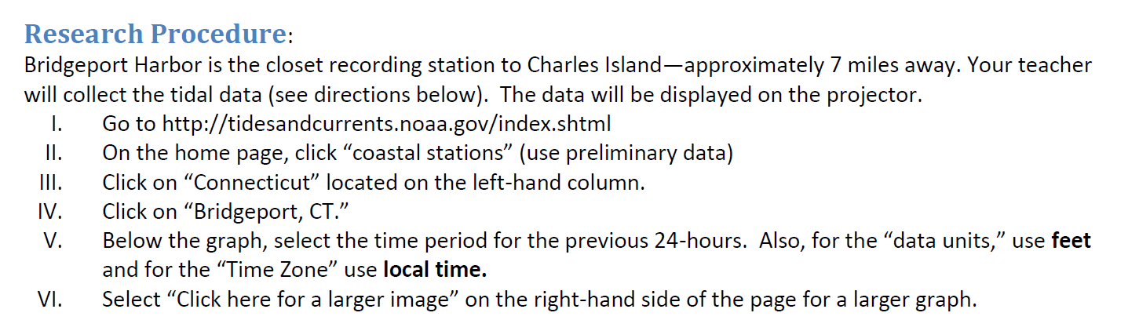
Phase 1: Research Procedure (Source: Teacher)
Teacher provides the research procedure to students. The aim is for students to become familiar with the data collection process and the website.

Slide 10
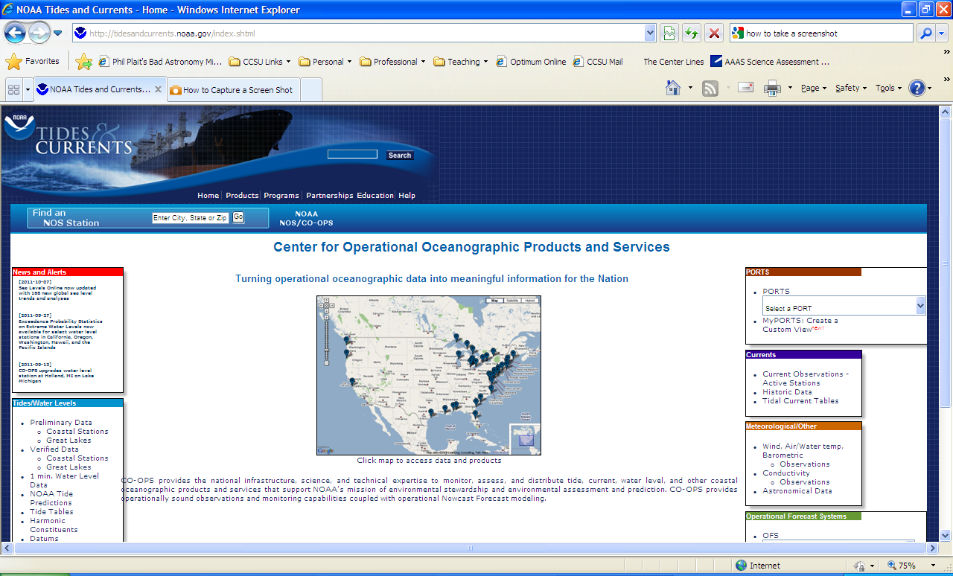
Part 1: Research Procedure (Source: Teacher)
Teacher completes the research procedure with students on projector/ smart board.

Slide 11
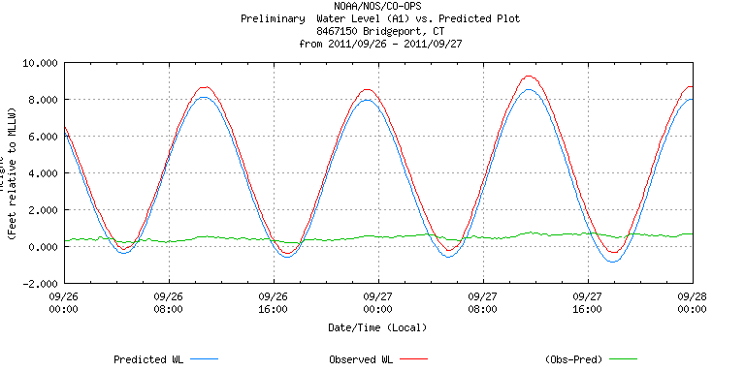
Phase 1: Data and Evidence (Source: Teacher)
Students generally have difficulty interpreting the graph such as the x-axis and the y-axis—teacher interprets the graph with the students.

Slide 12
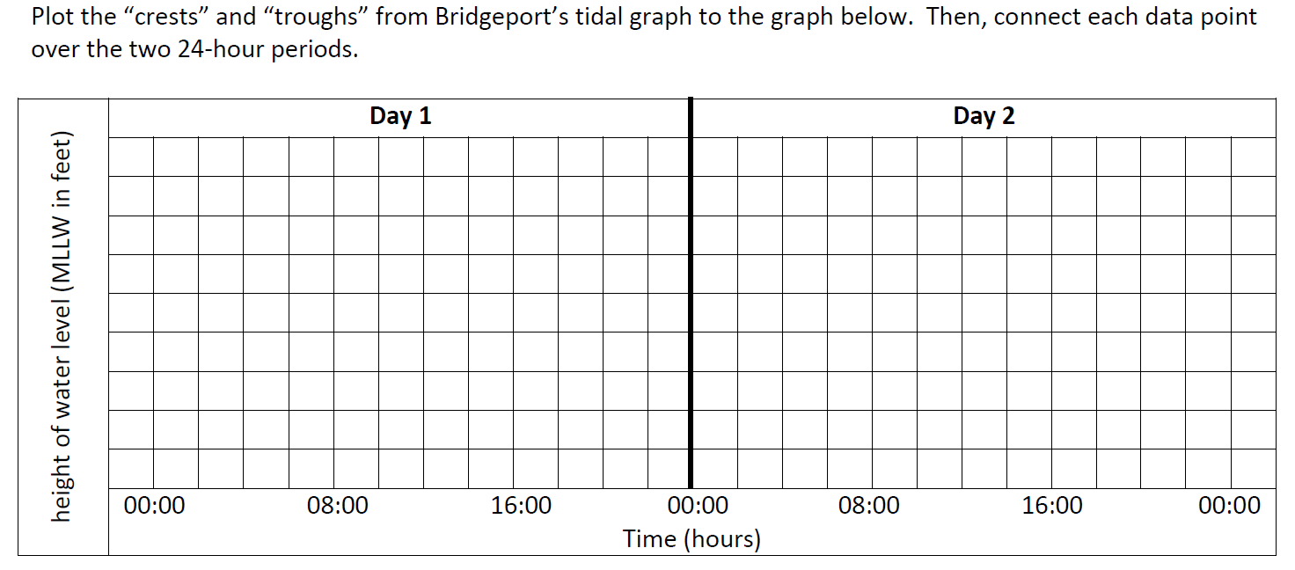
Phase 1: Data and Evidence (Source: Teacher)
Teacher provides the graph to record data—graph is pre-labeled.

Slide 13
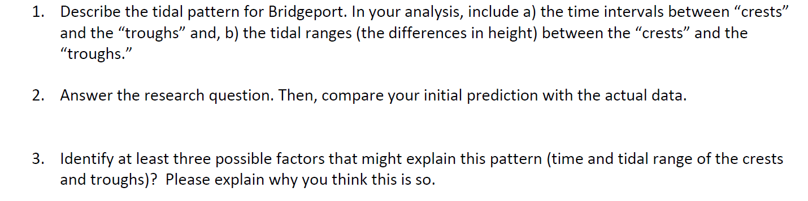
Phase 1: Conclusions (Source: Teacher)
Students’ conclusions are guided by teacher-directed questions to target specific content (e.g. two high and two low tides per day).

Slide 14
Phase 2 of the Investigation
The Tide is High

Slide 15
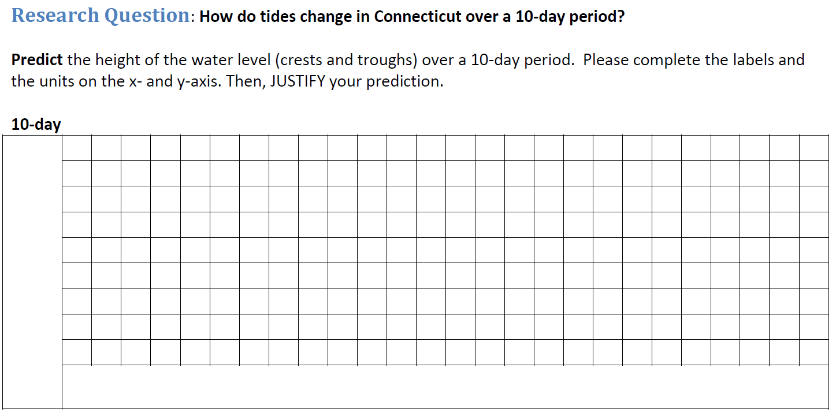
Phase 2: Research Question (Source: Teacher)
Teacher provides the research question, but asks the students to predict the outcome. Students are also asked to label the x- and y-axis.

Slide 16
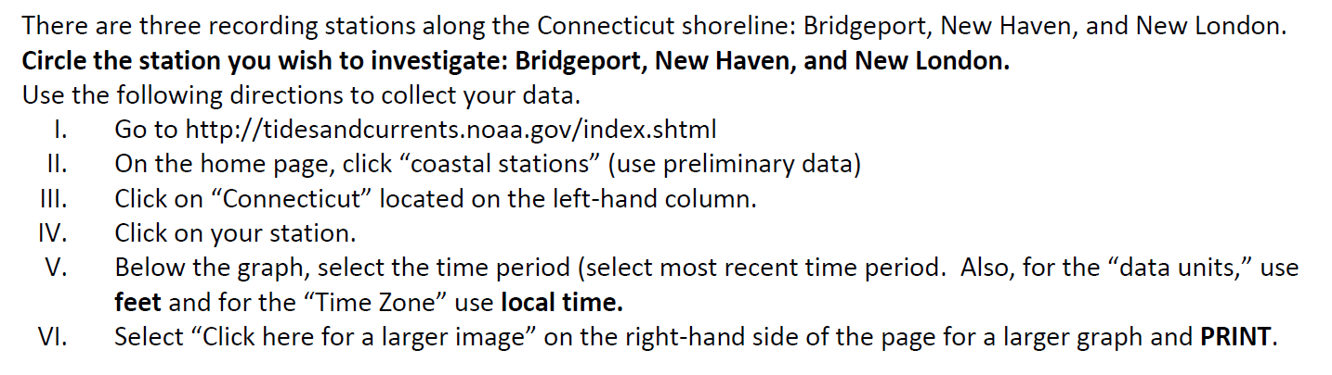
Phase 2: Research Procedure (Source: Teacher)
Teacher provides the procedure. Students, however, are now able to collect the data independently from one of the three recording stations in Connecticut.

Slide 17
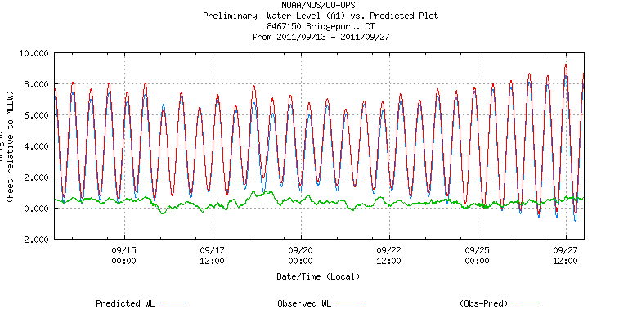
Phase 2: Data and Evidence (Source: Students)
Students independently print the data and interpret the results.
The 10-day graph provides evidence of spring and neap tides.

Slide 18
Phase 2: Conclusions (Source: Students)
Students interpret the results and respond to the research question without questions that target the science content.

Slide 19
Phase 3 of the Investigation
The Tide is High

Slide 20
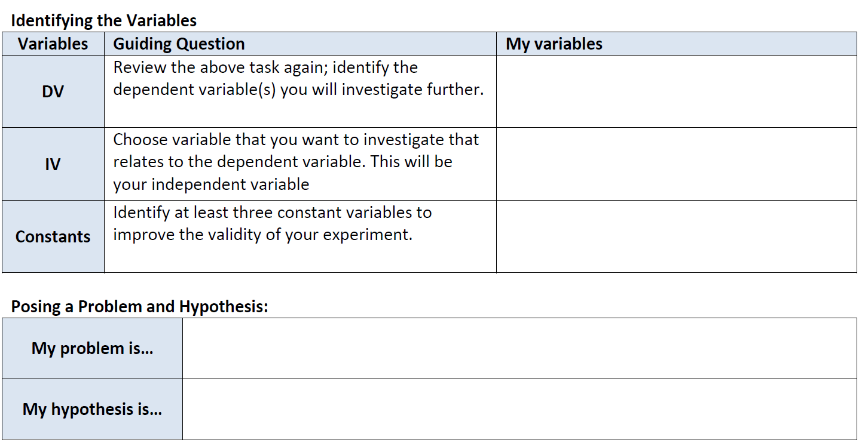
Phase 3: Research Question (Source: Student and partial teacher)
Students use graphic organizers to guide them through selecting the variables to pose their question and their hypothesis.

Slide 21
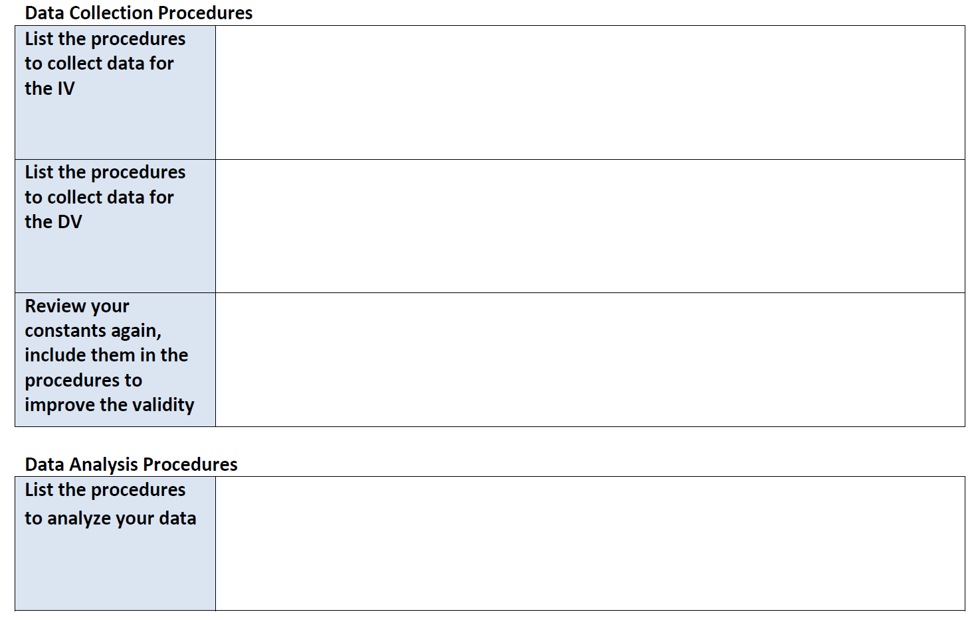
Phase 3: Research Procedure (Source: Student)
Again, students complete the graphic organizers to guide them through writing their own procedures

Slide 22
Phase 3: Data and Evidence (Source: Students)
Students use their research procedure to analyze the results

Slide 23
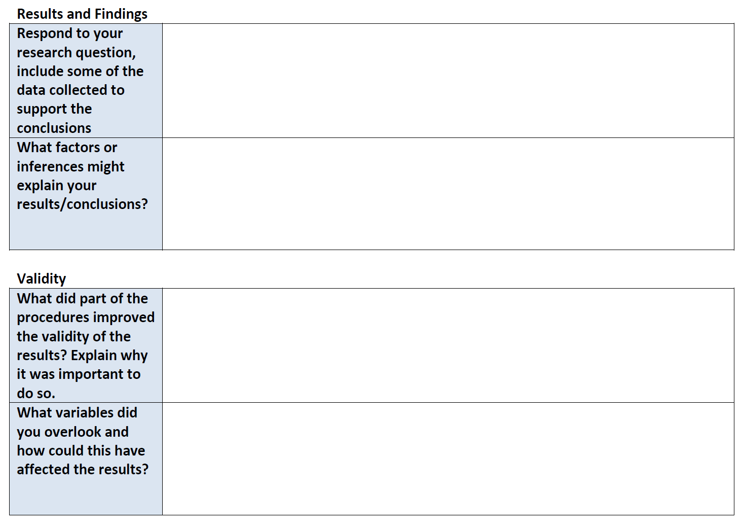
Phase 3: Conclusions (Source: Students)

Slide 24
Final Report
Tide is High

Slide 25
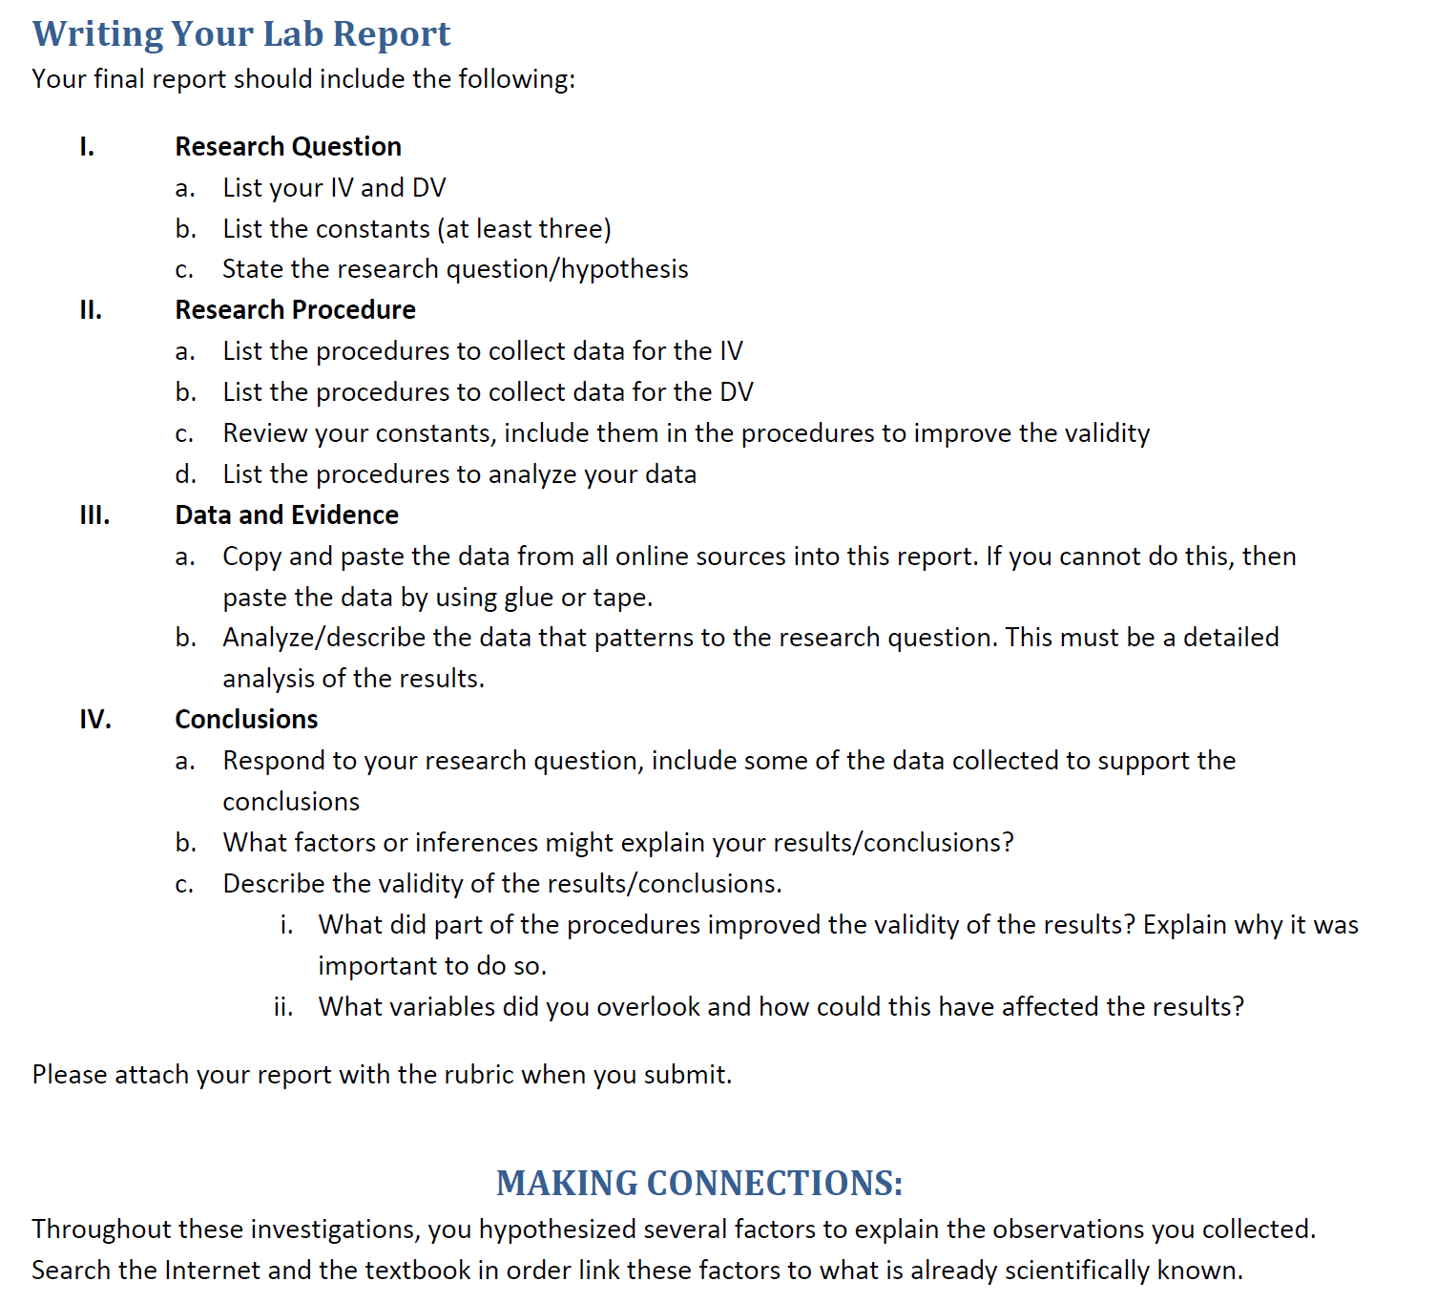
Student Work Sample

Slide 26
Questions?

Slide 27
Thank you!

Slide 28
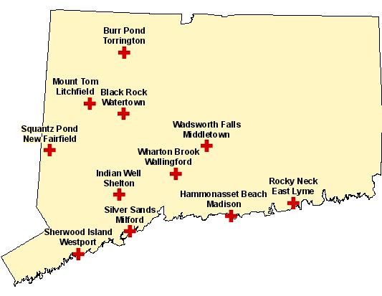
Map of Connecticut State Parks
Back
Image: CT DEP (www.ct.gov/dep)

Slide 29
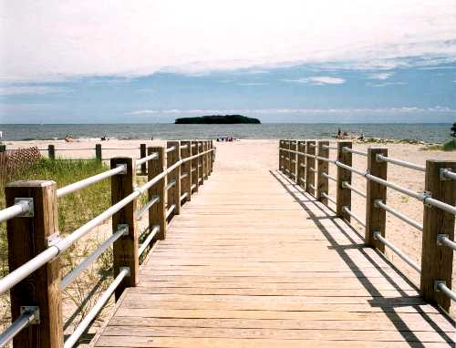
Video of Silver Sands State Park
Click on Image for Video
Back
Image: CT DEP
Link: http://www.ct.gov/dep/cwp/view.asp?a=2716&q=325262

