Slide 1
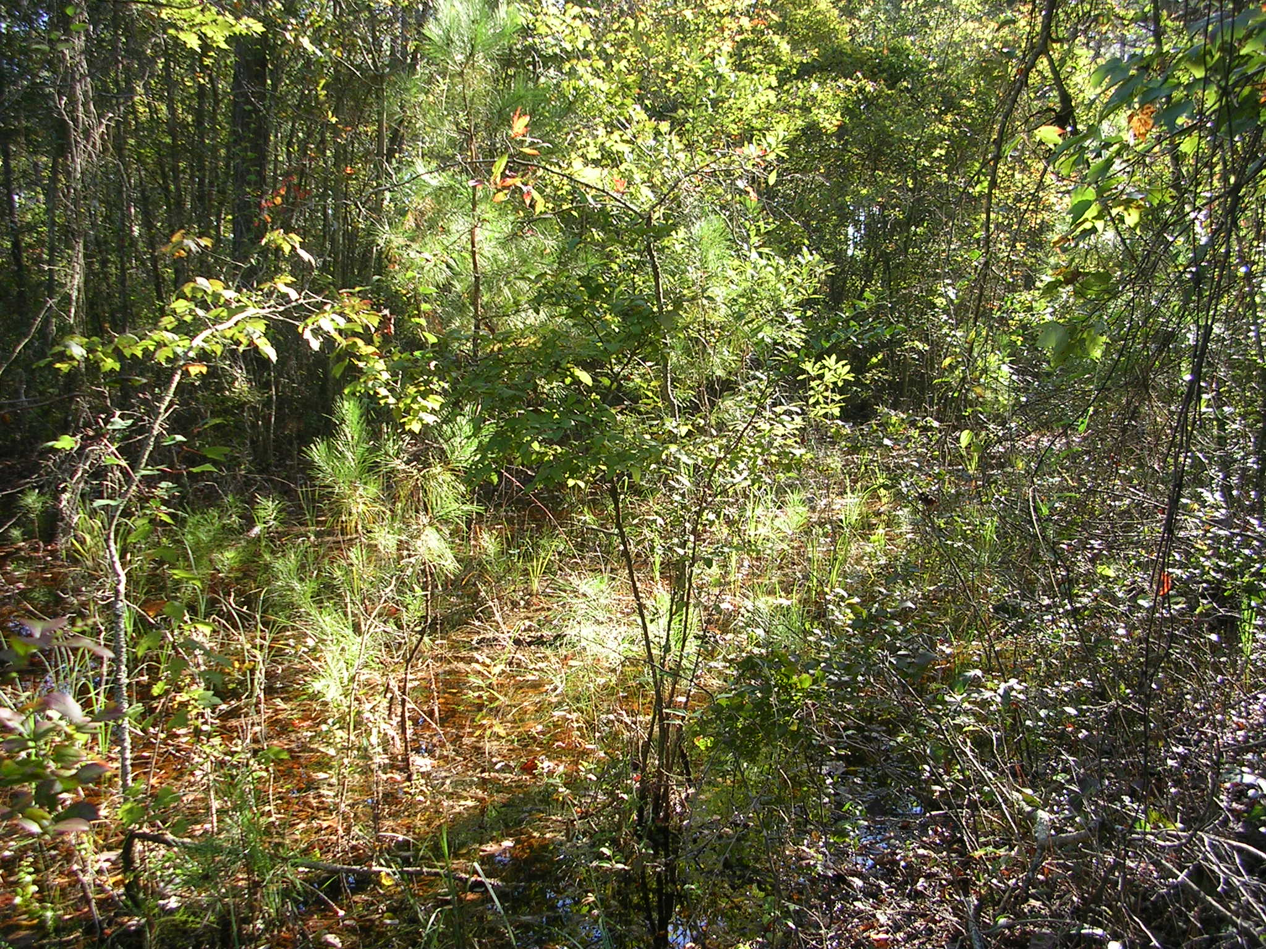
The Practical Application of Geology to the
Mitigation and Regulation of
Isolated Wetlands
November 6, 2012
Geological Society of America
Charlotte, NC
Amy Keyworth, Rick Bolich and Evan Kane
NCDENR, Division of Water Quality

Slide 2
Background
Geographically isolated from surface water
The Clean Water Act of 1972
does not protect IWs
  2001 – Solid Waste Agency of Northern Cook County (SWANCC)
  2006 – Rapanos/Carabell
Notes:
2

Slide 3
Background
Wetland functions
  Flood control
  Erosion control
  Surface water quality
  Biodiversity
  Unique functions – amphibian reproduction
NC – regulate IWs since 2001
  Protect the function, and the presence
Notes:
3

Slide 4
Isolated Wetlands Hydrologic Connectivity Study
Multidisciplinary EPA grant-funded study
  Biology, Ecology, Hydrology, Water quality
Our role – hydrologic connectivity to surface water
Bonus – knowledge we can apply to existing regulatory programs

Slide 5
Today’s objective
Activities that we regulate that might affect the presence and function of IWs
  Mine dewatering
  Land application of wastewater
What level of hydrogeologic assessment is necessary?
Notes:
5

Slide 6
North Carolina
50 Miles
Blue Ridge Province
Piedmont Province
Coastal Plain
Bladen County
Brunswick County

Slide 7
2 Miles
2 Miles
Owens 1989
1:250,000
Weems 2011
1:100,000

Slide 8
Isolated Wetlands Hydrologic Connectivity Study
Lessons learned
  Stratigraphy
  Hydrology
    Horizontal flow direction
    Vertical gradient

Slide 9
Data Collection
44 cores
72 monitoring wells
3 pumping wells
10 stream gaging stations
Water levels
  monthly point-in-time
  32 automatic data-loggers
3 Aquifer tests

Slide 10
Stratigraphic Conceptual Models

Slide 11

P
ET
Isolated wetland
Stream

Slide 12
Sand at Site BL7
Isolated wetland
Stream
Water Level
Sandy layer
Dark gray clay layer

Slide 13
Silt bodies at BL1
Isolated wetland
Stream
Water Level
Sandy layer
Silt body
Dark gray clay layer

Slide 14
Silt confining layer at site BL6
Isolated wetland
Stream
Unconfined aquifer
Unconfined aquifer
Confined aquifer
Water Level
Sandy layer
Silt body
Dark gray clay layer

Slide 15



Lower K layer at site GS1
Isolated wetland
Connected wetland
65
60
55
50
45
40
Elevation (feet)
35
30
25
20
15
10
5
0
0
200
400
600
Distance (feet)
Sandy layer
Wood
Interbedded sand and clay
Unknown
Clay chips

Slide 16
Site BL9 – cemented zones
250 Ft
Isolated Wetland
Core site
Cemented zone

Slide 17
Hydrology Results

Slide 18
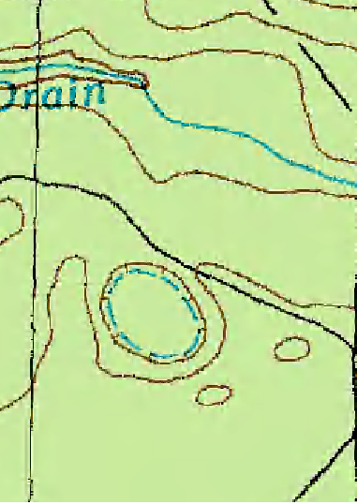
Flow direction
Site BL7 - topographic control
#
#
#
#
#
#
#
Flow direction
Surface Water gaging
500 ft
Monitoring wells

Slide 19
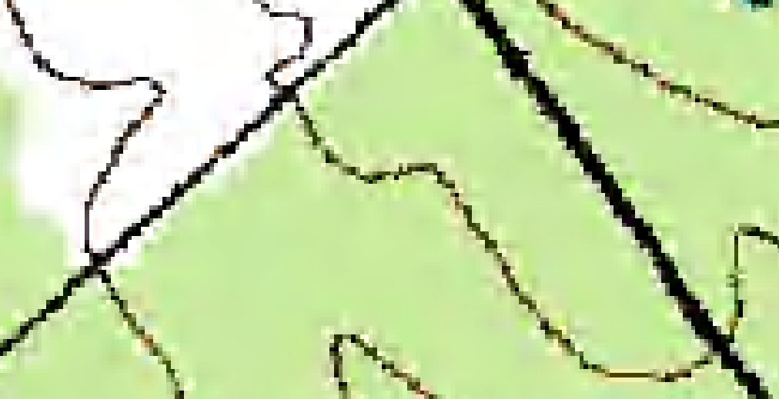
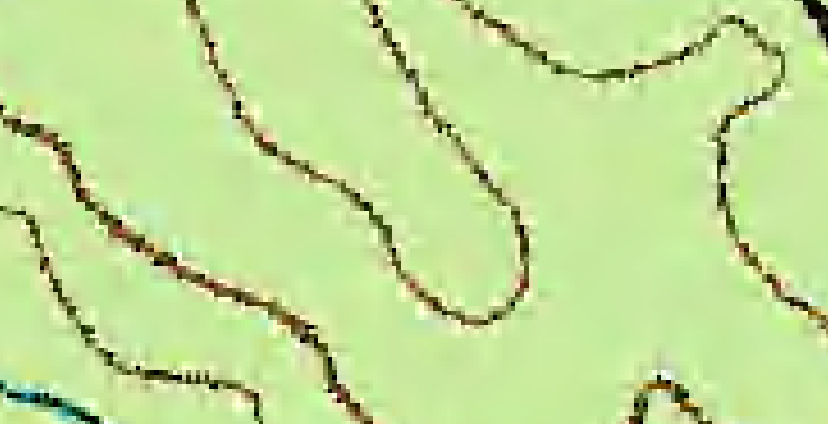

Flow direction
Site BL17 - radial
#
Flow direction
500 ft
Monitoring wells

Slide 20
Vertical gradient
Upward

Slide 21
Vertical gradient
Downward

Slide 22
Vertical gradient
No vertical gradient

Slide 23
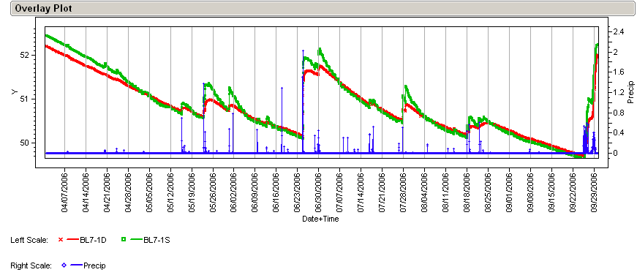
Vertical gradient
Changes with conditions
BL7 - MW1D and S
52
2
Water Table Elevation (ft msl)
Hourly Precipitation (in)
51
1
50
0
Apr
May
Jun
Jul
Aug
Sep
BL7-MW1D
BL7-MW1S
Precipitation

Slide 24
What level of assessment is necessary?

Slide 25
2 Miles
2 Miles
Owen 1989
Weems 2011

Slide 26
Conclusions
Can’t assume a simple system
Scale matters
Detailed stratigraphic characterization

Slide 27
Sample site plan
Core location
Monitoring well location

Slide 28
Conclusions
Can’t assume a simple system
Scale matters
Detailed stratigraphic characterization
Think local scale

Slide 29


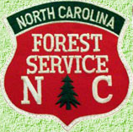
Acknowledgements
EPA Cooperative Agreement Number CD 95415809 and CWA Section 106
Bladen Lakes State Forest
Turnbull Creek Educational State Forest
The Nature Conservancy

Slide 30
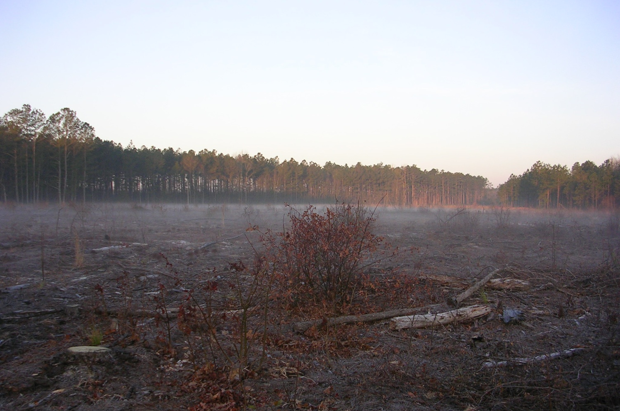
Contact Information
  Amy.Keyworth@ncdenr.gov
  Rick.Bolich@ncdenr.gov Evan.Kane@ncdenr.gov

