Slide 1

The Oregon Spatial Data Library in Context
Andrea A. Wirth¹
Bonnie Avery¹
Kuuipo Walsh²
Marc Rempel¹
Oregon State University
Geoscience Information Society November 6th, 2012

Slide 2
Scope of Study
State spatial data clearinghouses
Use by non-experts
History of NSDI and clearinghouses
Other assessments of clearinghouses?
Reviewed 50 state clearinghouses for features appropriate to new/novice users
Notes:
From ISTL:
This article reviews the nationwide setting for development of the NSDI and subsequent development of state geospatial clearinghouses. The paper first reviews these clearinghouses with a specific focus on five user-centric characteristics: keyword search options; availability of training or documentation; ease of access to metadata; presence of locally unique data; and calls for data or metadata contributions. These characteristics address the perspective of users who are neither GIS experts nor familiar with the clearinghouses. Information literacy concepts and the literature review informed the selection of the characteristics used in the review. The OSDL is reviewed in the same manner with the intention of commenting on steps which might be taken to make it more effective in the future.

Slide 3
Clearinghouses
“A spatial data clearinghouse can be defined as an electronic facility for searching, viewing, transferring, ordering, advertising and/or disseminating spatial data from numerous sources via the Internet and, as appropriate, providing complementary services.”
Crompvoets, J., Bregt, A., Rajabifard, A., and I. Williamson. 2004. Assessing the worldwide developments of national spatial data clearinghouses. International Journal of Geographical Information 18(7): 665-689.
Notes:
To start out, I want to make sure we’re all on the same page as to what a spatial data clearinghouse is. This definition comes from Crompvoets.
Background: As with other state data clearinghouses, a national commitment to providing framework layers provided the basis for the OSDL. Framework layers, established by the Federal Geographic Data Committee, include geodetic control, cadastral, orthoimagery, elevation, hydrography, administrative units, and transportation. Although these layers represent the basic elements of the clearinghouses, how does the technology stack up to facilitate discovery and use of the data provided?
Federal clearinghouse info from NSDI FGDC http://www.fgdc.gov/dataandservices/clearinghouse_qanda/?searchterm=clearinghouse

Slide 4
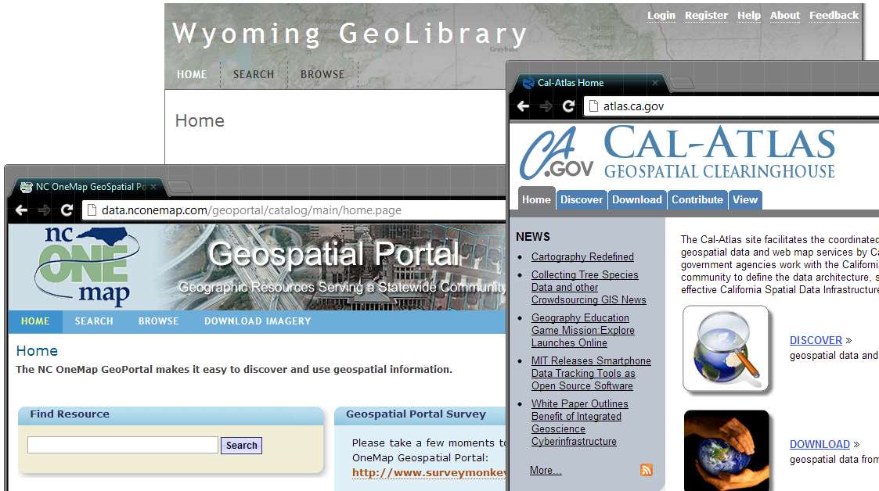
Notes:
[Examples of clearinghouses]

Slide 5
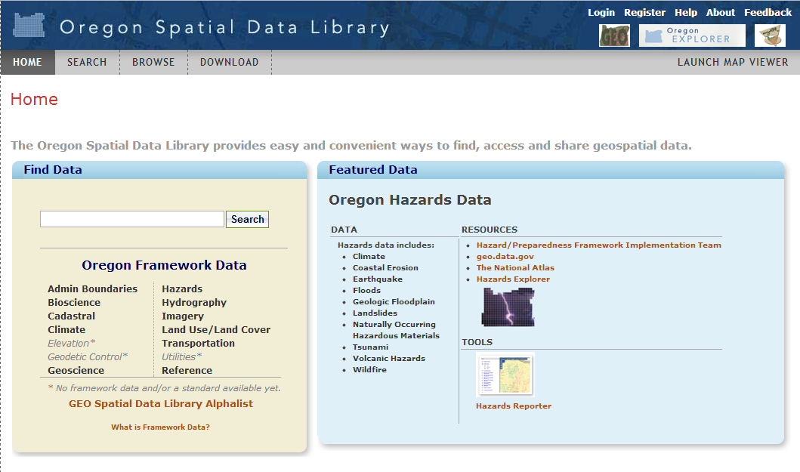
Notes:
[Examples of clearinghouses]

Slide 6
Oregon Spatial Data Library (OSDL)
Provides access to spatial data created by State of Oregon agencies
  Launched November 2009
  For: State of Oregon agency staff; general public, consultants, educators, and students.
  Framework data focus
  Multi-phase project, grant funding
  http://spatialdata.oregonexplorer.info
Notes:
10/2012: The Oregon Spatial Data Library (OSDL), Oregon’s geospatial clearinghouse, provides a method for sharing public domain geospatial data at no cost to users.
The OSDL, built on the foundation established by earlier collaborations between Oregon State University Libraries (OSUL), the Institute for Natural Resources (INR), AND GEO and state agencies is one of several portals that make up the Oregon Explorer: Natural Resources Digital Library.
From OSDL about page:
Audience
The targeted primary users for the Oregon Spatial Data Library are staff of agencies participating in the Oregon Geographic Information Council (OGIC), including Federal, State, and local governments and tribes. Secondary users include the general public, consultants, educators, and students.
2010:
Provides a method for finding, accessing, and sharing geospatial data. It provides access to spatial data with an emphasis on Framework data.
OSDL is a multiphase project that relies on continued funding and continued opportunities to grow with current and future partners.
Launched in November of 2009
This presentation is not about the technology used (if you visit ESRI’s website you’ll see several states, organizations, and others that are providing access to their data in a similar way using the same product -Geo portal toolkit 9.3).
Briefly however, these were the initial functional requirements for phase 1 of the project:
Able to integrate into existing initiatives – Oregon Explorer, and State of Oregon GIS management plan
Design to access and distribute geospatial data beyond State provided data and beyond framework data
Clip, zip, ship: Allow users to clip areas of interest (AOIs) rather than limit to entire layer download, compress data for quicker file transfer, with metadata included.
Support multiple projections and datums
Adhere to Federal Geographic Data Committee and Open Geospatial Consortium (OGC) standards
Provide stable around the clock access.

Slide 7


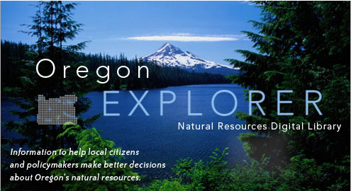

OSDL partners
Oregon State University
University Libraries
http://osulibrary.oregonstate.edu/
State of Oregon
Geospatial
Enterprise Office (GEO)
http://www.oregon.gov/DAS/CIO/GEO/
Oregon University System
Institute for
Natural Resources (INR)
http://oregonstate.edu/inr/
Notes:
Not unusual to have partnerships between .edu state gov, e.g. ID and MT.
10/2012:
Collaborative effort addressing data deluge on a state-wide level
Improves access to data
from OSDL “about page” The Oregon Spatial Data Library provides public access to reliable and up-to-date spatial data. The Oregon Spatial Data Library is a joint effort between the Department of Administrative Services Geospatial Enterprise Office and Oregon State University.
Currently, more than 200 spatial datasets are accessible from the Oregon Spatial Data Library, including all of the statewide framework data available for Oregon. These datasets serve as base data for a variety of Geographic Information System (GIS) applications that support research, business and public services. Framework datasets include administrative boundaries, transportation, land use and ownership, water, hazards, and wetlands.
Although all of the datasets on the Oregon Spatial Data Library currently pertain to Oregon’s geography, this is not a criterion for the inclusion of future datasets.
2010:
Slide bullets: Universities:
University (Libraries and INR)
Slide notes 2010: OSDL couldn’t have happened in our state this quickly without some established relationships already in place:
The University partners
Have technical expertise
Build on other portals – esp. Imagery Explorer – and expand OE
Build on collaboration with other universities in other “library” areas (University of Oregon)
INR is mandated by the State to provide access to NR information for Oregonians (public and stakeholders). Oregon State University is a Land Grant institution responsible for communicating with the public in Oregon.
Have connections and exist in a “natural habitat” for data management collaboration between state and federal researchers and OSU employees. Corvallis (where OSU is) has a large concentration of federal offices given the size of the community/university.
**Slide bullets: GEO
Interest in serving geospatial data in a cost effective and user-friendly manner
technical expertise and is the spatial data authority for the State
Geospatial Enterprise Office (GEO) coordination efforts focus on facilitating and promoting standards, reducing data collection duplication, and the promotion of GIS activities in Oregon. GEO both facilitates and collaborates with many committees and groups working toward these goals.
navigatOR is a statewide effort to coordinate with local, state, tribal, and federal government, and private companies. navigatOR will lower the cost of managing geographic information and benefit all Oregonians (even if indirectly).
Accelerate the full completion of Oregon geospatial Framework data for the entire state
Encourage and support geographic data sharing and access for a broad community of users throughout Oregon, including all levels of government, the private sector, not-for-profit organizations, and the general public data
Provide an efficient environment and tools to support ongoing update of Framework geographic data
Provide easily accessible services for geographic searching and query, GIS data access and download, and basic mapping.

Slide 8
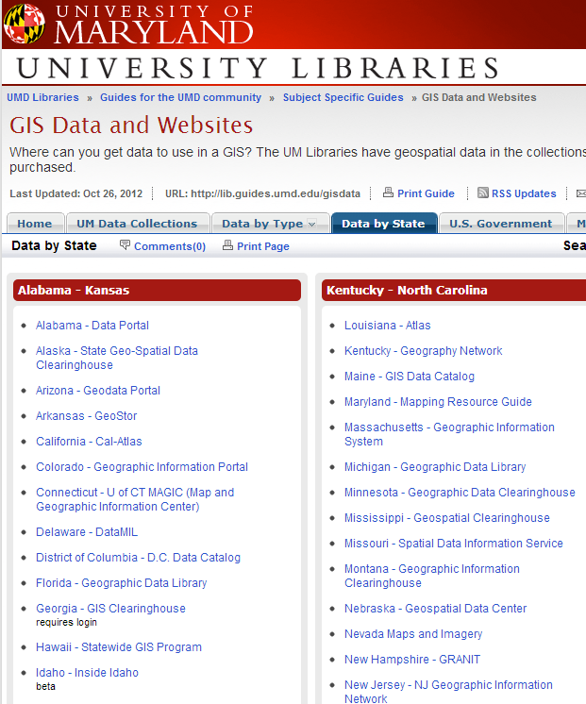
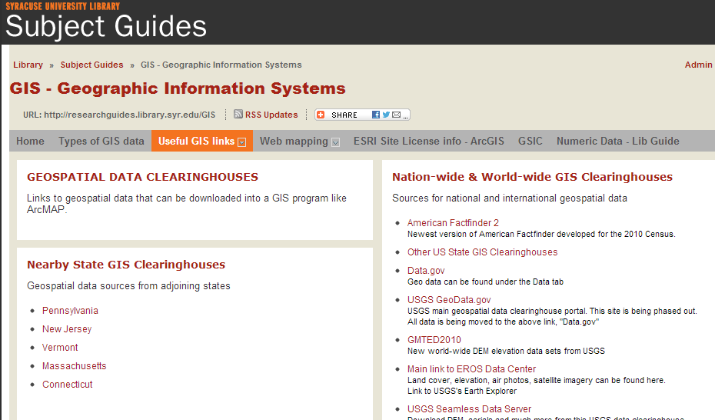
Libraries + clearinghouses
Long history of working with state “data”
New roles in data management
Helping users find and evaluate information sources
Pointing users to authoritative sources
Example subject guides: University of Maryland http://lib.guides.umd.edu/ &
Syracuse University Library http://researchguides.library.syr.edu/
Notes:
The relationship between OSU Libraries and Oregon Geo is not unique. University Libraries generally have a long history of working with state data as depository libraries. Additionally of course we want to help patrons such as students become savvy information users and we do this by helping them one to one or in classes but of course we also point them and other users to resources in our subject guides and from our libraries’ catalogs.

Slide 9
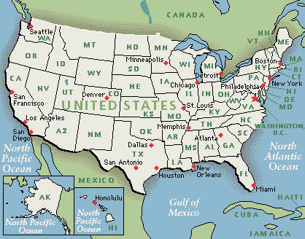
Methods
50 states’ clearinghouses
Selected characteristics
  Literature review
  Basis in information literacy concepts
Not a technical review
Notes:
So, what did we do.
In 2011-2012 we looked at data access points for all 50 states clearinghouse websites. And with that inforamtion hoped to learn how the OSDL stacked up against it’s national peers. Taking the perspective of the novice user (perhaps a student assigned to find and import data into a GIS and conduct basic analysis), this study reviewed user-centric characteristics of state geospatial clearinghouses.

Slide 10
keyword search
training or help documents specific to the site
ease of access to metadata
presence of locally unique data
Encourages data (or metadata) contributions
Information Literacy
5 Characteristics
Literature Review
Notes:
IL concepts:
Determine the extent of information needed
Access the needed information effectively and efficiently
Evaluate information and its sources critically
Incorporate selected information into one’s knowledge base
Use information effectively to accomplish a specific purpose
Understand the economic, legal, and social issues surrounding the use of information, and access and use information ethically and legally
With this in mind, the authors reviewed the web sites for the presence of five user-centered characteristics (Table 1) which reflect key information literacy concepts or were influenced by the literature described previously. The first three features emphasize the ability of a user to effectively discover information, understand it, and then subsequently evaluate and incorporate it into one's work. These were:
keyword search options
Availability of training or help documents specific to the site
Ease of access to metadata
Next, two characteristics were selected in an effort to address community and collaboration, which are important underpinnings of clearinghouse history and development.
Presence of locally unique data
Calls for data (or metadata) contributions from the broader state GIS community

Slide 11
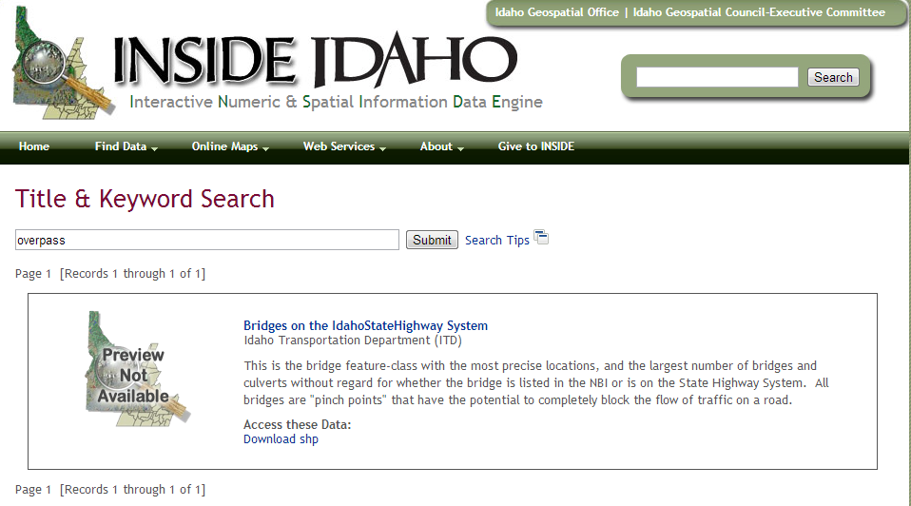
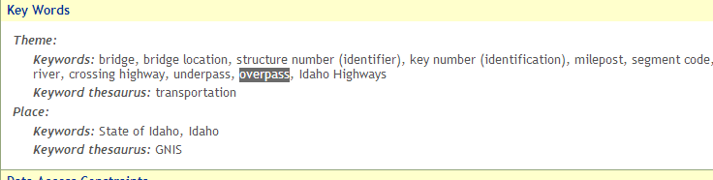
Keyword Search
http://www.insideidaho.org
Notes:
To determine if data could be found by users such as students and other non-GIS professionals, the presence of keyword searching was noted. In some cases, keyword searching was available, but did not appear to be working at the time of the review. Aside from keyword searching, many clearinghouses offered filtering by theme and some offered location searches.
For Idaho’s site multiple access points are also offered under “find data” – in addition to keyword, topic, most popular data, spatial search, and “what’s new” are additional options provided.

Slide 12
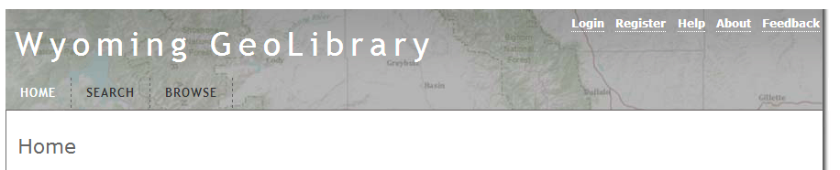
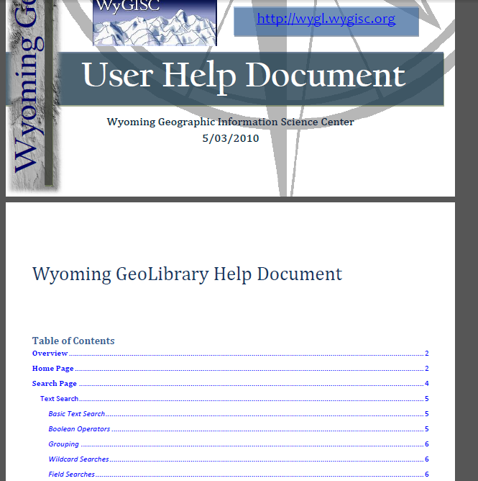
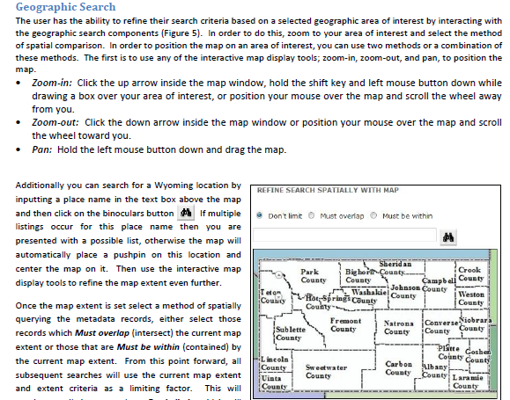
Help documents/training
http://wygl.wygisc.org/wygeolib/
Notes:
Many clearinghouse help links built with ESRI’s Geoportal toolkit connect their help link to the Geoportal server documentation. OSDL does this as well.
Wyoming’s geolibrary looked like it was going to be another one of those, but when clicked, the help link instead goes to a pdf document that provides
background and information about how to use the site to discover data including screenshots and descriptions of the data themes.

Slide 13
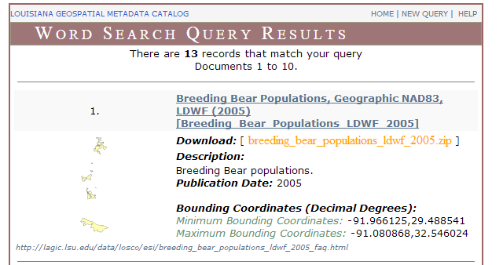
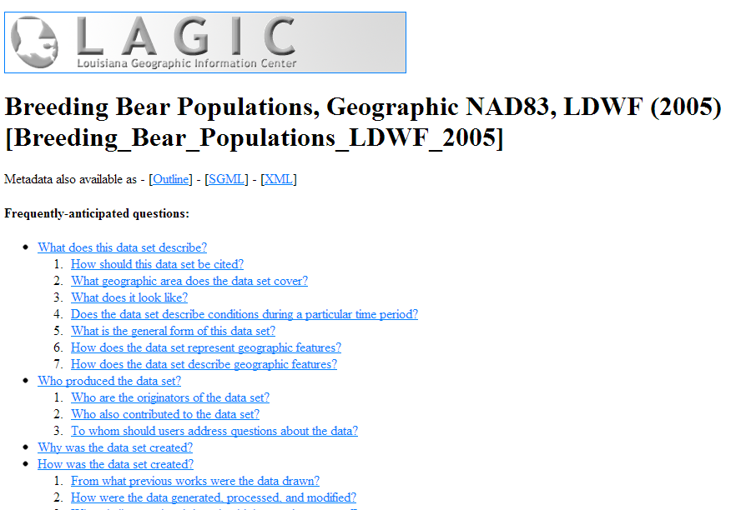
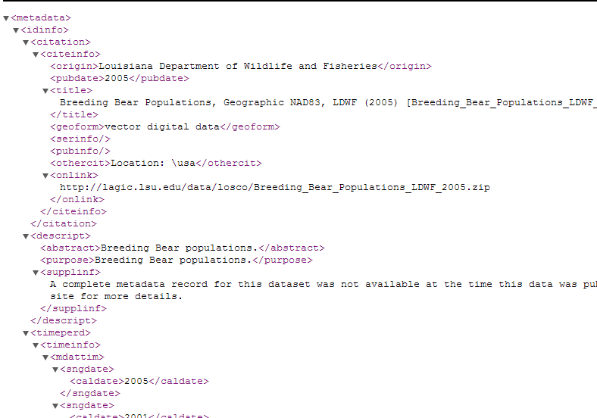
Metadata
http://lagic.lsu.edu/
Notes:
The Louisiana clearinghouse does a good job of offering easily findable metadata files in multiple formats (FAQ style as well as xml and more).

Slide 14
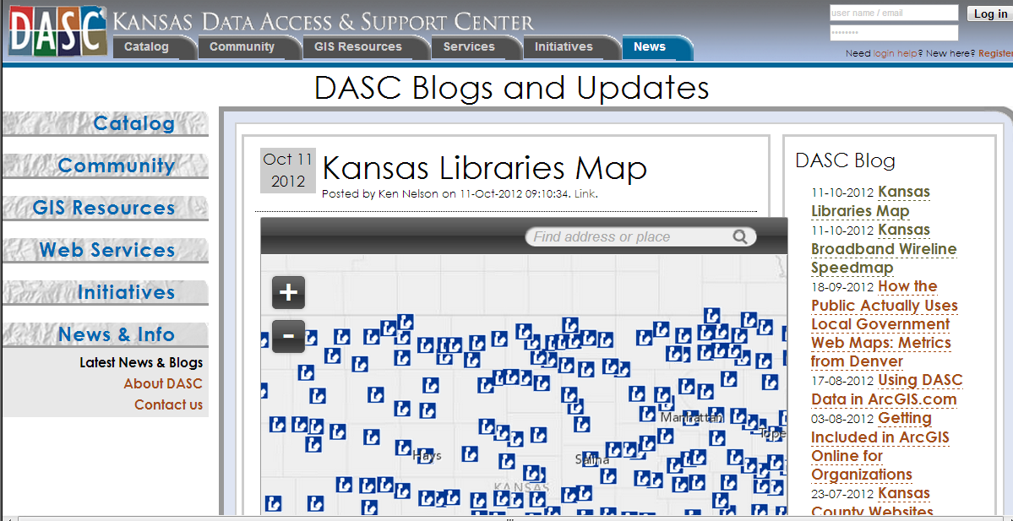
Local data
http://www.kansasgis.org
Notes:
Kansas keeps things fresh by including updates about new datasets on the news and blog sections of the clearinghouse. This would help a new user know that the site is active and being updated.

Slide 15
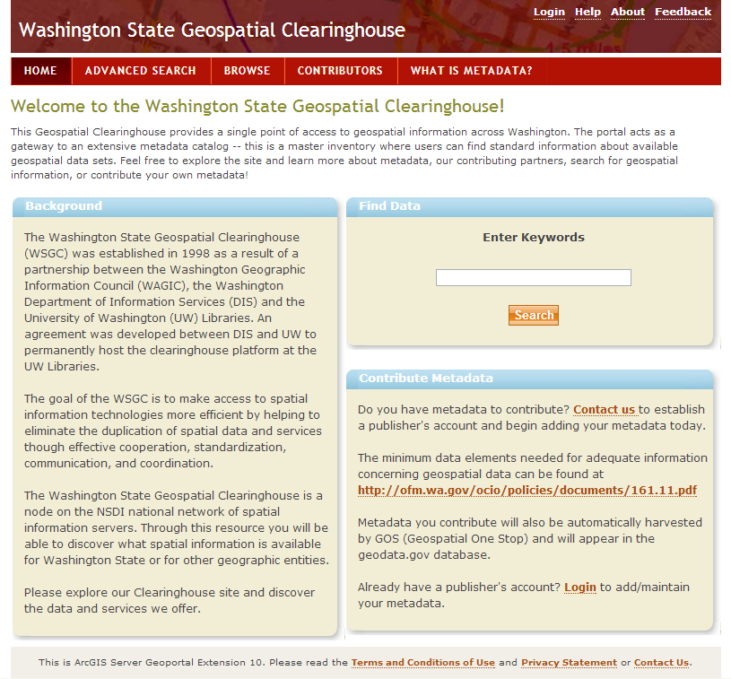
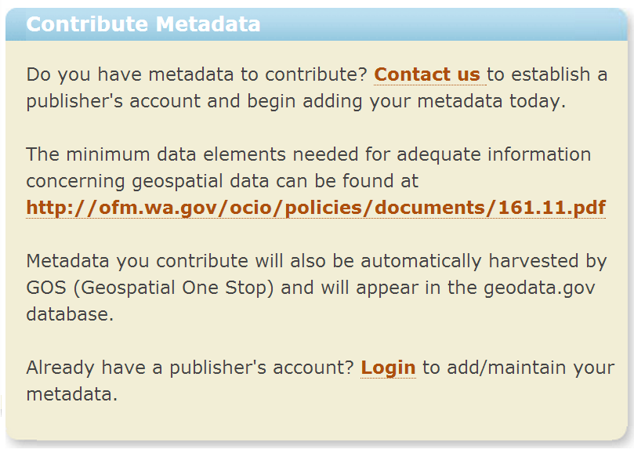
contributions
http://metadata.gis.washington.edu/
Notes:
Sharing GIS data is a primary tenet of the clearinghouse system. Some sites, such a Washington State’s clearinghouse offer the option of sharing vetted data by registering it with the clearinghouse.

Slide 16
Presence of characteristics
Characteristic | # clearinghouses (OSDL?)
Keyword search | 23 (Y)
Customized help | 17 (N)
Viewable metadata | 38 (Y)
Local data focus | 13 (Y)
Contributions solicited | 14 (N)
Notes:
Summary of how often we found the targeted characteristics on the 50 states’ clearinghouses, with OSDL in parentheses.

Slide 17
Looking forward
For all clearinghouses
Remember secondary audience for data
Referrals from other sites
Keep look and content “fresh”
Encourage contributions whenever possible
OSDL
Promote contributions to increase data
More dynamic interface/Less “out of the box” look
Customize help document
Notes:
Recommendations for clearinghouses generally and for OSDL specifically from the novice user perspective.

Slide 18
Thank you
&
Questions?
For more information:
Wirth, A.A., Avery , B., Walsh, K., & Rempel, M. (2012). Statewide spatial data clearinghouses: an Oregon Case Study. Issues in Science & Technology Librarianship 70.
http://www.istl.org/12-summer/refereed4.html
Andrea.Wirth@oregonstate.edu
Notes:
This presentation expands on a paper published by the authors:
Wirth, A.A., Avery , B., Walsh, K., & Rempel, M. (2012). Statewide spatial data clearinghouses: an Oregon Case Study. Issues in Science & Technology Librarianship 70. http://www.istl.org/12-summer/refereed4.html DOI:10.5062/F4RB72J1

