Slide 1
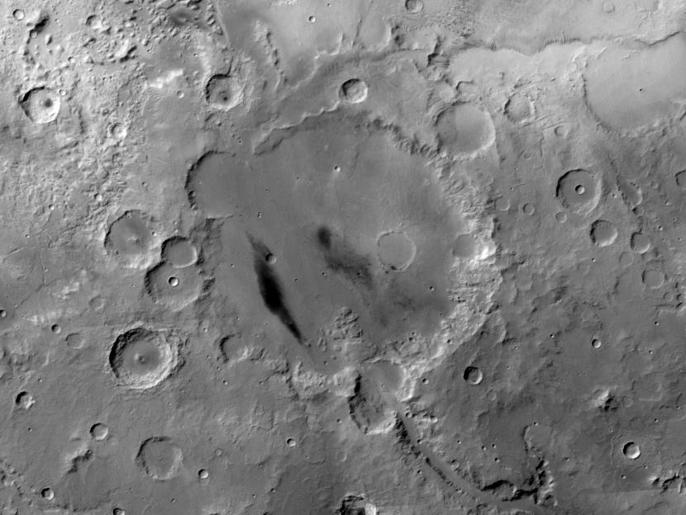
A Traverse through Hesperian Ridged Plains on Mars: Extending the Work of Ron Greeley in Gusev Crater
Steve Ruff, Arizona State University Vicky Hamilton, Southwest Research Institute

Slide 2
Overview
Greeley et al. [2005] recognized that the floor of Gusev crater has mare-like ridges and other features indicative of low-viscosity lava flows with a crater retention age of 3.65 Ga
We suggest that this surface should be mapped as Hesperian ridged plains (Hr)
Adirondack-class basalts identified by Spirit are one manifestation of crater-filling Hr material, but may not be universal

Slide 3
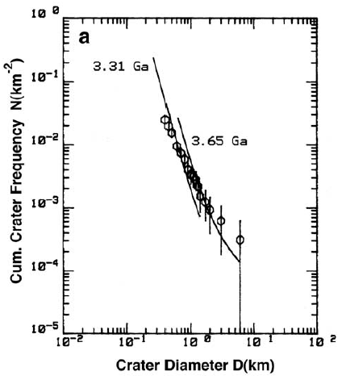
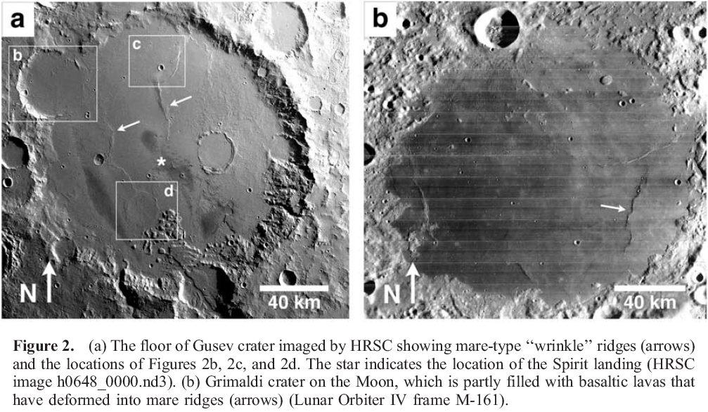
Wrinkle Ridges in Gusev
Hr ?
Early Hesperian
Greeley et al., 2005

Slide 4
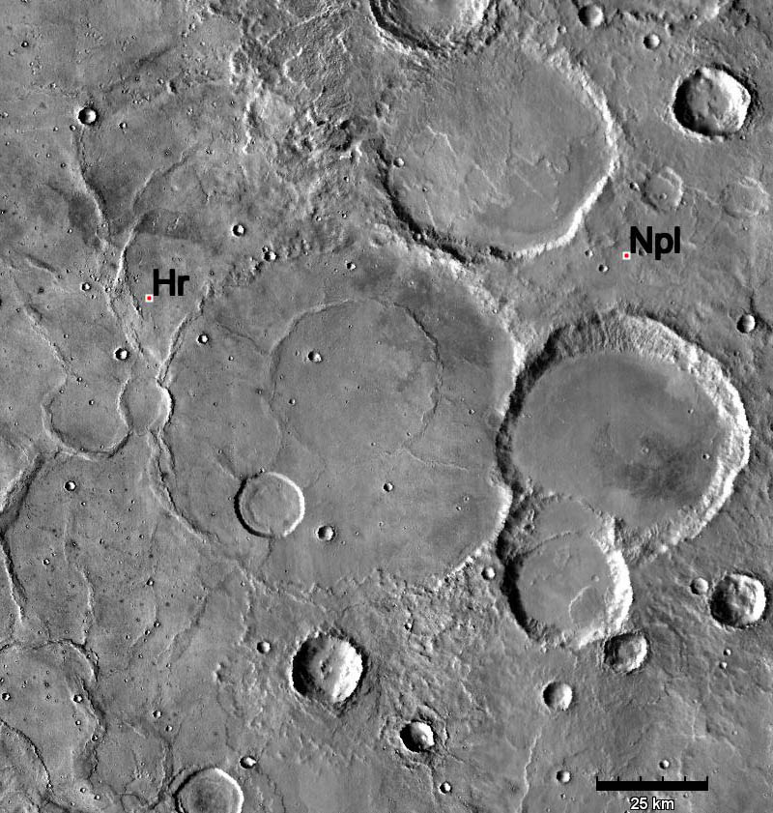
Hesperian Ridged Plains Type Locale
Embayment
relationship
Wrinkle
ridges
THEMIS daytime IR

Slide 5
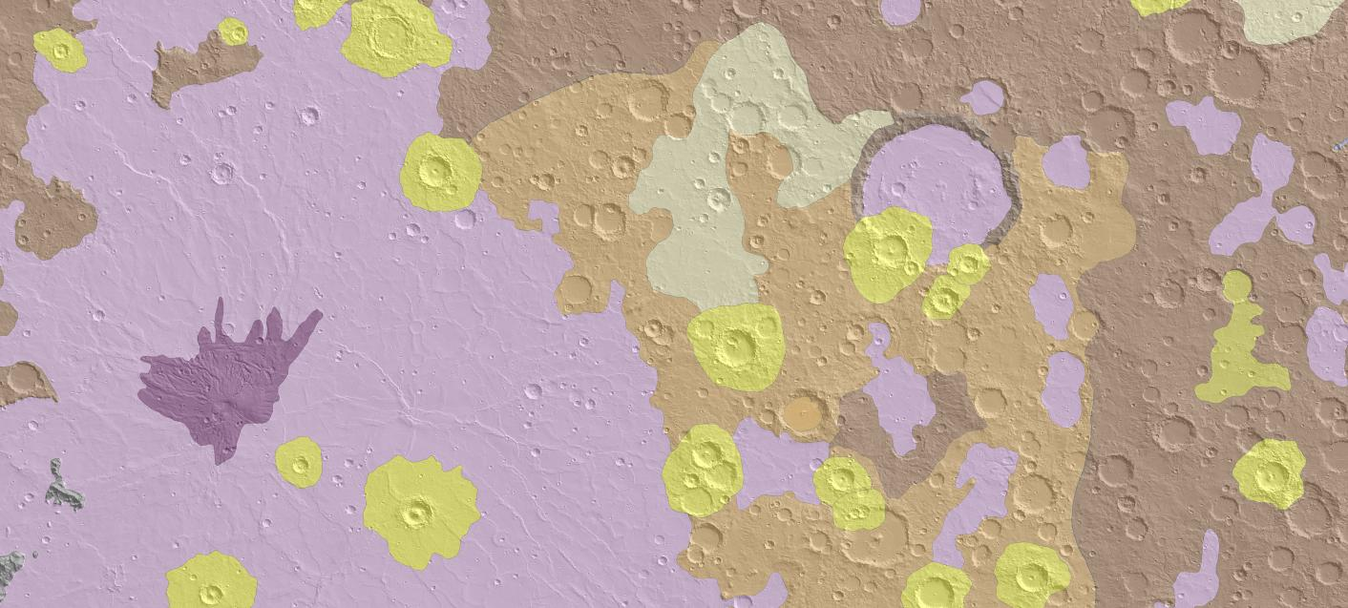
Hesperian Ridged Plains
Herschel Crater
Hesperia Planum
Skinner et al., 2006

Slide 6
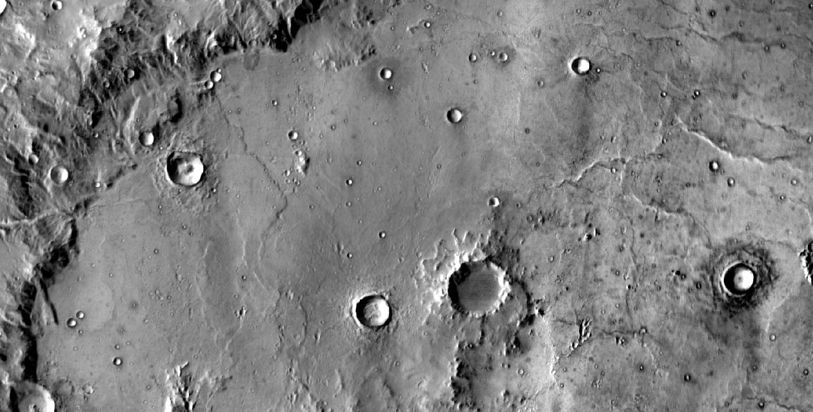
Hr in Herschel Crater
Wrinkle ridges
Embayment
relationship
THEMIS daytime IR

Slide 7
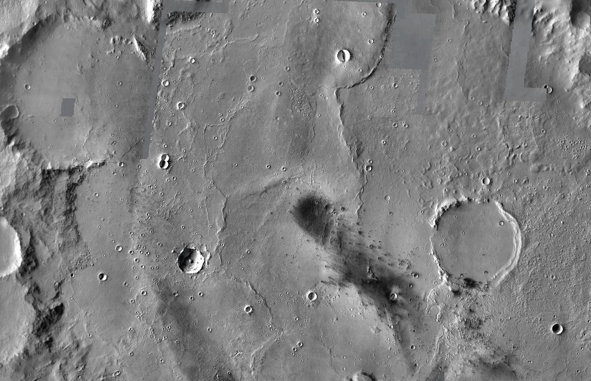
3.65 Ga Wrinkle-ridged Plains of Gusev
Hr
Wrinkle
ridges
Spirit landing site
X
Hr
Embayment
relationship
THEMIS VIS

Slide 8
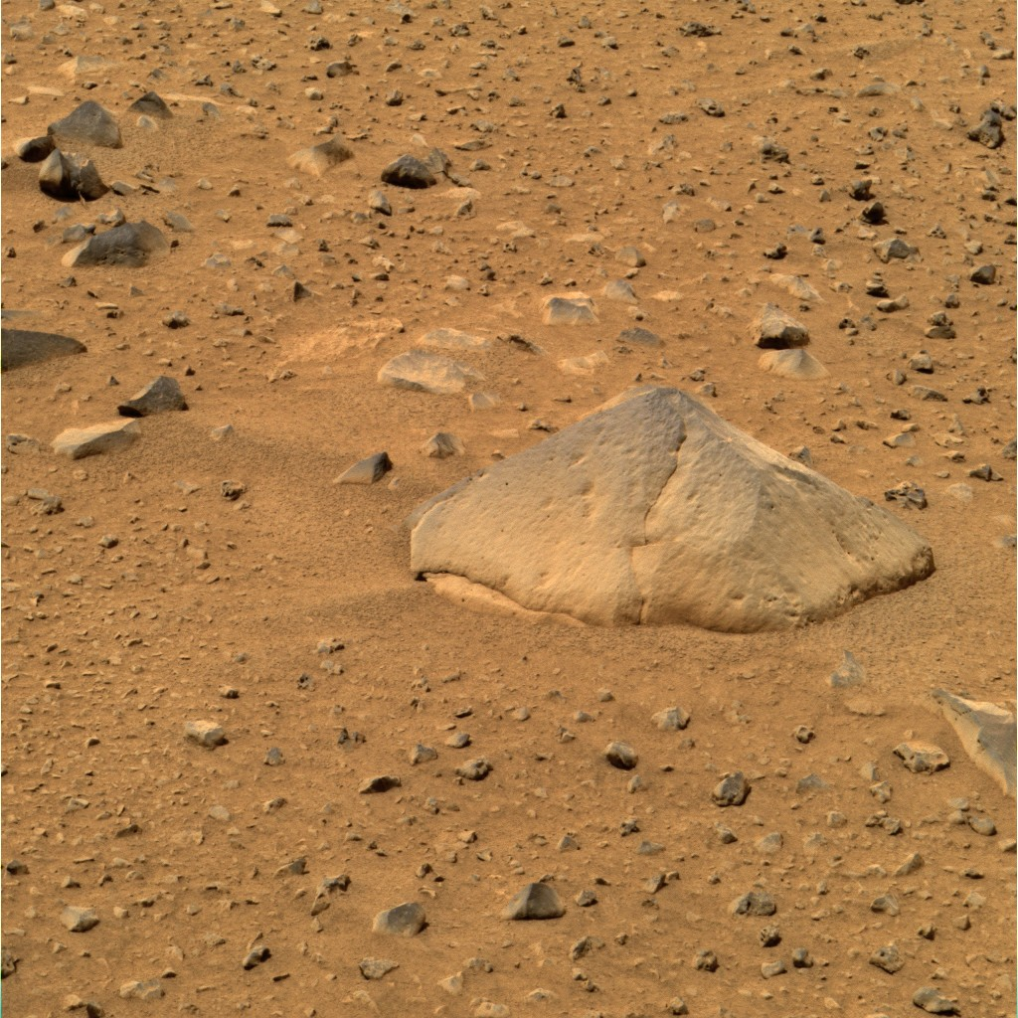
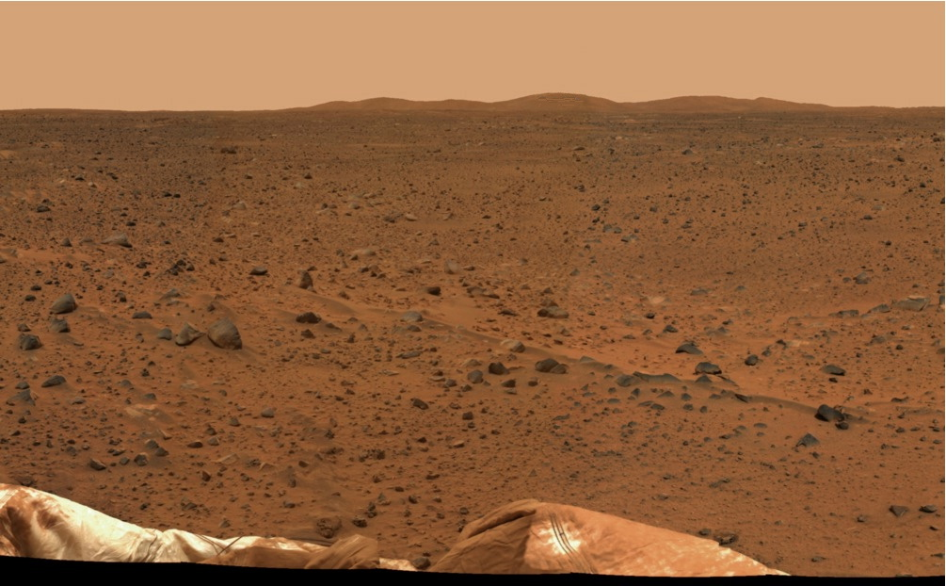
Gusev Plains: First in situ Hr?
Adirondack
Pancam approximate true- color

Slide 9
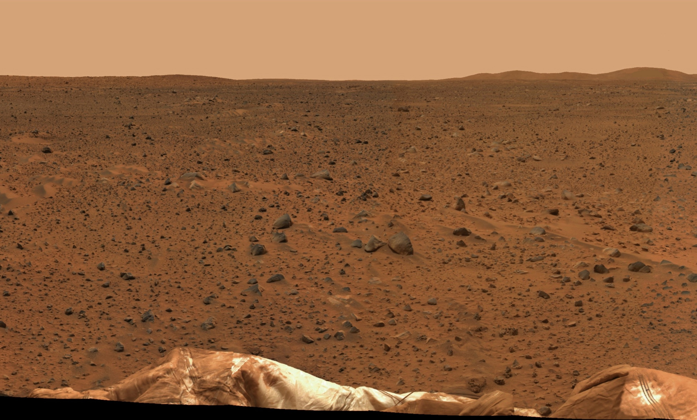
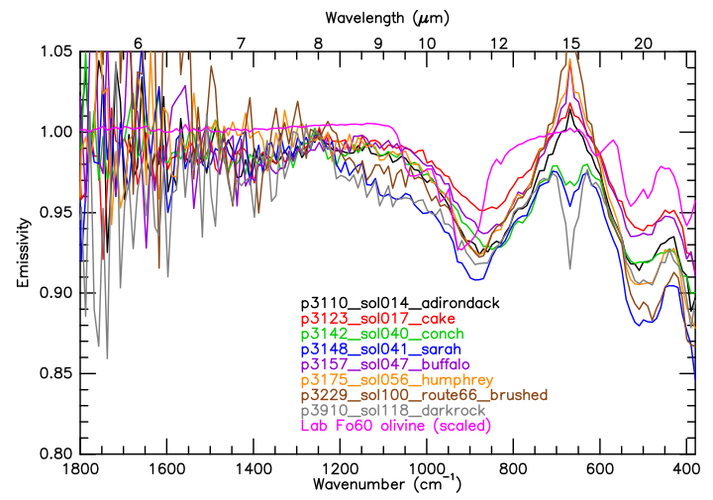
Gusev Plains: Adirondack Everywhere
To there
Here
CO₂
Mini-TES

Slide 10
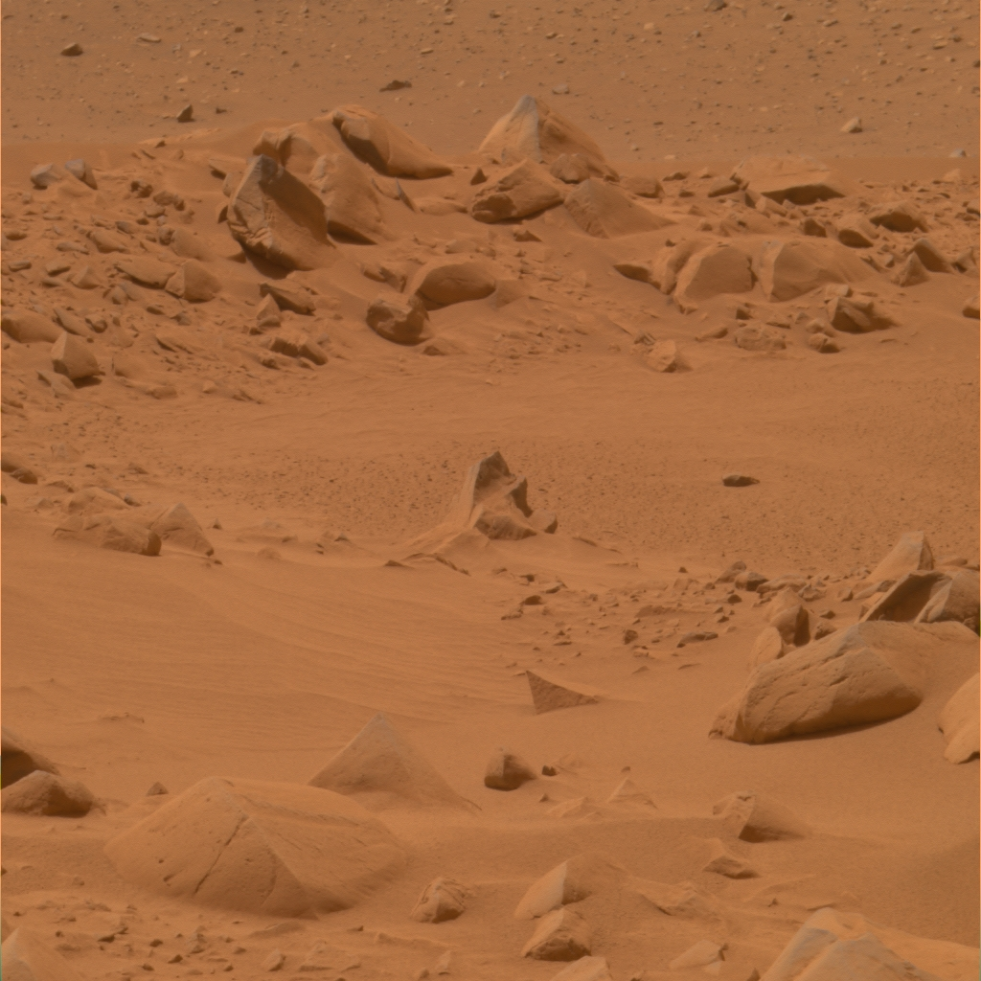
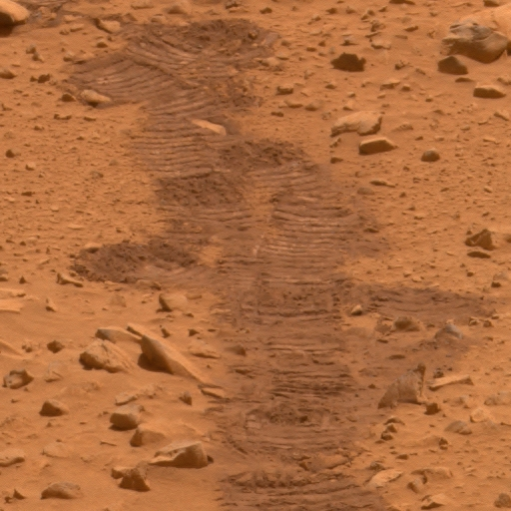
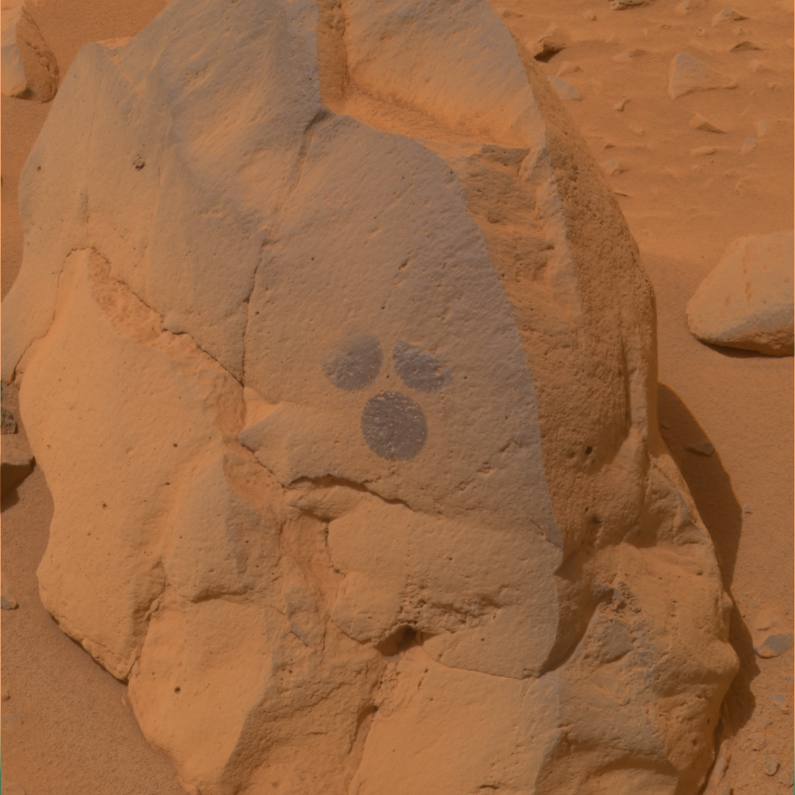
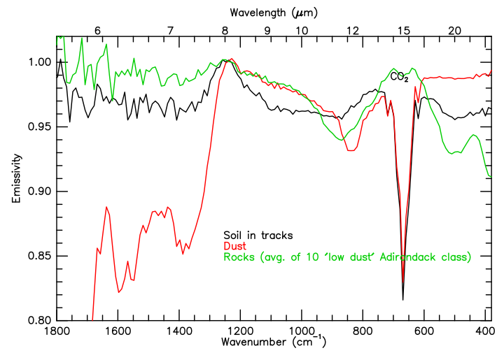
Plains Surface End Members
Pancam approximate true- color images
Dust
Soil
Rock
TES
DCI

Slide 11
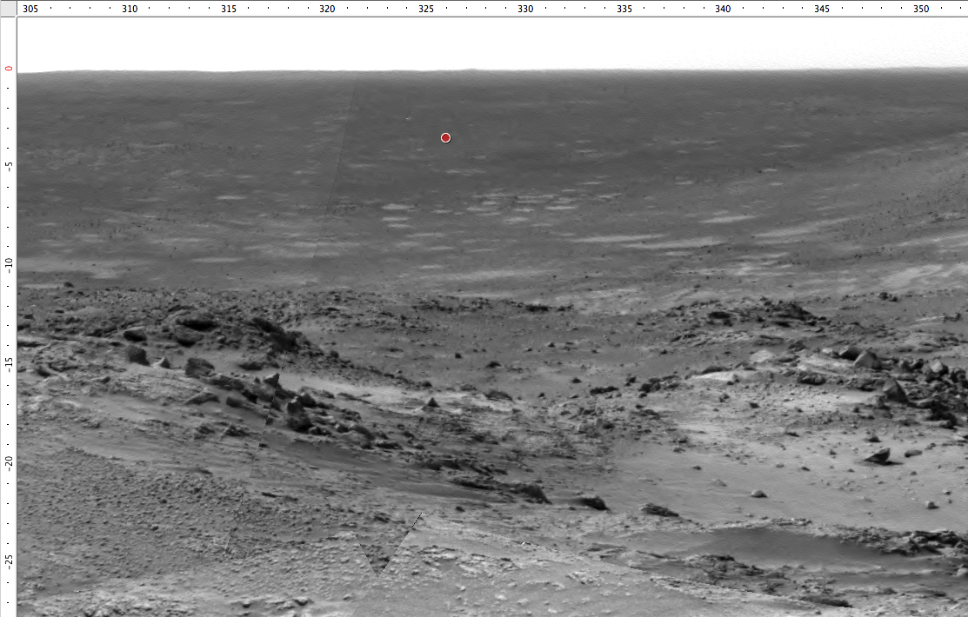
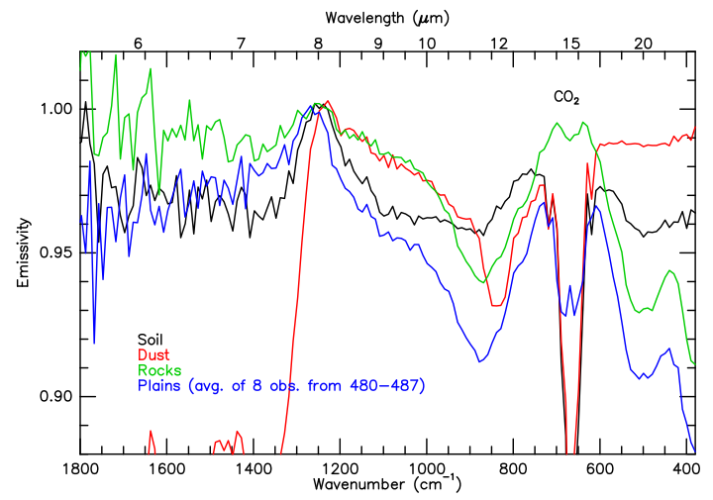
Gusev Plains: More Adirondack-class
Mini-TES
observation
Hamilton and Ruff, 2012
Navcam mosaic

Slide 12
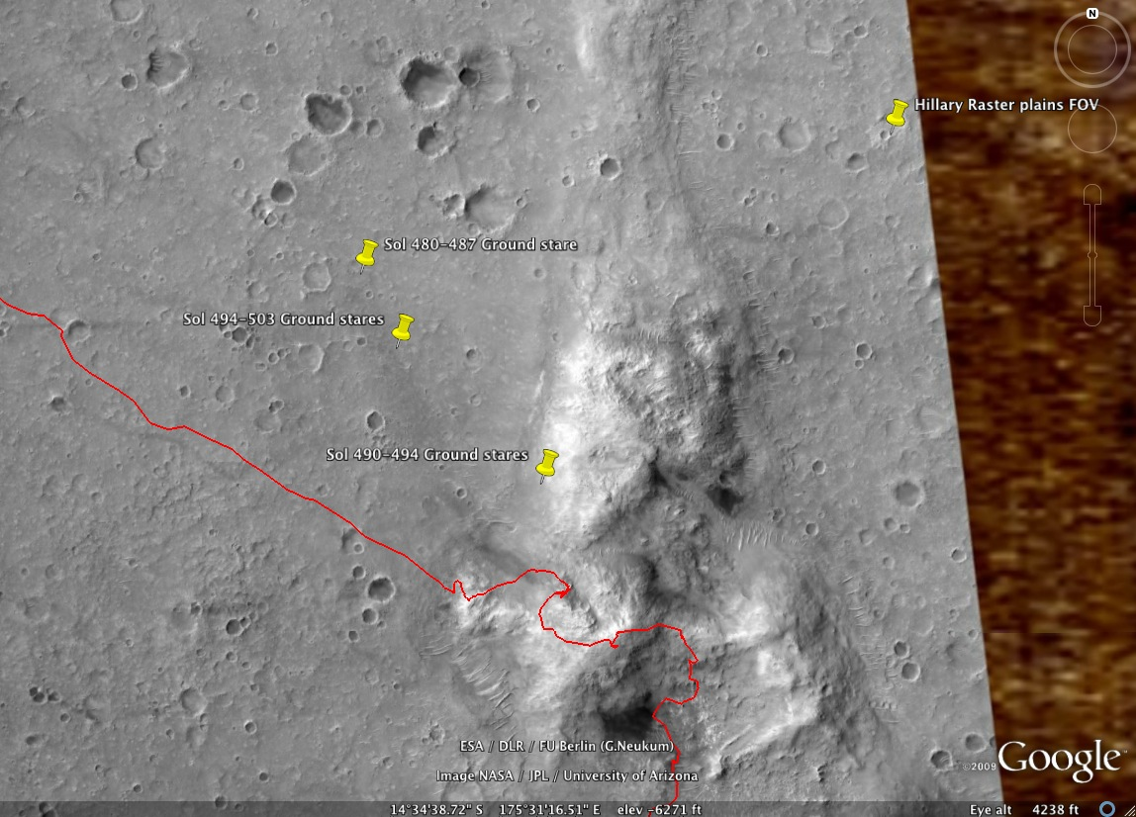
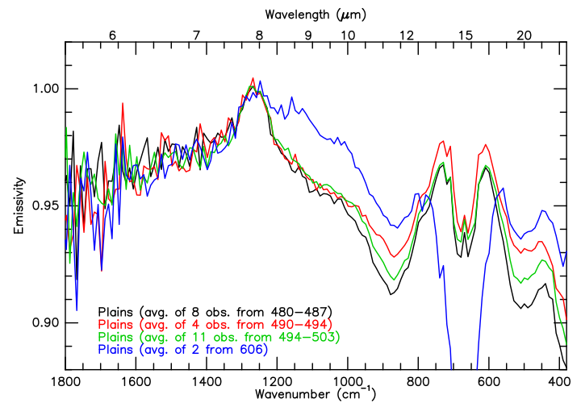
HiRISE
Plains
Columbia
Hills
Hamilton and Ruff, 2012

Slide 13
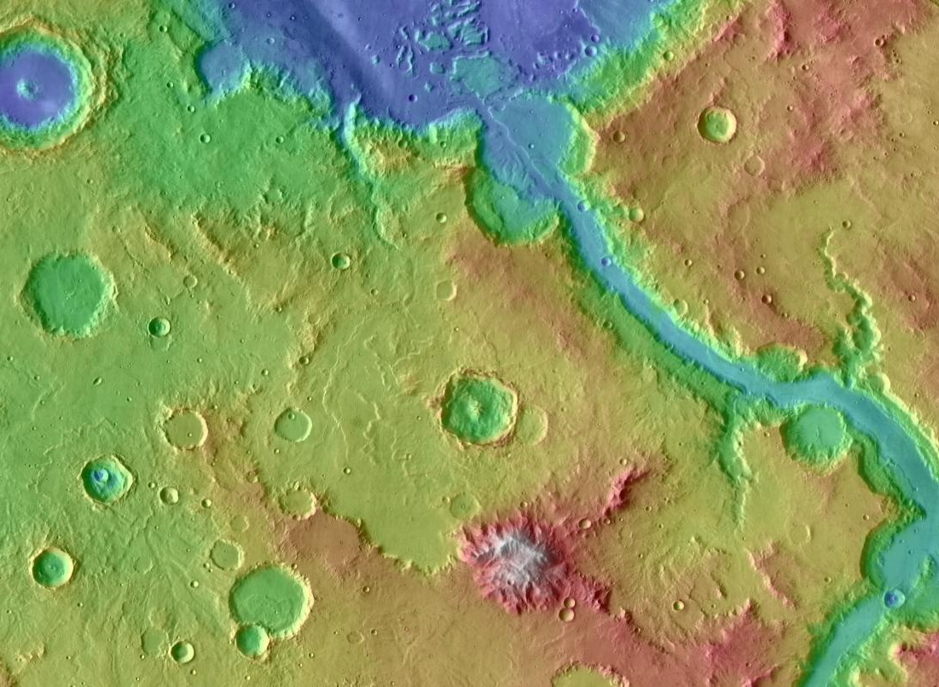
Gusev Crater
A Possible Source
for Adirondack-class
Basalt Flows
Ma’adim Vallis
Hamilton and Ruff, 2012
?
?
Apollinaris Tholus Stratovolcano
(Stewart and Head, 2001)
MOLA/THEMIS daytime IR
50 km

Slide 14
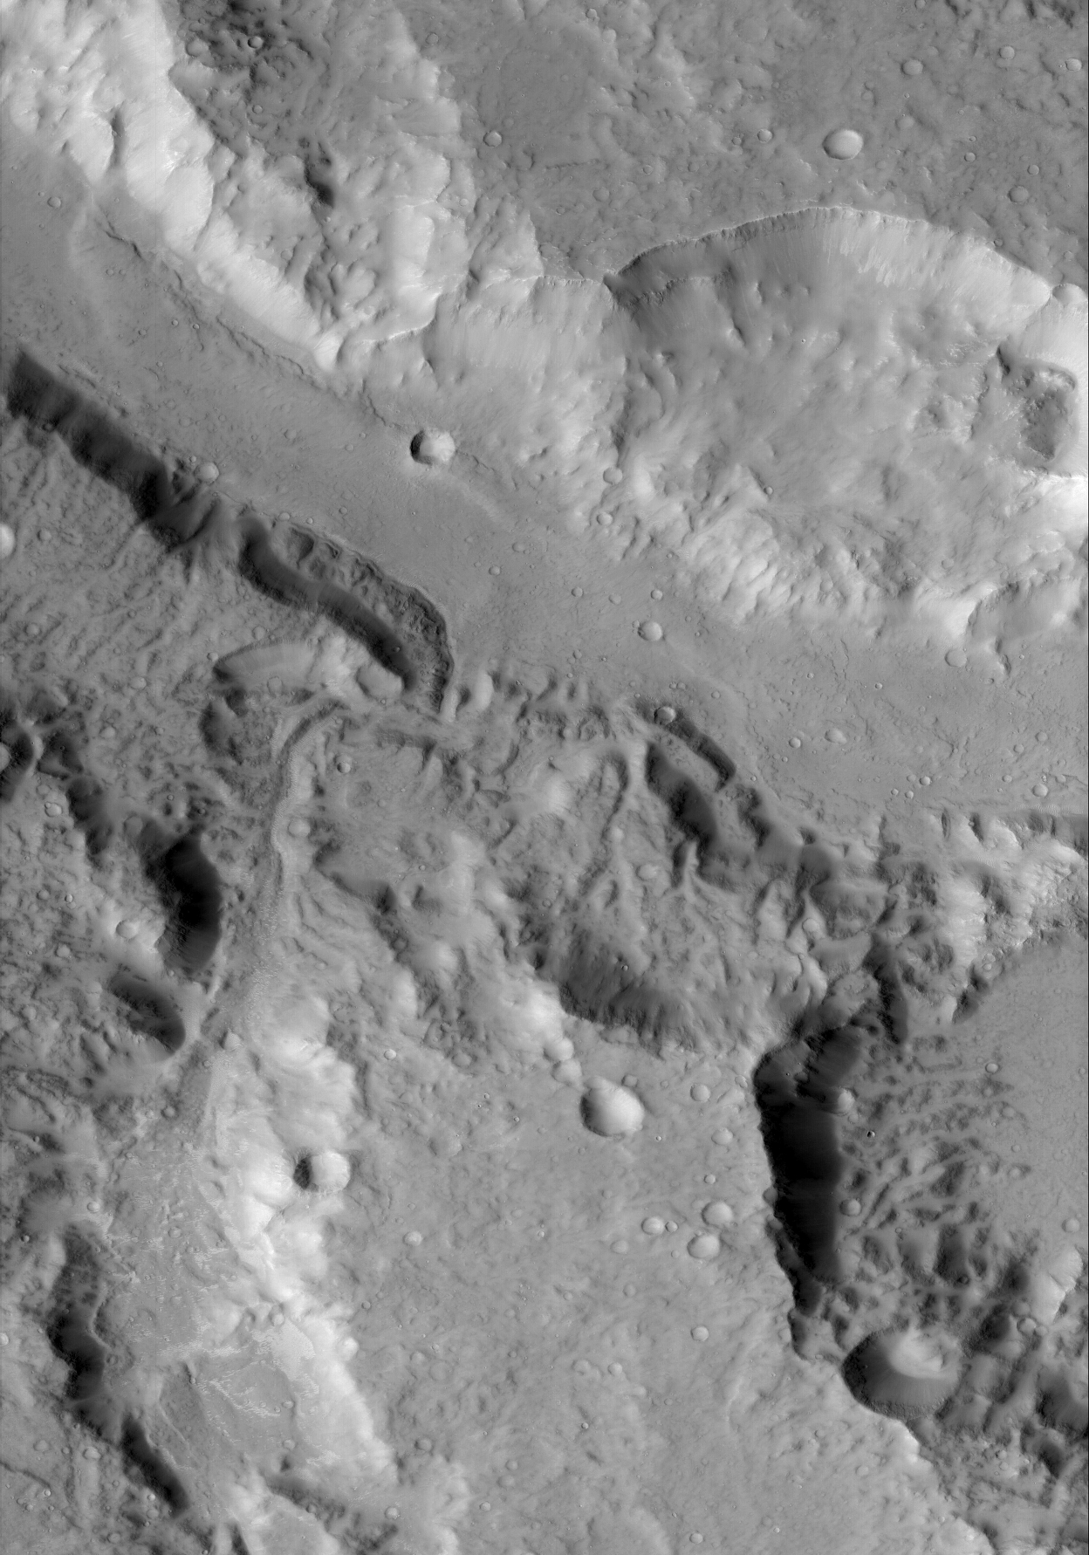
Lobate
Margins on the Floor of Ma’adim Vallis and Side Canyon
Figure 4.1.3.
A side canyon of Ma’adim Vallis may have fed lava flows from Apollinaris Tholus onto the floor of Gusev crater. The lobate margins (black arrows) of the floor unit in the canyon (bottom) and Ma’adim Vallis (top) seen in this sub-framed CTX image (P08_004045_1653_XN_14S183W) are similar to those of the lava flows on the floor of Gusev crater (compare with Figure 4.1.1).
Hamilton and Ruff, 2012
CTX
10 km

Slide 15
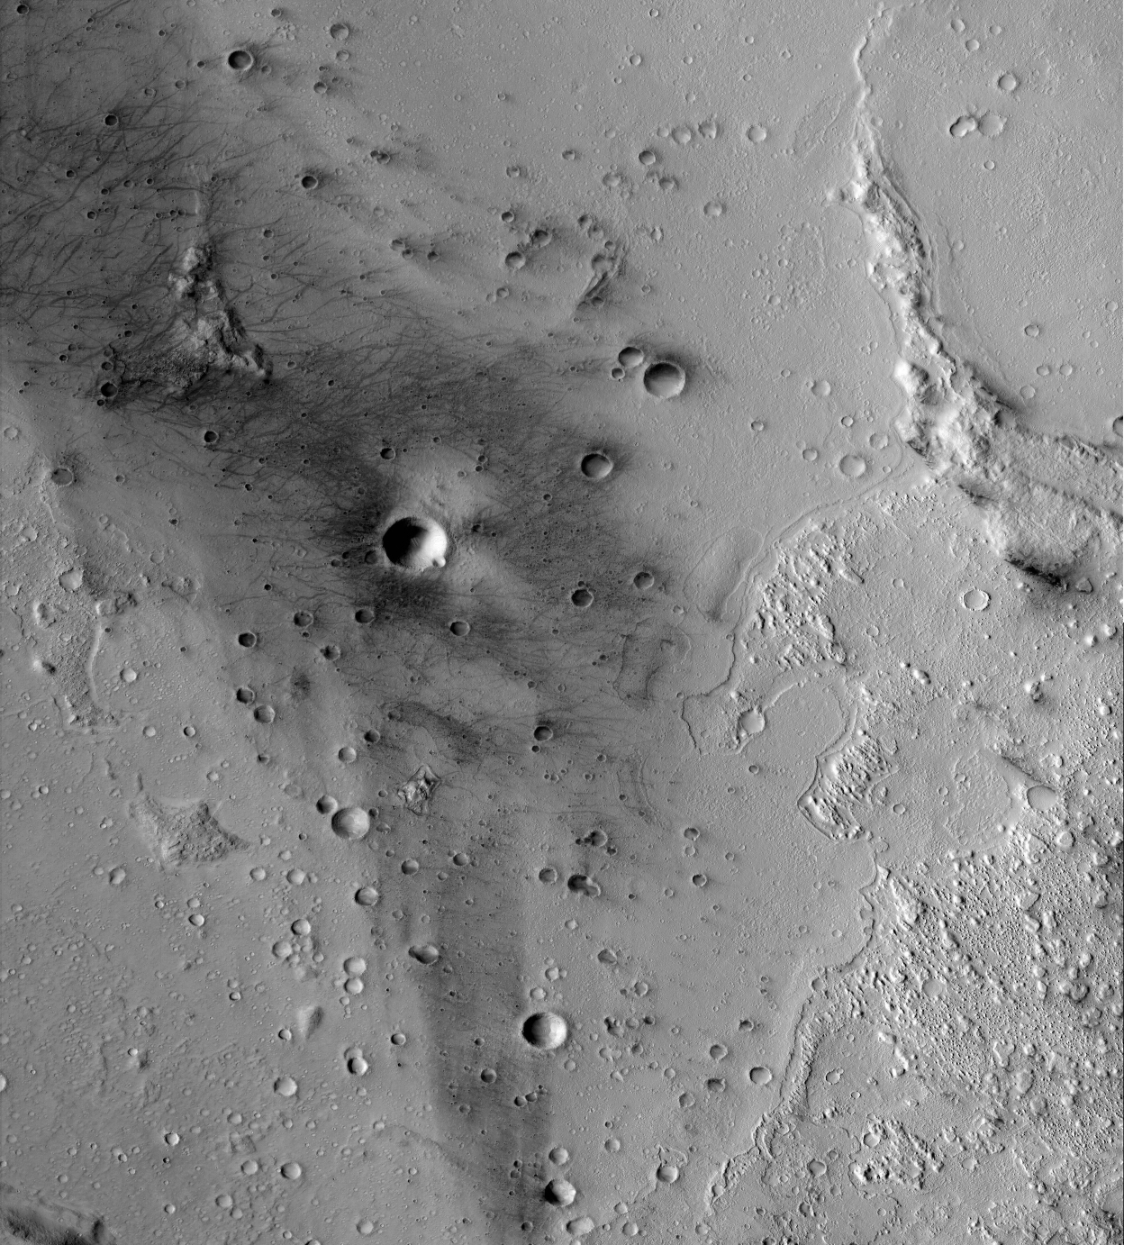
Lobate
Margins of Gusev Plains Unit
Columbia Hills
Hamilton and Ruff, 2012
CTX
10 km

Slide 16
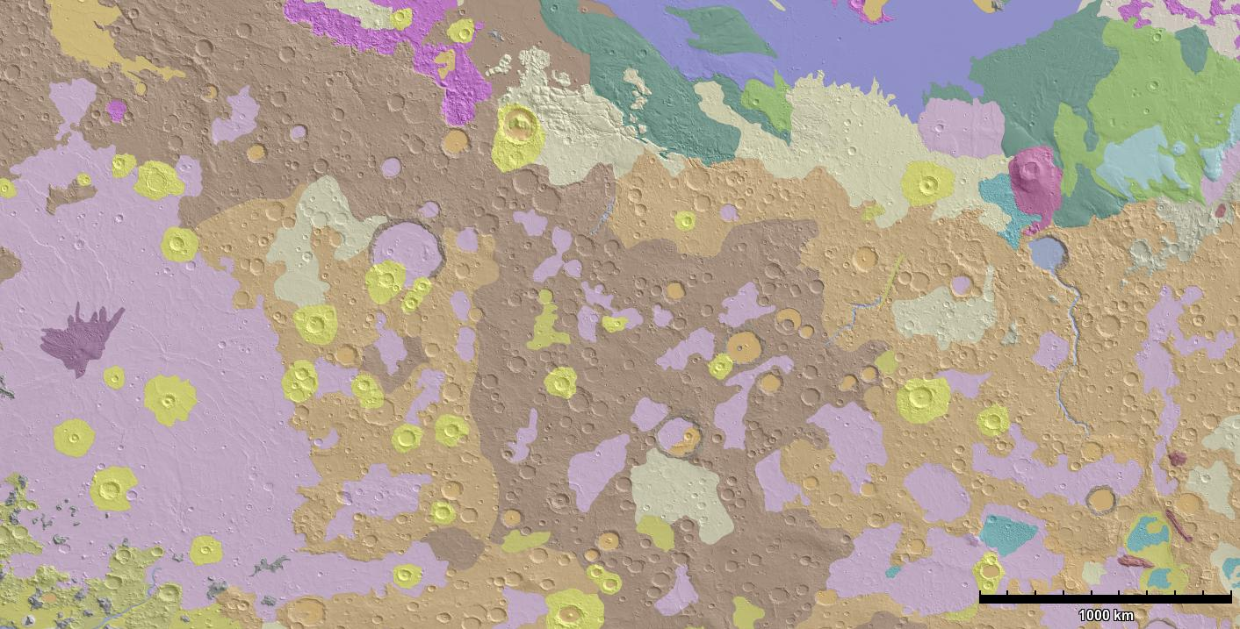
Hr = Adirondack-class?
Not really
Gusev
Crater
Hesperia
Planum
Skinner et al., 2006

Slide 17
Conclusions
The age and morphologic characteristics of much of the floor of Gusev crater are consistent with Hesperian ridged plains (Hr)
One candidate source for Gusev plains Adirondack-class lavas is Apollinaris Tholus
Adirondack-class materials are not evident in the type locale of the Hr unit

