Slide 1
Quantifying Errors in Manual Inclinometer Field Measurements
Garrett Bayrd, L.E.G.
Shannon and Wilson, Inc.

Slide 2
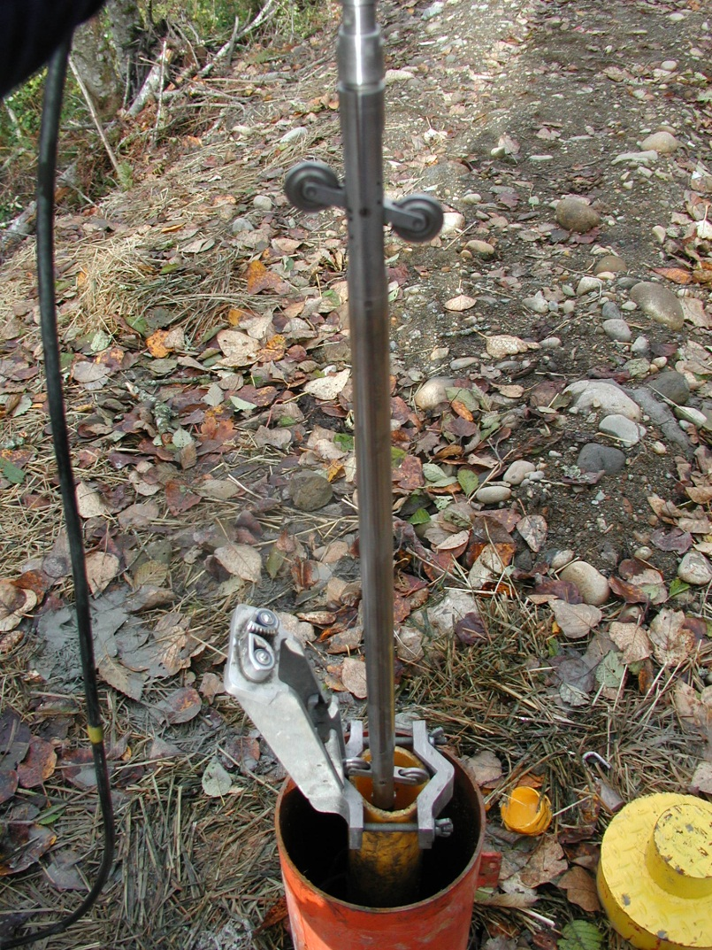
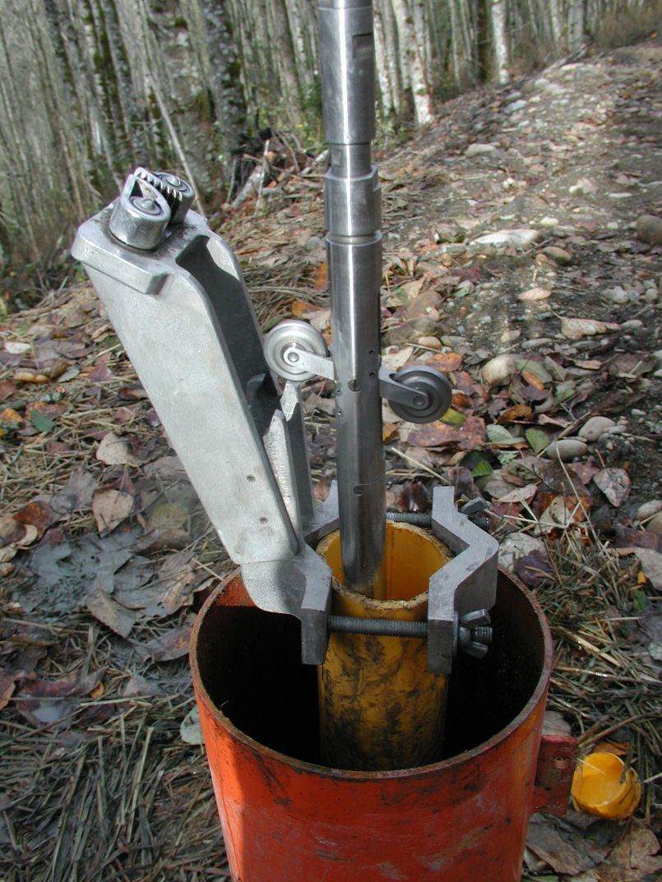
What is an inclinometer?

Slide 3
How do we know the accuracy of inclinometer readings?
Laboratory Tests
Checksum Values
Baseline Readings

Slide 4
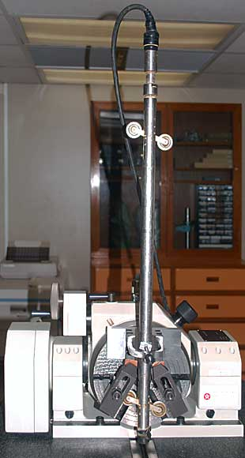
Lab tests

Slide 5
Comparing readings
When an inclinometer casing is read, two sets of readings are typically taken. The first set is then compared to the second, and the difference between these readings is called the checksum.
The average value of the checksum is good information about how repeatable the two readings were.
This does not, however, compare readings taken on one day to readings taken on another day.

Slide 6
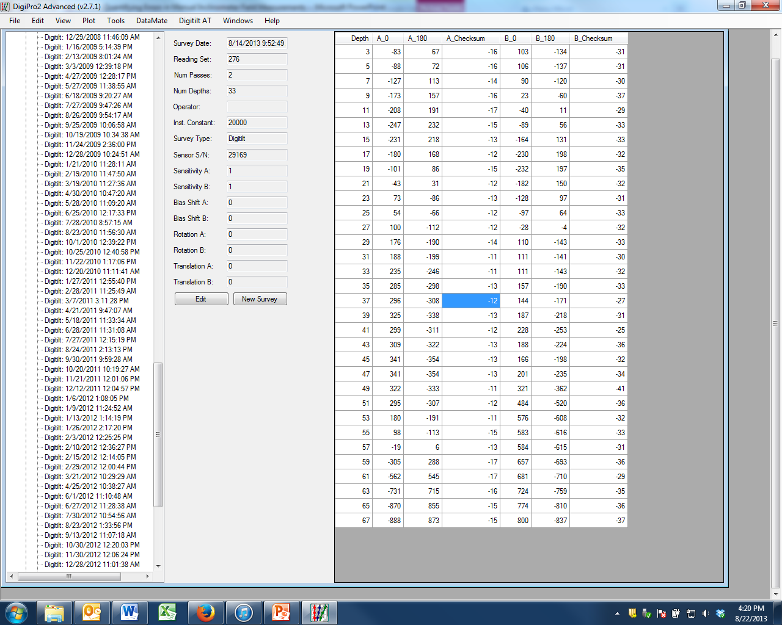

Slide 7
We can’t determine the long-period accuracy of an inclinometer unless we have multiple readings in a casing that does not move.

Slide 8
I analyzed data from 8 casings that had not shown motion over more than 6 years.
Each casing had over 100 individual readings
One probe was used to measure these instruments

Slide 9
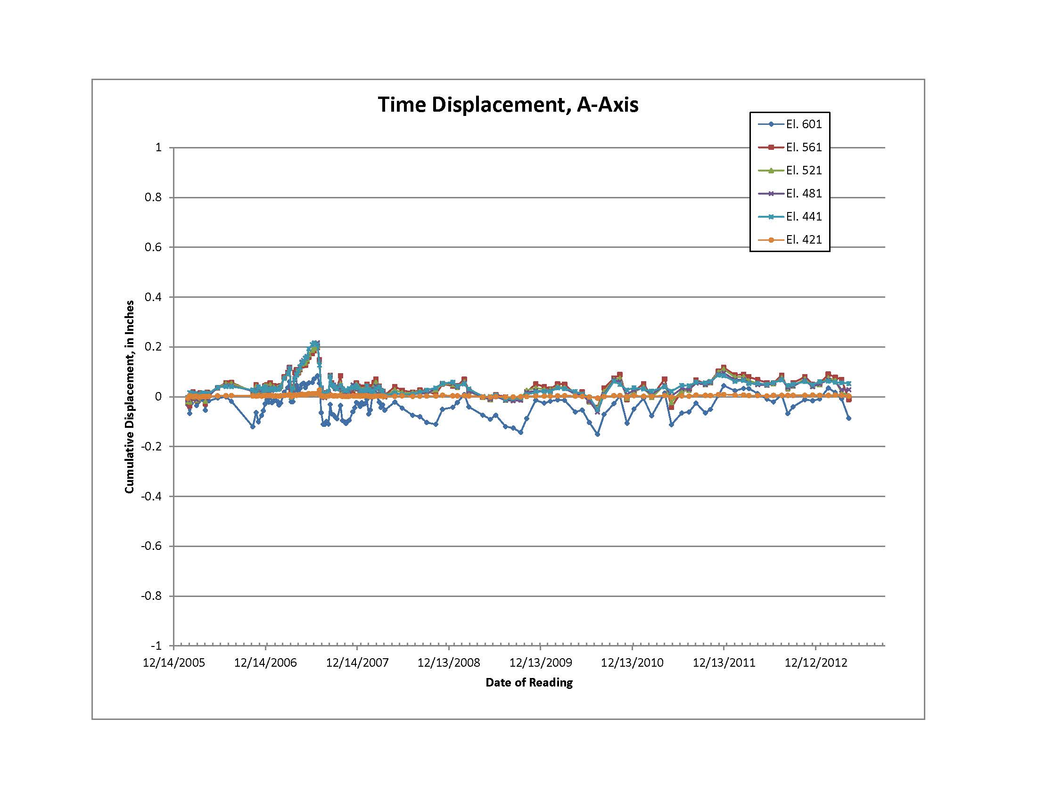

Slide 10
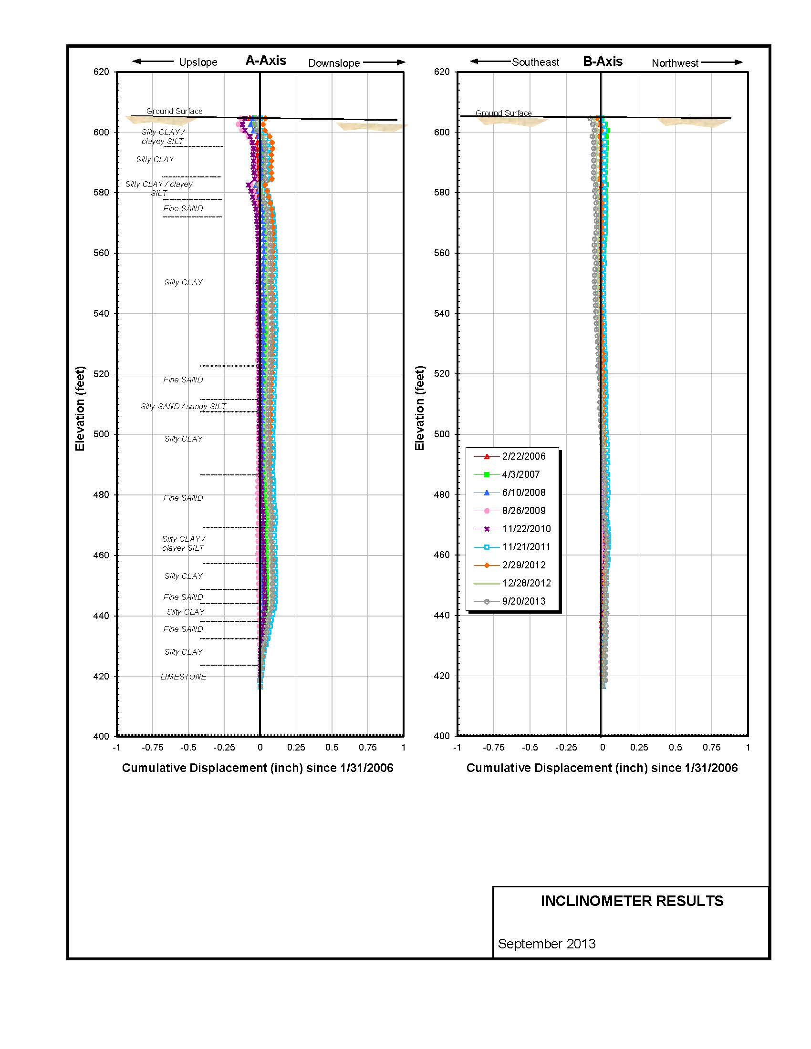

Slide 11
I worked with raw data to perform my analysis
Data pulled into excel.
Instead of comparing the readings to an initial reading, I compared the values to the average (mean) reading.
I used the deviation from the average reading as a measurement of both precision and accuracy.
This allowed me to determine how inaccurate a single set of readings could be.

Slide 12
Because I had accuracy data for each individual reading, I could see what independent variables contributed to the level of accuracy.
I checked to see if any of the following contributed to the level of accuracy:
  The time of the year
  The operator conducting the inclinometer readings
  The inclination of the inclinometer casing
  The variation of the inclination of the inclinometer casing
  The total depth of the casing
  The specific depth of the reading, i.e, is there more error at the top of the casing

Slide 13
Determining Error Levels.
To run these comparisons, I needed to know:
The accuracy of a single reading at a single depth.
The accuracy of an entire set of readings taken in one casing.
The accuracy of all of the sets of readings taken by a single operator.
The accuracy of all the readings at a specific depth.

Slide 14

So, I did some math
I posit that:
The accuracy of a single measurement at a single depth on a single day is the difference in value between that single measurement and the average measurement at that depth.
Equation is:
$$A= \left|R_{d}−R_{a}\right|$$
Where: A is the accuracy of a single measurement, R_{d} is the individual measurement at that depth, and R_{a} is the mean measurement at that depth

Slide 15

Then I did some more math:
I want to know what the error of the reading for an entire casing would be:
To calculate this, I take the sums of the absolute value of the difference between a single depth measurement and the average measurement for the entire set of readings.
Equation is:
$$E_{b}= \sum_{D_{b}}^{D_{t}}{A}$$
Where: E_{b} is the total error in the casing, D_{t} is the top depth, and D_{b} is the bottom depth

Slide 16

Even more math:
To determine if the accuracy changed at different depths, I had to know the standard deviation of all the measurements at a single depth.
Equation is:
$$A_{d}=\sqrt{\frac{{\sum{\left(R_{d}−R_{a}\right)}}^{2}}{\left(n−1\right)}}$$
Where: A_{d} is the accuracy at that depth, R_{d} is the individual measurement at that depth, R_{a} is the average reading for that depth, and n is the number of measurements.

Slide 17

Last math:
Taking the average of all of the standard deviations gives me a dimensionless value for the accuracy of all the readings in a single casing.
Equation is:
$$S_{a}= \frac{\sum_{T_{f}}^{Tl}{A_{d}}}{n}$$
Where A_{d} is the average standard deviation, and n is the number of measurements taken, T_{f} is the first measurement taken, and T_{l} is the last reading taken. I use S_{a} as an average error value for an individual reading in the casing.

Slide 18
So, I first wanted to know what average levels of accuracy were.
I want to know this so I can figure out what a “bad” or “good” reading would be, so I can educate my clients on what level of accuracy to expect, and so I can better analyze my own data.
I find that:
  The error level is smaller than I expected
    0.005 inches at a single reading, on average
    Highest commonly encountered single depth reading 0.01 inches
  On average, less than 0.1 inches of error per 100 feet accumulating from the bottom of the casing to the top
    This compares well with the manufacturer’s stated 0.3 inches of error per 100 feet

Slide 19
Remember, I’m checking to see what variables contributed to the error levels:
The time of the year
The operator conducting the inclinometer readings
The inclination of the inclinometer casing
The variation of the inclination of the inclinometer casing
The total depth of the casing
The specific depth of the reading, i.e, is there more error at the top of the casing
Let’s go through these, one by one.

Slide 20
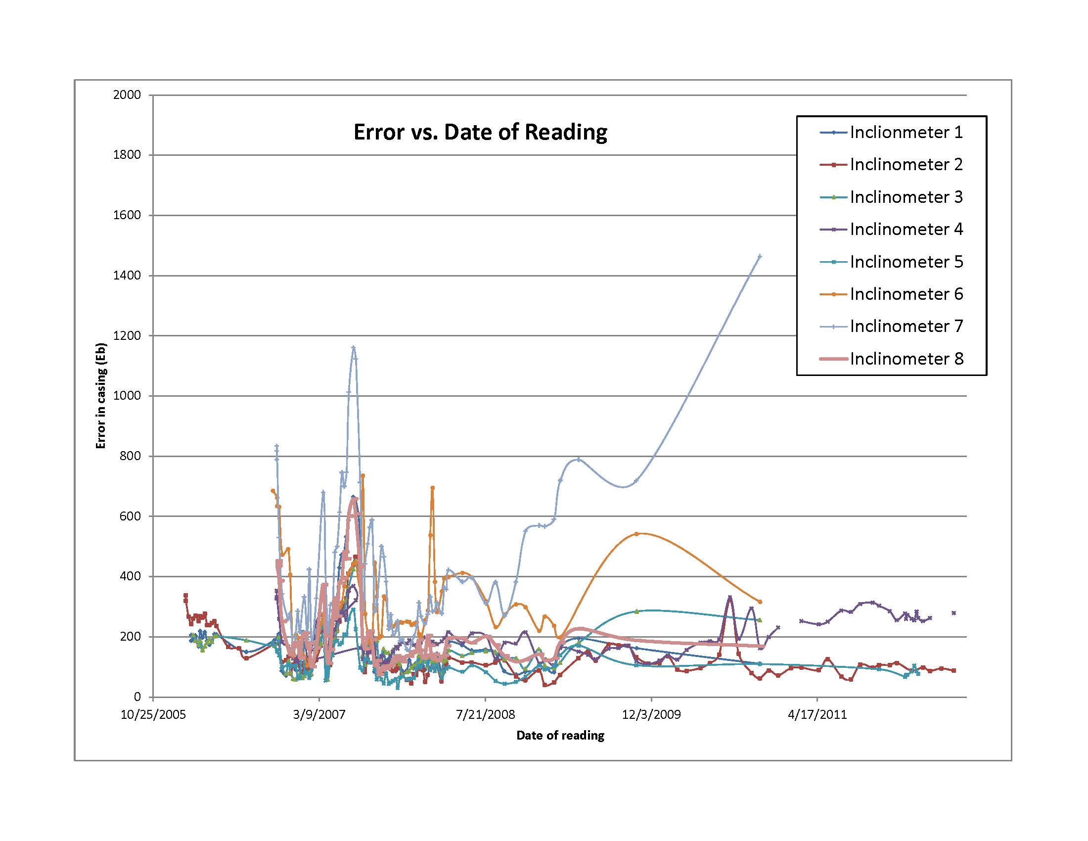

Slide 21
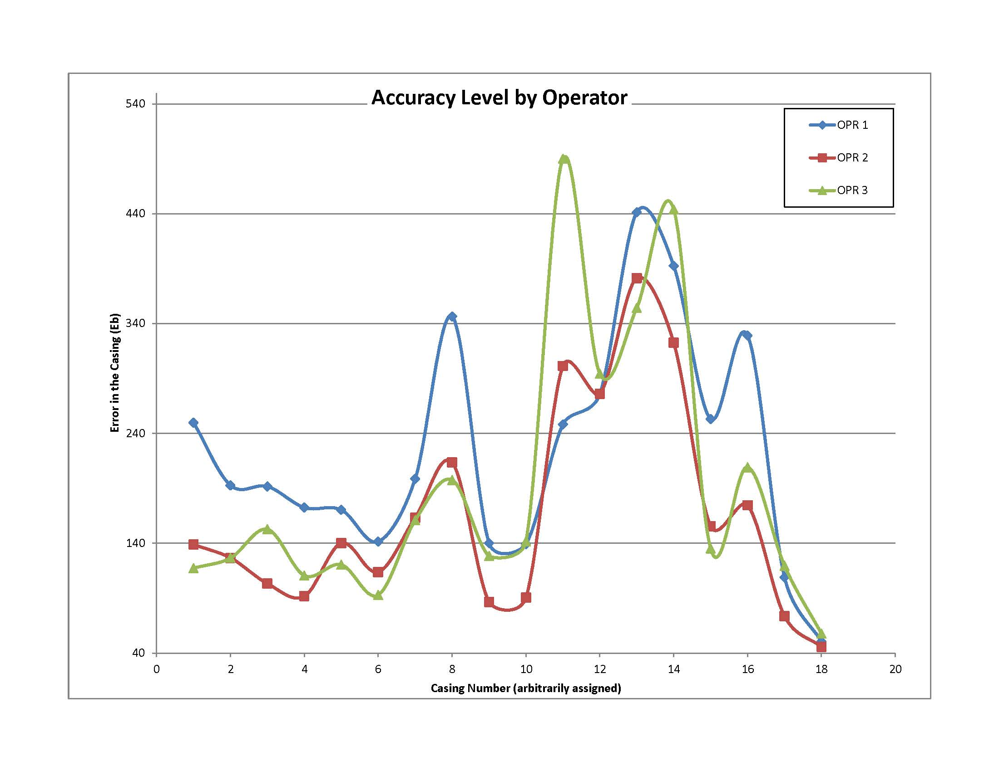

Slide 22
Correlation between angle and A_{d} (error at a depth)
Casing | A dir (combined) | B dir (combined
LS - 1 | 0.27 | 0.40
LS - 2 | 0.39 | -0.17
LS - 3 | 0.10 | 0.03
LS - 4 | -0.10 | -0.26
LS - 5 | 0.12 | -0.23
LS - 6 | -0.28 | -0.06
LS - 7 | -0.01 | 0.16
LS - 8 | -0.08 | 0.42
 | average correlation
 | 0.05 | 0.03

Slide 23
Correlation between Δ_{a} (change in angle) and A_{d} (error at a depth)
Casing | A dir (combined) | B dir (combined
LS - 1 | 0.1689 | 0.7742
LS - 2 | 0.3032 | 0.4533
LS - 3 | 0.2147 | 0.0753
LS - 4 | 0.3435 | 0.1754
LS - 5 | 0.3046 | 0.3893
LS - 6 | 0.2117 | 0.2190
LS - 7 | 0.2879 | 0.2918
LS - 8 | 0.4179 | 0.5621
LS - 9 | 0.1771 | 0.5124
 | average correlation
 | 0.269957 | 0.383654854

Slide 24
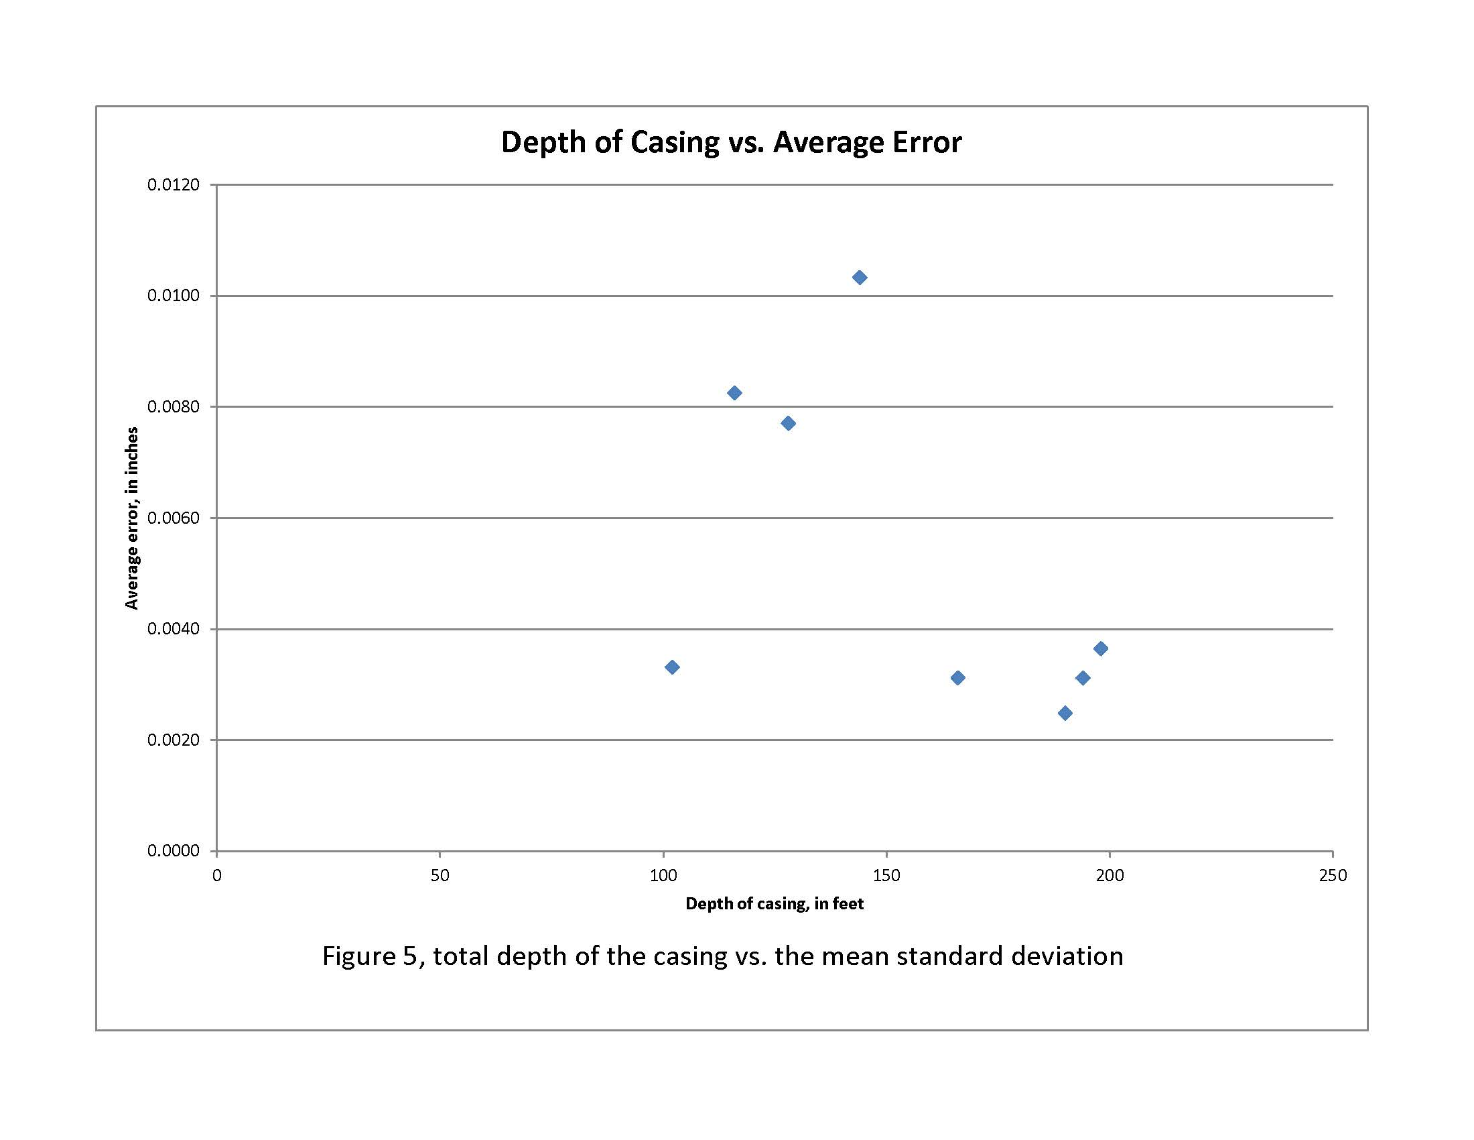

Slide 25
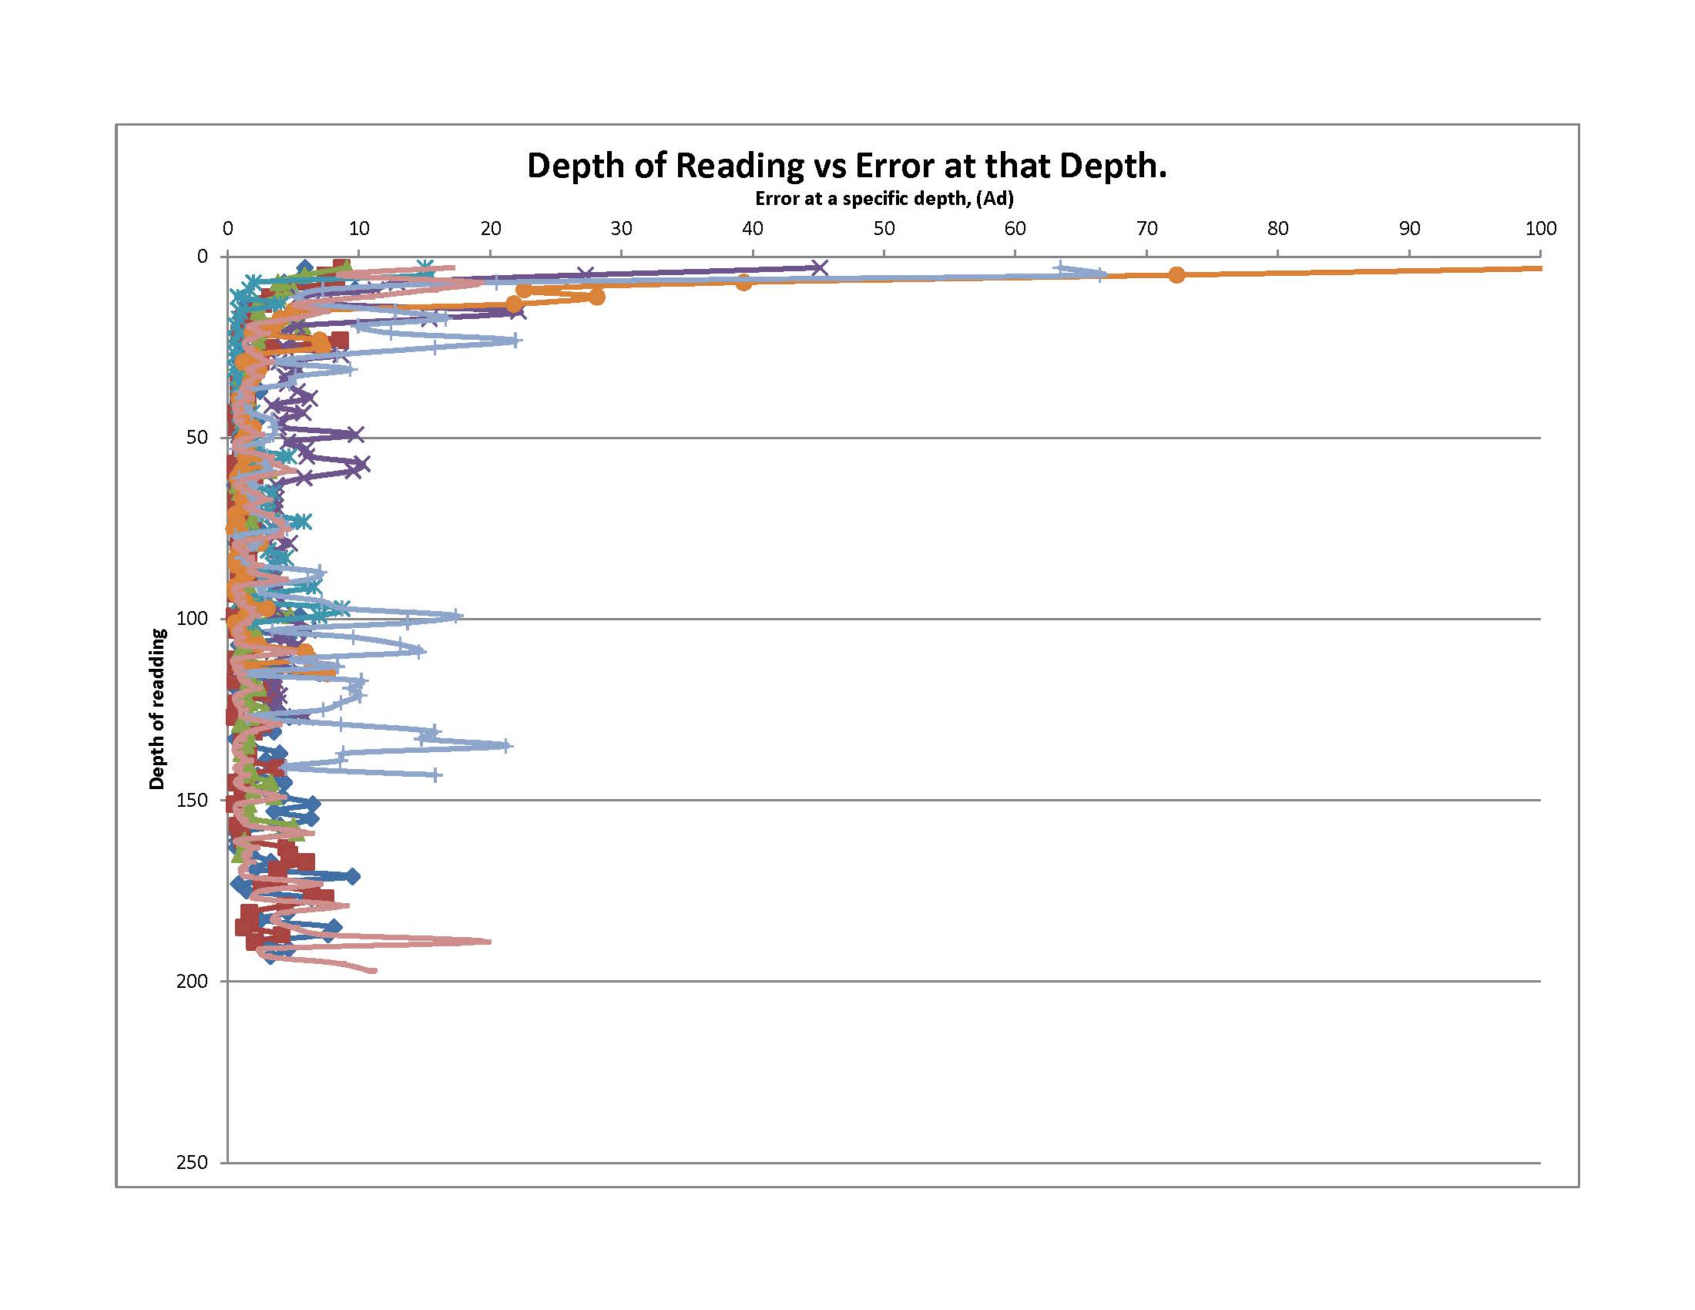

Slide 26
Conclusions:
We are consistently able to achieve error less than 0.1 inches per 100 feet of casing.
The operator performing the readings influences the level of error.
The “wobbleyness” (change in angle) of the casing influences the error.
The upper 10 feet of the casings have greater levels of error than the rest.

Slide 27
I’d like to thank
Robert Clark, for general instrumentation information
Shannon and Wilson’s internal research grant program
Hollie Ellis for his assistance with statistical analysis
Jeremy Butkovich for programming assistance
Slope indicator for help with data reduction, and images

