Slide 1
Kirtley Mather’s
Sourcebooks of Geology
1400-1900 (1939)
1900-1950 (1967)
Michele L. Aldrich and
Alan E. Leviton

Slide 2
Outline
Mather biography
Sourcebooks in general
Sourcebook 1400-1900
Sourcebook 1900-1950
Conclusion

Slide 3
Mather’s Early Life
Born 1888 in Chicago
BA Denison University 1909
PhD Univ. Chicago 1915
Taught at Queens Univ. 1915-1918
Taught at Denison 1918-1924

Slide 4
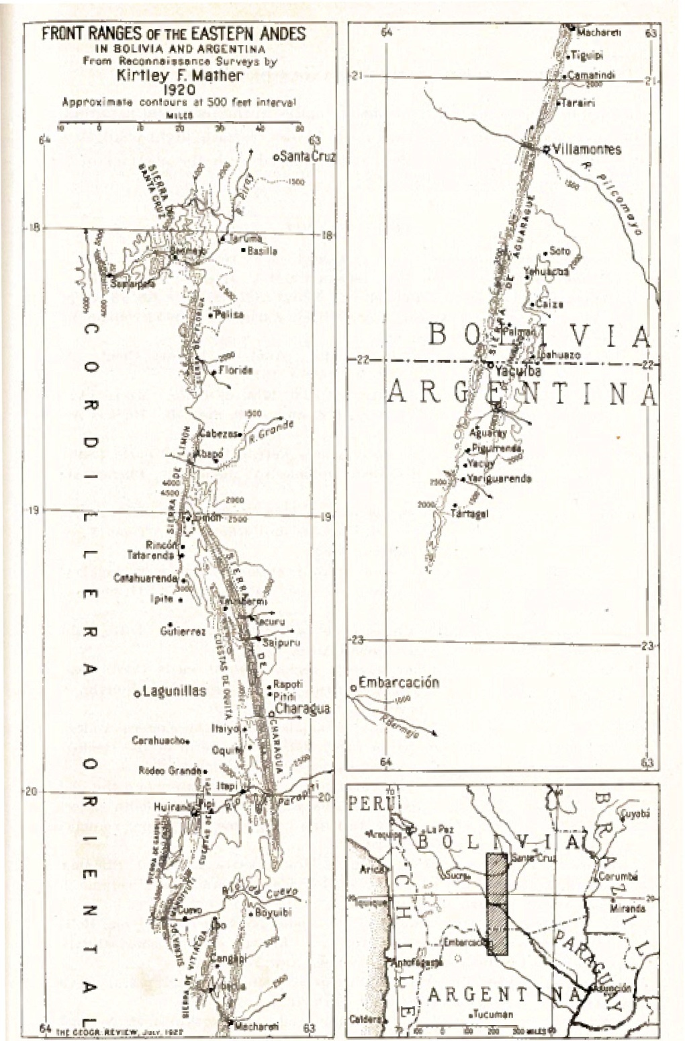
Map of the
Front Ranges of the Andes where Mather worked in Bolivia and Argentina.

Slide 5
Mather’s Life and Career
Taught at Harvard University 1924-1954
Taught at Univ. New Mexico 1954-1970
Died 1978
Scopes Trial, 1925
Mass. Teachers’ Loyalty Oath 1930s
Opposed McCarthyism,1950s
Active in AAAS – President, Board member

Slide 6
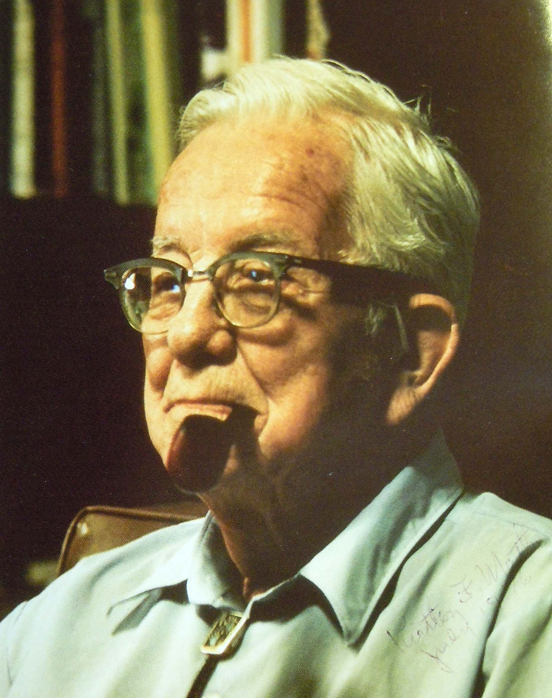
Kirtley Mather in
New Mexico

Slide 7
Sourcebooks to 1939
Astronomy (1929)
Mathematics (1929)
Physics (1935)
Geology (1939)

Slide 8
Source Books 1948-1967
Greek Science (1948)
Animal Biology (1951)
Chemistry (1952)
Astronomy 1900-1950 (1960)
Psychology (1965)
Geology 1900-1960 (1967)

Slide 9
Sourcebooks, 1967 -2002
Geology, 1900-1950 (1967)
Chemistry, 1900-1950 (1968(
Mathematics, 1200-1800 (1969)
Classical Analysis (1973)
Medieval Science (1974)
Geography (1978)
Astronomy 1900-1975 (1979)
Mathematical Logic, 1876-1931 (2002)

Slide 10
Comparison of Sourcebooks
1499-1800 1900-1950
1939 1967
708 pages 438 pages
128 author’s 60 authors
5.8 pp/author 7.3 pp/author
S. Mason, coeditor No coeditor
McGraw Hill publ. Harvard Unv. Press publ.
G. Walcott series ed. E. Madden, series ed.

Slide 11
Sourcebook Commonalities
Survey Method
Selection by Great Ideas
Organization
Author Birth date
Peculiarities
Indexes

Slide 12
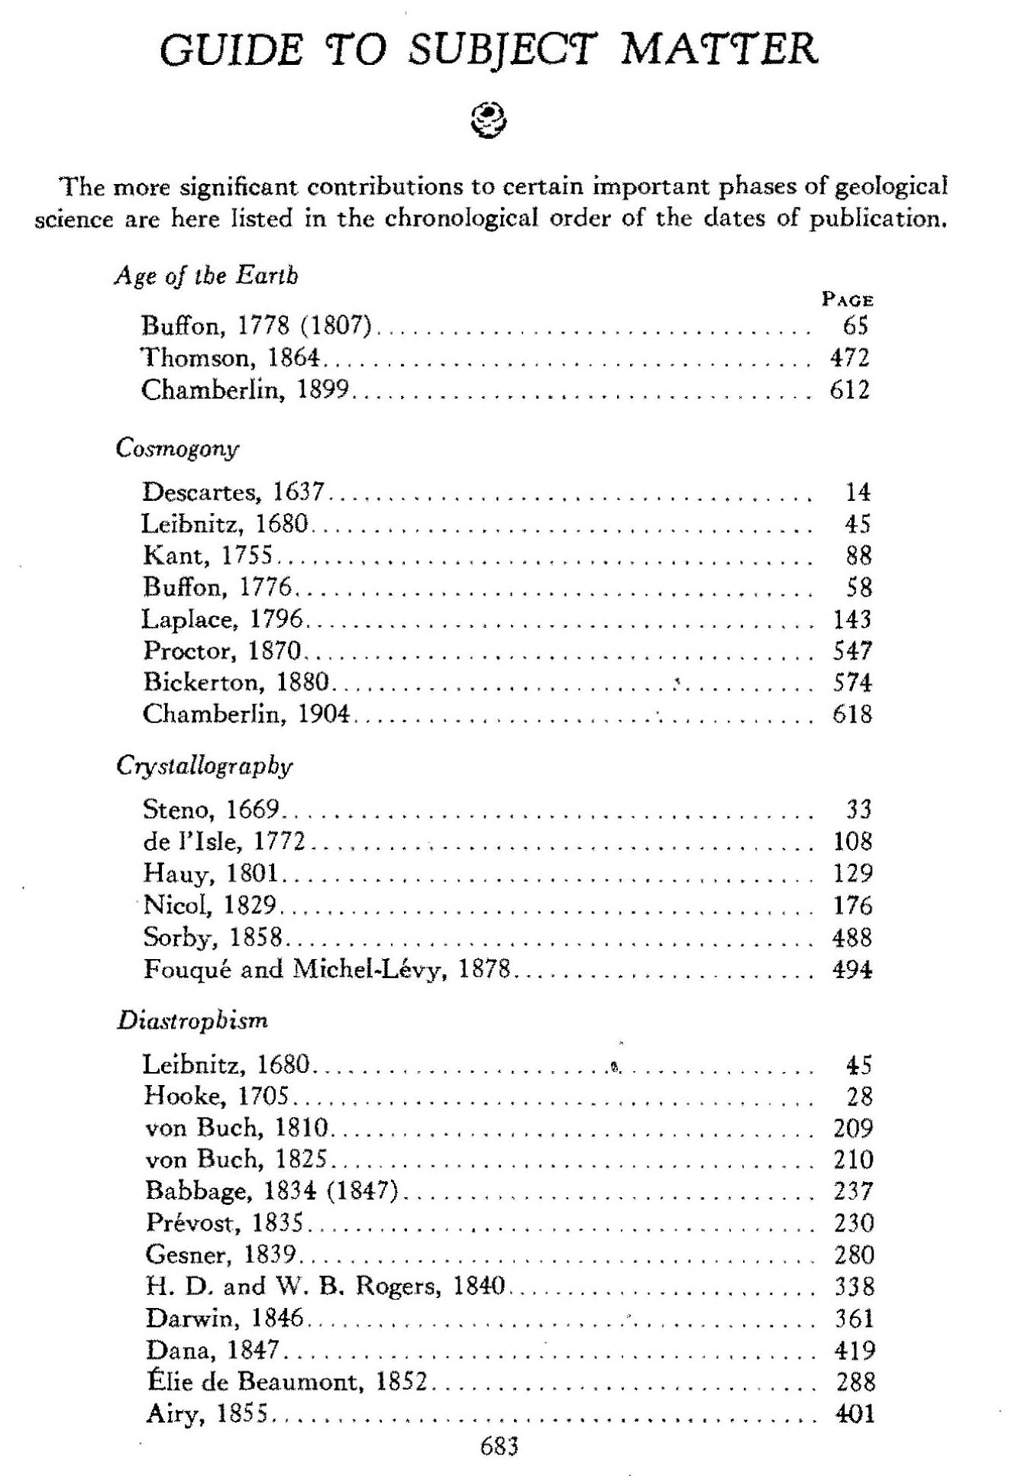
Sourcebook I

Slide 14
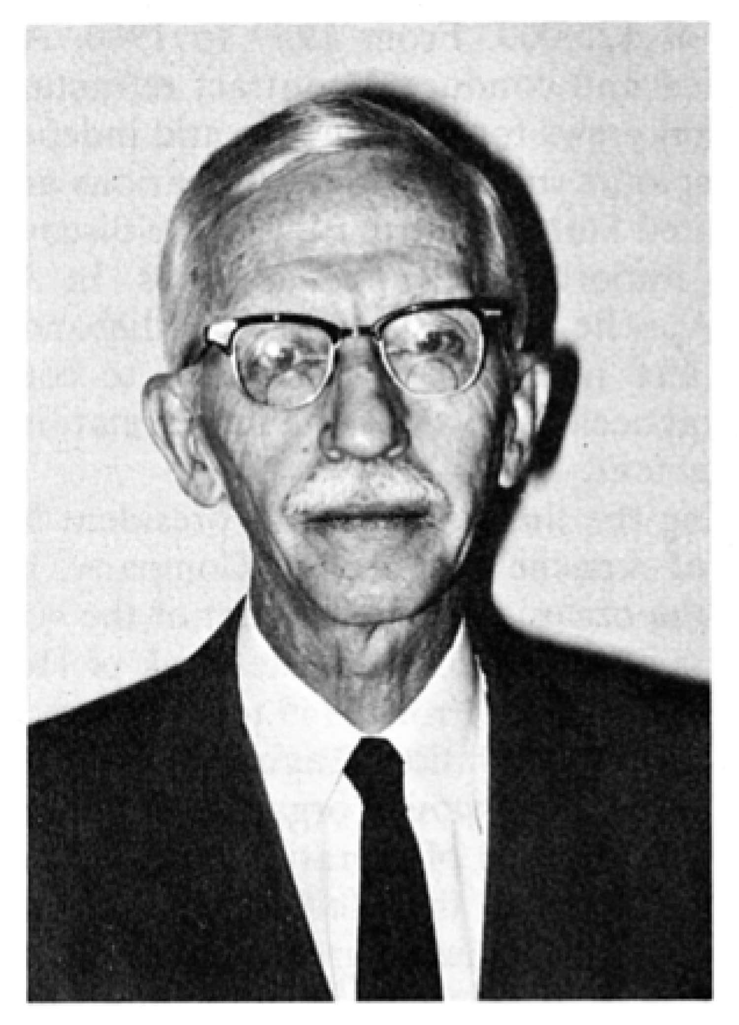
Shirley Mason,
Co-editor,
Sourcebook I

Slide 15
Mather and Mason’s Predecessors
Karl von Zittel, History of Geology and Paleontology (1899),
English and German.
Archibald Geikie, Founders of Geology (1897, 1905)
George Merrill, Contribtions. to History of American Geology (1906).
Frank Adams, Birth and Development of Geol. Sciences(1938).

Slide 19
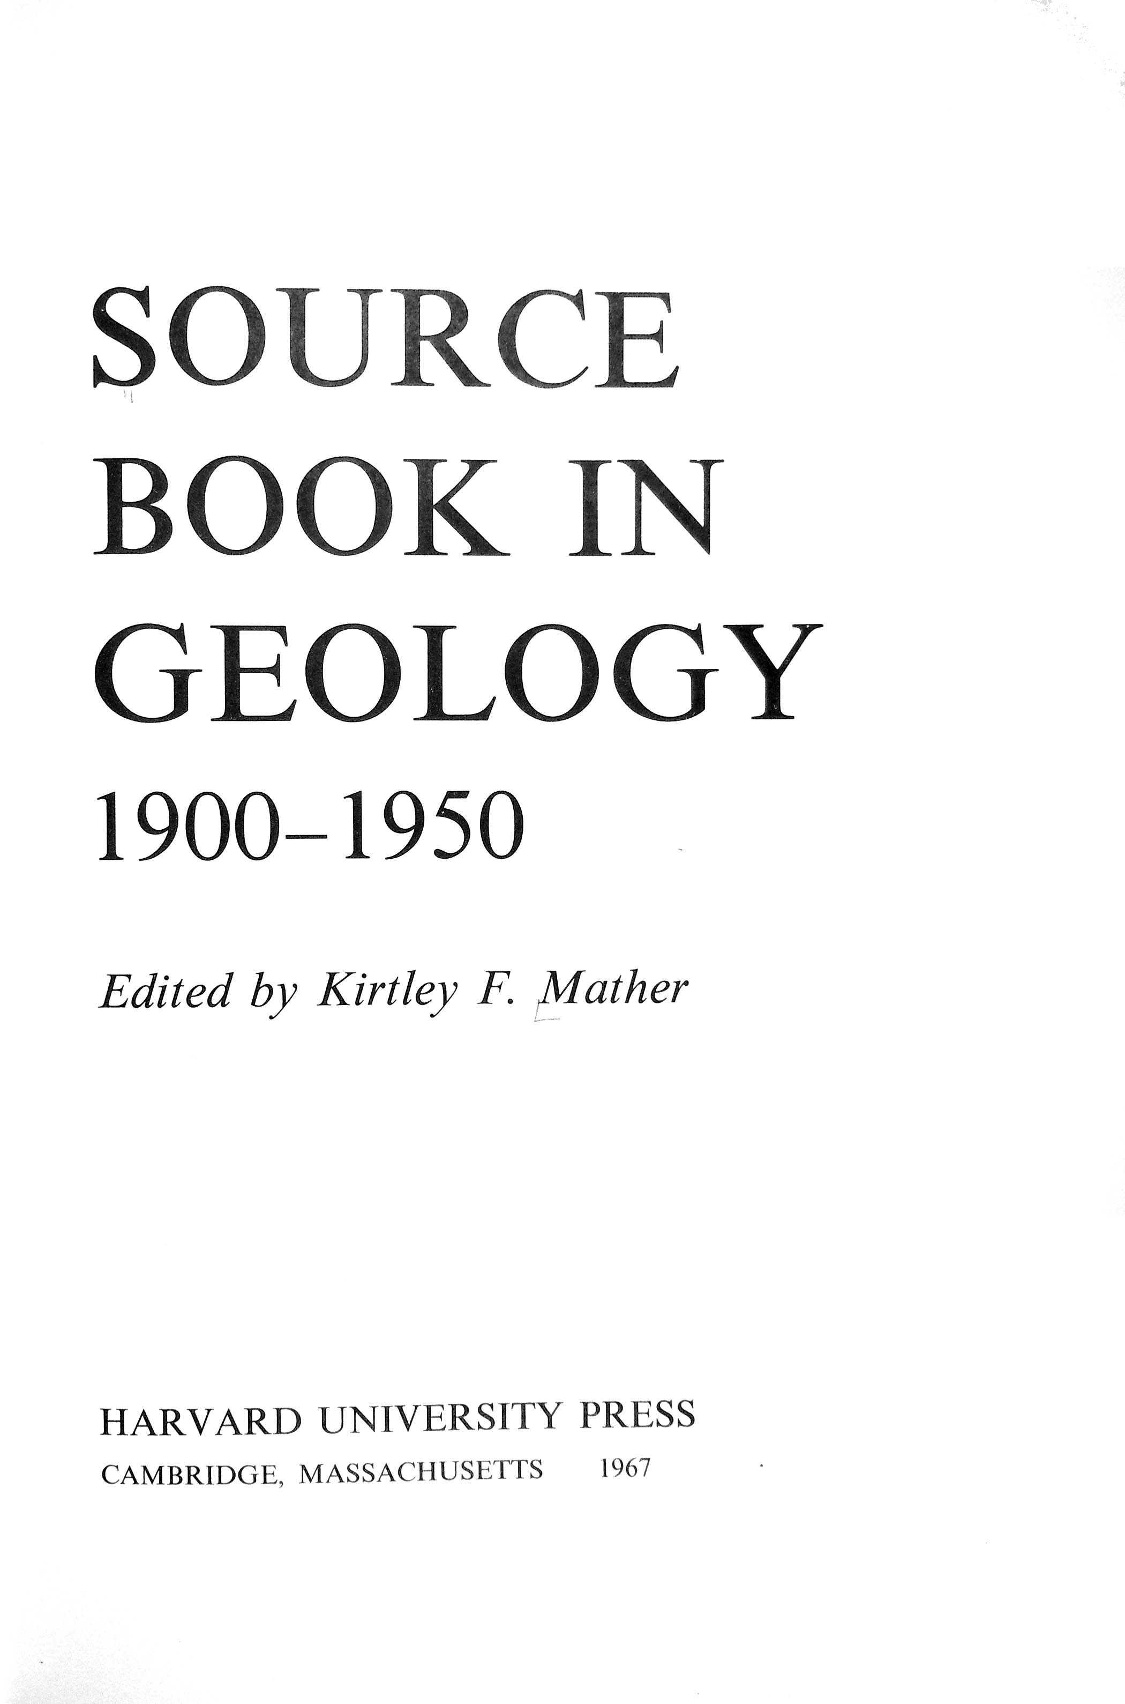

Slide 22
Not in Sourcebook 1900-1950
Paleontology
Micropaleo, 1920s
Modern Synthesis, 1940s
China
Bretz, Channeled Scablands
Wegener

Slide 23
Durability of Sourcebook 1400-1900
Predecessors
Mason as coeditor
G. Walcott as series editor
Survey results
Trained the trainers

Slide 24
Datedness of Sourcebook 1900-1950
Mather’s Experiences
No coeditor
Edward Madden as series editor
Survey results
Pioneer, no predecessors

Slide 25
Thanks
To Ken Bork for his biography of Mather and for
many insights via email as we composed this
presentation.
To Mark Aldrich for Power Point help.
To Josephine Hernandez for reference help..

