Slide 1


MAPPING OF MASS MOVMENTS SUSCEPTIBILITY USING SATELLITE IMAGE AND GIS TECHNOLOGY
University Mohammed V
Faculty of Sciences of Rabat
Department of Earth sciences
Prepared By : Meryem ELMOULAT, and Ikram ELHAMDOUNI, PhD Students at the University of Sciences of Rabat, Morocco.
Supervised by : Lahsen AIT BRAHIM, Professor at the University Mohamed 5 Agdal, Faculty of Sciences of Rabat, Morocco.
Co-Supervised by : Mohamed MASTERE, Professor at the National Institute of Urban and Planning (INAU), Rabat, Morocco.
GSA Annual Meeting
27-30 October, 2013
Denver, Colorado - USA

Slide 2
Outline
Study Area
Results & Discussion
Conclusion
Introduction
Objectives
Methodology

Slide 3
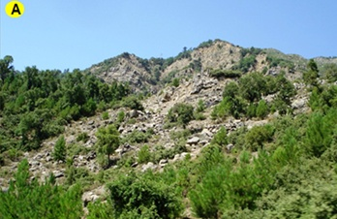
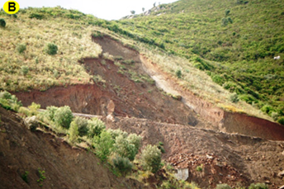
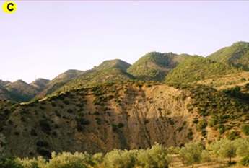
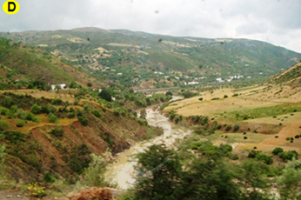
Introduction
Introduction
Objectives
Study Area
Methodology
Results
Conclusion
Geographic Information System (GIS) and remote sensing data covering large and inaccessible areas within a short time and with high precision have proved to be very effective tools to manage and assess mass movements’ hazard, allowing the probability, location, and frequency of this phenomenon in the future to be predicted.
Zoumi is one of the areas of the Morocco Rif which presents a very high frequency of mass movements.
A: Rock falls, B: Superficial landslides, C: Rotational landslides, D: Mudflow

Slide 4
Objectives
Introduction
Objectives
Study Area
Methodology
Results
Conclusion
Mass movements susceptibility mapping using Weight of Evidence approach (Bonham-Carter and al 1989). This map is used in a support role for development of the region of Zoumi, guiding the selection of new roadway networks and extension of urban and rural housing.

Slide 5
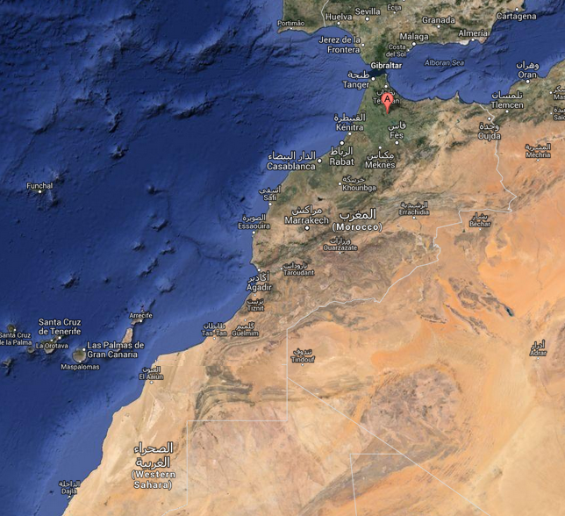
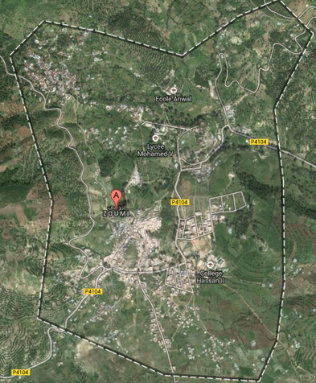

Study area
Introduction
Objectives
Study Area
Methodology
Results
Conclusion
Latitudes : 35 ° 00‘ - 34 ° 45'N
Longitude : 5 ° 15’-5 ° 30’W
Surface : 613Km²
Population : 9,900 inhabitants
Density : 110 inhabitants / km²
N
N

Slide 6
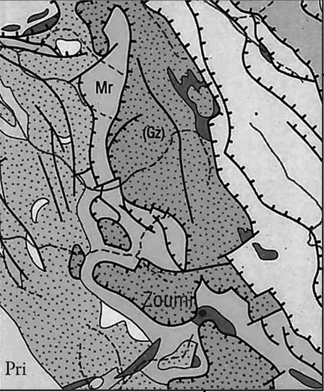
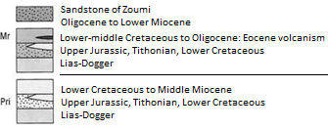
  Geographical and Geomorphological Framework
Introduction
Objectives
Study Area
Methodology
Results
Conclusion
The Rif area, located in the northwest of Morocco, is the occidental end of the Alpine chain of Maghreb which crops out along the Mediterranean coast of North Africa from Calabria to the Arc of Gibraltar (Didon et al 1973 Delga Durand et al 1960). The study area is located in the external domain of the Rif chain . It consists of :
I. Intrarifains : represented by all the units of Tangier, and Loukkos Ouazzane; age, lower Cretaceous ;
II. Mesorifains : essentially formed by the unit sandstones of Oligocene to Miocene Zoumi land;
III. Prerifains : presented with a portion of Ouazzane middle; age, Miocene Cretaceous street.
This morphology is the result of a combination of several factors: the complex lithology , the climate system , the active tectonics , and erosive dynamics , giving rise to multiple mass movements.

Slide 7
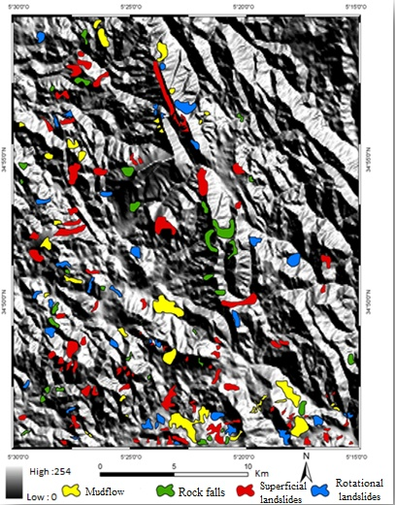
  Mass Movements
Introduction
Objectives
Study Area
Methodology
Results
Conclusion

Slide 8
  Mass Movements
Introduction
Objectives
Study Area
Methodology
Results
Conclusion
Class | Number of Events | % of Events | Area in km² | % of area
Mudflow | 32 | 17,11 | 11,22 | 24,08
Rock falls | 34 | 18,19 | 6,83 | 14,66
Superficial landslides | 85 | 45,45 | 19,97 | 42,85
Rotational landslides | 36 | 19,25 | 8,58 | 18,41
Table 1: Characteristics of mass movements

Slide 9
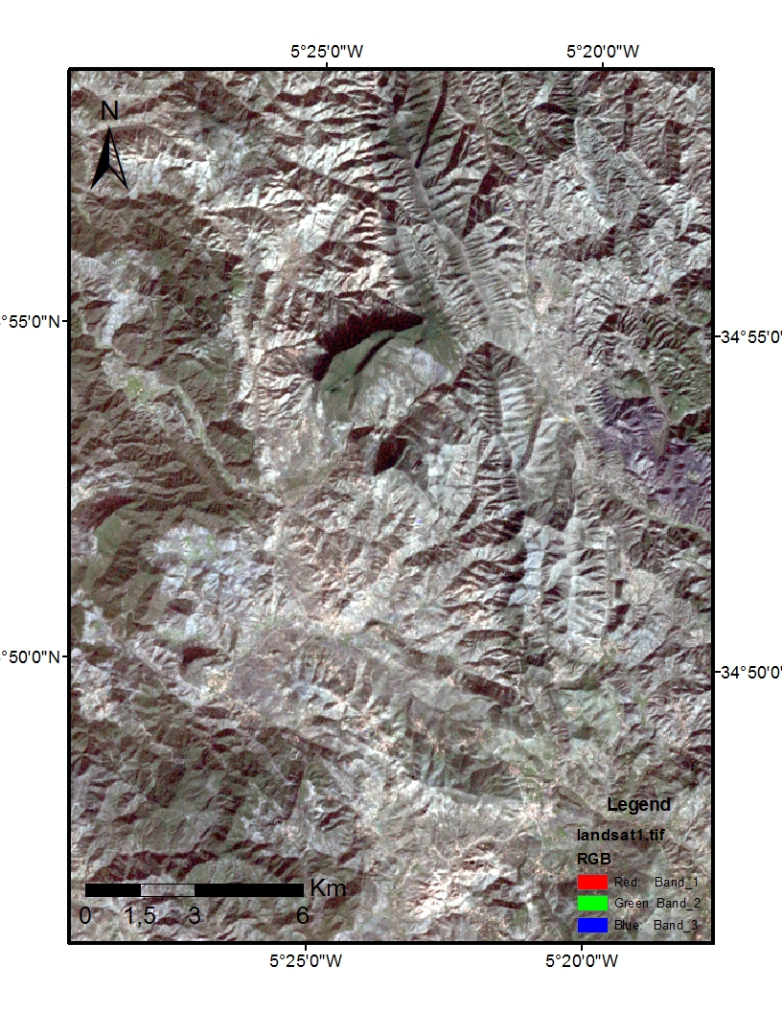
  LandSat image
Introduction
Objectives
Study Area
Methodology
Results
Conclusion

Slide 10
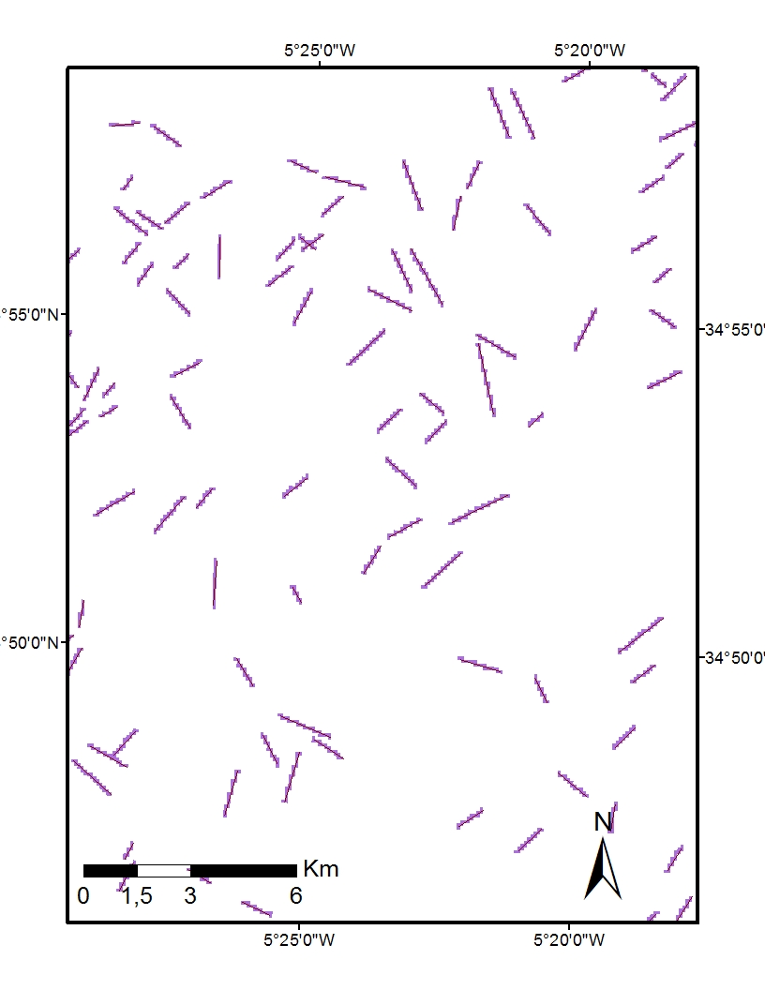
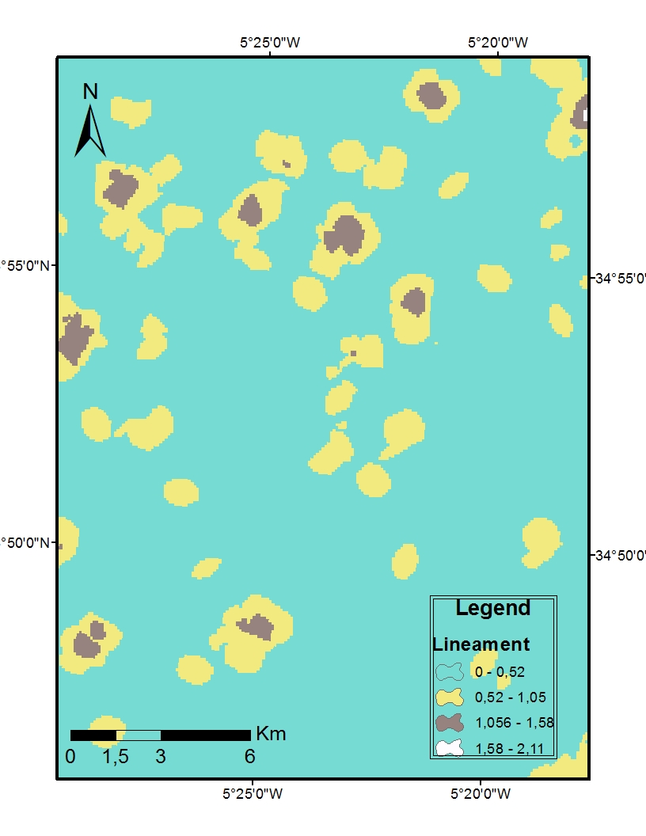
  Lineament
Introduction
Objectives
Study Area
Methodology
Results
Conclusion

Slide 11
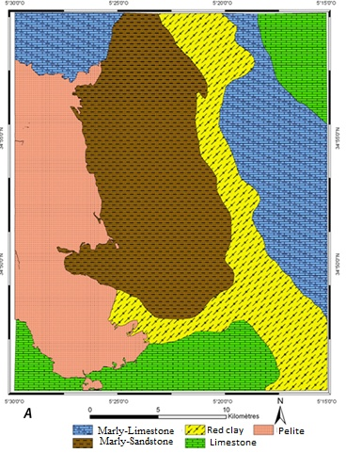
  Lithology
Introduction
Objectives
Study Area
Methodology
Results
Conclusion

Slide 12
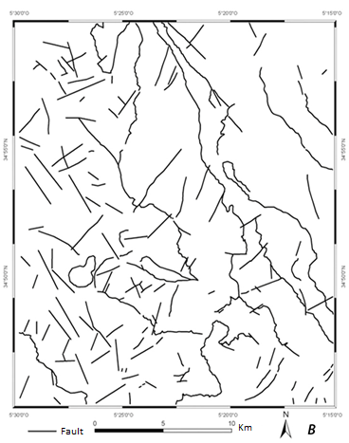
Fracturing
Introduction
Objectives
Study Area
Methodology
Results
Conclusion

Slide 13
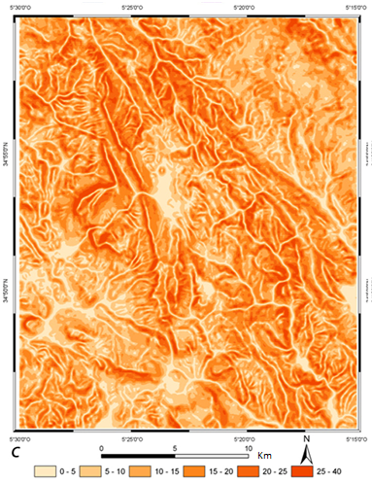
  Slope degree
Introduction
Objectives
Study Area
Methodology
Results
Conclusion

Slide 14
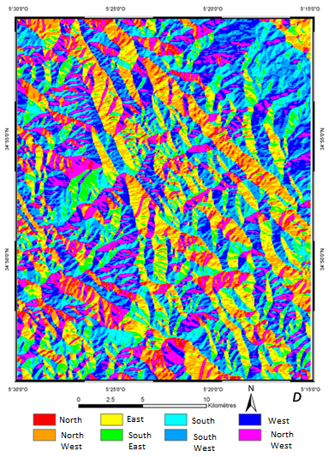
  Slope aspect
Introduction
Objectives
Study Area
Methodology
Results
Conclusion

Slide 15
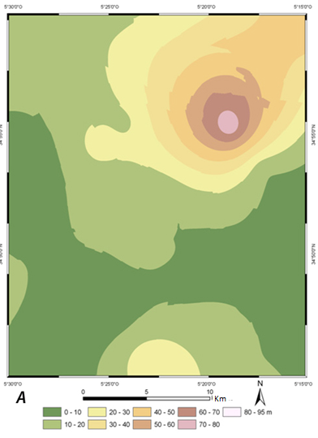
  Equal depths of earthquakes
Introduction
Objectives
Study Area
Methodology
Results
Conclusion

Slide 16
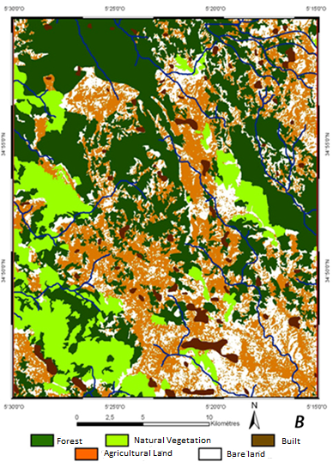
  Land Use
Introduction
Objectives
Study Area
Methodology
Results
Conclusion

Slide 17
  Methodology for mass movements susceptibility mapping for the Zoumi region
Introduction
Objectives
Study Area
Methodology
Results
Conclusion
Data
Field
Thematic maps
Geology
Catalogs
Aerial Photos
Satellite Imagery
Collecting Information
Mass movements
Lithology
Hydrology
Seismicity
Fracturing
Land use
Slope Aspect
Slope degree
Classification of Mass Movement
Class 1
Rock falls
Class 2
Superficial landslides
Class 3
Rotational landslides
Class 4
Mudflow
Application of Weight of Evidence
Spatial Probabilistic Analysis
4 Classes of susceptibility
Test of unconditional independence
Homogenization of Classes
Selecting the best combination of factors
Susceptibility Map
Verification
Statistical Validation
Final map of susceptibility

Slide 18
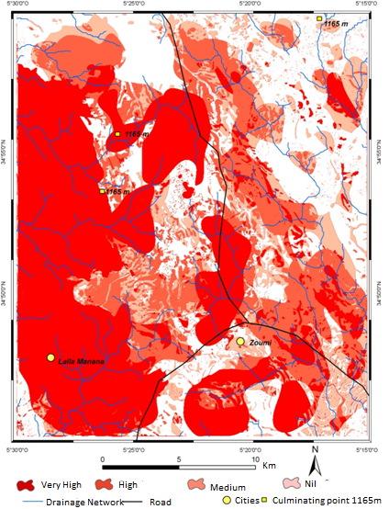
  Susceptibility Map
Introduction
Objectives
Study Area
Results
Methodology
Conclusion

Slide 19
  Validation of susceptibility map
Introduction
Objectives
Study Area
Results
Methodology
Conclusion

Slide 20
  Conclusion
Introduction
Objectives
Study Area
Results
Methodology
Conclusion
A mass movements susceptibility map of the Zoumi region has been developed through a bivariate model (Weight of Evidence Theory) , which is an indirect probabilistic approach . The application of WOE assumes :
I. The potential movement of fields is triggered by the same conditions as in the past,
II. The set of predisposing factors is known and introduced in the analysis,
III. All mass movements are inventoried in the study area.
Through this study, Mapping mass movements corresponding to the variable or model ( dependent variable DV) was conducted on the entire study area from SPOT 5 to 2.5 m resolution , aerial photos , previous work and data from field .
.

Slide 21
  Conclusion
Introduction
Objectives
Study Area
Results
Methodology
Conclusion
Causative factors were: the parameters extracted from the ASTER data Radar ( slope degree , elevation, and slope aspect) , the parameters derived from existing geological maps associated to high resolution satellite data (Lithology , fracturing , the drainage stream and land use ) , and the parameter equal depth of earthquakes from the archives of seismic records .
The results indicate that the combination of the seven predictors was sufficient for assessing the susceptibility of our study to mass movements. The validation phase shows that the resulting map is realistic to the extent that 76% of the inventoried mass movements are located in the zone of very high susceptibility.

Slide 22
References
Bonham-Carter G.F, Agterberg F.P, Wright D.F.1989-Weights of evidence modeling: a new approach to mapping mineral potential. In: Agterberg, F.P., Bonham-Carter, G.F. (Eds.), Statistical Applications in the Earth Science: Geological Survey of Canada Paper, vol. 89-9, pp. 171–183.
Didon J., Durand Delga M. Et Kornprobst J. 1973 - Homologies géologiques entre les deux rives du détroit de Gibraltar (Cordillères bétiques occidentales, Espagne). Bull. Soc.Géol.Fr., (7) XV, 2, p.77-105.

Slide 23
Thank you

