Slide 1
Investigation of Gem Materials using 405nm Laser Spectroscopy
Henry Barwood
Troy University
Troy, Alabama

Slide 2
405nm laser diode
GaN diode lasers were developed for Blu-Ray players. They are now widely manufactured in power levels ranging up to 500mW.
Inexpensive diode assemblies are now available in the 5-200mW range, both battery powered (laser pointers) and with AC power supplies and collimating lenses that provide either a spot or line focus.

Slide 3
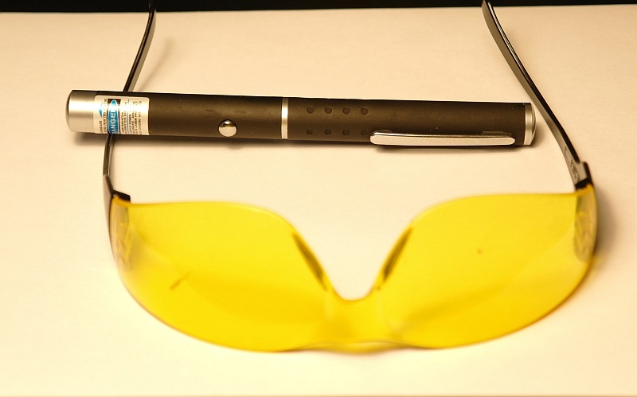
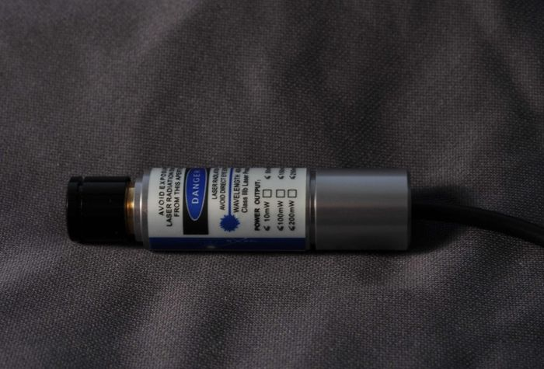
5mW 405nm Laser pointer. Inset 150mW Diode

Slide 4
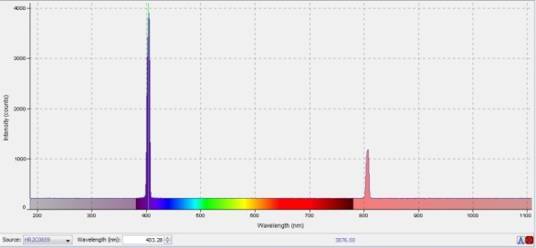
405 nm laser spectrum

Slide 5
Spectrometer/Diode holder for spectroscopy of small sample areas
A simple holder was constructed that focuses the laser beam onto a small aperture that is centered on the focus of the spectrometer collimator (UV-NIR). The resultant fluorescence is fed into the spectrometer via a standard fiber optic cable (also UV-NIR).

Slide 6
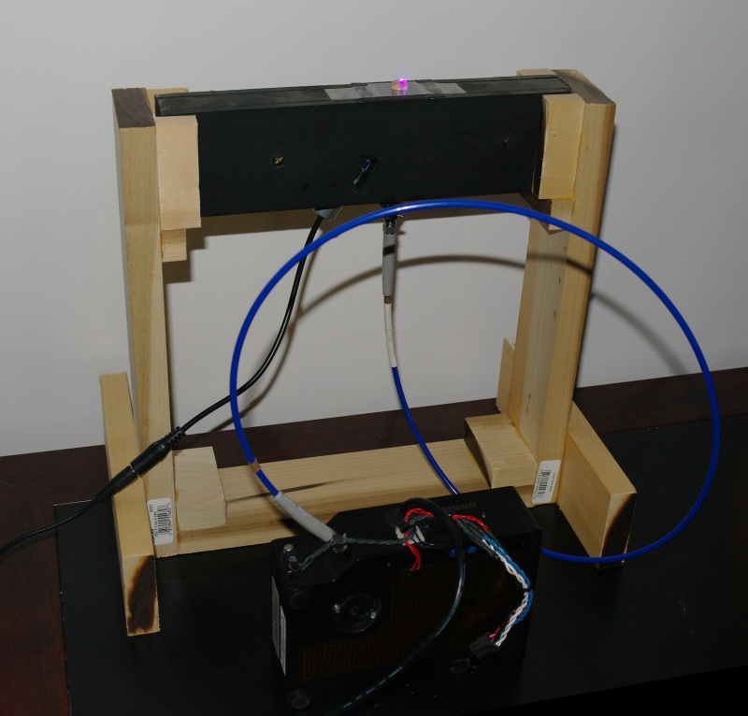
Laser Diode and Collimator Holder

Slide 7
Spectrometer modification
An Ocean Optics HR2000 spectrometer was modified with the addition of a new grating that increased the wavelength range to 200-1100nm.
The 10 micron slit on the spectrometer was replaced with a 100 micron slit to improve light gathering power.
A UV-IR fiber optic cable and collimator were added that allow the full 200-1100nm wavelength range. While stiff, a 200 micron fiber was selected for maximum light transmission.

Slide 8
Laser imaging for photomicrography
Spot focusing lasers are adaptable for imaging gems, small crystals, or areas of petrographic slides.
The high visible output of the laser must be blocked with a yellow filter before a useful image may be obtained.
Imaging as a substage light source is dangerous, and only incident illumination should be used

Slide 9
Imaging of Samples with an Un-collimated Laser Beam
The output of a laser diode operated without the collimating lens can be scanned across a specimen while the camera is in Bulb mode. This allows the collection of a macro image of the specimen. By blocking most of the visible light with a yellow filter, minerals having a response to the 405nm laser emissions may be imaged. Processing of the images can also provide a quantitative measure of the amount of the fluorescent mineral.

Slide 10
In order to test the laser fluorescence of diamonds, small < 1mm crystals were purchased from a number of sources. No information as to the actual source localities of the diamonds was available; however, they were simply listed as “Congo”. The body colors of the diamonds were mostly yellow to off white.

Slide 11
Diamonds Fluorescent colors observed in diamonds using 405 nm laser
Green (common)
Yellow ( 5 examples)
Blue (single example)
Red (single example)

Slide 12
In all subsequent figures, the fluorescent specimen is pasted in the upper right hand corner of the figure

Slide 13
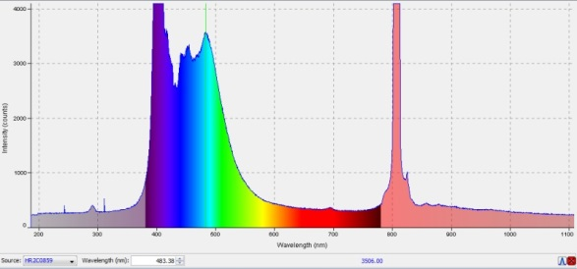
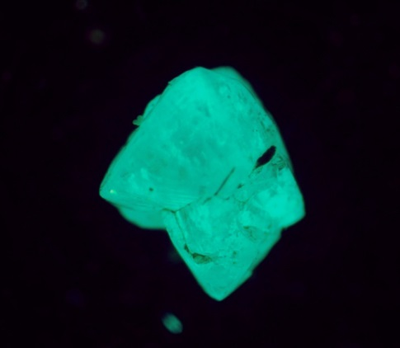
Blue luminescent diamond spectrum

Slide 14
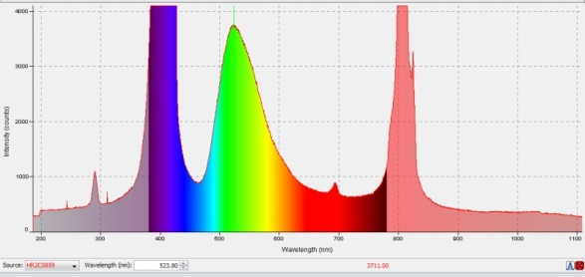
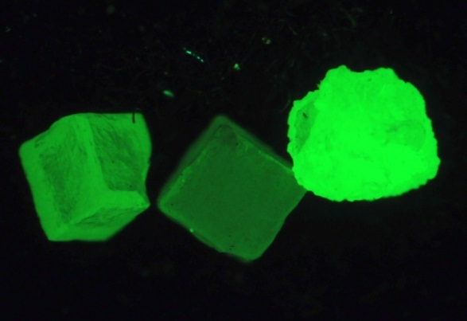
Green luminescent diamond spectrum

Slide 15
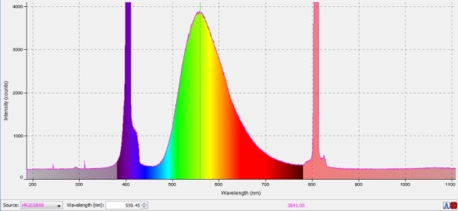
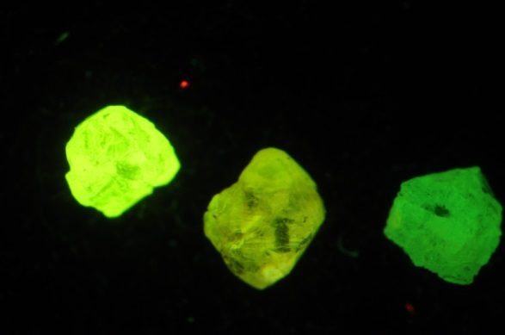
Yellow luminescent diamond spectrum

Slide 16
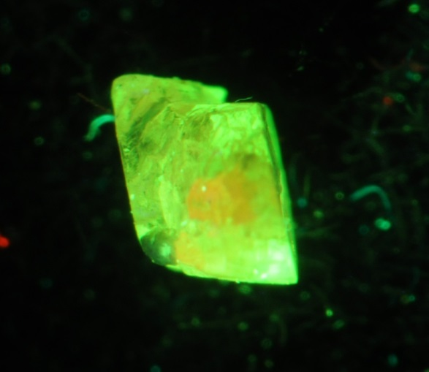
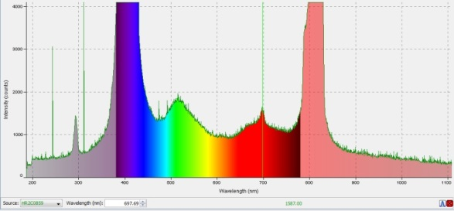
Red luminescent diamond spectrum

Slide 17
Gems showing dominant Cr3⁺ (and Fe3⁺) response to 405nm laser
Beryl var. Emerald
Chrysoberyl var. Alexandrite
Corundum var. Ruby
Grossularite var. Tsavorite
Kyanite
Spinel
Spodumene var. hiddenite
Topaz

Slide 18
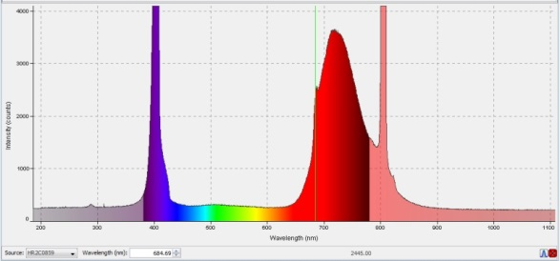
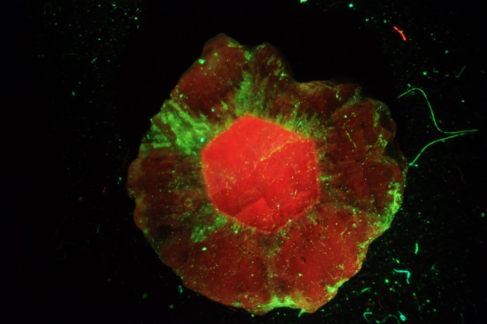
Emerald spectrum showing Cr3⁺ and Fe 3⁺ (?) activation

Slide 19
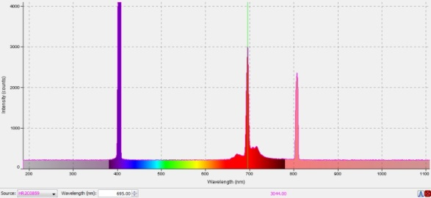
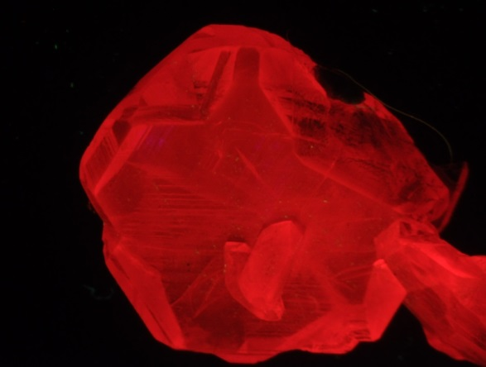
Corundum var. Ruby (synthetic) spectrum showing Cr3⁺ activation

Slide 20
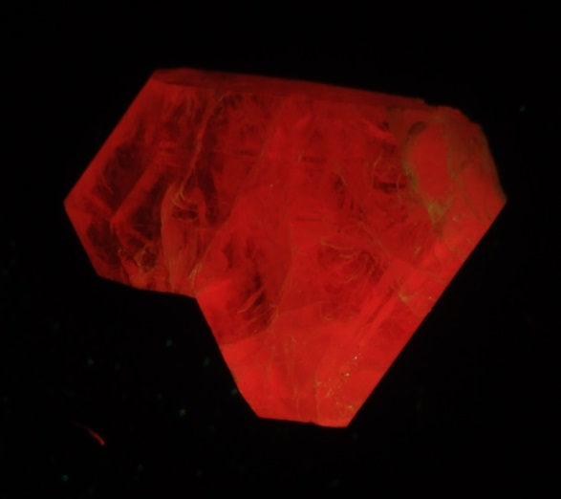
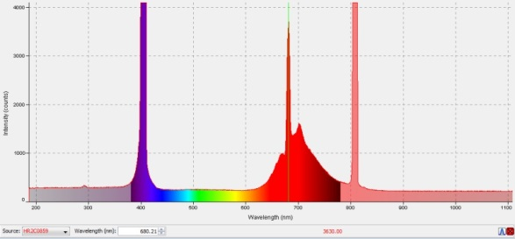
Chrysoberyl var. Alexandrite spectrum showing Cr3⁺ activation

Slide 21
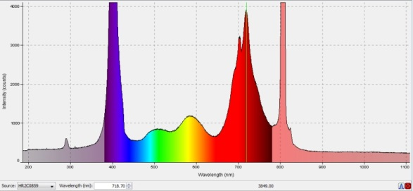
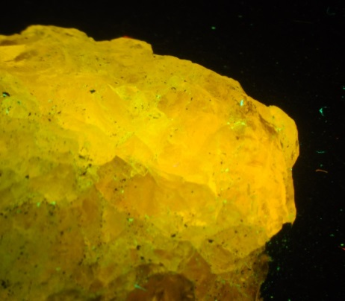
Grossularite var. Tsavorite spectrum showing Cr3⁺ and Fe3⁺ (?) activation

Slide 22
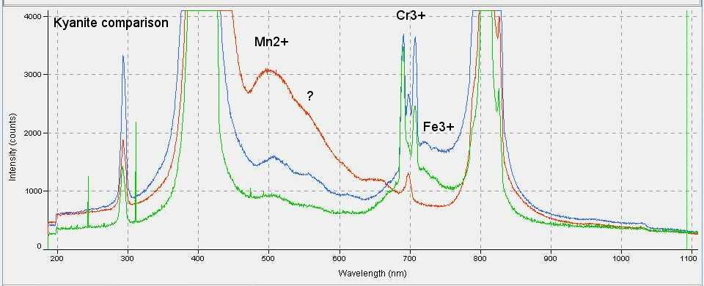
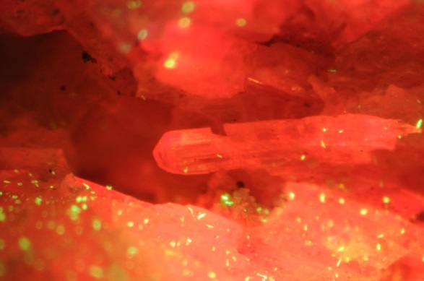
Comparison of 405nm Spectra for Kyanite Color Variations (line colors correspond to blue, green and orange kyanite). Note Differences in Cr3+ Lines

Slide 23
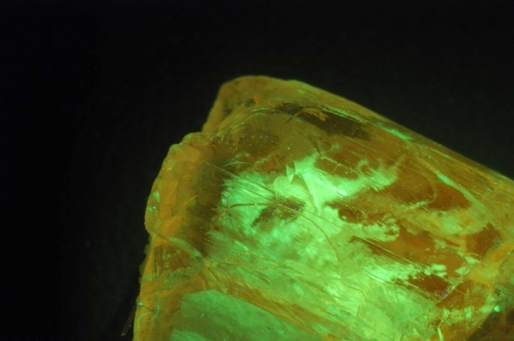
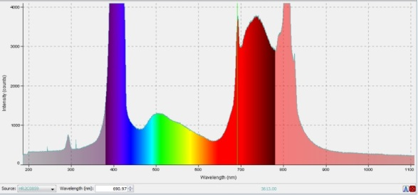
Spodumene var. Hiddenite spectrum showing Cr3⁺ and Fe3⁺ (?) activation. The green response on the spectrum is from the unknown green luminescing inclusions in the spodumene

Slide 24
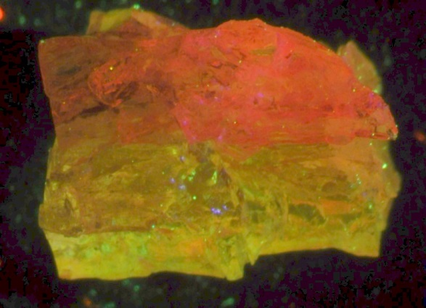
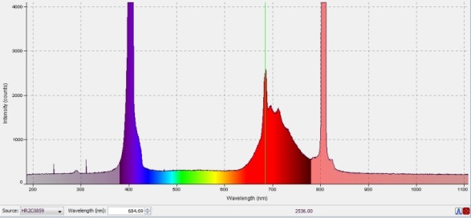
Topaz (Brazil) spectrum showing Cr3⁺ and weak Fe3⁺ (?) activation

Slide 25
Gems showing dominant Mn2⁺ activation
Fluorapatite
Grossularite
Kyanite
Spodumene var. Kunzite
Titanite
Zoisite var. Tanzanite

Slide 26
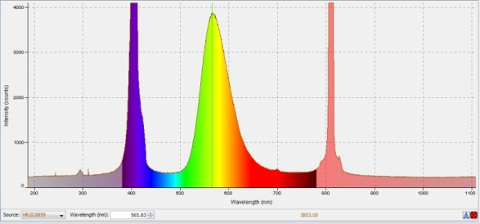
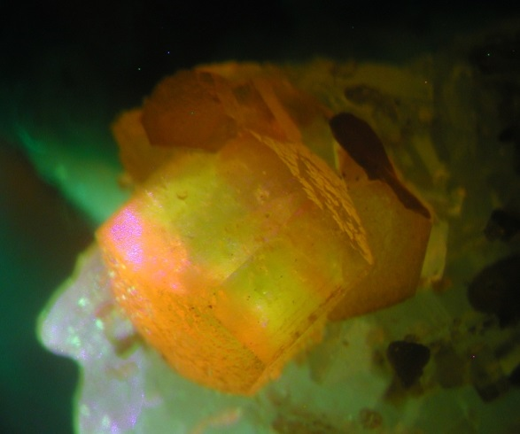
Fluorapatite spectrum showing Mn2⁺ activation

Slide 27
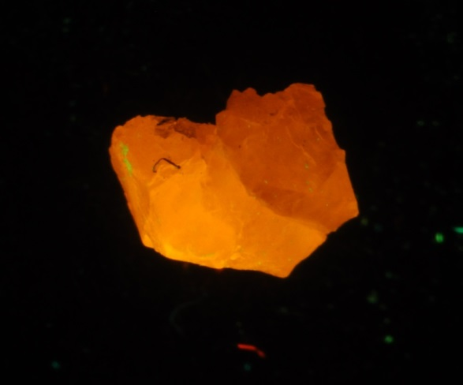
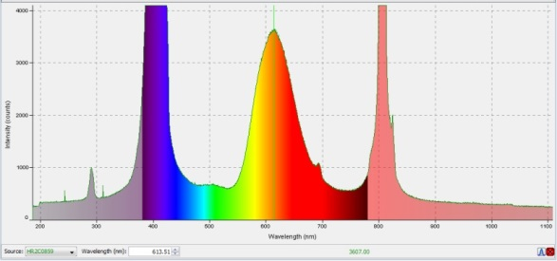
Grossular (Mexico) spectrum Mn 2⁺ activation

Slide 28
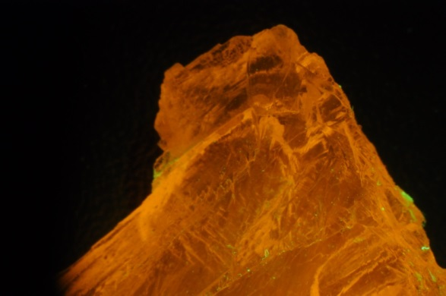
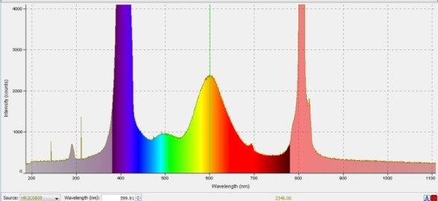
Spodumene var. Kunzite spectrum showing Mn2⁺ activation

Slide 29
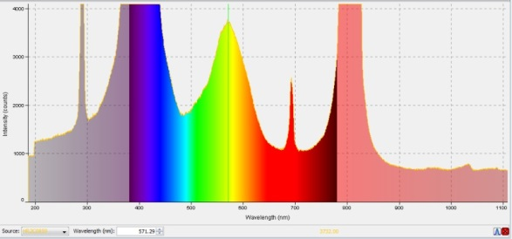
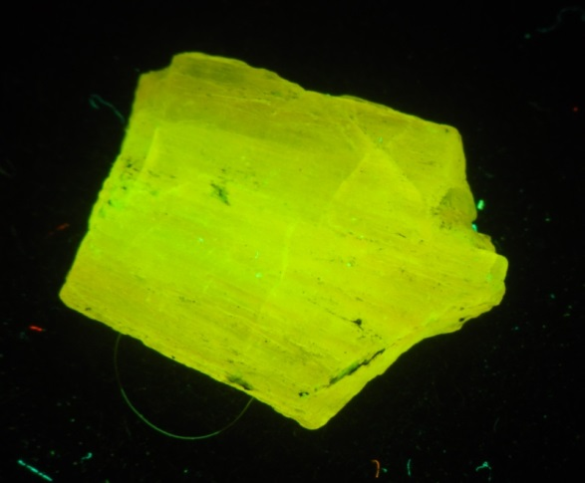
Pink Tanzanite spectrum showing Mn2⁺ activation

Slide 30
Gems showing dominant REE activation (Sm3⁺ and Dy 3⁺)
Fluorapatite
Scheelite
Titanite

Slide 31
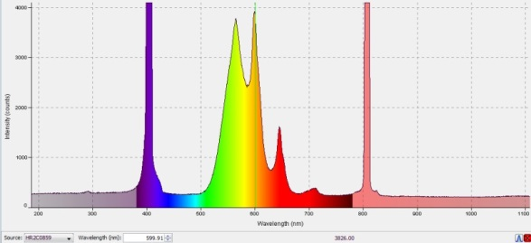
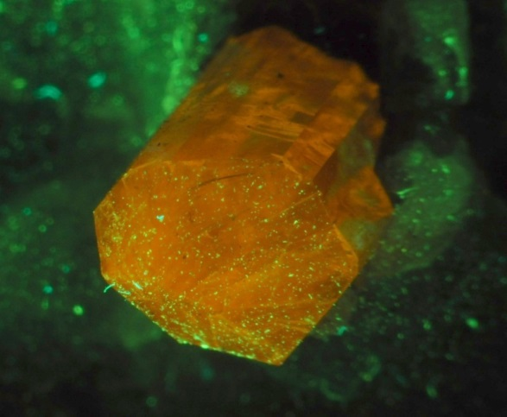
Fluorapatite spectrum showing REE activation

Slide 32
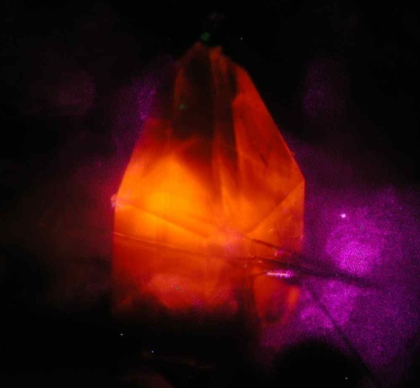
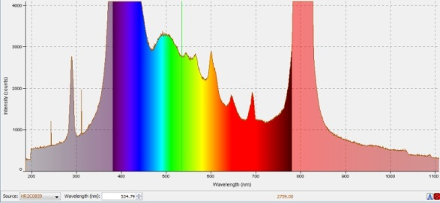
Titanite spectrum showing REE activation

Slide 33
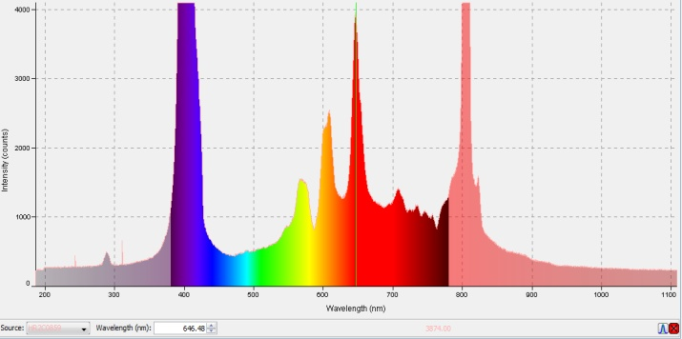
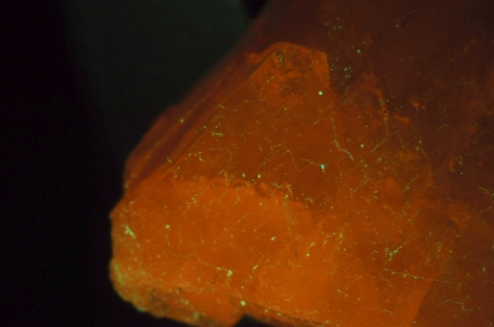
Scheelite (China) spectrum showing REE activation

Slide 34
Gems with other activators
Amber (organic)
Axinite
Cancrinite
Chalcedony (Uranium)
Opal (Uranium)
Petroleum and shell (organic)
Scapolite
Sodalite

Slide 35
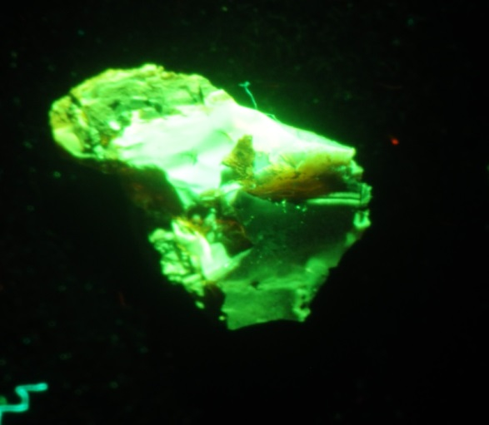
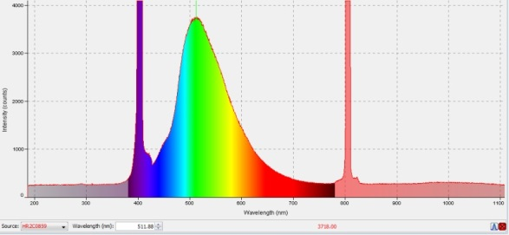
Amber (Arkansas) spectrum

Slide 36
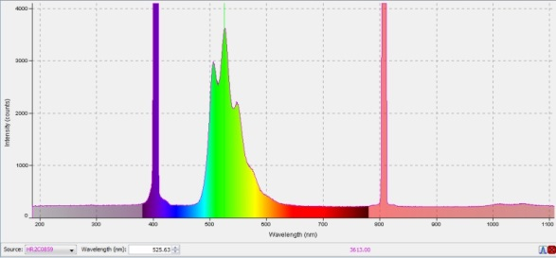
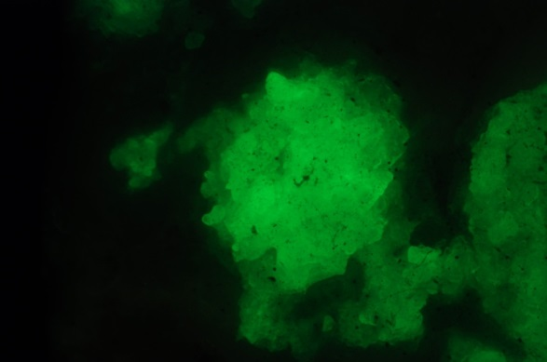
Opal (Hyalite) spectrum showing Uranium activation

Slide 37
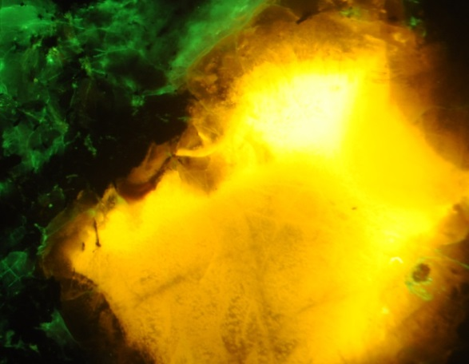
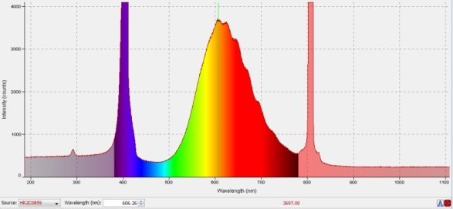
Sodalite spectrum

Slide 38
Summary of Initial Research
Diamond provenance, and activators need to be defined
Other gem materials should be investigated for additional activators
Potential for gem identification should be investigated

