Slide 1
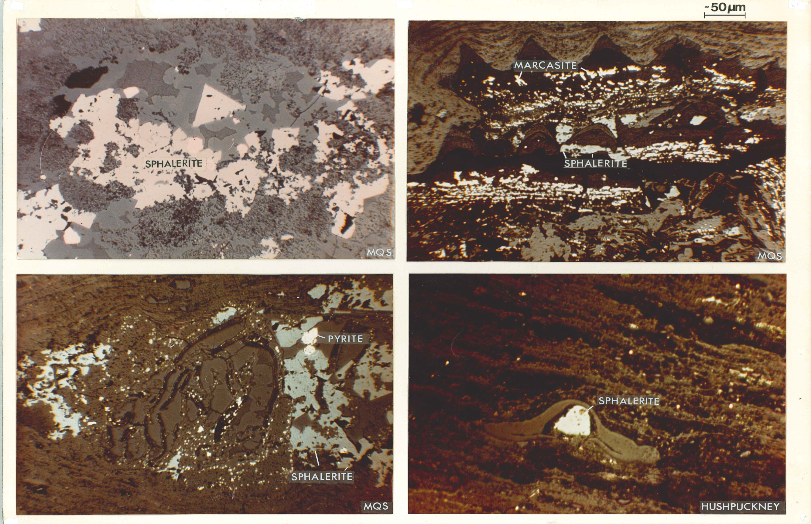
GSA fall 2013 Poster 235-2 (booth #114) THE AMBIGUOUS TEMPORAL RELATIONSHIP BETWEEN HYPERENRICHED METALLIFEROUS PENNSYLVANIAN BLACK SHALES AND THE CLASSIC Pb-Zn ORES OF THE MISSISSIPPI VALLEY Raymond M. Coveney Jr. - UMKC Geosciences 64110 coveneyr@umkc.edu
Abstract
Thin hyperenriched Pennsylvanian black shales of the central Midwest contain thousands of ppm Zn, Mo, U, and V (Coveney & Murowchick 2012 GSA abstr; Fig. 1; Table 1). During the Late Paleozoic, probably including the Pennsylvanian, hydrothermal fluids traversed the region and formed the Mississippi Valley-type (MVT) Pb-Zn ores of the Midwest (Wenz et al. 2012 Amer. Journal of Science; Leach GSA Abstract 1973; Leach & Rowan, Geology, 1986) leaving 80-120oC saline fluid inclusions in country rocks (Coveney & Goebel, 1983; Cobb 1981; Coveney et al. Econ. Geol.1987). Whether a causal relationship exists between the hyperenriched shales and the MVT ores is not certain, but this scenario is a distinct possibility. The possibility of a very complex diagenetic history for the shales suggests that it is inadvisable to utilize the geochemistry of the shales to infer the nature of the original sedimentary environment.
Fig 1. sphalerite in hyperenriched Pennsylvanian shales
Fig. 2. 17 hyperenriched shales ~17 m.y.
~298 Ma
~298 Ma
Key Facts
Thin Pennsylvanian black shales of the Midwest contain thousands of ppm Zn, Mo, U, and V and are termed hyperenriched (Coveney & Murowchick 2012 GSA Abstracts; Fig. 2; Table 1).
Traces of Mississippi Valley-type (MVT) minerals are ubiquitous throughout the central US craton in Paleozoic strata even far from ore deposits (Fig. 1). For example hydrothermal (80-120ºC) sphalerite occurs in limestones, coals, and shales of the U.S. craton. Wenz et al. 2012 Amer. Journal of Science; Leach GSA Abstract 1973; Leach & Rowan, Geology, 1986)
The main Pb-Zn ores formed during the late Paleozoic when hydrothermal fluids formed from basinal brines traversed the region and left 80-120ºC saline fluid inclusions in country rocks.
Initial Working Hypothesis
Metals were mainly introduced to 15 widespread and 2 local hyperenriched Pennsylvanian black shales during sedimentation having been transported by the same basinal brines that formed the main Pb-Zn deposits of the Midwest in Paleozoic sedimentary rocks.
~315 Ma
~315 Ma
from Coveney, Ragan & Brannon
Table 1. Typical assays, Penn. hyperenriched black shales (ppm)
 | Indiana | Indiana | Illinois | Missouri | Kansas | Change
Aluminum | 43000 | 47000 | 48000 | 69000 | 68900 | x1.6
Sulfur | 28000 | 33700 | 19000 | 60000 | 22500 | x0.8
Calcium | 4400 | 5500 | 21000 | 26000 | 46000 | x9.6
Iron | 32000 | 33800 | 29500 | 69400 | 35000 | x1.1
Zinc | 3000 | 3350 | 1300 | 5300 | 1900 | x0.6
Vanadium | 3170 | 2850 | 3880 | 210 | 400 | x0.1
Selenium | 247 | 231 | 251 | 67 | 78 | x0.3
Molybdenum | 2500 | 1400 | 690 | 40 | 60 | x0.2
Uranium | 140 | 165 | 99 | 25 | 39 | x0.3
C _{organic} | 36.8% | 37.5% | 32.7% | 18.5% | 14.9% | x0.4
 | Mecca Qu | Mecca Qu | Mecca Qu | V shale | V shale | IN to KS
 | 8.9 cm | 8.9 cm | 9.9 cm | 22 cm | 7.6 cm

Slide 2
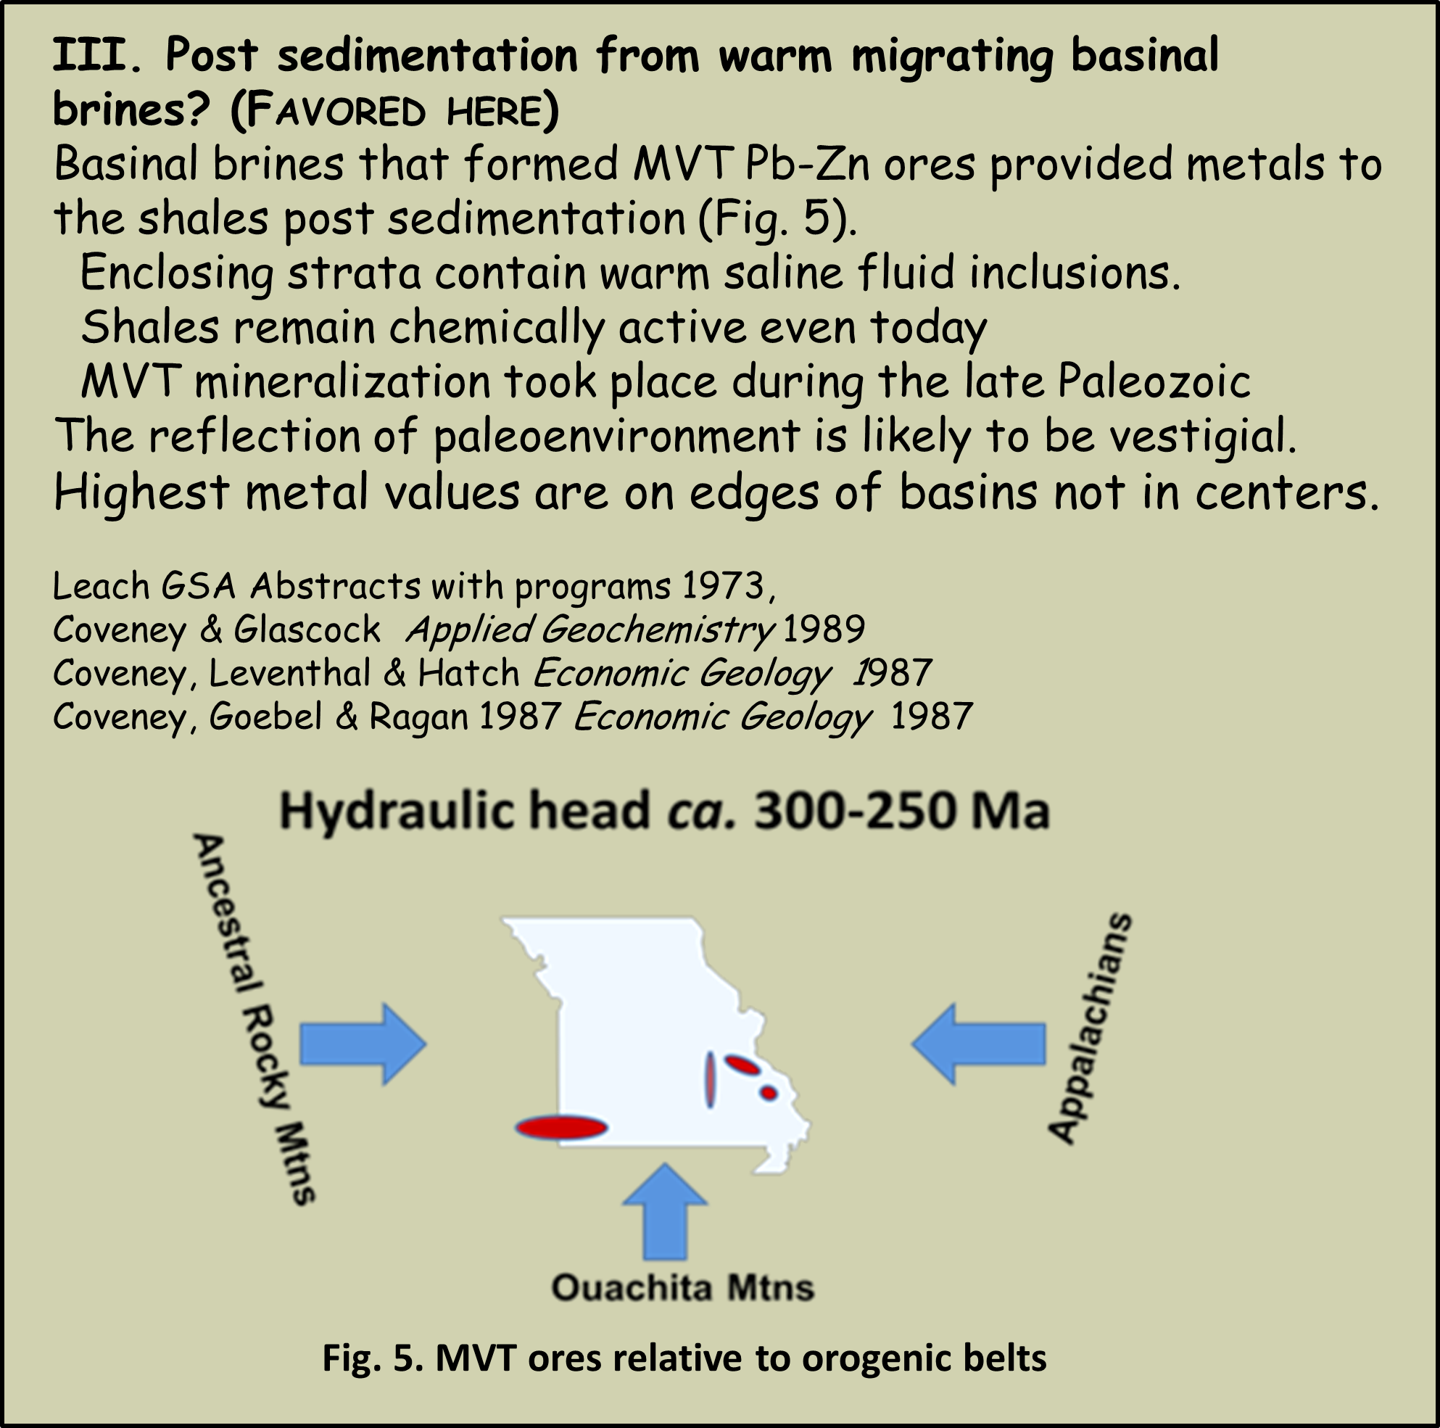
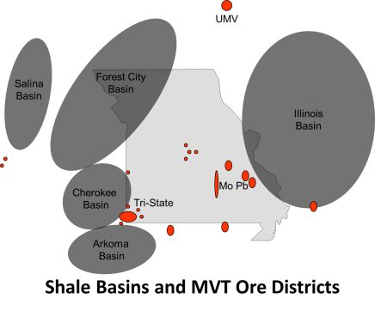
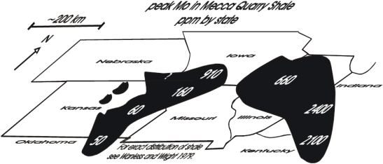
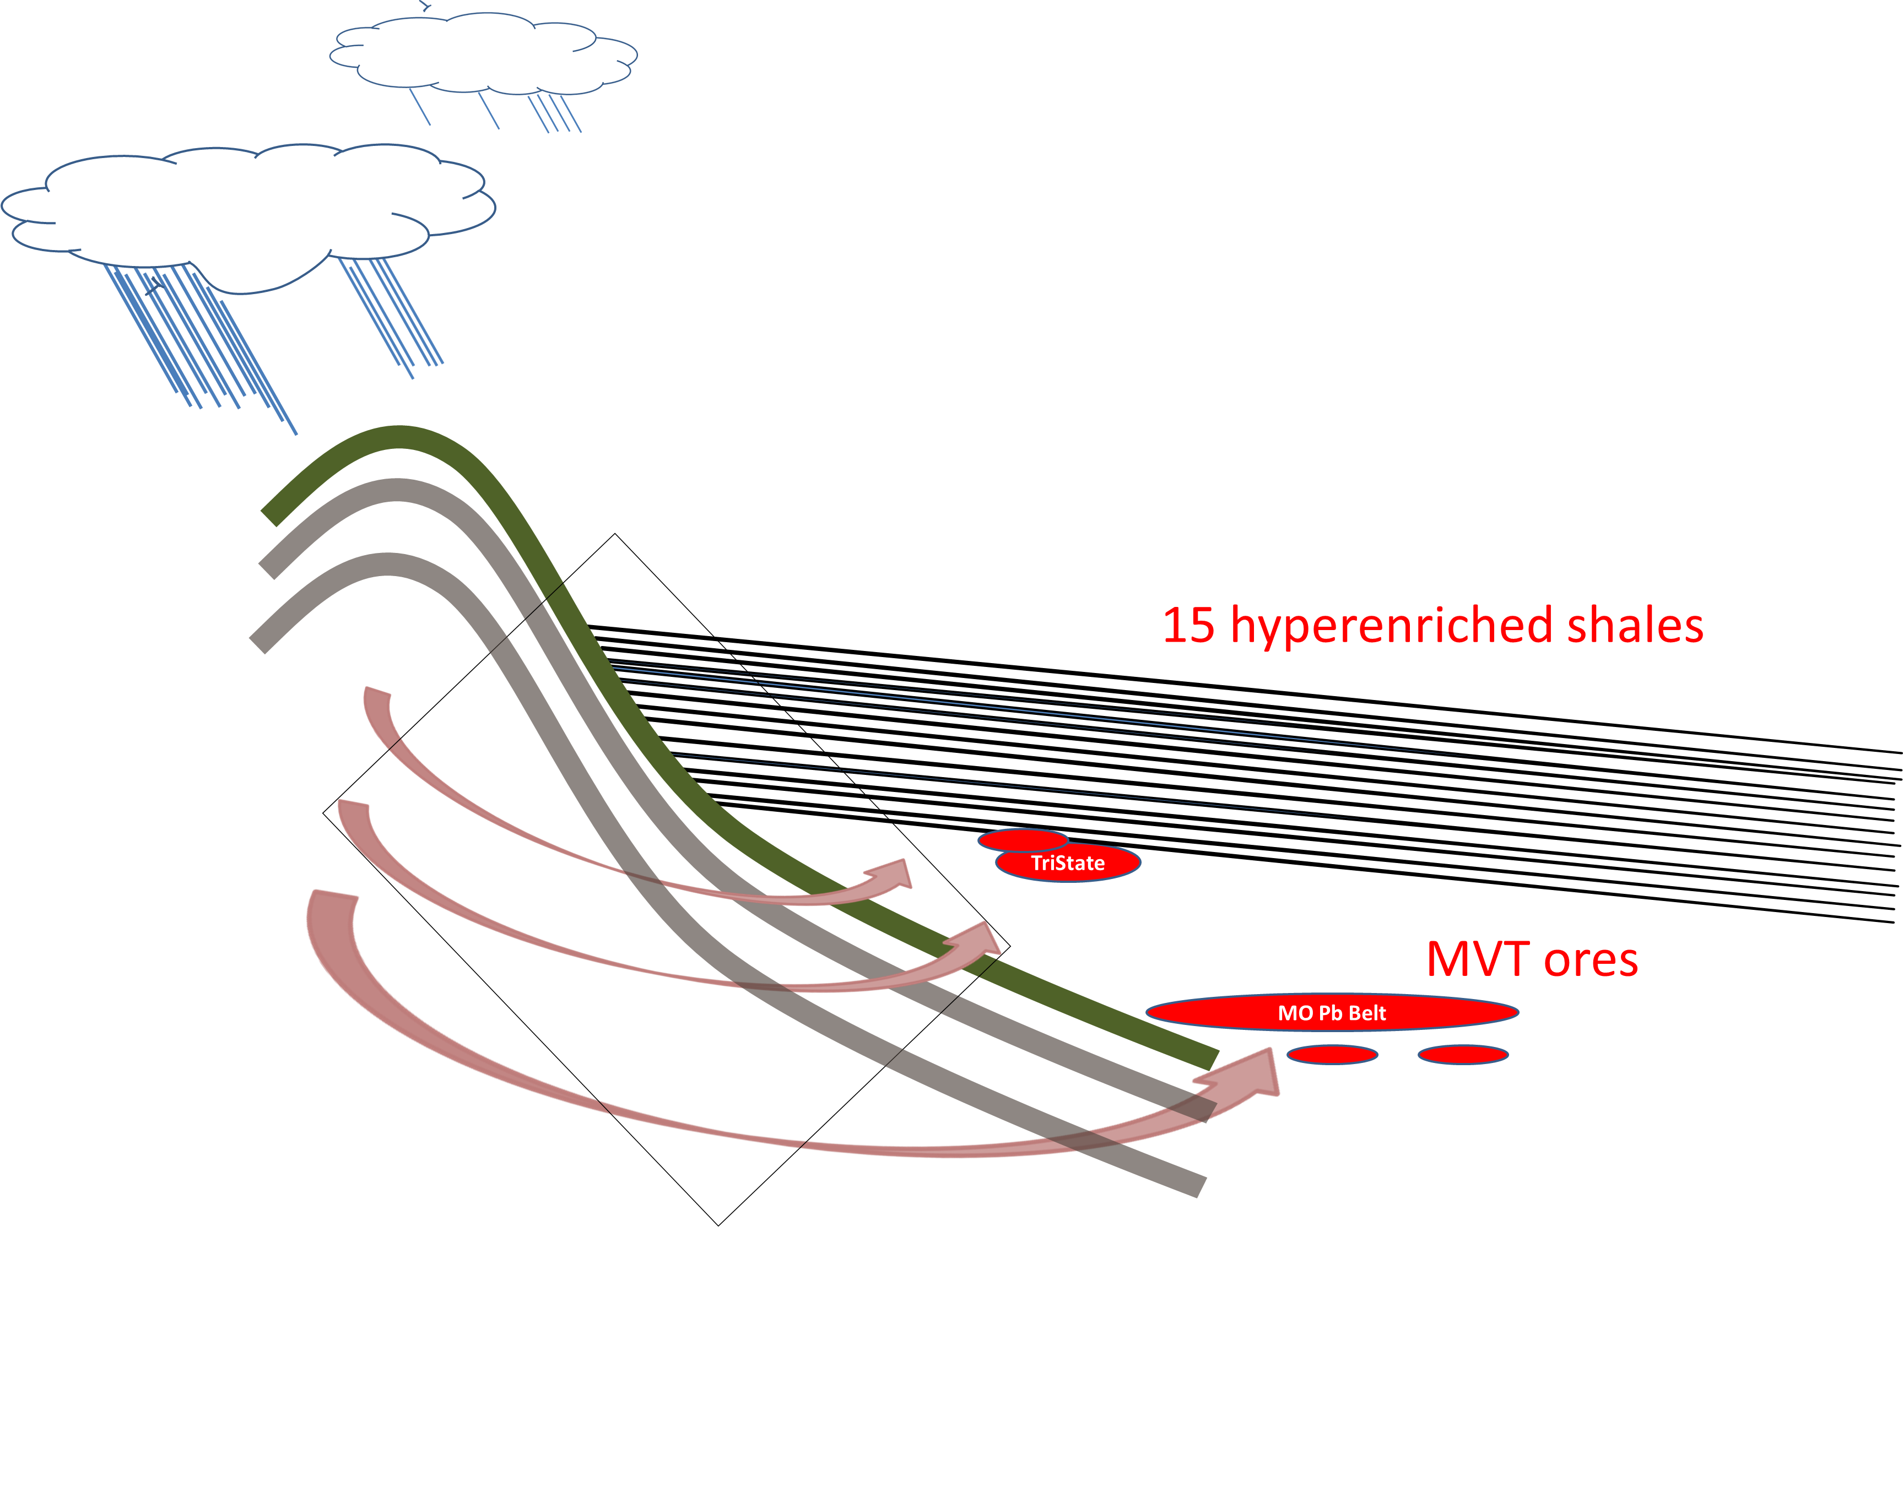
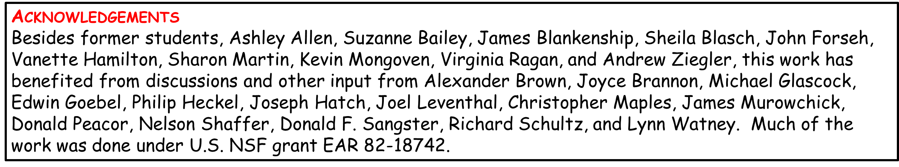
I. During sedimentation from sea water?
Metal values reflect paleogeography (Fig. 3).
but no modern black muds are so hyper-enriched, raising doubts about whether sufficient time existed for enrichment from sea water to occur during the Pennsylvanian.
Also the most enriched values are on basin edges not in centers.
Heckel, AAPG Bulletin 1977
Holland Economic Geology 1979
II. Hydrothermally during sedimentation? (initial hypothesis)
Hyperenriched shales occur in the same region as MVT Pb-Zn ores (Figs. 4, 5).
World’s most diffuse sedex ores??*
Coveney & Glascock, Applied Geochemistry 1989
*D.F. Sangster pers. comm. 1990
Coveney & Goebel UMR International Mtg 1983
Fig. 5 Shale basins, ore districts and minor MVT occurrences
Fig. 4 Mo in Penn. Mecca Quarry Shale Member (ppm by state)
Fig. 4. MVT ores relative to shale basins
6
Fig. 7 Current Working Hypothesis: The 15 hyperenriched
shales were mineralized diagenetically during the
Pennsylvanian and Permian by migrating warm MVT basinal
brines driven by regional flow.
Conclusions
Basinal brines that formed MVT Pb-Zn ores provided most metals to the hyperenriched shales after sedimentation.
It is risky to draw conclusions about the Pennsylvanian paleoenvironment from the hyperenriched shales.

