Slide 1



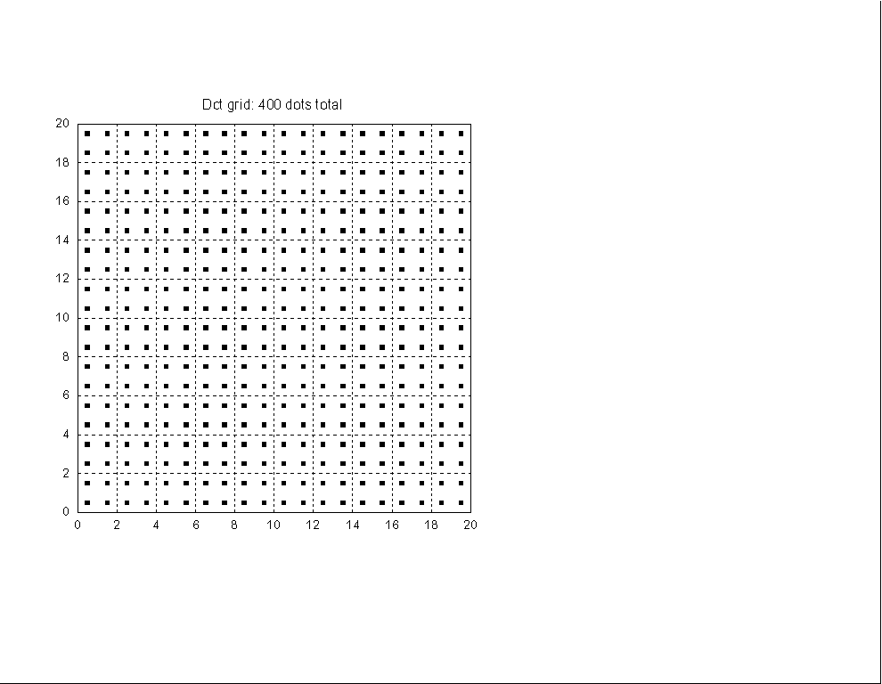
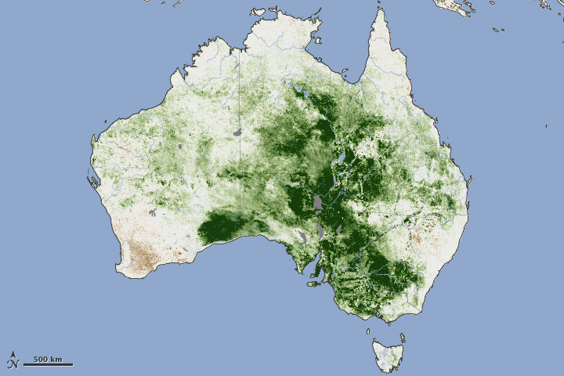
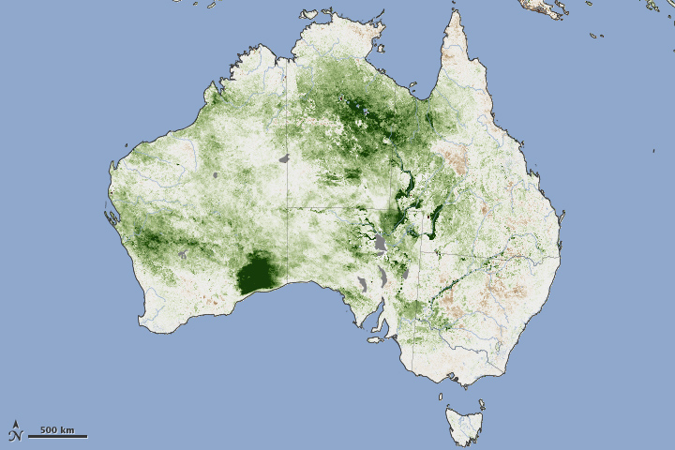
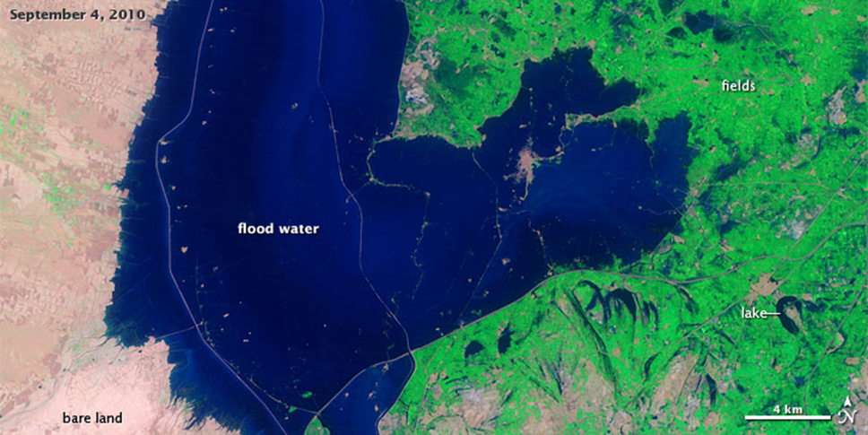
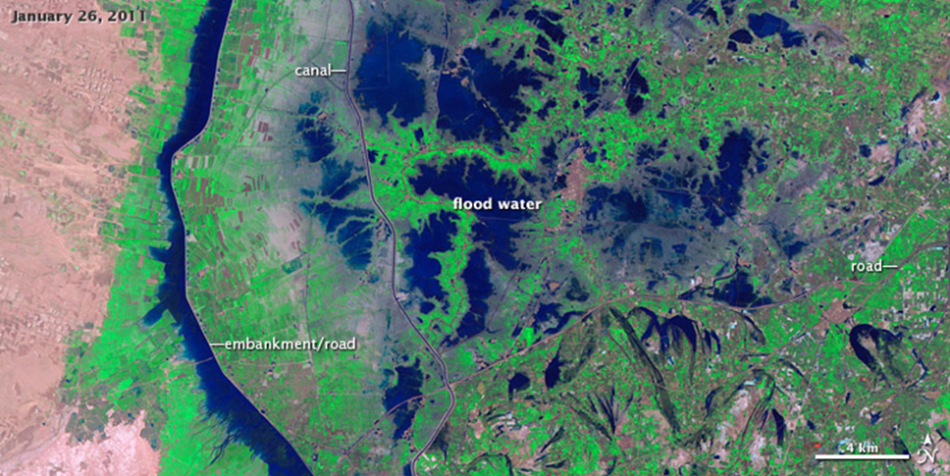
Utilizing dot grids to measure areal change: remote sensing outreach
Robert RJ Mohler¹ & M. Justin Wilkinson²
Civil Programs/Bioastronautics, Lockheed Martin Exploration and Mission Support, P.O. Box 58487, Houston, TX & Texas A&M, Galveston robert.mohler@lmco.com
2 ESCG–Jacobs Technology, NASA–Johnson Space Center
Houston TX 77058 justin.wilkinson-1@nasa.gov
Abstract:
Dot grids are often used to measure the area of an object using images. A dot grid transparency may be placed over the image and the dots that touch the object in question may be counted. By using the RF scale of the photo, in correlation with the dots, an area can be determined. To help ensure consistency of measures, the dot grid should be dropped randomly on the map around the given area. This should be done at least twice so that an average area can be determined.
Such a system may be readily adapted to the classroom, from middle school through high school for modules emphasizing mapping and areal change. This work portrays a series of images (before and after) in which different “changes” have occurred (changes in vegetation, snow fields, ice floes, flooding). The students are provided the images, background data on each image, dot grid transparencies and the RF scales for the various images. The students are asked to measure/determine the area (km²) of change from one image date to another and are also asked a series of critical thinking questions concerning the assessment of change. As an aid to ensure the students are onboard with the requirements of the module, an example is worked for them prior to the initiation of their portion of the module.
This activity was successfully utilized at a Science Olympiad for high school students for a “Remote Sensing” event emphasizing the Earth’s hydrosphere and is readily adaptable to other areas of emphasis and grade levels.
Directions provided for the students: Place the transparency over the image and count the dots that touch the object in question. By using the RF scale (representative fraction scale) of the photo, in correlation with the dots, an area can be determined. Drop the dot grid randomly on the map around the given area, do so at least twice and use the average number of dots for your calculations. This will give you a more accurate area for the desired object.
In this event, you will use dot grids to determine the change in disturbance areas. Question 1 is provided as an example with all the work shown. In doing the exercises, remember to utilize the RF scale associated with each set of images.
Another example:
Monsoons are common in Pakistan but the summer of 2010 was an exception as a result of La Niña and jet stream patterns. A rising Indus River resulted in a dam failure in the Sindh Province. Areas remained flooded for several weeks causing extensive damage to crops, roads and communities.
Other issues associated with the standing water included diseases such as cholera as well as malaria carried by the mosquitoes associated with the stagnant pools of water. With evacuation of communities came crowded relief camps and poor sanitation which increased the spread other diseases such as measles.
In the second image, a network of irrigation infrastructure is visible as the landscape dries. As the water flooded the riverbanks, the manmade canals and embankments proved very effective in holding water in areas not originally intended for such (M. Scott/University of Colorado, Boulder)
Questions:
What is the difference in dots between the images?
What is the change in area?
Critical thinking question: How could lessons learned from this incident be used in preventing flooding of the area in the future?
Questions:
In the first image below major flooding via La Niña caused an increase in vegetation depicted in green (April 2011). The second image (September 2011) is a return to more normal conditions.
What is the difference in dots between the images?
What is the change in area?
Critical thinking question: In a region known for its dry climate and extensive wildfires, how would this increase in vegetation affect the risk of a wildfire in the future?
Given:
Dot Grid is scaled at four dots per cm²
1 km² = 10,000,000,000 cm² or 10¹⁰ cm²
RF = 1:35,000,000
Comments from Students:
Thank you for doing an exercise like this, I now understand that remote sensing is much more than weather maps and weather satellites.
This was much more interesting than the typical bubble tests we used to do at these events.
I appreciated you working out an example, made it much easier to follow and complete in the limited time we had.
AVHRR NOAA-18 POES (Polar Operational Environmental Satellite) : J. Allen, J. Small and A. Anyamba/NASA Global Inventory Modeling and Mapping Studies Group at GSFC and Foreign Agricultural Service Global Agricultural Monitoring Project.
What is the difference in dots between the images?
Image 1 = 138 dots, image 2 = 108 dots: difference 30 dots
What is the change in area?
1 cm² on the map represents (35,000,000)² or 1.225 E¹⁵ cm² on the ground
Since 1 km² = 10¹⁰ cm², this 1 cm² on the map represents 122,500 km² on the ground
Since 4 dots on the grid represent 1 cm², then 122,500 km²/4 dots = 30,625 km²/dot
Therefore, 30 dots * 30,625 km² per dot = 918,750 km²
In a region known for its dry climate and extensive wildfires, how would this increase in vegetation affect the risk of a wildfire in the future?
An increase in vegetation implies an increase in the risk of wildfires. This vegetation is temporary and it is only growing so extensively because of the flooding. When it becomes dry, there is a higher risk for wildfires.
Landsat 5 TM natural color: R. Simmon/NASA GSFC

