Slide 1
Provenance of a modern soil of Middle Tennessee assessed using trace elements and zircon U-Pb geochronology
KATSIAFICAS, Nathan J. and AYERS, John C.
Department of Earth & Environmental Sciences, Vanderbilt University, 2301 Vanderbilt Pl, PMB 351805, Nashville, TN 37235

Slide 2
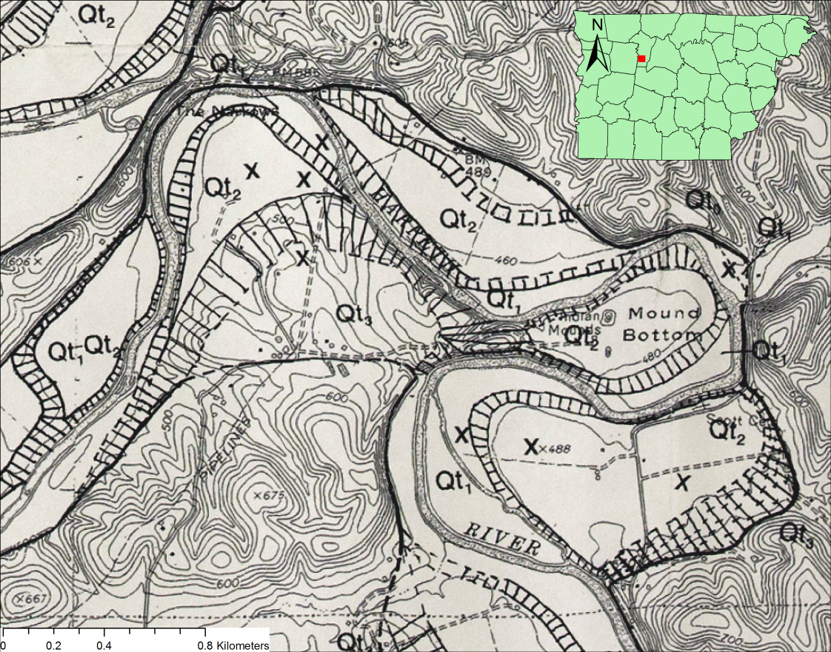
Harpeth River Terrace Soils
Huckemeyer (1999) hypothesized loess component in terrace soils
We are testing her hypothesis using zircon U-Pb geochronology and immobile trace element concentration ratios
Huckemeyer (1999)
Notes:
-Focusing today on soils atop terrace surface along the Harpeth River, which is a tributary of the Cumberland River in Middle Tennessee.
-Previous work in this area by Vanderbilt Master’s student, Jessica Huckemeyer (Huckemeyer (1999)) examined soil formation along a 40 km segment of the downstream end of the river and classified soils atop terraces. The study identified four terrace surfaces which the authors correlated with other studies to constrain timing of different stages in the history of the soil development.
-Most importantly, the Huckemeyer (1999), relying only on basic soil mineralogical observations, hypothesized that soils atop terrace surfaces along the Harpeth were derived, at least in part, from a loess component.
-We are testing this hypothesis using U-Pb geochronology, element mass fluxes, and immobile trace element concentration ratios on samples collected of soils and underlying bedrock.

Slide 3
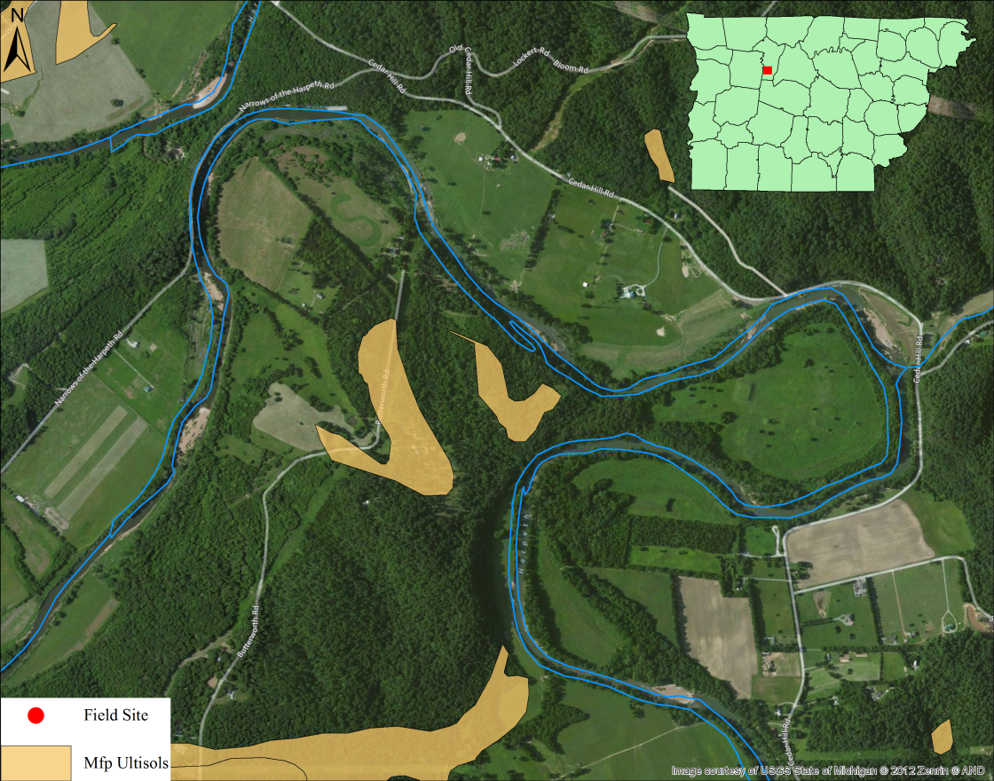
Field Site
Ultisols atop Sangamon age equivalent terrace (~128-75 ka)
Fort Payne Fm. (Mfp) Mississippian cherty limestone bedrock (Wilson, 1990)
Soil data from NRCS (2012)
Notes:
-We chose a location that was used as the type-section for a specific terrace surface that Huckemeyer (1999) correlated to an Sangamon age equivalent (128-79ka)
-We chose a site at high elevation with low slope that was forested in order to minimize likelihood that soils had been disturbed
-Terrace features Ultisols atop Mississippian-aged cherty limestone bedrock of the Ft. Payne Fm.
-Bedrock is exposed at steep cliff face where the Harpeth incised into bedrock

Slide 4
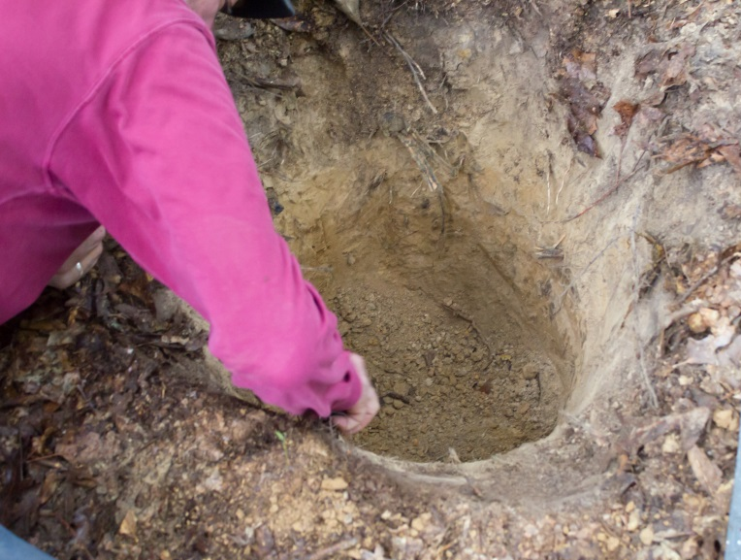
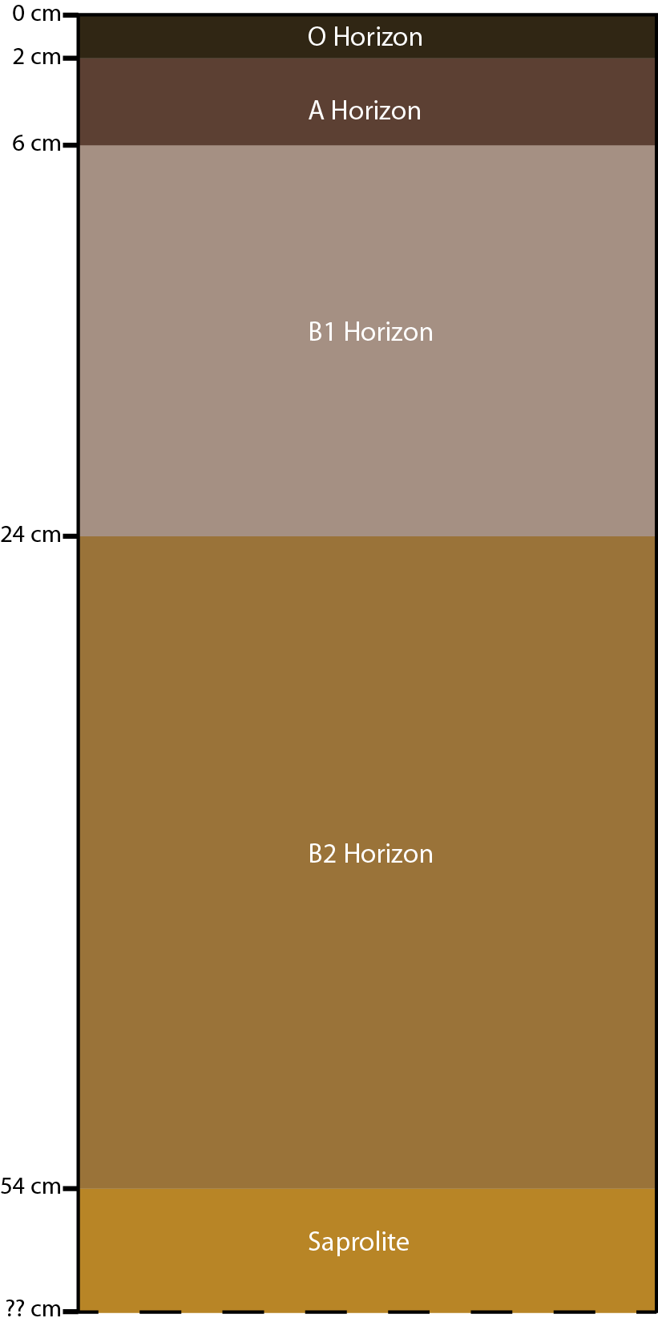

Sampling
B1
B2
Notes:
-Excavated pit down to saprolite layer (which we couldn’t break through)
-We collected 2 gallons each of a B1 and B2 horizon from Ultisols atop terrace
-B1 horizon, as noted by Huckemeyer (1999) did not appear to have been reworked
-B2 horizon may have some component of alluvium
-Both were of a silt loam texture
-We also collected a large (and heavy!) sample from top of cliff face of Mfp bedrock.
OTHER INFO: We won’t collect samples of horizons O and A because they are very thin in middle TN and consist mostly of organic matter. They are also more likely to be affected by recent anthropogenic inputs and bioturbation than the B horizon. B horizons tend to be the thickest in middle TN, and contain material mostly sand grain sized or smaller. C horizons, on the other hand, usually contain pieces, sometimes large, of weathered bedrock. C horizons therefore almost certainly form by weathering of bedrock. The origin of B horizons is more in dispute. B horizons in middle TN and the greater southeastern U.S. could have formed by either chemical weathering of bedrock or by external inputs of alluvial or Pleistocene aeolian material. Thus, the origin of B horizons is the focus of this study.

Slide 5
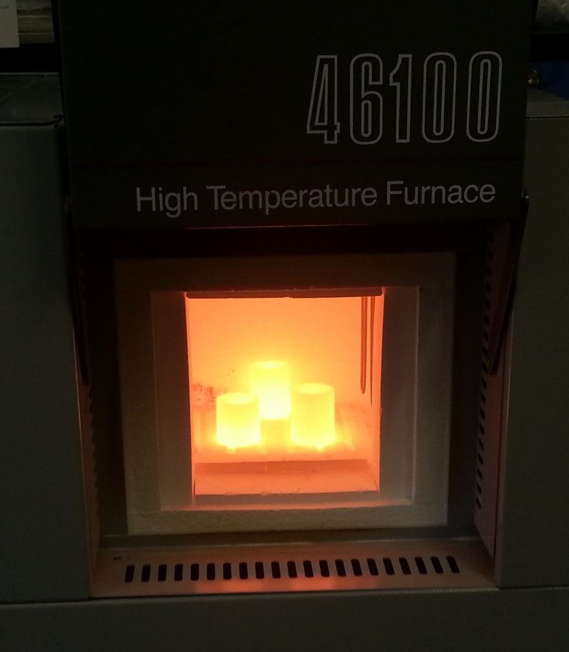
Bulk Samples
Whole rock and soil samples fused to glass with LiBO₂
Glasses analyzed for major elements and trace elements using LA-ICP-MS
Concentration ratios of immobile trace elements (e.g. Nb, Ta, Zr, etc…)
Notes:
-Portion of rock sample pulverized (shatterbox) and then rock and soil samples each heated to 1000 C to remove organic content, structural water from any clay minerals present, and carbonates. ~ 0.5g of each sample then ground in mortar & pestle under acetone with lithium metaborate and fused to glass beads at 1100 C for bulk chemical analyses
-Bulk sample trace element concentrations of glasses measured for each sample using Perkin Elmer Alan 6100 ICP-MS with a New Wave 213 nm laser (trace element conc.)
-Calculated immobile trace element concentration ratios calculated from compositional data

Slide 6
Major Element Concentrations
Measured using EDS
 | Mfp | B1 | B2
SiO2 | 92.54 | 90.83 | 86.29
Al2O3 | 3.71 | 4.71 | 7.58
FeO | 2.26 | 1.73 | 3.44
K2O | 0.78 | 1.17 | 1.1
TiO2 | 0.19 | 1.11 | 1.04
Na2O | 0.06 | 0.27 | 0.22
MgO | 0.23 | 0.07 | 0.31
CaO | 0.23 | 0.1 | 0.03
Notes:
Note that (CLICK) Si highest concentration because it’s primarily cherty (though still a little limey)

Slide 7
Bulk Sample Immobile Trace Element Concentration Ratios
Notes:
Nb/Ta vs Zr/Hf for B1, B2 and Mfp
Bulk trace element concentration ratios seem to show a definite difference between the composition of the rock and the soil, though the soils appear to be similar to one another.

Slide 8
Bulk Sample Immobile Trace Element Concentration Ratios
Notes:
-Nb/Ta vs Zr/Hf for B1, B2 and Mfp
-Bulk trace element concentration ratios seem to show a definite difference between the composition of the rock and the soil, though the soils appear to be similar to one another.
-But, if we plot trace element concentrations alongside major elements, things look a bit different…

Slide 9
Grain Size and Density
Sample | Bulk Density (cm³) | Mean Grain Size (μm)
B1 | 1.5 | 16-31
B2 | 1.5 | 16-31
Mfp | 2.1 | (NA)
Notes:
Here we have the grain size distributions for B1 and B2 as determined by analyses using a Malvern Mastersizer, as you can see they’re pretty similar.

Slide 10
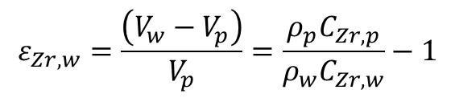
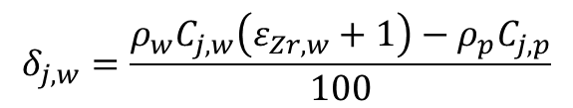
Element Mass Fluxes
Element | B1 avg | B2 avg | MFP | B1/MFP | B2/MFP | B1/B2
Zr91 | 37283.59 | 28149.40 | 4101.97 | 9.09 | 6.86 | 1.32
$$ε_{Zr,w}=\frac{\left(V_{w}−V_{p}\right)}{V_{p}}=\frac{ρ_{p}C_{Zr,p}}{ρ_{w}C_{Zr,w}}−1$$
$$δ_{j,w}=\frac{ρ_{w}C_{j,w}\left(ε_{Zr,w}+1\right)−ρ_{p}C_{j,p}}{100}$$
Brimhall et al. (1991)
B1: 85% volume removal of Mfp
B2: 80% volume removal of Mfp
Mass fluxes ≤ 0 consistent with bedrock source
Notes:
If we look first at the concentration of zirconium in the samples it’s evident that B1 and B2 have very high levels from concentration of Zr through weathering. (Point out ratios, 9:1 and 6.8:1 respectively for B1 and B2.
Element mass fluxes for the samples were calculated following Brimhall et al. (1991)’s methods and equations.
First, the volume change during weathering was calculated using the strain eq. from densities and from concentrations of major and trace elements normalized to zirconium, which was assumed to be immobile.
We find from volume strain calculations using Zr as the index element, that weathering of Mfp to form B1 would require ~85% volume removal and to form B2 ~80% volume removal.
Mass fluxes were calculated using the calculated volume change during weathering as an input as well as densities and concnetrations, using the second equation for each element.
Mass fluxes for all elements are negative except for Nb (because like Zr, it’s perfectly immobile), consistent with soil formation by weathering of Mfp.
Looking back at the Zr concentrations, these levels suggest the presence of zircon…..

Slide 11
Zircon!
Standard mineral separation procedures to concentrate heavy minerals
BSE and CL imaging of zircon on SEM
Trace elements and U-Pb dating of zircon using LA-ICP-MS with 20 μm spot size
Construction of age spectra for each sample
B1
B2
Mfp
Notes:
-Majority of rock sample and soil samples each processed using standard mineral separation procedures to concentrate heavy minerals
-Zircon and/or monazite (though monazite not identified for this specific soil/bedrock pair) handpicked from each sample and placed into 1” epoxy mounts
-1” grain mounts imaged on SEM to collect BSE and CL images prior to U-Pb analyses
-Based on SEM imaging, U-Pb ages measured from 20 um spots with Perkin Elmer Alan 6100 ICP-MS with a New Wave 213 nm laser due to limitations from size of a majority of zircons in the Mfp mount
CL Images. Left to Right, B1, B2, Mfp

Slide 12
Zircon Trace Elements
Notes:
Basically explain that we did look at trace elements for Zircon. Had issue with Hf detection so no Hf, Th/U vs Ce/Nb, U vs Yb (second slide) and U/Yb vs Y (3rd slide), none of them really show any discernible differences between samples.

Slide 13
Zircon Trace Elements
Notes:
Basically explain that we did look at trace elements for Zircon. Had issue with Hf detection so no Hf, Th/U vs Ce/Nb, U vs Yb (second slide) and U/Yb vs Y (3rd slide), none of them really show any discernible differences between samples. While these aren’t very effective for discriminating sources of parent materials, U-Pb analyses are.

Slide 14
Zircon U-Pb
Notes:
-This is a cumulative probability plot of 206Pb to 238U ratios from all of our analyses of zircon.
-We determined several of the zircon in each sample were discordant, and have low ratios of 206Pb to 238U due to lead loss.
-It’s difficult to interpret the data plotted as they are now, but if we remove the discordant zircon we get slightly better results…

Slide 15
Age Spectra
Notes:
-Here is another cumulative probability plot, this time with zircon 206Pb/238U ages except for zircon with ages > 1000 Ma (which are 207Pb/206Pb ages)
(Normalized distribution=why peak looks like it’s at 250 when it’s really at 300-something) constructed following Soreghan et al. (2002)
-Due to the error associated with these measurements we can’t use these as absolute ages but we can compare the age distributions of each of the samples to determine if the bedrock could be the sole contributor of parent material to the soils (Some discordant may remain, but we don’t think that these are causing the differences in the locations of the peaks around 250-300 and 500Ma)
-Peak in B1 suggests a source other than bedrock, could potentially be loess or alluvium.
-The peak in B2 and the smaller peak in B1 are both similar to the peak in Mfp, which suggests that weathering of the Mfp bedrock does contribute to soils on the terrace

Slide 16
Trace Element Ratios and Element Mass Fluxes vs. U-Pb Analyses
Bulk immobile trace element ratios:
Similar origins for B1 and B2
Lack of similarity of overlying soils to Mfp
Element Mass Fluxes
Consistent with derivation of B1 and B2 from Mfp
Zircon U-Pb analyses:
Input of outside source for B1?
Some component of Mfp in B1 and B2?
Soils atop Mfp formed from insoluble residue?
Other potential end-member parent materials
Loess (Peoria)
Alluvium
Notes:
-The Bulk immobile trace element concentration ratios and mass fluxes, and the U-Pb analyses suggest two different stories for the origin of the B1 and B2 soils.
-The trace element ratios for the bulk samples seem to suggest that B1 and B2 share the same parent material, and that both are different in composition from Mfp.
-The Mass fluxes suggest that there was just one homogenous parent for the soil.
-The zircon analyses also suggest that B2 and to a lesser degree, B1, both have some component from the Mfp bedrock.
-However, from our U-Pb analyses of zircon, there is a definite source for B1 that does not seem to be present in B2, and does not match with the bedrock. More zircon from each sample are needed to see if this peak around 1 Ga is something real.
-Other potential sources of parent material are Peoria loess from Miss. R. Valley (B1) and alluvium from the Harpeth River (B2), which we have yet to analyze.

Slide 17
Future Work
Future analyses to be conducted on Thermo iCAP Qc ICP‐MS with 193nm excimer laser
Limestone soil/bedrock pair and potential end-member parent materials
Larger populations of zircon
Addition of monazite U-Th-Pb ages?
Notes:
-These results comprise small part of larger study for my Master’s Thesis testing this approach to soil provenance to examine how soils at different locations in the region form.
-We had hoped to use our department’s brand new quadrupole ICPMS but it was not calibrated in time to do our analyses ahead of GSA (Thermo iCAP Qc ICP‐MS with Photon Machines Excite 193nm excimer laser ablation).
-This new instrument will return more precise data than what we have now and will allow us to better address any discordant zircon, either by getting better 207Pb/206Pb ages, or by just aiding in identifying them so that we may remove them from spectra
-We will also be collecting at least 1 additional soil-bedrock pair, one that features soils atop Middle Ordovician Limestone, and will collect samples of Peoria Loess from the bluffs of West TN, and Harpeth River alluvium for analysis
-We had hoped to find monazite as well within the samples presented today but were unsuccessful, however preliminary work elsewhere in soils atop Middle Ordovician bedrock in this region has found monazite in soils. The shaly nature of the Middle Ord. limestone in the region makes it highly likely for monazite to be present.
-We plan to analyze at least 100 or more zircon per sample and the same number of monazite, if present, for all future samples, and will reanalyze the samples presented today.

Slide 18
Potential Implications
Use of zircon and potentially monazite for soil provenance in regions with limestone bedrock
Potentially, Peoria loess presence further south and east than previously documented
Possibility of tracing zircon in bedrock to sources of clastic input at time of deposition
Notes:
1. If we are able to reconcile zircon U-Pb ages after further analyses, this will mark only the second study that we know of to use zircon U-Pb geochronology for modern soil provenance and if monazite is present, this will be the first study to utilize it for these purposes.
2. We hope to eventually be able to show that zircon and monazite are useful provenance indicators in modern soils for regions with limestone bedrock.
3. If we find that loess is a contributing input for soils along the Harpeth or elsewhere in Middle Tennessee, this will be concrete evidence for the presence of Peoria loess further South and East than previously documented
4. Zircon or potentially monazite within the bedrock may be traced using their ages back to potential source terranes that contributed the zircon during the formation of the limestone to determine sources of clastic inputs during the Middle Ordovician and Early Missippian

Slide 19
Acknowledgements
GSA Southeastern Section Graduate Research Grant
Assistance from Vanderbilt EES students and faculty, especially Aaron Covey, Susanne McDowell, Abraham Padilla, and Tamara Carley
High school student collaborator, Camille Lasley

Slide 20
Works Cited
Brimhall, G.H., Lewis, C.J., Compston, W., Williams, I.S., and Reinfrank, R.F., 1994, Darwinian zircons as provenance tracers of dust-size exotic components in laterites: mass balance and SHRIMP ion microprobe results, in Ringrose-Voase, A.J., and Humphreys, G.S., eds., Soil Micromorphology: Studies in Management and Genesis: Amsterdam, Elsevier, Developments in Soil Science, v. 22, p. 65-81.
Huckemeyer, J.L., 1999, Late Quaternary Alluvial Stratigraphy and Soil Development Along the Harpeth River, Central Tennessee: Nashville, TN, Vanderbilt University Press, 192 p.
NRCS, 2012, Gridded Soil Survey Geographic (gSSURGO) Database for Tennessee: United States Department of Agriculture, National Resources Conservation Council. Available at: http://datagateway.nrcs.usda.gov (Accessed March, 2013).
Wilson, C.W., 1990, The Geology of Nashville, TN: Nashville, TN, State of Tennessee, Dept. of Environment and Conservation, Division of Geology, 172 p.

Slide 21
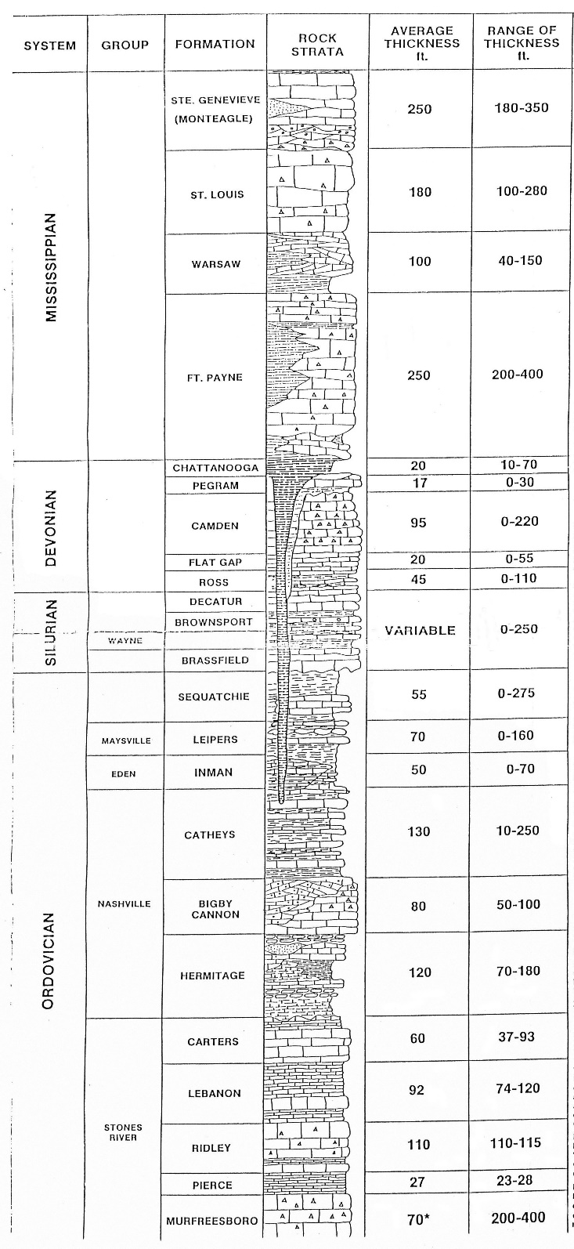
Notes:
Supplemental figure depicting Middle TN stratigraphy (Wilson, 1990)

