Slide 1
FACTORS INFLUENCING THE SUCCESS AND GROWTH OF THE DUAL-CREDIT PHYSICAL GEOLOGY PROGRAM IN MICHIGAN
Steve Mattox, Grand Valley State University, Allendale, MI, mattoxs@gvsu.edu,
Sandi Rutherford, University of Wisconsin-Madison, Madison, WI, srutherford@wisc.edu, and
Chris Bolhuis, Hudsonville High School,
Hudsonville, MI, cbolhuis@hpseagles.net

Slide 2
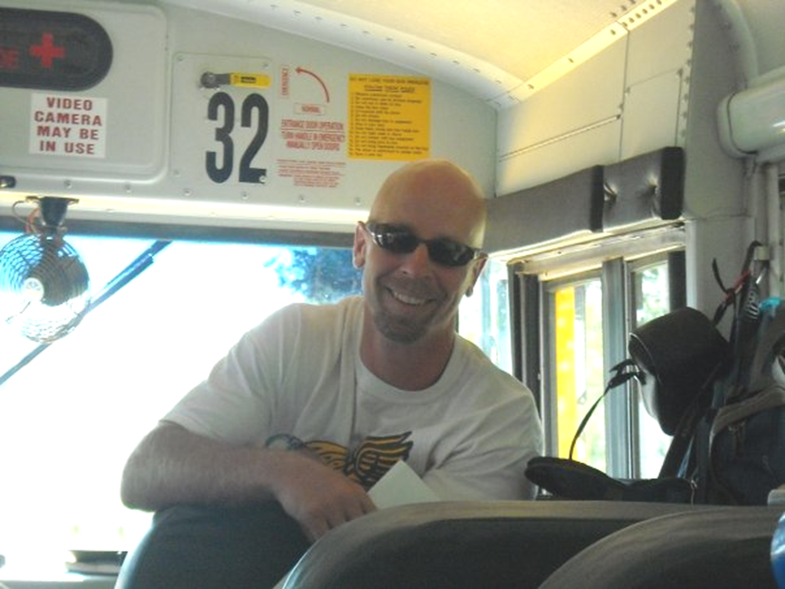
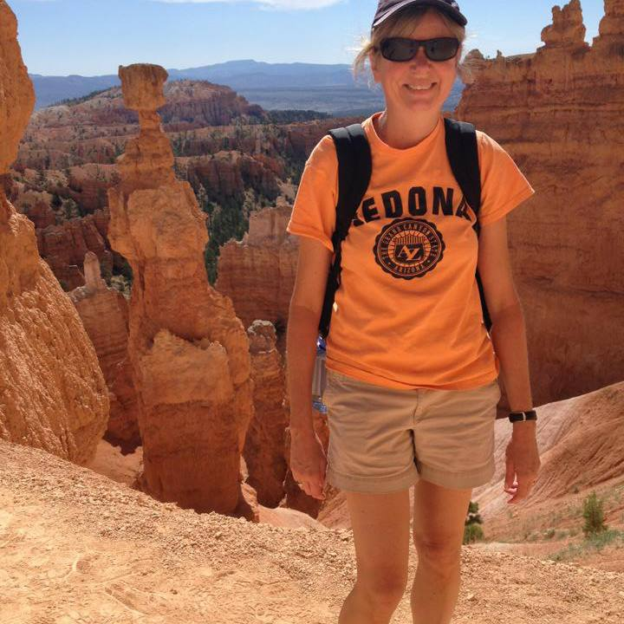
Early History

Slide 3
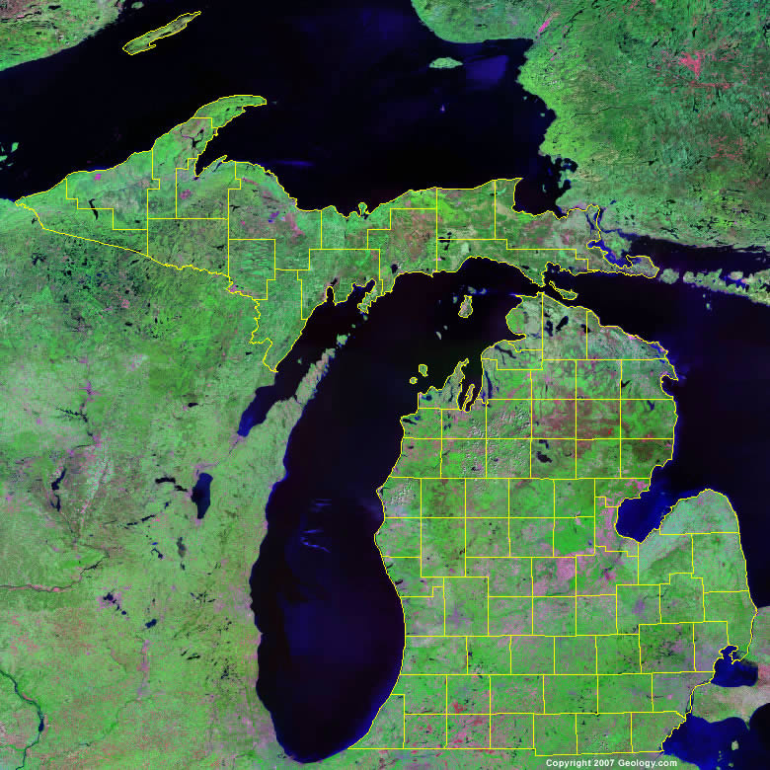

Planning Grant
University
partners
Notes:
Add stars

Slide 4
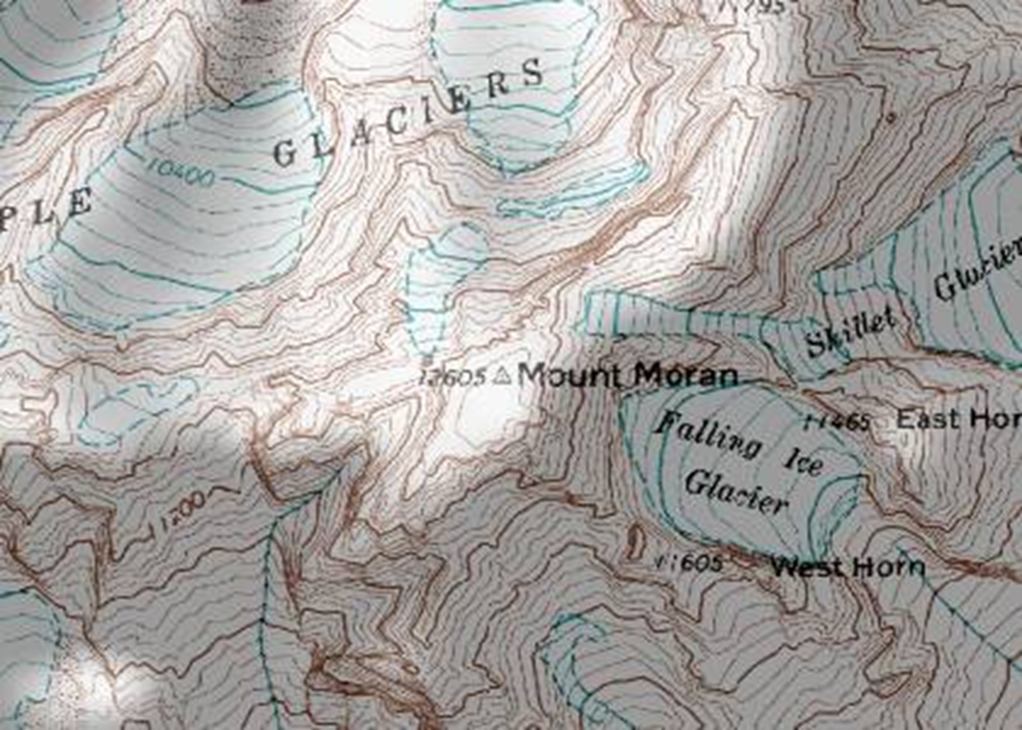
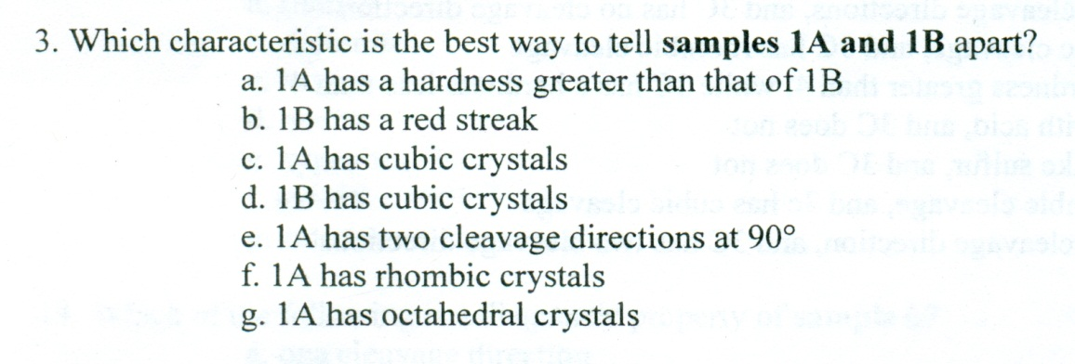
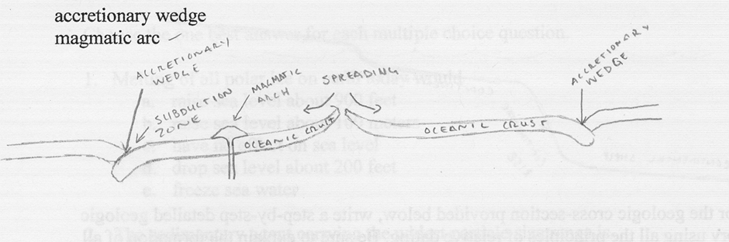
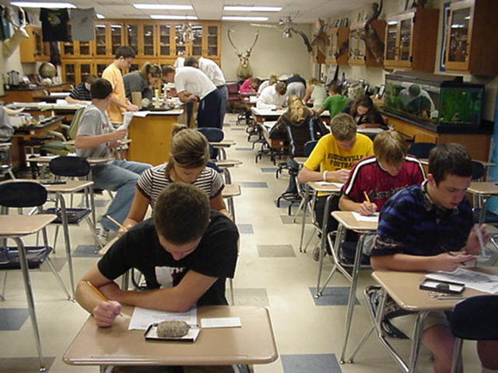
the test
Notes:
Scan newer questions

Slide 5
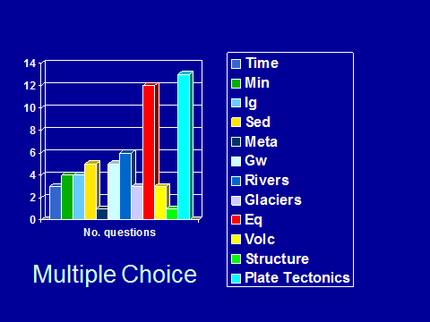

Slide 6
Students Taking Test (early years)
 | # taking | # passing | % passing
2008 | 47 | 41 | 87%
2007 | 30 | 27 | 90%
2006 | 39 | 34 | 87%
2005 | 25 | 24 | 96%
2004 | 38 | 38 | 100%
2002 | 16 | 7 | 50%
2001 | 6 | 4 | 66%
total | 201 | 175 | 87%

Slide 7


OEDG Grant
Notes:
Opportunities for Enhancing Diversity in the Geosciences (OEDG)

Slide 8

Talks at MESTA, MDSTA, MSTA, regional GSA, ILSG
District science coordinators
RMSC newsletters

Slide 9
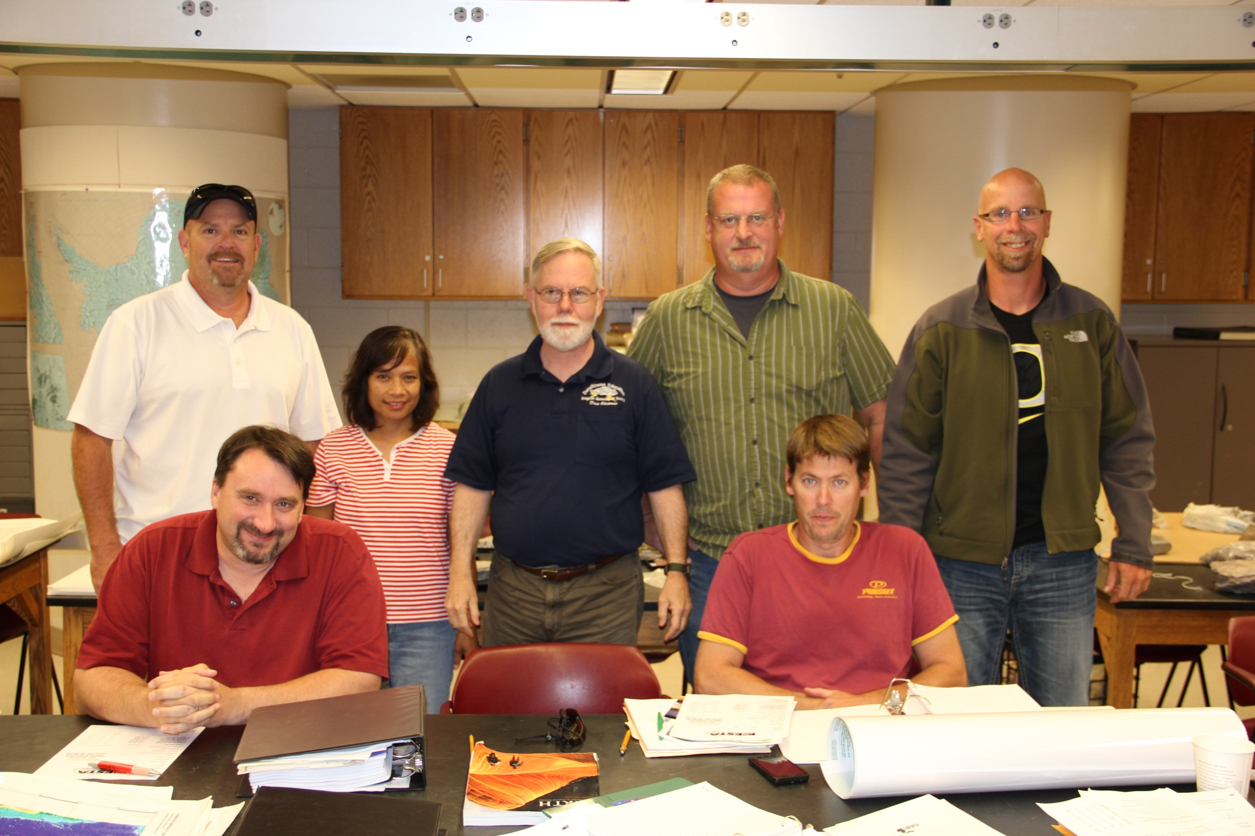
+3
Notes:
Plus Brett Bittrick and Lisa Bouda and Sue Ransom…Maybe Gary Gerson

Slide 10
Students Taking Test
 | # taking test | # passing | % passing
2013 (6) | 91 | 59 | 65%
2012 (4) | 84 | 47 | 56%
2011 (2) | 65 | 44 | 64%
2010 (2) | 83 | 42 | 50%
2009 (2) | 87 | 37 | 42%
total | 410 | 229 | 56%

Slide 11
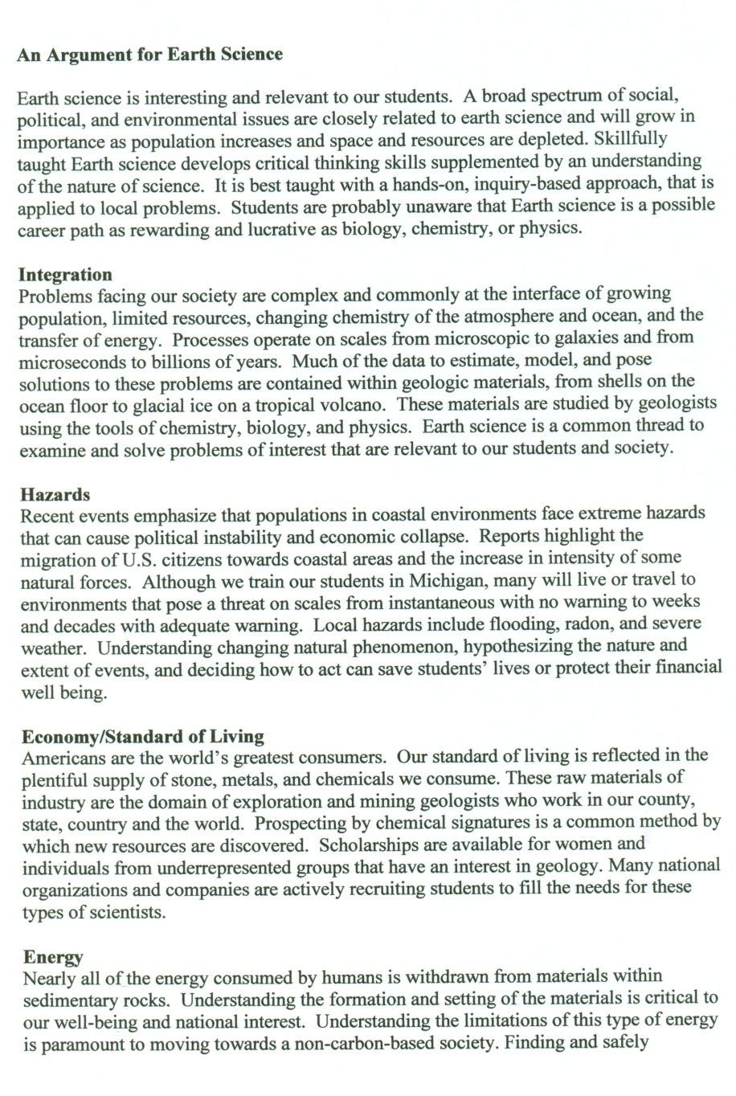

Inform & Recruit

Slide 12
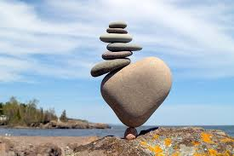
Finding the Right Balance
Certified in Earth science
Diverse students
Supportive administration, peers
University support
Financial support

Slide 13
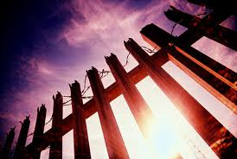
Barriers
Lack of certified Earth science teachers
Geology as a lesser science
Peers
Course proposals, enrollments
Waiting for NGSS
Enrollment

Slide 14

Teacher Support
Professional Development
Lab materials
Study Guides
Grant writing
Letters to administrators

Slide 15
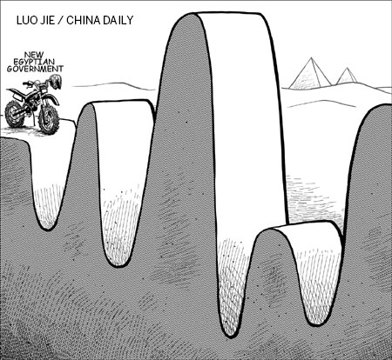
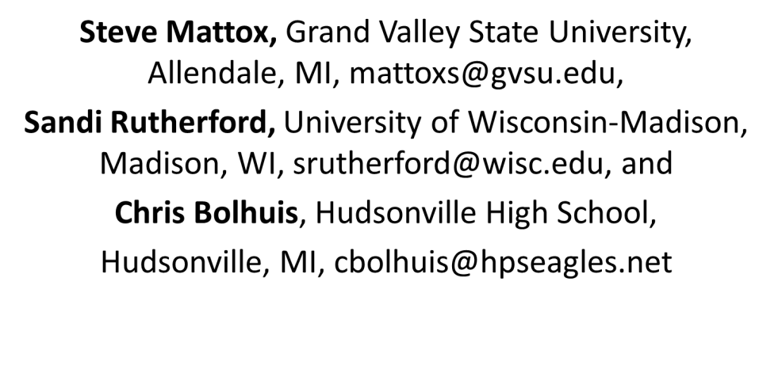
Challenges
Finding diverse schools
Charge a fee? vs.
sponsor
Go electronic?
Xxxxxxxxxxx
xxxxxxxxxxxx

