Slide 1
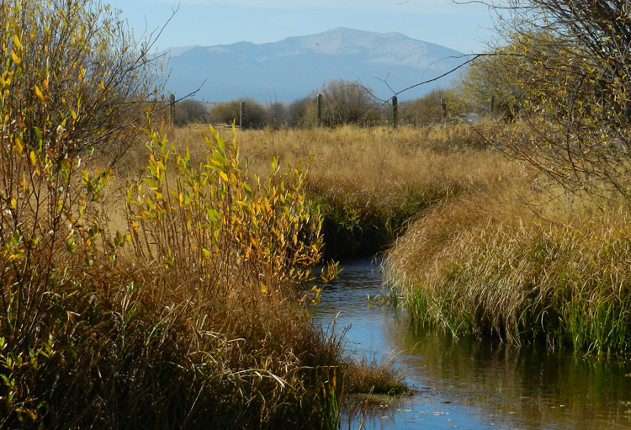


FLUVIAL ARCTIC GRAYLING HABITAT RESTORATION AND ASSESSMENT OF ROCK CREEK, UPPER BIG HOLE RIVER DRAINAGE, SOUTHWEST MONTANA
Mishella J. Craddock and Robert C. Thomas
Department of Environmental Sciences
The University of Montana Western r_thomas@umwestern.edu

Slide 2

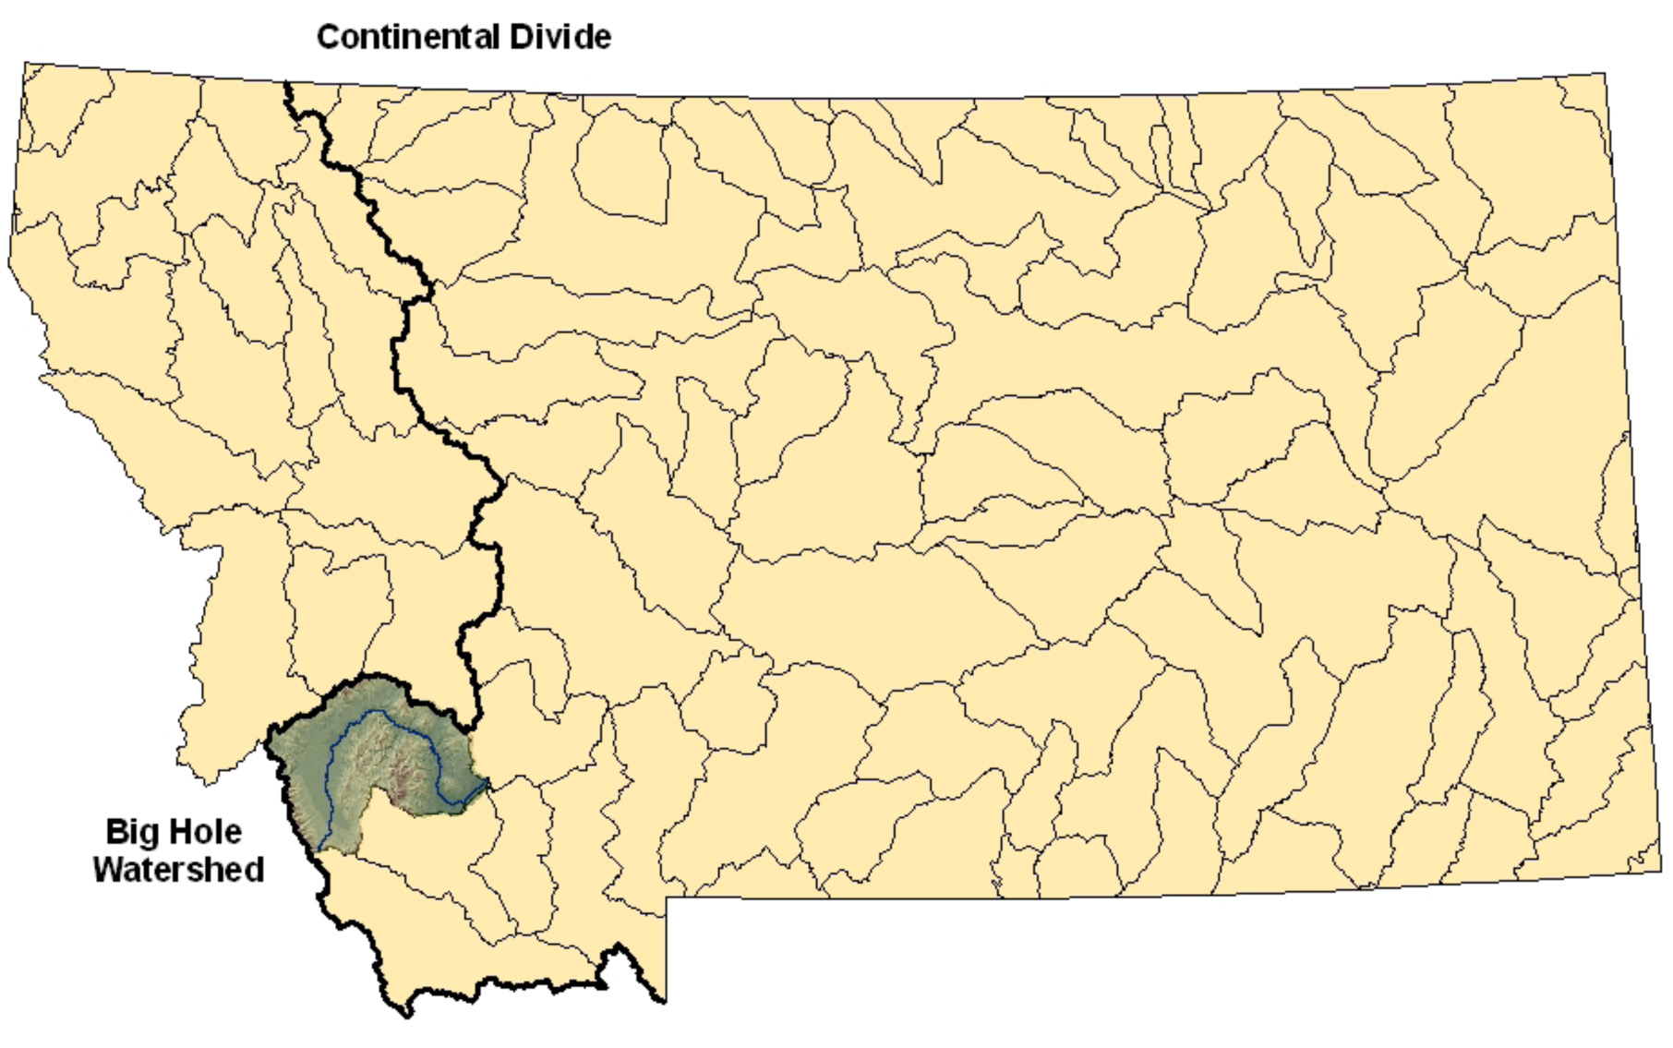
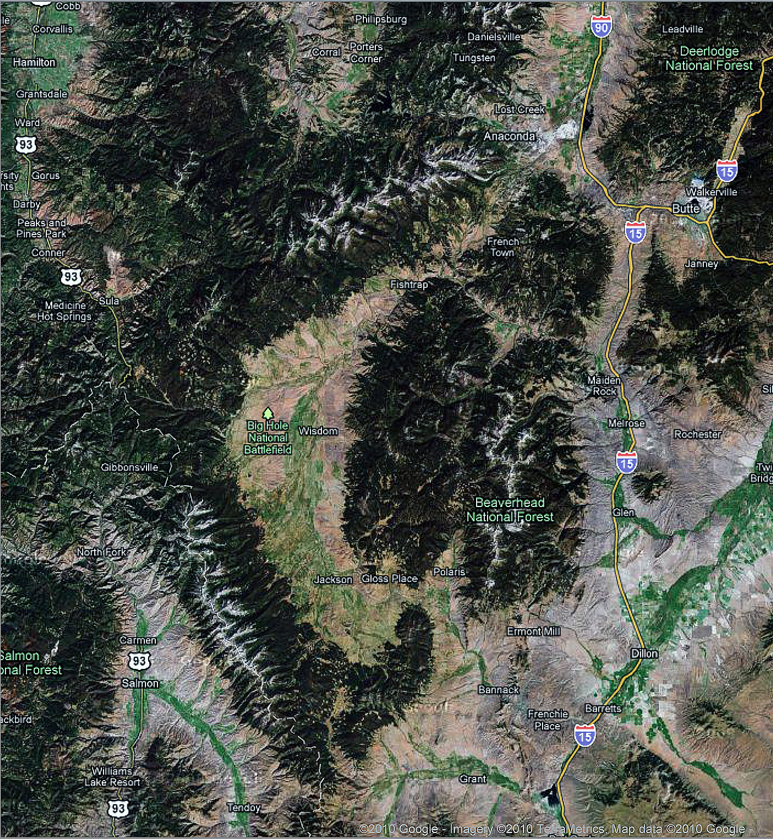
THE BIG HOLE RIVER WATERSHED
Courtesy of USF&WS
A tributary of the Jefferson River that is 153 miles (246 km) long
Contains the last population of native fluvial Arctic grayling in the contiguous U.S.
The upper Big Hole River is a low-gradient stream that flows on outwash in an active graben at an elevation of over 6,000’
Google Earth, 2010

Slide 3
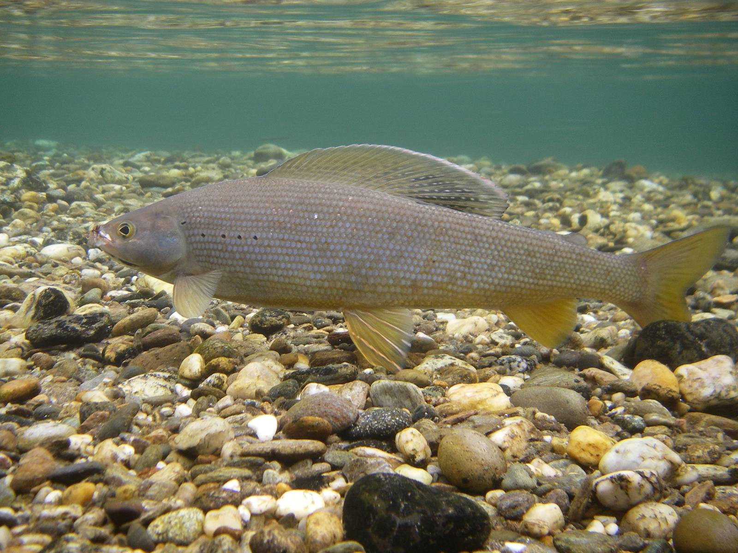
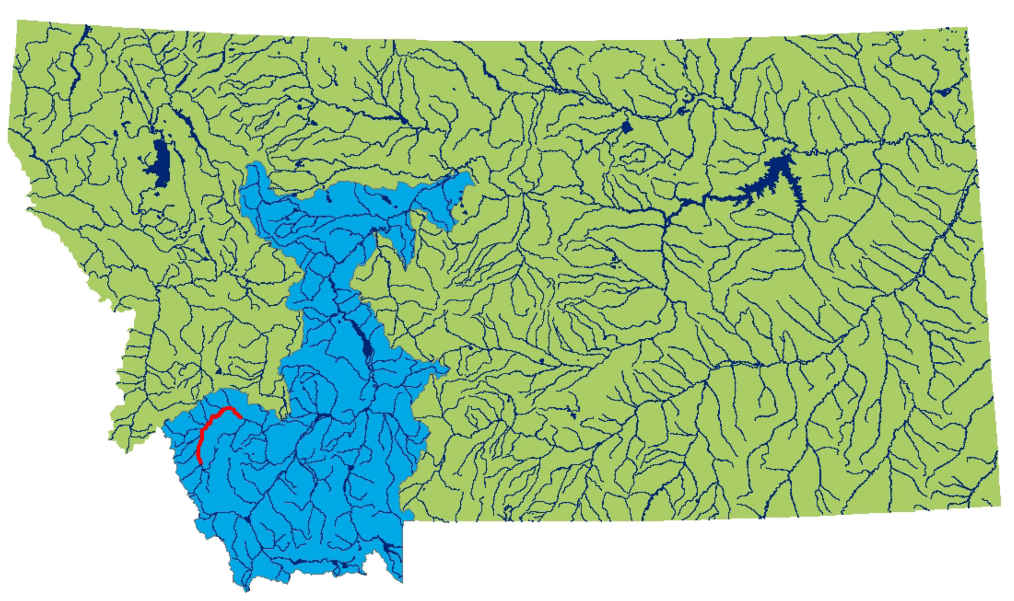
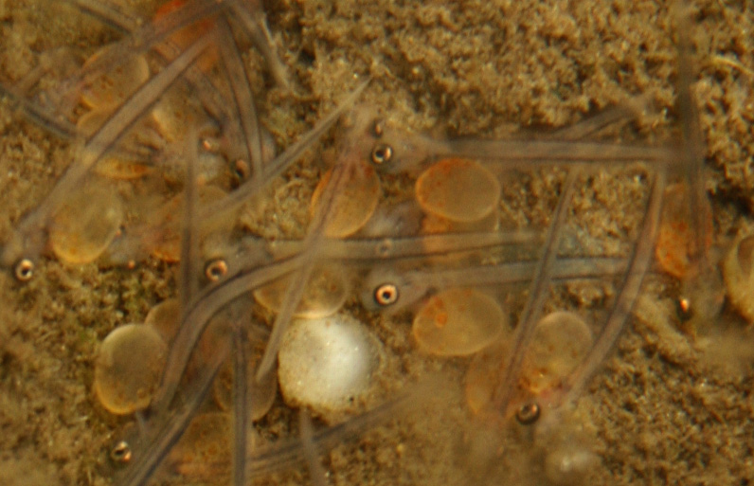
FLUVIAL ARCTIC GRAYLING
(Thymallus arcticus)
Member of family Salmonidae that originally occupied most of the upper Missouri River drainage
Live ~5 years and can reproduce in 3 to 4 years
Travel up to 50 miles in main stem channels to tributaries in the spring to broadcast spawn
Eggs are porous and sensitive to siltation
Emergent fry live in low-velocity environments protected by overhanging willow
Temperature-sensitive with 100% death at 77⁰ F
~1000 grayling remain in the upper Big Hole River drainage. Courtesy of USF&WS

Slide 4
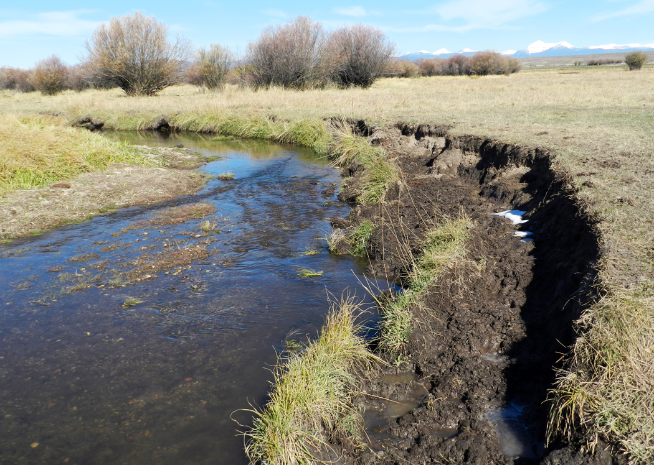
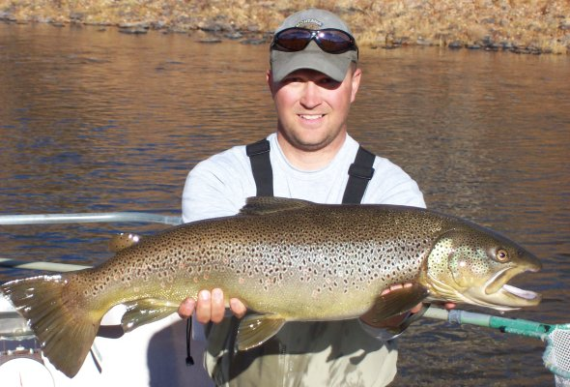
PRIMARY IMPACTS
Impacts related to ranch activities:
          Bank instability, siltation and changes in channel morphology due to overgrazing
          Human alteration of natural channels
          Human removal of bank vegetation
          Irrigation dewatering (~1000 cfs)
          Impacts related to other activities:
          Invasive species (non-native fish)
          Predation by pelicans and other species
          Increasing drought frequency and intensity

Slide 5
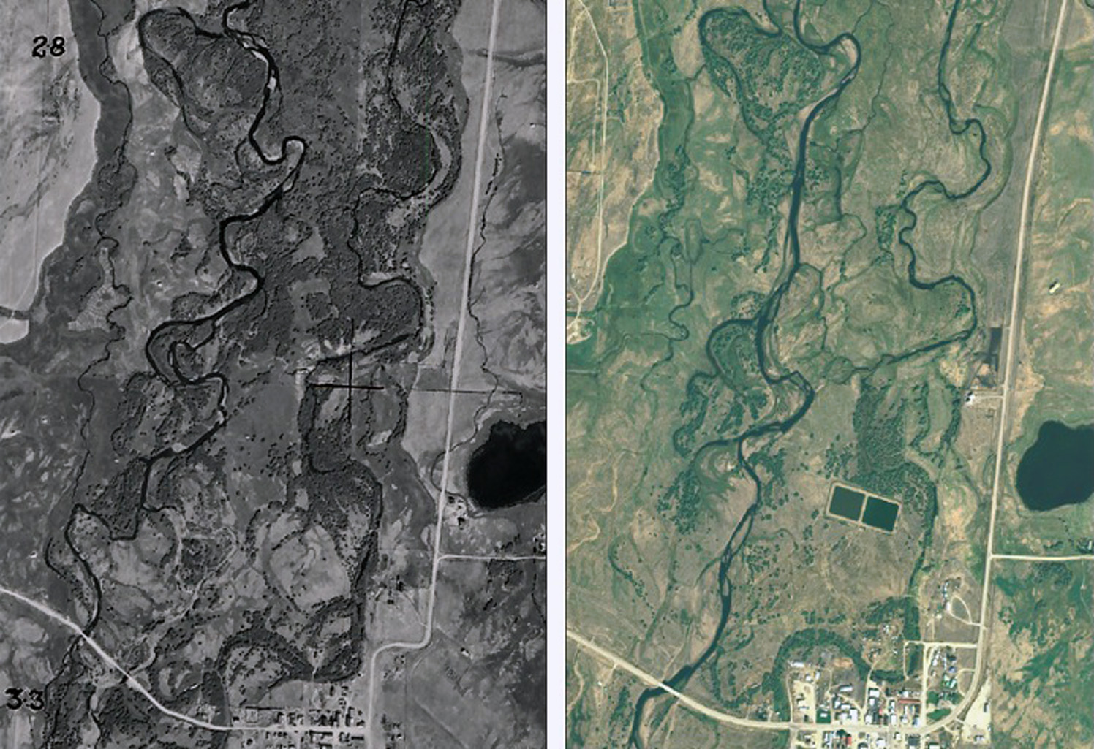
MORPHOLOGICAL CHANGE OVER TIME
1942
2005

Slide 6
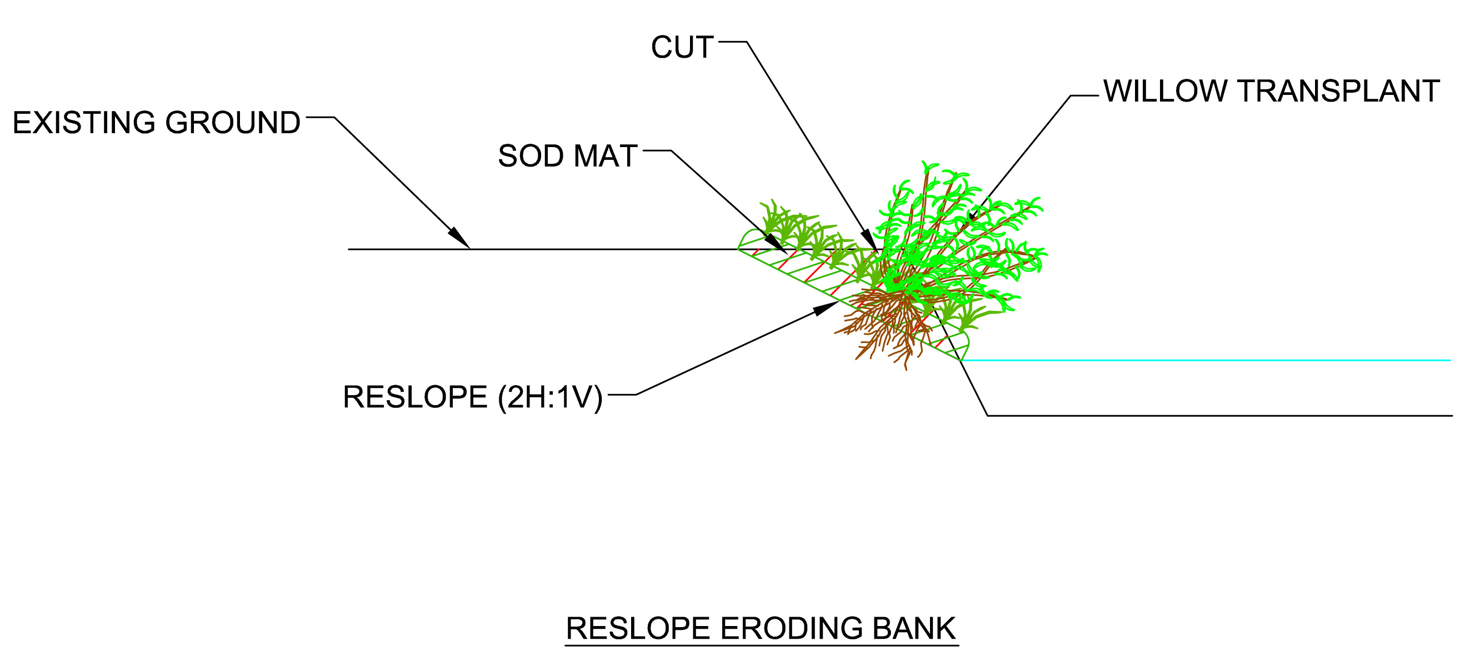
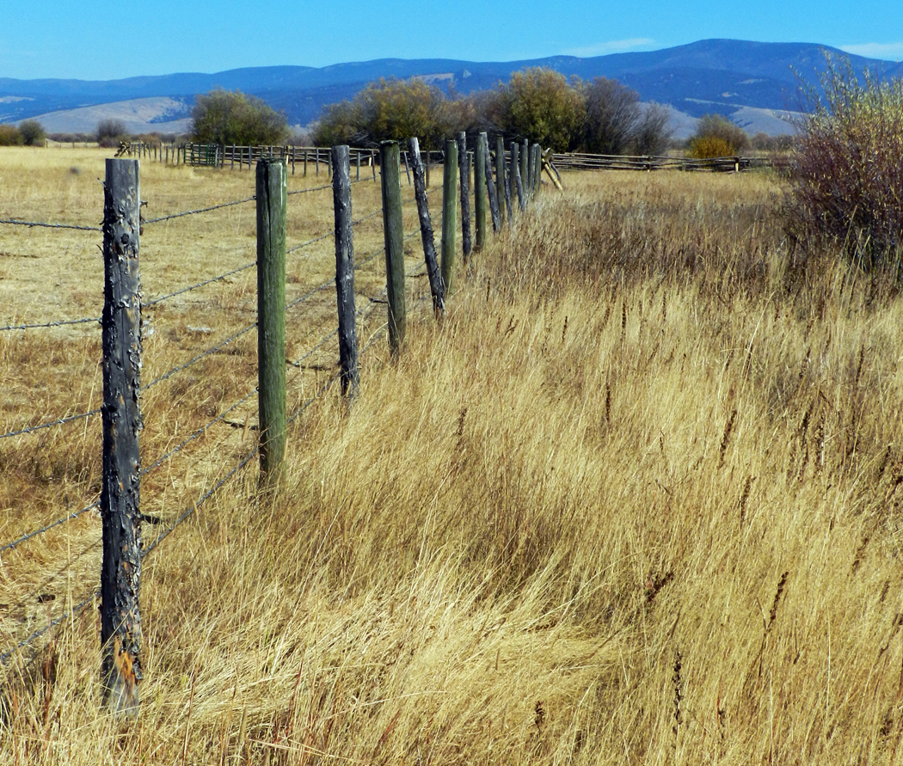
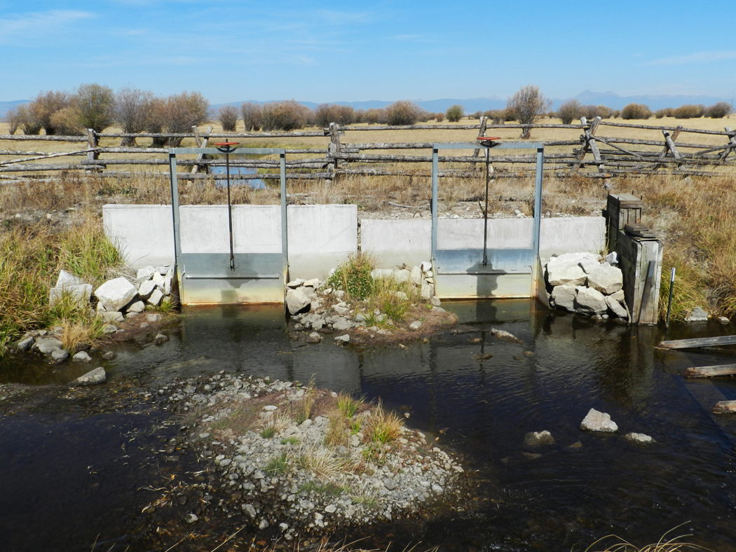
RESTORATION PROJECTS
USF&WS established a restoration agreement with landowners in 2006.
Restoration projects:
          Riparian fencing to preclude cattle for 5 years
          Mechanical reconstruction of channel segments
          Upgraded diversions to improve in-stream flows
          Planting of willows and sedge mats
Courtesy of Confluence, Inc.

Slide 7

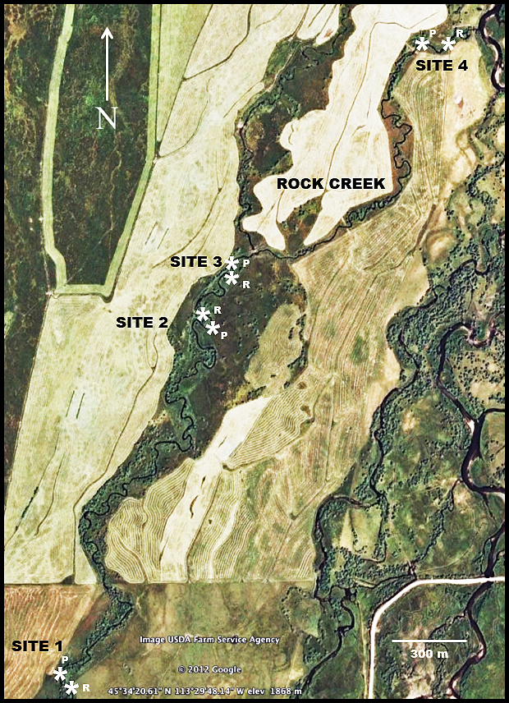
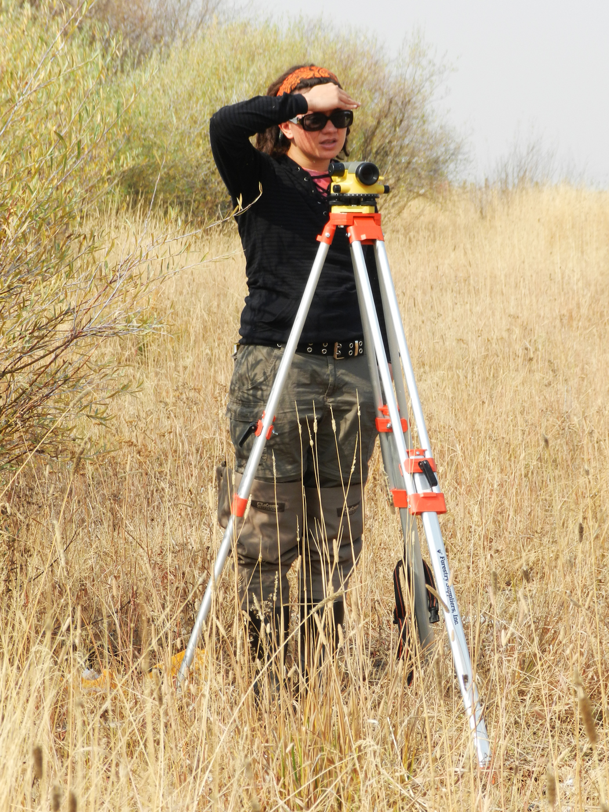
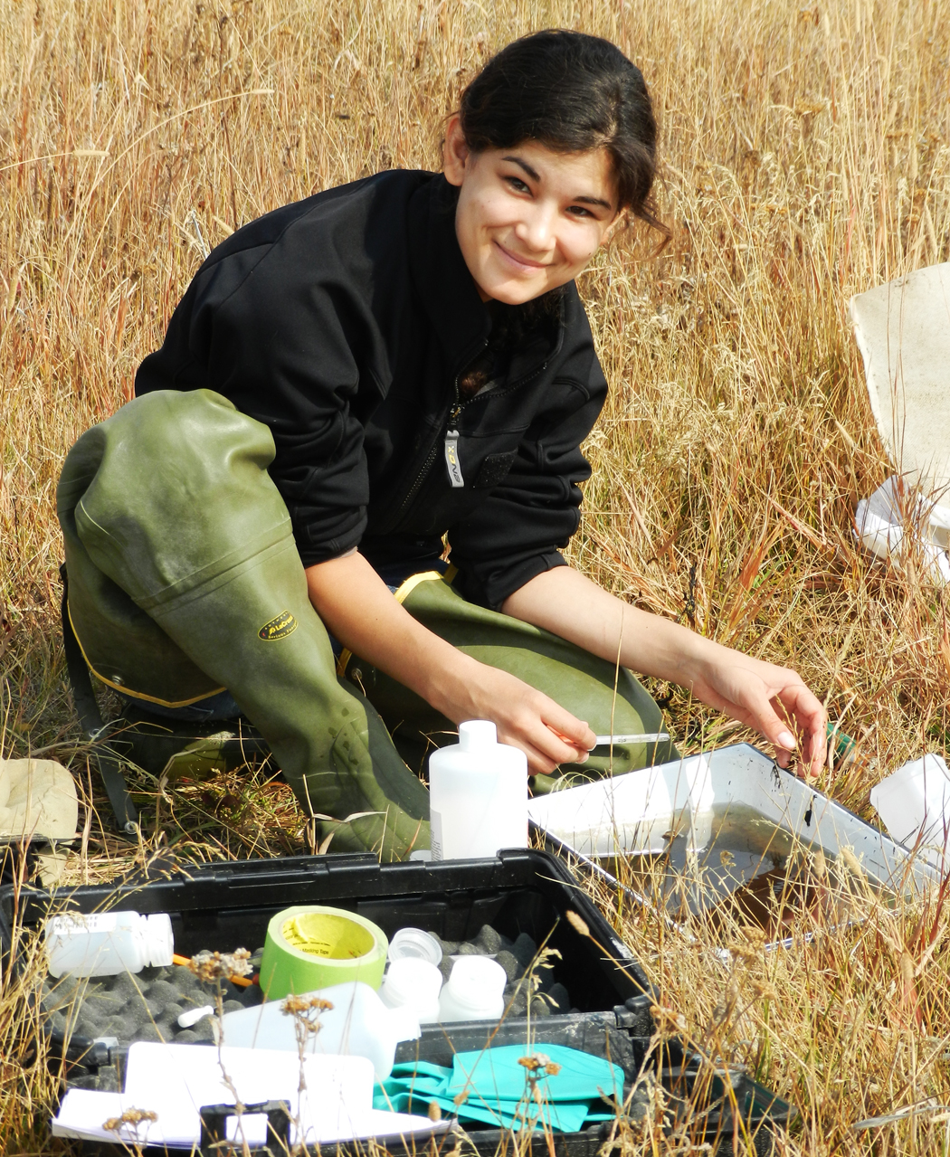
ASSESSMENT STRATEGY
Research includes:
          Stream morphology survey
          Macroinvertebrate survey
          Riparian vegetation survey
          Stream habitat survey
* Establish baseline data and monitor post-restoration changes over time: Rock Creek, Wisdom, MT

Slide 8
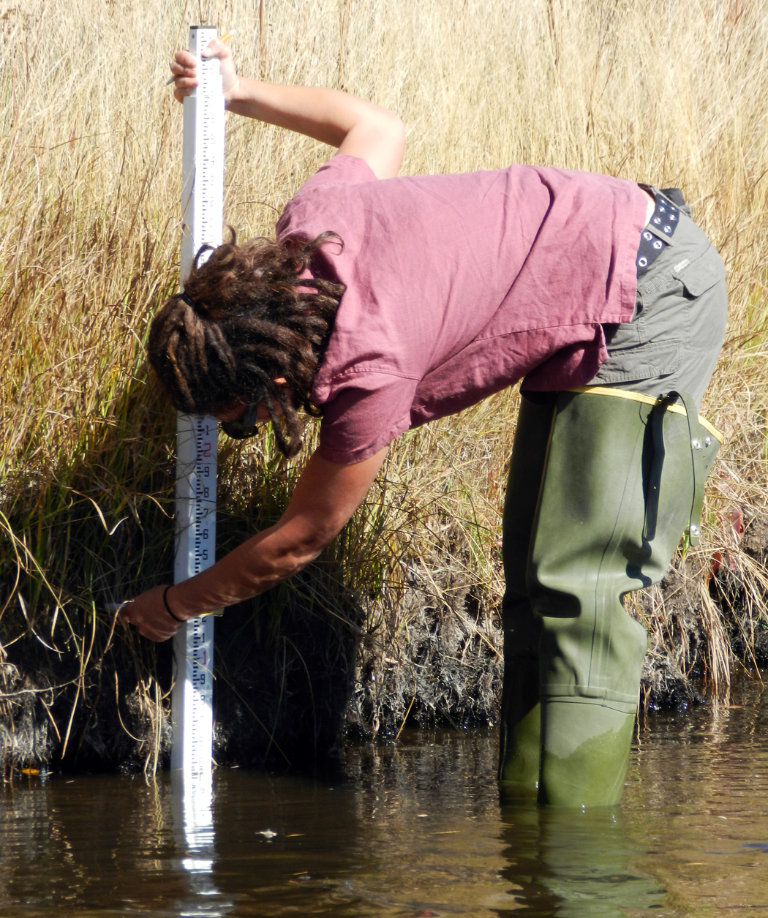
STREAM MORPHOLOGY SURVEY
          Stream Morphology Survey:
          Stream profiles
          Channel width/depth ratios
          Gradient and sinuosity
          Pebble counts
          Bank Erosional Hazard Index
          Channel narrowing and deepening

Slide 9
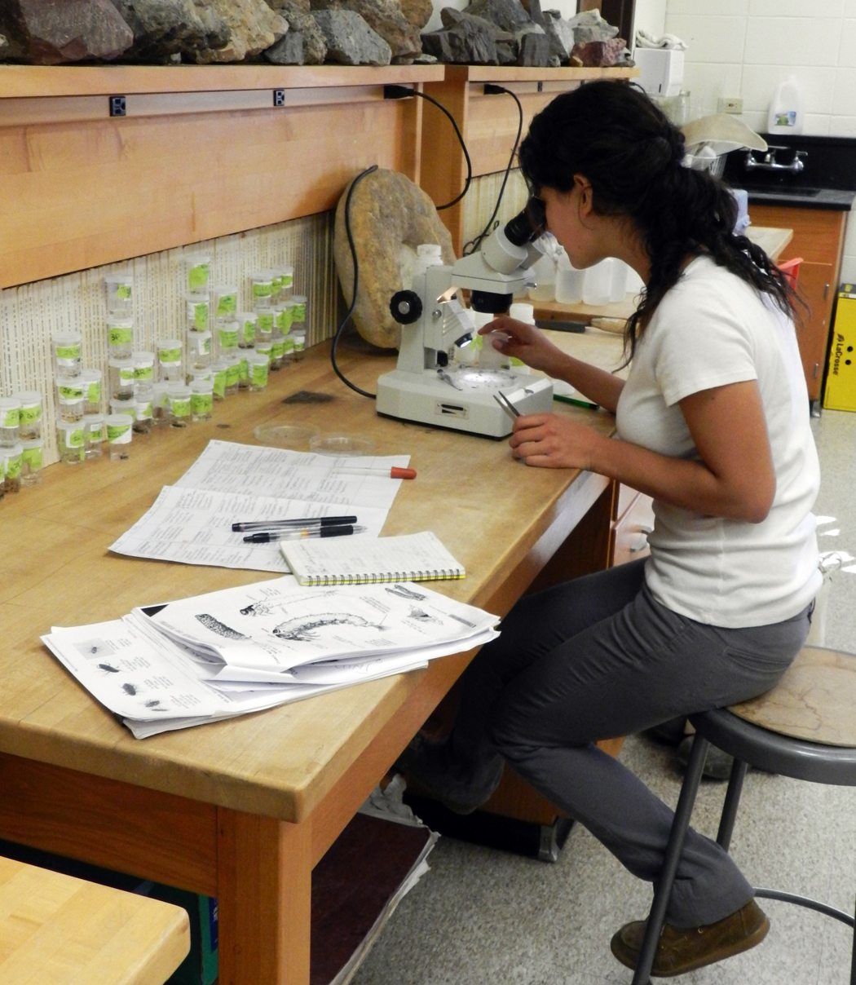
MACROINVERTEBRATE SURVEY
Macroinvertabrate Survey:
Infaunal invertebrates were sampled to determine diversity, relative abundance and total number
Simpson’s Similarity Indexes and Margalef’s Richness Indexes were calculated from the data
Simpson’s Diversity Index values for Rock Creek at each cross-section site, 2012.

Slide 10
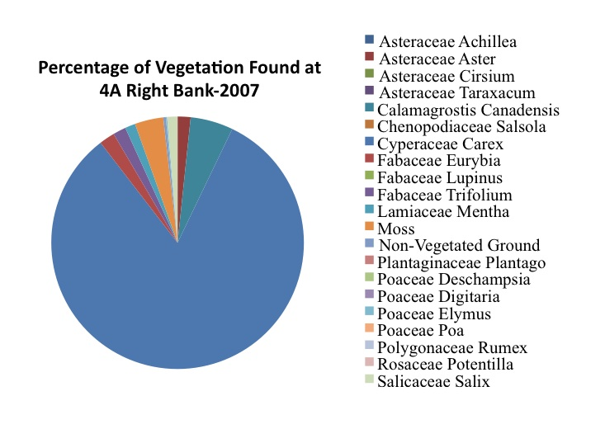
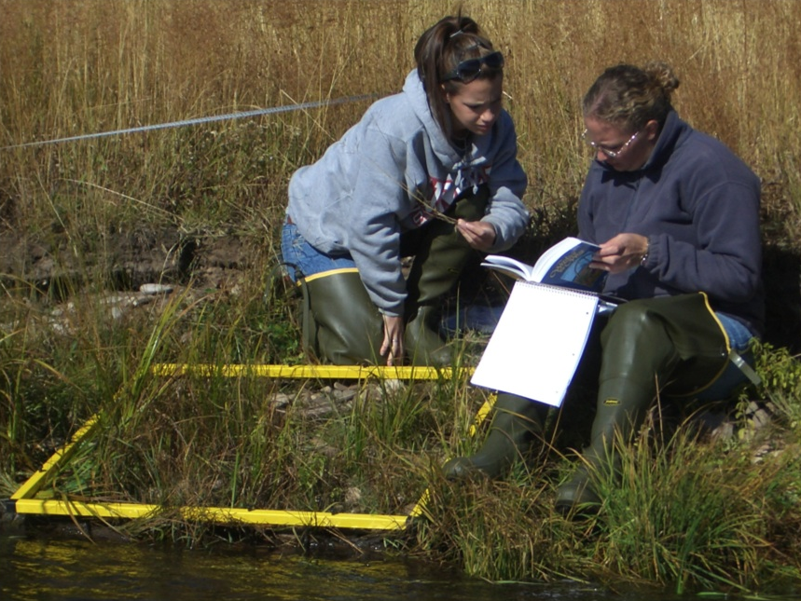
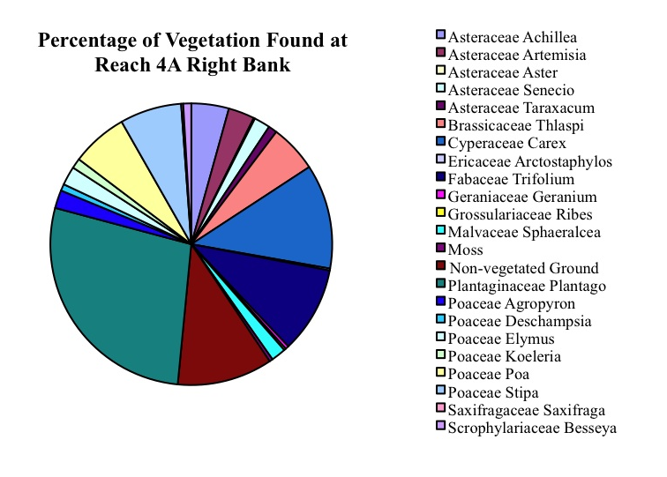
RIPARIAN VEGETATION SURVEY
Riparian Vegetation Survey:
Assessment of stream bank vegetation
Increased diversity with cattle preclusion
Increased willow and sedge/grass from 2010 to 2012 on Rock Creek

Slide 11
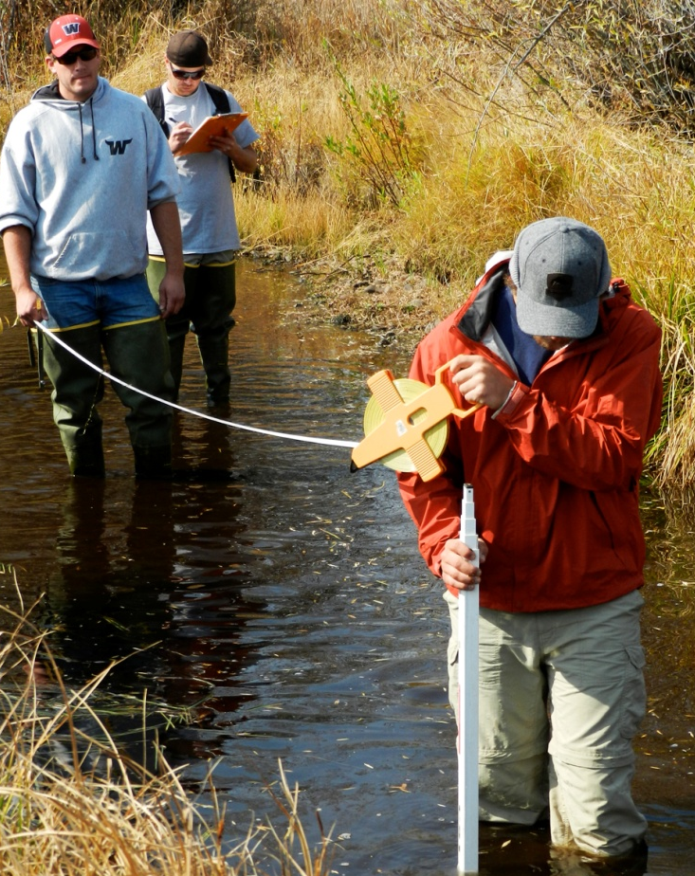
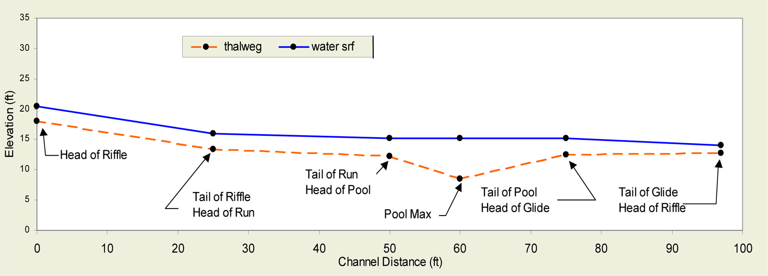
STREAM HABITAT SURVEY
Stream habitat survey:
Measuring the length, width and depth of each riffle, run, pool and
Visual estimate % of non-vegetated banks and willow cover for each riffle to glide segment
Stream habitat data show Rock Creek is narrowing with deeper pools - optimal habitat for fluvial Arctic grayling
Vegetation data show increased overhanging willow and decreased bare ground – also optimal for grayling

Slide 12
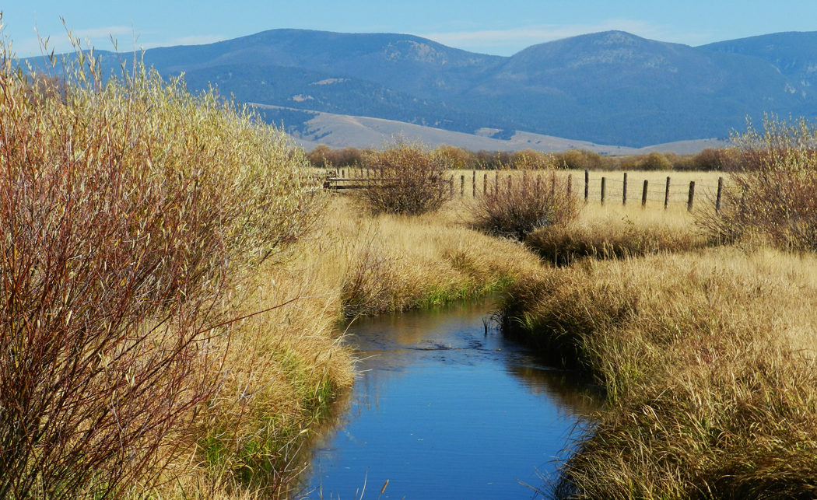
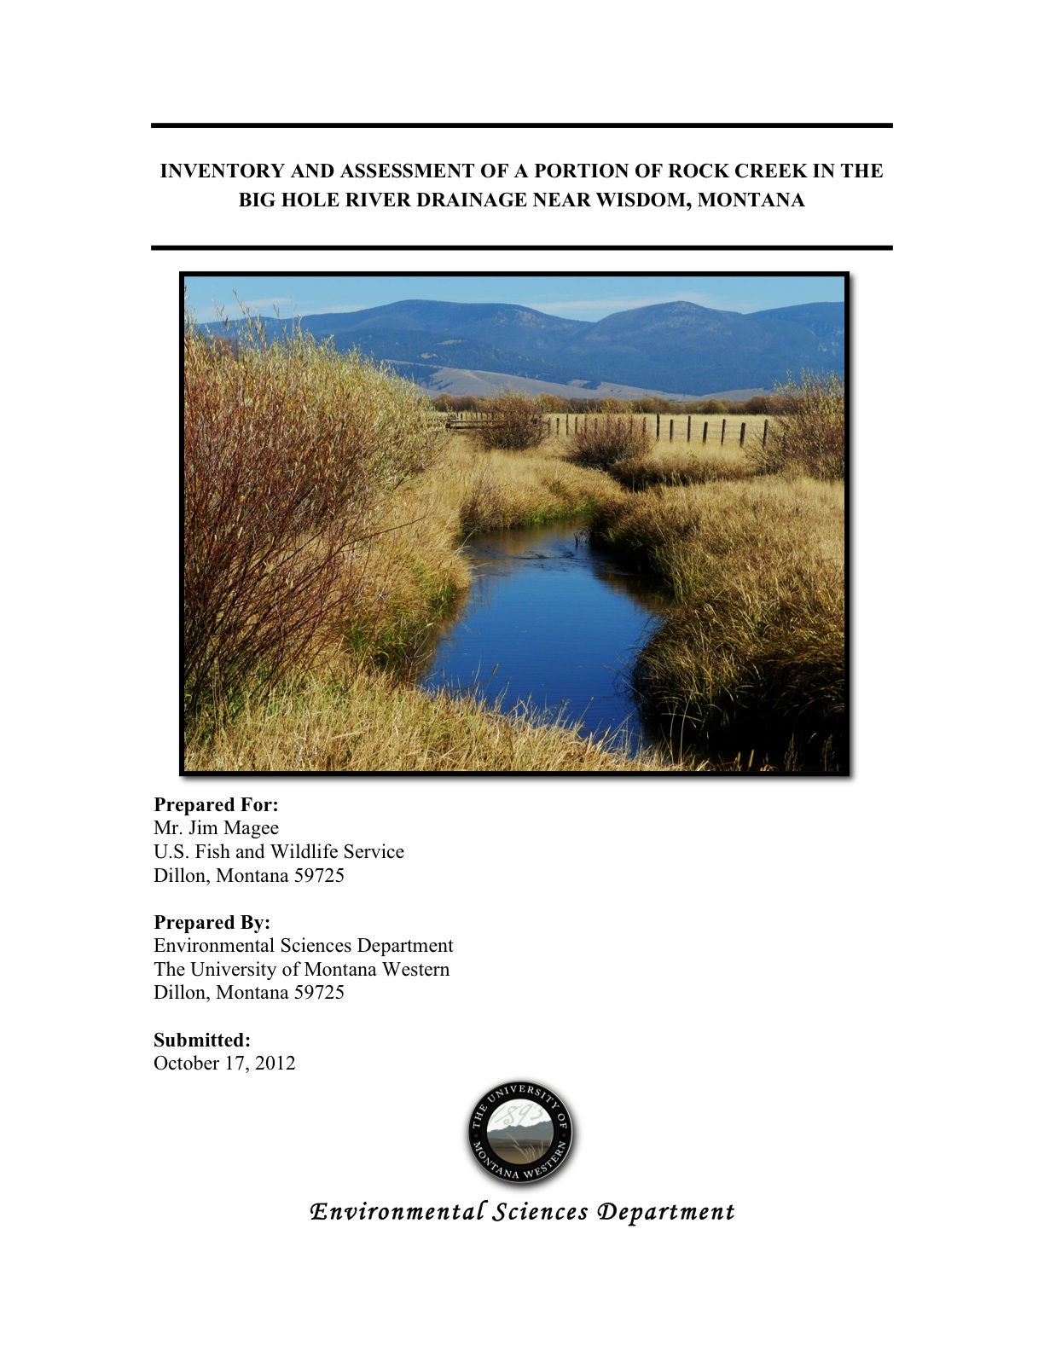
OUTCOME OF ASSESSENT

