Slide 1

Big data meets big dunes – a 21st century approach to understanding dune system dynamics on multiple spatial and temporal scales
Nick Lancaster
Desert Research Institute
Reno, Nevada

Slide 2
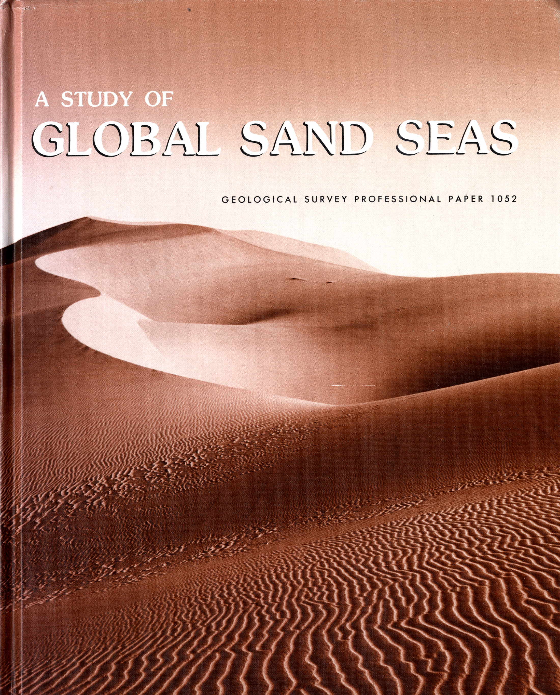
Beginning of the Modern Era
Use of satellite images to provide synoptic view
Comparisons of dune morphology in widely separated areas
Models for the relationships between dune type and wind regime

Slide 3
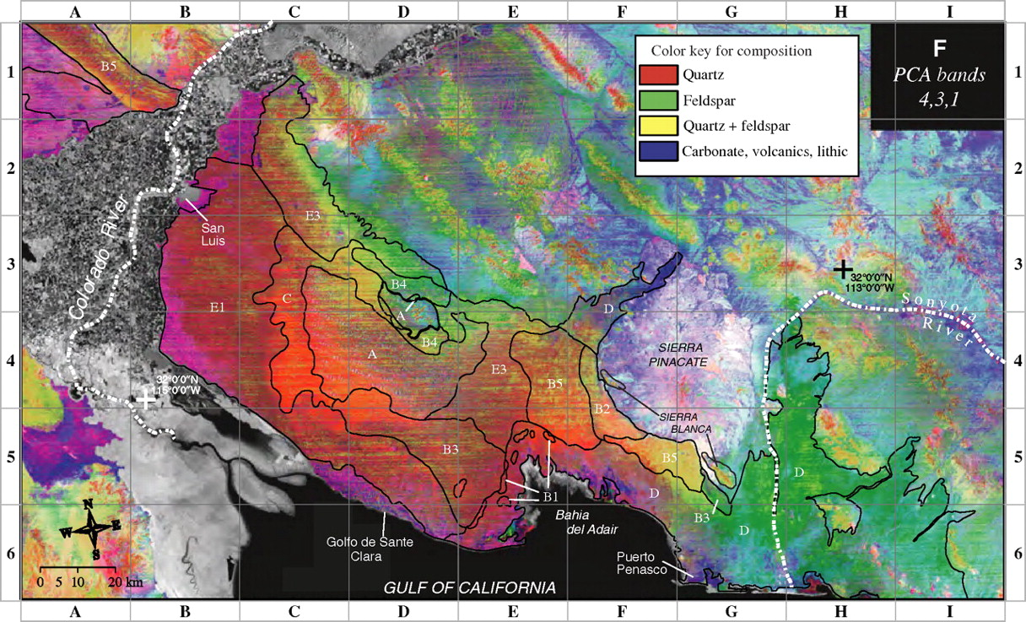
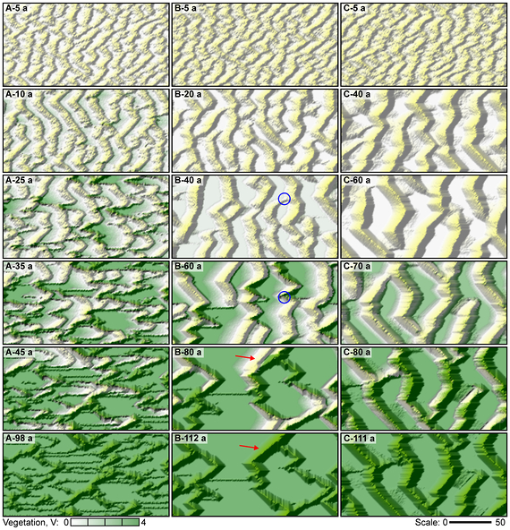
Many new data sources and approaches
Data sources
Remote sensing image data
Digital Elevation Models
Luminescence dating
Ground Penetrating Radar
Trace element geochemistry
Approaches
Statistical analysis of dune patterns
Numerical modeling of dunes and dune fields
Scheidt et al., 2011
Barchyn and Hugenholtz, 2012

Slide 4
Luminescence Dating
Revolutionized understanding of dune history and relations to climate change
Provided data on rates of processes
Total Number of Sites with data = 1082
Comprising 3556 ages

Slide 5
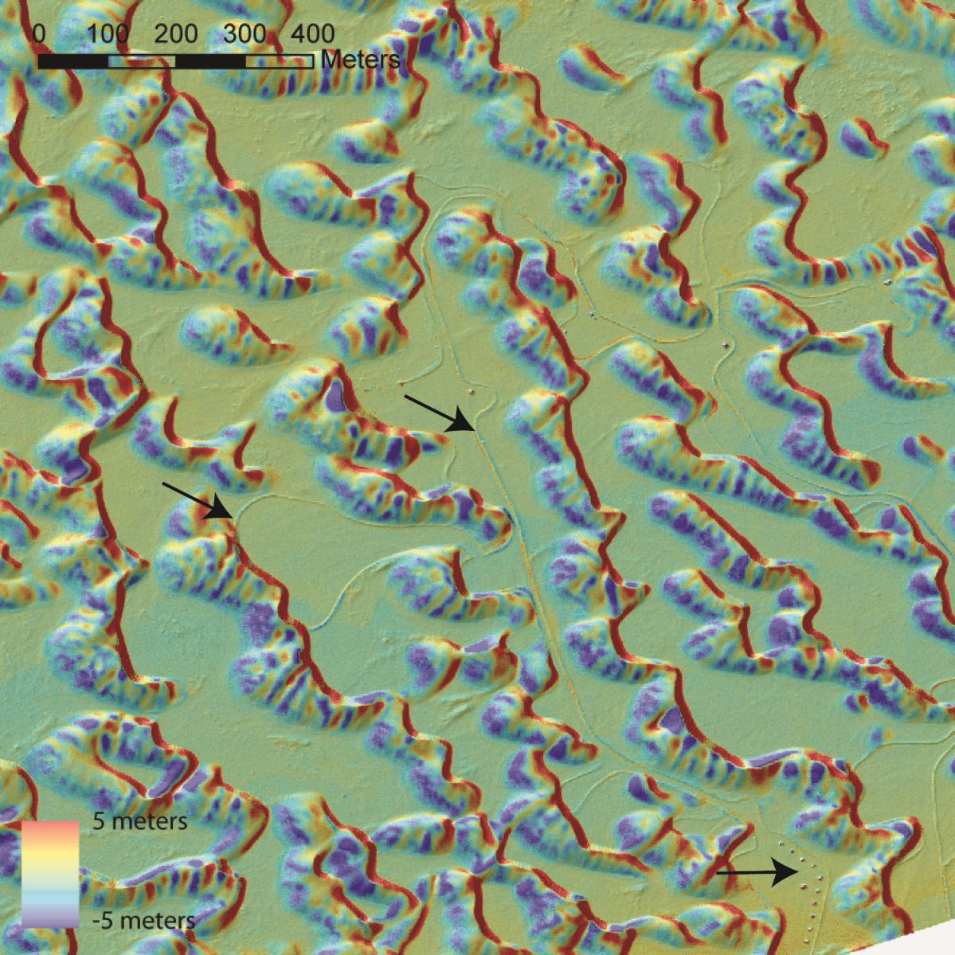
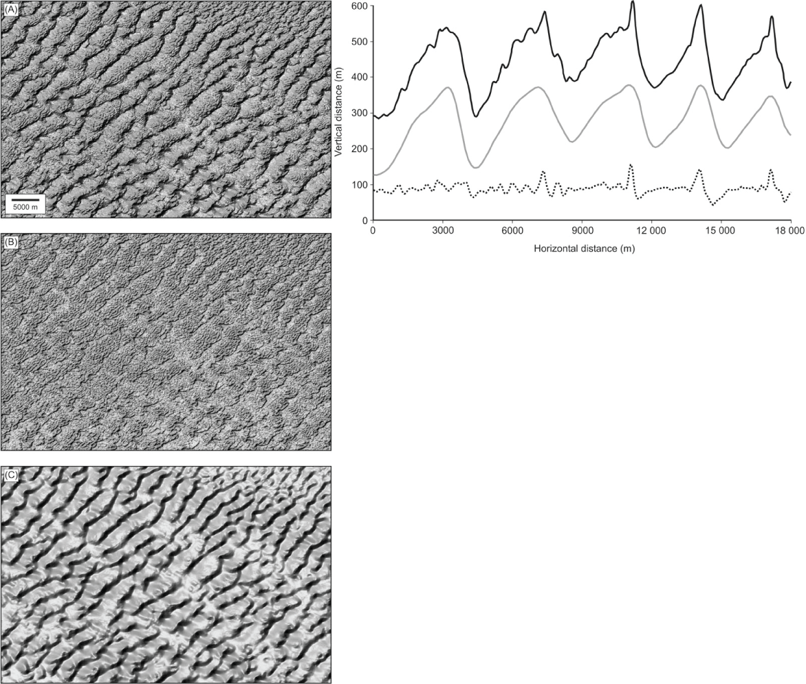
Digital elevation models
LIDAR DEM of White Sands –
Dune dynamics
Kocurek, et al , 2011
ASTER DEM – dune pattern analysis
Hugenholtz, et al 2012.. Earth Science Reviews 111, 319-334.

Slide 6
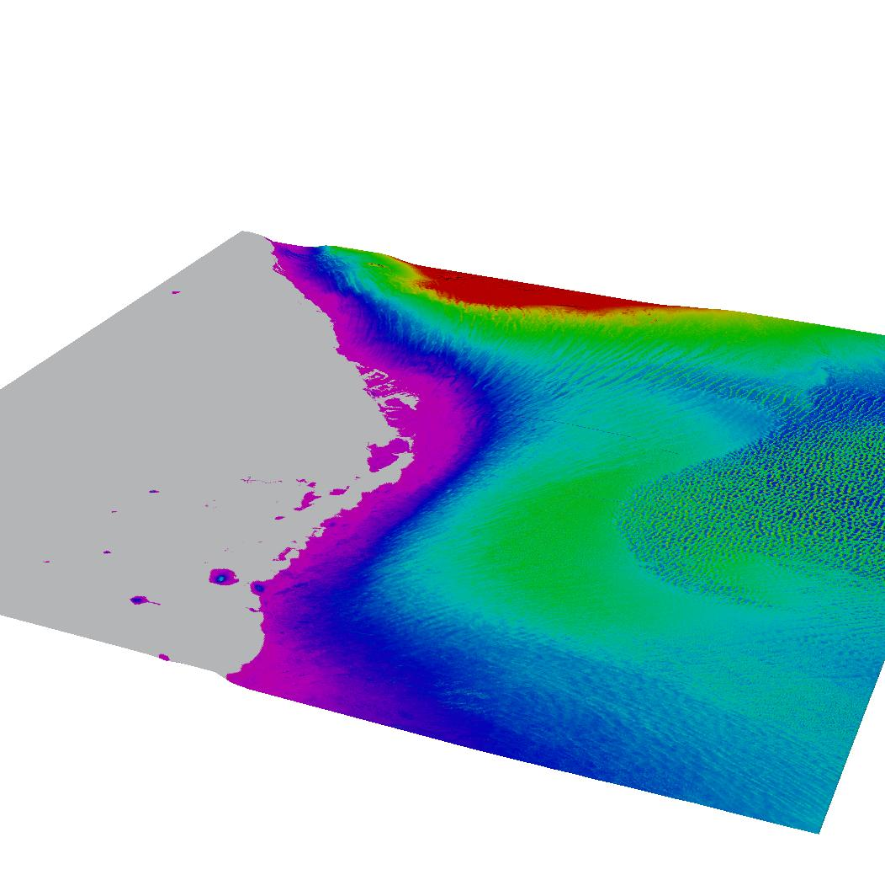
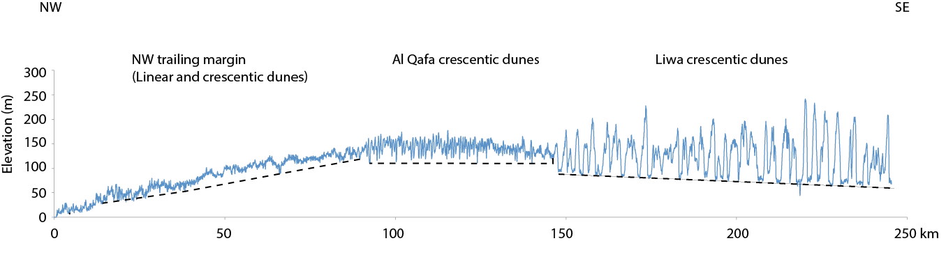
ASTER DEM Data of
United Arab Emirates

Slide 7
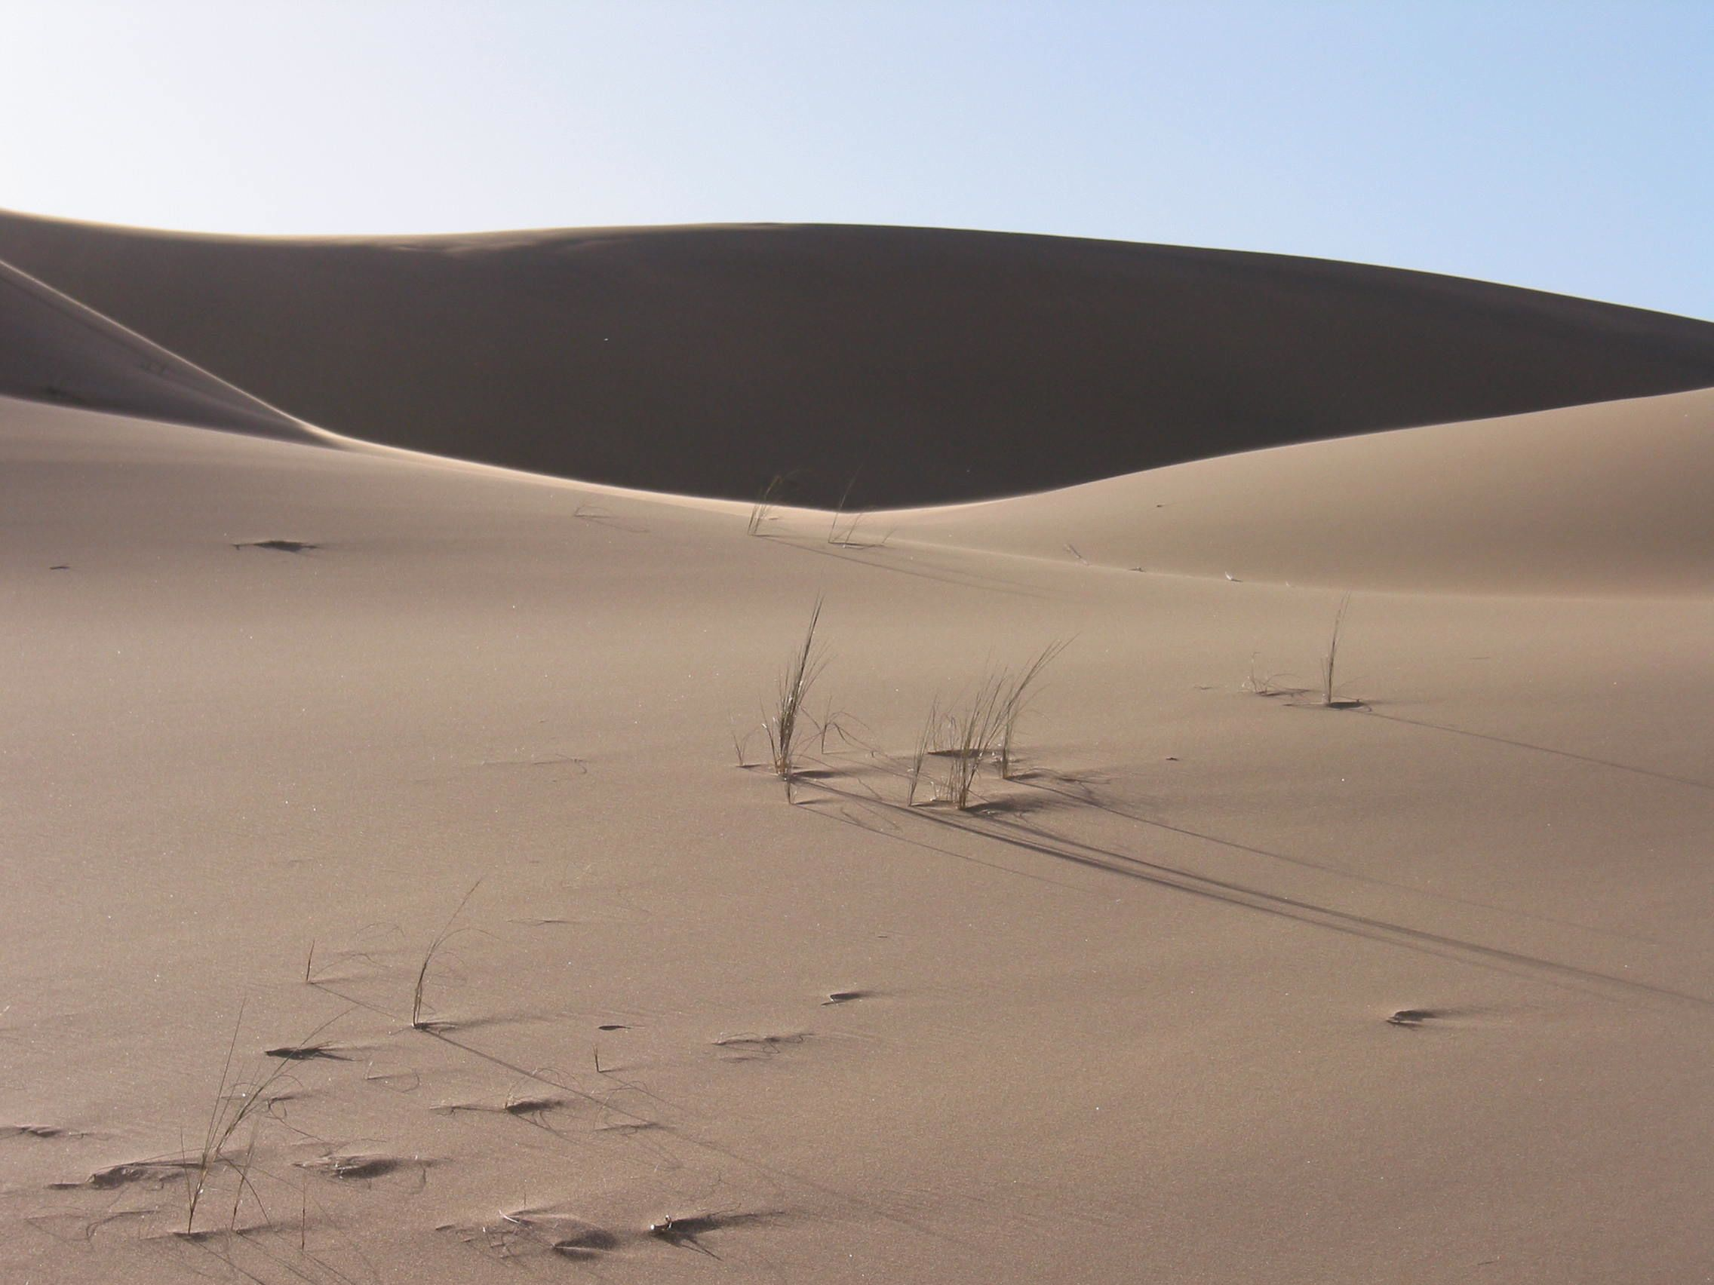
Current situation
New and emerging trends provide a wealth of data with which to develop and test new models for aeolian system dynamics and their response to changes in boundary conditions
Data required to provide such an understanding is dispersed and has yet to be synthesized in a meaningful way

Slide 8
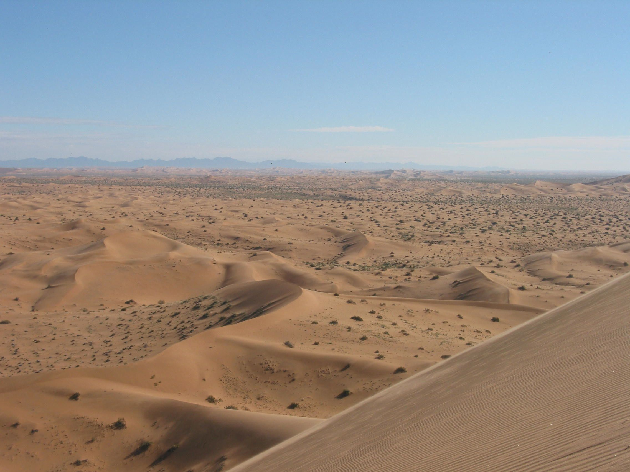
The challenge
How do we use these multiple datasets to understand dune systems in space and time?
How do we integrate data on dune patterns, dune sediments, and dune ages?
How do we synthesize multiple-scale field, remote sensing, and modeling datasets to inform earth system response to climate change, past and future?

Slide 9
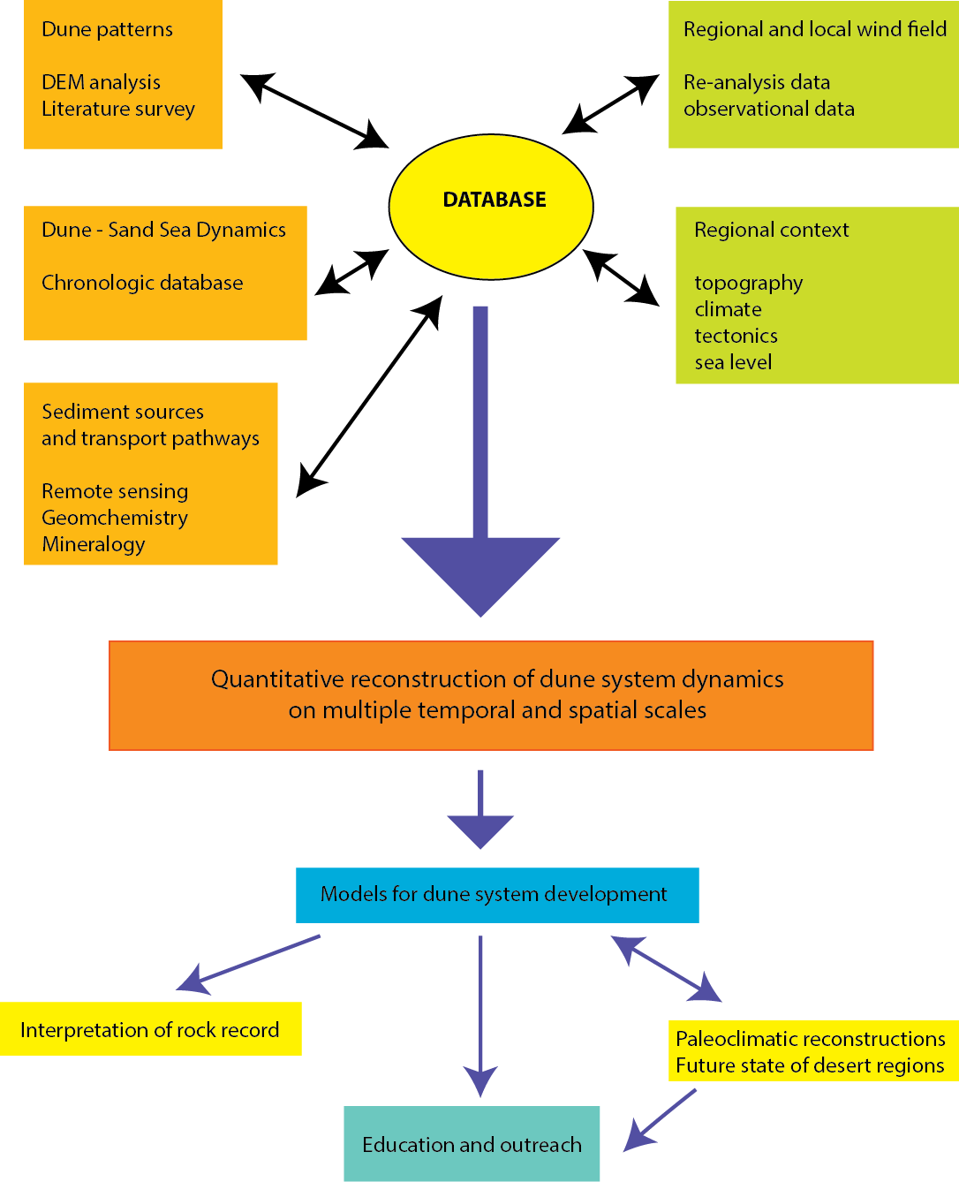
A framework for dune systems research
Data-intensive approach to explore multiple-scale field, remote sensing, and modeling datasets

Slide 10
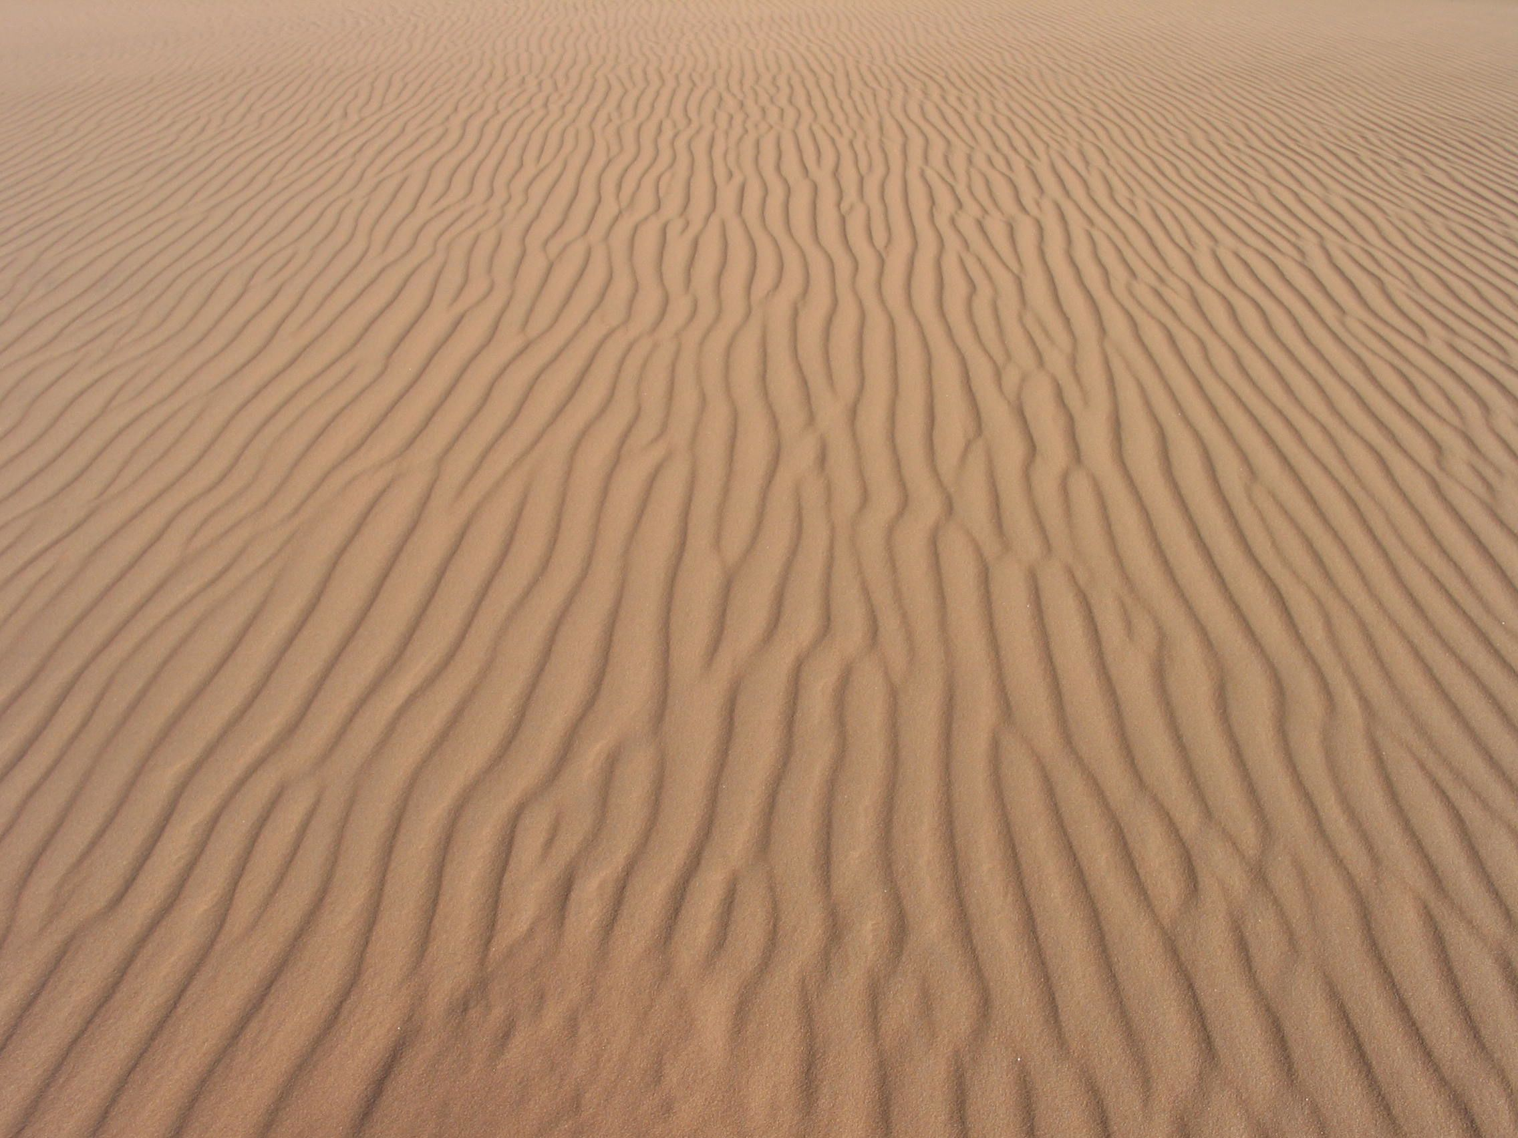
Database Conceptual Framework
Global geographic database for low and mid latitude desert dune systems
dune morphology, chronology, and stratigraphy
topographic and geologic context of each system
climate variables – wind regime (observations and models)
Published sedimentological information

Slide 11
Existing data centric approaches
Mars Global Digital Dune Database – MGD³ (Hayward et al., 2007, 2010, 2012)
Data for > 550 dune fields – emphasis on morphology and morphometry
Namib Sand Sea database (Livingstone et al., 2010)
Multiple GIS layers for dune morphology, DEM data, winds etc.
INQUA Dunes Atlas
Geo-located chronologic and morphologic data

Slide 12
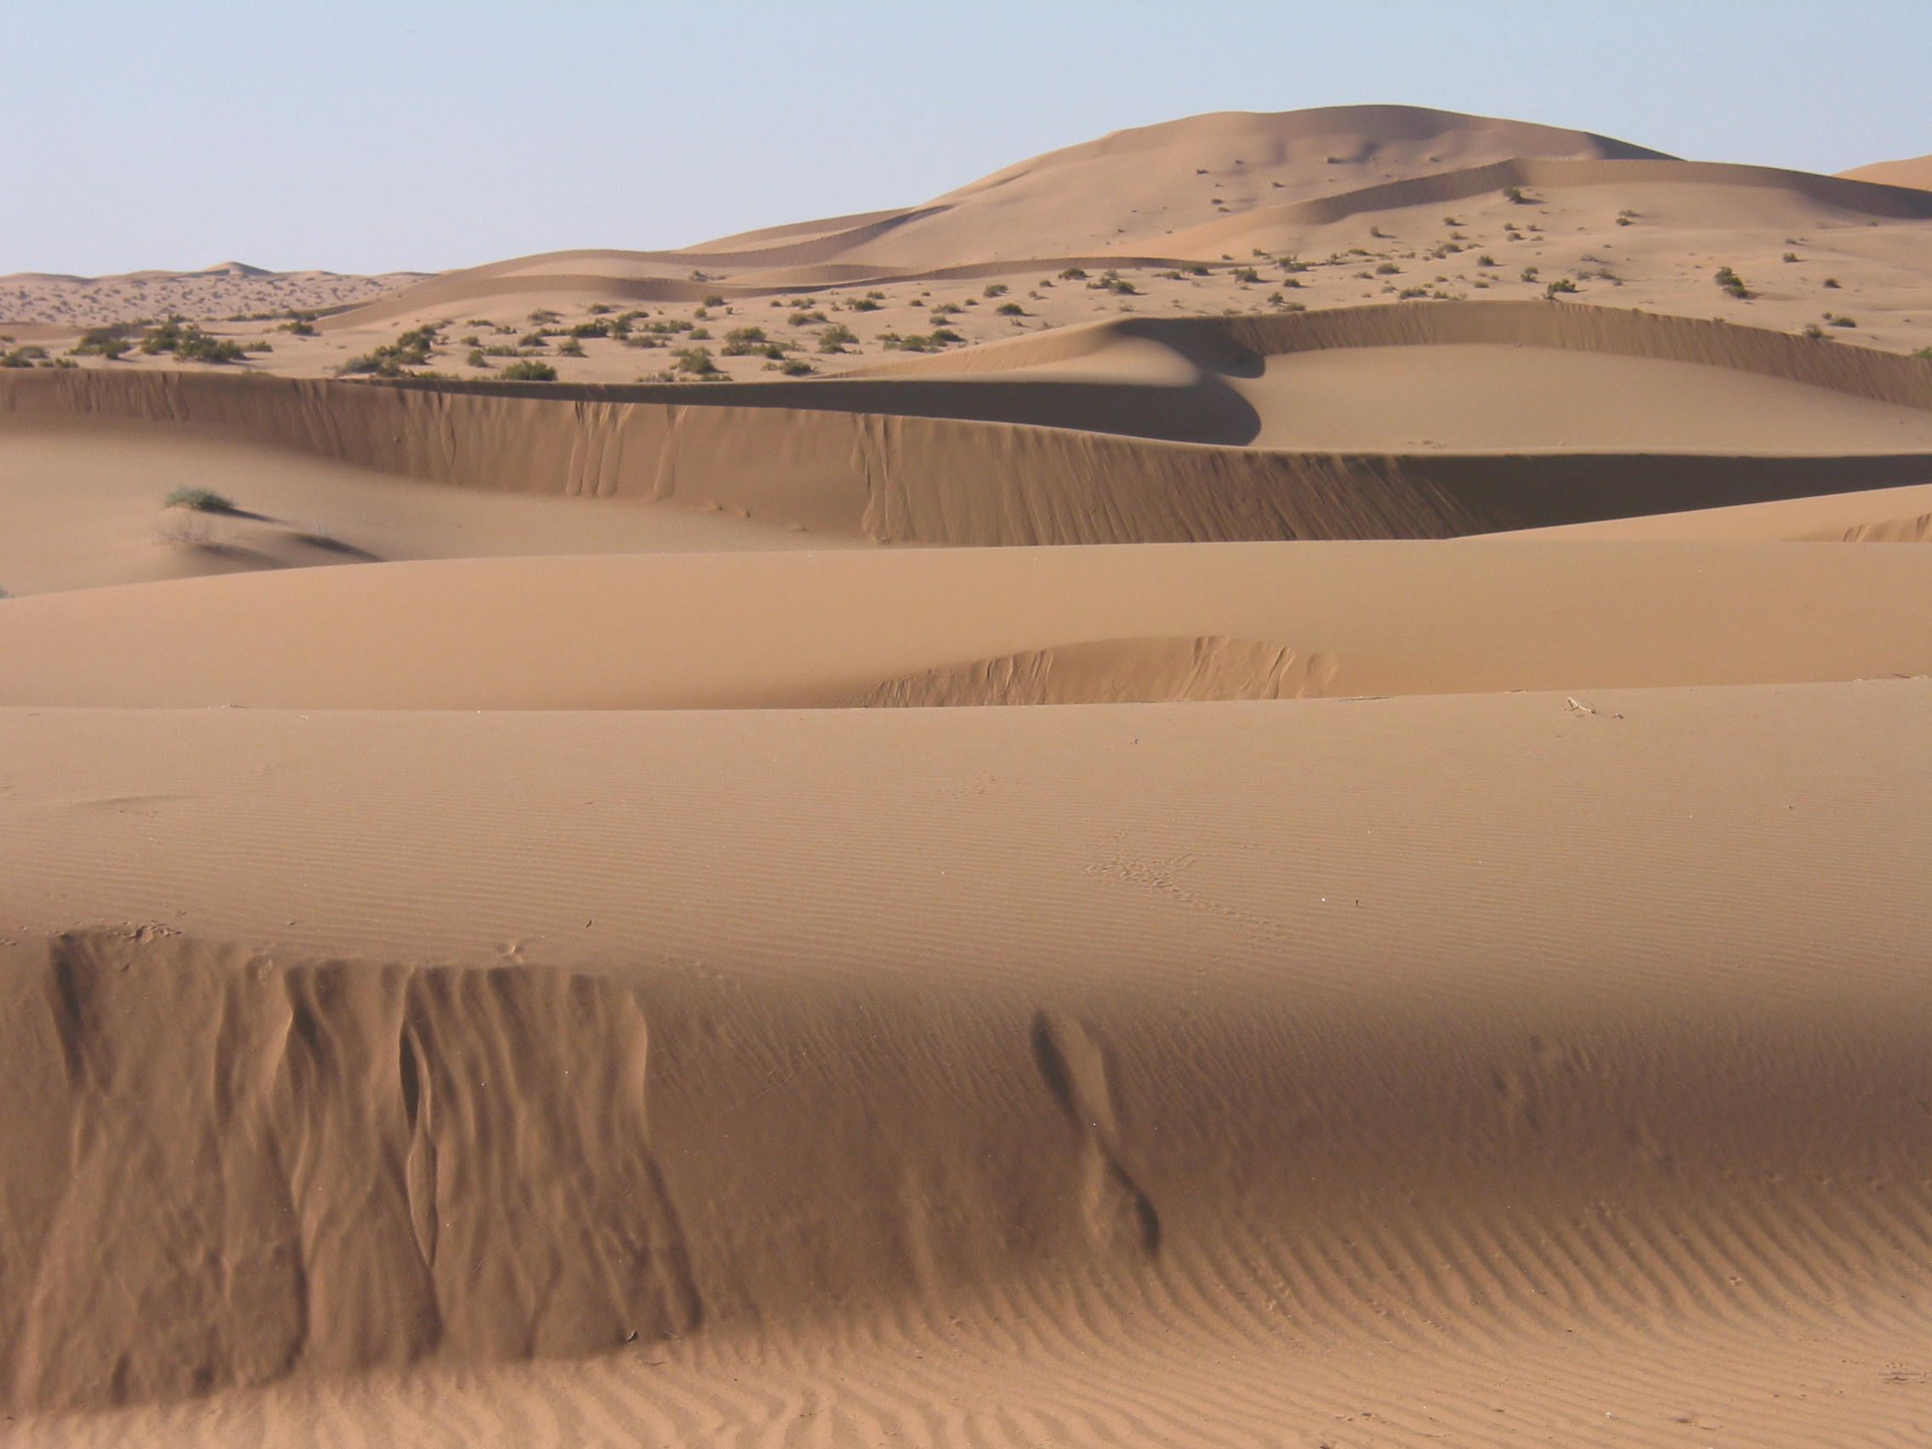
Value of data-centric approach
Enables connections to be made between morphology and chronology
Testing of models using a global approach
Links to earth system models
Tools and approaches for data analysis and visualization
Facilitates archiving of research data

Slide 13
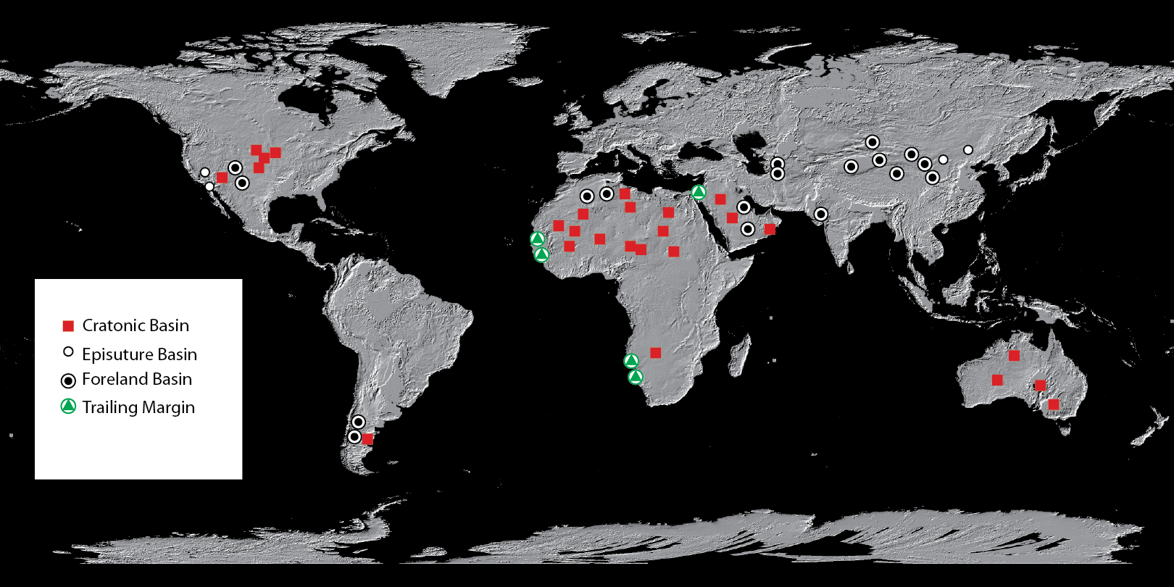
Tectonic setting of sand seas
Tectonic data from Fugro Tellus Sedimentary Basins of the World
http://www.datapages.com/AssociatedWebsites/GISOpenFiles/FugroTellusSedimentaryBasinsoftheWorldMap.aspx

Slide 14
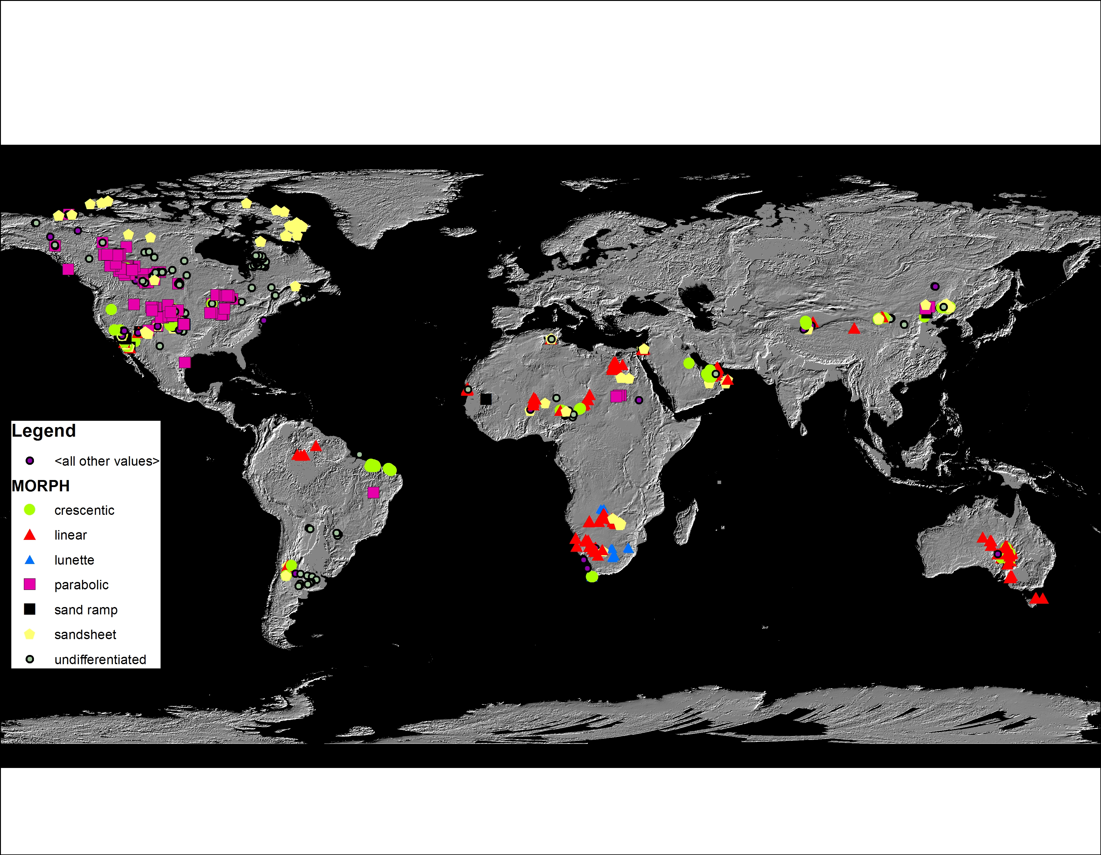
INQUA Dunes Atlas Database
Total Number of Sites with data = 1082
Comprising 3556 ages

Slide 15
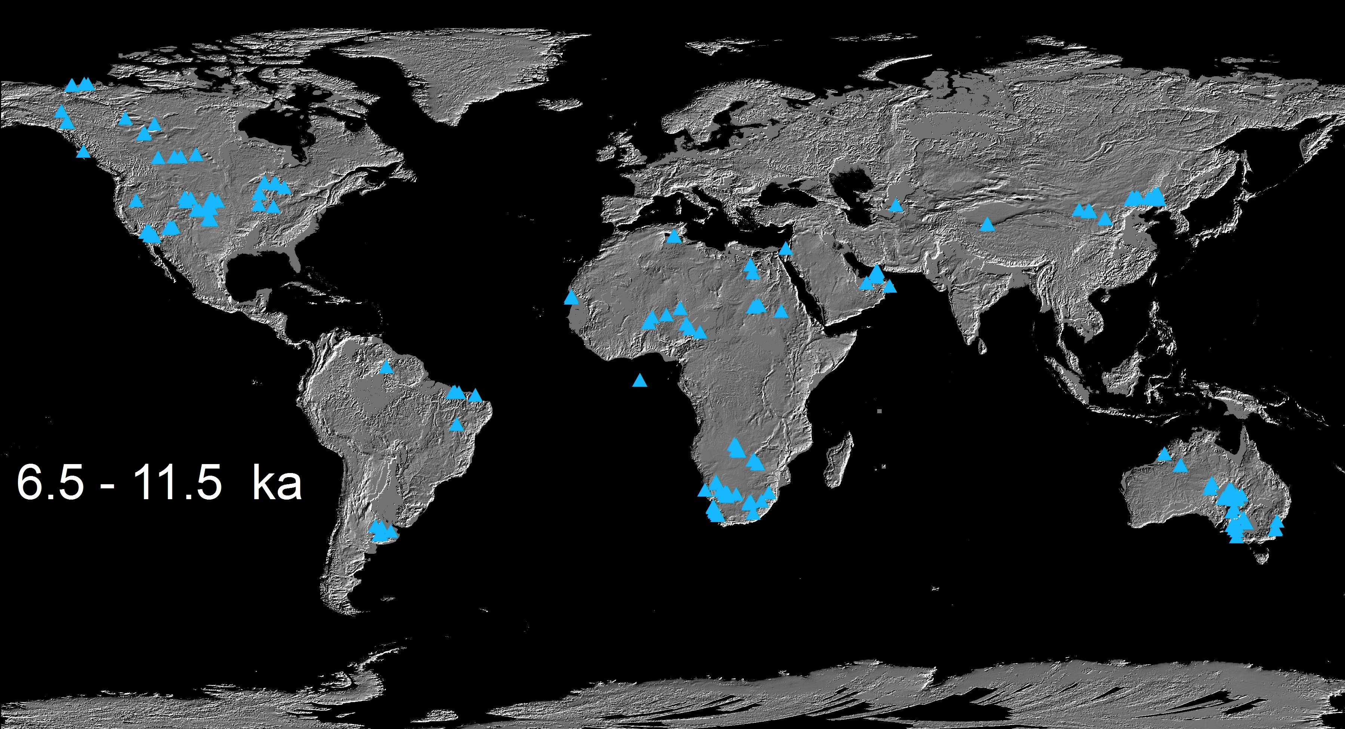
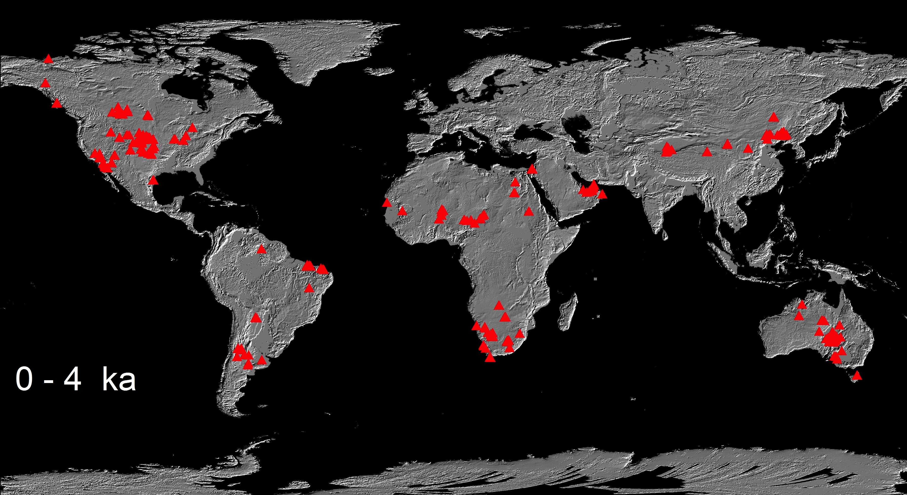
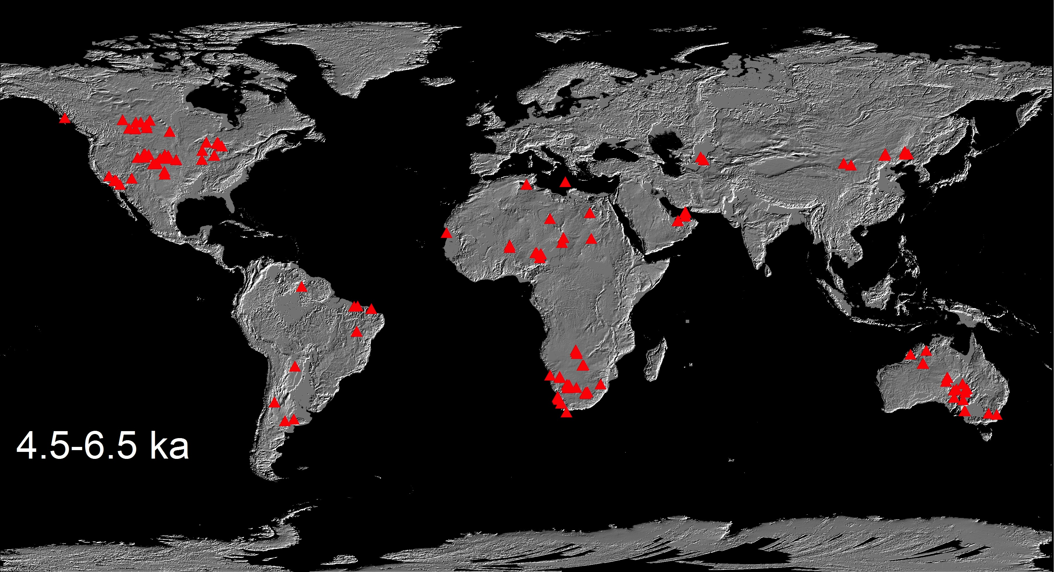
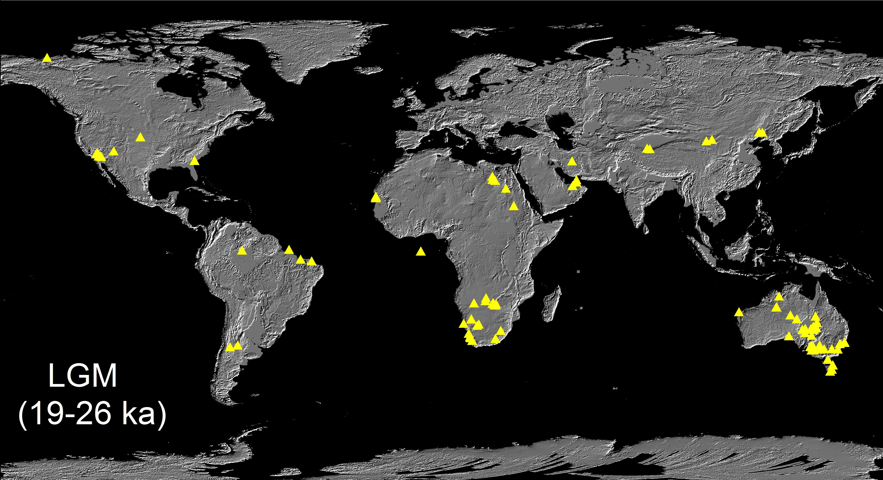
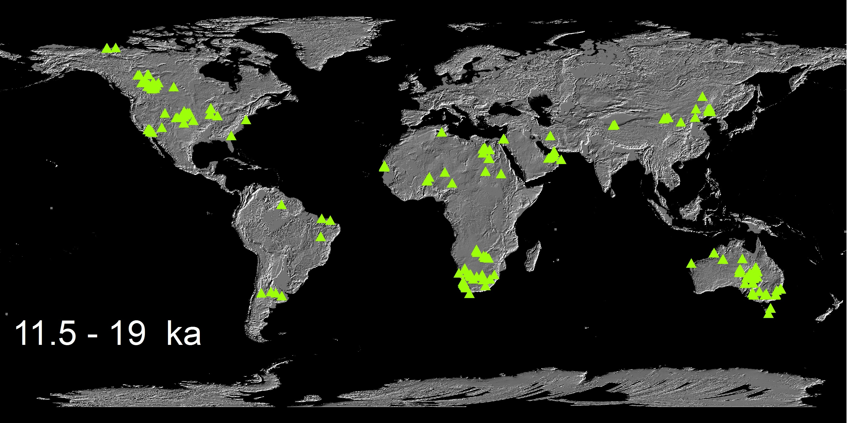
Time slice maps of dune accumulation

Slide 16
The way forward
Community-driven approach
Based on concept of INQUA Dunes Atlas
Contributed data sets, maps, field data
Robust database that can be used by all
Open access to data via web
And some funding !

