Slide 1
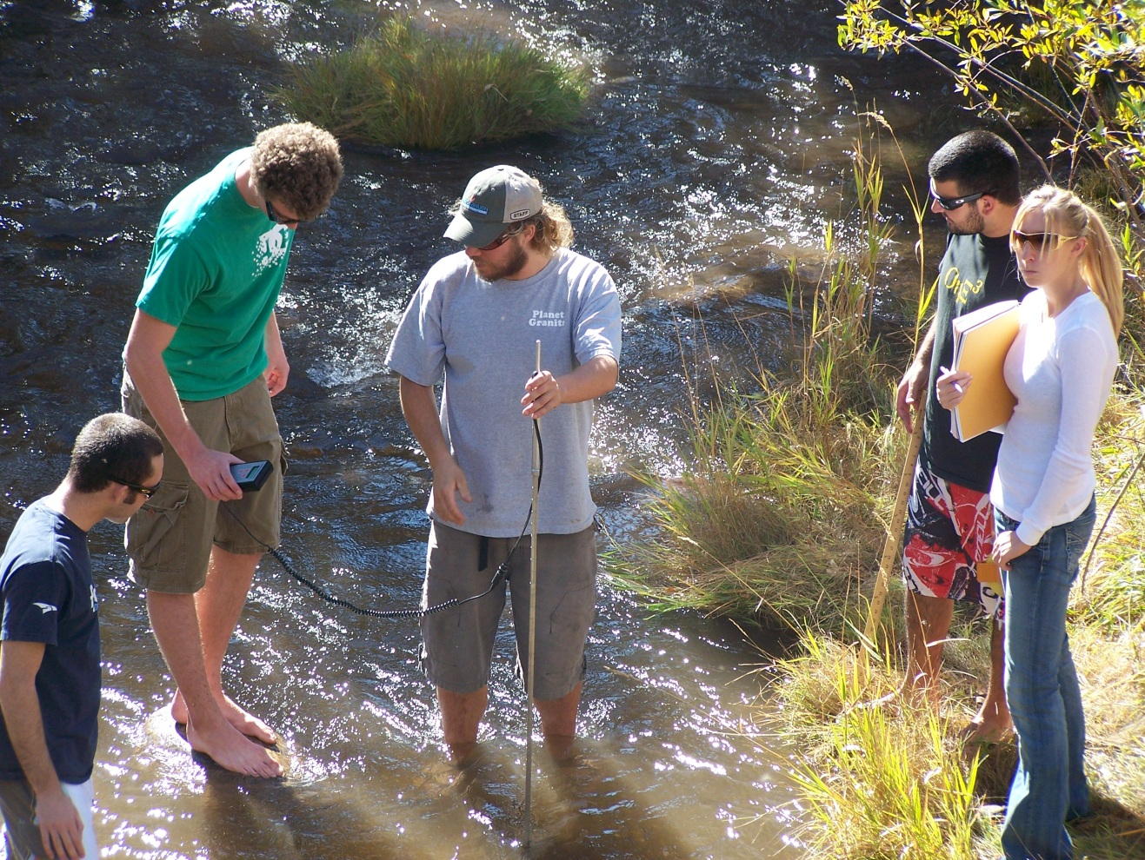

The Challenge of Student Ownership of Research Projects in Introductory General Education Geoscience Courses
Kim Hannula
Geosciences Department
Fort Lewis College
Durango, Colorado
hannula_k@fortlewis.edu
Lisa Snyder,
Office of Assessment
Fort Lewis College

Slide 2
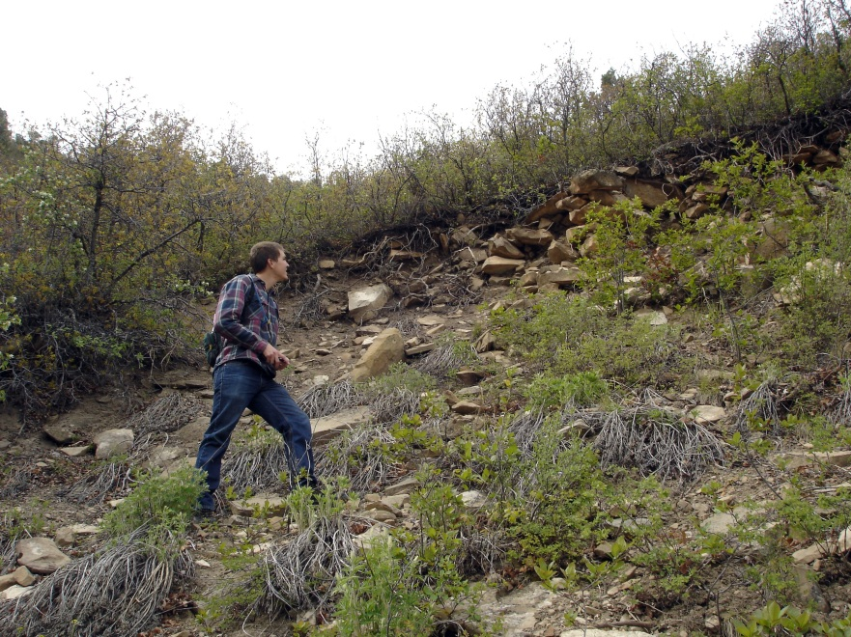
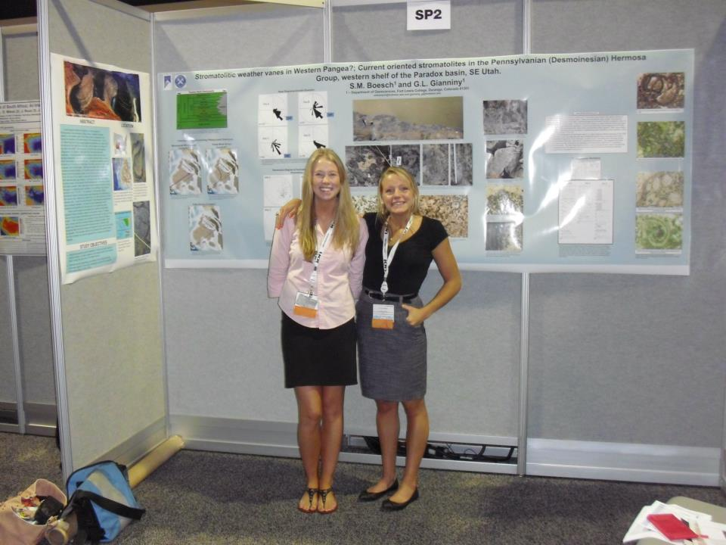
Undergrad research is good
Learning how to be a scientist
Developing self-confidence in discipline
Starting early is better
Ref: Thiry et al., 2012

Slide 3
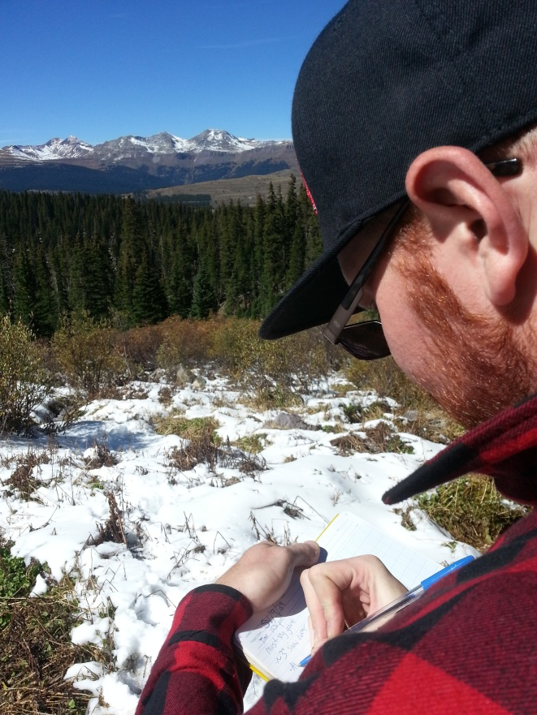
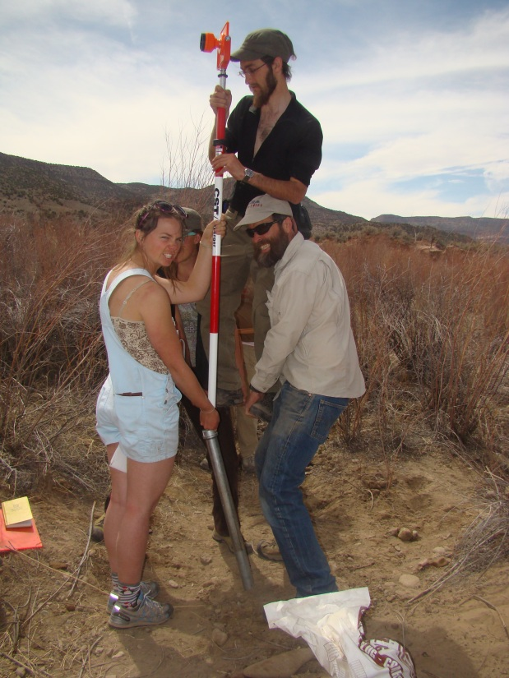
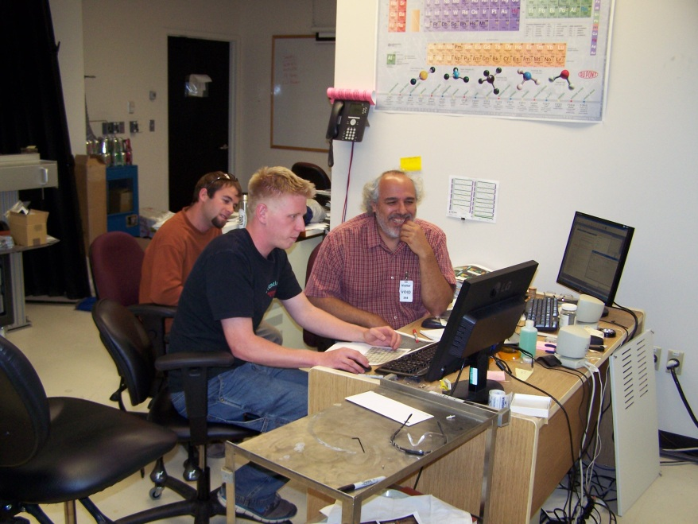
Sources of benefits?
Authentic research
Guidance/mentoring
Student sense of ownership
Refs: Thiry et al., 2011
Hanauer et al., 2012

Slide 4
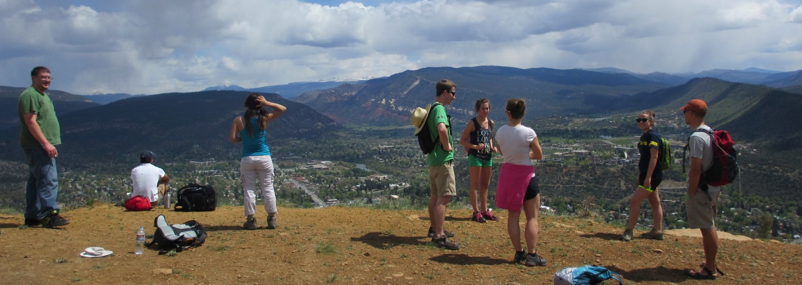
Four Corners Undergraduate Student Success (FOCUSS)
NSF-STEP grant
6-week summer research for freshmen & sophomores
All STEM fields
Collaboration with 2-yr college (San Juan College)
13 students, 6 faculty mentors
Interview results
Students want to continue work
Most positive experiences:
Mentoring
Ownership
Early mini-project improved ownership

Slide 5
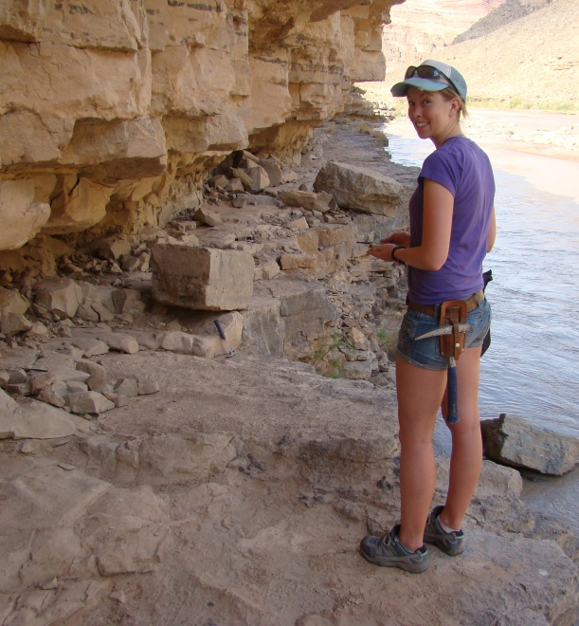
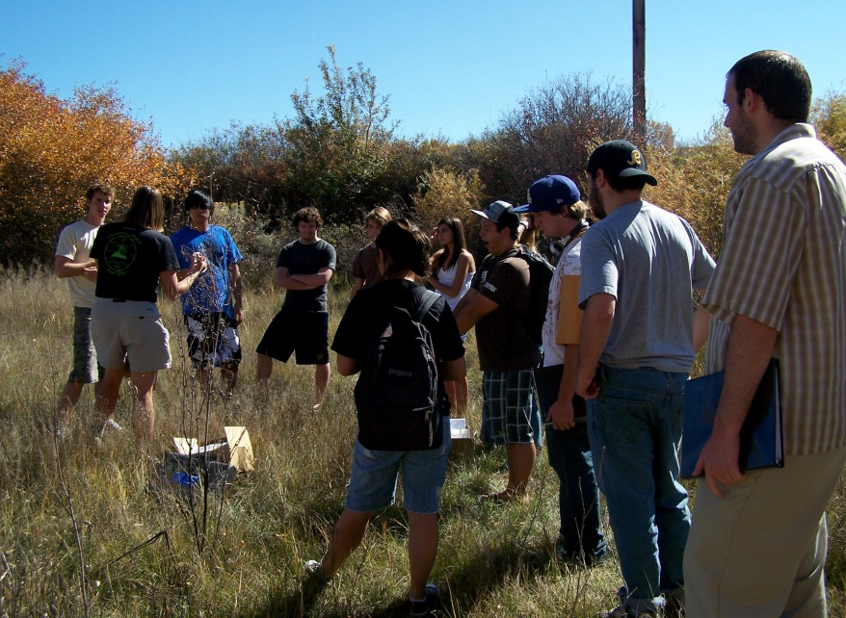
Apprenticeship challenges
Expensive
Limited to few students
Challenges in course-based projects
Ownership
Low intrinsic student motivation (80 to 90% non-majors)
Minimal background in subject
Interactions with mentor
Large class = less one-on-one interaction
Would course-based projects work?

Slide 6

Earth Systems Science
Colorado general education lab science course:
predominantly hands-on and inquiry-based
student generation and analysis of actual data
abstract reasoning to interpret these data
communication of the results
50-student lectures
25 students per lab section
Group projects since 2000

Slide 7
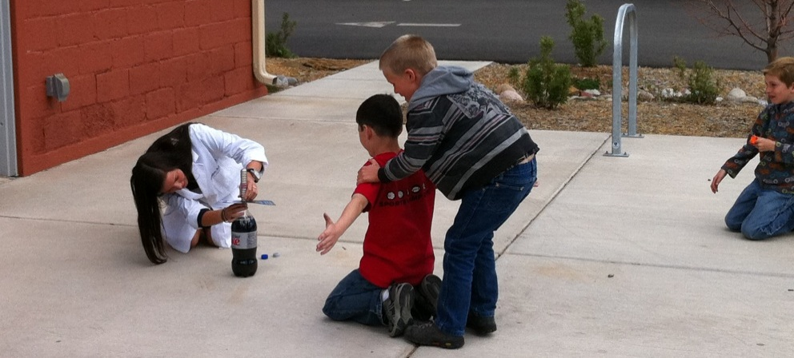
2000-2007 Student-defined projects
Groups of 3 to 5 students
Propose topic
Develop hypothesis
Collect data
Write group paper
Present poster & talk
Two lab meetings
Week 3: plan project
Week 13: present project
Examples of projects
Good: Testing infiltration of soil in Missionary Ridge burn area (high, medium, low intensity burns)
Bad: Effect of growing potato plants in a closet

Slide 8
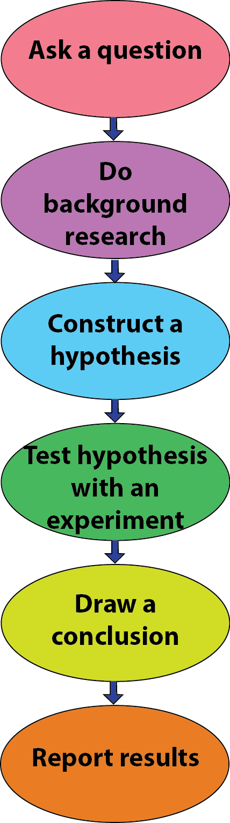
Issues with student-generated projects
Difficulty choosing topic
Topics covered by 3rd week:
Scientific method
Geologic time
Minerals (started)
Stressful
Stereotypical view of process of science
Limited hypotheses
Simplistic tests
Did not feel like scientists
Did not improve experience in later projects
Independence required, but no ownership
Course evaluations: neutral to negative experience

Slide 9
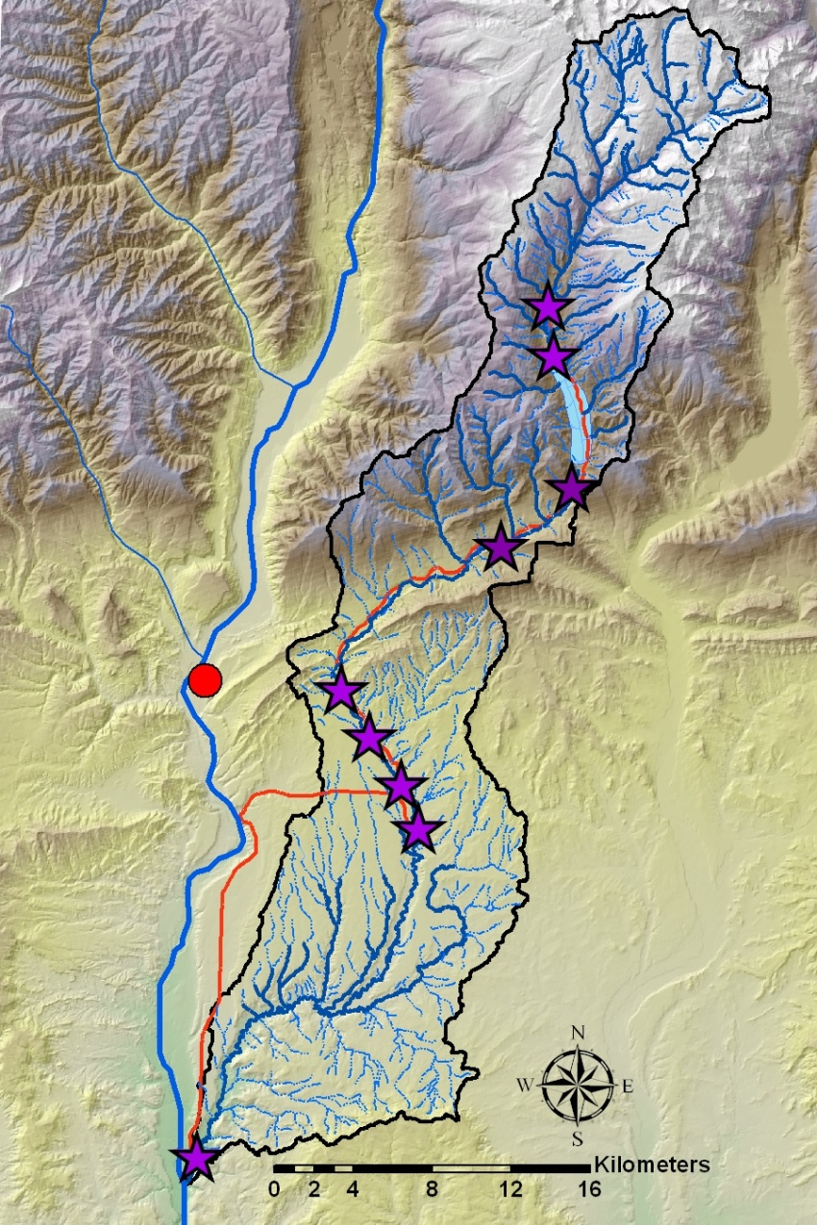
2008-2012 Florida River Group Project
Data contributes to larger project
Up to 9 sites along same river
Each lab section works one site
Groups collect pre-defined data
Animas R
Durango
Florida R
Discharge | Water chemistry in field
Turbidity | Water chemistry by ICP

Slide 10
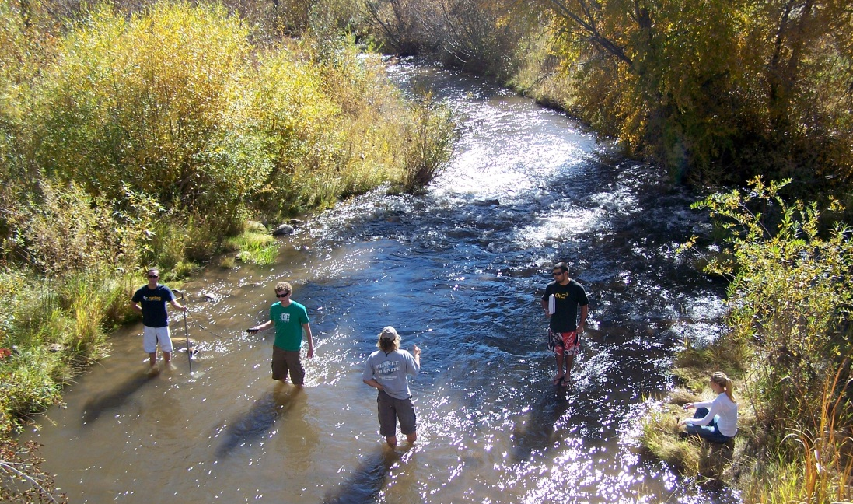
Florida River Project
Preparation
Labs – topo maps, sedimentary rocks
Homework
Graphing monthly discharge by hand
Graphing previous data by Excel
Writing assignments
Background
Hypothesis/prediction
Project
Data collection in lab
Oral presentations – discussion of group data
Group paper

Slide 11
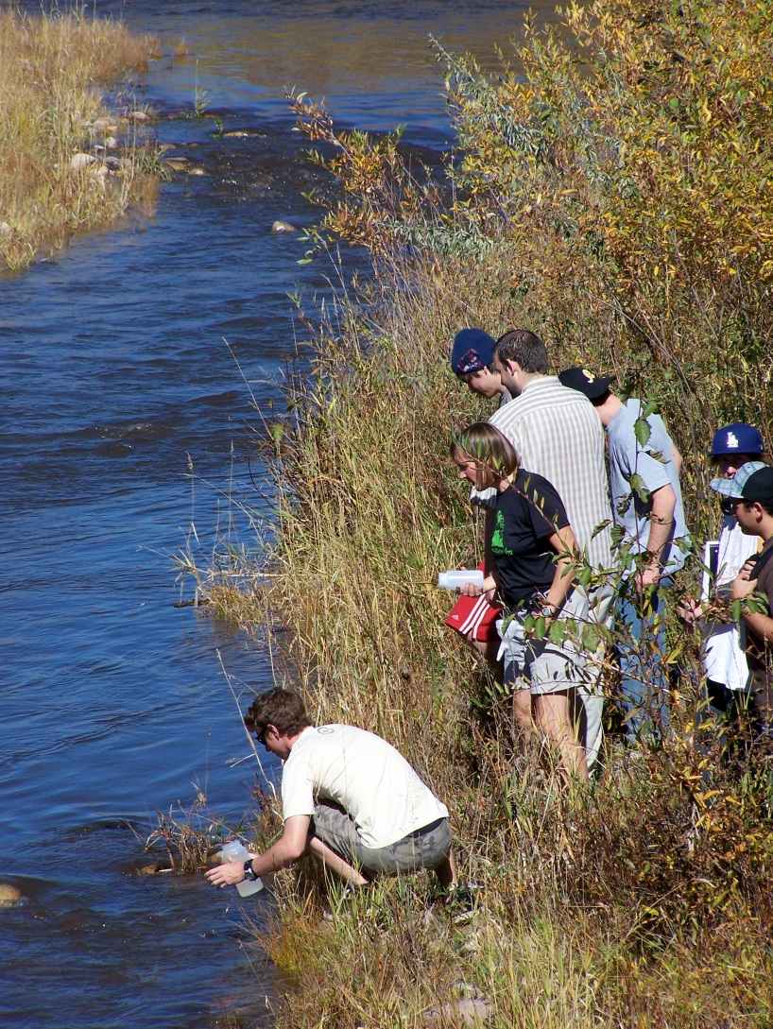
Florida River Project Issues
Weak papers
“Was our hypothesis correct?”
Engagement varied
Field = fun
Prep assignments = not done
Participation in group writing = variable
Pro: Real data
Con: Minimal ownership
Students not part of design

Slide 12
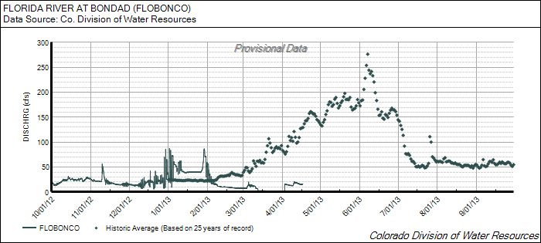
2013 - ? Revised Florida River Project
Changes:
No separate hypothesis
Partly a group project
Collect field data
Present data
Discuss of how groups’ data are related
Partly an individual project
Propose question
Use past data + new data
Can include other public data
Individual meeting with instructor
Refine question
Brainstorm ways to plot data
Individual paper based on question

Slide 13
Revised Florida River Project What happened?
Optional meetings don’t happen
Would 50 individual meetings be possible?
Many simplistic papers
Making graphs is hard
Some excellent papers
Thoughtful questions
Good analysis
Ownership?
Not as much enthusiasm as in summer research projects
Other outcomes TBD
Interviews with students
Longitudinal study with geo majors

Slide 14
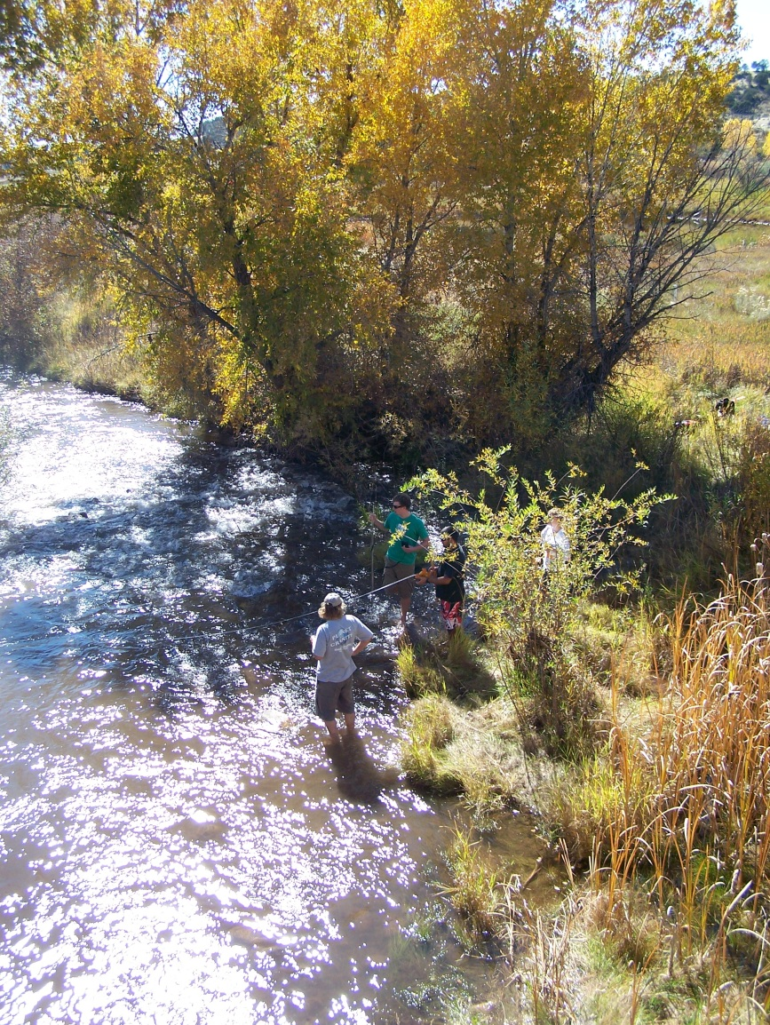
Final thoughts
Apprenticeship model:
1st & 2nd year students have great experiences
In-class research:
Developing ownership is challenging
Mentorship is time-consuming
Importance of preparation for developing ownership
Mini-projects modeling research?
Can course-based projects improve later apprenticeship experiences?

