Slide 1
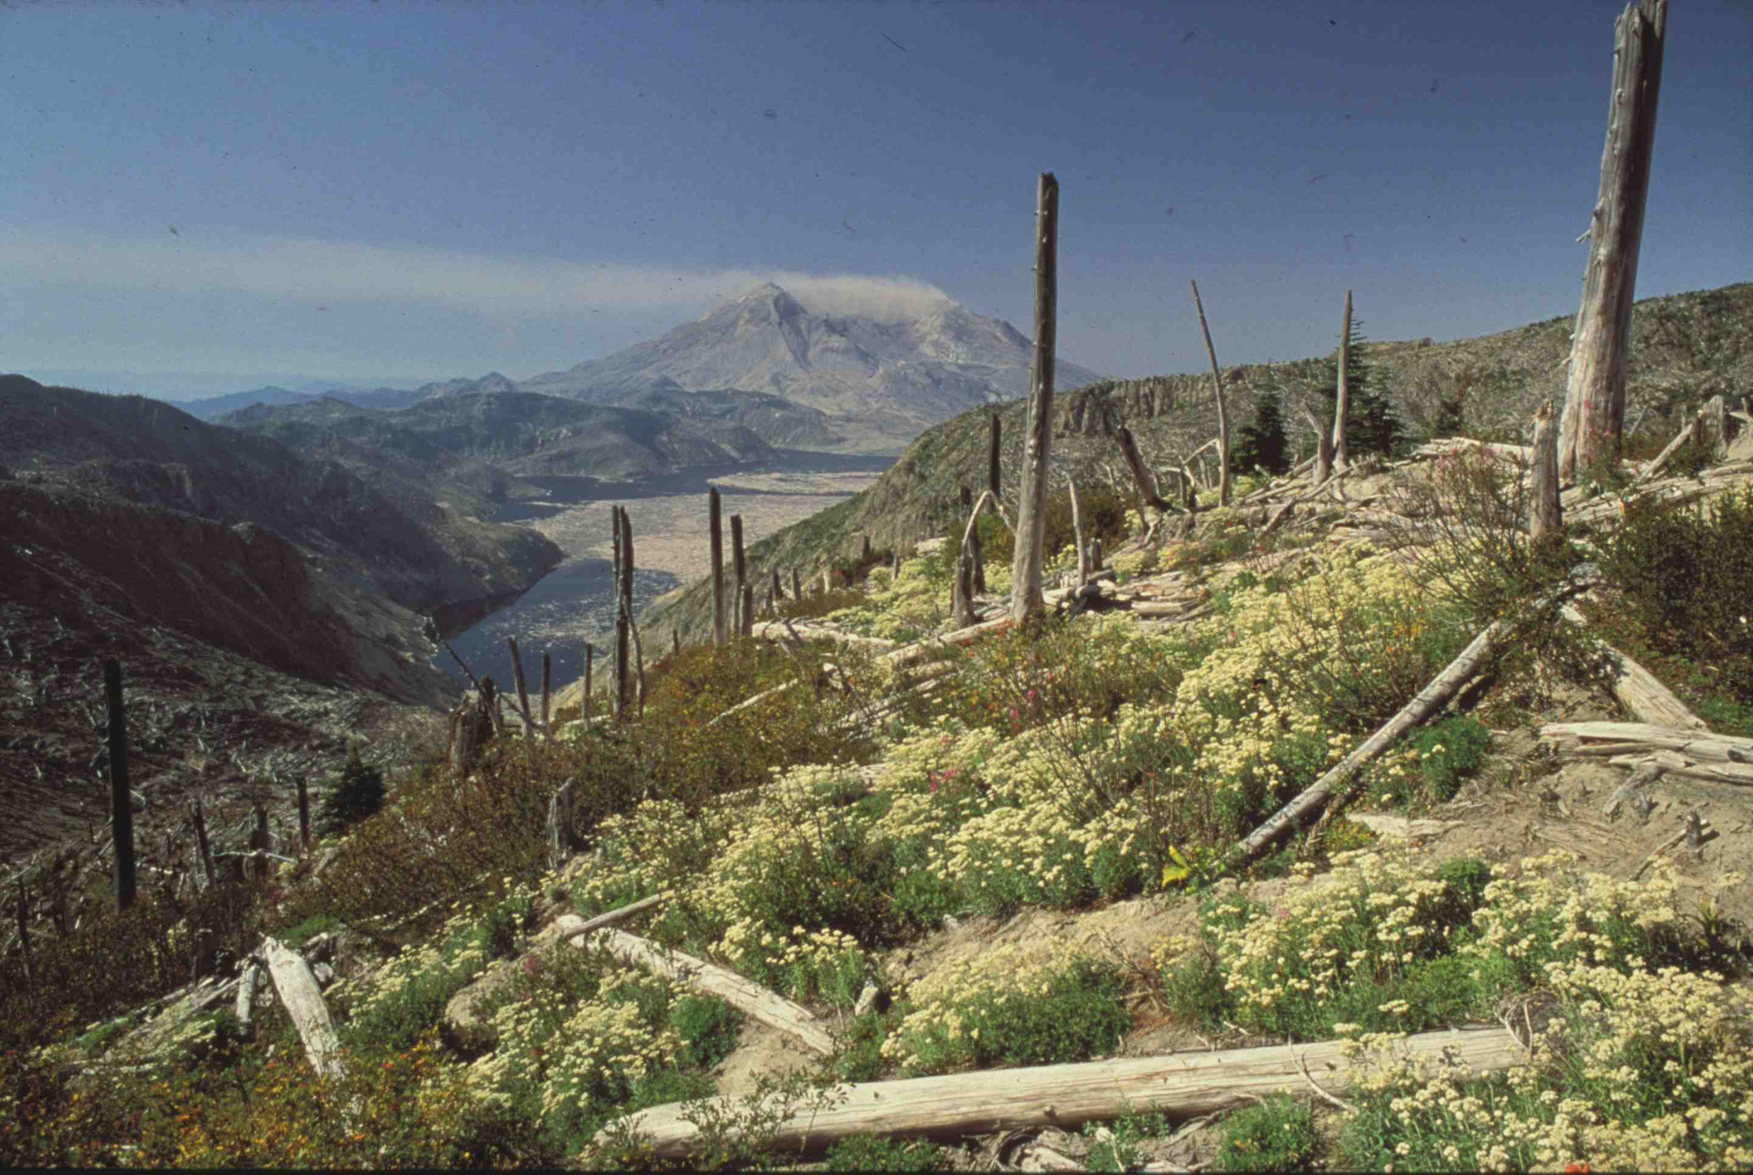
Forging Connections and Improving Understanding
of Earth Processes at Mount St. Helens
Peter Frenzen USFS Gifford Pinchot National Forest Mount St. Helens National Volcanic Monument

Slide 2
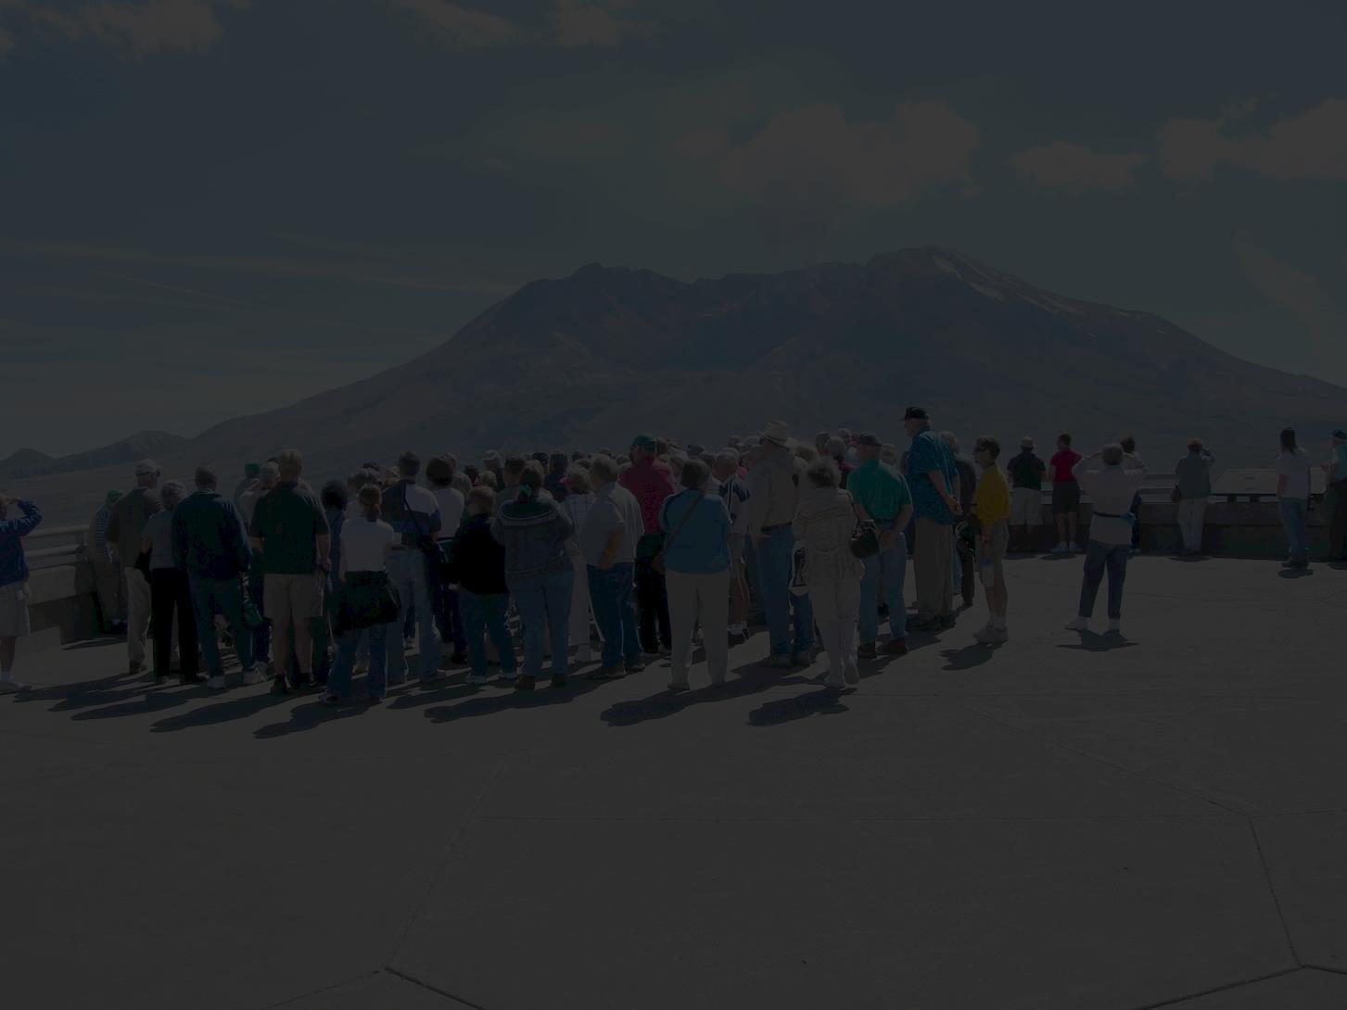
Ingredients for Effective Place-Based Connections
Dynamic landscape features and stories related to things visitors can see.
Collaborative research and strong relationships with land managers and local officials.
Effective, message-based interpretive programs and exhibits.
Committed partners and volunteers and a strong vision for the future.

Slide 3
Ingredients for Effective Place-Based Connections
Dynamic landscape features and stories related to things visitors can see.
Collaborative research and strong relationships with land managers and local officials.
Effective, message-based interpretive programs and exhibits.
Committed partners and volunteers and a strong vision for the future.

Slide 4
Ingredients for Effective Place-Based Connections
Dynamic landscape features and stories related to things visitors can see.
Collaborative research and strong relationships with land managers and local officials.
Effective, message-based interpretive programs and exhibits.
Committed partners and volunteers and a strong vision for the future.

Slide 5
Ingredients for Effective Place-Based Connections
Dynamic landscape features and stories related to things visitors can see.
Collaborative research and strong relationships with land managers and local officials.
Effective, message-based interpretive programs and exhibits.
Committed partners and volunteers and a strong vision for the future.

Slide 6
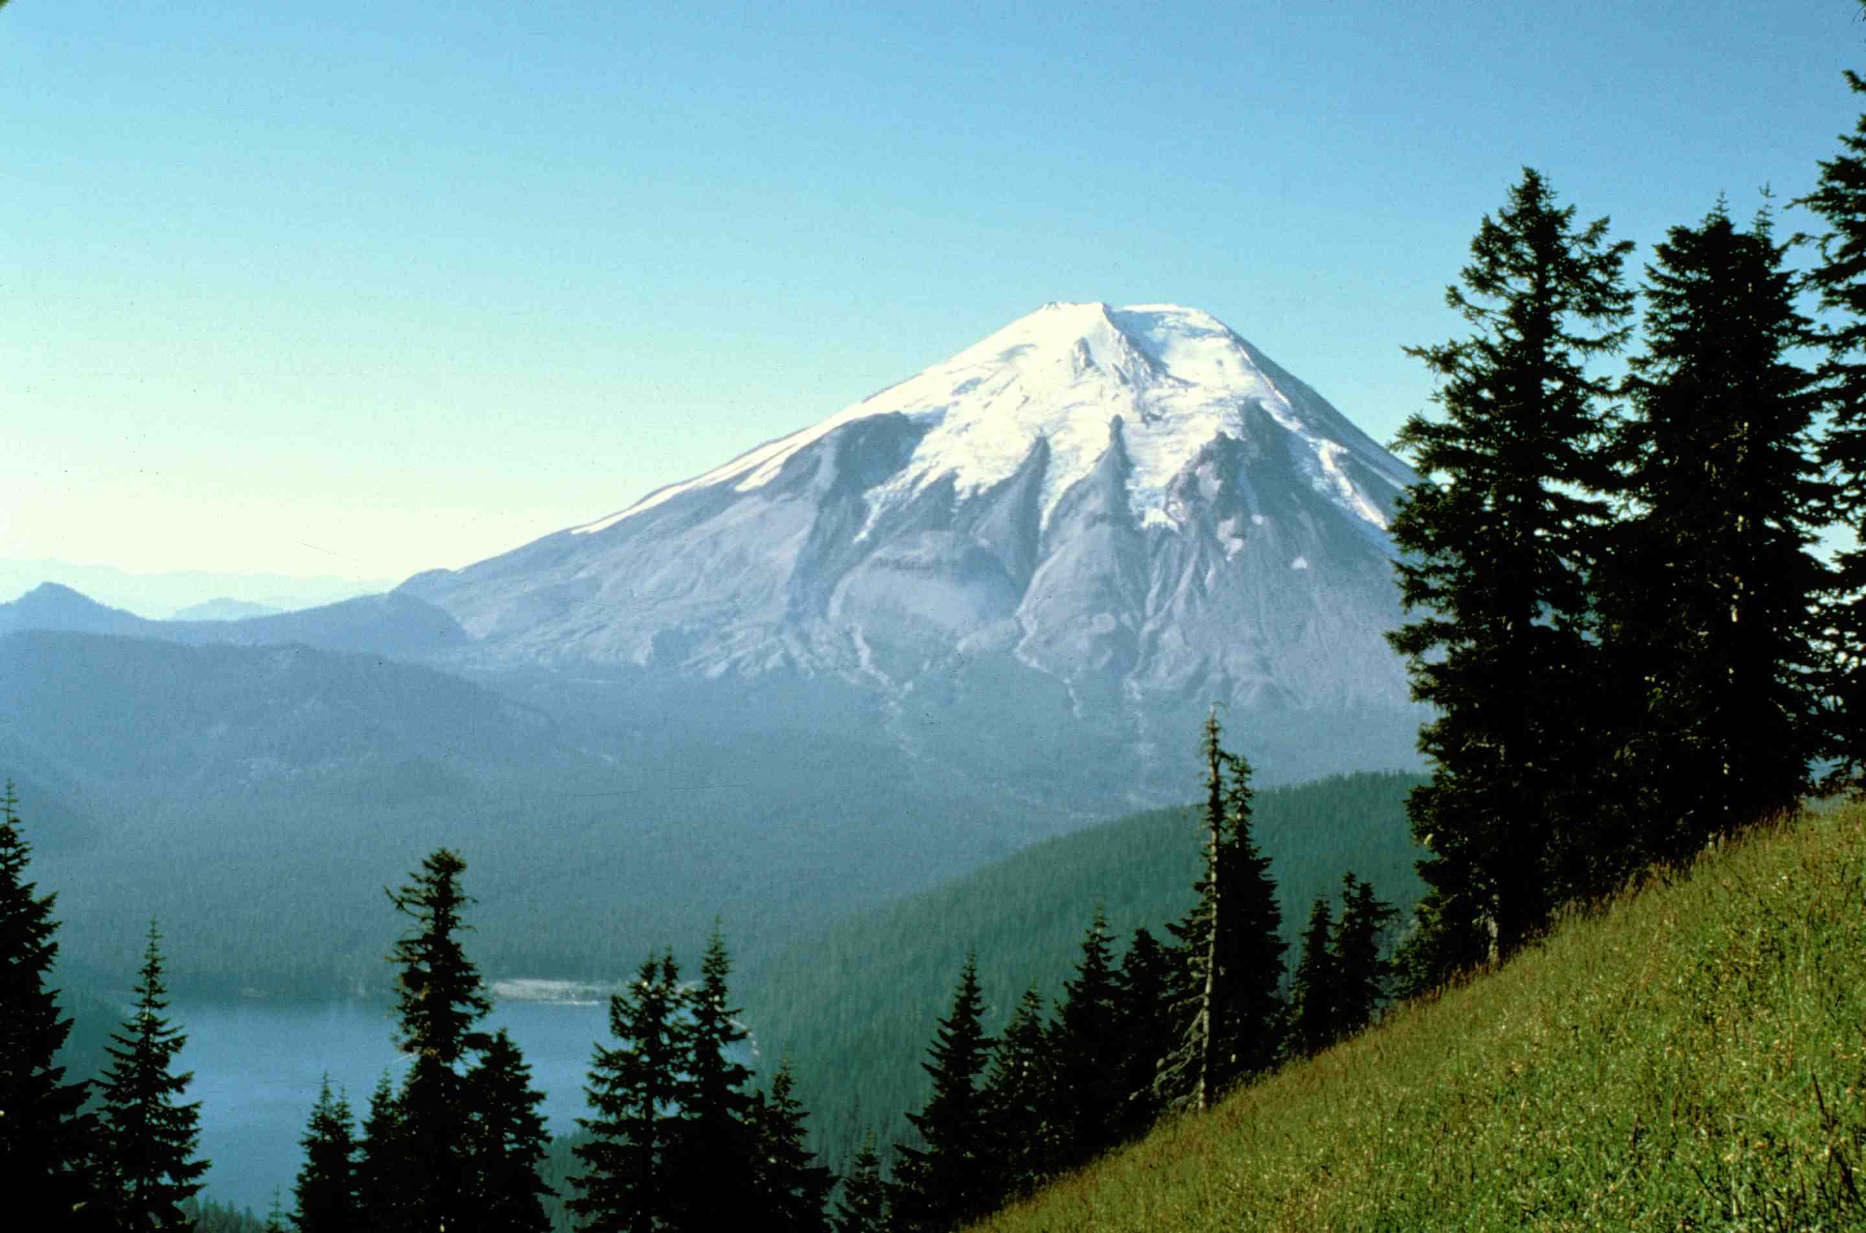
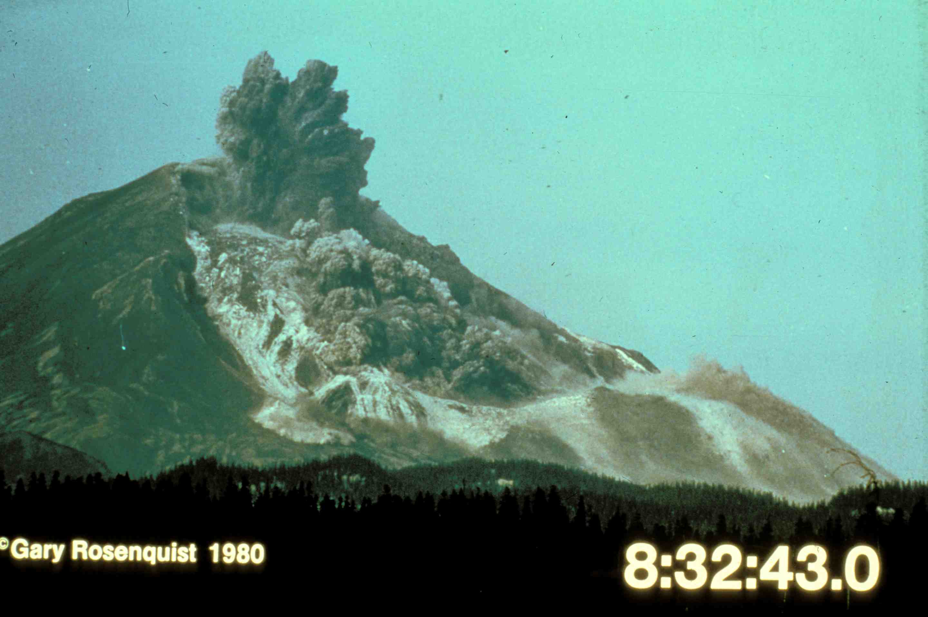
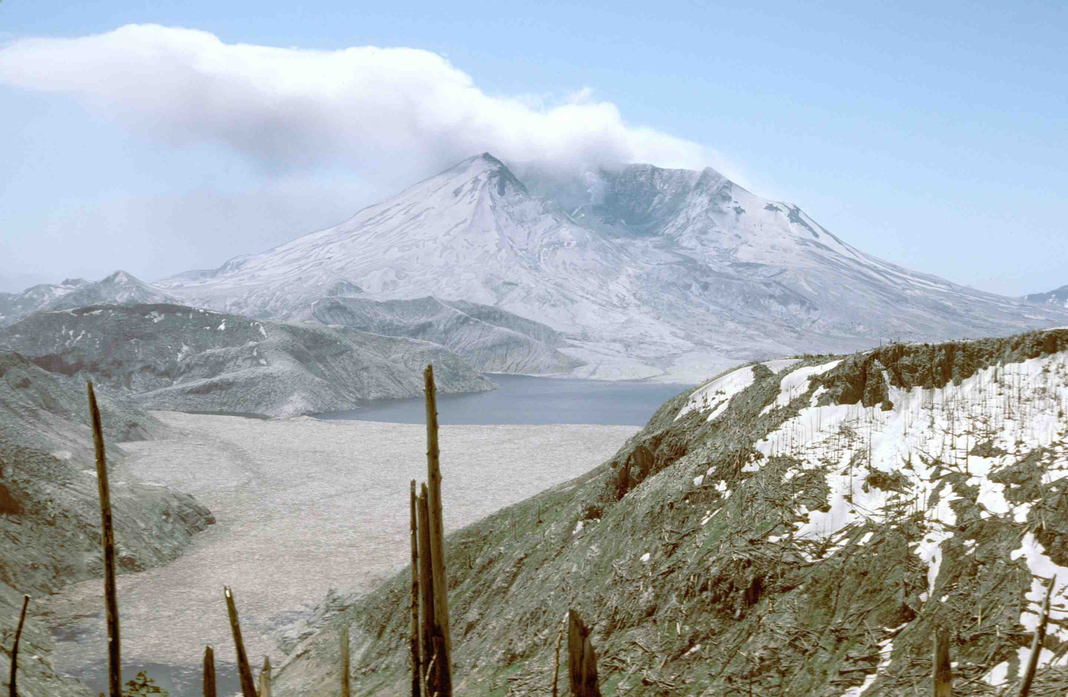
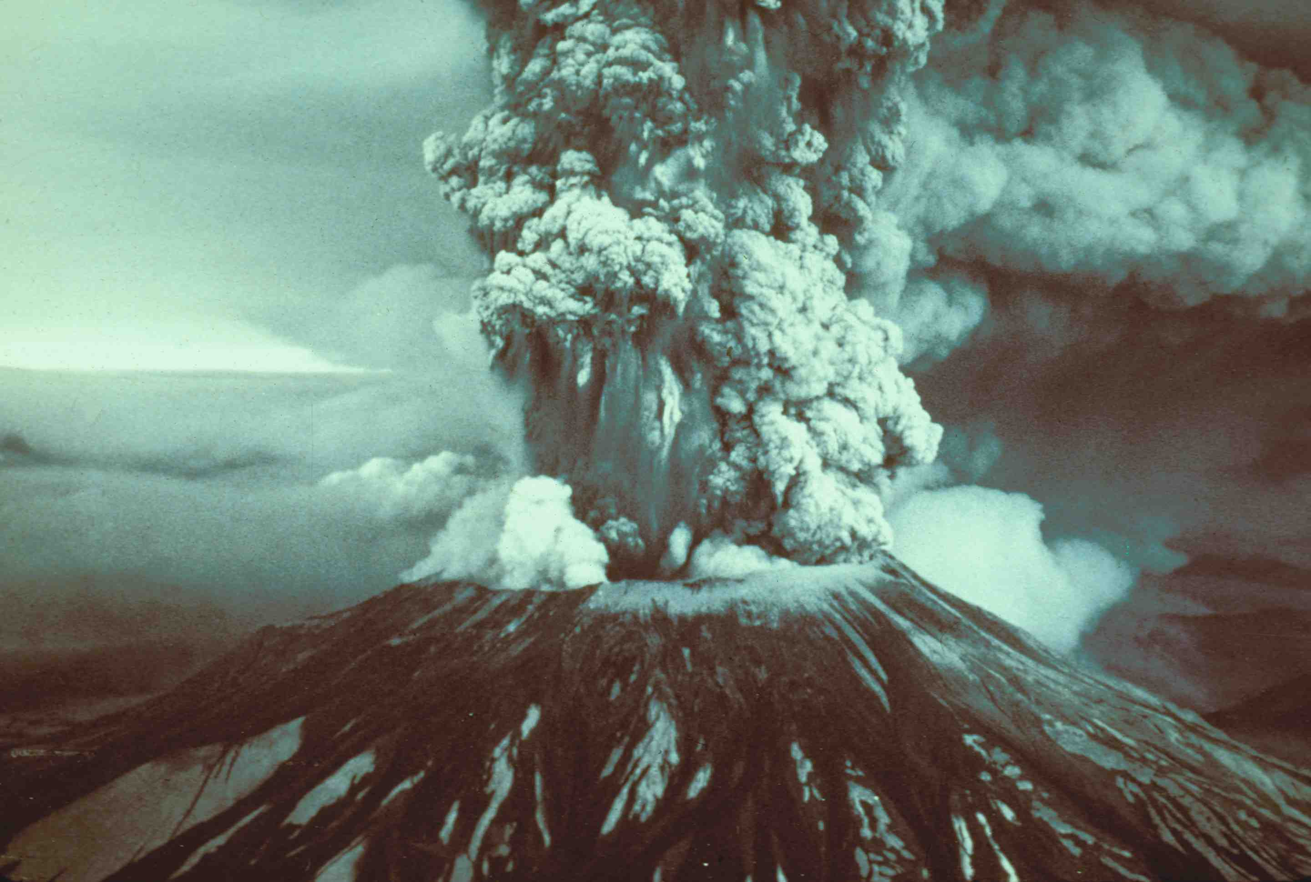
1979
1980
Notes:
In less than 10 minutes, the 1980 eruption completely transformed the landscape . . .

Slide 7
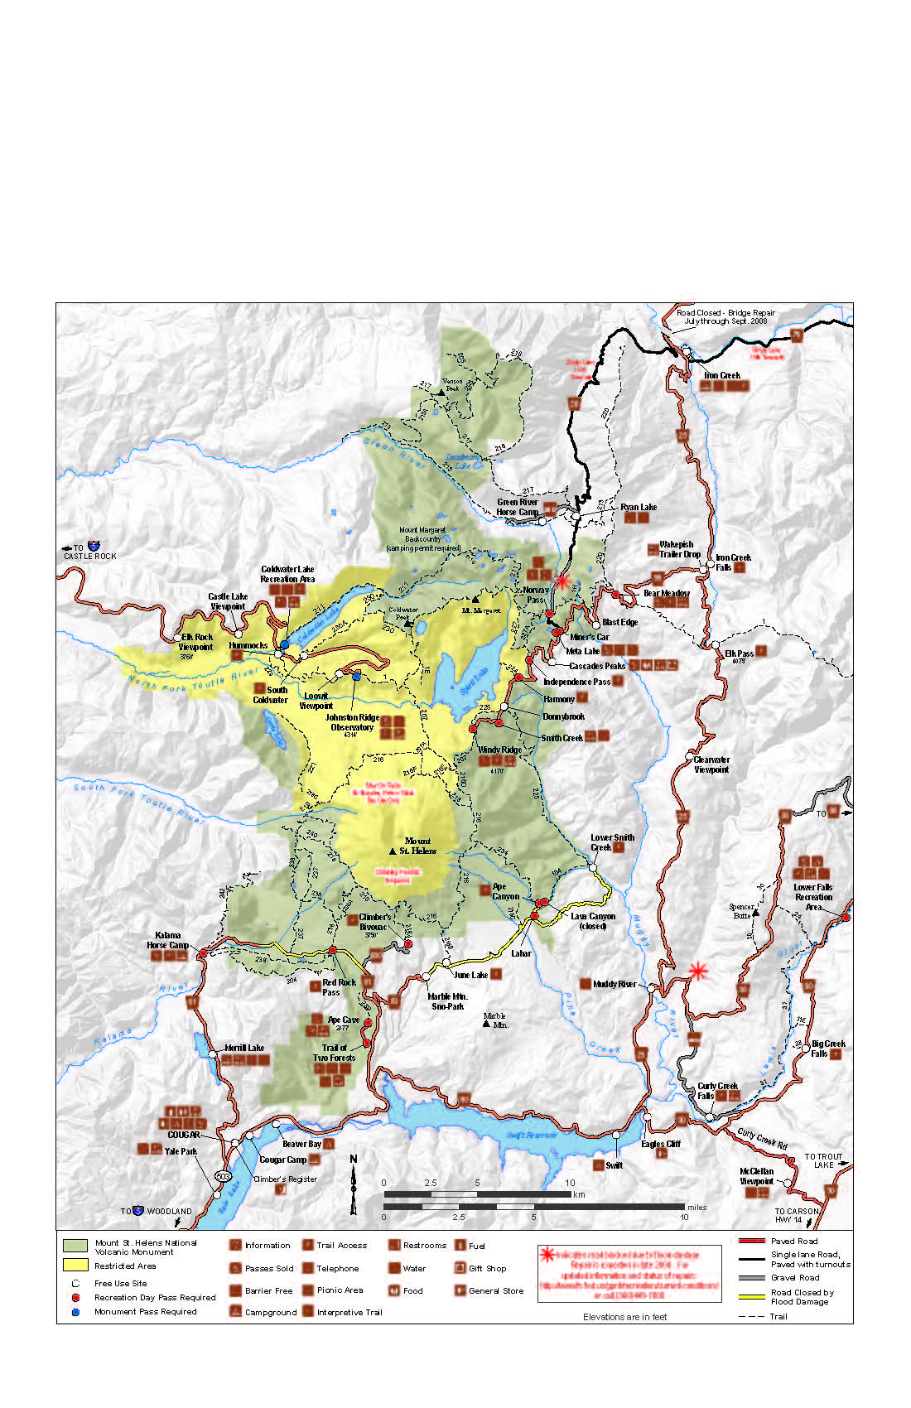
Mount St. Helens National Volcanic Monument
44,700 hectares, established in 1982

Slide 8
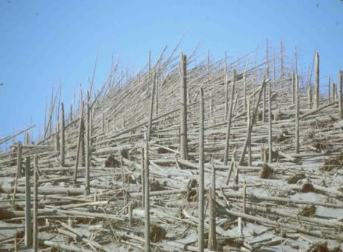
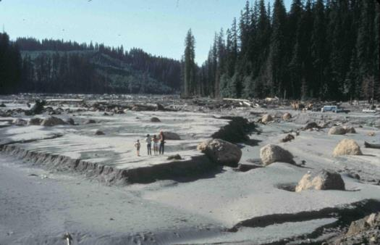
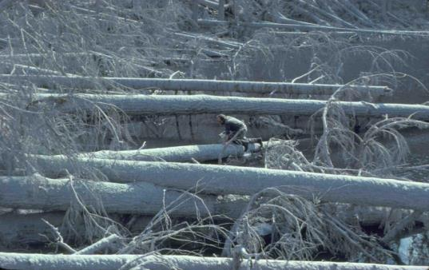
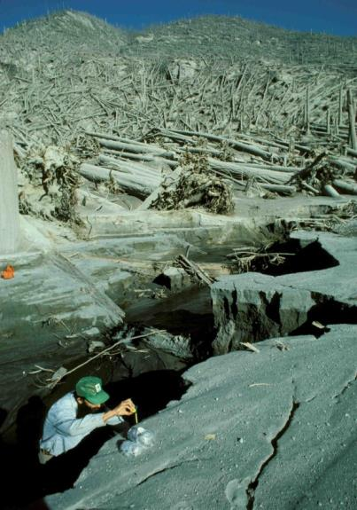
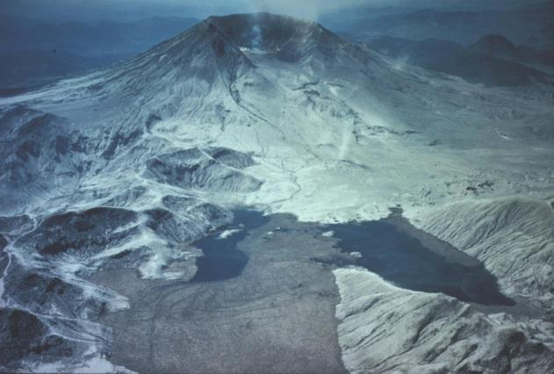
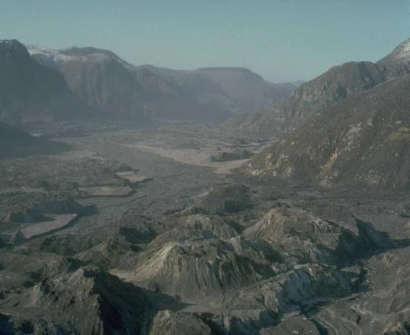
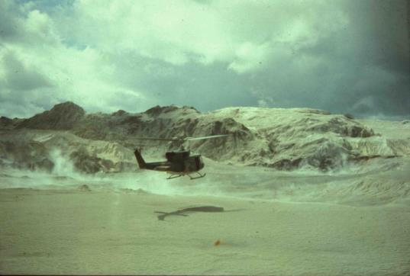
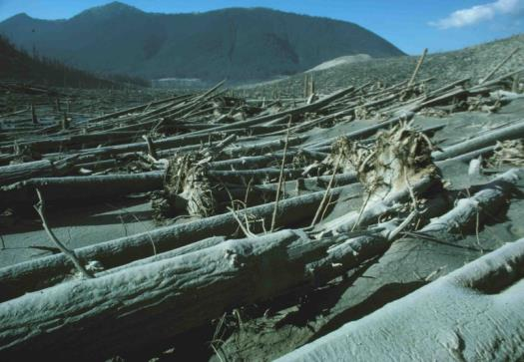
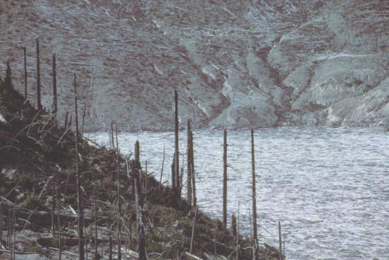
Eruption Features
Compelling Stories and Landscape Features
Notes:
Eruption Features

Slide 9
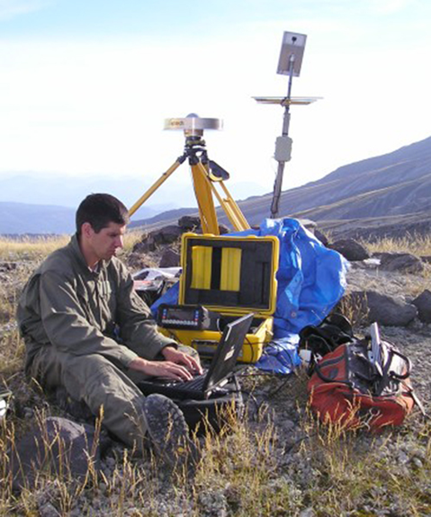
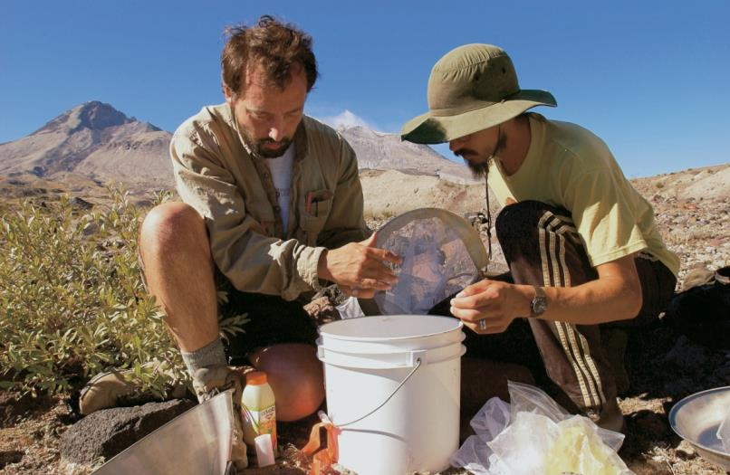
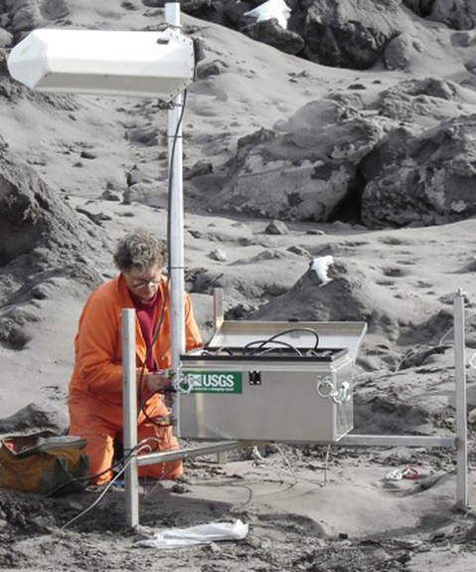
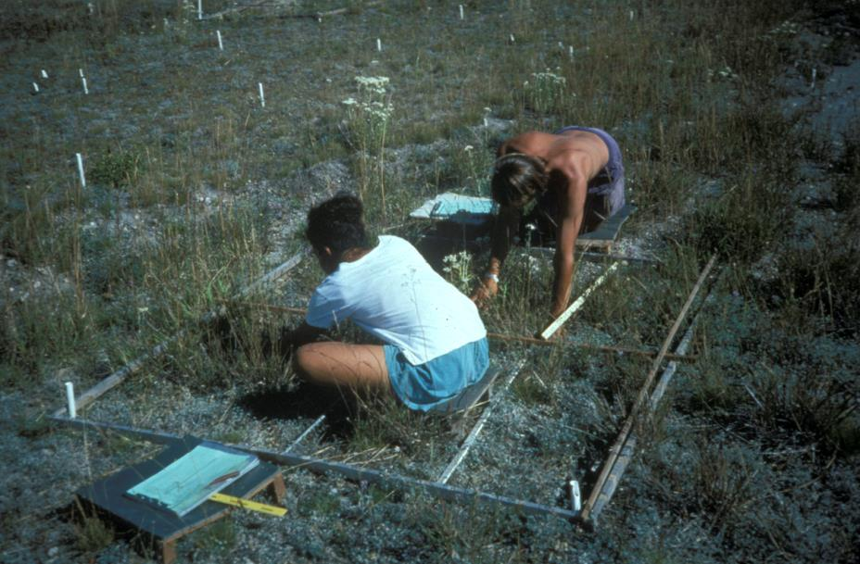
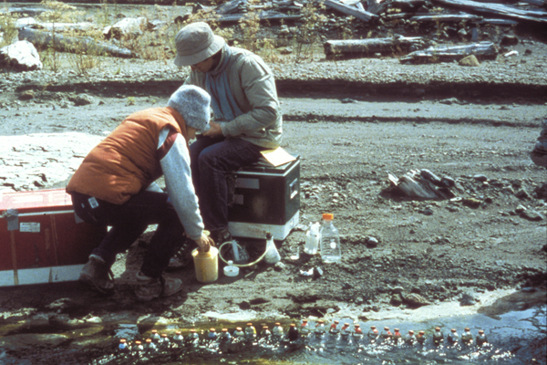
Collaborative Geologic and Ecological Research

Slide 10
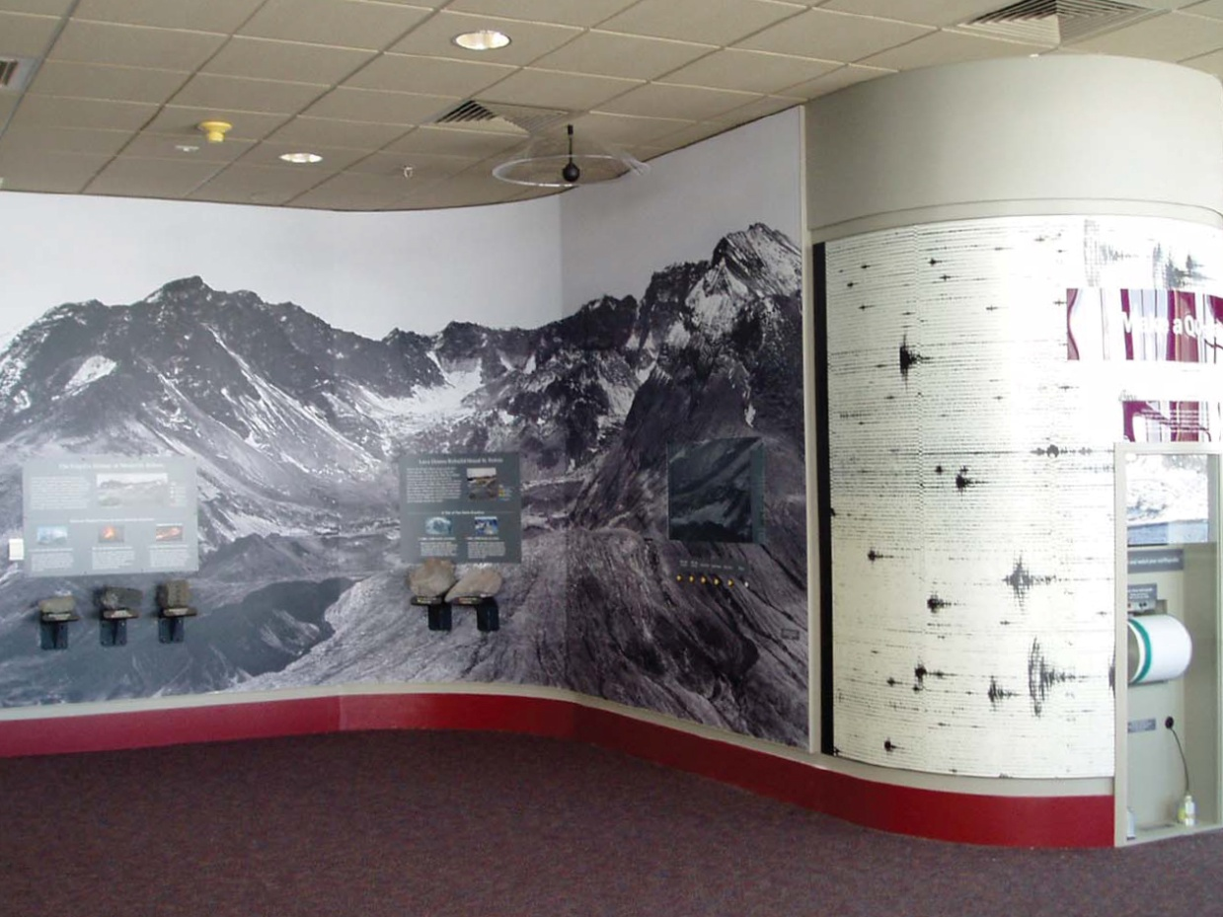
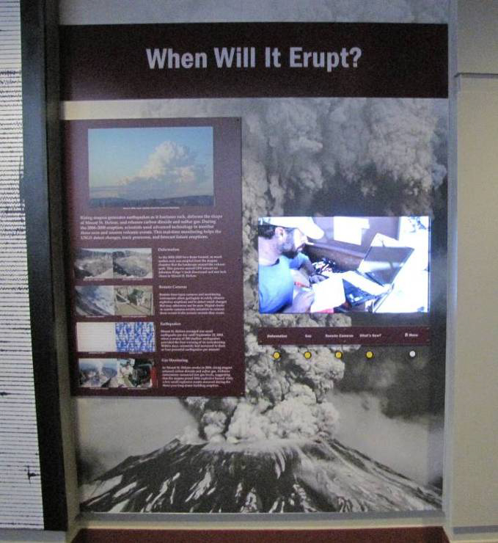
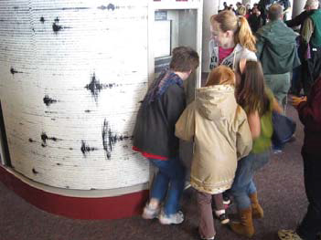
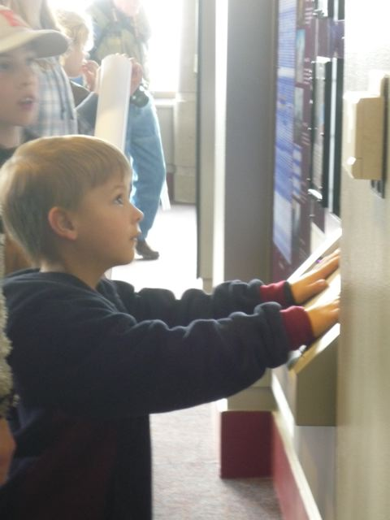
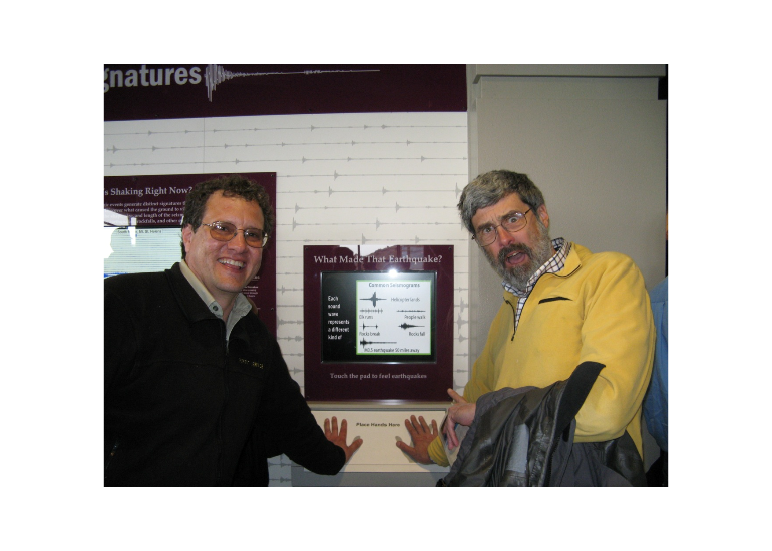
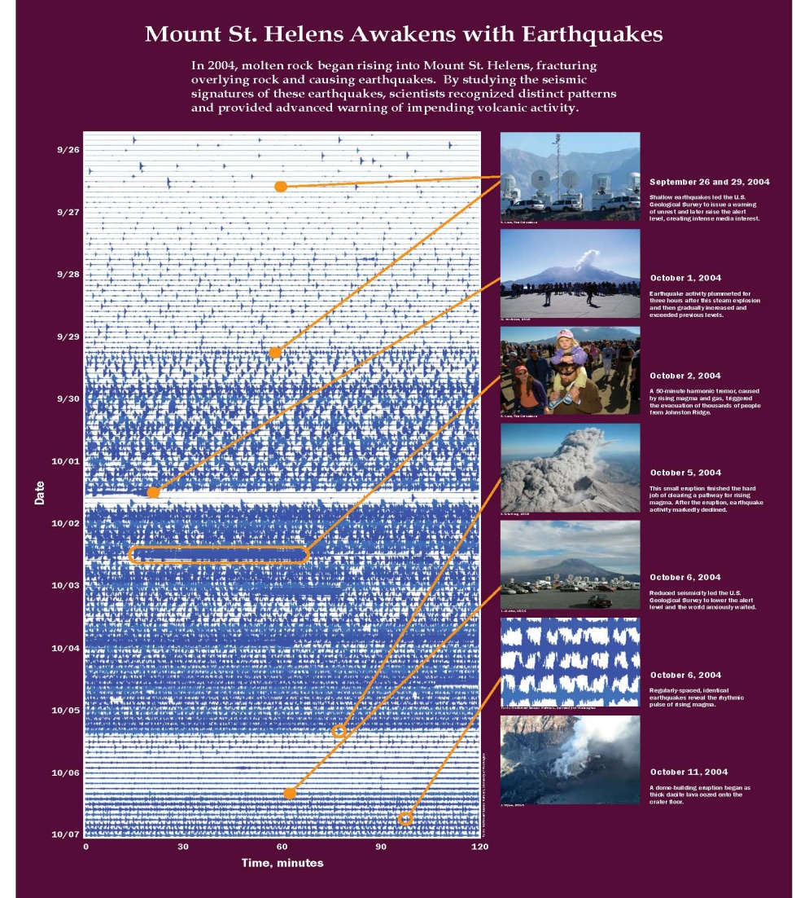
Strong Science Collaboration Benefiting Programs and Exhibits

Slide 11
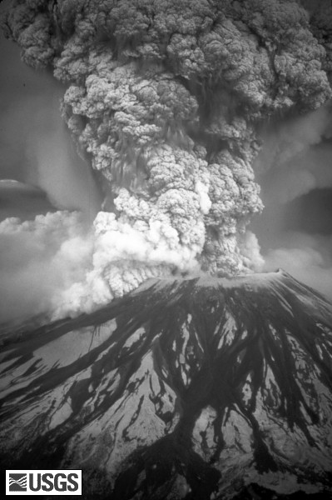
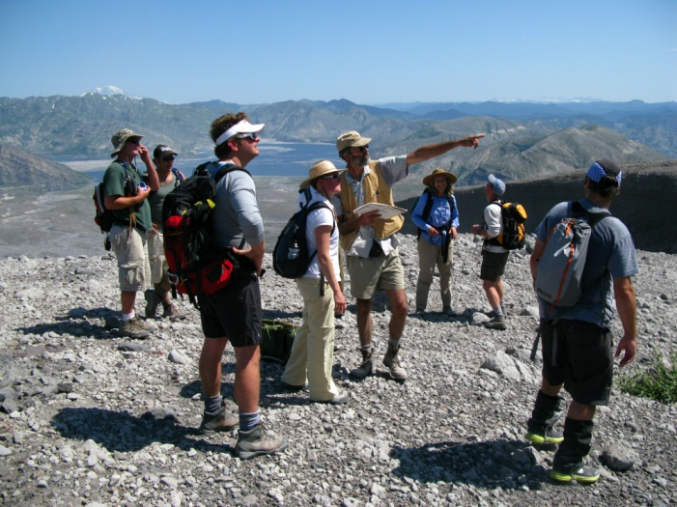
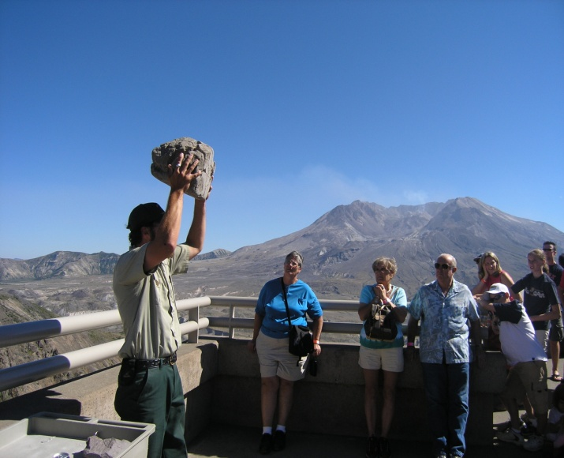
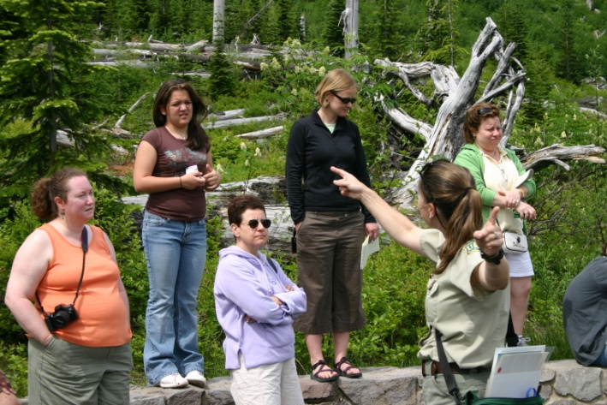
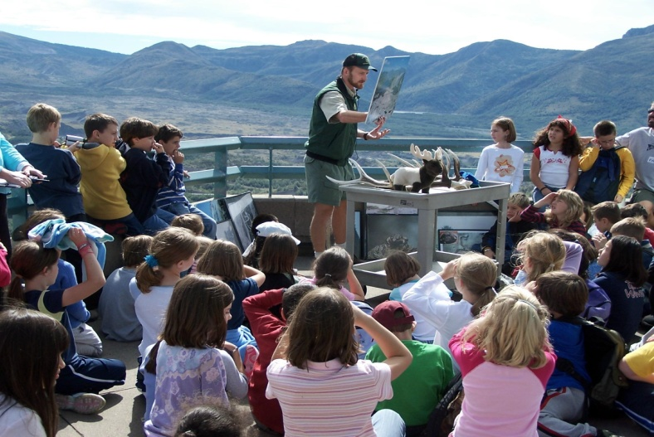
Effective message-based programs that are concise, personally relevant…
…and capture the hearts and minds of visitors of all ages.
Mount St. Helens, 1980

Slide 12
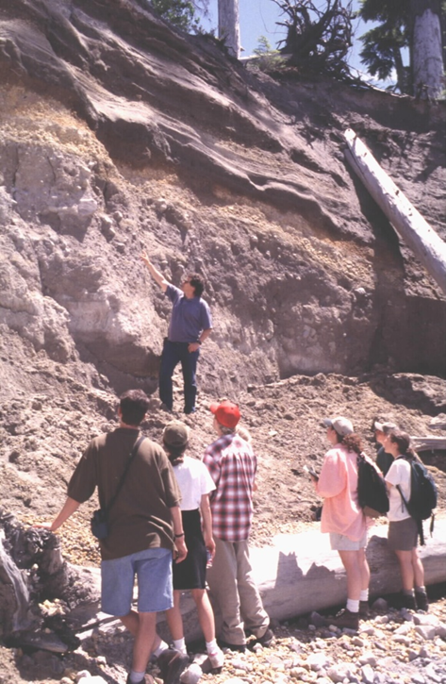
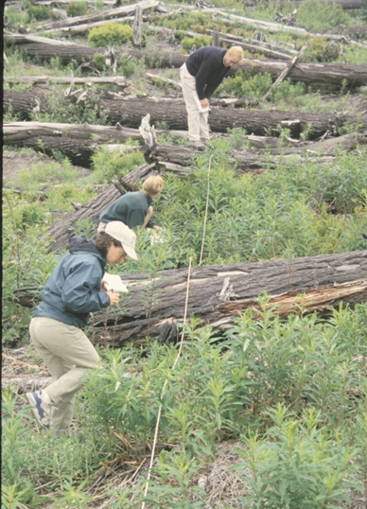
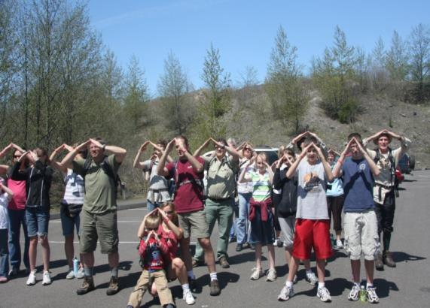
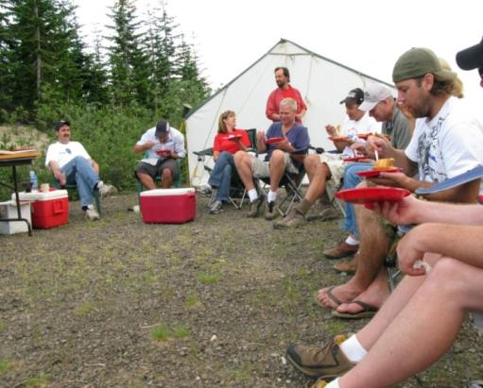
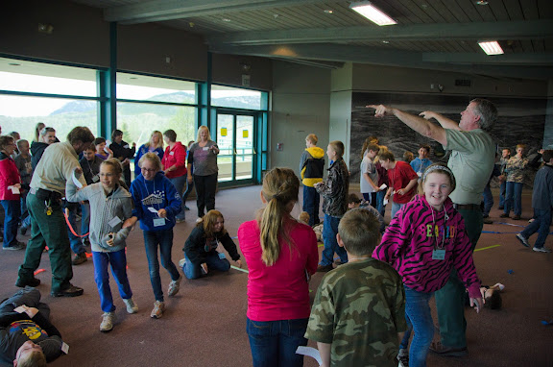
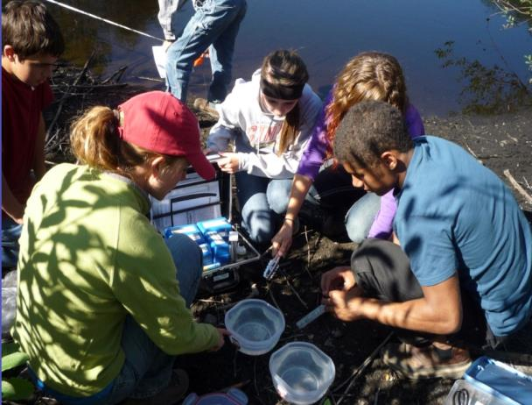
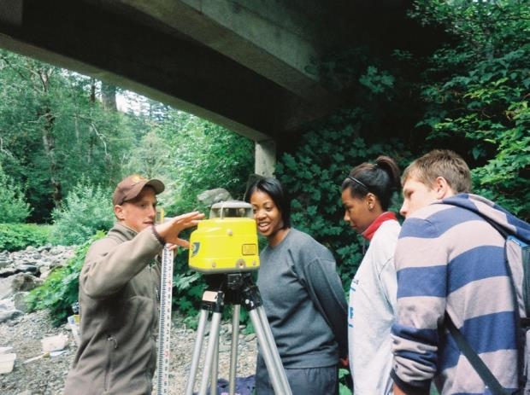
Unparalleled Hands-On Research
and Learning Experiences …
Teacher Workshops
Field Seminars
Guided Hikes
Field Trips
School Activities
STEM Field Classes
Youth Stream Team

Slide 13
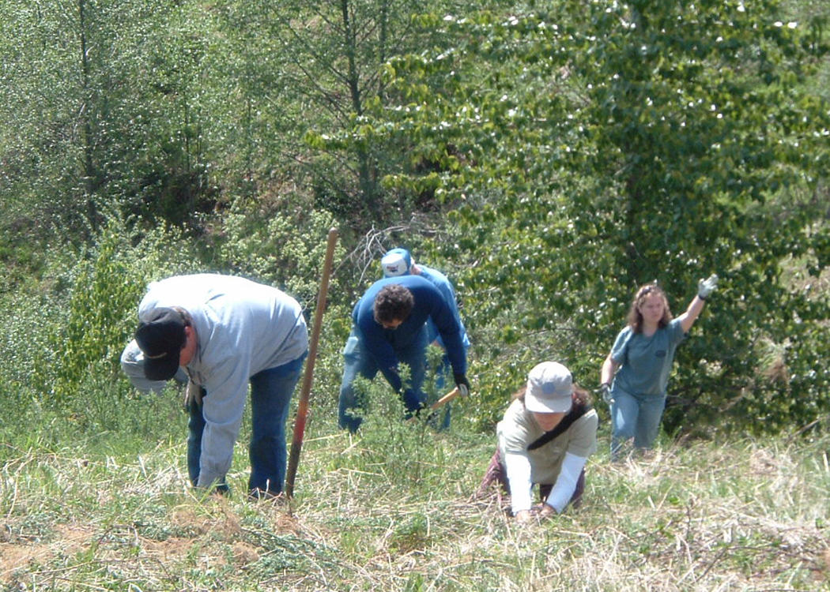
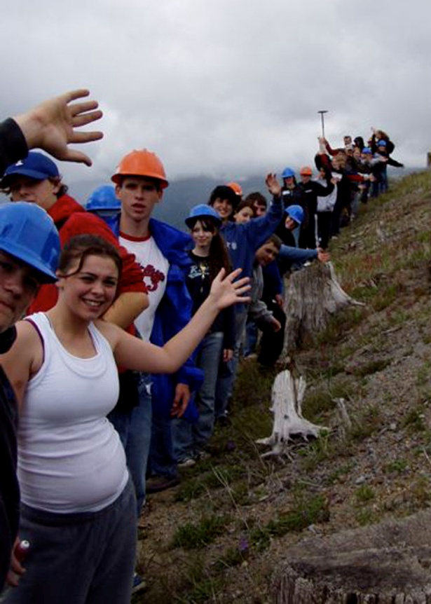
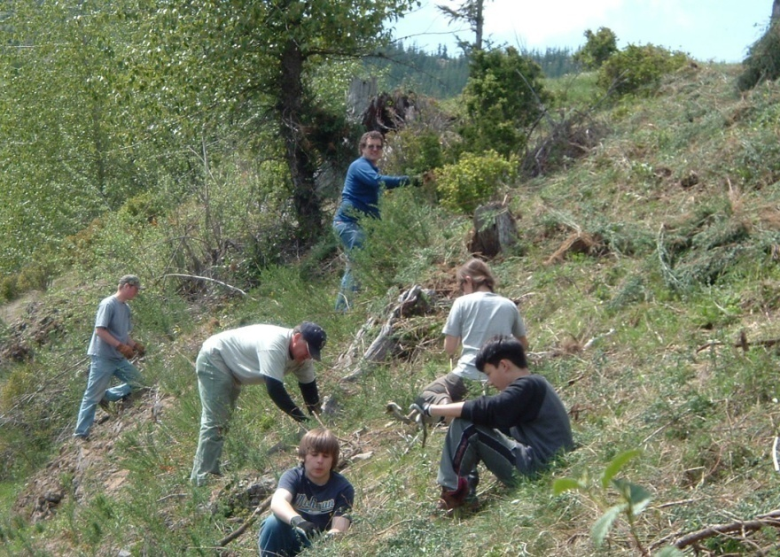
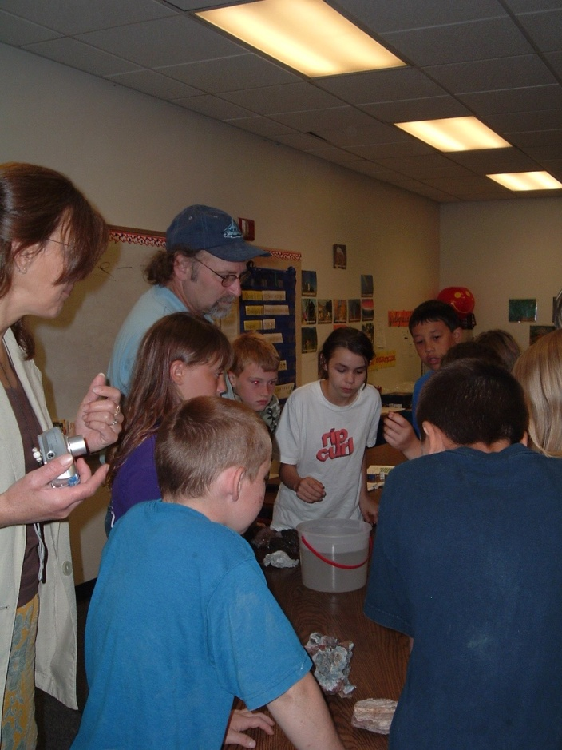
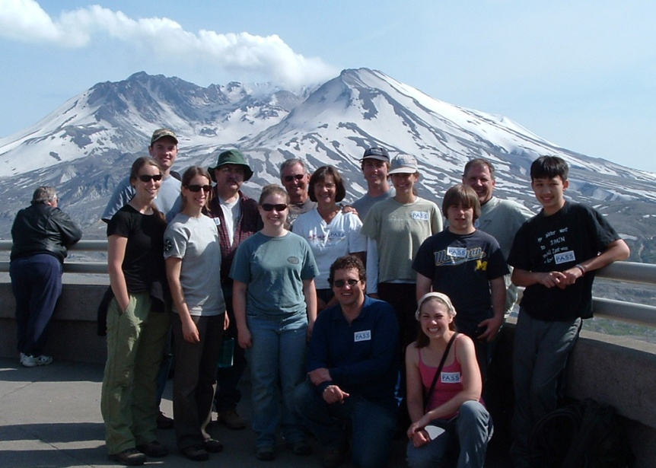
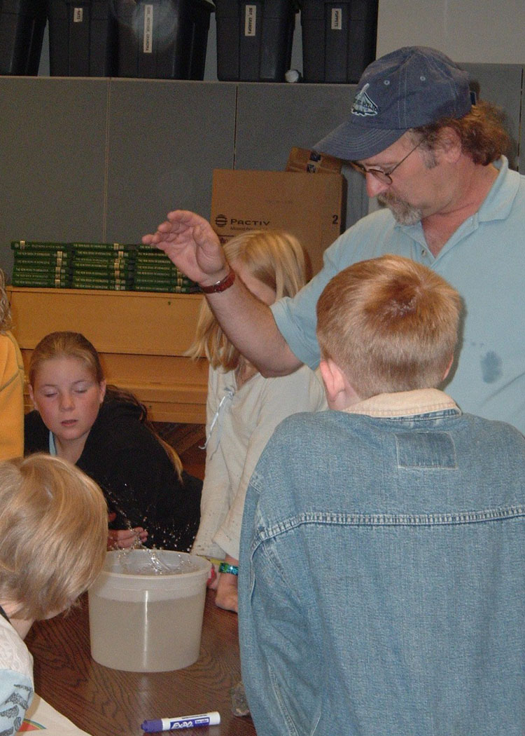
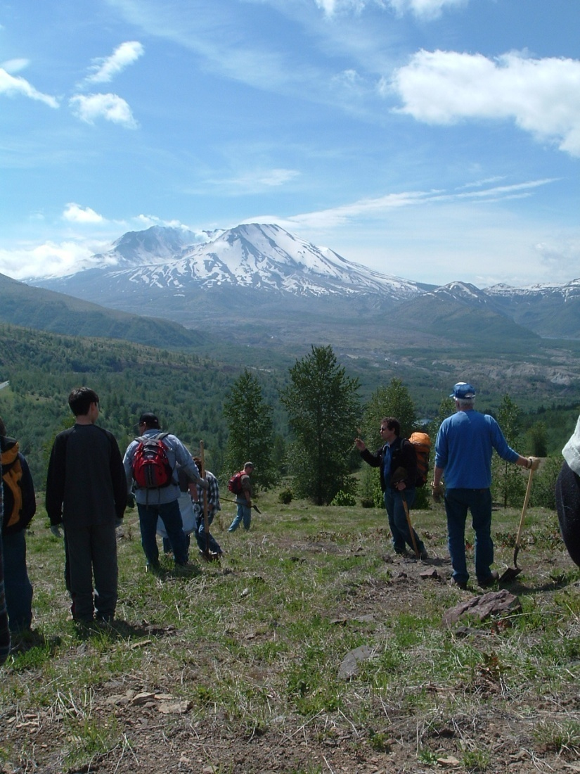
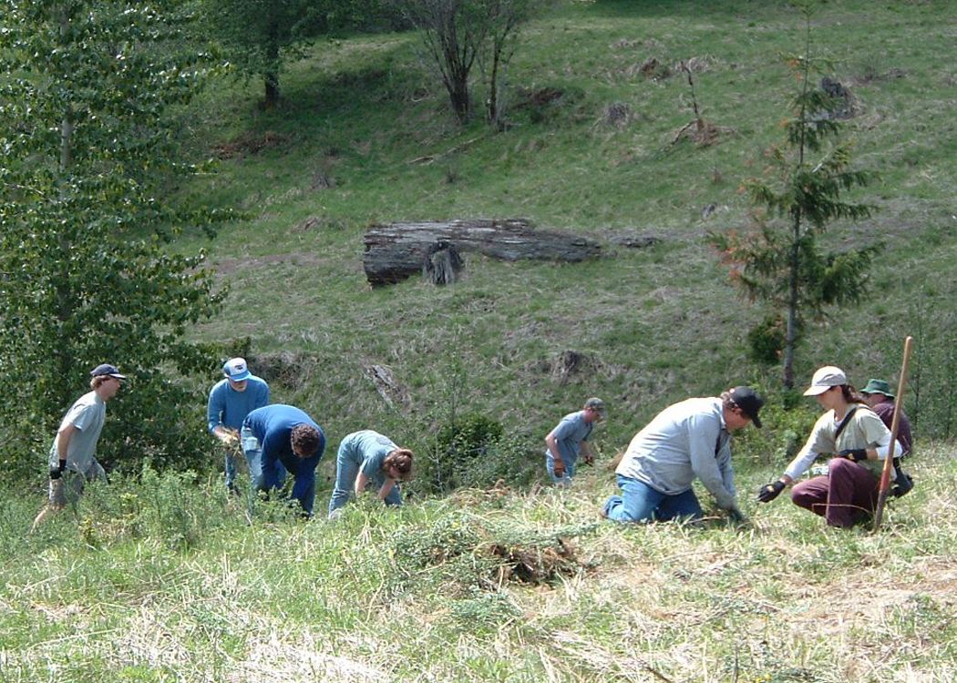
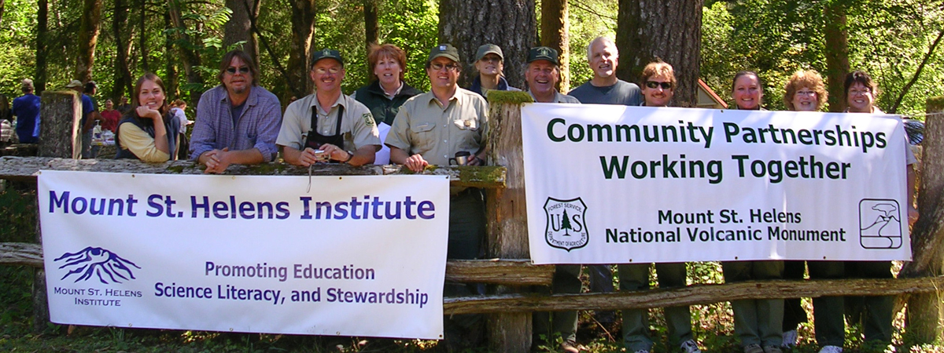

Dedicated Partners and Volunteers
3rd Annual Mount St. Helens Weed Rodeo – June 28, 2008
Get Involved. Become a Volcano Volunteer

Slide 14
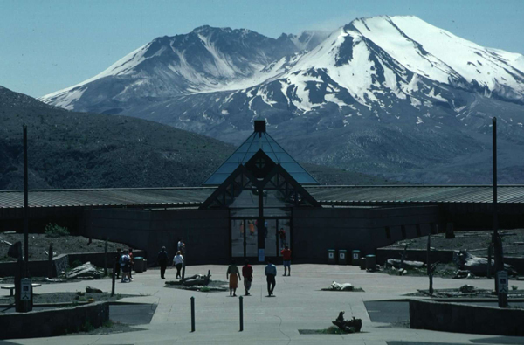
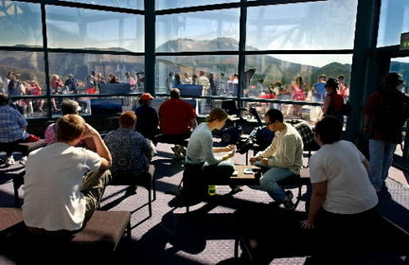


Mount St. Helens Science and Learning Center
Connecting People with Nature through Science, the Arts, and Adventure Recreation

Slide 15


Excellent Venue for
Programs and Events
*
Event / Exhibition Space

Slide 16

Sci
Sci
Capital Campaign to Develop Group Campsites and Cabins
Sci
Sci
Sci
Sci
Toilet
Group 1
Group 2
Shelter
To Johnston Ridge
Group 3
Toilet
MSHI Group site
Field Camp Parking
Cabins
Possible Future RV Camping
Trail to Coldwater Lake
Possible Public Walk-in Tent Sites
& Cabins
Sci & Lrng Center
Interpretive Trail/ Env. Educ. Area

Slide 17


Science and Learning Center Website
www.mshslc.org

Slide 18

Stay tuned . . . our adventure continues. . .
Contact: Peter Frenzen mshslc.org
(360) 449-7835 pfrenzen@fs.fed.us
Thank you.

