Slide 1
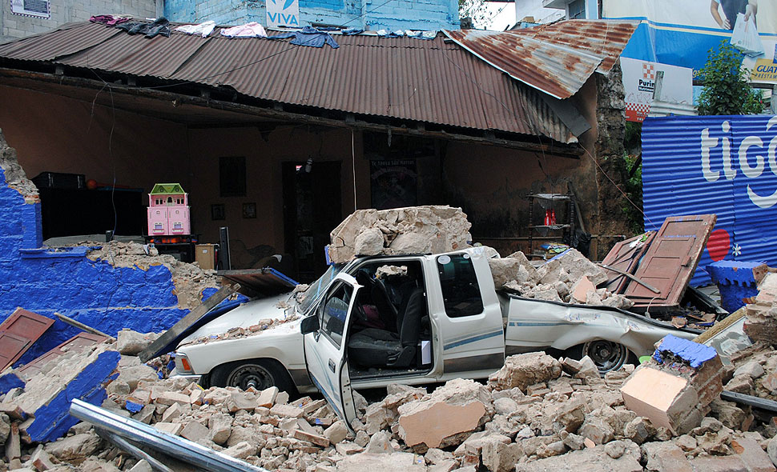
Increasing Resilience to Earthquakes:
Teaching Earthquake-Resistant Building Techniques in Guatemala
Ciudad de San Marcos, November 7, 2012
BBC News photo
Prof. David C. Greene, Dept. of Geosciences, Denison University

Slide 2
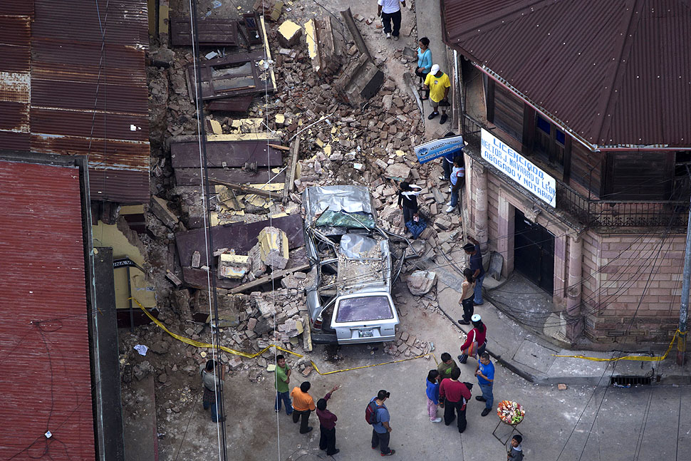
Ciudad de San Marcos, November 7, 2012
BBC News photo

Slide 3
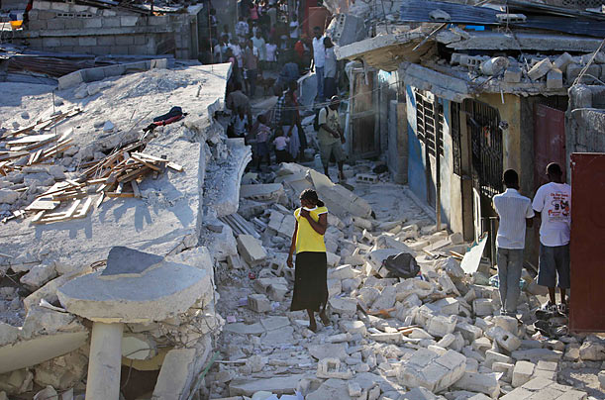
chicagofree.info
Haiti 2010

Slide 4
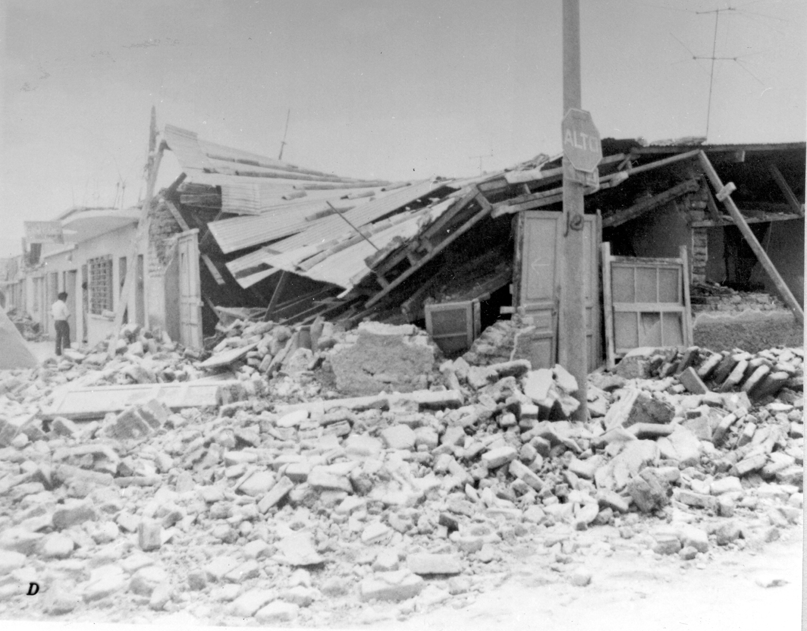
Guatemala City 1976
Photo USGS

Slide 5
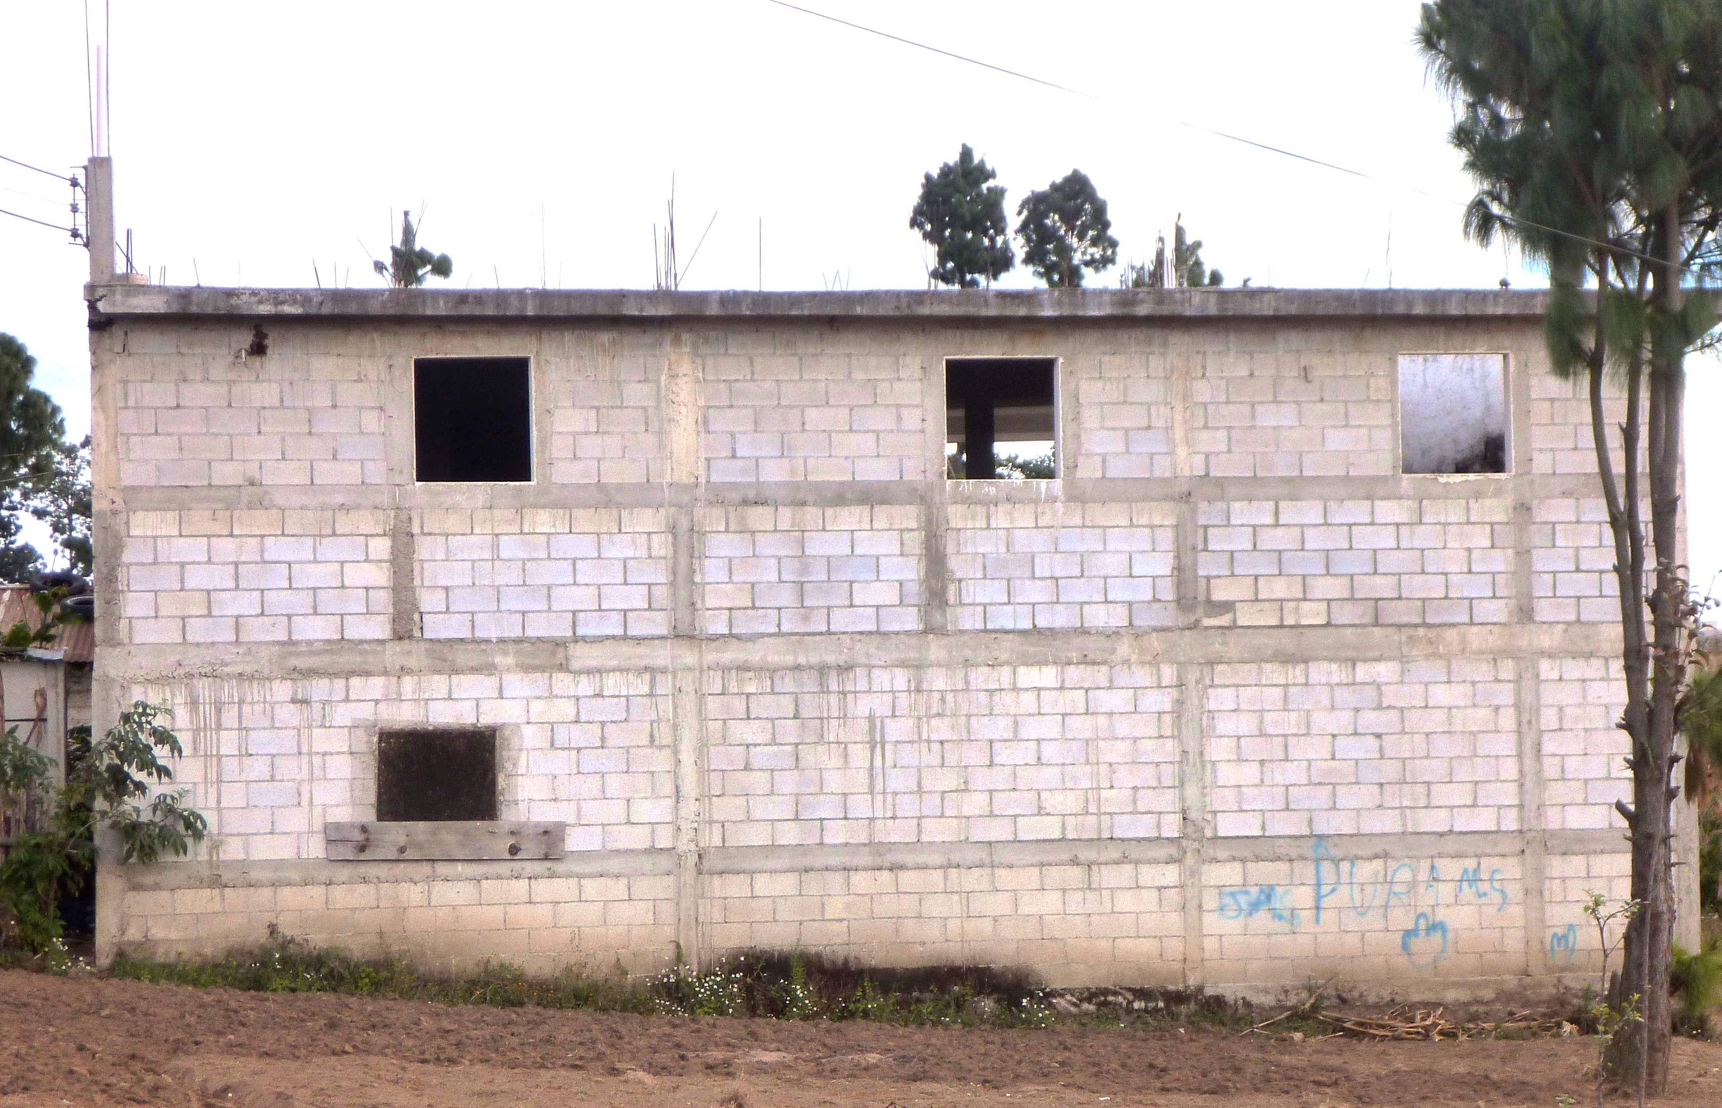
One Solution:
Improve Building Practices at the Local Level
Earthquake-resistant building techniques have been developed by the civil engineering community.
  Use the same concrete and masonry block construction typical
  in the developing world.
Technique is called Confined Masonry.
  Effective in low-tech environments
  Requires only modest changes from customary building practices.
Major challenge remains
disseminating these techniques to local builders.

Slide 6
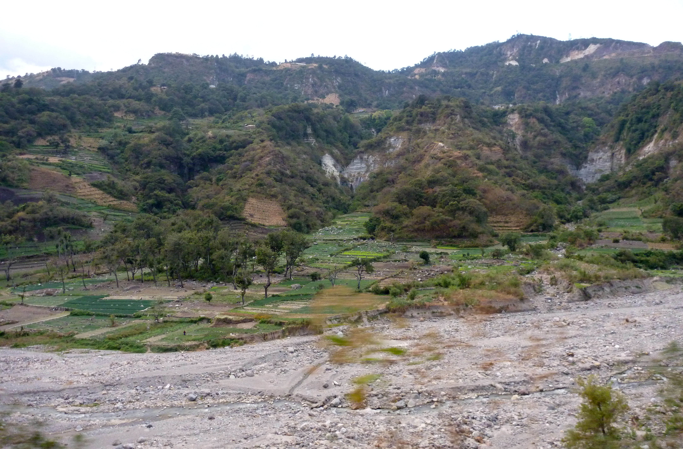
Main Points
Introduce principles of Confined Masonry
  as an appropriate technique for earthquake-resistant building.
Teaching, targeted to a specific problem
can be a powerful intervention
and one that is relatively simple and cost effective.

Slide 7
Riesgos de Terremoto y Construcción Sismorresistente en Guatemala
Prof. David C. Greene
Dept. of Geosciences
Denison University
Estados Unidos
Photo USGS
Ciudad de Guatemala 1976

Slide 8
¿Qué sucede con los edificios durante un terremoto?
Durante un terremoto
Los terremoto
empuja hacia los lados

Slide 9
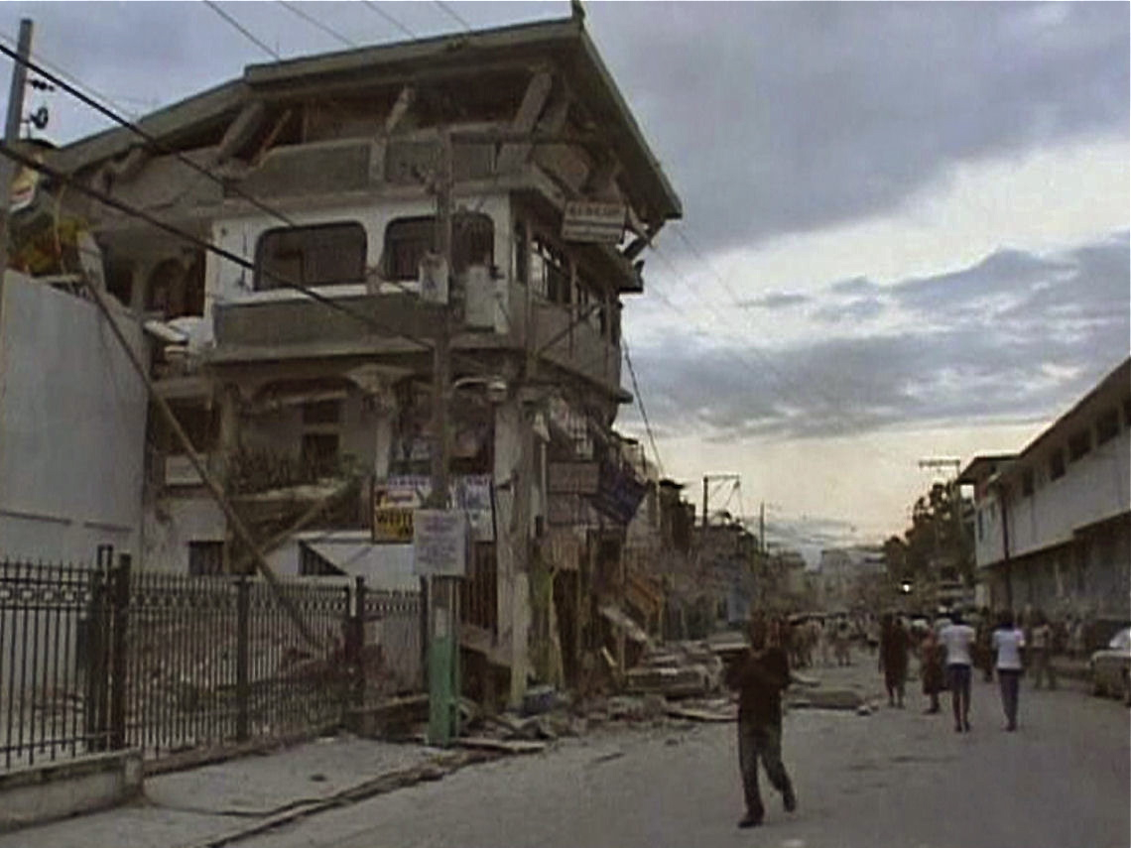
Haiti 2010
Reuters/Reuters TV

Slide 10
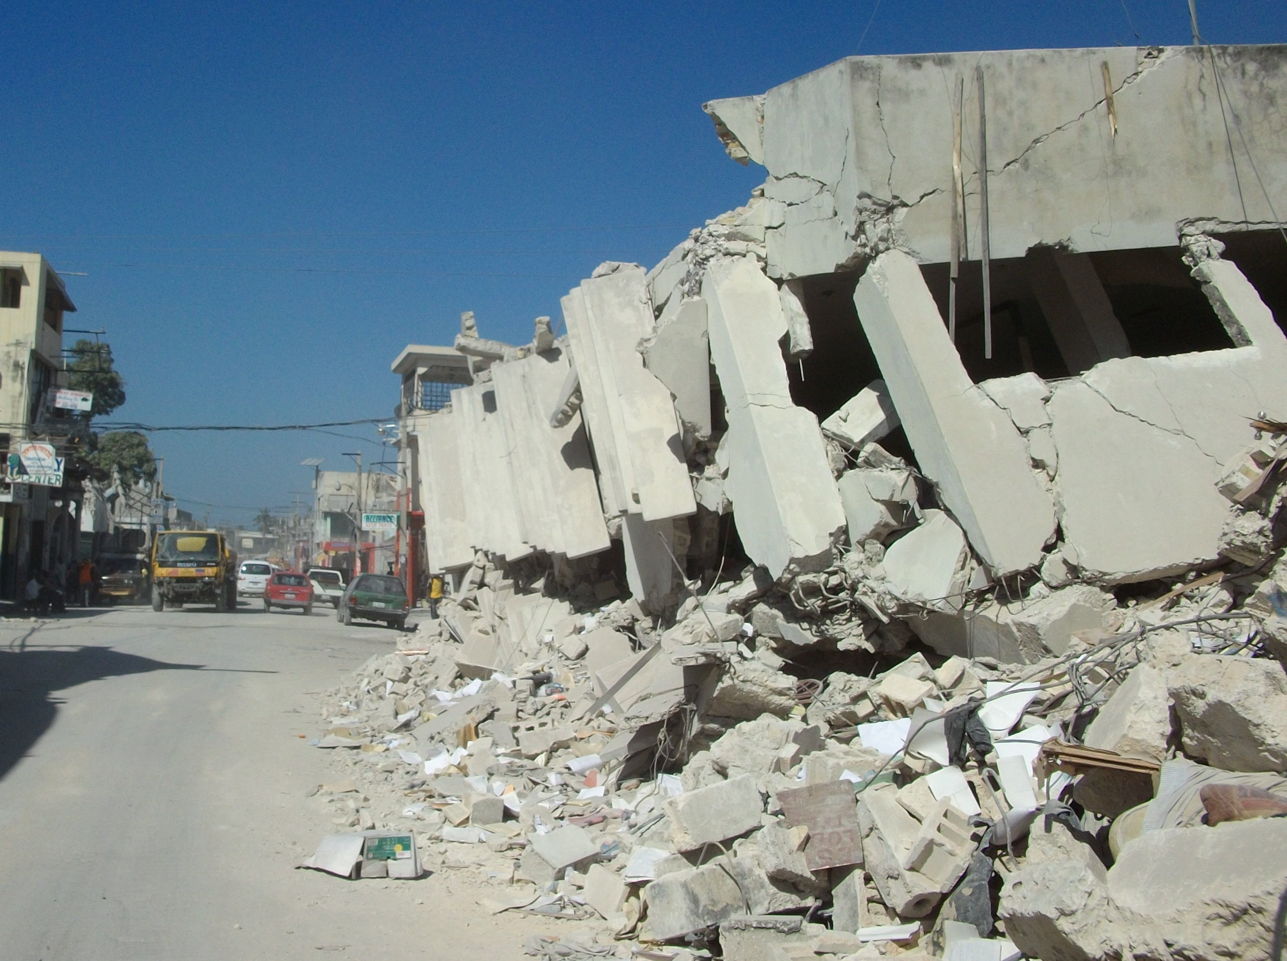
Haiti 2010
haitigps.wordpress.com

Slide 11
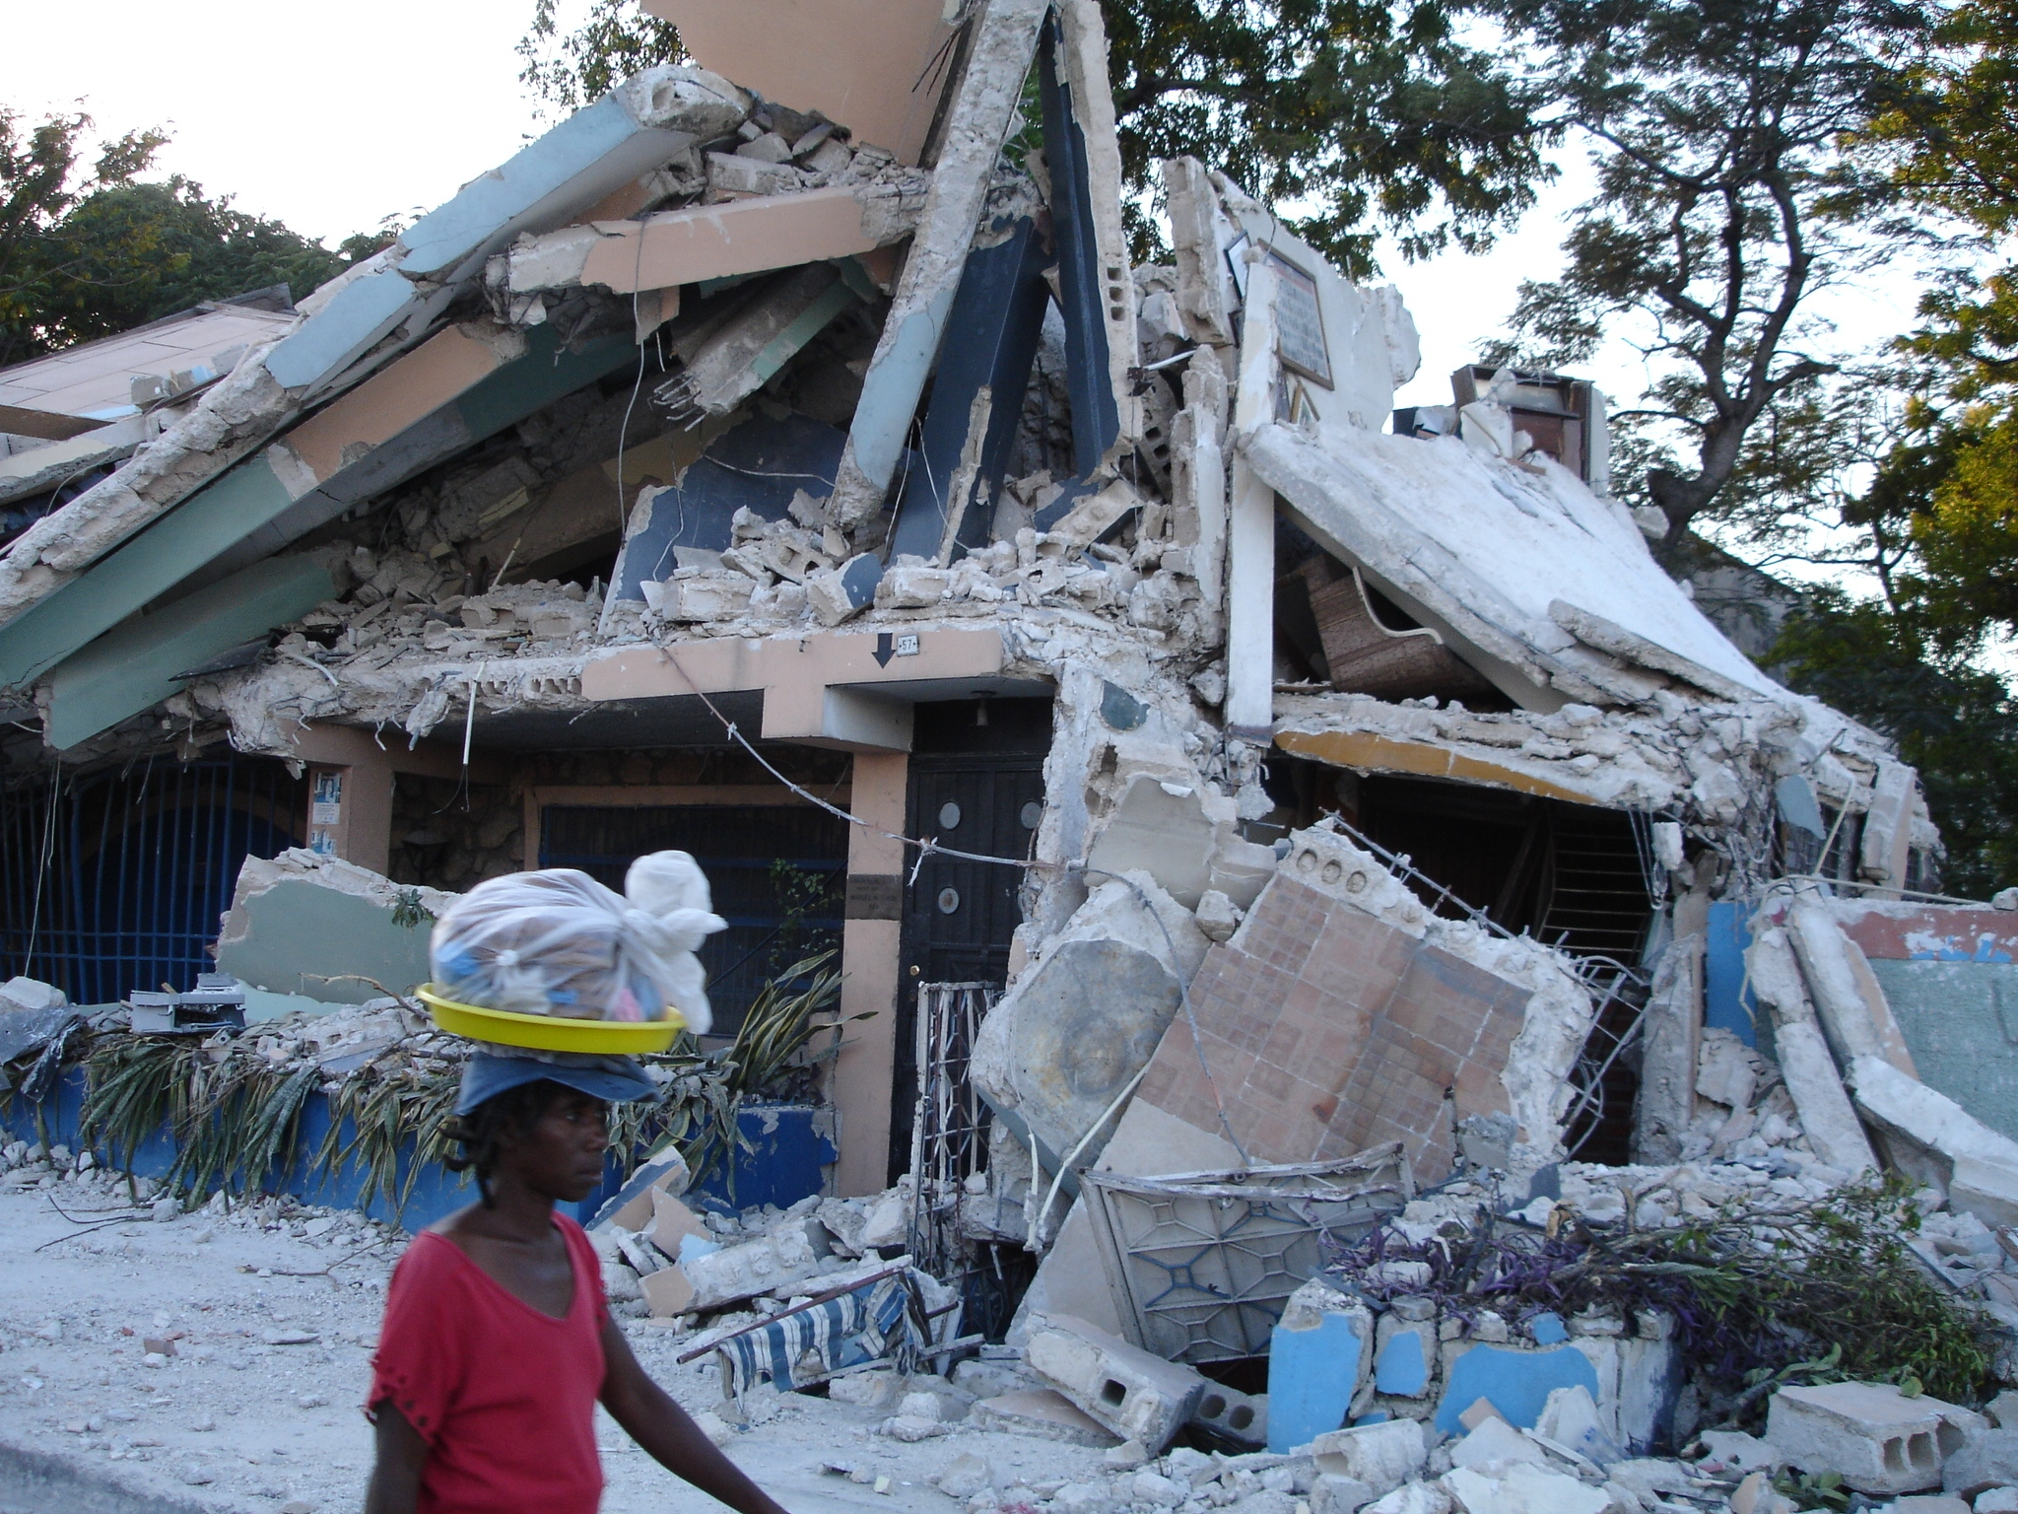
Haiti 2010
Lansingunited.org

Slide 12
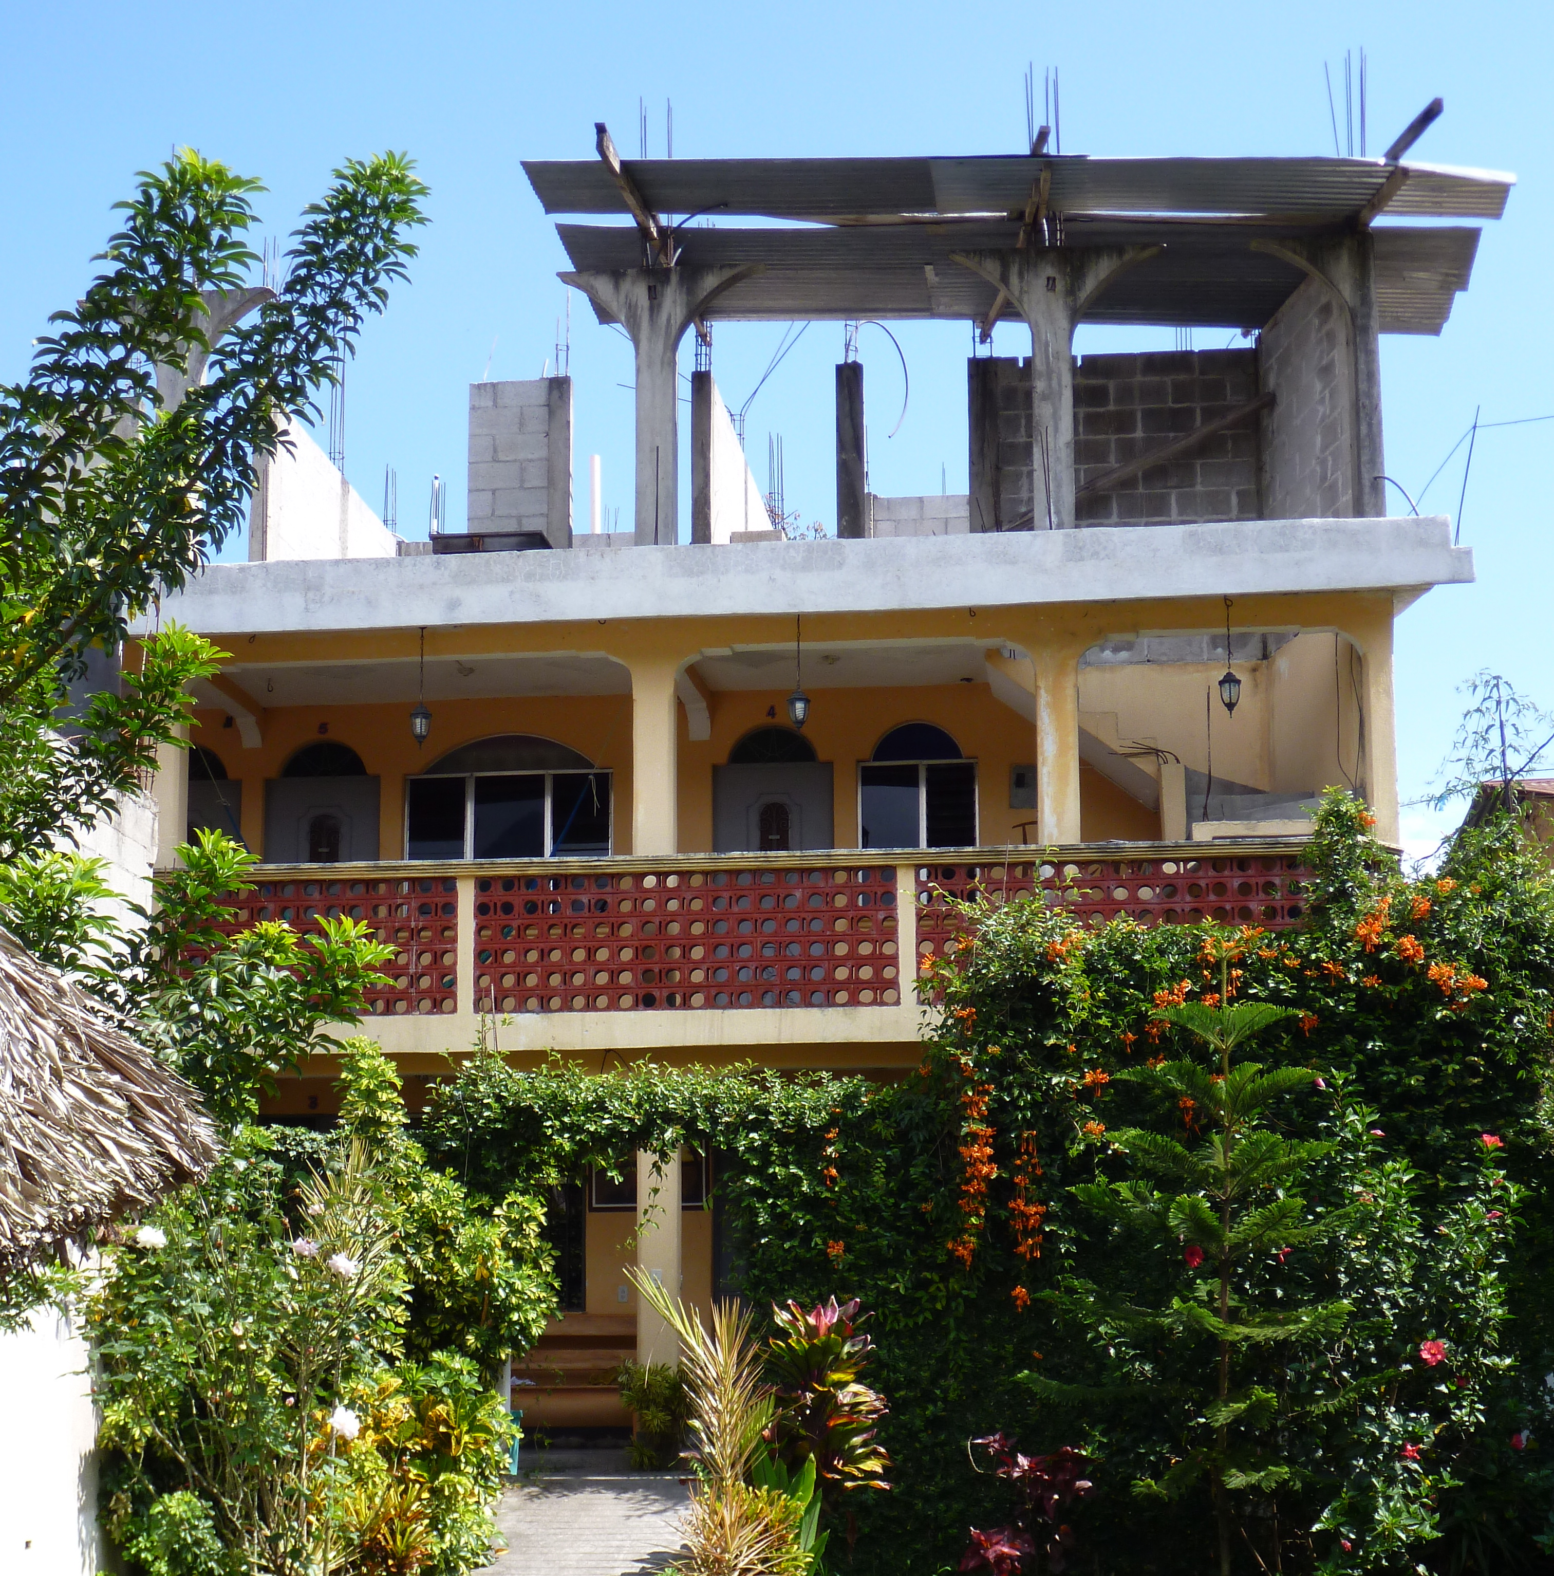
Técnicas de construcción con concreto y mampostería
Marco de concreto reforzado
El marco se resiste a los terremotos
Bueno si diseñado por un ingeniero

Slide 13
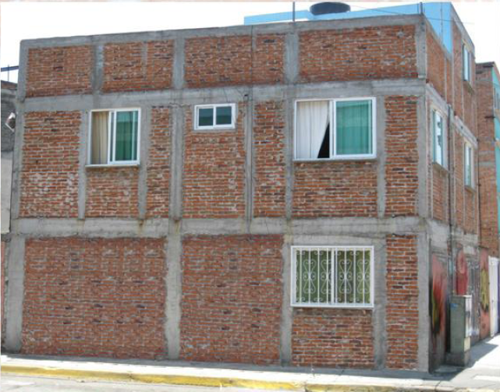
Técnicas de construcción con concreto y mampostería
Mampostería Confinada
Los muros se resiste a los terremotos.
Bueno para la construcción de los hombres
(Meli et al., 2011)

Slide 14
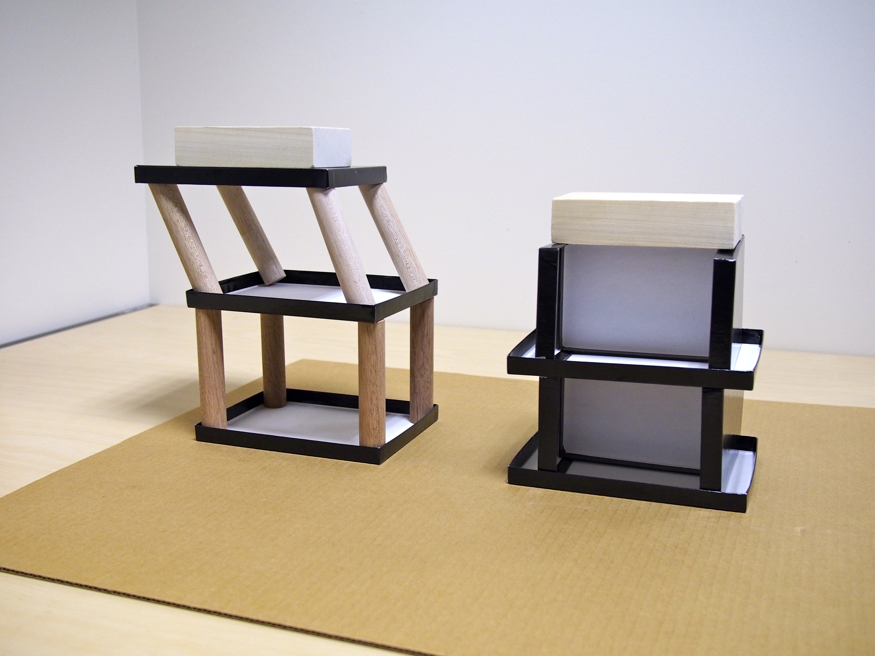
Demonstration
Columns versus Walls
During Earthquake Shaking

Slide 15
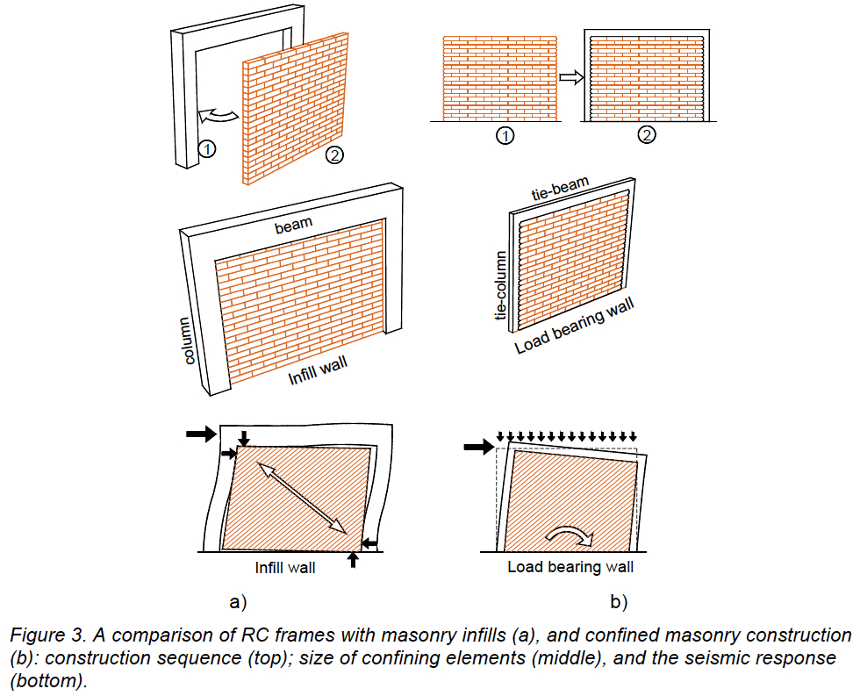
Marco de Concreto con Mamposteria
Muro de Mampostería Confinada
(Meli et al., 2011)

Slide 16
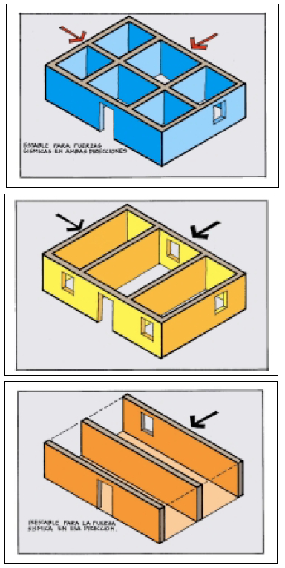
Diseño Sismorresistente
Si
Muros en las dos direcciones
No
(AIS)

Slide 17
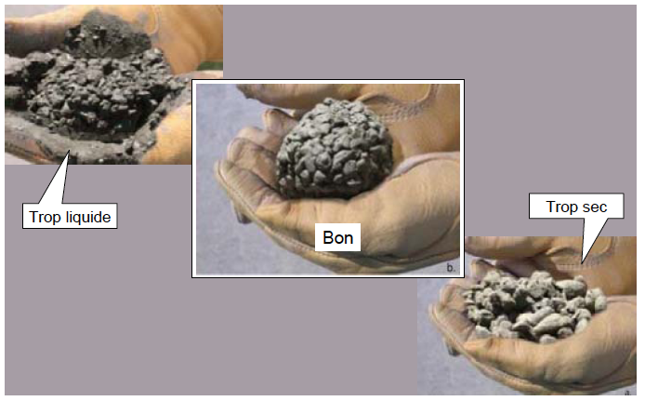
El concreto es mucho más fuerte
con la cantidad correcta de agua
Los detalles son importantes
Muy Liquido
Muy Seco
Bueno
Tom Schacher du Centre de Compétence Reconstruction, 2011

Slide 18
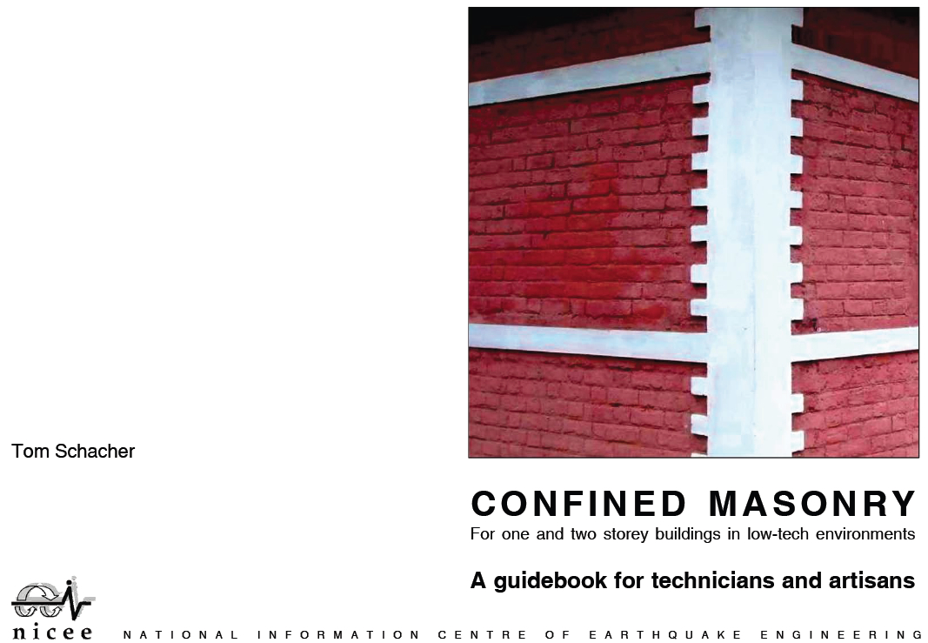
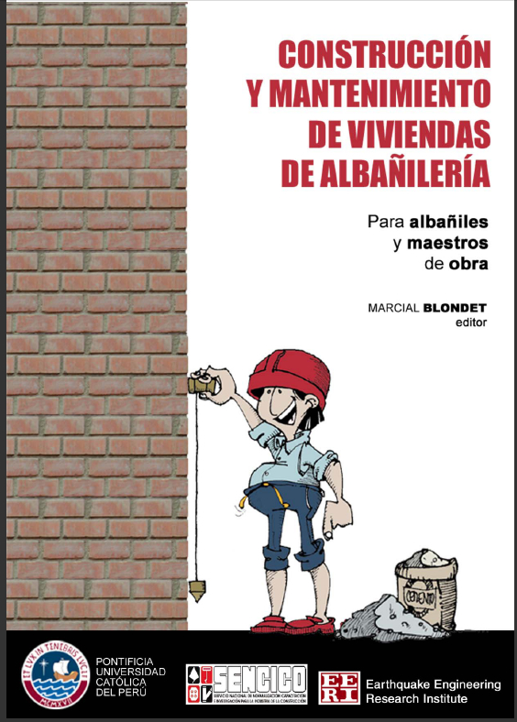
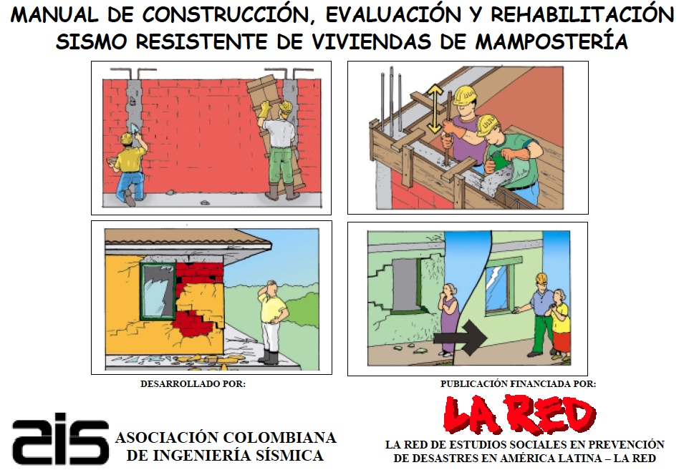
Más Información
Greened@denison.edu

Slide 19
Initial Concerns
and Lessons Learned
Will my limited expertise be useful?
  Yes. What’s needed is not necessarily an engineer, but someone who can teach simple engineering.
Will language barriers be a major problem?
No, translators are easy to find.
Can I use a computer for presentations?
Yes! Pictures are ideal for communicating ideas.
    Laptop computers and small projectors are robust and easily transported.

Slide 20
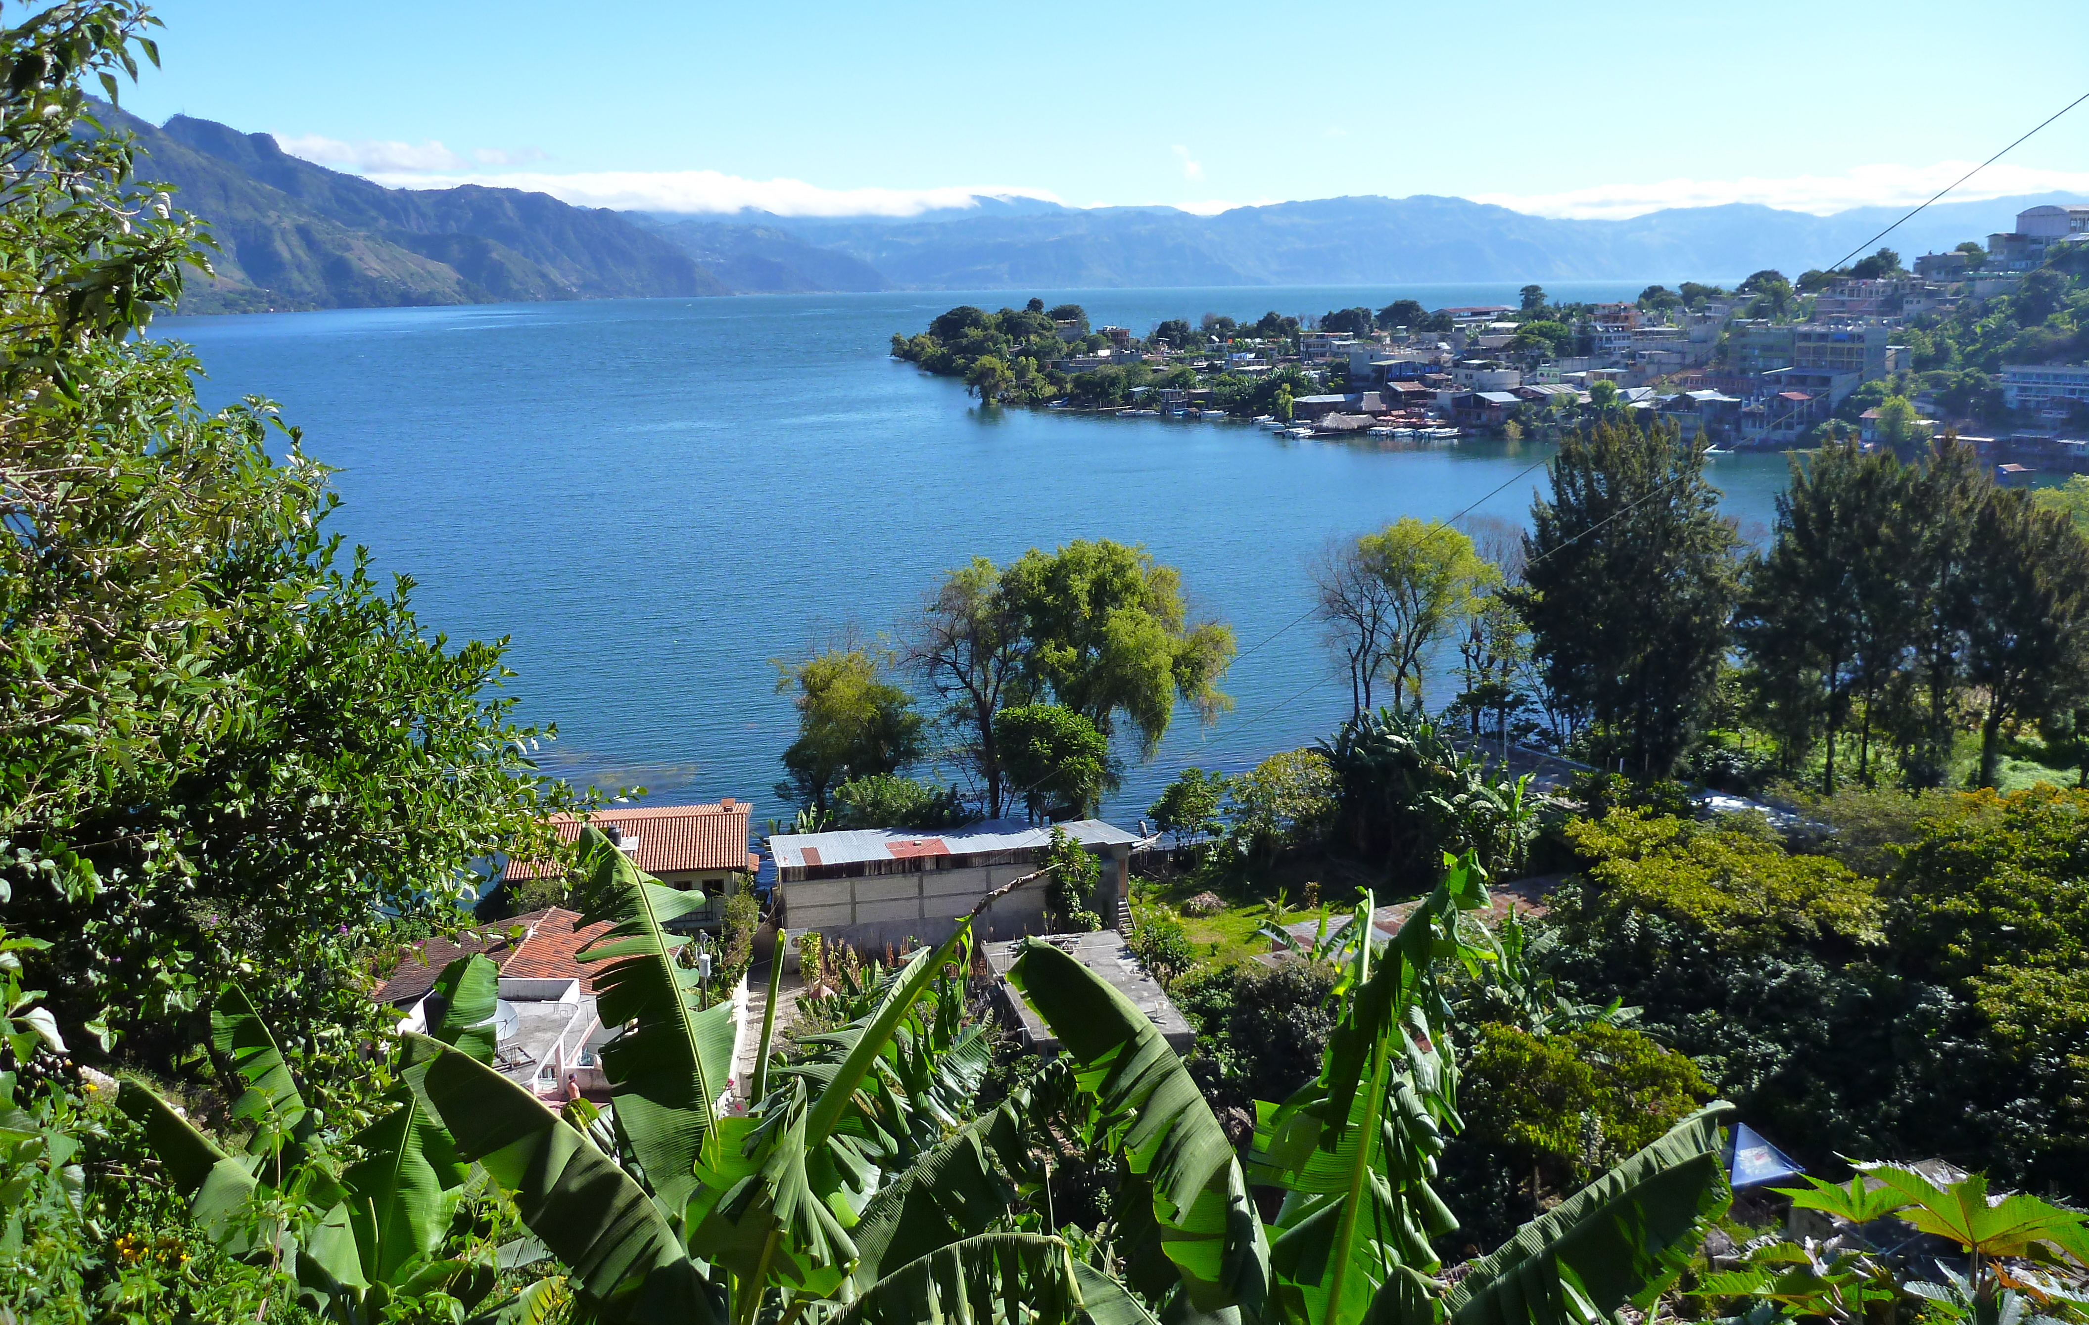
In Summary
There are now techniques for earthquake-resistant building in low-tech environments.
Challenge is disseminating these techniques
Teaching useful and appropriate knowledge is one of the most productive interventions we can make in the developing world.
Major requirement is simply the ability to
teach effectively.
Funding provided by a grant from GLCA New Directions Initiative
Logistical support in Guatemala provided by Mayan Families aid organization

