Slide 1
Adolf Morlot the Measure of Quarternary Time
by
Leonard G Wilson

Slide 2
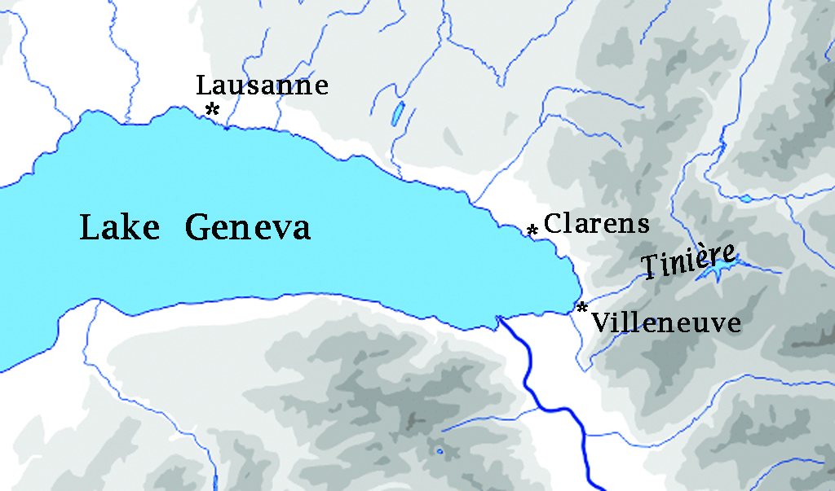
Eastern end of Lake Geneva
N

Slide 3
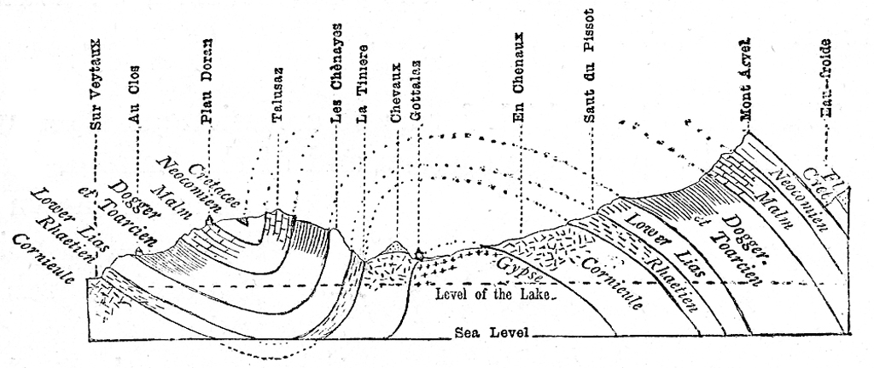
Geological section of the Tinière valley
in Lubbock, Scenery of Switzerland, 1896

Slide 4
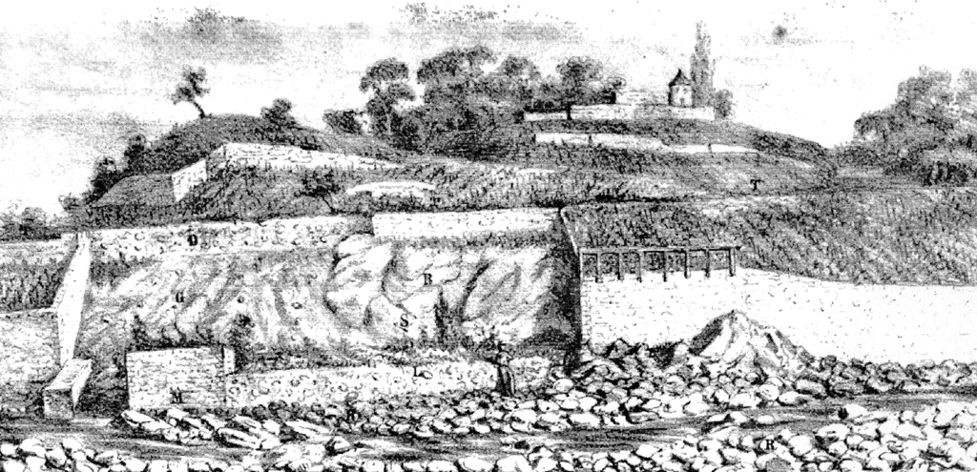
Clarens Section
Glacial clay containing limestone blocks
Alluvium containing rounded pebbles

Slide 5
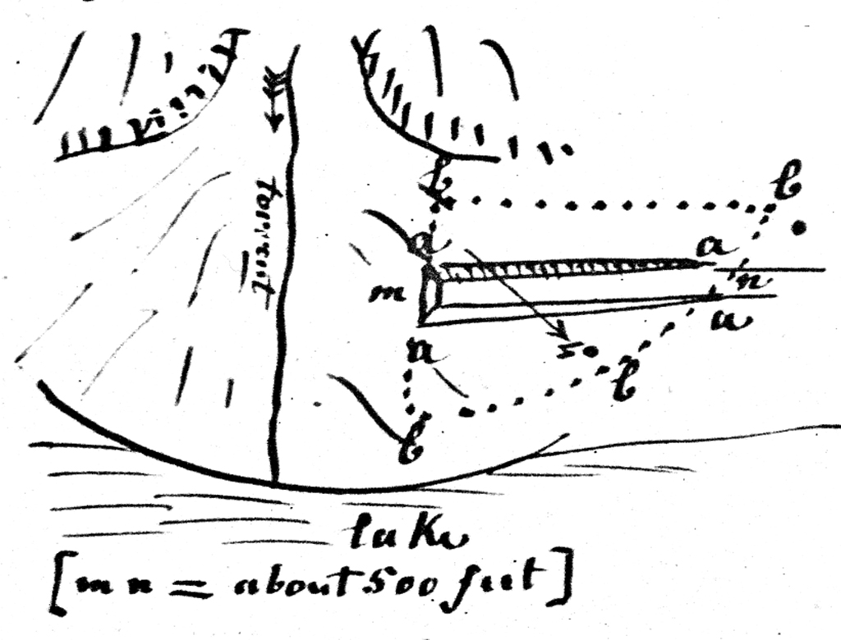
Beginning of railway cut at Villeneuve through the southern half of the Tinière cone.

Slide 6
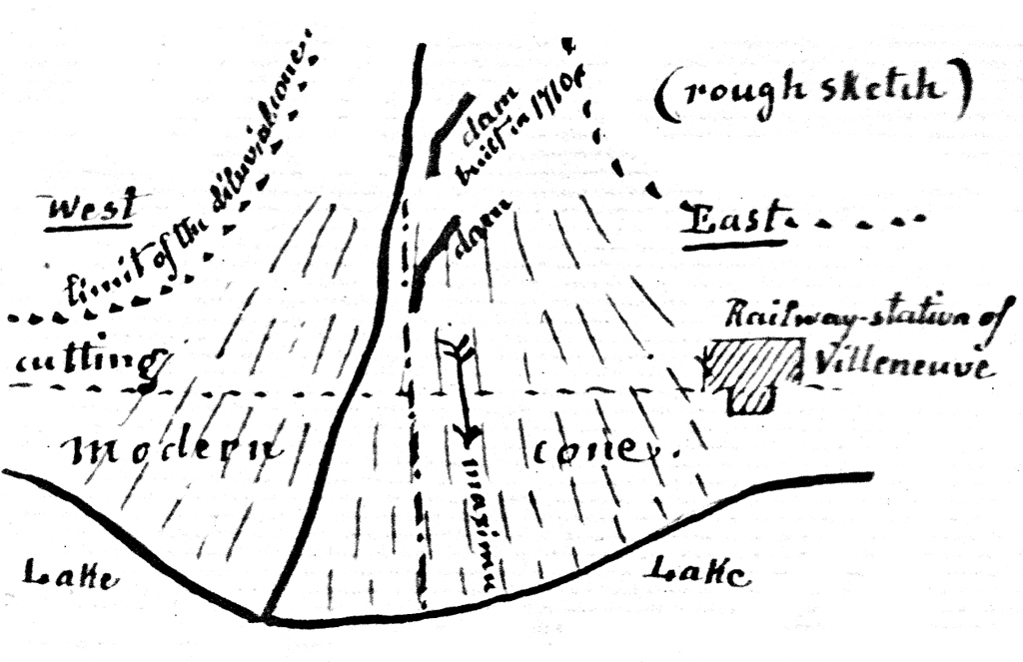
Railway cut through Tinière cone completed in 1860

Slide 7
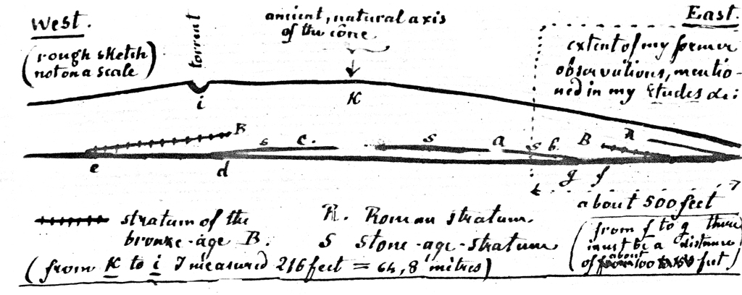
Diagrammatic section through Tinière cone, showing Roman (Iron), Bronze, and Stone Age levels

Slide 8
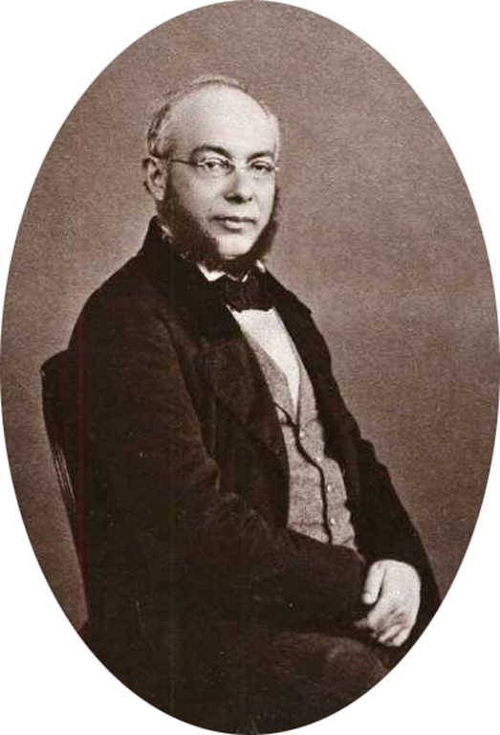
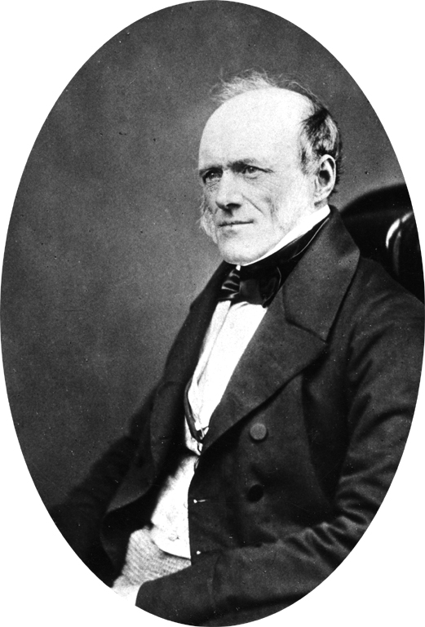
Adolf Morlot
1820 - 1867
Sir Charles Lyell
1797 - 1875

Slide 9
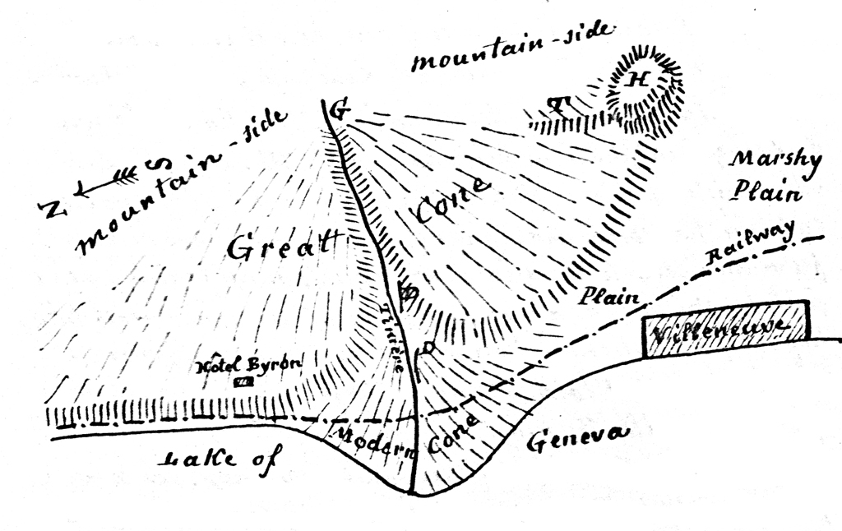
Older and higher Tinière cone above and behind the modern cone

