Slide 1




CLIMATE CHANGE COMMUNICATION BETWEEN TV BROADCAST METEOROLOGISTS AND THEIR VIEWING AUDIENCE
Doner, L.A., Davis, P.T., Lyons, R., Wilkinson, K., Foley, K., McGarry, M.A.,
Meldrum, H., Szymanski, D.W., Oches, E.A., and Avilés, L.B.
Plymouth State University, Plymouth, NH
Bentley University, Waltham, MA 02452

Slide 2
American belief in human-caused climate change lower now than in 2007
www.eesi.org
Factsheet April 2013

Slide 3
Challenge – How to break down barriers that inhibit many of the doubters from accepting the validity of 3 key facts:
that there are measurable and significant temperature increases in many places in the last 30 years;
that CO₂ emissions from human activities are responsible for at least some of those increases; and
that almost all scientists are in agreement on these points
Need a delivery mechanism the public is familiar with and trusts. The local news? Most news reporters don’t understand the science and often gloss over, or misrepresent, climate findings.

Slide 4

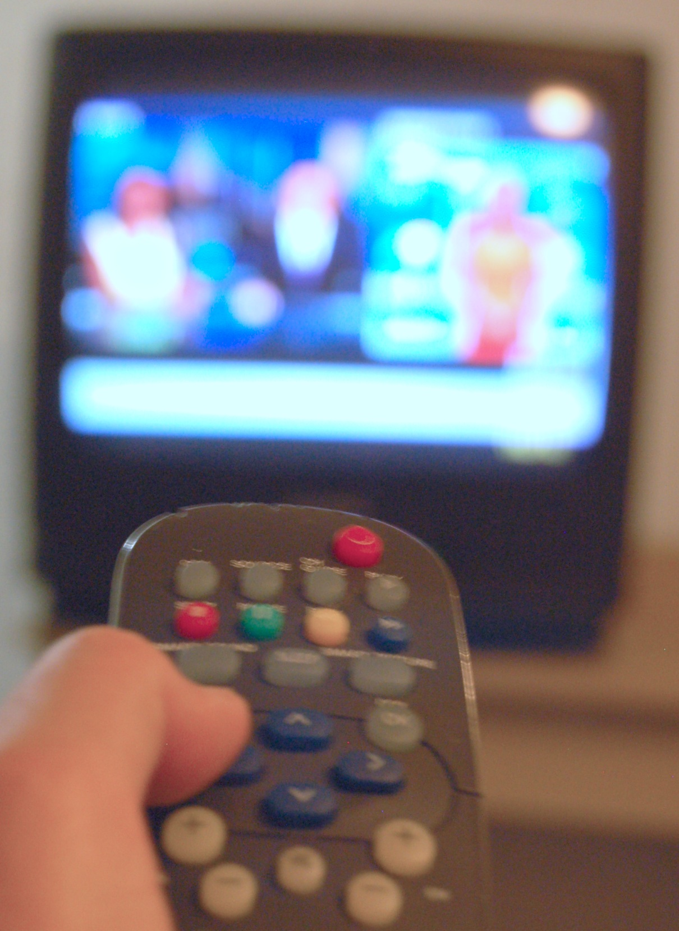
70% of Americans watch televised local news primarily to see the weather forecast
(Miller et al, 2006; PEW, 2011)
and
the public generally considers meteorologists to be climate experts
(Leiserowitz et al., 2011)

Slide 5
Broadcast meteorologists (weather forecasters) are also well-positioned to be our informal educators about climate change to the public:
Broadcast meteorologists are “station scientists” at most TV stations; this role is supported by the American Meteorology Society (Maibach, 2011)
2/3 of TV broadcast meteorologists wish to report on climate change (Maibach et al., 2011)

Slide 6
Problem solved – the local weatherman can do the needed outreach!
Public trust
High impact
Large reach
One rather big glitch in the plan:
meteorologists with opportunity to bring climate news to the public rarely do so
some publically deny climate impacts from CO₂ increases

Slide 7
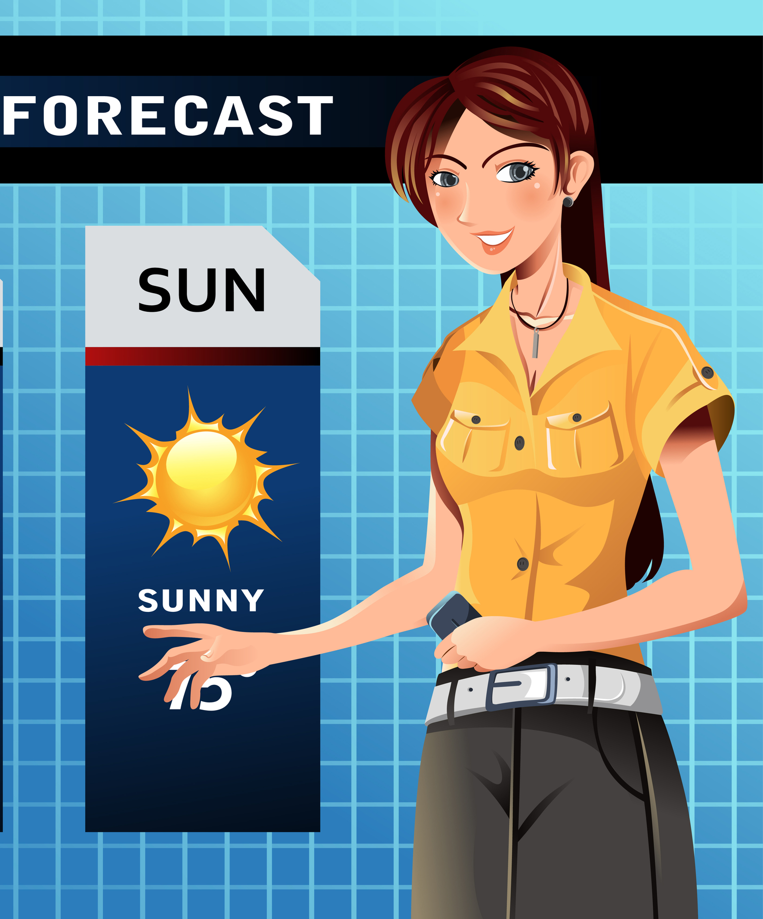
Polls suggest 50% of TV broadcast meteorologists are skeptics about human causes for climate change
(Maibach et al., 2010a, b; Leiserowitz et al., 2011)
Best meteorology models cannot accurately predict weather over 5 days out. Creates doubt about assumptions in climate models
The physics of greenhouse gas influences not contested, but ability to predict climate responses given annual variability is ...

Slide 8
Our Approach
Bentley Univ. and Plymouth State Univ. Team:
climate scientists (climate researchers) - 2
meteorologists (forecasters, instructors) - 3
geologists – 2 (besides climate researchers)
science educators - 1
social scientists – 1
Primary question - why are some TV broadcast meteorologists and commercial weather forecasters skeptical or uncertain about anthropogenic global warming?
Aim: to use this information to improve outreach communications on climate to the public by meteorologists, especially those on television news programs
Notes:
Developed a plan to identify the issues preventing this seemingly ideal task for disseminating climate change concepts and findings to the public.

Slide 9
Multiple working hypotheses based on one theme –
that broadcast meteorologists often fail to attain adequate climate literacy before graduating into the work force (an education gap)
Hypotheses:
Some TV broadcast meteorologists may have only degrees in broadcast journalism with limited backgrounds in meteorology or climate science.
U.S. meteorology degree programs lack specific training on geophysical mechanisms for climate change
Meteorology students take few courses in the Earth systems sciences that support understanding of climate feedbacks and records of past changes (i.e. geology, geography, ecology).

Slide 10
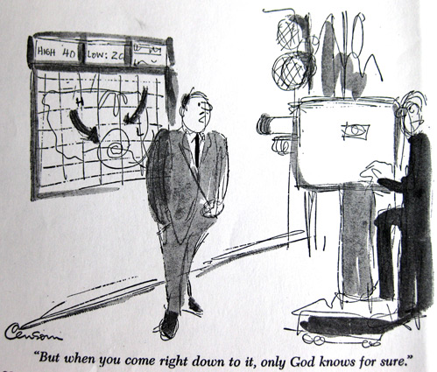

Methods:
qualitative survey of TV/radio meteorologists in the greater Boston and northern New England areas on their training level in science
quantitative survey of >120 U.S. undergraduate programs with B.S. degrees in meteorology or related disciplines

Slide 11
New survey tool used to gauge climate literacy of meteorology students (and preparedness for communicating climate information) Tested on PSU meteorology students in Spring 2012.
Survey conditions:
Survey Monkey for online responses, administered under instructor supervision.
All first year and graduating students included in the pilot survey.
5 point Likert scale used to quantify responses
Literacy assessment from “Essential Principles of Climate Science” (joint effort by NOAA, AAAS, NASA, NSF, USAID, DOD, EPA, NGOs and science agencies and individuals from varied professional fields (www.climatescience.gov)

Slide 12
Findings to date

Slide 13
72% broadcast meteorologists in the survey area have BS degrees in meteorology or atmospheric science
14% have graduate degrees in meteorology or atmospheric science

Slide 14
We were generous in what we grouped into the “literate” category
Gave desired answers positive values, undesired answers negative
Desirable answers
Undesirable answers
3
2
1
-1
-2
0

Slide 15
Some questions and responses in pilot survey

Slide 16
Conclusions:
Our hypothesis that broadcast meteorologists are not trained as scientists is rejected for New England.
Meteorology students in our pilot survey exhibit low understanding of climate feedbacks and consequences, and exhibit a marked lack of literacy in climate aspects related to biology and geochemistry.
Hypothesis that students lack training in disciplines outside of atmospheric sciences is not rejected (so far).

