Slide 1
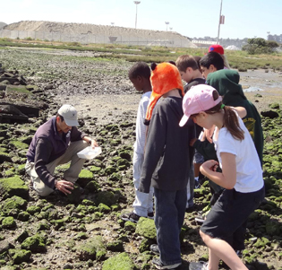
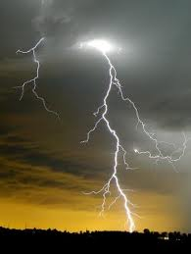
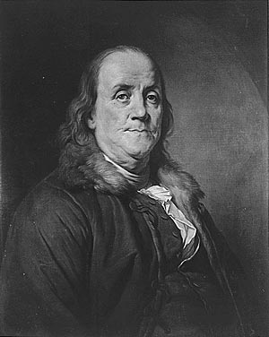

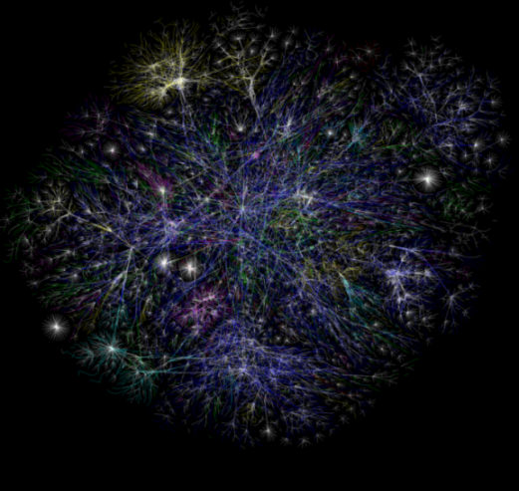

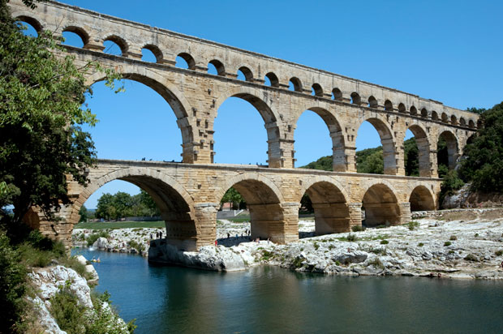
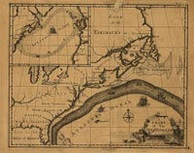
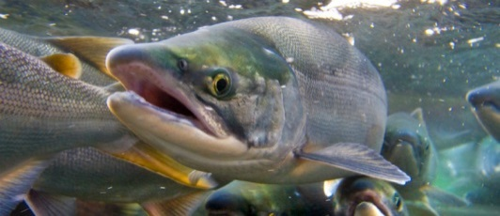


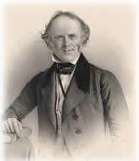

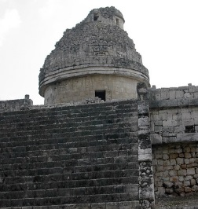
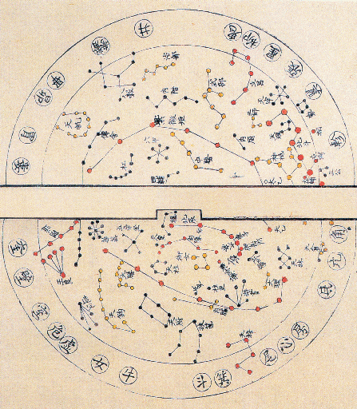
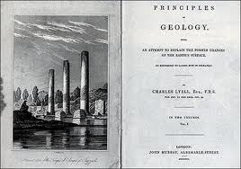
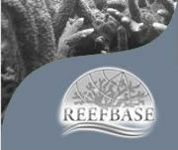
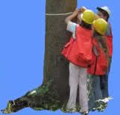
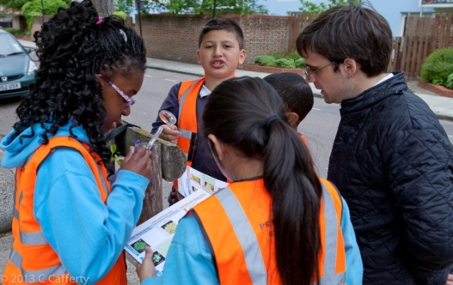
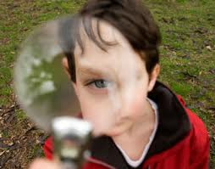
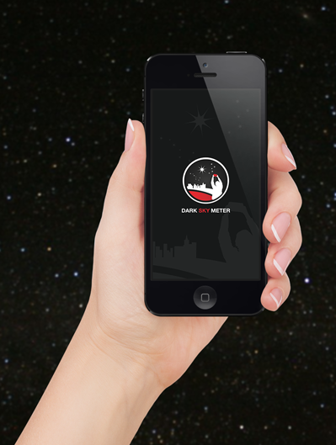
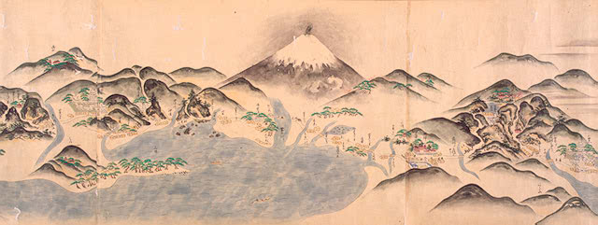
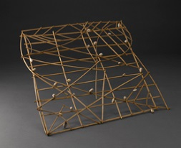
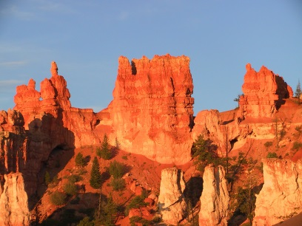
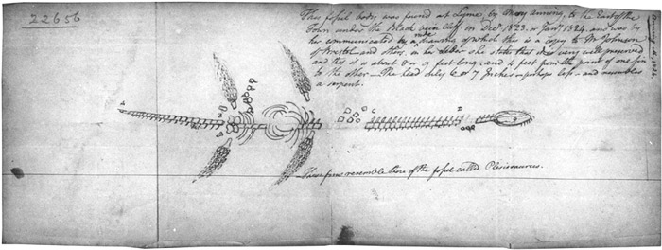
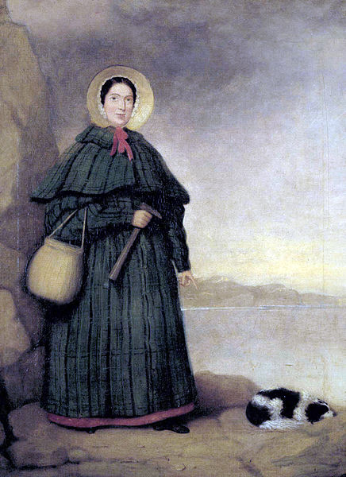
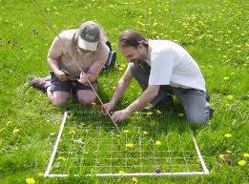

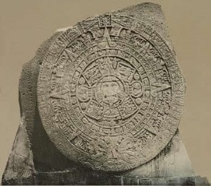
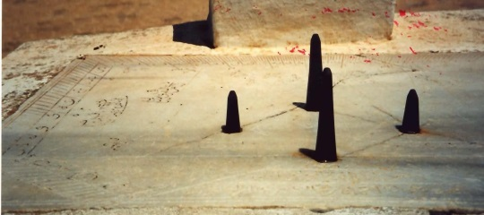
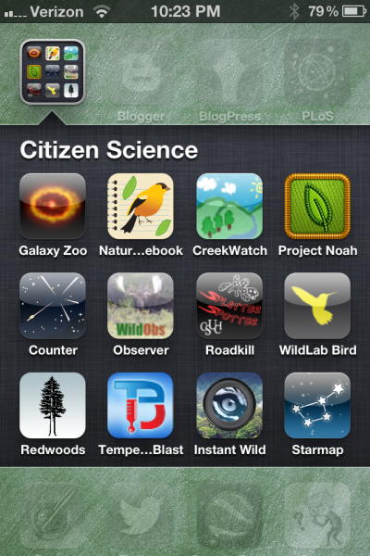


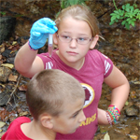
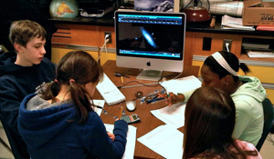
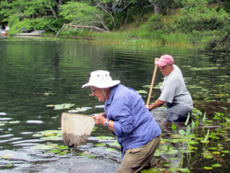
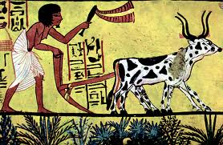
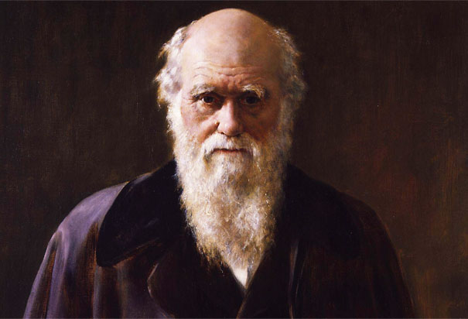
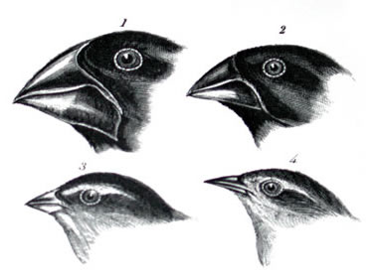
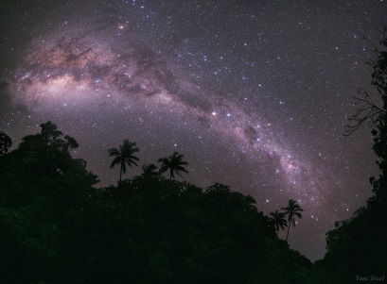


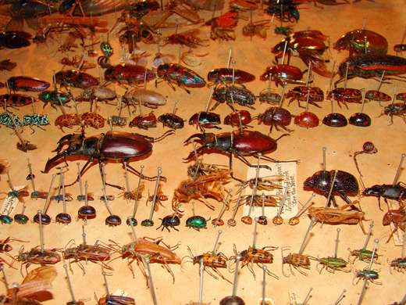
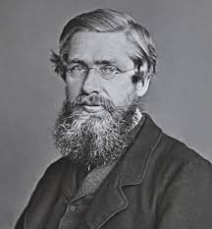
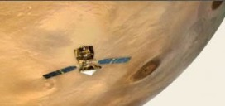

Getting Down and Dirty: Citizen Involvement in Science
Cynthia Prosser, Science Library, University of Georgia, Athens, GA (cprosser@uga.edu)
Monica Pereira, Broome Library, California State University, Channel Islands, Camarillo, CA (monica.pereira@csuci.edu)
1
33
Definition of Citizen Science
Citizen science is defined as the systematic collection and analysis of data; development of technology; testing of natural phenomena; and the dissemination of these activities by researchers on a primarily avocational basis. (Open Scientist, http://www.openscientist.org/2011/09/finalizing-definition-of-citizen.html).
Weather & Climate
CoCoRaHS (http://www.cocorahs.org/)
The Community Collaborative Rain, Hail & Snow Network relies on volunteers provide accurate precipitation data.
Old Weather (http://www.oldweather.org/)
Old Weather aims to transcribes ships’ logs to determine historical weather conditions.
Benjamin Franklin (1706-1790)
Printer turned inventor and statesman. While probably best known for his involvement with the American Revolution, his work as an inventor is also of note. His work with electricity led to the description of the positive and negative aspects of it and he coined many of the words associated with this science, such as charge and discharge, conductor, condense, and electrify.
11
The Changing Nature of Science
The work of science in the twentieth and twenty-first centuries has been spurred by computer technologies. At first, such infrastructural capacities were expensive, so science was increasingly funded by academic, government, and private institutions. That meant that the acquisition of new data and knowledge became the purview of such institutions and in large part dissemination was affordable by only those affiliated with such agencies.
21
Proto-Citizen Science
Interacting with natural environments and understanding natural phenomenon has been a matter of cultural and physical survival. Before ‘science’ existed, humans have observed, and sometimes, expressed their understanding in tangible ways:
2
As telecommunication protocols developed, large packets of data could be sent and received, and the Internet further accelerated the exchange of scientific information. Still, this technology was available only to those involved in scientific pursuits. Funded by the United States Department of Defense, and the National Science Foundation, this amalgam of networks eventually developed an interface that was approachable by ordinary citizens: the Worldwide Web.
12
34
Ecology & Environment
Christmas Bird Count (http://birds.audubon.org/christmas-bird-count)
Possibly the oldest citizen science project (114 years), the Christmas Bird Count charts trends in bird populations.
Nature’s Notebook (https://www.usanpn.org/natures_notebook)
Nature’s Notebook focuses on animal and plant phenology. Hyperlocal data would be impossible to collect if scientists did not receive help.
ReefBase (http://www.reefbase.org)
ReefBase collects data about coral reef health, including photographs and maps. The organization also serves as a repository of publications on reefs.
Citizen science can be said to have its earliest roots in the observations made by people as they went about their daily lives observing the recurring rhythms of nature, such as the annual flooding of rivers, the appearance and disappearance of constellations, the phases of the moon, the migration of animals, and the progression of the seasons.
Examples include: Ancient Egyptians observing the flood cycles of the Nile, the Early Polynesians noting the constellations and their movements with regard for navigation, the Aztecs using engineering for city building and agriculture, and the Early Chinese developing medical system and equatorial astronomy.
13
22
The Worldwide Web vastly accelerated the dissemination of scientific information. As computer technologies become more affordable, larger numbers of citizens are engaging with scientific concepts and data via the Web. Science has become more approachable.
As citizen interest in science converges with affordable and mobile technologies, scientists are recognizing the benefits of citizen participation in the cycle of data collection and dissemination.
Charles Lyell (1797-1875)
Lawyer turned geologist. He travelled extensively in England, Eastern North America, and Europe. He wrote Principles of Geology, outlining his observations of geologic phenomena, and put forth the Theory of Uniformitarianism.
3
4
14
Astronomical observation
Navigation
Timepieces and calendars
Agricultural practices
23
24
25
26
5
6
35
15
Citizen scientists are not full- or part-time professional scientists; nevertheless they have a keen interest in scientific inquiry and are willing to volunteer to support scientific progress. Researchers have depended on volunteers for many years. Typically these volunteers have been relatively local to the project. With the advent of the Internet, and the Worldwide Web, volunteers are able to connect with more widespread projects via a global network through their home computers and smart phones. Furthermore, this has allowed the researchers to curb costs while expanding the scope of the project.
Geology & Earth Science
Did You Feel It? (http://earthquake.usgs.gov/earthquakes/dyfi/)
Did You Feel It? allows citizens to report the intensity of earthquakes felt. The data is georeferenced and used to created maps close to real time.
Skywarn (http://skywarn.org/)
Skywarn uses the observation skills of thousands of citizen scientists who report timely and accurate severe weather events.
7
16
27
8
31
9
Mary Anning (1799-1847)
Fossil collector turned self-taught geologist and anatomist. Working on the Dorset Coast, she found large intact fossil skeletons, many the first of their kind. By the time of her death, Geology had become firmly established as a science in its own right.
28
29
30
10
17
18
Collections of Citizen Science Activities
The Worldwide Web is a rich source of citizen science opportunities. Government agencies and private institutions compile lists of available projects, showcasing a diverse array of choices for all ages.
Various U.S. government agencies such as the U.S. Geological Survey, the National Park Service, and National aeronautics and Space Administration, among others, provide opportunities for citizens to get their hands dirty and help with observation and data collection.
Contributions of Individual Citizen Scientists
Since the invention and formalization of science, areas of scientific inquiry have benefited immensely from the contributions of citizen scientists.
Gentlemen scientists such as Charles Darwin, Antoine Lavoisier, John Muir, John Wesley Powell, David Rittenhouse, and Henry David Thoreau, have all made contributions.
Women scientists such as Mary Anning, Clara Barton, Ada Lovelace, Maria Sibylla Merian, Maria Mitchell, and Ellen Richards have likewise contributed in spite of financial and social obstacles.
This is a select list. However, in all cases, a key skill has been, and continues to be, careful observation.
Charles Darwin (1809-1882)
Gentleman naturalist. Circumnavigated the globe on the HMS Beagle and made many observations. Proposed the Theory of Evolution and later wrote On the Origin of Species.
32
Finding Citizen Science Opportunities
Astronomy
SETI@home (http://setiathome.berkeley.edu/)
SETI@home uses the computing power of personal computers to analyze radio telescope data with the intent of detecting intelligent life beyond Earth’s boundaries.
Planet Four (http://planetfour.org/)
Planet Four invites citizens to identify features on images of the Martian surface.
20
SciStarter (http://scistarter.com)
SciStarter provides a variety ways to sift through all the ongoing citizen science projects listed on its website.
Zooniverse (https://www.zooniverse.org/)
Zooniverse is a suite of citizen science activities developed and maintained by the Citizen Science Alliance.
19
Alfred Russel Wallace (1823-1913)
Surveyor turned naturalist. He independently described the Theory of Evolution. On a voyage to the Malay Archipelago in the 1850’s, his observations led him to describe what has become known as Wallace’s Line, the division between Australian and Asian fauna.
1. http://www.coastal.ca.gov/publiced/plate/highlights/highlights.html
2. http://project45.edublogs.org/
3. http://astrophysics.gsfc.nasa.gov/outreach/podcast/wordpress/index.php/2010/07/08/maggies-blog-ancient-astronomy/
4. http://abyss.uoregon.edu/~js/ast122/lectures/lec07.html
5. http://www.loc.gov/rr/geogmap/guide/gmillspc.html
6. http://www.sciencemuseum.org.uk/objects/navigation/1927-8.aspx
7. http://www.loc.gov/pictures/resource/det.4a31868/
8. http://www.eaae-astronomy.org/sundials-project/index.php?option=com_content&view=article&id=48&Itemid=63
9. http://www.freedomsphoenix.com/News/023382-2007-09-04-archaeologists-discover-ancient-beehives.htm?EdNo=001&From=
10. http://www.bluesci.org/?p=4321
11. http://www.americaslibrary.gov/aa/franklinb/aa_franklinb_subj.html
12. http://www.loc.gov/exhibits/treasures/franklin-scientist.html
13. http://dnr.ne.gov/LB1057/presentations/GW_Availability_0411.pdf
14. http://www.pbs.org/wgbh/evolution/library/02/4/image_pop/l_024_01.html
15. http://westcumbriasitp.org/2013/10/09/the-victorian-age-of-dinosaurs/
16. http://blog.biodiversitylibrary.org/2013/03/the-woman-naturalist-mary-anning.html
17. http://americanvision.org/6945/congressman-wants-to-celebrate-darwin-day-in-america/#sthash.vBVh0FRH.dpbs
18. http://www.calacademy.org/science_now/archive/where_in_the_world/galapagos.php
19. http://news.science360.gov/obj/pic-day/20120208/
20. http://wallace-online.org/
21. http://blyon.com/blyon-cdn/opte/maps/static/1105841711.LGL.2D.1024x1024.png
22. http://www.zanebenefits.com/product-update-blog/bid/295618/What-is-a-Browser
23. http://www.serc.si.edu/education/citizen/
24. http://www.climatechangecafe.com/tag/climate-change-cafe/
25. http://www.thedailygreen.com/environmental-news/latest/citizen-science-47121401#slide-1
26. http://scistarter.com/topic/16-Astronomy%20&%20Space
27. http://www.open.edu/openlearn/nature-environment/natural-history/ever-thought-becoming-citizen-scientist
28. http://www.worldwatermonitoringday.org/
29. http://scistarter.com/topic/16-Astronomy%20&%20Space
30. http://www.nature.nps.gov/air/Studies/air_toxics/dragonfly/
31. http://sciencemadefun.net/blog/wp-content/uploads/2013/03/Citizen-Science-Apps.png
32. http://apod.nasa.gov/apod/ap110924.html
33. http://blyon.com/blyon-cdn/opte/maps/static/1105841711.LGL.2D.1024x1024.png
34. http://www.yakimawa.gov/media/points-of-interest/restoring-salmon-in-washington-state-video/
35. http://www.nature.nps.gov/geology/tour/cplateau.cfm
125th Annual Meeting and Exposition of the Geological Society of America, Denver, CO (October 28, 2013)
© 2013 Prosser & Pereira

