Slide 1





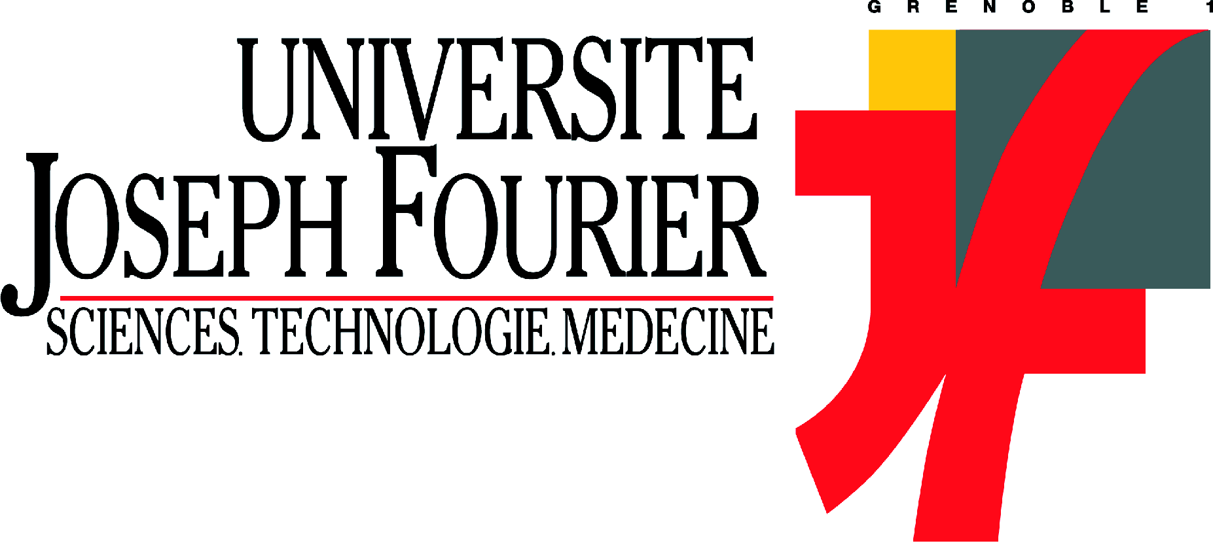

Syn-tectonic, meteoric-water derived carbonation of the New Caledonian peridotite nappe
Quesnel Benoît, Géosciences Rennes, Université de Rennes1
Gautier Pierre, Géosciences Rennes, Université de Rennes1
Boulvais Philippe, Géosciences Rennes, Université de Rennes1
Cathelineau Michel, G2R, Université de Lorraine, Nancy
Maurizot Pierre, BRGM, DIMENC / SGNC, Nouméa, Nouvelle-Calédonie
Cluzel Dominique, PPME, Université de la Nouvelle-Calédonie
Ulrich Marc, ISTerre, Université Joseph Fourrier, Grenoble
Guillot Stéphane, ISTerre, Université Joseph Fourrier, Grenoble
Lesimple Stéphane, BRGM, DIMENC / SGNC, Nouméa, Nouvelle-Calédonie
Couteau Clément, Koniambo Nickel SAS, Voh, Nouvelle-Calédonie

Slide 2
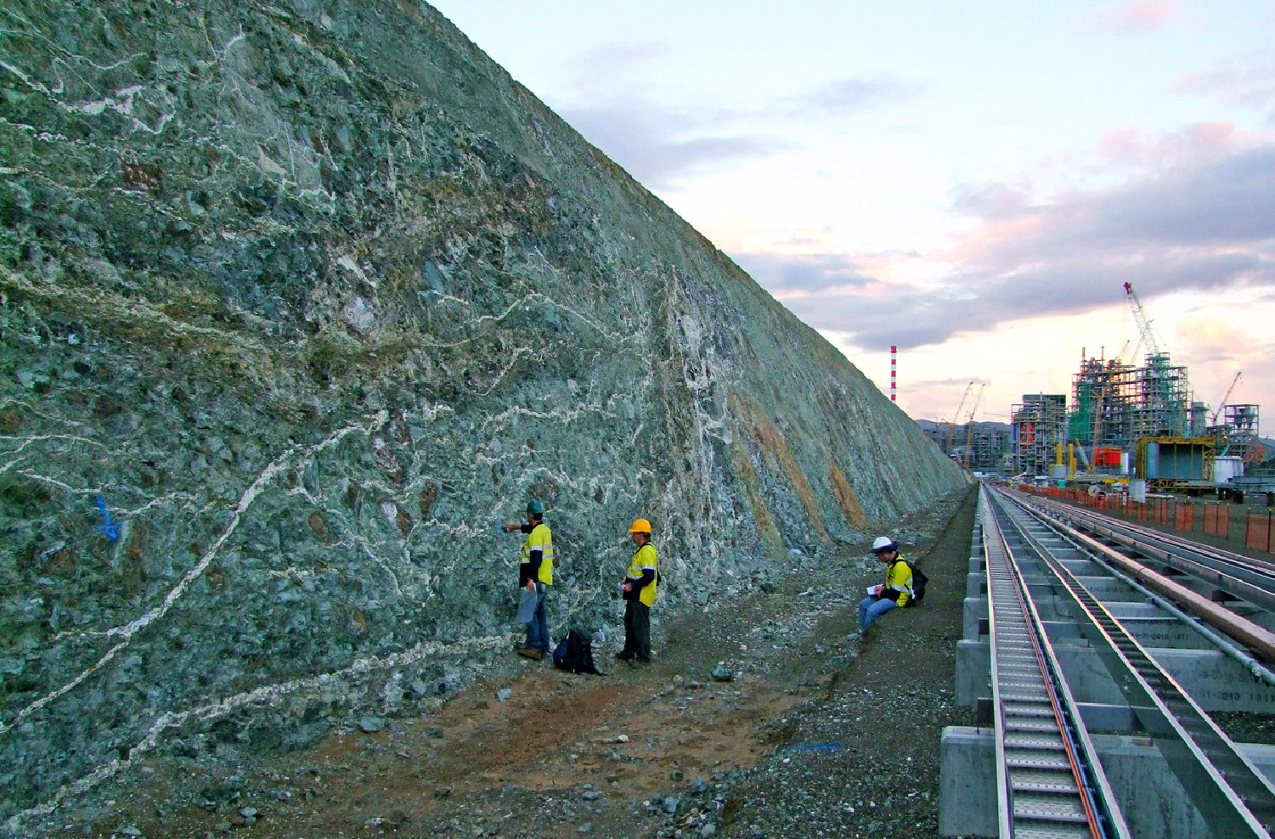

Slide 3
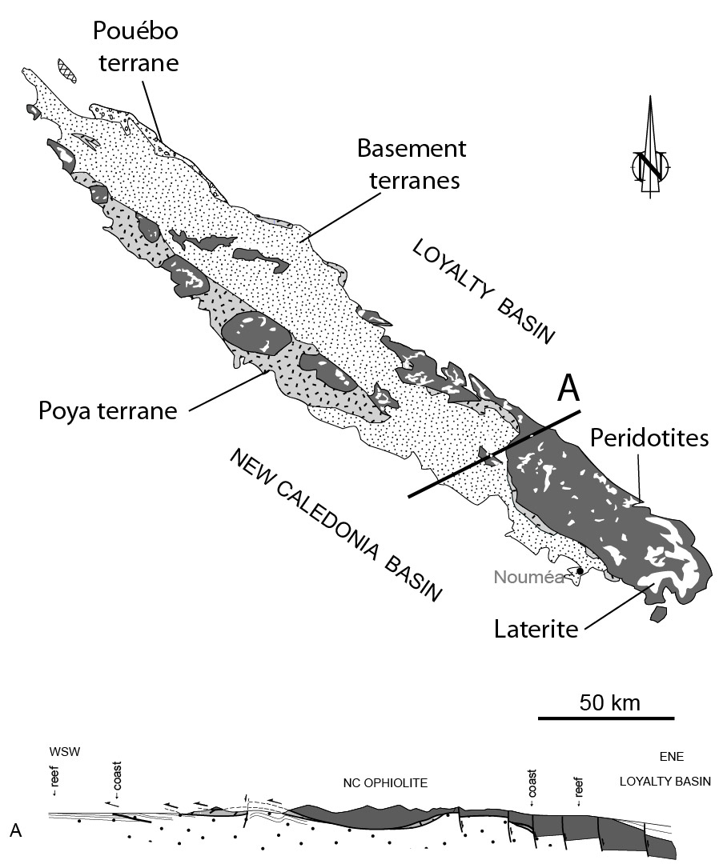
Koniambo
Adapted from Cluzel et al, 2001.
Laterite are compiled after Paris,1981

Slide 4
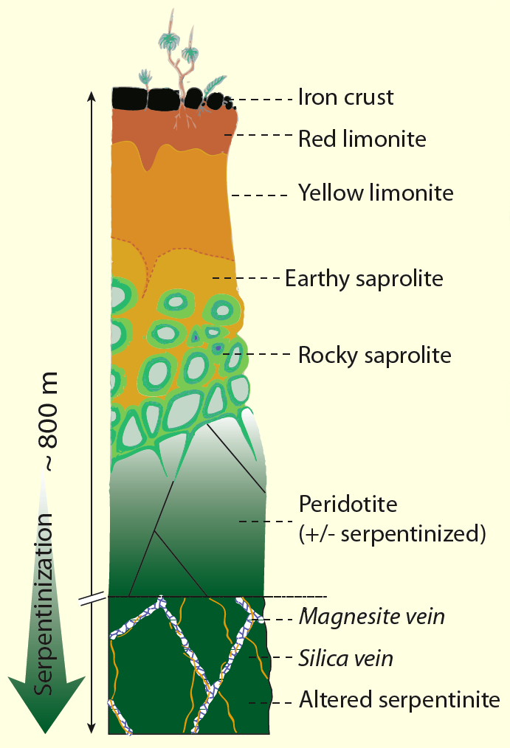
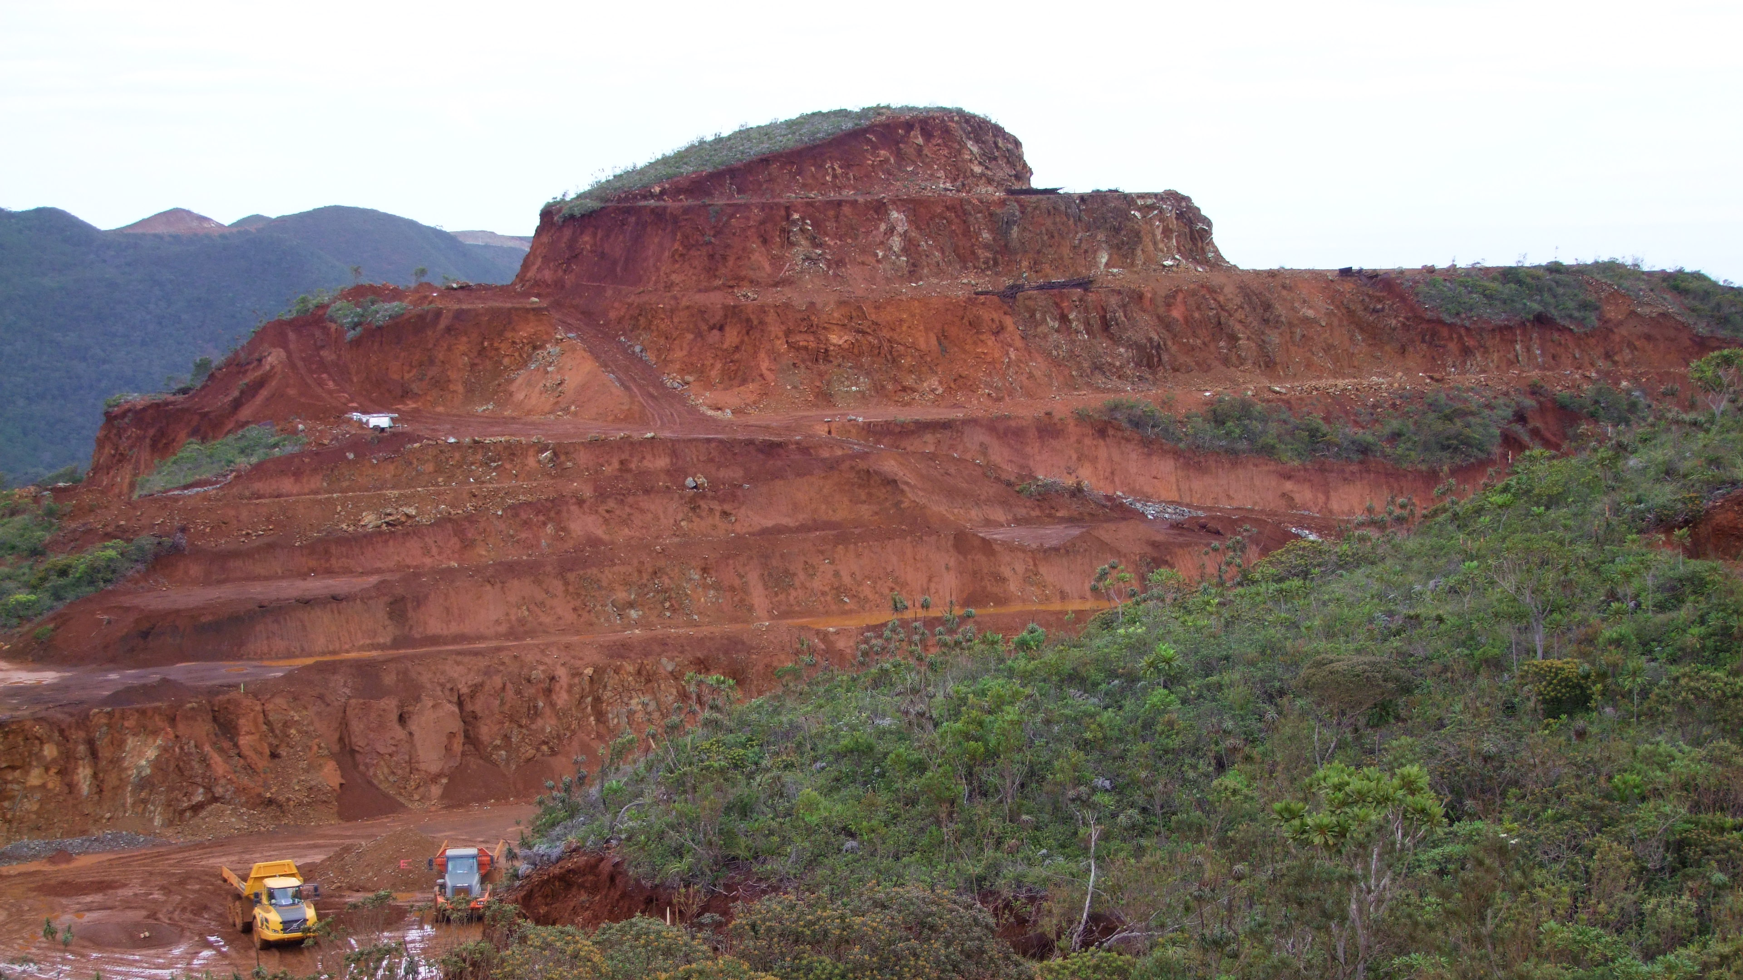
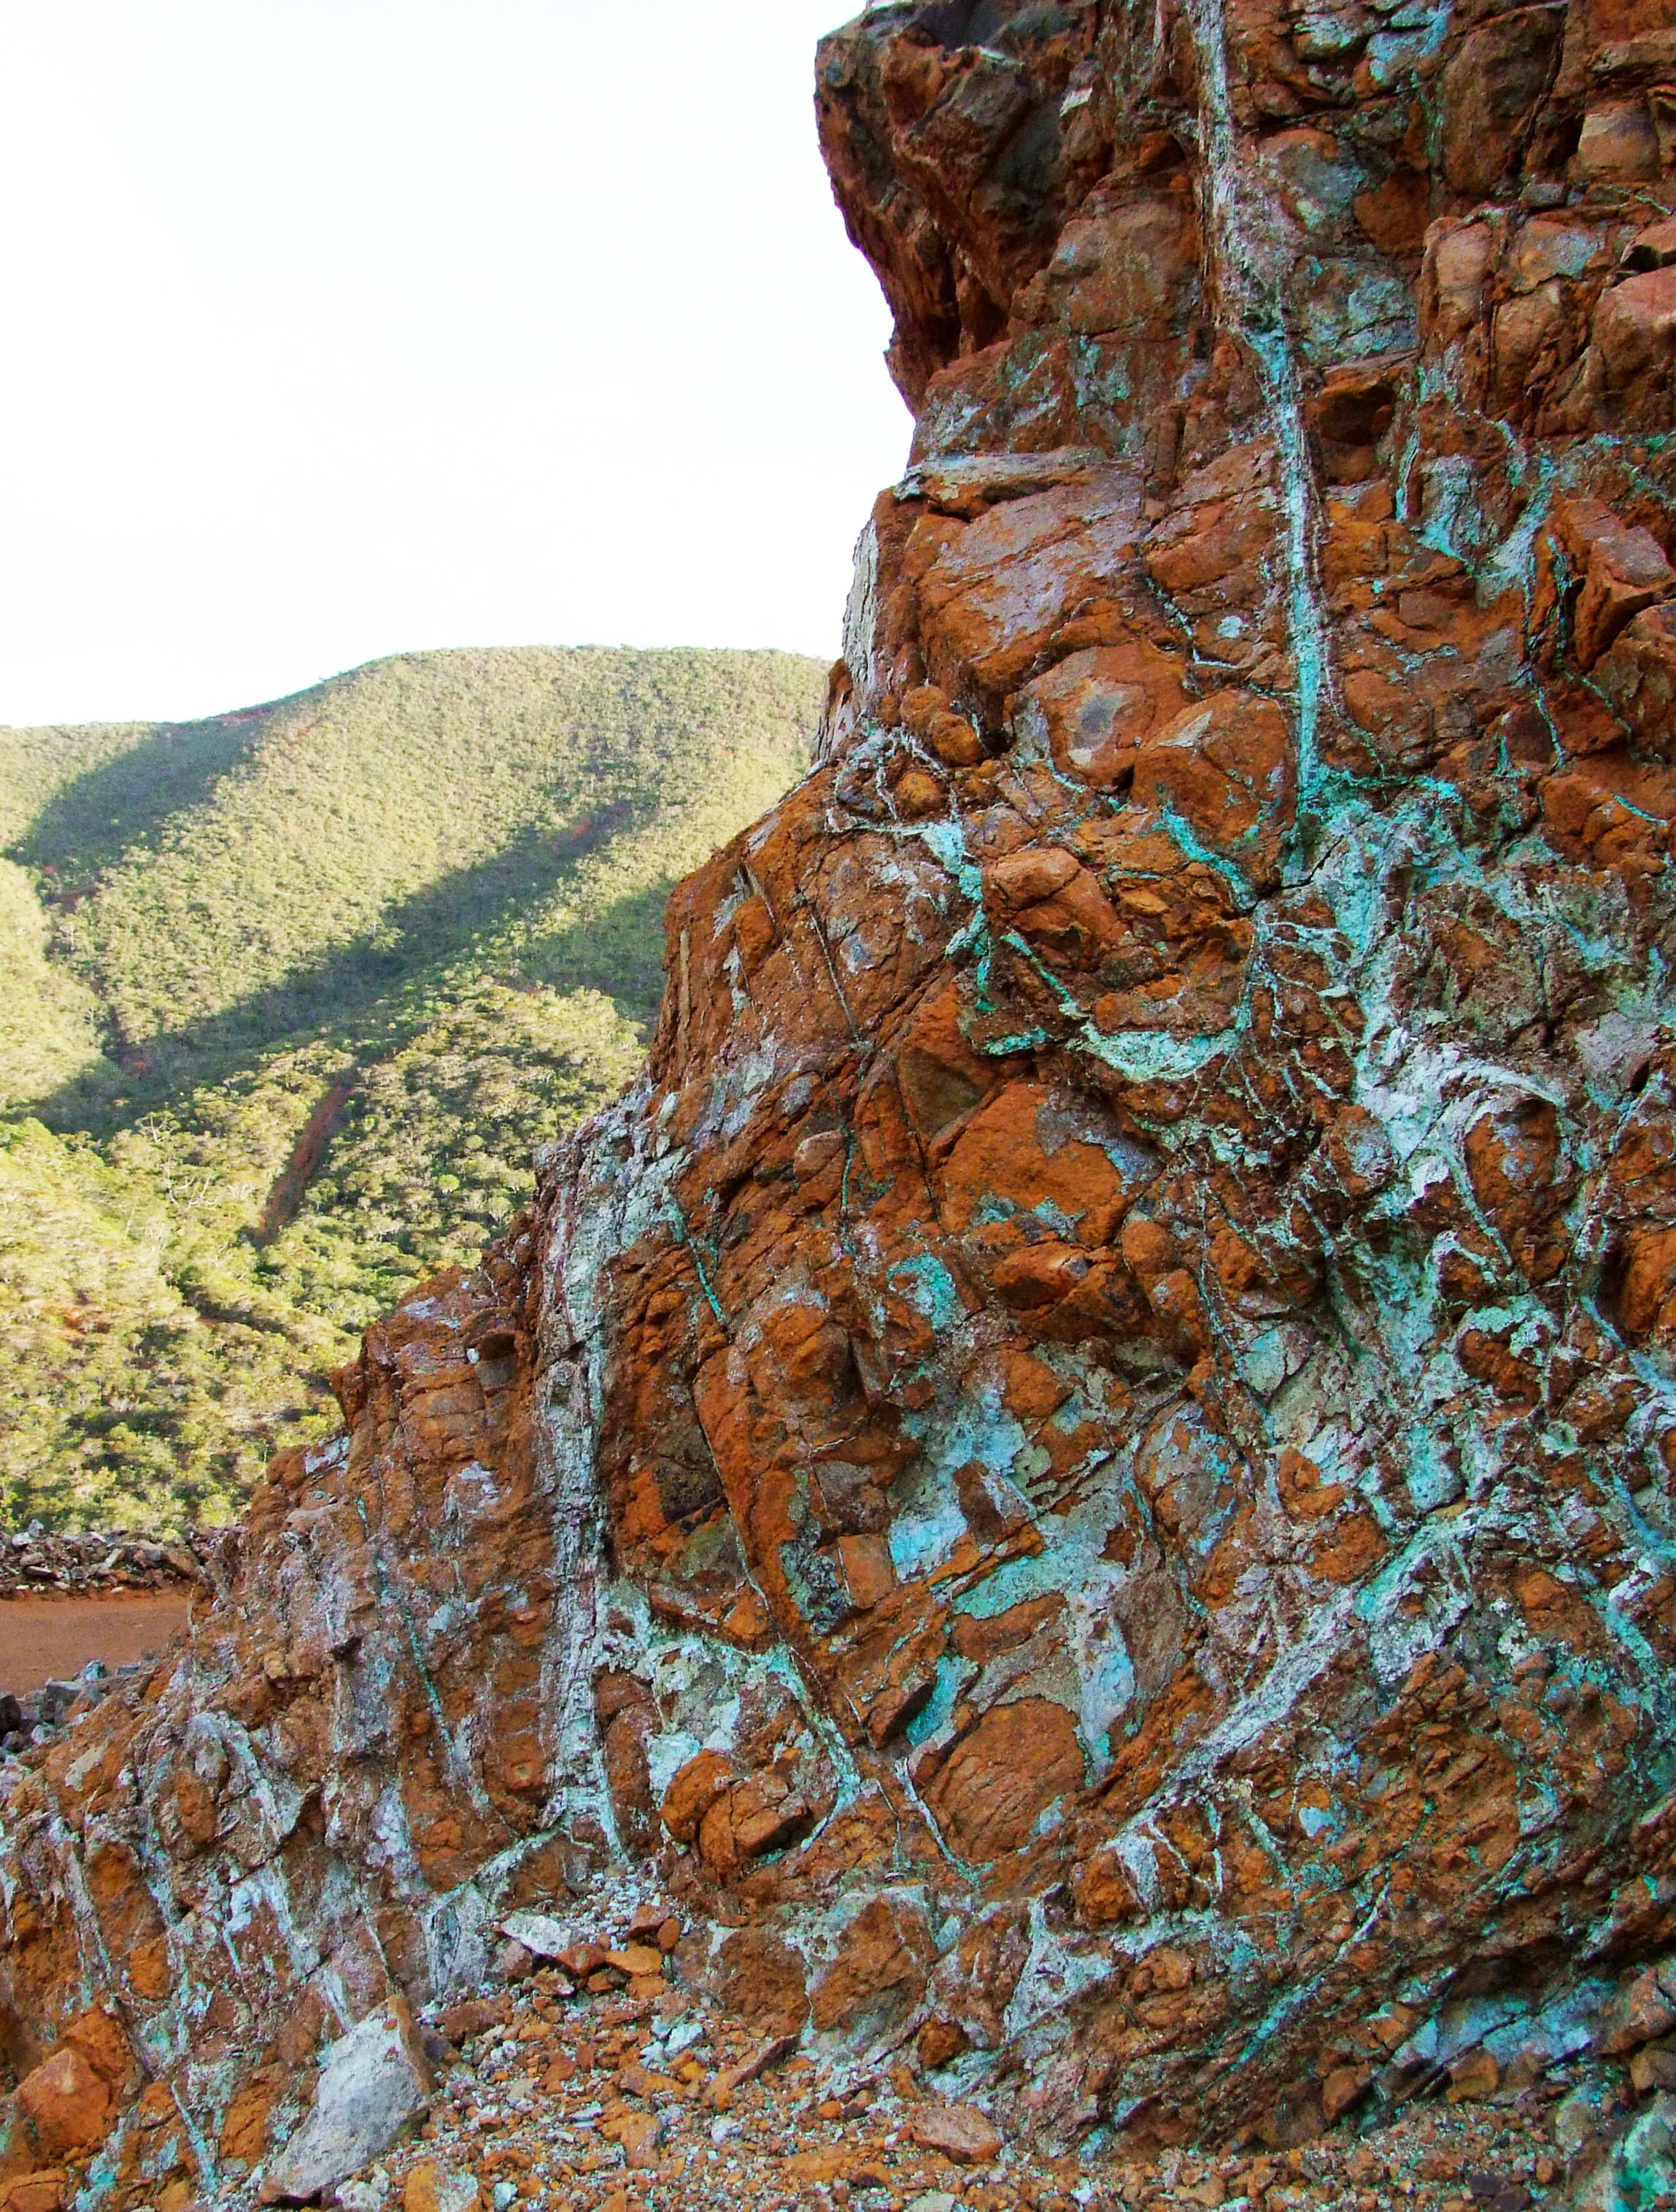
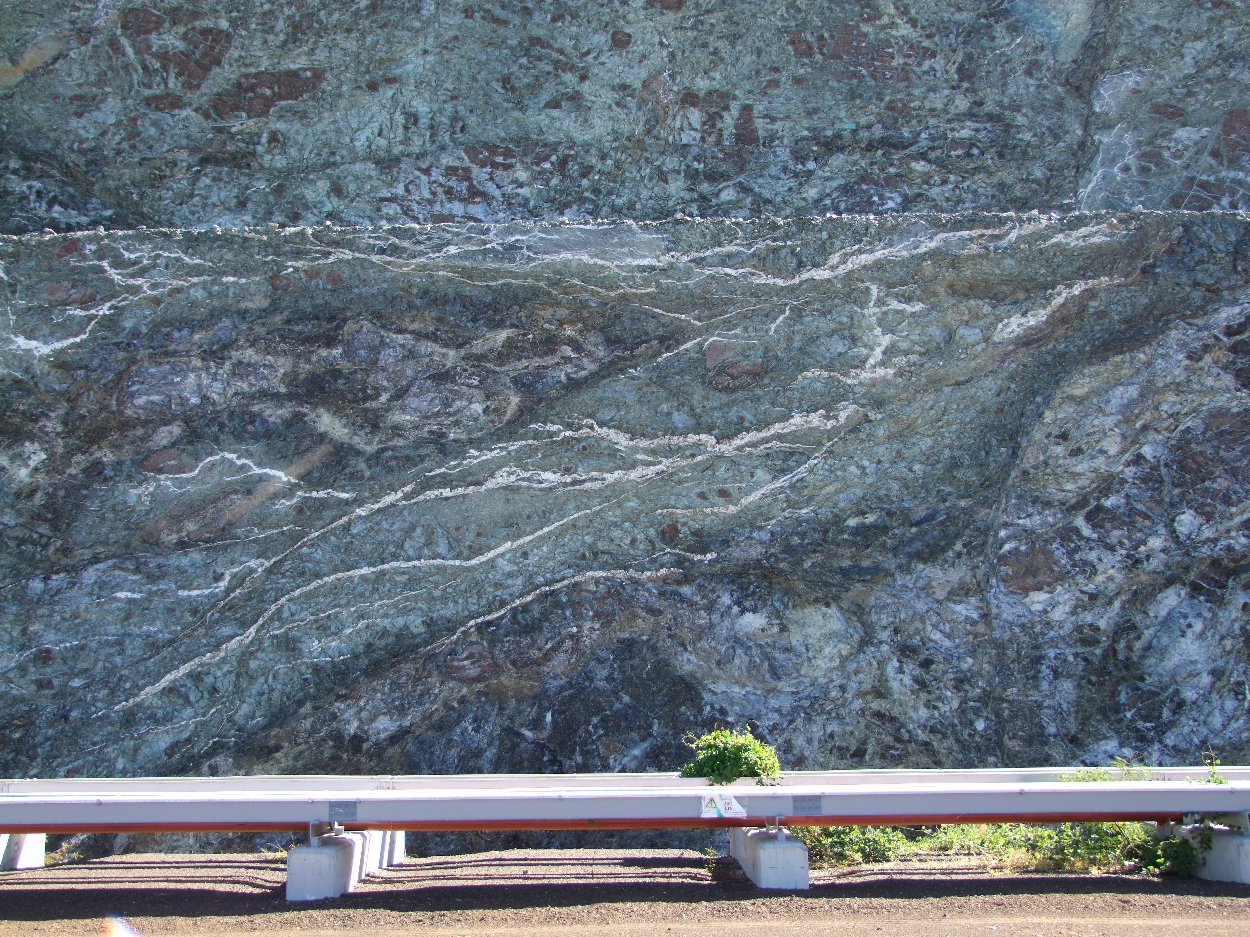
1m
5 m

Slide 5
Laterization
Olivine + pyroxene + meteoric water(H₂O+CO₂)
→ FeO(OH) + meteoric water(H₂O, CO₂,Mg²⁺, Ni²⁺ , Si⁴⁺ )
Carbonation
Serpentine + fluid (H₂O, CO₂, Mg²⁺)→ Magnesite + Silica+H₂O

Slide 6
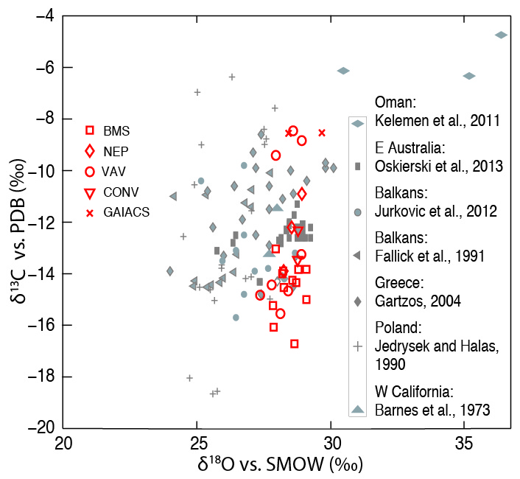
Quesnel et al., 2013
Notes:
Parler aussi Clumped

Slide 7
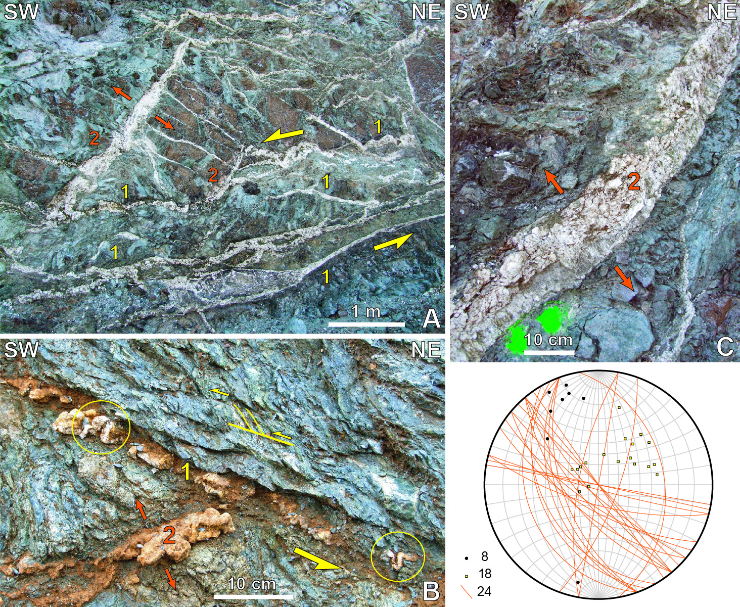
Quesnel et al., 2013

Slide 8
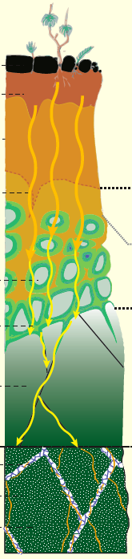
Meteoric origin of the fluid
Syn-tectonic carbonation of the serpentine sole

Slide 9
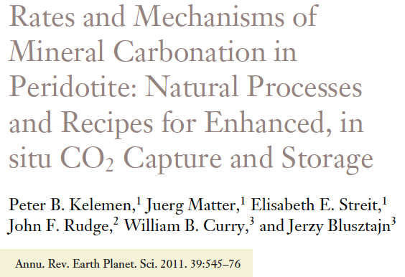
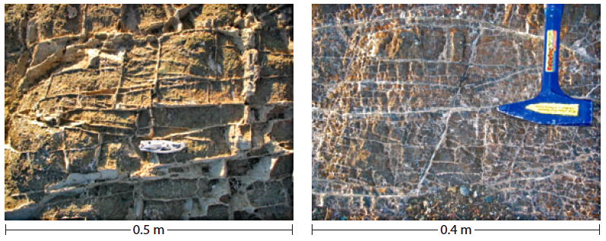
« Carbonate veins in Oman peridotites commonly occur in three mutually perpendicular vein sets, suggesting that they formed in a nearly isotropic stress regime and not because of tectonic compression or extension »

Slide 10
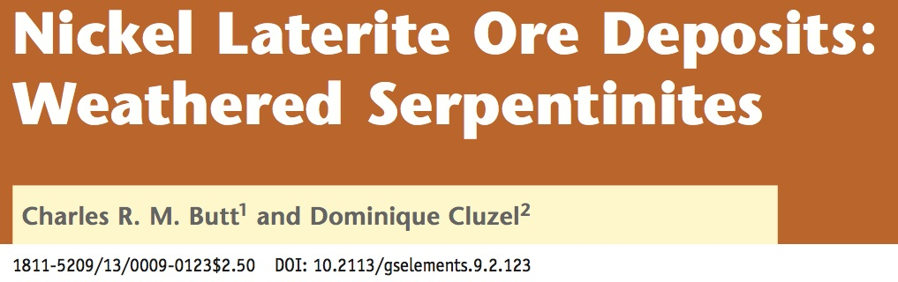
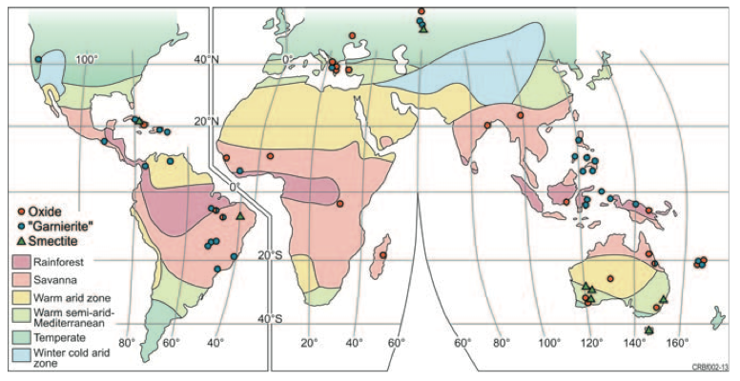
“Fractures, faults and shear zones in bedrock and regolith can strongly influence the thickness, grade and, in places, type of Ni laterite deposit.
Mostly, these effects are passive, with pre-existing structures affecting drainage characteristics either by forming barriers to water flow or, more commonly, by increasing permeability and promoting deeper weathering and preferential concentration of Ni along the fracture zone.
Similarly, movement contemporaneous with weathering on existing faults in bedrock and new low-angle shears in the regolith formed by slope failure may be the focus of Ni concentration."

Slide 11

Thank you for your attention

Slide 12
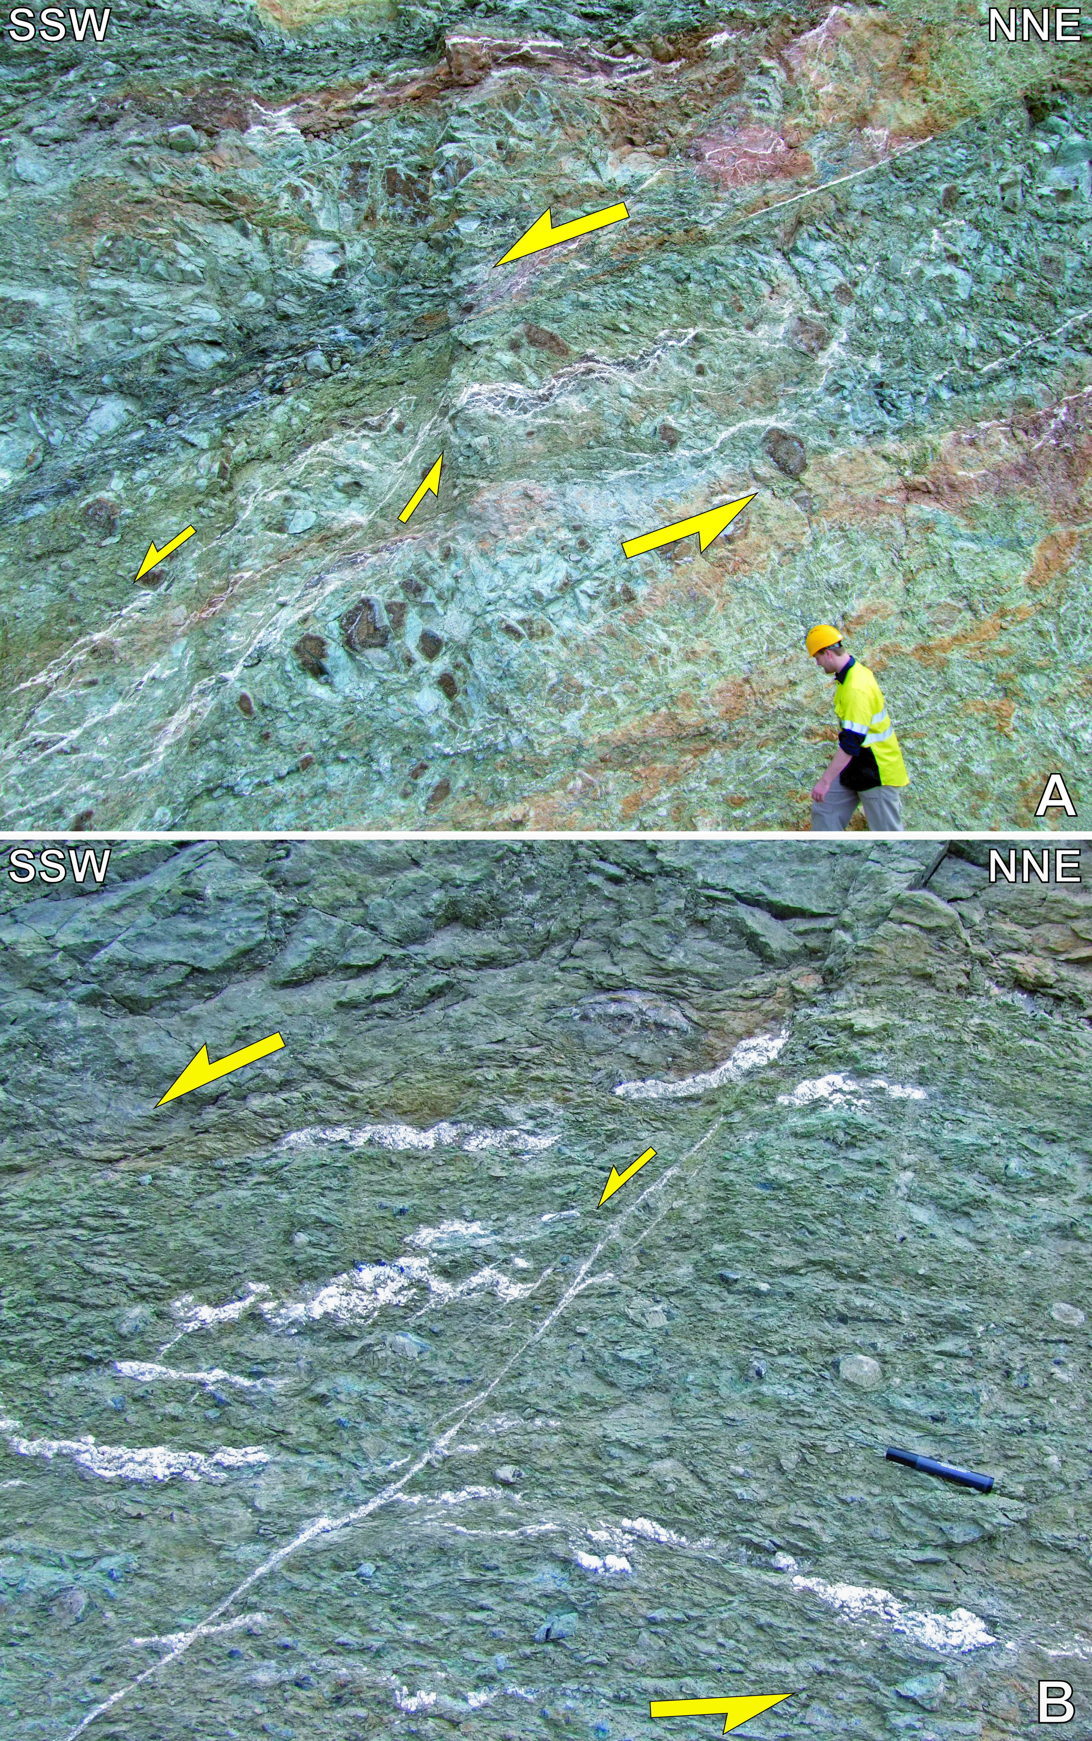
Quesnel et al.; 2013

