Slide 1

“High-performance Computing Cooperative in support of inter-disciplinary research at the U.S Geological Survey (USGS)”
Geological Society of America
October 2013
Michael Frame,¹ Jeff Falgout,² and Giri Palanisamy³
¹ Core Science Systems, U.S Geological Survey, mike_frame@usgs.gov;
²Core Science Systems, U.S Geological Survey, jfalgout@usgs.gov;
³Environmental Science Division, Oak Ridge National Laboratory, palanisamyg@ornl.gov

Slide 2
Topics:
Who is USGS CSS CSAS
USGS Science Data Life Cycle Concept
Focus on “Analyze” process
  Summary of USGS High Performance Computing activities
Questions, Comments

Slide 3
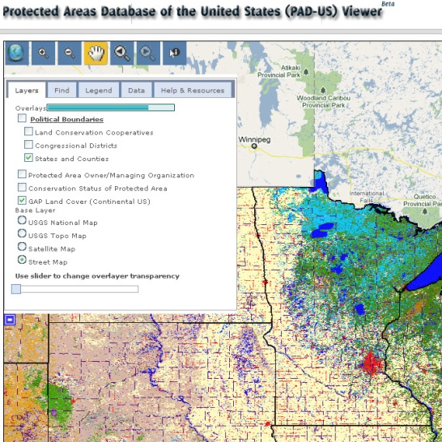
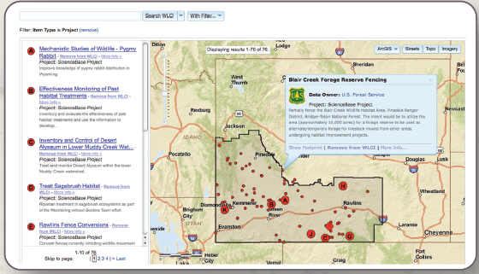
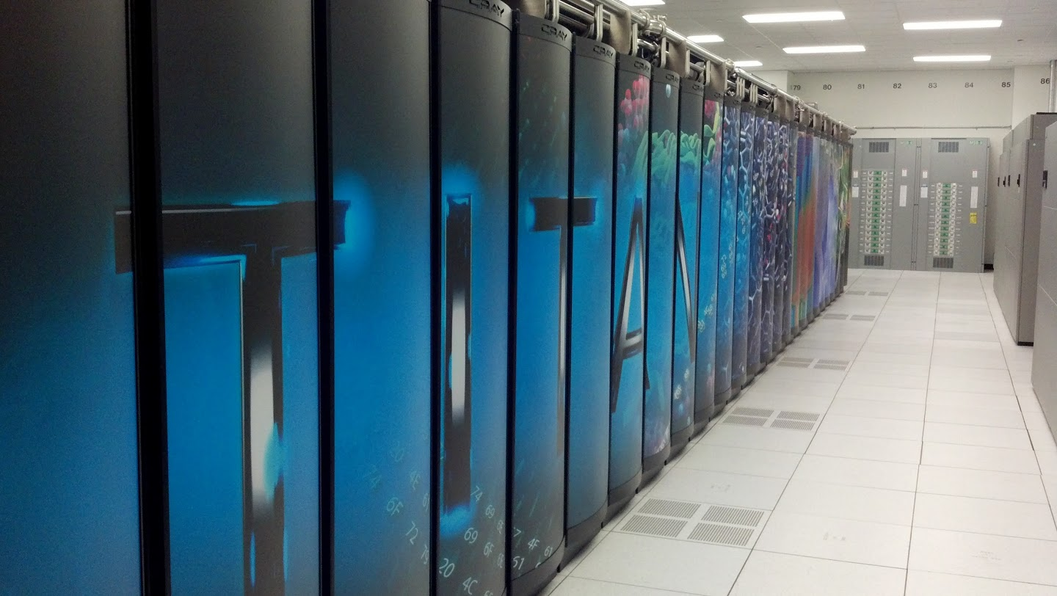
USGS Core Science Systems
Core Science Analytics and Synthesis
Emerging Mission…..
Drive innovation in biodiversity, computational and data science to accelerate scientific discovery to anticipate and address societal challenges.
Notes:
Vision:
Develop national data products through analysis and synthesis to enable USGS science.
Lead strategic research and informatics partnerships.
Mobilize data and create innovative tools and technologies for scientific discovery and rapid response to societal issues.
Provide biodiversity informatics and biogeographic characterization for the Nation.

Slide 4
How We Accomplish Our Mission
Characterize species and habitats
Understand relationships among species
Model responses to influences
Facilitate conservation and protections
Data analysis and synthesis
Data collection, acquisition, and management
Data transformation, and visualization
Data documentation (fitness for use)
Derive new knowledge and new products through integration
Ecological Science
Data Science
Computational Science
Modeling and synthesis methods
Computer science research and development
Computer engineering
Technology-enabled science response
High volume, high speed computing for science
4
Notes:
CSAS combines fundamental and applied research, and integrates scientific data with information analysis and synthesis. We do this by conducting biological occurrence data acquisition, biological taxonomic analysis and interpretation, performing computational analytics, and informational synthesis.
The USGS Science Strategy emphasizes applied Earth systems information research with a focus on data integration and new methods of investigation. In 2012, CSAS worked closely with other mission areas to leverage expertise and apply it to the computing and information needs of science research projects. To help respond to complex and sometimes perplexing science questions, CSAS collaborates with other USGS Mission Areas, and partners with institutions, programmers, modelers, application developers, and others.

Slide 5
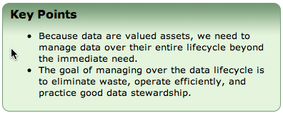
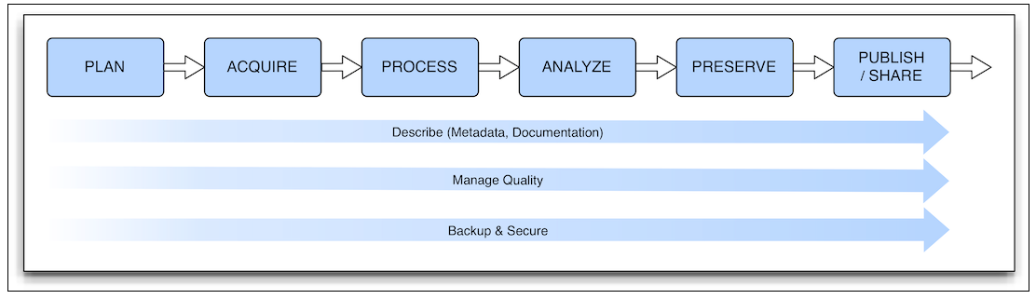
Science Data Lifecycle Model
Serves as a foundation and framework for USGS data management processes
Notes:
Already being used as teaching/reference tool
Midwest Region using it extensively
Chesapeake Bay OFR

Slide 6


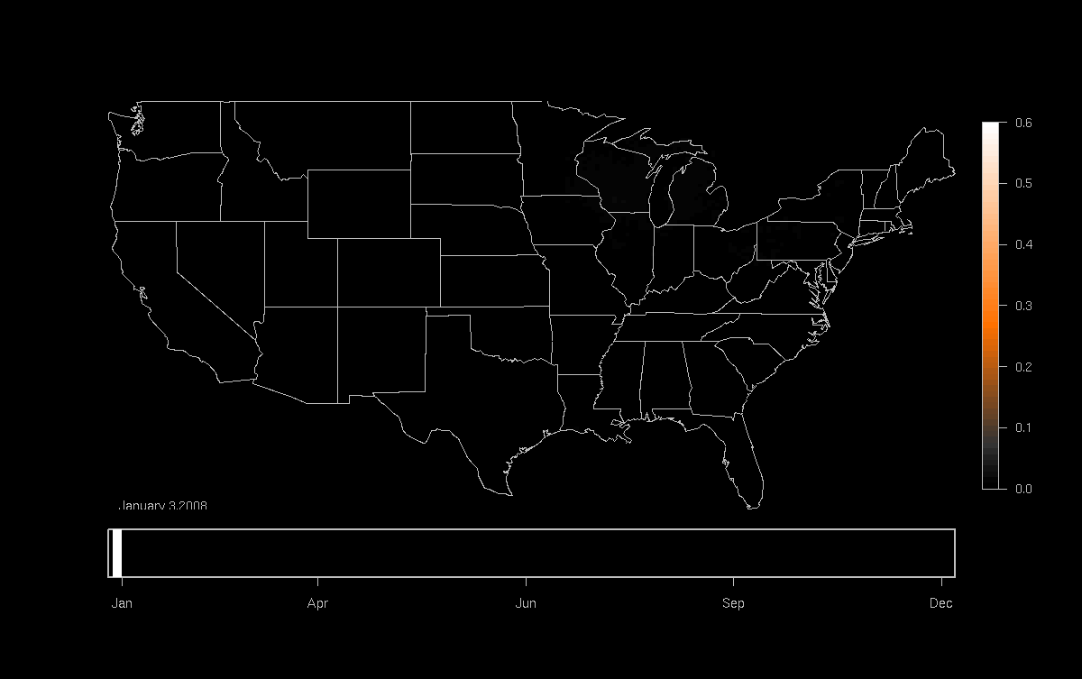

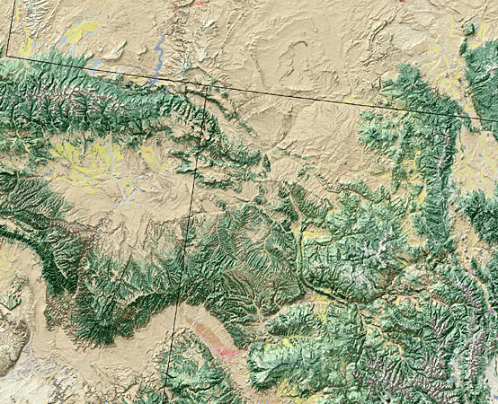
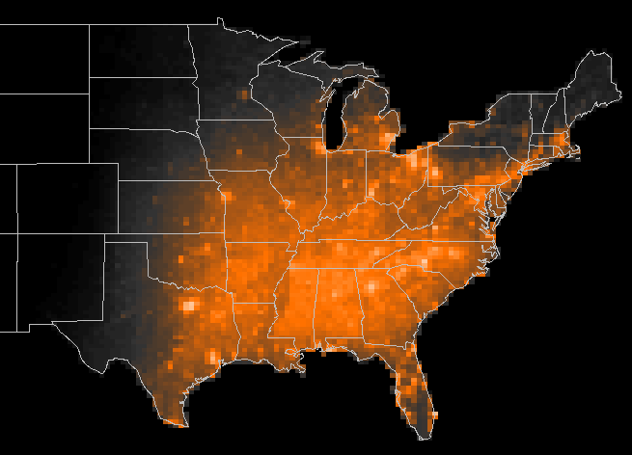


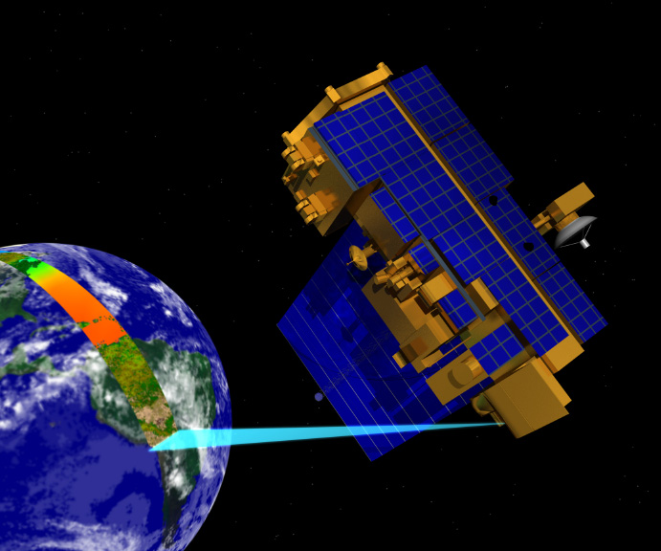

Data Analysis Examples – endless possibilities with science data
eBird
Model results
Occurrence of Indigo Bunting (2008)
Land Cover
Jan
Apr
Jun
Sep
Dec
Meteorology
Potential Uses-
Examine patterns of migration
Infer impacts ofclimate change
Measure patterns of habitat useage
Measure population trends
Spatio-Temporal Exploratory Models predict the probability of occurrence of bird species across the United States at a 35 km x 35 km grid.
MODIS – Remote sensing data

Slide 7
Why did USGS need HPC capabilities?
Large data sets require extensive processing resources
Large data sets require significant storage capacity
Often a desktop computer or single server just isn’t enough
  CPU speed
  Number of CPUs
  Amount of physical memory
  Speed of hardware bus
  Disk space, disk input/output speed
Decrease time to solution/answer on long computations
Increase the scope of the research question by removing computational limits

Slide 8

How It All Got Started
USGS Powell Center need
Suggestion box / Idea Lab - “ improved computing capabilities in USGS are needed”
National Biological Information Infrastructure (NBII) Program terminated in FY 2012 budget – hardware reuse
USGS Scientist Assessment currently deploying also targets this need

Slide 9
USGS JW Powell Center
How It All Got Started
JW Powell Center project - computational needs not satisfied
Each simulation takes about 2.5 minutes to process
Initial project scope was to run 7.8 million simulations
      7.8M sims on single CPU –> 19.5M minutes = 37.1 years
Scaled scope back to 180,000 simulations due to lack of resources
    180K sims on single CPU –> 450K minutes = 312.5 days
Perfect candidates for parallel processing
Brought processing time down to 21 hours

Slide 10
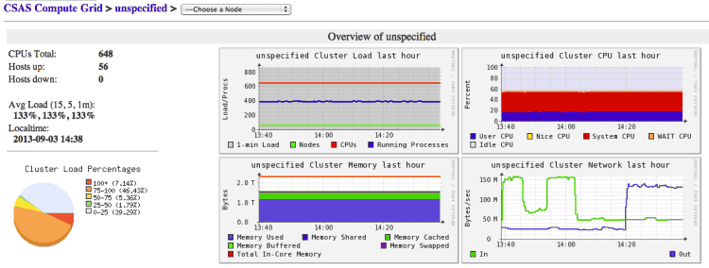
Where are we now?
Hardware
560 Core Linux Cluster
  52nodes
2.3 TBs Memory
32 TBs Storage
1 Gb/s Ethernet Interconnect

Slide 11
Hardware Comparison
Laptop, CSAS, Titan
 | My Laptop | CSAS Cluster | ORNL Titan
CPU Cores | 4 | 560 | 299,008
GPUs | 1 | 0 | 18,688
Memory (GB) | 8 | 1,951 | 710,144
Disk Storage (TB) | 0.5 | 32 | 10,000
TFLOPs (Linpack) | 0.33 | TBD | 17,590
Number of Nodes | 1 | 52 | 18,688
Power Consumption | < 15W | TBD | 8209 kW
Notes:
The CSAS benchmark is projected because the cluster has been in use since we’ve had it working. We need sole access to the cluster to run the benchmark to get accurate acc

Slide 12
CSAS Computational Science Goals
Provide scientific high performance computing (HPC), high performance storage (HPS), high capacity storage (HCS) expertise, education, and resources to scientists, researchers and collaborators.
  Decrease “time to solution”
    Faster results
  Increase “scope of question”
    Complex questions
    Higher accuracy
  Address growing “data” issues
    “Big Data” Challenges
    Data transfer
  Access to HPC environment
    People
    Availability
Time
Data
Scale
Access

Slide 13

Established formal DOE ORNL Partnership
Collaborative group formed between USGS and ORNL
  Strategic guidance for development of USGS HPC strategy
  Technical expertise with executing compute jobs on HPC
Granted access to ORNL ESD compute block
  Successfully ran first project on 22 node, 176 core cluster (Dec 2012)
  New 832 core cluster completed (Feb 2013)
Recruiting for candidate projects for allocation on ORNL Leadership Computing Facility (OLCF) - Titan
  Demonstrate what is possible to rest of USGS

Slide 14
Pilot Projects:
Four initial pilot projects adopted
  Daily Century (DayCent) Model for C and N exchange (Ojima)
  Using R, Jags, Bugs, to build a Bayesian Species Model (Letcher)
  Using R -> Python/MPI to process Landsat images (Hawbaker)
  PEST Model doing ground water estimations (King)

Slide 15

2. Bayesian Species Modeling
Ben Letcher, Research Ecologist
JW Powell Center Project
Modeling species response to environmental change: development of integrated, scalable Bayesian models of population persistence
Running complex models in a Bayesian context using the program Jags.
Jags is very memory intensive and slow.
  + running chains in parallel
  3-5x memory vs. non-parallel runs.
Notes:
Just another Gibbs sampler (JAGS) is a program for analysis of Bayesian hierarchical models using Markov chain Monte Carlo (MCMC)

Slide 16
2. Results – Bayesian Species Modeling
Scope of study (science question) was expanded significantly
Project is able to run many test models at a reasonable speed - up to 500 Gigabytes Memory.
Efficient model testing would have been impossible without access to the cluster.
Model runs have been processing for several months (and are still running at this moment)

Slide 17
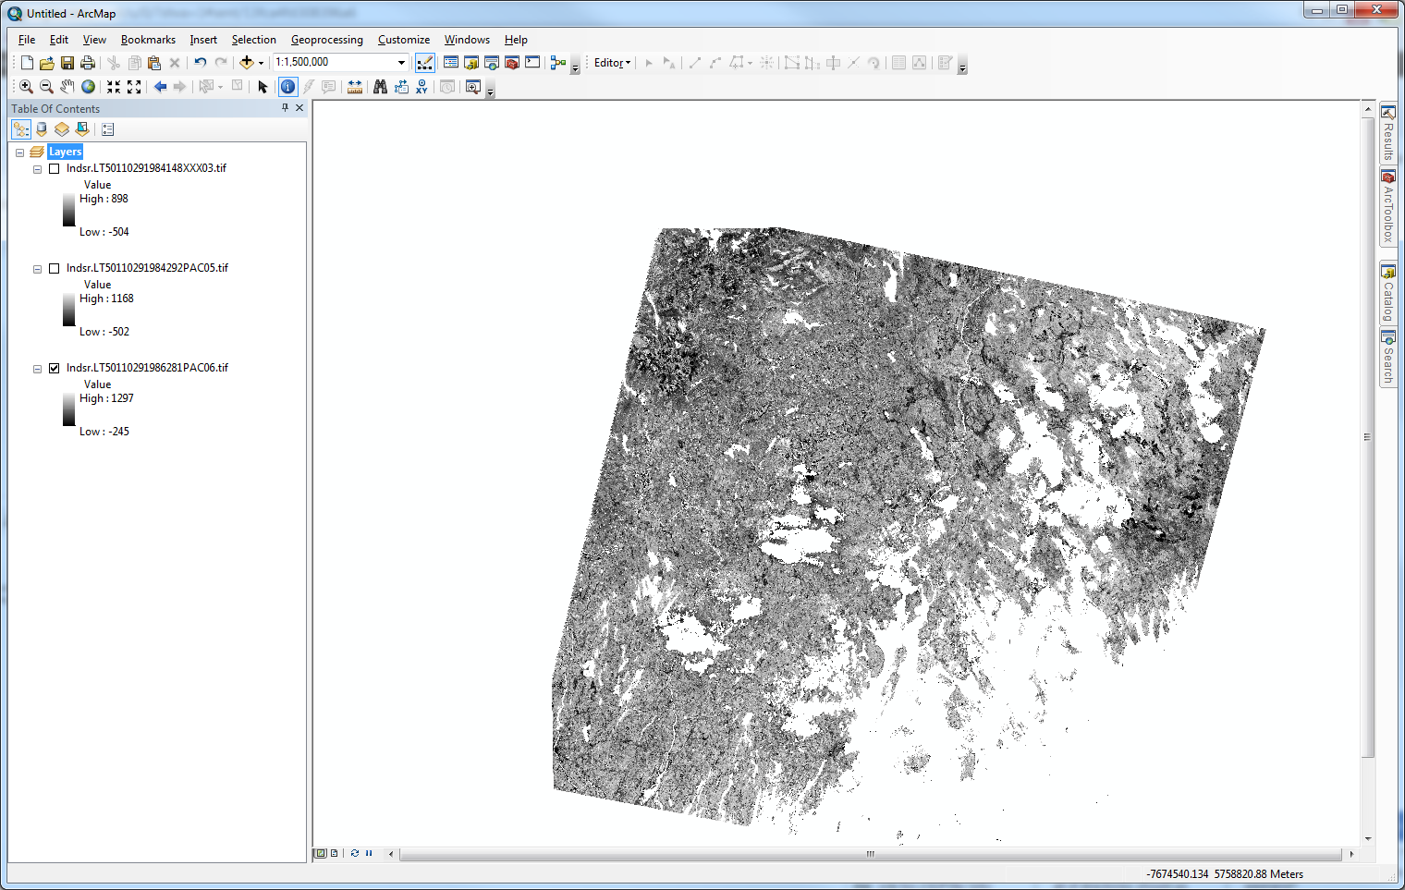
4. Finding Burn Scars in Landsat Images
Todd Hawbaker, Research Ecologist
Identify fire scars in Landsat scenes across the U.S.
Striving to produce the algorithm for the planned burned area product which is part of the Essential Climate Variables project
Using R & Gdal to train the algorithm using boosted regression trees to recognize burn scars
Notes:
Essential Climate Variables project – Stitt http://pubs.usgs.gov/sim/3155/
On my workstation (3.2 GHz Xeon W3670 w/ 24 GB RAM, writing across the
network), it takes about 55 minutes for R to processing 1 landsat scene.
There are 410 scenes in our test site, so with 1 thread, it will take about
15.66 days to process all 410 images! That makes your 2 hour processing
time look awesome!
There are about 184,275 landsat scenes covering the lower 48 states for
1984-2010. Using just my workstation, that would take 19.28 years to
crunch them all with 1 thread, or 2.41 years with 8 threads. Obviously,
this isn’t a good solution and we need more processing power!
The R code is just the first step of the algorithm, the second step takes R
output (burn probabilities) and filters it to produce a binary burn|noburn
image. Currently, we have a python script (attached) to complete that
step, but ultimately we will port it to C++.

Slide 18
4. Results – Burn Scars
Single workstation processing 410 scenes
  About 55 minutes for R to process single landsat scene
  15.66 days to process all 410 scenes
CSAS Compute Cluster processing 410 scenes
  2 hrs 6 mins for R to process 410 scenes
  Added MPI support to R code to enable parallel computation of scene images

Slide 19
4. Results – Burn Scars
Updates
Project abandoned the R code and ported to Python
Significant improvement in processing times and memory footprint but reverted back to single threaded processing
Reworked logic in processing to leverage more CPUs and limit memory footprint
Implemented MPI for the Python code – substantial improvement in processing time
  134 Mins to 3 Mins on test scene
  Over 6 days to 14 hours on a single full scene
  300 new Scenes daily to process
    (Network bandwidth is now current limit …)
Code provided to Science Team
Notes:
MPI stands for Message Passing Interface. The MPI specification is basically an API, providing useful routines for communication between the nodes. Normally Fortran or C++

Slide 20
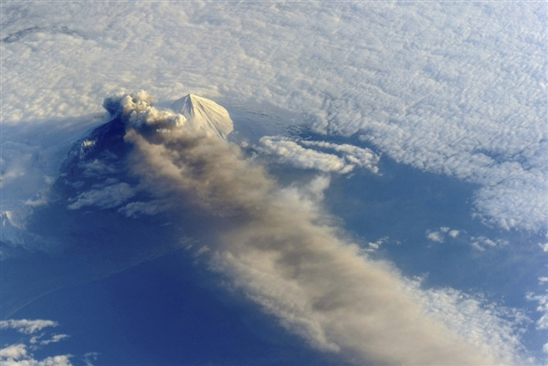
Pending Project: Ash3d
Peter Cervelli, Larry Mastin, Hans Schwaiger
Alaska and Cascades Volcano Observatories
Volcanic ash cloud dispersal and fallout model forecasts
3-D Eulerian model built in Fortran
Excellent candidate for parallelization and GPU processing
Possible OLCF Director’s Discretion project

Slide 21

Summary of Projects Results
Measuring success
  Decreased “time to solution”
    Burn Scars:
      Single machine takes 2 weeks
      CSAS compute cluster takes 2 hours
    Parameter Estimation:
      26 hours on Windows cluster
      12 hours on CSAS cluster
      10 hours on ORNL Institutional cluster
  Increased “scope of question”
    Daily Century: allowed processing of 7.8 million simulations – up from 185,000
    Bayesian Species Modeling: increased number of simulations able to run.

Slide 22
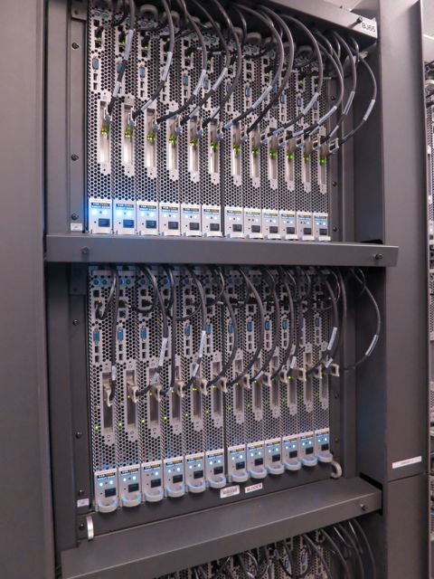
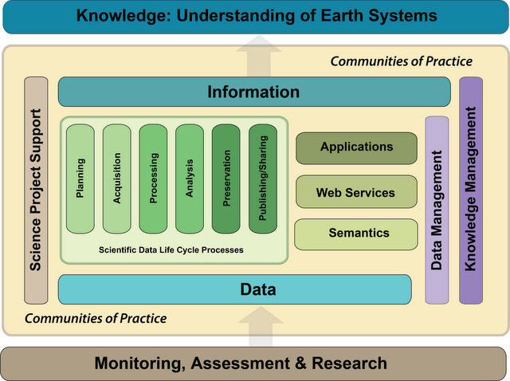

Where are we going?
USGS HPC Owners Cooperative (CDI Group)
Solidify partnership with ORNL HPC
CSAS and USGS staff education and training
Powell Center research requirements
Broaden usage of HPC in USGS – Volcanic Ash
XSEDE Campus Champions
USGS HPC Business plan
Notes:
USGS Cooperative:
Compile and maintain a list of available HPC resources within USGS
Establish resource access workflows
Connect the researcher to the appropriate resources
Develop governance, usage, and resource allocation policies
Technical collaboration and assistance
Procurement planning
ORNL:
Established access to institutional cluster (OIC)
Developing process for receiving allocations on supercomputing resources
Formalizing relationships for technical assistance through existing Interagency Agreement
Volcanic ash cloud dispersal and fallout model forecasts
3-D Eulerian model built in Fortran
Excellent candidate for parallelization and GPU processing
Possible OLCF Director’s Discretion project

Slide 23
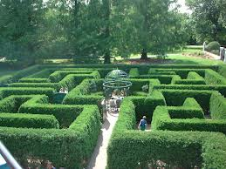
USGS HPC-Owners Cooperative
Currently Forming
FL Water Science Center
  200+ Core Windows HPC
Astrogeology Science Center
  Linux cluster with fast disk I/O
Center for Integrated Data Analysis / WI Water Center
  HTCondor cluster with Windows / Linux compute nodes
Core Science Analytics and Synthesis
  Linux compute cluster supporting OpenMPI, R, and Enthought Python Distribution
Notes:
USGS Cooperative:
Compile and maintain a list of available HPC resources within USGS
Establish resource access workflows
Connect the researcher to the appropriate resources
Develop governance, usage, and resource allocation policies
Technical collaboration and assistance
Procurement planning

Slide 24
J.W. Powell Center for Analysis and Synthesis
Research Computing Support
Establish priority access to HPC resources for Powell Center projects
Provide guidance and expertise for utilizing computing clusters
Assist with code architecting, profiling, and debugging
  This is a long term goal ….

Slide 25
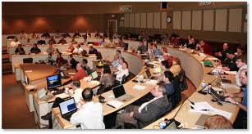
Training Programs
Geared towards researchers and scientists
  Similar to Software Carpentry
Seminars and Workshops on using HPC technology
  Programming intros, best practices
  Code management
  Job Schedulers
  Parallel Processing
  MPI
Partnerships with Universities
  Student programs, post-masters, post-docs

Slide 26
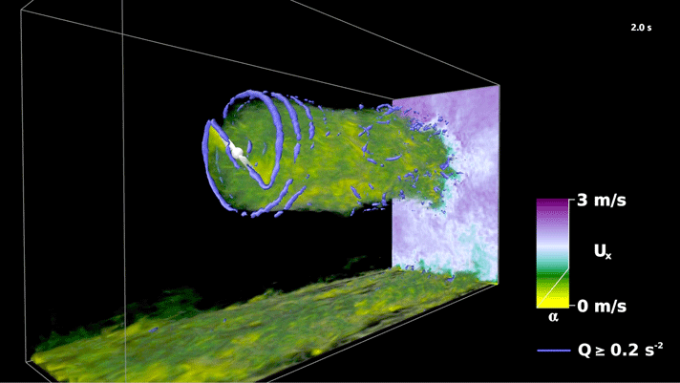
Challenges
HPC environments require unique skill sets
Long-term Funding
Bandwidth and Network
  Wide Area Networks
  IPv6
Facilities
  Power
  Cooling
  Footprint
Supporting science needs
Notes:
Needs work

Slide 27
Cast of Characters
Jeff Falgout - USGS
Janice Gordon - USGS
James Curry – USGS (Student) (+1)
Mike Frame – USGS
Kevin Gallagher - USGS
John Cobb – ORNL
Pete Eby - ORNL
Giri Palanisamy – ORNL
Jim Hack - ORNL
+++ Several Researchers in USGS

Slide 28

Questions? Comments?
Mike Frame
USGS CSAS
Mike_frame@usgs.gov

