Slide 1
Supergiant Triassic Amphipod from Nevada: Oldest Known Amphipod
Mark McMenamin, Lydia Orr, Rose Minichiello, Lesly Zapata & Meghan Hussey
Department of Geology and Geography
Mount Holyoke College
2013

Slide 2
Triassic Nevada
Key sedimentological question: “Is the Luning Formation a shallow or deep marine deposit?”
Triassic Kraken hypothesis (2011-2013)
May 2013: compelling evidence that the Luning Fm. is indeed a deep water deposit.

Slide 3
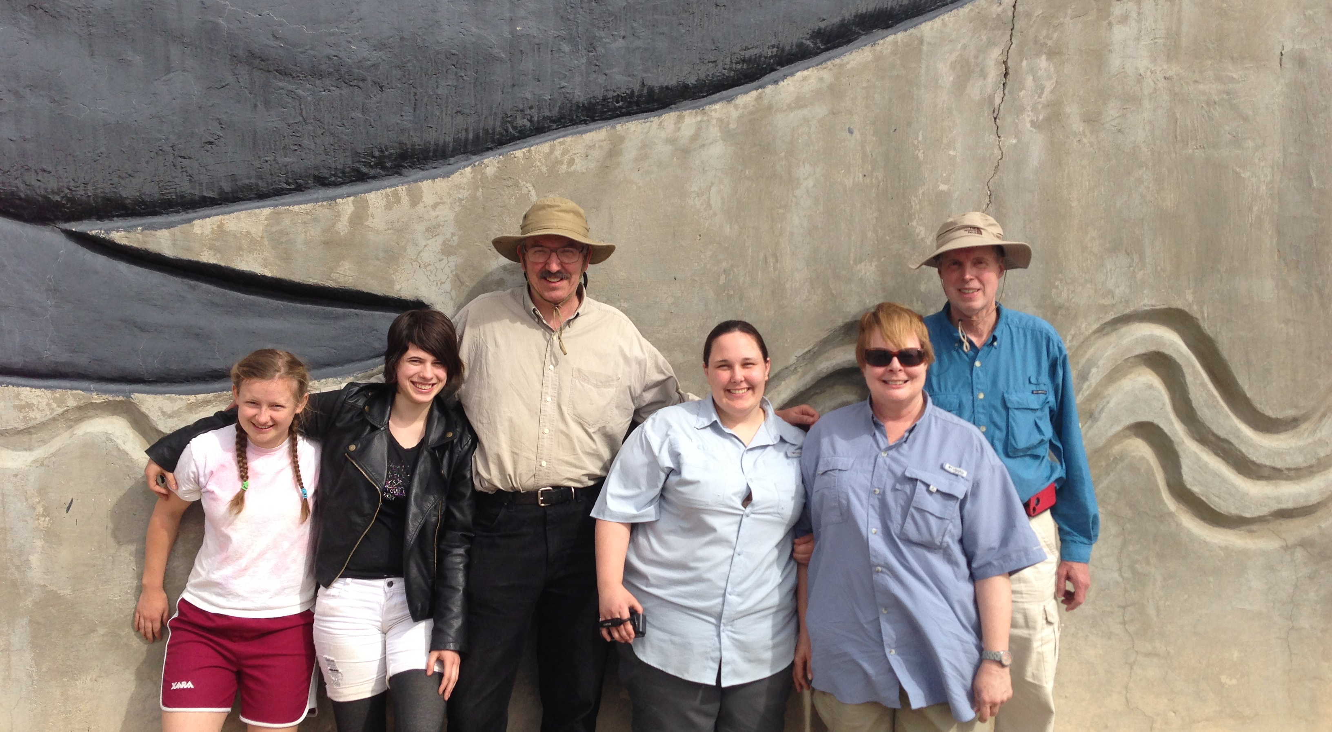
Triassic Nevada Expedition May 2013
Photo Credit: Ranger Todd Wheeler

Slide 4
Protopaleodictyon ichnosp.

Slide 5
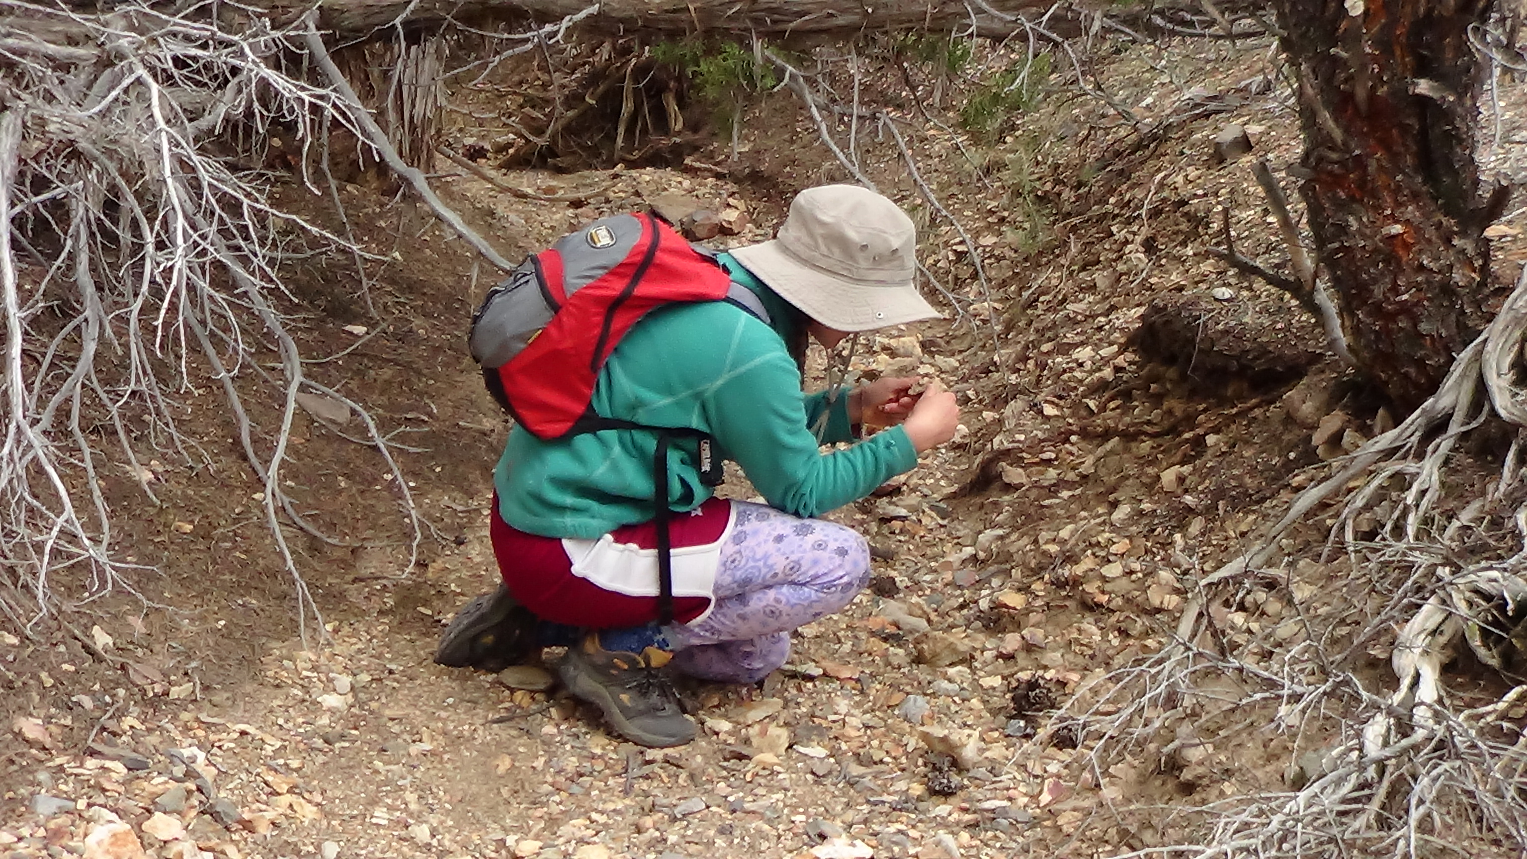
Rose Minichiello at work
Photo Credit: Lydia Orr

Slide 6
Rosagammarus minichiellus

Slide 7
Coxal Plate 5 to Basis

Slide 8
Amphipod Cuticle
Photo Credit [B]: Petr Jan Juracka

Slide 9
Fossil plotted on Acanthogammarid
Rosagammarus minichiellus n. gen. n. sp.

Slide 10
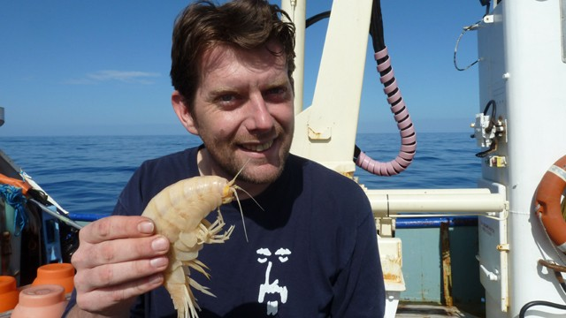
Supergiant Alicella gigantea

Slide 11
Acid Maceration of Luning Formation Limestone

Slide 12
“Swiss Army Knife” Microclaw

Slide 13
Microchelae Features
1. A scimitar-like dactyl.
2. Saw teeth on the propus .
3. A bulging tooth at the base of the dactyl .
Hypothesis: This tiny chelate decapod is an early manifestation of the Mesozoic Marine Revolution.

Slide 14
Luning Formation: Evidence for Deep Marine Setting
unwinnowed wackestone matrix (J. Holger, 1992)
Protopaleodictyon ichnosp.
supergiant (17 cm long) amphipod (Jour. Crustacean Biology [2013] v. 47, n. 7).

Slide 15
Conclusions
The Luning Fm. is unquestionably deep marine.
R. minichiellus extends the geological range of Amphipoda by at least 170 million years.
Micropredators played an early role in the Mesozoic Marine Revolution.
Gigantism in deep marine amphipods may help them avoid abyssal predators.

Slide 16
The Triassic Foundation of the Modern-style Deep Marine Ecosystem
Ichthyosaur carcasses play the same role as whale carcasses in the modern deep sea.
Supergiant amphipods feed on the large vertebrate remains.
Large body size allows abyssal amphipods to avoid smaller predators.
NEXT: Giant cephalopods prowl the depths.

Slide 17
Acknowledgments
Sincere thanks to Doug Fleury, Dr. Douglas Orr and Dr. Nancy Hodge for assistance with various aspects of this research.
Thanks to Mount Holyoke College for funding this research and our May 2013 expedition to Berlin-Ichthyosaur Park in Nevada.

