Slide 1
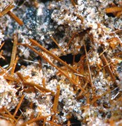
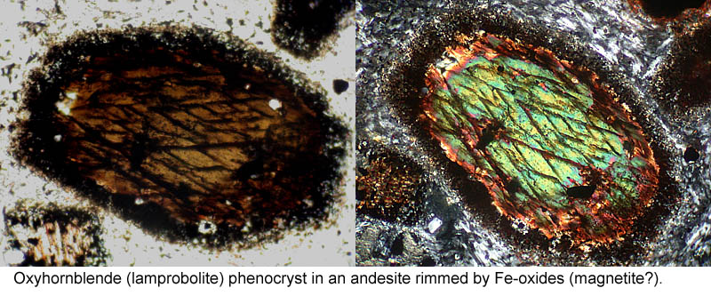
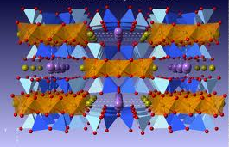
Crystal chemical controls on halogen and hydroxyl partitioning into igneous amphiboles
Paul Giesting
Justin Filiberto
Southern Illinois University, Carbondale
Illustrations: Dakota Minerals, Marshall University Dept. of Geology, CrystalMaker Software Ltd.

Slide 2
Igneous amphibole
Mineral | Octahedral: Tetrahedral Cations | Monovalent: Divalent Anions
Olivine | 2:1 | 0
Pyroxene | 1:1 | 0
Amphibole | 5:8 (7:8 inc. B sites) | up to 1:11
Mica | 3:4 | 2:10

Slide 3
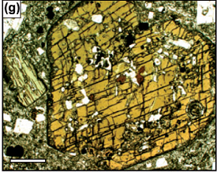
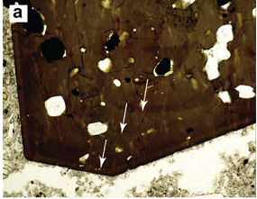
Amphibole in dacites
Chambefort et al. (2013): Yanacocha volcanics
Amphibole tracks H₂O/OH and F/Cl of magmas and fluids
Cl influences metallogenesis of Au deposits
Humphreys et al. (2009):
Soufriere Hills
Amphibole partitioning model allows calculation of Cl content of magmas
Cl tracks history of magma injection into chamber

Slide 4
Amphibole in Martian meteorites
Melt inclusions in chassignites evolved to high volatile content
Halogens (F and Cl) partitioned between melt, amphibole, phosphates
Can we use glass & amphibole compositions to better understand Martian magmatic volatiles?
Cl map from data collected at Open University

Slide 5
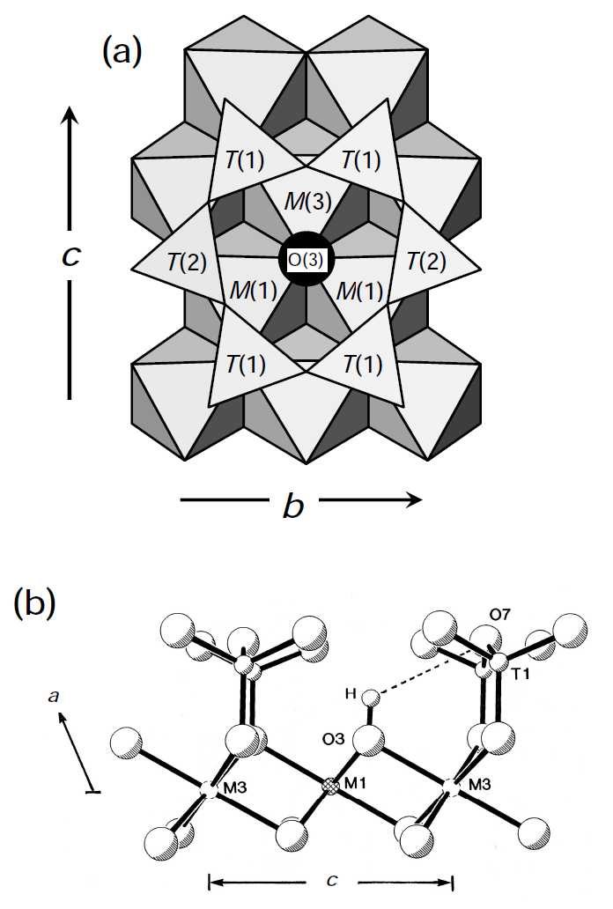
O(3) site in amphibole
A
Cl
F
M1, M3:
Mg - favors F
Fe - favors Cl
Fe³⁺, Al, Ti - favor O²⁻
A: K - favors Cl
Na, Vacancy - ?
Reviews in Mineralogy & Geochemistry, V. 67

Slide 6
OH, F, Cl partitioning

Slide 7
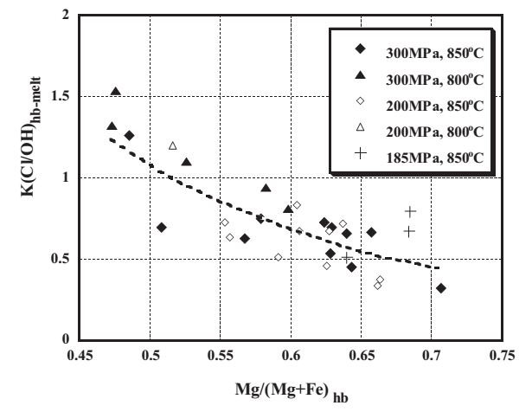
Sato model: Cl/OH partitioning
Sato et al. (2005)
Synthetic dataset: Compositions based on Unzen dacite
Links partitioning coefficient to Mg# of hornblende amphibole
Assumes 2 = OH + F + Cl for amphibole
(no ^{O(3)}O²⁻)

Slide 8
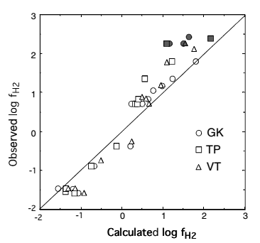
Popp model: Controls on ^{O(3)}O²⁻
Popp et al. (2006)
Annealing experiments on natural mantle xenocrysts
Calibrates an equilibrium constant for the internal amphibole reaction
Fe²⁺+OH⁻ ↔ Fe³⁺+^{O(3)}O²⁻+½H₂
using the Ti and Al content of the mineral

Slide 9
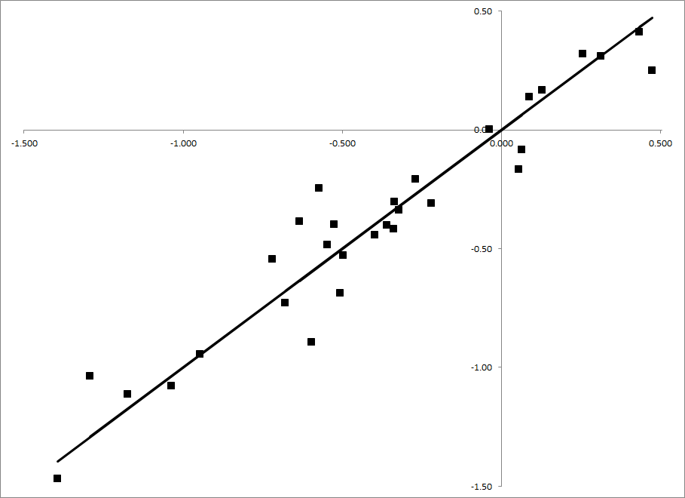
Composite model
In a controlled experiment, Popp model can be reversed to calculate OH/O content of amphibole O(3) sites.
This allows us to calculate a regression providing a better fit to the Sato data (R = 0.97 vs. R = 0.82).

Slide 10
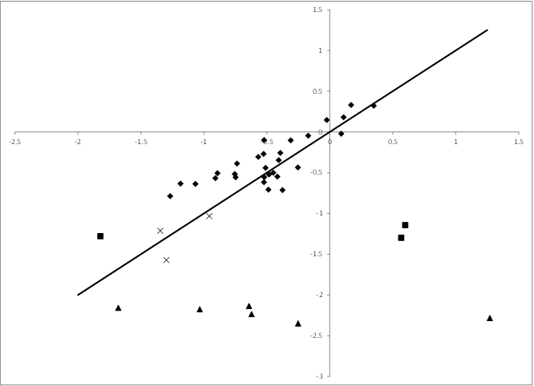
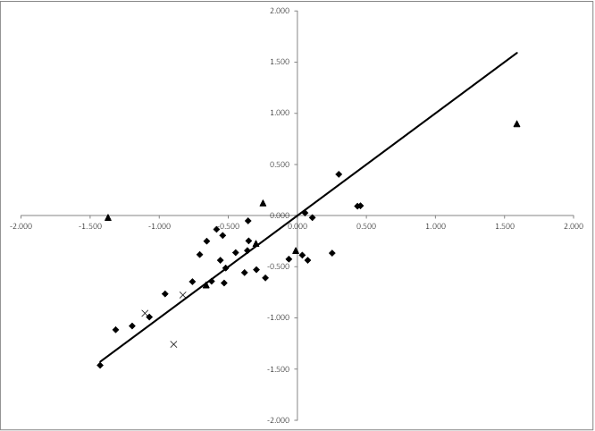
Extended model
Sato et al. (2005)
Giesting et al. (2013)
Sato (dacite)
Browne (dacite)
McCubbin (Martian basalt)
Adam & Green (alkalic basalt)

Slide 11
Models | Dixon 8 | Dixon 3 | Lesne 8 | Lesne 3 | Sato Only
R, R² | 0.95, 0.90 | 0.87, 0.77 | 0.95, 0.89 | 0.86, 0.75 | 0.97, 0.95
Parameters | Coefficients | Coefficients | Coefficients | Coefficients | Coefficients
K (apfu) | -20.0±8.5 | 9.2±1.9 | -14.6±7.2
K/(Na+^{[A]}[ ]) | 29.7±7.3 |  | 30.9±6.3 | 6.6±0.9
Na (apfu) | 10.8±2.3 |  | 20.6±4.2
^{[A]}[ ] (vpfu) | 12.9±2.1 | 3.2±0.5 | 20.5±4.0
Ca (apfu) | -1.7±0.7 |  |  |  | -5.2±0.7
Mg (apfu) | -3.4±0.7 | -1.0±0.1 | -4.7±1.0 | -0.7±0.1 | -5.2±0.4
Mg/(Mg+Fe) |  |  |  |  | 39.1±5.1
^{[6]}Mg/ (^{[6]}Mg+^{[6]}Fe) | 9.6±3.1
^{[6]}Fe (apfu) |  |  | -3.6±1.0 | 0.5±0.1 | 3.9±0.7
(Mg+Mn+^{[6]}Fe) / (Ti+Cr+^{[6]}Al) |  |  | 0.2±0.1
T (K) |  |  | -3.4±1.8·10⁻³ |  | -5.9±1.9·10⁻³
ln P (bar) | -0.8±0.2

Slide 12
Amphibole in chassignite melt inclusions
 | Measured |  |  | Deep equilibration
 | Cl (amph) | Cl (melt) | H₂O (amph) | H₂O (amph) | H₂O (melt) | H₂O/Cl (melt)
NWA 2737 mean | 0.13% | 0.34% | 0.15% | 0.33% | 0.21% | 0.68
Chassigny mean | 0.13% | 0.28% | 0.15% / 0.58% | 0.20% | 0.12% | 0.45
Cl/OH model calculation allows estimation of amphibole H₂O content at crystallization.
Drop in H₂O content since crystallization is likely due to shock - never before quantified.
Melt H₂O/Cl contents are lower than almost anything seen on Earth.

Slide 13
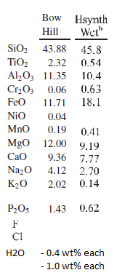
Experimental program
Popp model (3 compositions) and extended model (39 compositions) need further calibration data.
We have selected two mafic compositions from the literature with contrast in Mg#, alkali, and Ti contents.

Slide 14
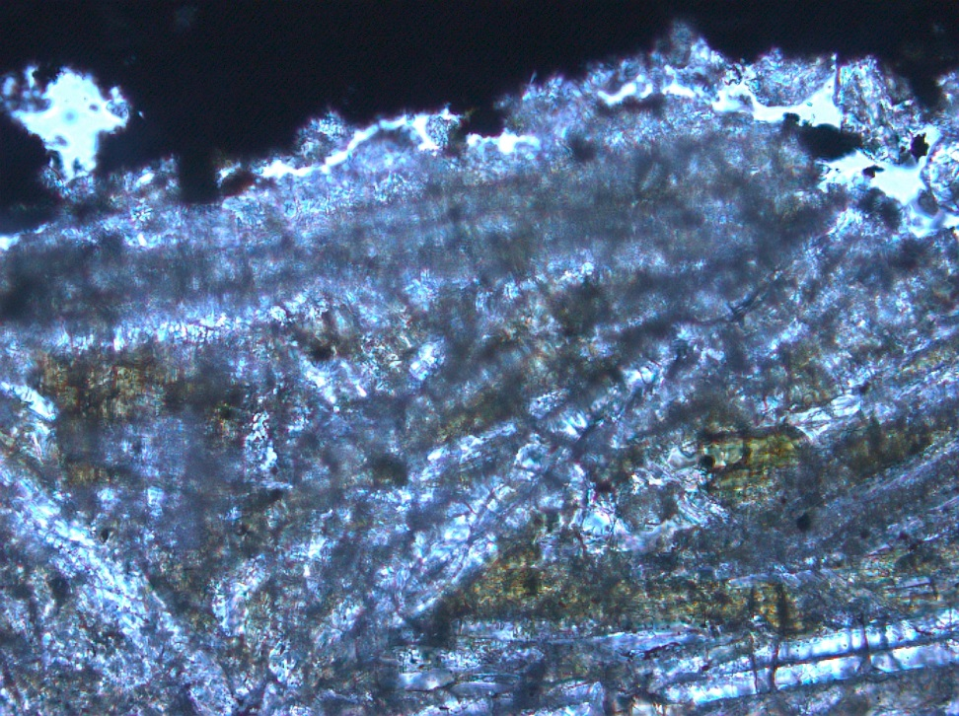
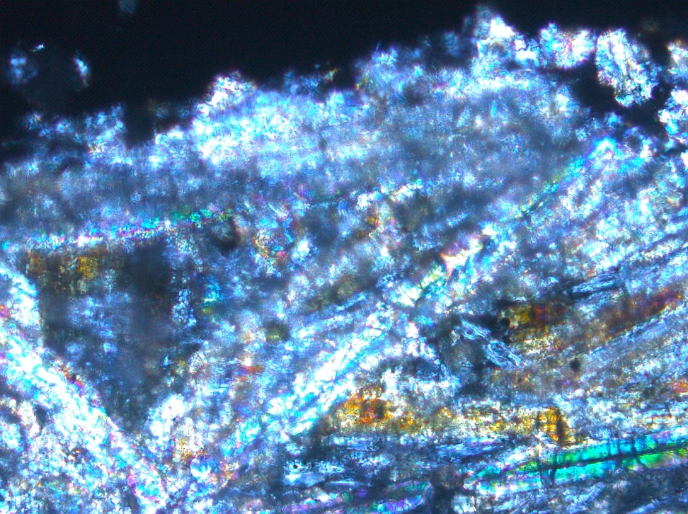
Synthesis results
Bow Hill + 0.4 wt% F,Cl,H₂O
950 ºC
(crossed polars)

Slide 15
Acknowledgements
Open University - EMP and SIMS data
Bob Popp & Wally Lamb
Tony Withers
NASA MFR grant # NNX13AG35

