Slide 1

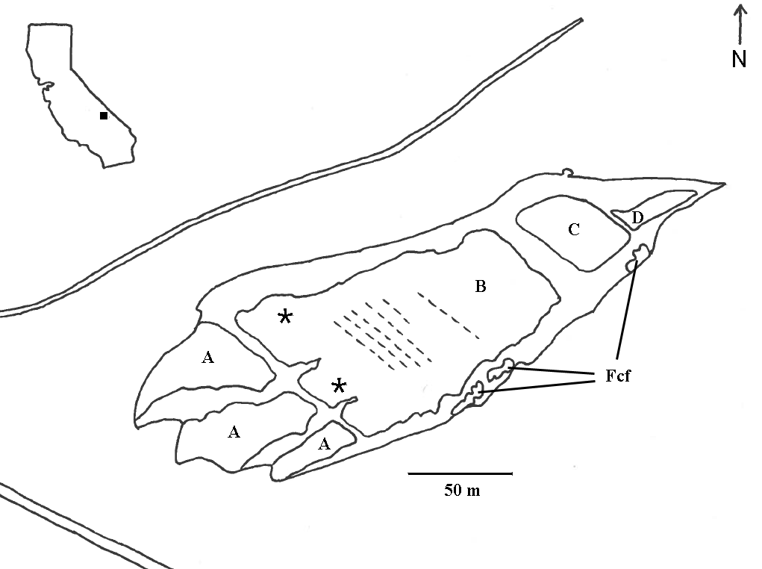
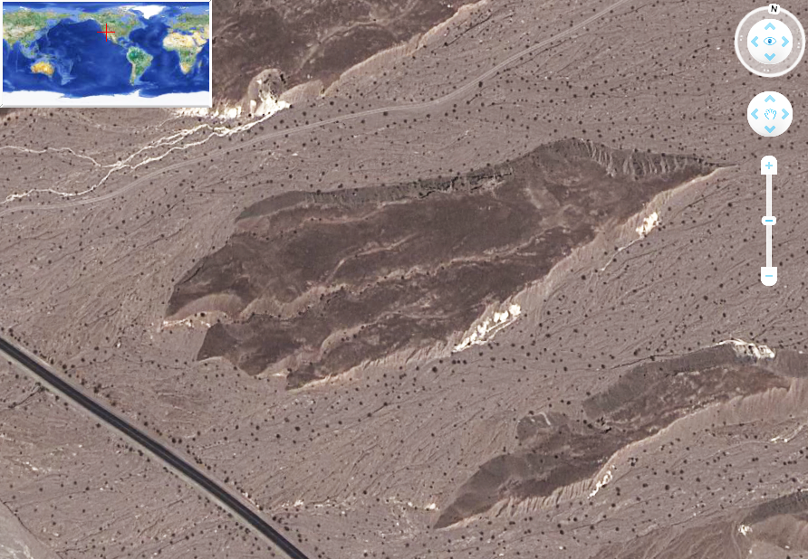
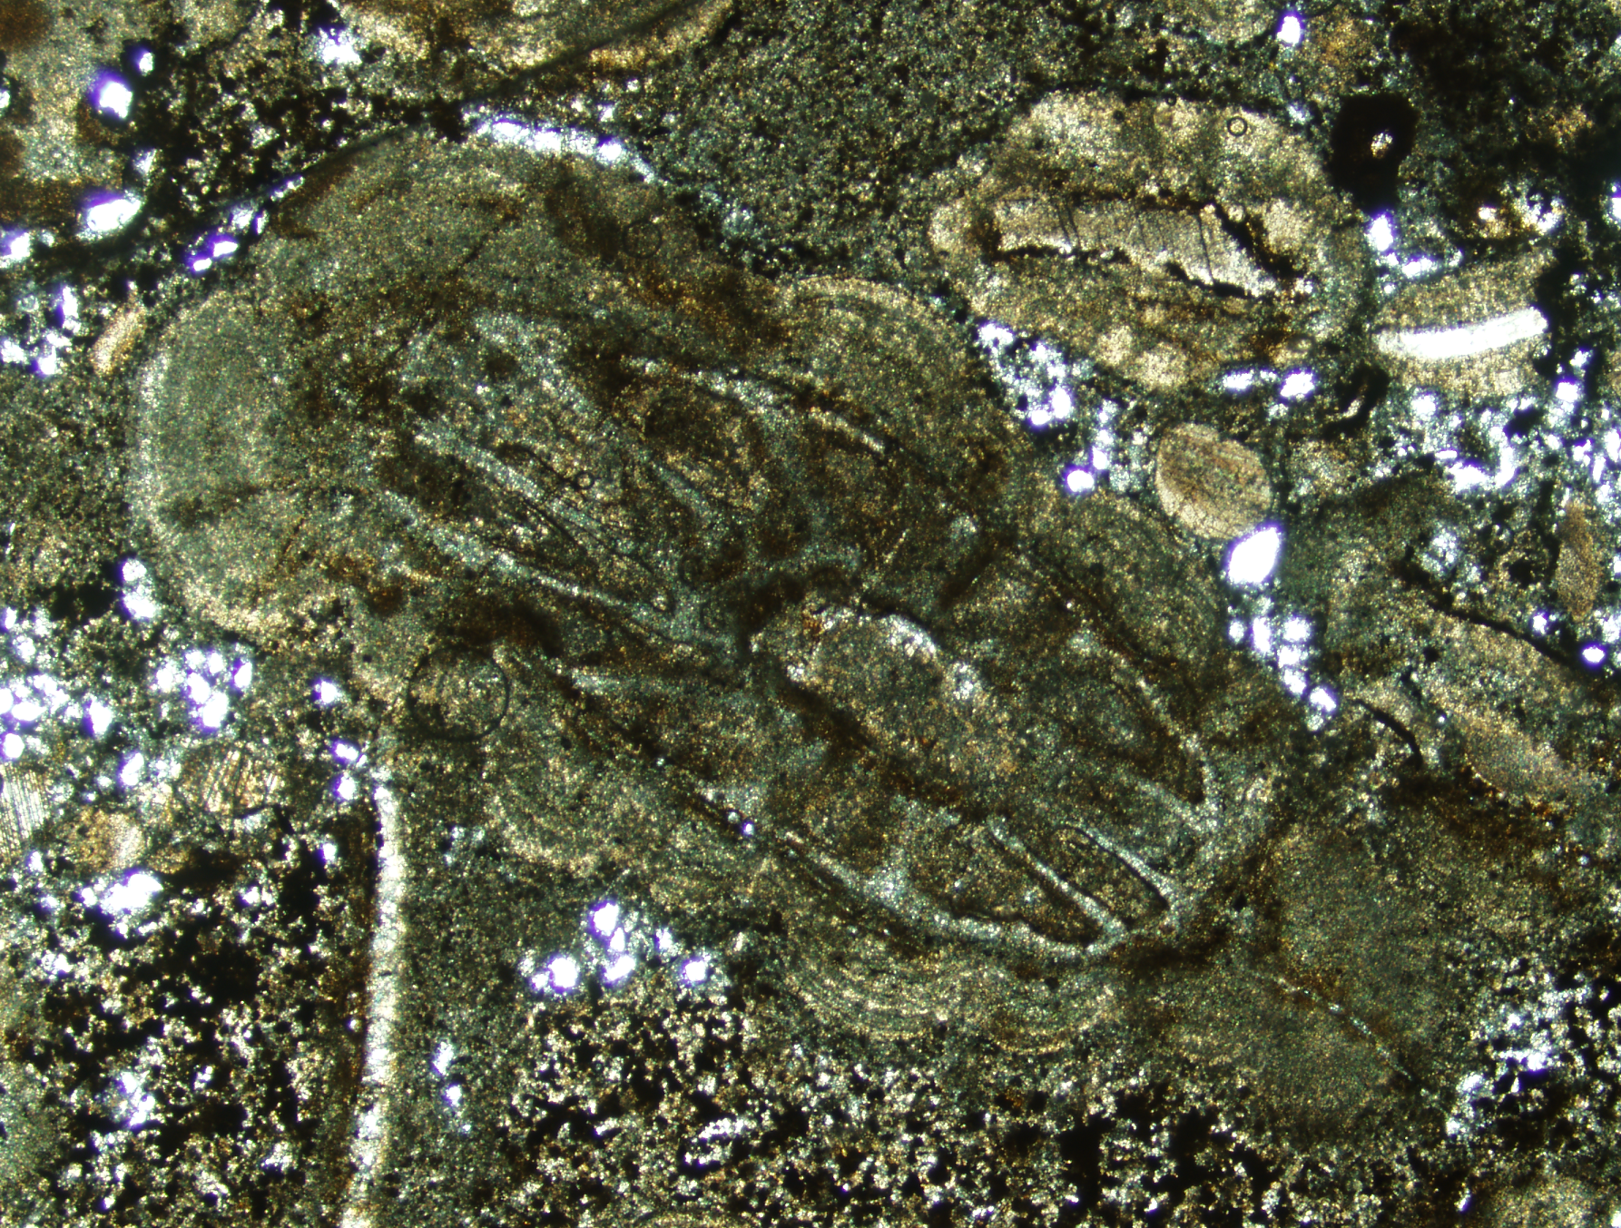
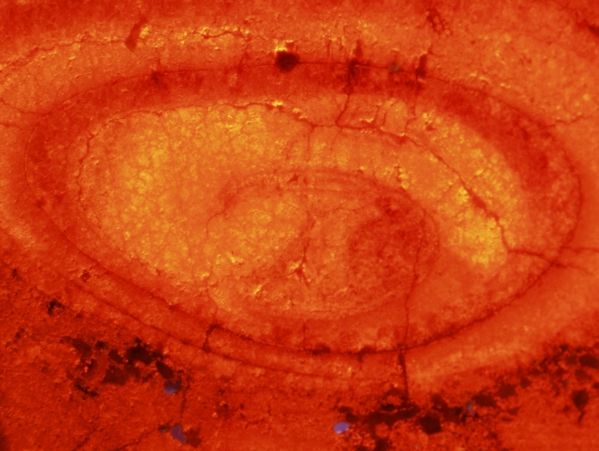
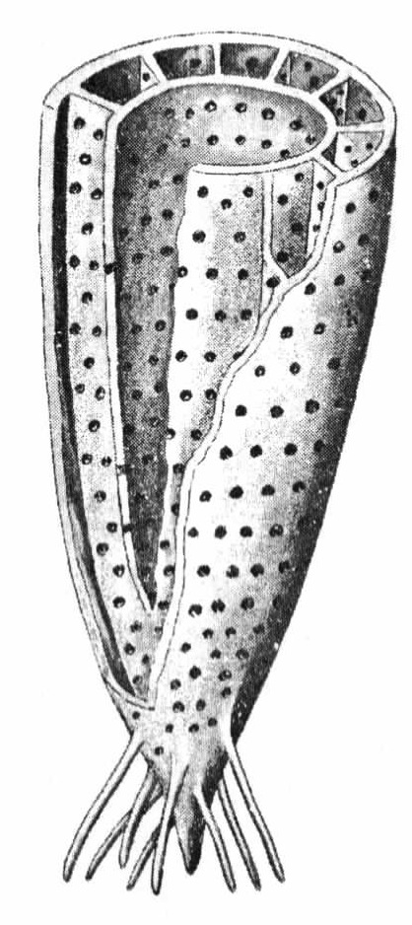
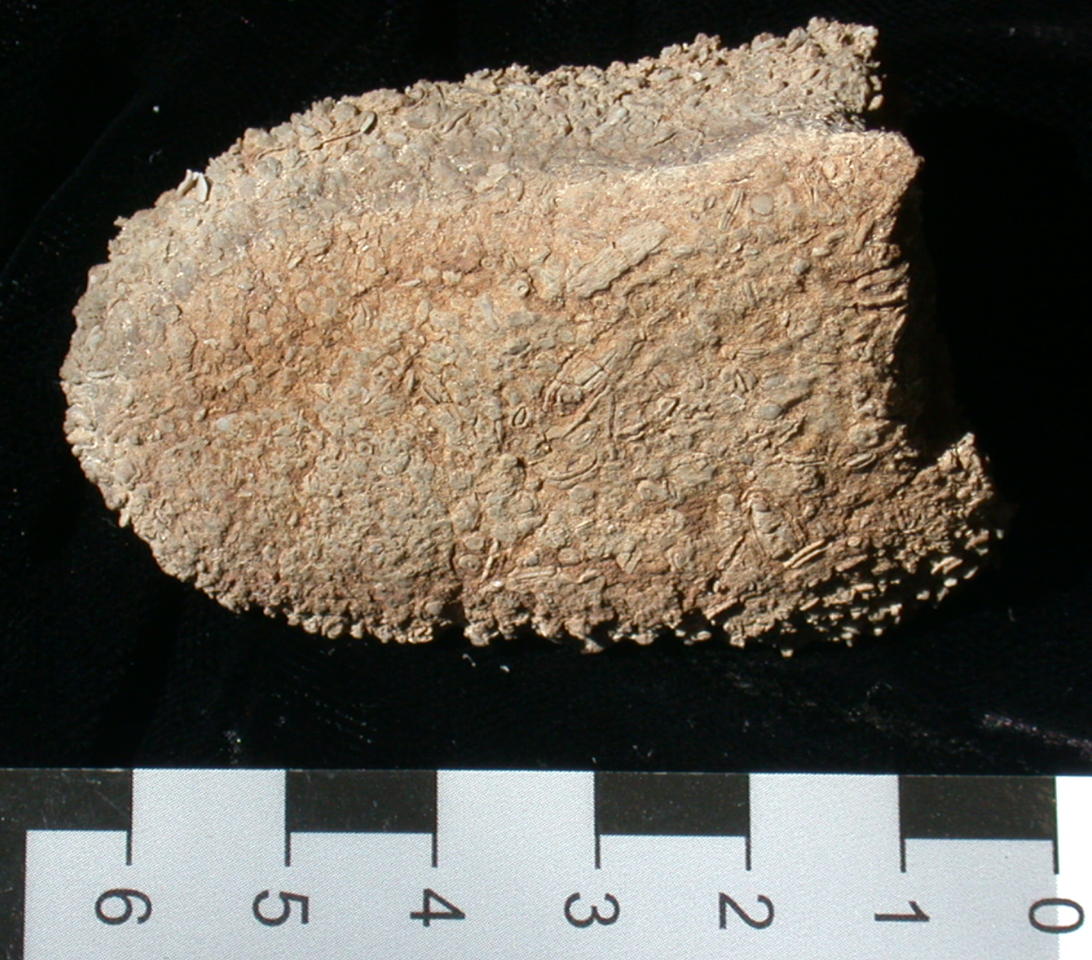
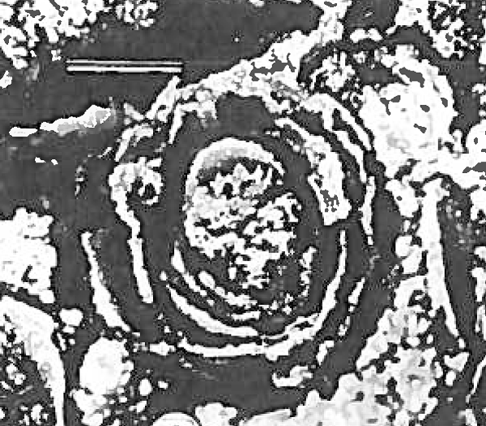
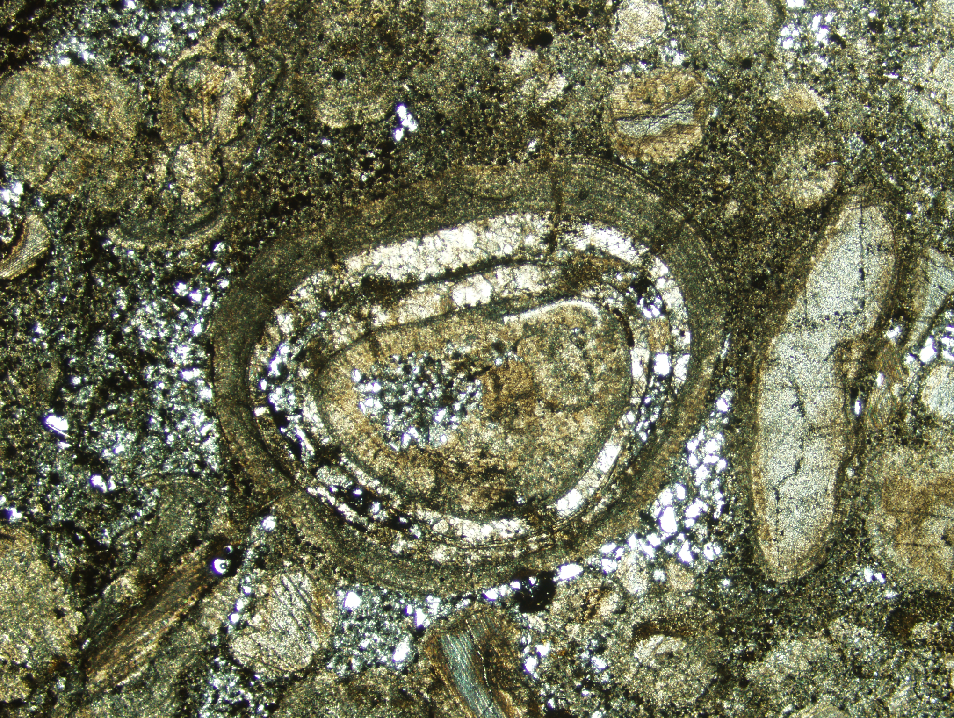
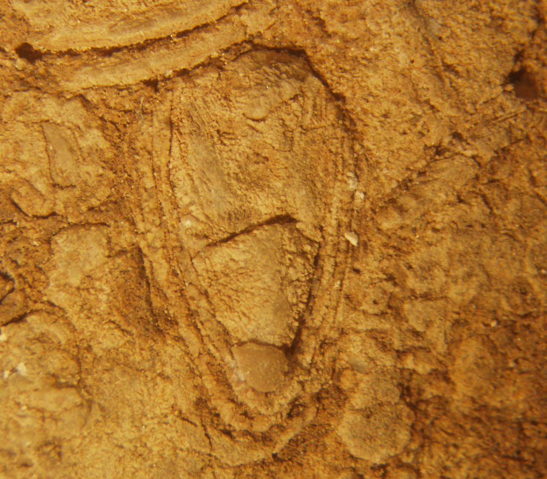
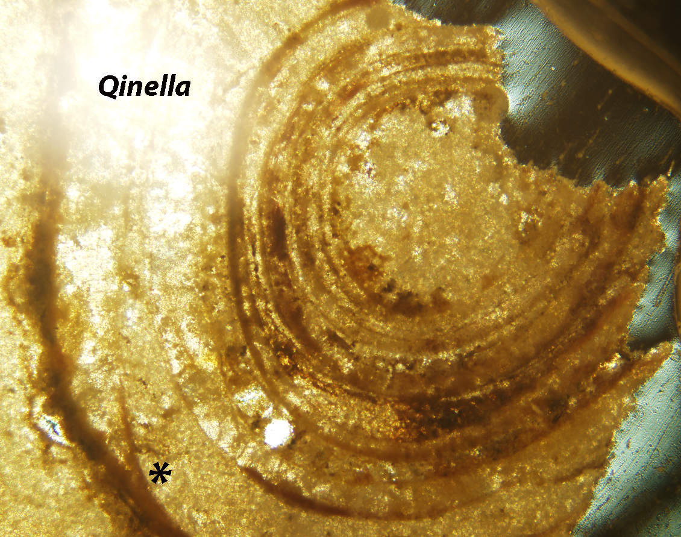
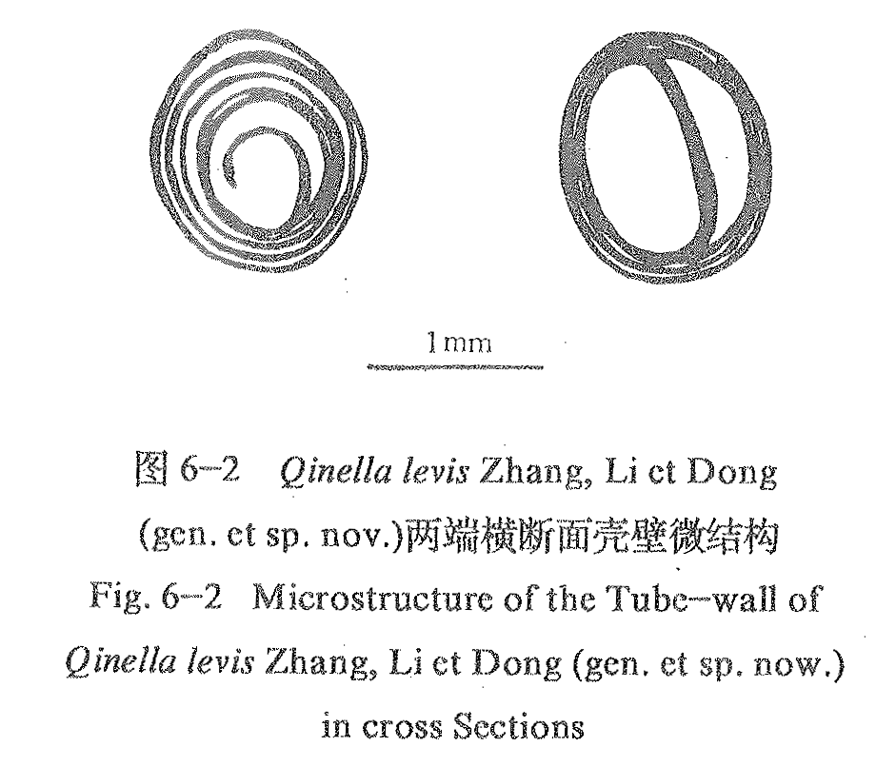
SURVIVING THE CAMBRIAN EXPLOSION: QINELLA FROM DEATH VALLEY, CALIFORNIA
The small shelly fossil Qinella occurs in an oolite sample from the Lower Cambrian Wood Canyon Formation, Echo Canyon, Death Valley, California. Until now, Qinella has been reported exclusively from upper Proterozoic strata. The Death Valley specimens reach 3.5 mm diameter, and are preserved in limestone matrix that hosts ooids, trilobites, and archaeocyaths with lumpy, cerebroid coatings. Although reworked, the Qinella specimens are not derived from Proterozoic deposits, as one specimen has a trilobite fragment lodged deeply in its interior.
The fossils were collected under permit from an elevated desert pavement surface during a Mount Holyoke College expedition to Death Valley. The oolite sample suite was initially thought to belong to the Proterozoic Johnnie Formation. Thin sections, however, revealed the presence of juvenile ethmophylloid archaeocyaths occurring as coated grain nuclei alongside the Qinella. Cerebroid ooids characterize the lower oolite of the upper Wood Canyon Formation. Under cathodoluminescence, the small shelly fossils reveal characteristic Qinella wall structure, manifest as nested, loosely‑spaced cylindrical walls of variable thickness. Walls may thin and pinch out (asterisk in lowest Qinella thin section photograph to right) against adjacent walls, as seen in both transverse and longitudinal section.
Qinella, also known from the Proterozoic La Ciénega Formation of Sonora, México, is one of very few genera known to survive the Cambrian explosion. Qinella's wall structure evidently provided a formidable defense against boring micropredators. The enhanced protection afforded by its multilamellate shell allowed Qinella to survive well into the Cambrian.
Mark A. S. McMenamin
Whitney A. Hughes
Jessica M. McMenamin
Mount Holyoke College
The newly discovered fossil described here is evidently a Cambrian-age relict of the Proterozoic
Sinotubulites-Chenmengella-Qinella shelly biota that occurs in both China and Sonora, México
(McMenamin, 1985; Zhuravlev et al., 1992). This very interesting Proterozoic paleobiogeographic
linkage represents the first confident (i. e., multiple shelly taxa) Proterozoic biostratigraphic
correlation between Asia and the Americas (McMenamin, 1985). The Qinella sp. described here from the Wood
Canyon Formation is a Cambrian survivor of Sinotubulites-Chenmengella-Qinella shelly biota that was
otherwise apparently extinct by the Cambrian. Qinella’s multilamellate wall structure may have served as an
antipredatory exaptation, allowing it to survive the onslaught of emerging Cambrian predators.
Geological map of the “Bear Claw Alluvial Terrace,” mouth of Echo Canyon,
Death Valley, California (see Sharp and Glazner, 1997, p. 118). Key to labels: A-C,
successively higher alluvial terrace levels; dashed lines, low shoreline terraces;
asterisk; Wood Canyon Formation fossil localities; Fcf = Furnace Creek
Formation (Pliocene). Geologic mapping by the abstract authors.
“Bear Claw Alluvial Terrace,” satellite view. For
scale see map view to left.
Ethmophylloid archaeocyath with cerebroid coating. Ethmophyllid
archeocyaths are index fossils for Lower Cambrian strata. The cerebroid
coating (characteristic for the Wood Canyon Formation) also suggests a
Cambrian age for the rock. Width of archaeocyath 1.5 mm.
Cathodoluminoscope image of Death Valley Qinella in thin section.
Width of view approximately 3.3 mm.
Qinella sp. from the La Cienega Formation,
Sonora, Mexico (McMenamin, 1985). Originally interpreted as
a circothecid hyolith, the fossil has been recently reassigned to the
Proterozoic genus Qinella (Zhuravlev et al., 2012). Scale bar = 1 mm.
Weathered clast of Wood Canyon Formation oolite recovered
from the “Bear Claw Alluvial Terrace.” Note abundant shelly
fossils. Scale bar in centimeters. Collected by Jessica McMenamin
Qinella sp. from Death Valley, CA showing
cerebroid coating. Note trilobite “shepherd’s crook”
inside the Qinella to the upper right. Maximum
width of fossil (includes cerebroid coating) = 4 mm.
Oblique cut on a weathered surface though a
specimen of Qinella. Note wall layers of different
thicknesses. Maximum width of fossil (includes
cerebroid coat) = 3.7 mm.
References:
Ding, L.-F., L. Zhang, Y. Li and J. Dong. 1992. The Study of the Late Sinian—Early Cambrian Biotas from the Northern Margin of the Yangtze Platform. Scientific and Technical Documents Publishing House, Beijing, 135 p.
Lengner, K. E. 2009. A Trip Through Death Valley’s Geologic Past (The Magnificent Rocks of Death Valley). Deep Enough Press, Pahrump, Nevada.
McMenamin, M. A. S. 1985. Basal Cambrian small shelly fossils from the La Ciénega Formation, northwestern Sonora, Mexico. Journal of Paleontology, 59(6): 1414-1425.
Sharp, R. P. and A. F. Glazner. 1997. Geology Underfoot in Death Valley and Owens Valley. Mountain Press, Missoula, MT.
Zhuravlev, A. Yu., E. Liñán, J. A. Gámez Vintaned, F. Debrenne and A. B. Fedorov. 2012. New finds of skeletal fossils in the terminal Neoproterozoic of the Russian Platform and Spain. Acta Palaeontologica Polonica, 57(1):205-224.
Qinella sp. from Death Valley as seen in thin section with
transmitted light illumination. Asterisk
indicates merging zone between two thin
shell walls. Note recrystallized carbonate
mud in the center of the tube. Width of view
approximately 2 mm.
Qinella levis Zhang, Li and Dong (in
Ding et al., 1992) from the Sinian
of the Yangtze Platform, China.

