Slide 1
Projections for Ultimate Coal Production from Production Histories Through 2012
Dave Rutledge, Caltech
2013 GSA Annual Meeting, Denver

Slide 2
Outline
Projections from regional coal histories
Projection for world coal production
Comparisons with the scenarios used by climate modelers
Update of David Rutledge, 2011, “Estimating long-term world coal production with logit and probit transforms,” International Journal of Coal Geology

Slide 3
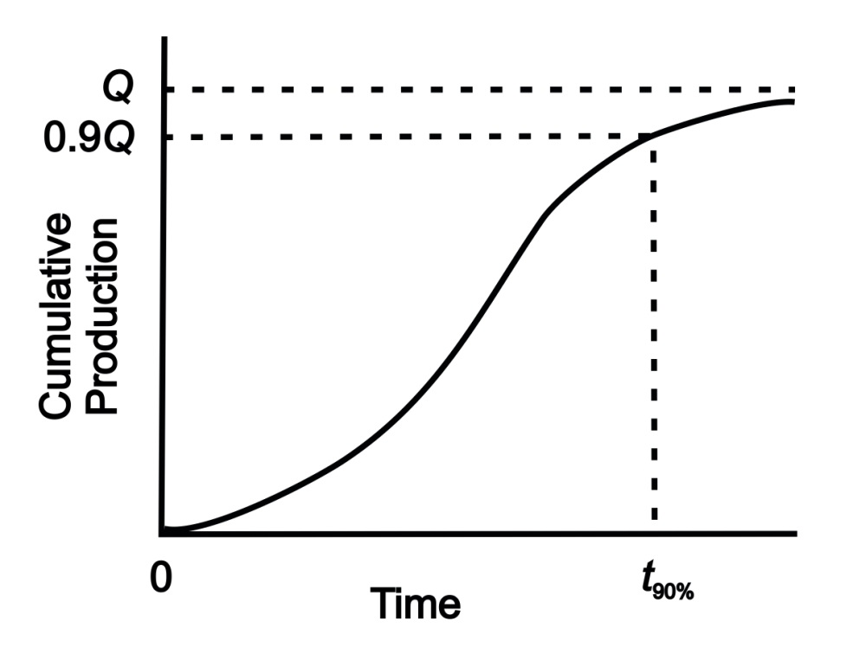
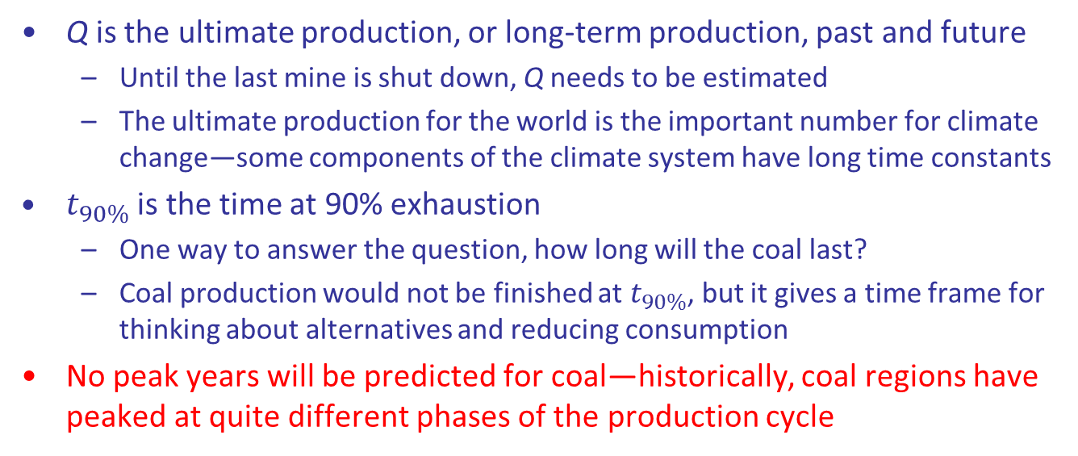
A Representative Cumulative Production Curve
Q is the ultimate production, or long-term production, past and future
  Until the last mine is shut down, Q needs to be estimated
  The ultimate production for the world is the important number for climate change—some components of the climate system have long time constants
$t_{90\%}$ is the time at 90% exhaustion
  One way to answer the question, how long will the coal last?
  Coal production would not be finished at $t_{90\%}$, but it gives a time frame for thinking about alternatives and reducing consumption
No peak years will be predicted for coal—historically, coal regions have peaked at quite different phases of the production cycle

Slide 4
Recent Milestones in Climate Change
2009: At the G8 meeting in L’Aquila, Italy, leaders set the goal of reducing fossil-fuel CO₂ emissions 80% by 2050
2012: the 1997 Kyoto Agreement to reduce CO₂ emissions finished up — the most significant lack of support was from the United States, which did not ratify, and from Canada, which ratified, but withdrew
2014: UN IPCC (Inter-Governmental Panel on Climate Change) plans to finish its 5th Assessment Report

Slide 5
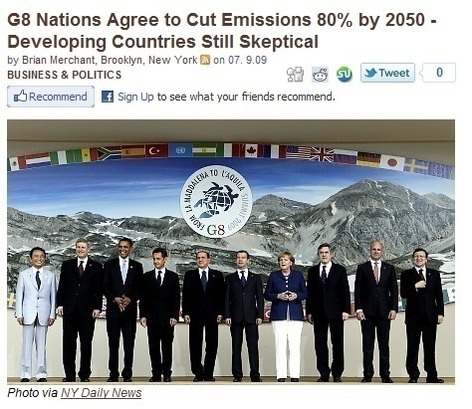

Slide 6
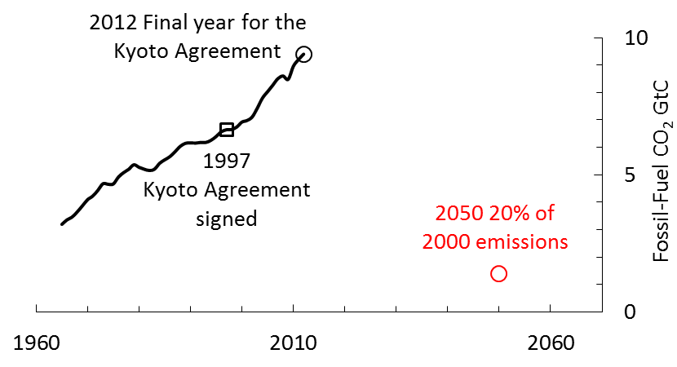
The Kyoto Agreement
World fossil-fuel carbon-dioxide emissions from the BP Statistical Review
For an 80% reduction by 2050—imagine the collapse of the Soviet Union, repeated four times, voluntarily

Slide 7
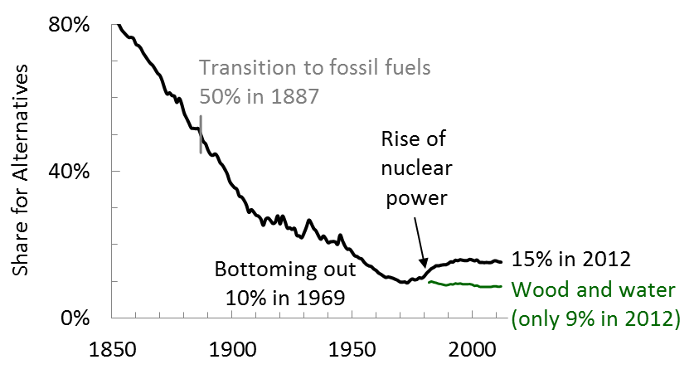
Alternatives Share in World Primary Energy Production
From Brian Mitchell, International Historical Statistics, the BP Statistical Review and FAO (UN) and Arnulf Grubler, Technology and Global Change
Since 1985, locked in a range from 14% to 16%
Will make projections that do not depend on climate or alternatives policy

Slide 8
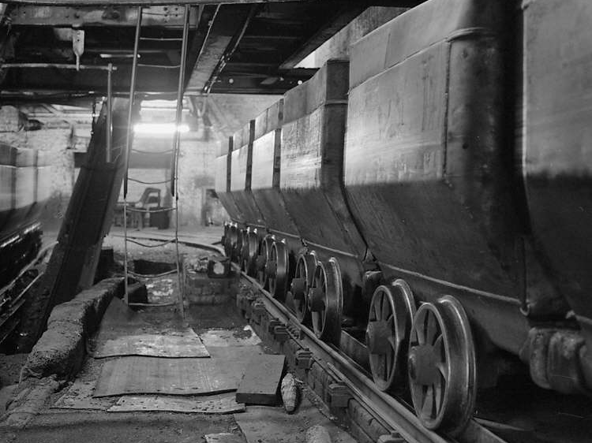
British Coal
Photo by John Cornwell
Notes:
John Cornwell Collection of Coal Mining Photographs http://www.tlysau.org.uk/en/item10/28955 Coal trams, Merthyr Vale Colliery, Aberfan
From Celebrating the Jewels, October 2003 By May 2003 the website at gtj.org.uk will contain over 20,000 images of Welsh life through the ages. These have been gathered from hundreds of museums, libraries, record offices and archives throughout Wales, putting them in one collection for the first time available to all free of charge.

Slide 9
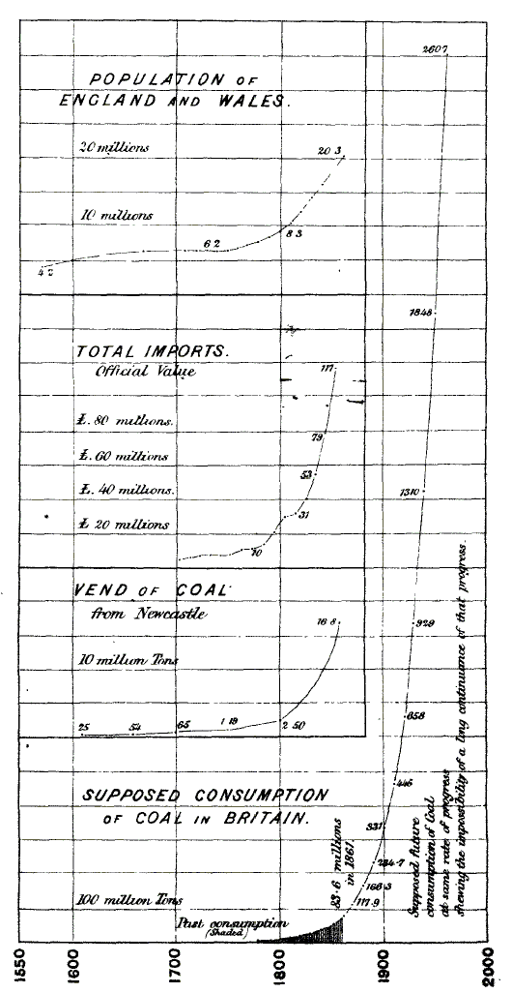
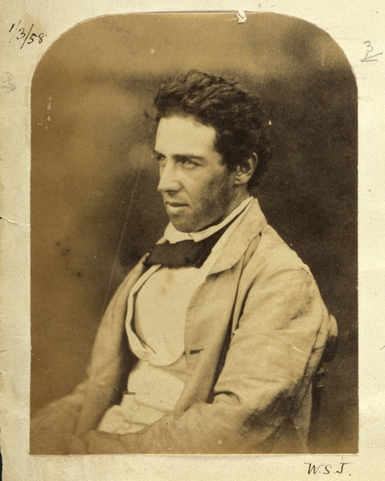
Stanley Jevons, 1865 The Coal Question

Slide 10
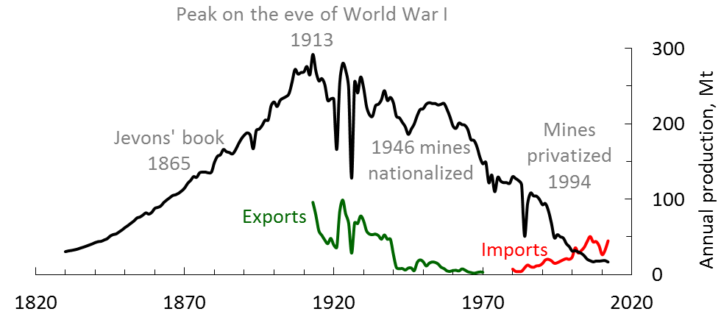
UK Coal Production
Mt = millions of metric tons
From Brian Mitchell, International Historical Statistics
Three collieries left with an active longwall (Hatfield, Kellingley, Thoresby)—down from 803 faces in 1972

Slide 11
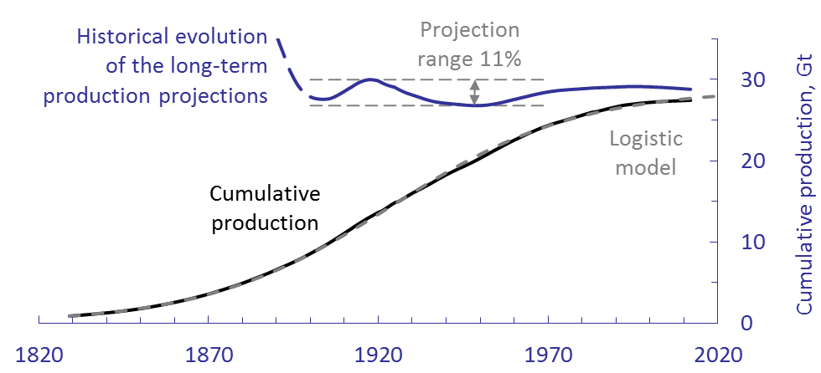
Logistic Model for the Cumulative UK Coal Production
Cumulative production through 2012 is 27.4Gt and reserves are 228Mt
A logistic curve fit to the production history in 1900 would have given 27.9Gt as a projection for the ultimate production
The range of the curve fits for the ultimate production since 1900 is narrow, 27–30Gt, and it seems to have captured the correct value

Slide 12
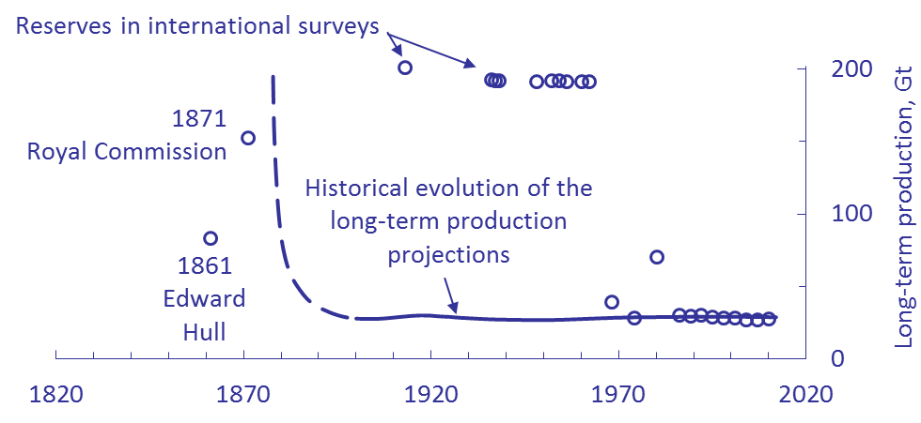
Historical Projections Compared with Reserves
Produced only 19% of the 1871 Royal Commission reserves + cumulative
Criteria chosen were too optimistic―1-ft seams, 4,000-ft depth
Severe downgrade of reserves in 1968―late in the cycle (t_{87%})

Slide 13
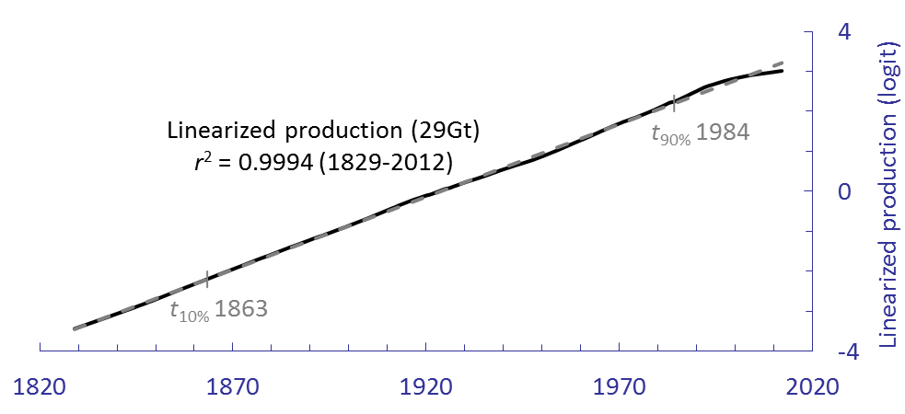
UK Coal Linearized with the Logit Transform
The approach is described in David Rutledge, 2011, “Estimating long-term world coal production with logit and probit transforms,” International Journal of Coal Geology
Q is found by a single-parameter fit by maximizing r²
Once Q has been determined, t_{90%} is calculated from a regression formula
For the UK, t_{90%} (1984) was the year of the coal miner strike against the Thatcher government and a time of rising North Sea oil production

Slide 14
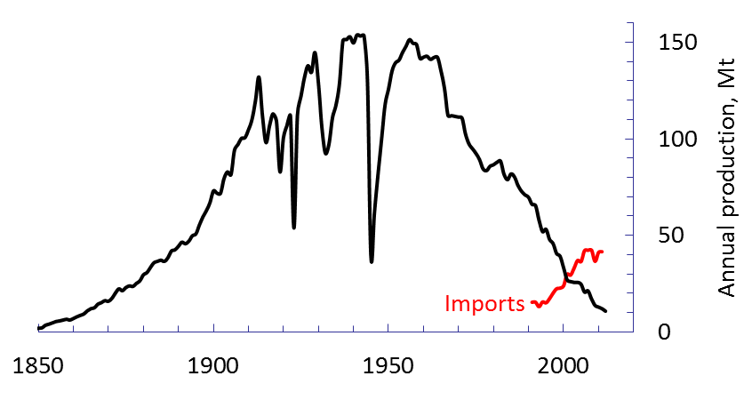
German Hard Coal Production
From the German Hard Coal Association
Large drops during the world wars
Down to three mines: August Victoria, scheduled to shut down in 2015, and Prosper-Hamel and Ibbenburen, which will close in 2018
Germany has subsidized hard coal production at several times the world price—the cumulative subsidy is 200G€
This may be the closest we will get in the real world to “technically recoverable coal”—because of the subsidy

Slide 15
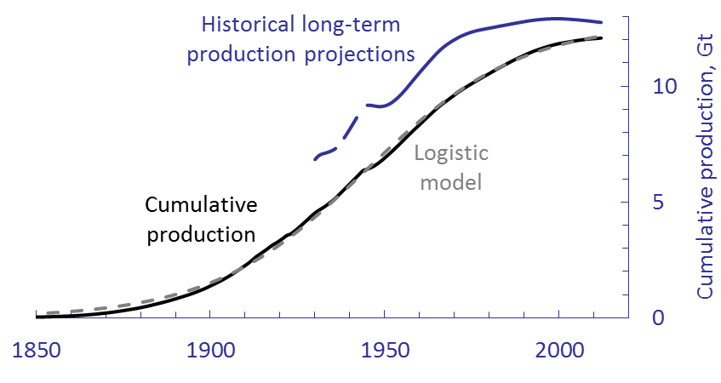
Logistic Model for the Cumulative German Hard Coal Production
Cumulative production through 2012 is 12.1Gt and reserves are 48Mt
The production drops during the wars would have prevented the early projections for ultimate production from being of much use—the projections did not stabilize to an appropriate range until 1970

Slide 16
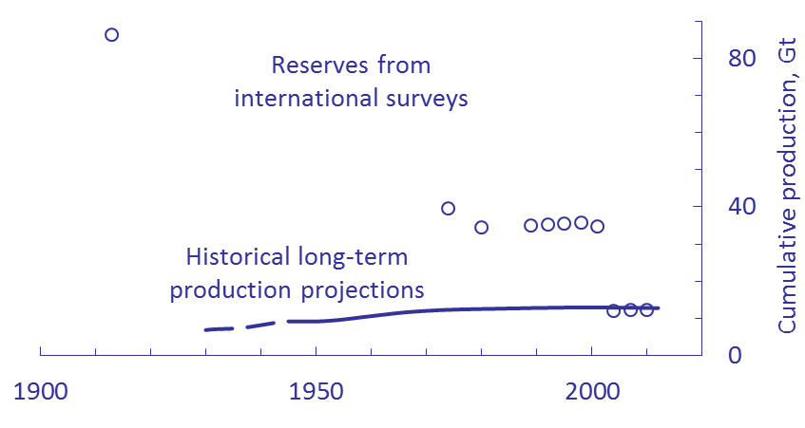
Historical Projections Compared with Reserves for German Hard Coal
Produced only 14% of the early reserves
Severe downgrade of reserves in 2004―very late (t_{99%})
One problem with German government resource assessments is that they show signs of political influence―for example, the BGR lists hard coal resources as 83Gt, more than the cumulative production of the United States

Slide 17
Summary for Mature Coal Regions
Region | 2012 production Mt | Cumulative production Gt | Long-term production projection Gt | Long-term production projection range Gt | Early reserves + cumulative Gt | Reserves year | Long-term production projection as % of early reserves + cumulative
United Kingdom | 16.8 | 27.4 | 28.8 | 26.8 - 30.0 (11% span) | 153 | 1871 | 19%
Pennsylvania anthracite | 2.1 | 5.04 | 5.05 | 3.1 - 5.1 (40% span) | 12 | 1921 | 42%
France and Belgium | 0.1 | 7.2 | 7.6 | 4.3 - 8.5 (56% span) | 33 | 1936 | 23%
Japan and South Korea | 3.4 | 3.6 | 3.7 | 2.2 - 3.8 (44% span) | 17 | 1936 | 21%
Germany hard coal | 10.8 | 12.1 | 12.2 | - | 86 | 1913 | 14%
Estimate of the long-term production based on the early reserves were four times too high, on average
Where feasible, curve fits gave reasonable estimates of the eventual long-term production (±20% on average)

Slide 18
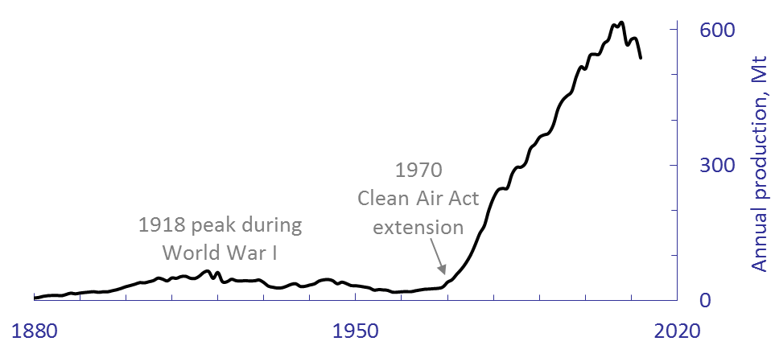
Western US Coal Production
Early production cycle peaked in 1918 — centered on Colorado, extremely limited by lack of railroad capacity to customers
New start after the 1970 Clean-Air Act Extension, which encouraged the use of low-sulfur coal, and the 1980 Staggers Rail Act, which deregulated the railroads

Slide 19
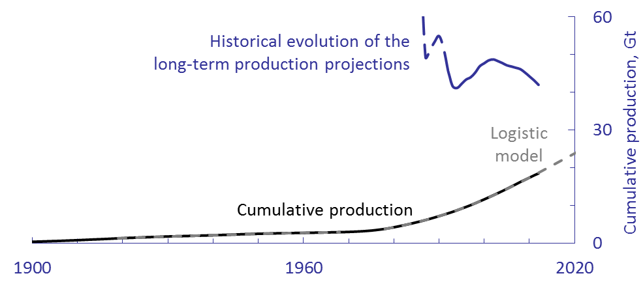
Western US Coal Production
Long-term production fit is 42Gt
This amounts to 26% of reserves + cumulative production (160Gt)

Slide 20
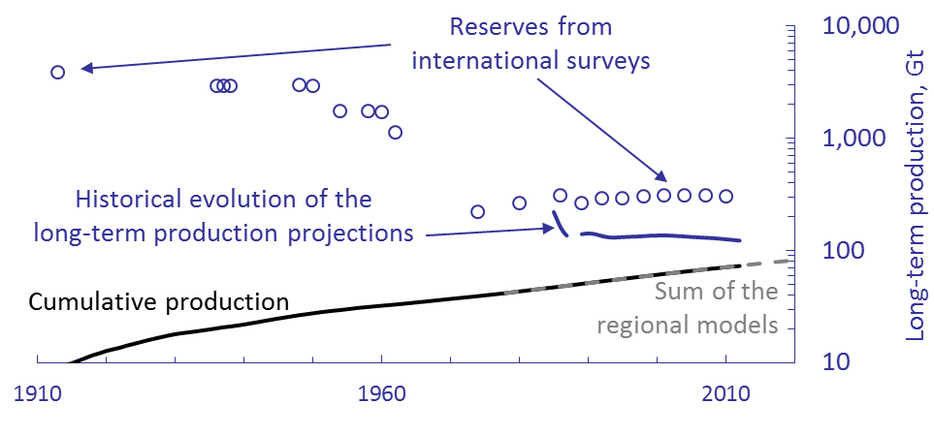
Historical Projections Compared with Reserves for US Coal
Marius Campbell of the USGS did the first reserves in 1913
Paul Averitt was responsible for the reserves from 1948-1975. He responded to criticism from mining engineers by tightening reserves criteria — seams at least 28 inches thick, up to 1,000 feet deep, within 3/4 mile from a measurement, 50% recovery
The reserves are now 16 times lower than in 1913

Slide 21
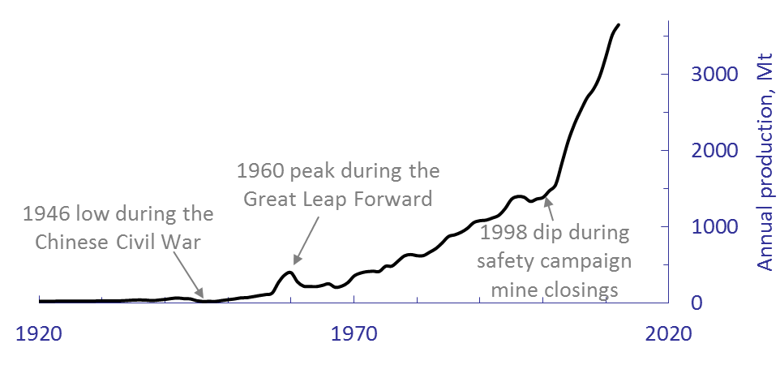
Chinese Coal
From Elspeth Thomson, The Chinese Coal Industry, and Economic History
46% of world’s production in 2012
The Asia Times reported that Chinese production through July is off 4% this year—stay tuned

Slide 22
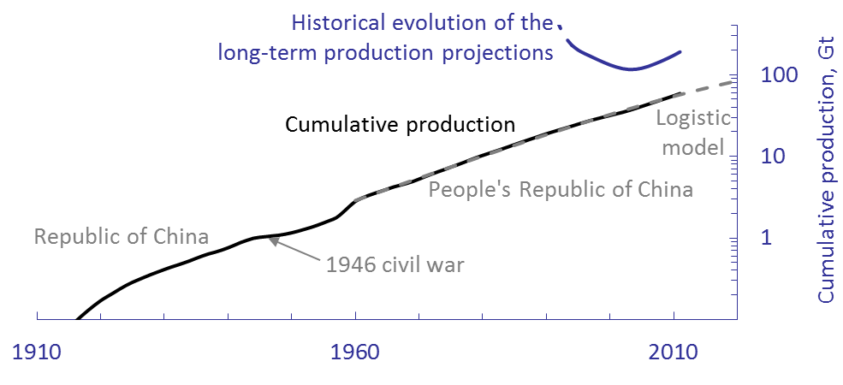
Cumulative Production with Curve Fits
Similar trends for the Republic of China and the People’s Republic
Curve fit for long-term production is 211Gt (122% of reserves + cumulative)

Slide 23
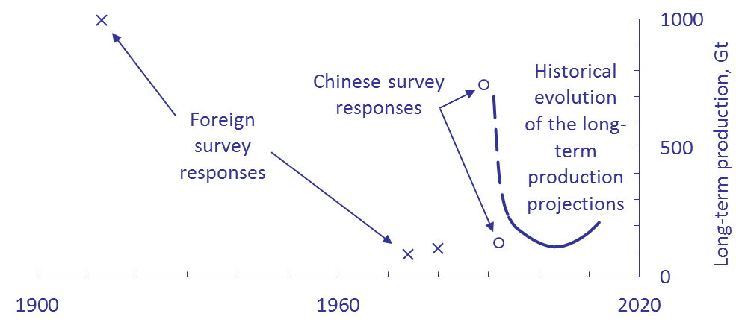
Historical Fits for Long-Term Production Compared with Reserves
Reserves submitted to World Energy Council in 1989 and 1992 differ by 6:1
Reflects historical indifference to reserves estimation by Chinese governments

Slide 24
Summary for Active Regions
Region | 2012 production Mt | Cumulative production Gt | Long-term production projection Gt | Reserves + cumulative Gt | Long-term production projection/ (reserves + cumulative) | Long-term production projection range Gt | Regression t90%
Australia | 436 | 12 | 46 | 88 | 52% | 28 - 52 (53%) | 2073
China | 3,650 | 62 | 211 | 173 | 122% | 116 - 231 (54%) | 2060
Africa | 254 | 9 | 18 | 41 | 45% | 18 - 29 (63%) | 2048
Europe | 768 | 86 | 134 | 201 | 67% | 133.9 - 134.4 (0.4%) | 2078
Russia | 496 | 28 | 52 | 222 | 24% | - | 2079
Western United States | 537 | 18 | 42 | 160 | 26% | 41 - 49 (18%) | 2051
Eastern United States | 383 | 49 | 76 | 138 | 55% | 76 - 85 (12%) | 2071
Canada | 67 | 3 | 5 | 10 | 46% | 4 - 5 (22%) | 2032
South Asia | 1,128 | 20 | 117 |  |  | 80 - 115 (30%) | 2073
Latin America | 111 | 2 | 19 |  |  | 12 - 24 (63%) | 2081
World with mature regions | 7,863 | 334 | 736 | 1,218 | 60% | 667 - 785 (16%) | 2067
Projection ranges from 1994 on
The fits for Q for South Asia and Latin America do not converge—for these the projection for ultimate production is reserves + cumulative production (this gives the world projection a modest high bias)

Slide 25
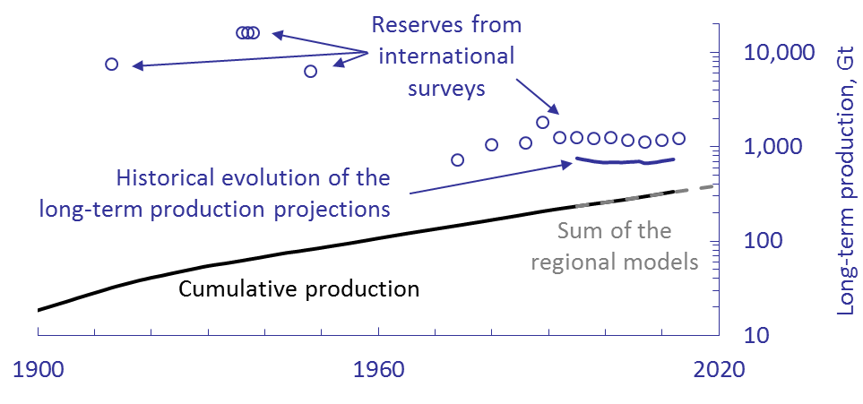
World Coal Production
The projection range from 1994 on is 16%
Current long-term fit is 736Gt (397GtC), 60% of reserves + cumulative

Slide 26
The IPCC’s Modeling Approach
Representative Concentration Pathways (RCPs)
Completed
Specify an interval in radiation forcing between RCPs that is meaningful in climate terms 1.5W/m²
Specify radiation forcings at this interval — 3, 4.5, 6 W/m² plus the big one at 8.5 W/m² (the 3W/m² scenario actually peaks earlier at 3W/m² and declines to 2.6W/m² by 2100)
Specify gas concentrations that give these forcings for climate modelers
Ongoing work
Develop an economic story for each RCP that gives these gas concentrations
A different modeling group is responsible for each RCP—no systematic economic relationship between the RCPs (unlike the forcings)
Limited information so far on coal production in the RCPs, except RCP 8.5
Danger of this approach is that there may be
little relationship to the actual historical mining experience

Slide 27
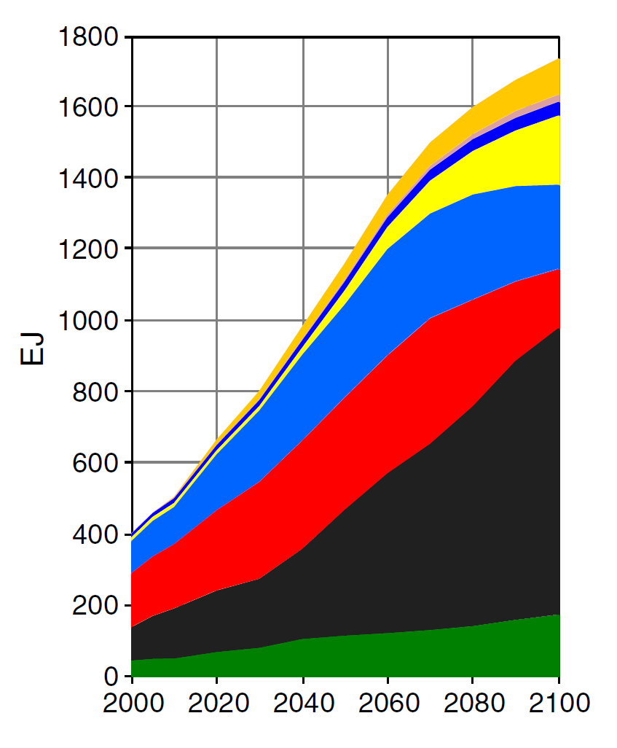
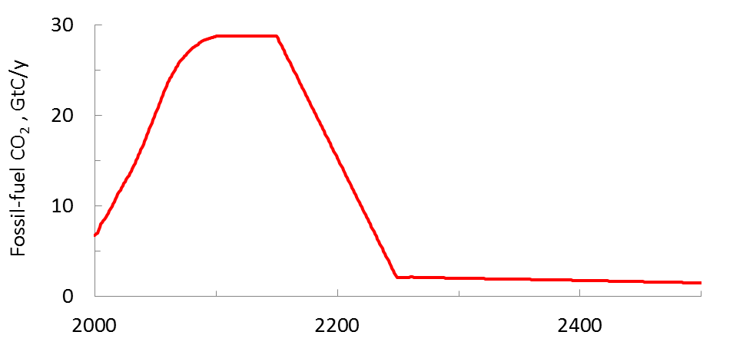
Coal in RCP 8.5
From Keywan Riahi et al., 2011, Climatic Change, “RCP 8.5—A Scenario of comparatively high greenhouse gas emissions” (this is the refereed journal definition of the RCP) and the RCP data base at http://www.iiasa.ac.at/web-apps/tnt/RcpDb
The Riahi et al. paper does not mention coal resources—may reflect severe criticism of the SRES scenarios in the earlier assessment reports
Conversion factors for comparisons: energy 21GJ/t and CO₂ 0.54tC/t

Slide 28
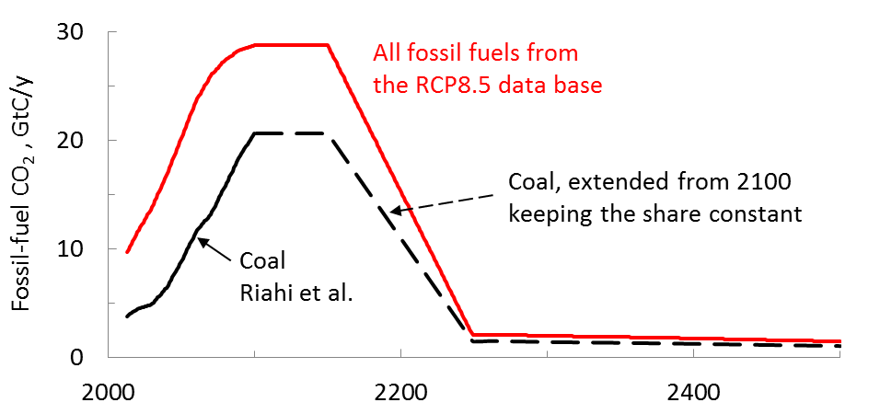
Coal Emissions in RCP 8.5
Coal dominates future fossil-fuel CO₂ emissions in RCP 8.5—65%
The long-term coal production in RCP 8.5 is 6.6Tt
  9x the projection for ultimate coal production
  5x reserves plus cumulative production
This is completely contrary to the historical experience—RCP 8.5 should not be used for any purpose

Slide 29
Fossil-Fuel Comparisons with all the RCPs
Scenario (includes cumulative production) | Total CO₂ emissions, TtC
RCP 2.6 (3W/m² peak) | 0.3
Projection coal (397GtC), oil and gas (529GtC) | 0.9
Reserves coal (658GtC), oil and gas (508GtC) | 1.2
RCP 4.5 | 1.5
RCP 6.0 | 2.4
RCP 8.5 | 5.6
RCP CO₂ emissions from the RCP data base, oil and gas reserves from BP
RCP 2.6’s future net fossil-fuel CO₂ emissions are negative—is this plausible?
For oil and gas, the projection from a curve fit is similar to the reserves
  Not clear how relevant Venezuela’s 297Gb reserves (R/P 291y) are to a climate model
  US reserves have historically underestimated future US production
  A disadvantage of oil and gas reserves compared to projections based on production data is that reserves have historically been subject to political manipulation
The uncertainties due to differences between projections and reserves and variations with time do not appear to be significant from a climate perspective

Slide 30
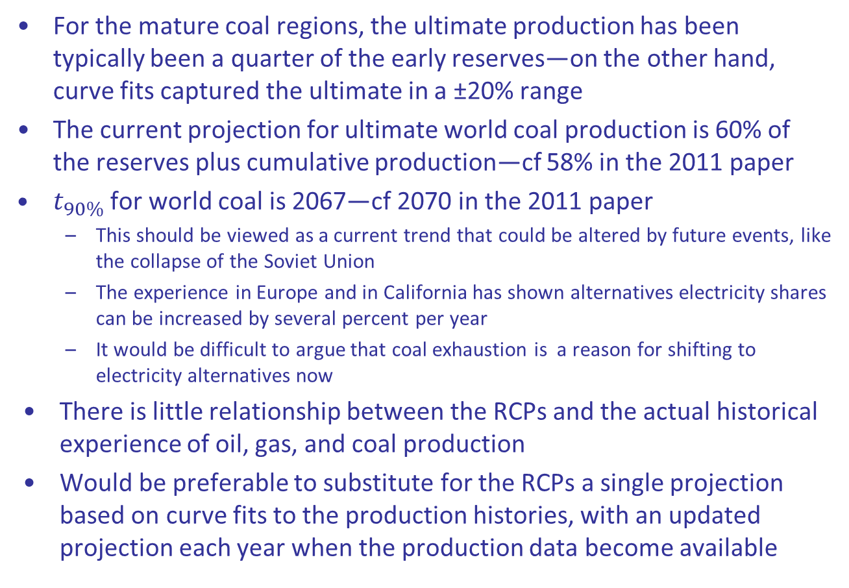
Conclusions
For the mature coal regions, the ultimate production has been typically been a quarter of the early reserves—on the other hand, curve fits captured the ultimate in a ±20% range
The current projection for ultimate world coal production is 60% of the reserves plus cumulative production—cf 58% in the 2011 paper
$t_{90\%}$ for world coal is 2067—cf 2070 in the 2011 paper
  This should be viewed as a current trend that could be altered by future events, like the collapse of the Soviet Union
  The experience in Europe and in California has shown alternatives electricity shares can be increased by several percent per year
  It would be difficult to argue that coal exhaustion is a reason for shifting to electricity alternatives now
There is little relationship between the RCPs and the actual historical experience of oil, gas, and coal production
Would be preferable to substitute for the RCPs a single projection based on curve fits to the production histories, with an updated projection each year when the production data become available

